Slide 1
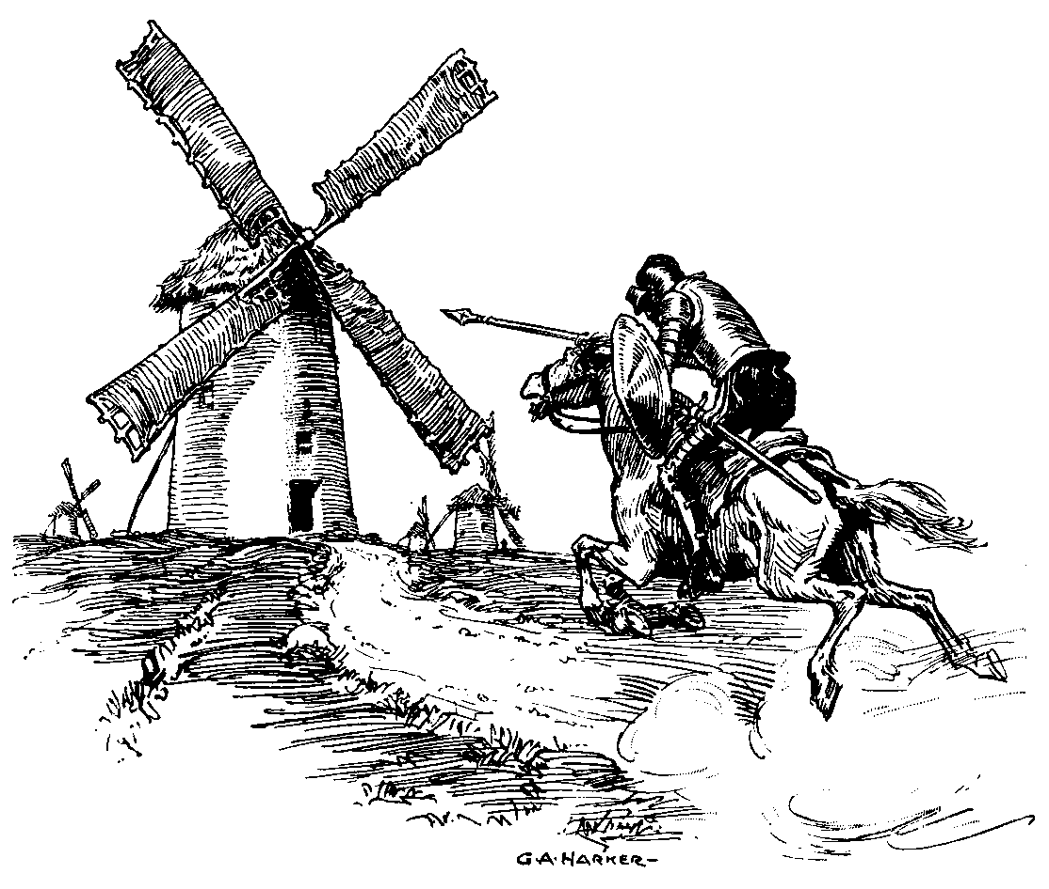
The Guiding Principles, Realities and Future of Cloud Resolving NWP Models
by
G. J. Tripoli
The University of Wisconsin - Madison

Slide 2
Synoptic Paradigm
(1903) V. Bjerknes Use natural laws to predict Weather
(1922) L. F. Richardson Weather Prediction is an initial value problem
(1950) Charney performs 1st NWP integration
(1961) Lorenz shows that there are limits to predictability

Slide 3
The last 50 years
We developed climate models, GCMs, weather prediction models, cloud models, LES models and more
We developed multivariate analysis schemes that evolved into data assimilation systems
Physics representation has steadily improved
Resolution increasing with Moores Law
Weather forecasts have generally improved

Slide 4
But..
There has been a troubling problem with the “QPF” and “Warm Season” prediction in particular, it just hasn’t been improving as much.
The tropical cyclone problem is similar in that improvement of intensity prediction error is slow or nonexistent
What do these two problems have in common?
  Energy driving system evolution moving upscale from below where it is poorly resolved and poorly observed
  Previous synoptic analysis and NWP has never had sufficient resolution before now to represent such scale interaction

Slide 5
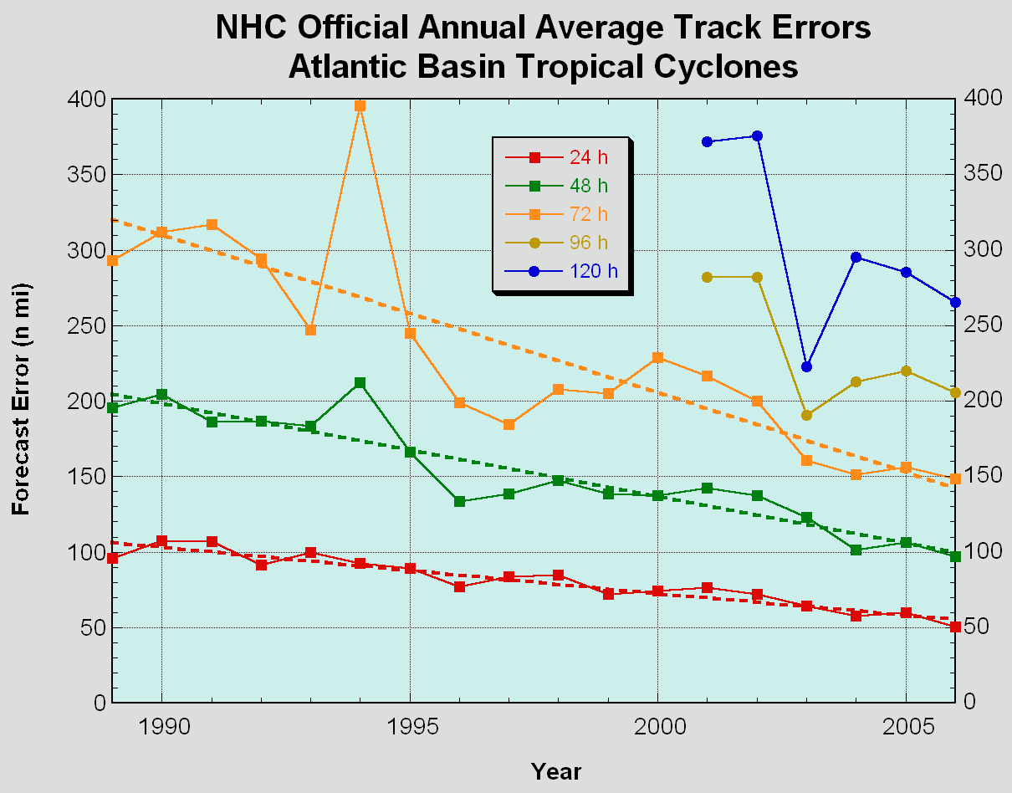
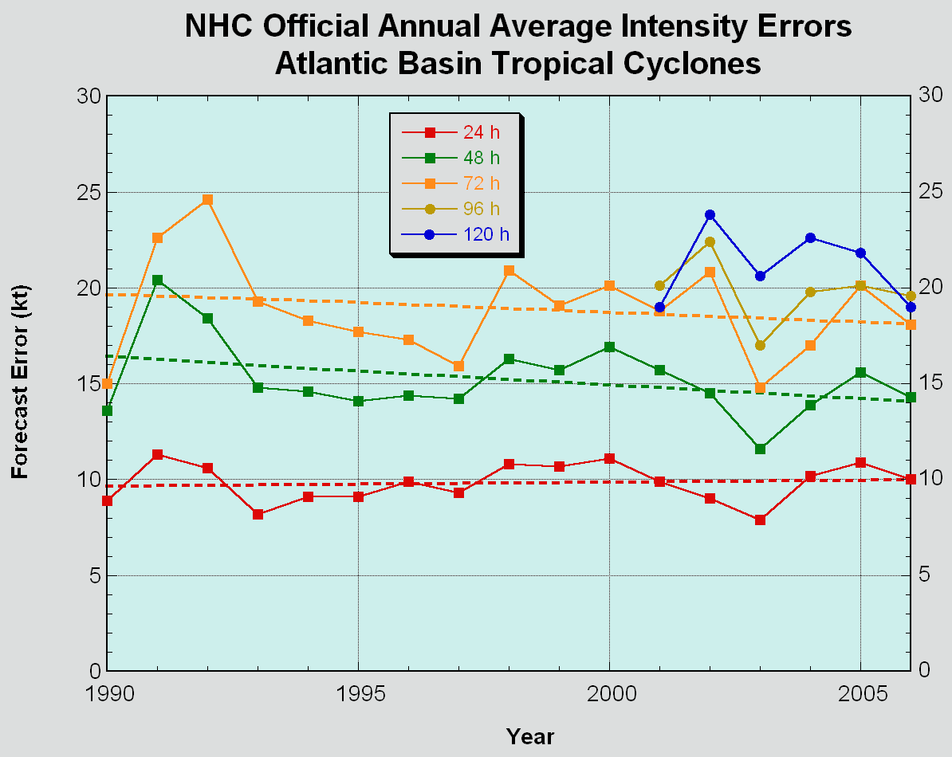
Hurricane Forecast Problem
Track forecast skill is steadily improving while intensity prediction skill is showing little improvement…Why?

Slide 6
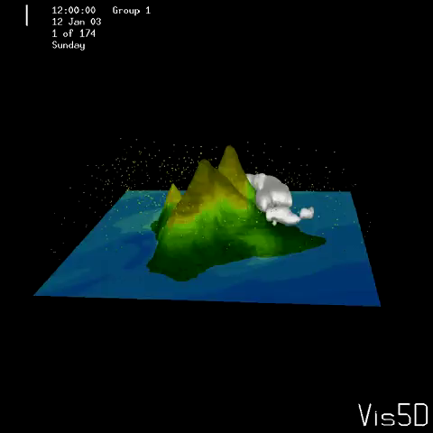
20th Century Paradigm for NWP
Deterministic Prediction of Subordinate Disturbances
  Initialize model with deterministic “synoptic scale” flow
  Predict mesoscale features created by the interaction of predictable features with definable surface characteristics
  Mesoscale features take on the predictability of the synoptic scale flow
Notes:
Here I am showing a “mesoscale” (10 km resolution) simulation, typical of modern models which actually work deterministically. This is because the “synoptic” flow is controlling the outcome and the synoptic flow is resolved by conventional observations. The 10 km scales can be predicted because they are created by the interaction of a definable topographical barrier with the synoptic flow. This simulation has the predictability of the traditional synoptic scale of 6 days but hs the prediction scale of 10 km. Hurricanes are not like this, because they evolve on the small scales and have predictability defined by the small scales.

Slide 7
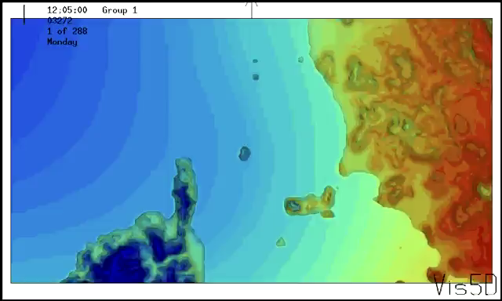
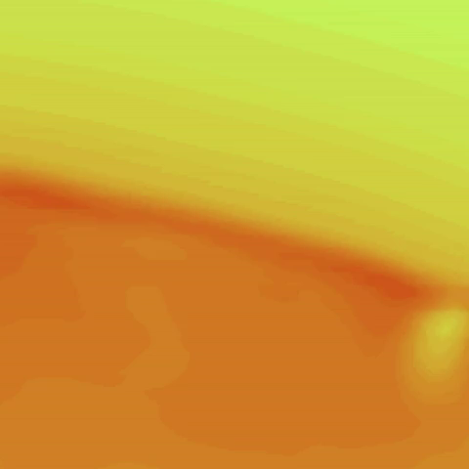
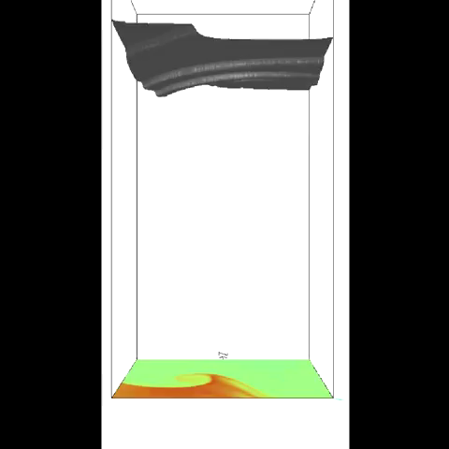
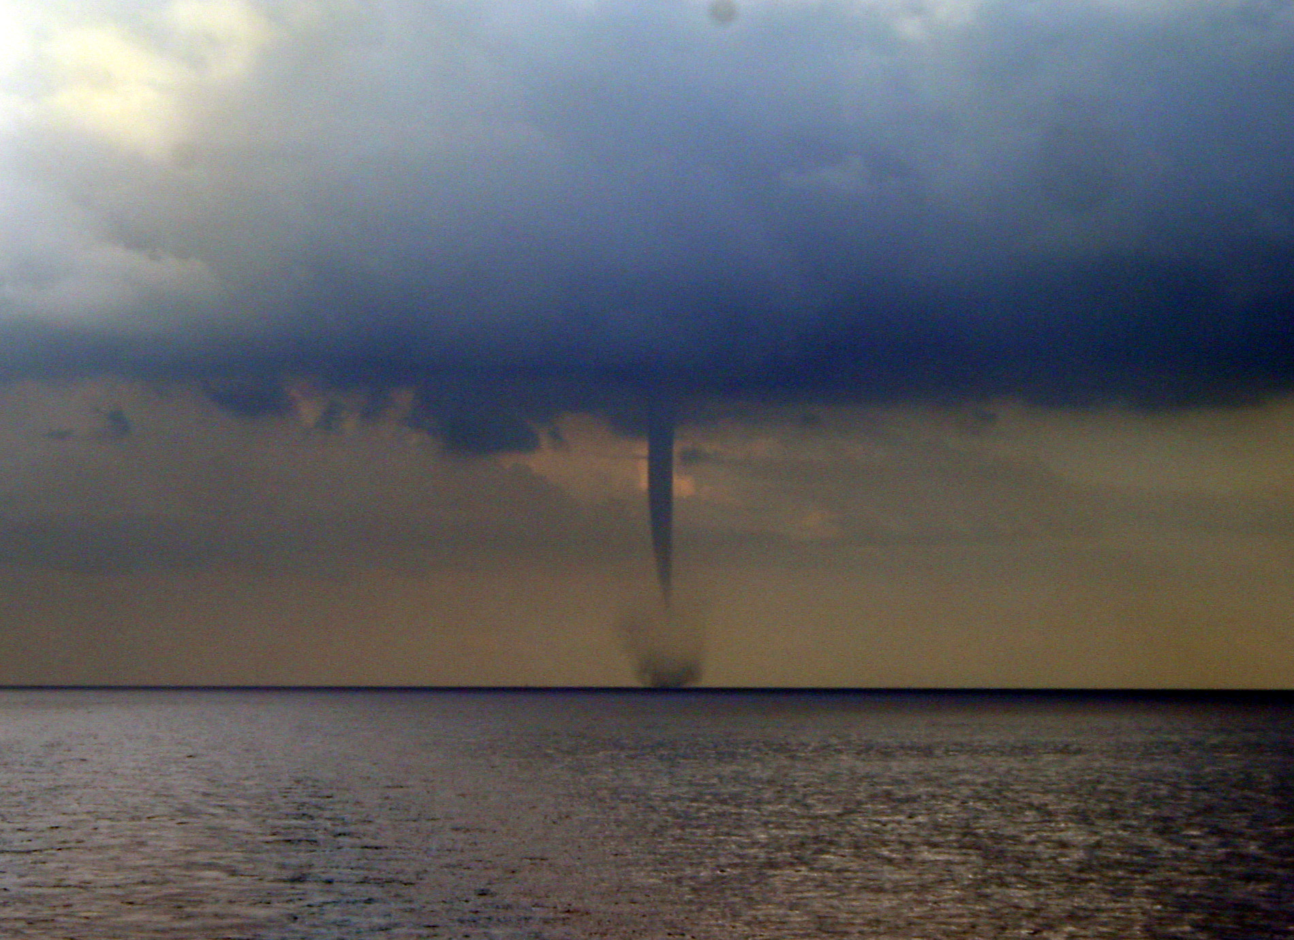
20th Century Paradigm for NWP
Simulation of Subordinate Disturbances
  Initialize model with deterministic flow
  Predict mesoscale features created by the interaction of predictable features with definable surface characteristics
  Simulated mesoscale features have independent behavior, but may be used to explain the behavior of simulated phenomena
Notes:
These simulations of small scale features are in between. The flow systems causing waterspouts is set up by the interaction of synoptic flows with a topographical barrier, but the waterspout, itself, is probabilistic so that although the existence of waterspouts in the region may be predictable deterministically, a particular waterspout event is not.

Slide 8
Hurricane Forecast Improvement Project
How can we move forward with tropical cyclone intensity prediction?
Can implementing high resolution forecast systems, utilizing the most powerful computers lead to the break throughs that we need?

Slide 9
The High Resolution Test
Hypothesis:
  Given an initial condition of the hurricane vortex defined at 9 km resolution then
    Decreasing the horizontal numerical model grid spacing from 9 km to 1 km, will result in a significant increase in the skill of intensity forecasts in the 5 day time frame
    The dependence of intensity forecast accuracy on resolution is a robust property of all numerical models

Slide 10
The Test
Control model will be the GFDL hurricane model having nesting resolutions:
  Coarse Grid 1:
    ~ 75 latitude x 75 longitude degrees (8000 x 8000 km)
    Delta x = Delta y ~ 9 km (1/12 degree)
  Medium Grid 2:
    ~ 9 latitude x 9 longitude degrees latitude (1000 x 1000 km)
    Delta x = Delta y ~ 3 km (1/36 degree)
  Fine Grid 3:
    ~ 3 latitude x 3 longitude degrees (330 x 330 km)
    Delta x = Delta y ~ =1 km (1/108 degree)

Slide 11
The Test
Test impact of resolution by 3 part tests for each case:
  5 day forecast, Grid 1 only
  5 day forecast, Grids 1 and 2 only
  5 day forecast, Grids 1, 2 and 3
Hypothesis verified if:
  significant improvement in track and intensity going from a to b and from b to c
  Similar improvements for each model tested

Slide 12
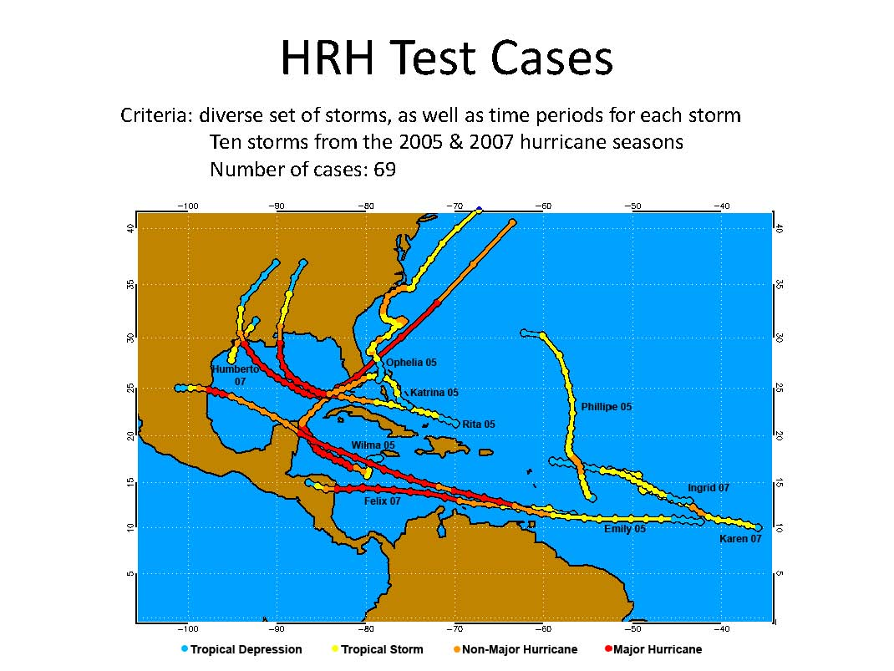

Slide 13
Modeling Groups
U. Rhode Island - GFDL Hurricane Model (I. Ginis/ M. Bender)
  Operational NOAA hurricane model hydrostatic, compressible, sigma vertical coordinate
  GFDL initial vortex (bogused with guidance from reconnaissance)
AOML- HWRF-X (S. Gopalakrishnan)
  Research hurricane model nonhydrostatic, compressible, sigma vertical coordinate
  Adapted WRF model
  GFDL initial vortex
NCAR/MMM- AHWRF (C. Davis/ R. Torn)
  Research hurricane model nonhydrostatic, compressible, sigma vertical coordinate
  EnKF data assimilation initial vortex
PSU - WRF-ARW (F. Zhang)
  Research mesoscale model nonhydrostatic, compressible, sigma vertical coordinate
  EnKF data assimilation initial vortex
NRL - COAMPS - TC (M. Peng/ R. Hodur)
  Operational NAVY TC nonhydrostatic model, quasi-compressible, sigmaz vertical coordinate
  Initial vortex relocated from previous 12 hour forecast
U. Wisconsin - NMS - (W.Lewis/ G. Tripoli)
  Research mesoscale model; nonhydrostatic Lamb Vector form, quasi-compressible, vertical height coordinate with VST
  Uniquely constrained dynamics core
  GFDL initial vortex

Slide 14
Evaluation
Track Error (nm) vs lead time
Intensity Error (kt) vs lead time
Absolute Intensity Error (kt) vs lead time
Wind radii error (nm) (34,50, 64 kt) SS improvement
Rapid Intensification and Rapid Weakening using event and episode methodologies SS improvement with resolution?
Consistency --subjective inspection or 10 difference measurements
Overall evaluation

Slide 15
Final Conclusions of HRH Test
Results are suggesting that the hypothesis is NOT verified!
Less than significant and less than robust improvements found.
In a few cases, increased resolution led to degraded results
No apparent increase in skill for those employing 4DVAR (NRL) or EnKF (PSU, MMM) data assimilation systems

Slide 16
Bottom Line
THE SYNOPTIC PARADIGM
HAS HIT THE WALL

Slide 17
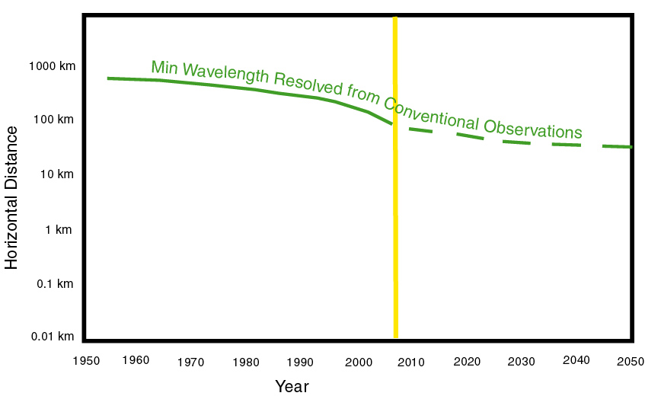
Conventional “Synoptic” Observations
Notes:
I am showing the original idea of synoptic observations and what they resolve.

Slide 18
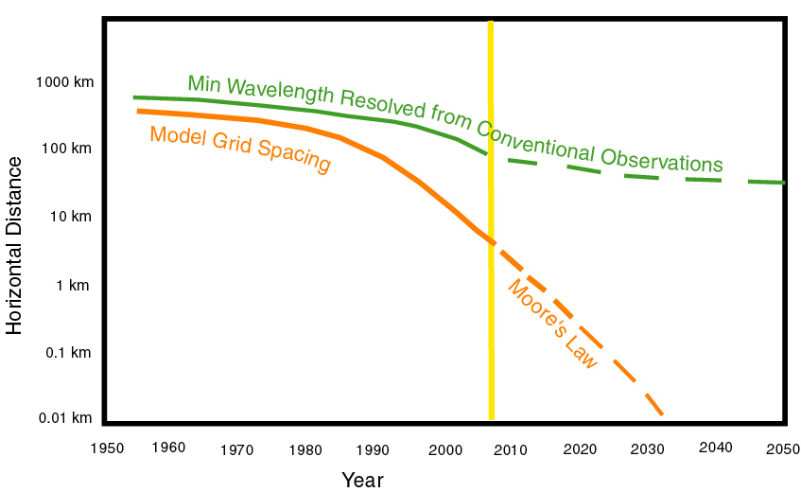
Model Grid Spacing
Notes:
Now I add the evolution of models and how they originally began deterministically forecasting what the original conventional “synoptic” observations could see

Slide 19
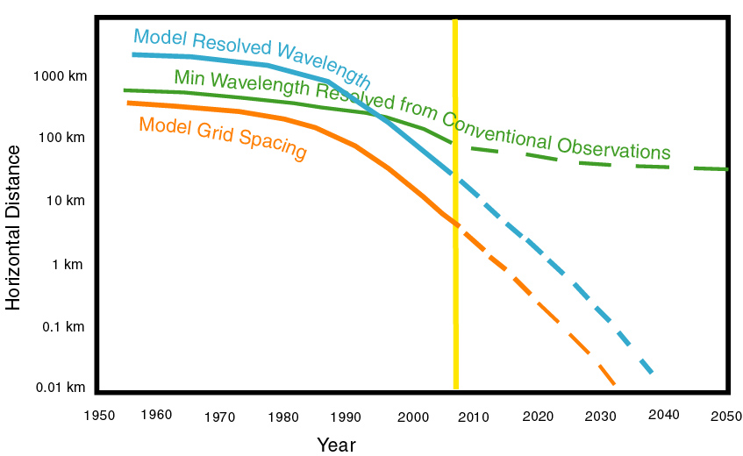
Model Resolution
Notes:
Now I Include an estimate of the scales of features that the models actually resolve which is larger than the grid spacing. Note that the scales are now becoming less than what the conventional observations can resolve.

Slide 20
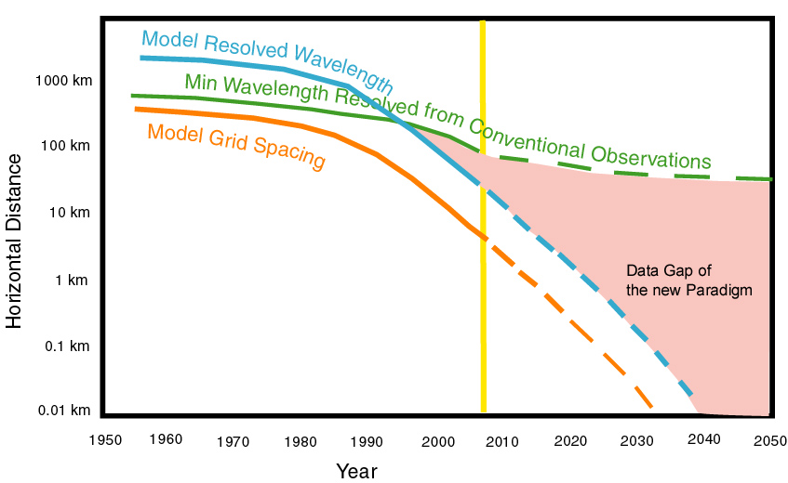
5 Dimensional Gap between conventional “synoptic” observations and model resolution
Notes:
Now I show that we are developing a data gap with these new models.

Slide 21
Can we overcome the gap?
“we can just fill it with satellite data?”
“ we just need more satellite resolution to match the model scales, right?”
Or is the existence of a simple resolution gap “problem” really just good old time “synoptic” thinking?

Slide 22
Filling the Gap
The only option to fill this continually widening gap is through remote sensing, i.e. satellite, radar, lidar, E-M signals, specialized aircraft
  But remotely sensed weather analysis is indirect, under-specified and dependent on models to make a connection with state measurement.

Slide 23
Predictability Issues in Age of Cloud Resolving Models
Deterministic predictability is practically confined to time scales less than 1 lifecycle period of the energy containing disturbance, i.e. linear time scales
  NWP successes
    Baroclinic Cyclone ~ 6 - 7 days (classic synoptic problem)
  Things we have trouble with
    Eye Wall ~ 20 - 40 hours
    Rainband, MCS ~ 4-20 hours
    Cumulus cloud ~ 20 - 60 minutes
Perhaps probabilistic predictability of certain small space-time scale features can be attained from the predictability of their sustaining environment
  Most typically, this will be the slow manifold, balanced portion of the flow field…but not always
Notes:
Summary

Slide 24
Can we initialize cloud scales with Cloud Resolving Data?
How much data resolution does it take to define a feature?
  Dependent on spatial scales
  Dependent on time scales
We were raised with the “synoptic” paradigm, but recall the classic “synoptic” disturbance has a lifecycle of 6-7 days.
It is no accident that we typically take 3D observations 1-2 times a day, because that is about 6-12 observations pre lifecycle…of the “synoptic” wave with which we have had some success with prediction
Most of us who have worked with numerical systems know the 2nd order numerical representation of a simple sine wave yields 9% phase error when represented by 10 points, 28% error when sampled by 5 points and 100% error when sampled by 2 points!
Notes:
Summary

Slide 25
The Space-Time Problem
We have had success with the “synoptic” paradigm until now because
  multivariate observations have adequately defined the “synoptic” problem in both space and time.
The problems that we are encountering in NWP are because resolved model scales have become smaller than the power of our observing systems to resolve those scales in space-time
We must build observation systems to optimally equip our prediction systems with observations having space-time resolution comparable to those resolved by the models
Notes:
Summary

Slide 26
How can we move forward?
Remote sensing based data assimilation the only option
  Goals of data collection and modeling must be modified to reflect the new S-T paradigm, i.e. optimizing S-T resolution to fit that of the model
  Multivariate needed to define relationship between dynamics and thermodynamics
  To define these entities, we need a minimum of 6-10 observations per S-T dimension
  Models must ultimately merge with data collection to:
    Form a probabilistic analysis , such as an ensemble analysis
    The optimal analysis must select the S-T model physics and evolution at space and time scales that support the observed behavior of radiance over time.

Slide 27
Expectations and Goals
Expectations should be for:
probabilistic forecasts, where uncertainty becomes an expected and necessary part of a forecast.
  Deterministic forecast is a special case
  Deterministic forecast probably only possible over time scales less than one lifecycle - ( 20 minutes for convective plume)
The goal of NWP should not be for a most likely atmospheric state, but for a range of possibilities articulated in a standardized probabilistic format

Slide 28
Why can’t space time be predicted as an Initial Value Problem?
Initial state contains all of the information necessary for a nonlinear forward prediction (hollographic principle of NWP)
To access this information, infinite multivariate spatial resolution necessary
Otherwise, to predict linear progression of a truncated space-time analysis we need to define the space-time structure to filter the space-time structures that are not resolved from the initial condition

Slide 29
We need to define or initial state with matching Space-Time fidelity
Requires high spatial AND temporal scale resolution
Requires multivariate definition
Doppler radar is one such observation system that fills this need for smor of the convective scale features that we now resolve
Geostationary passive satellite observations are the best option we have today from space, although they only view 2 spatial dimensions in the convective areas

Slide 30
Observation Options
High frequency Doppler radar observations are the only feasible technology to fill the data gap in cloudy regions
  Reconnaissance aircraft based Doppler radar has been demonstrated to improve space-time definition, but:
    is not available for all disturbances affecting a TC genesis
    Is not available continuously throughout the lifecycle of the TC
    expensive limited deployments affordable only by a few societies
  UAVs may work, but it would take a lot of expensive UAVs to define cloud structures across an ocean basin and without defining the structures outside as well as within the TC, analysis would be incomplete

Slide 31
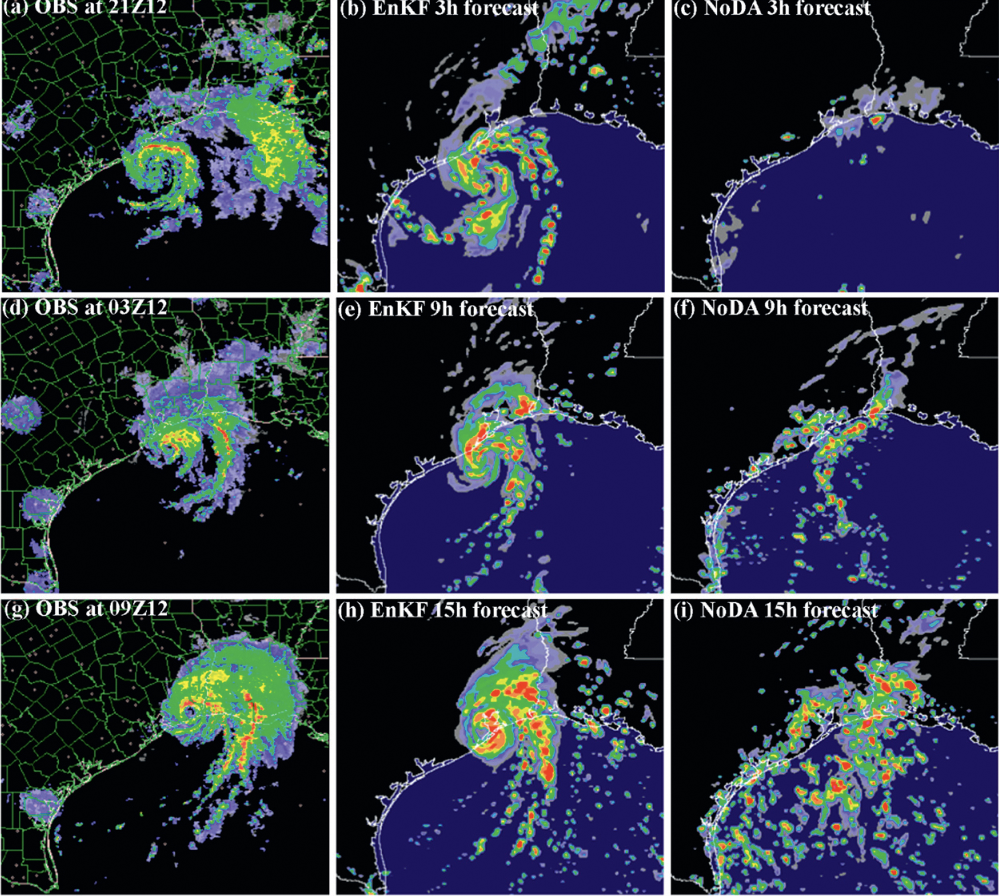
NEXRAD assimilation
Zhang et al., 2009

Slide 32
Future Observations
GeoSTAR- Microwave in geostationary orbit
  Very important advance in helping resolve the time dimension, but
    Vertical dimension still not observed
    No direct independent multivariate observation, requiring assumptions of balance to assimilate dynamics

Slide 33
Future Observation Option
High frequency three-dimensional Doppler radar observations taken by satellite in geostationary orbit would be the only option featuring space-time multivariate resolution that can fill the data gap over the remote regions of TC and convective system genesis
Such an observational platform, named “NEXRAD in Space” has been under development at NASA for nearly a decade and is now reaching a stage where an experimental launch could be made within a decade

Slide 34
NIS Design and Performance Parameters

Slide 35
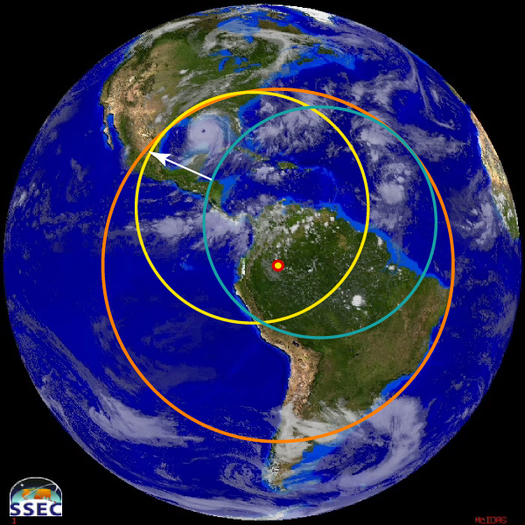
NEXRAD in SPACE Scan Area (200 m vertical resolution, 55 degrees diameter)

Slide 36
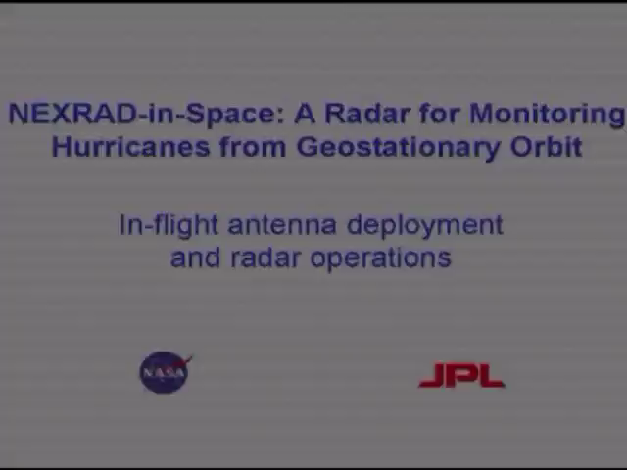
NEXRAD in Space
Deployable Antenna

Slide 37
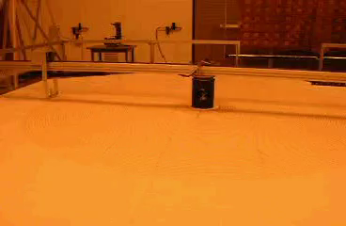
Level 3 Technology
(Rotating Arm Test)

Slide 38
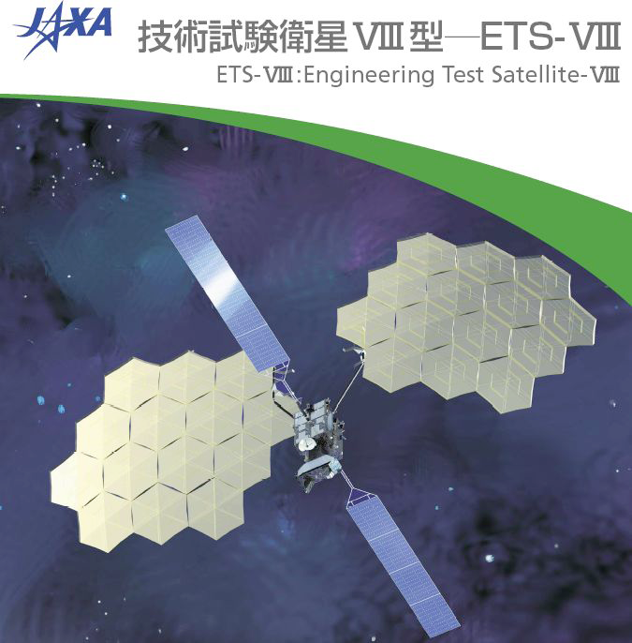
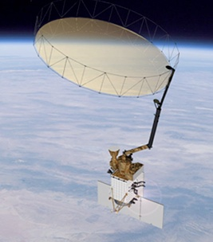
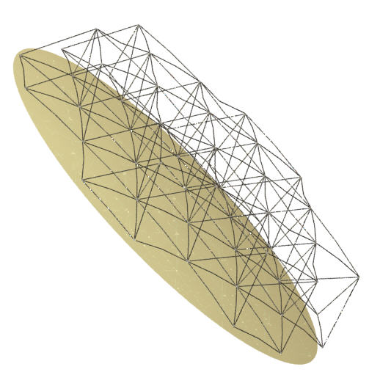
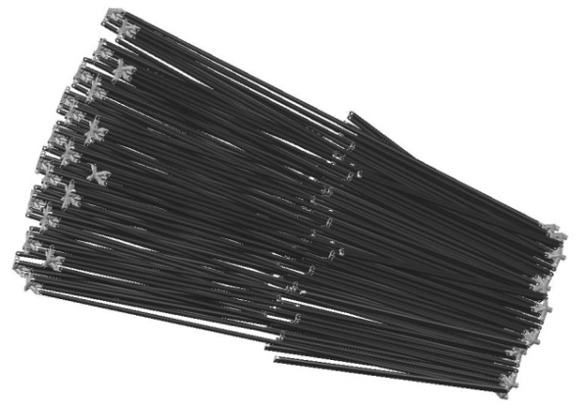
Large, Lightweight, Deployable, Scanning Reflector Antennas
Game Changing POC: Eastwood Im; eastwood.im@jpl.nasa.gov
Needed Technology Advances
Missions Enabled:
Earth Science – many
NOAA/FAA – hurricanes & severe storms
Manned Mars Comm
DoD – surveillance imaging
Astrophysics - VLBI
Increase the resolution of the state-of-the-art systems by a factor >15.
Enable microwave remote sensing from GEO and MEO
Enable scanning of super-large antennas without reflector or spacecraft motion
First Technology Advance:
Membrane, mesh and composite materials; in-space metrology; actuators, real-time surface accuracy control algorithms; structural architectures; and mechanical scanning feed system.
Next Technology Advance:
Phased Array feed for rapid scan and aberration compensation.
How It Works:
A deployable structure grants structural integrity, deployment and overall reflector shape.
High-precision actuators and metrology system enable fine-tuning of the surface to compensate for distortions and sporadic failures.
A variety of different types of feeds and mechanical configurations thereof provide rapid and/or precision scan capability over the field of view as required for numerous crosscutting Missions
Assumptions and Limitations:
The RF reflective surface material is compatible with the operating wavelength and does not suffer from stowage or long-term exposure in-space
The deployable structure is reliable and robust in deployment and incorporates precision actuators that compensate for surface shapes errors
STATUS QUO
Deployable mesh reflectors with diameter/wavelength (D/λ)<250
• Telecom, Military and Earth Remote Sensing applications
Non-deployable reflectors result in excessive mass and envelope at launch. Current deployable solutions do not achieve, or scale to, the desired D/λ.
QUANTITATIVE IMPACT
Stow
Deploy
Ground demonstration of a flight-like, 20-m dia., 60-GHz scanning antenna with real-time metrology and control
Scalable to a 40-m dia. Ka-Band antenna (D/λ = 4000) for a GEO Doppler radar that tracks the 3-D structures of out-at-sea severe-storms and hurricanes, and ocean vector winds every 30 minutes or less.
New materials,
architectures, and
active surface control
enable lightweight deployable
antennas with D/λ > 4000, necessary for high-resolution measurements from various vantage points.
New electrical and/or mechanical scanning solutions enable use of large reflectors for wide spatial and temporal coverage.
NEW INNOVATIONS
END-OF-TASK OBJECTIVES
Total Budget:
$70M over 3 Years
Potential Partners: NOAA, DoD, FAA, Industry
Enable high-resolution, large spatial, and frequent reconnaissance, hurricane/hazard monitoring, climate trending, and aviation safety applications from LEO to GEO platforms
Notes:
Include notes that would be helpful to the reader or someone (other than yourself) who needs to understand the details. Ideally the chart will be useful even without the author to explain the details. Also include references to published papers plus URLs to online versions if available.
Keep in mind that somewhere or other in this chart, each of these questions should be answered:
1. What technical challenge is being undertaken on behalf of the project
2. Why is it hard and what are the open problems
3. How has this problem been addressed in the past
4. What new intellectual tools are being brought to bear on the problem
5. What is the main intermediate achievement
6. How and when does this achievement align with the project roadmap (end-of-phase or end-of-project goal)
7. What are the even long-term objectives and consequences?

Slide 39
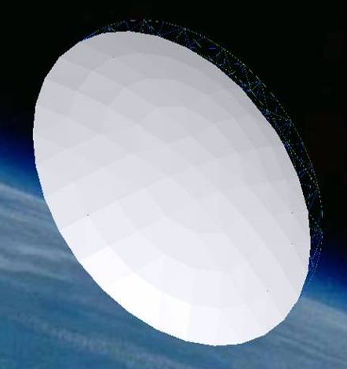
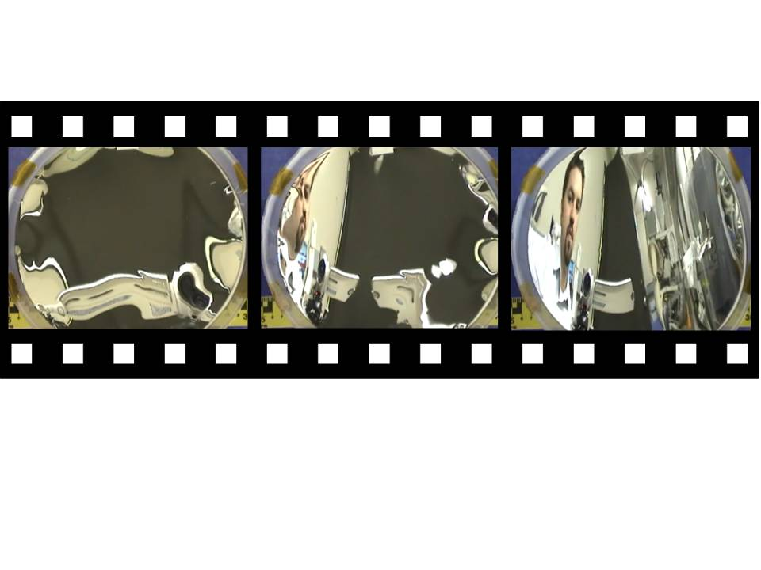
ESTO Advanced Technology Progarm (ACT-2008)
A Large Deployable Reflector for Ka- and W-band Remote Sensing
PI: Houfei Fang, JPL
Objective
Develop a large, high frequency and high gain deployable reflector technology to enhance the Aerosol, Clouds and Ecosystem (ACE) Mission and enable the Nexrad-In-Space (NIS) mission.
  This will be implemented by leveraging and integrating several recently developed material technologies, including Shape Memory Polymer (SMP) material; high-precision Membrane Shell Reflector Segment (MSRS) casting process; near zero CTE (coefficient of thermal expansion) membrane NovastratTM; and Poly-Vinylidene Floride (PVDF) electro-active membrane.
This technology offers precision an order of magnitude higher than the currently used tensioning cable truss reflector and provides a desirable surface contour.
Architecture: a deployable SMP tetrahedral truss supports a set of MSRS to form a high definition, smooth and continuous surface
An optical quality PVDF film deforms from a flat shape to a concave shape with the application of voltage
Approach
Key Milestones
Develop Shape Memory Polymer tetrahedral truss
Develop Membrane Shell Reflector Segment
Integrate a 1.5-m subscale prototype
Conduct tests for the 1.5-m prototype
Analytically scale-up from 1.5-m to 5-m for ACE application, and to 35-m for NIS application
Complete structure concept 09/09
Complete MSRS design and optimization 06/10
Complete structure prototype design 06/10
Complete structure component developing 12/10
Complete MSRS manufacturing technology 12/10
Complete subscale prototype integration 06/11
Complete subscale prototype testing 09/11
Complete scale-up and final report 12/11
Co-Is/Partners:
Simone Tanelli, Mark Thomson, JPL; James Moore, NeXolve Corporation; John Lin, ILC Dover
TRL_{in} = 2 TRL_{current} = 2
04/10
Notes:
39

Slide 40
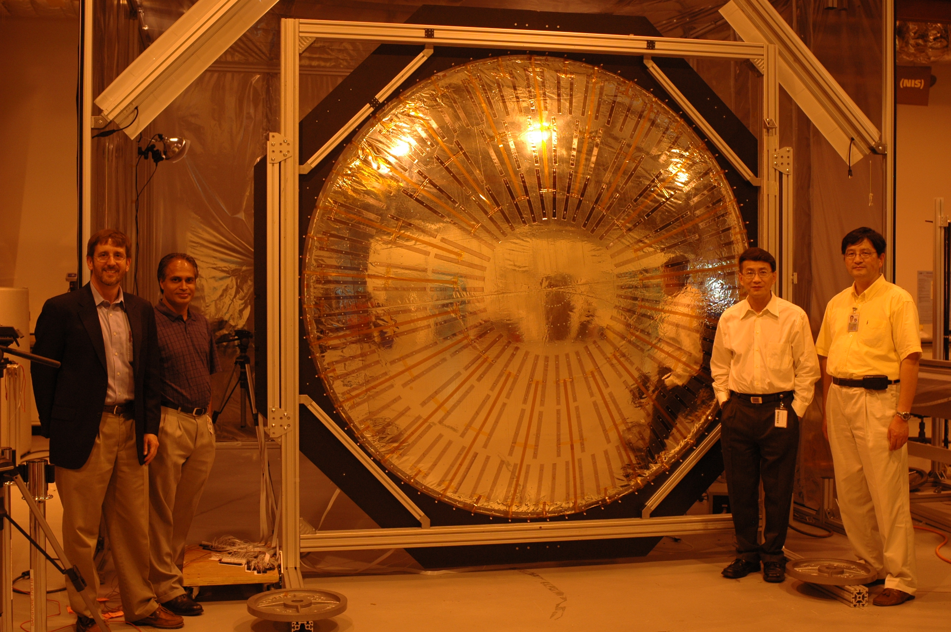
ESTO Advanced Technology Program (ACT-2005)
High-Precision Adaptive Control of Large Antenna Surface
PI: Houfei Fang, JPL
Objective
Develop a high precision adaptive surface figure control system to correct for the surface distortions in large deployable membrane antennas, enabling earth remote sensing from higher (Geostationary and Medium) earth orbits and with improved resolution
  The architecture is based on state-of-the-art technologies in Flexible PVDF (Poly-Vinylidene Floride) Copolymer Film (FPCF) actuators, wavefront sensing metrology, and active shape control laws.
Enable high-resolution monitoring of rapidly changing environments, such as hurricanes and severe storms, from a geostationary orbiting radar
The 2.4-m diameter prototype model. It consists of an inflatable membrane reflector, 84 single and 84 double actuators, flexible circuits, and photogrammetry targets.
Accomplishments
Assessed the performance of optical wavefront sensing-based and laser-based metrology technologies.
Characterized the performance of several membrane materials for space antenna application and fabrication scalability.
Developed PVDF actuator fabrication process and fabricated 372 actuators for the prototype antenna.
Prototyped a 2.4-m-diameter membrane antenna and installed 168 actuators for controlling the surface contour.
Developed an Influence Coefficient Matrix-based model for regulating the input voltages to actuators for antenna surface correction.
Conducted initial surface actuation test on the 2.4-m antenna prototype and the test results were well-correlated with the model predictions.
Scaled the experimentally verified model to the design of a 35-m-diameter antenna surface contour control system.
Co-Is/Partners: Xian An, Ubaldo Quijano, JPL; Kon-Well Wang, Jeff Hill, University of Michigan; Frank Djuth, Geospace Research; James Moore, James Pearson, ManTech SRS Technologies
TRL_{in} = 2 TRL_{out} = 4
05/09
Notes:
40

Slide 41
NIS as an observational tool
Lewis et al. (2010) simulate NIS observations for Hurricane Wilma (2005)
using a UW-NMS high-resolution simulation.
Assessment of structure reconstructed from V_{R} and Z_{e} observations
Retrieval of relevant (i.e. operationally interesting) metrics

Slide 42
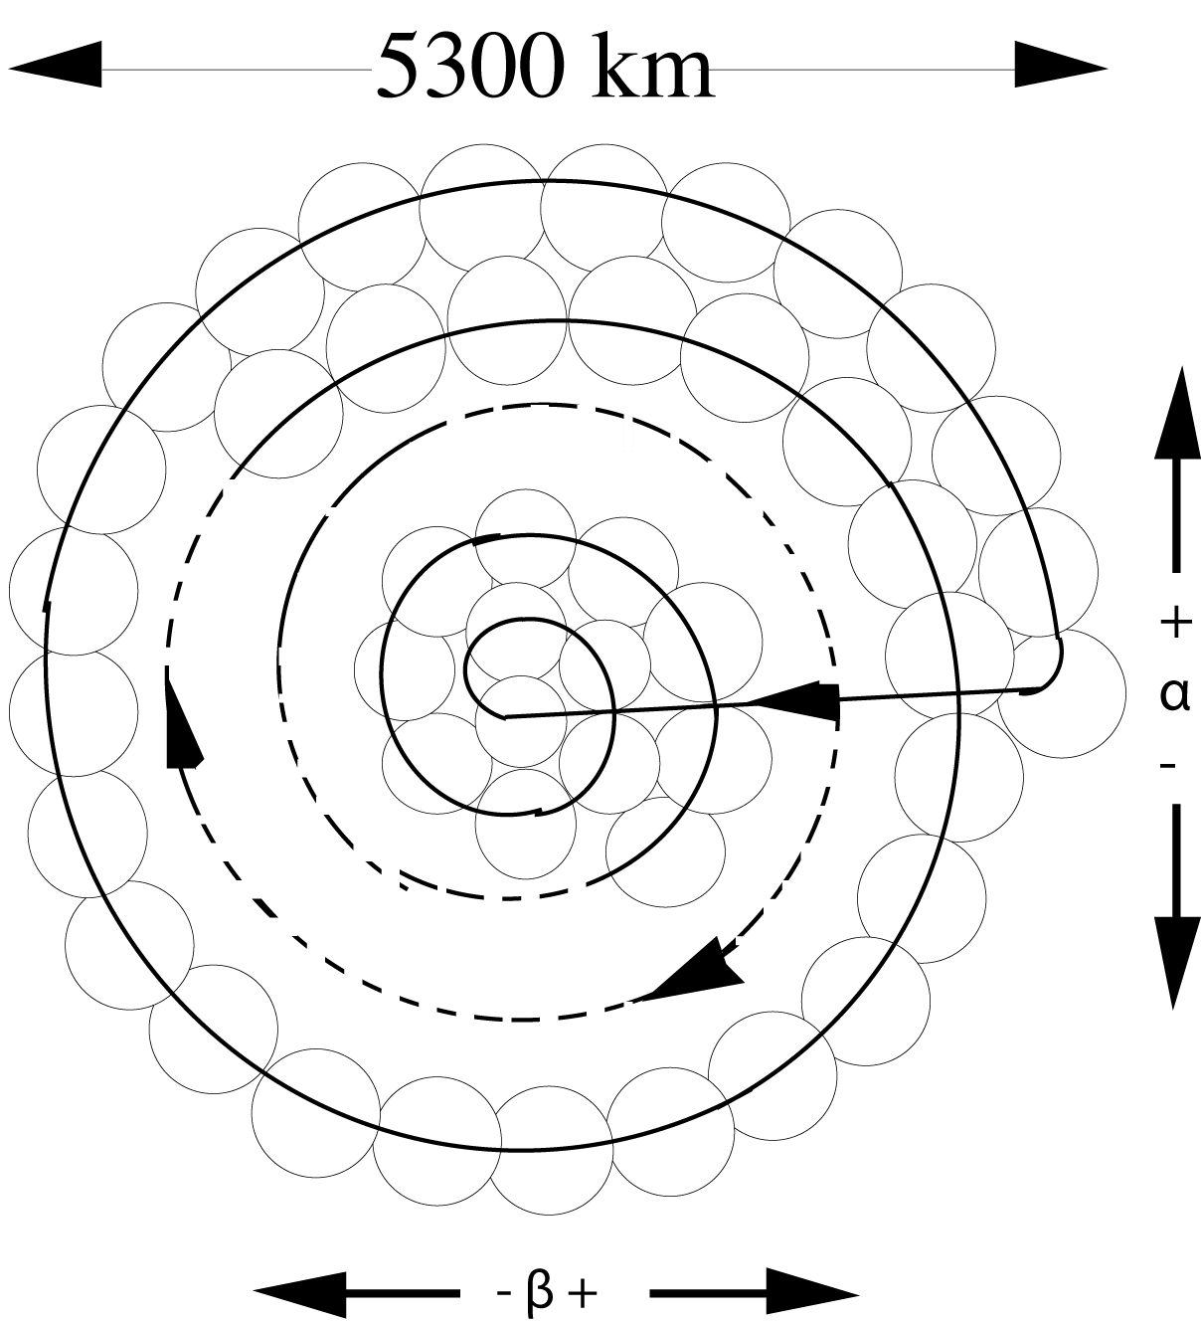
Retrieval of V_{H}
If we assume V_{H} >> w , then
the horizontal wind may be retrieved
in terms of the measured (here, assumed
dealiased) Doppler radial velocity:
where
and d is the range to the target and a is
the earth’s radius.
V_{H} = |V_{R} | / (cos² θ sin² γ + sin² θ cos² γ)^{1/2}.
θ = α + sin⁻¹ [(d sin α)/a]
γ = β + sin⁻¹ [(d sin β)/a].

Slide 43
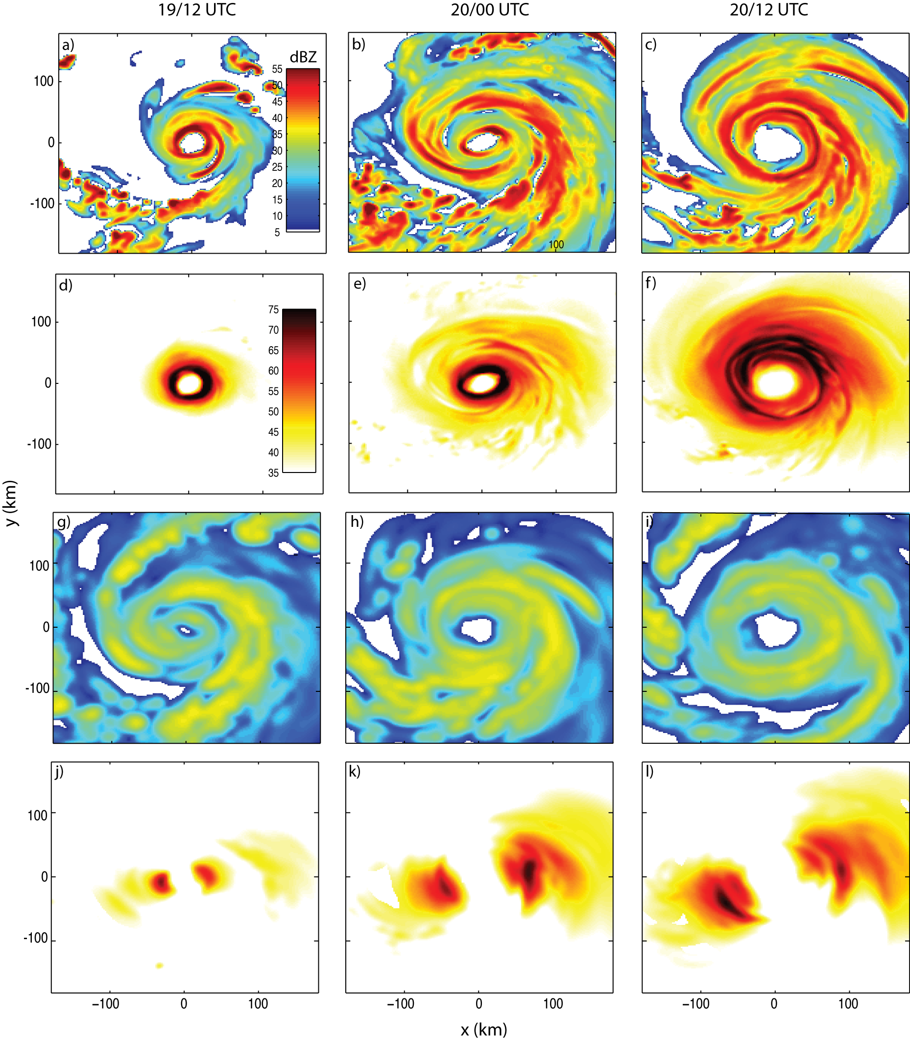
Z_{e} (X band)
TRUTH
V_{H}
Reflectivity and Winds (4.5 km AGL)
Z_{e} (Ka-band)
NIS
V_{H}

Slide 44
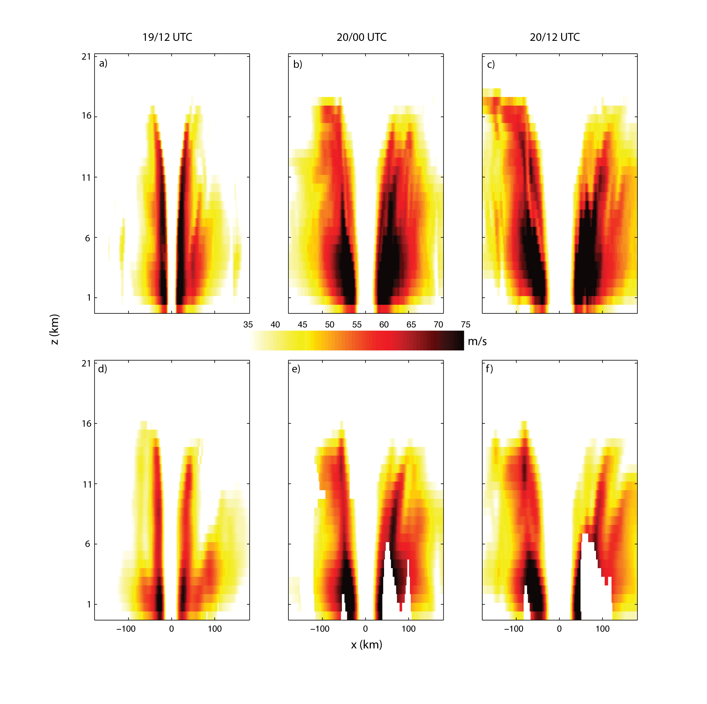
Horizontal Wind Cross Section
TRUTH
NIS RETRIEVAL

Slide 45
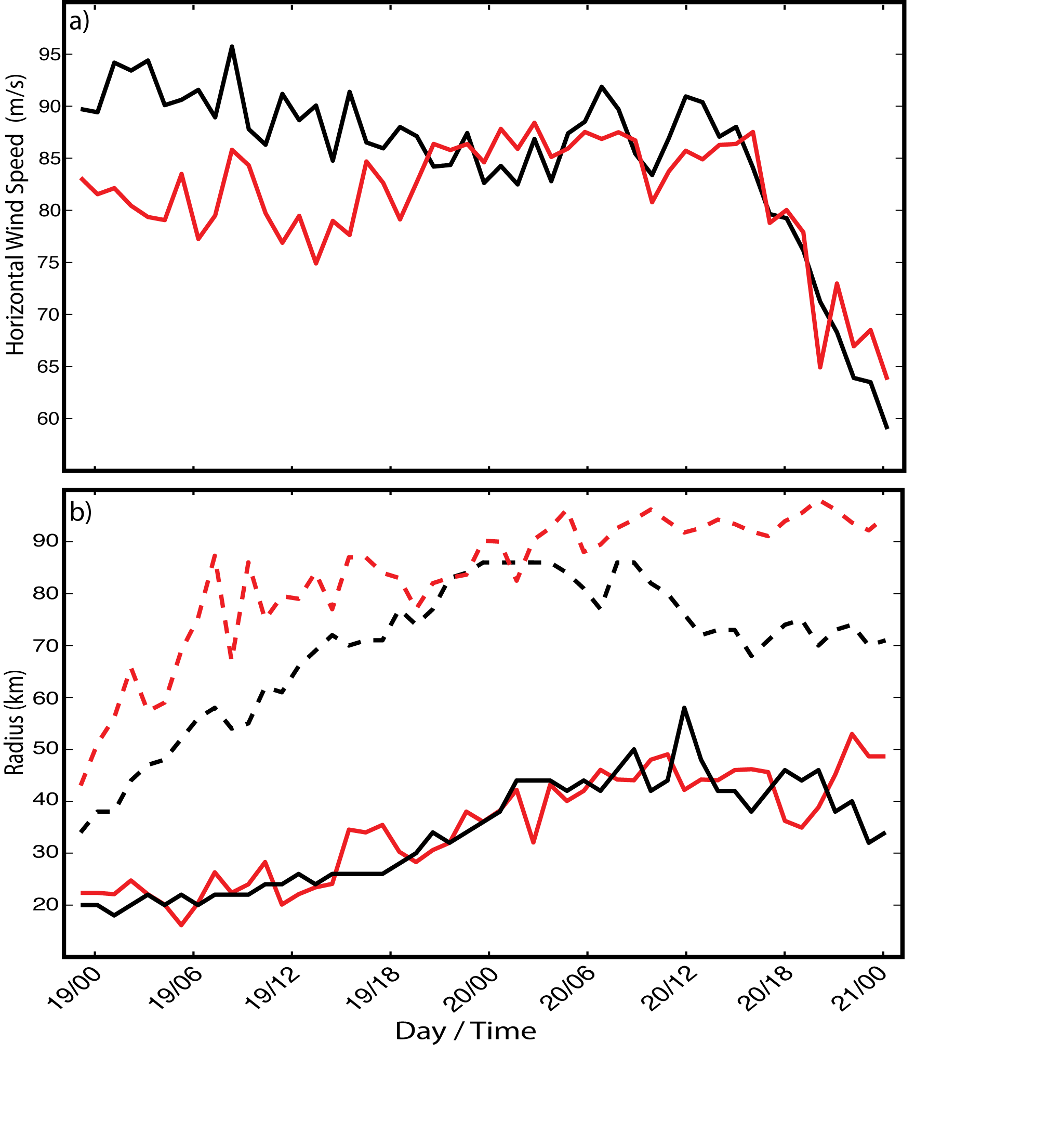
Max Wind and Wind Radii (TRUTH, NIS RETRIEVAL)
V_{max} RMSE = 7 ms⁻¹ (before ERC)
= 3.7 ms⁻¹ (after ERC)
V_{max}
R64 RMSE = 16 km
R64
RMW RMSE = 6.4 km
RMW

Slide 46
Conclusions
To realize the potential for predictability of TC intensity and track, as well as the “summertime prediction problem”:
  Understand the numerical and physical limitations of predictability relative to the space-time scales driving the system evolution
  Develop observational strategies to define the space-time multivariate structures driving storm evolution
  Embrace and support the development of future Geo 3D multivariate observation technologies (NIS, multi spectral, Doppler lidar, etc) because they represent the only practical hope of filing the 5D data gap that continues to widen as models achieve higher resolution

