Slide 1
Assimilation of satellite cloud and precipitation observations in regional scale systems Tomislava Vukicevic¹
In collaboration with
Altuğ Aksoy^{1,2}, Sim Aberson¹, Kathryn Sellwood^{1,2}, Gopal¹, Frank Marks¹, Thiago Quirino¹ and Lisa R. Bucci^{1,3}
¹NOAA/AOML Hurricane Research Division
²U. Miami/RSMAS Cooperative Institute for Marine & Atmospheric Studies
³Science Applications International Corporation

Slide 2
Overview
From : Assimilation of Satellite Cloud and Precipitation Observations in Numerical Weather Prediction Models: Introduction to the JAS Special Collection. J. Atmos. Sci., 64, 3737–3741, 2007, by Errico, Ronald M., George Ohring, Fuzhong Weng, Peter Bauer, Brad Ferrier, Jean-François Mahfouf, Joe Turk
“To date, the assimilation of satellite measurements in numerical weather prediction (NWP) models has focused on the clear atmosphere. But satellite observations in the visible, infrared, and microwave provide a great deal of information on clouds and precipitation.
Since clouds and precipitation often occur in sensitive regions for forecast impacts, such improvements are likely necessary for continuing to acquire significant gains in weather forecasting “

Slide 3
How much has been done?
Short answer is NOT MUCH
Use of satellite observations in -cloud and -precipitation conditions in operational systems
Precipitation affected microwave (MW) radiances over ocean and infra red (IR) above clouds at ECMWF
MW un-contaminated by precipitation, over oceans, at EMC, NAVDAS, JMA, UKMO and MSC
TRMM-PR ??
Cloud properties are not analyzed in operational systems
Limited number of research case studies on assimilation of satellite cloud and precipitation observations with high-resolution regional models

Slide 4
What hinders progress? Issues summarized in the review article
Observations
IR observations are limited to information about cloud tops and above
Passive MW observations are sparse in space and time, and highly sensitive to surface emissivity which is difficult to evaluate well over land
Visible observations are highly sensitive to cloud top micro-properties
Active sensors such as TRMM, CloudSat and CALIPSO have limited temporal and horizontal coverage
NWP Models
Inaccurate representation of clouds and precipitation due to resolution and parameterizations
Uncertainties in parameterizations which link cloud and precipitation to thermal, humidity and other variables
Highly nonlinear relationship between variables
Radiative transfer (RT) models
Uncertainties or poor knowledge of particle properties which affects evaluation of emission and scattering by precipitation and clouds
Uncertainties due to 3D effects which are typically not modeled (too expensive)
Assimilation methodology
Limited to near-linear relationships between observed and analyzed quantities
Poor background information from NWP

Slide 5
Example of research on assimilation GOES imager visible and IR observations in cloudy conditions
4DVAR assimilation of GOES imager observations with cloud resolving model (Polkinghorne et al, 2009 and Polkinghorne and Vukicevic, 2010, Vukicevic et al, 2005, 2006)
NWP model : RAMS (Regional Atmospheric Modeling System, Cotton et al, SCU)
GOES imager observations from visible, near-IR and IR wavelengths at frequency of 15 or 30 minutes and resolution of 1-4 km
Cases of mixed clear and multi-layer cloudy atmosphere without convection in South-Central US , centered at ARM site in Oklahoma
4DVAR includes cloud microphysics through adjoint of full physics of the cloud resolving model
Major issues
Model background data had large biases in surface temperature, cloud cover and spatial distribution of clouds
Strongest nonlinearities in the assimilation occurred when cloud types in the model and observations were different, including cloud- no-cloud conditions

Slide 6
background
Example of optimal analysis
observed
analysis

Slide 7
Summary of what has been learned
Large background bias in cloud distribution strongly limits success of assimilation
More frequent observations improve the assimilation results
Coupling of time and space dimensions improves the assimilation
Achievable by 4D assimilation approaches: 4VAR or ensemble filters with frequent cycling
Impact of nonlinearities is reduced by more accurate background and inclusion of dynamic coupling with frequent observations
IR observations in cloudy conditions are valuable when the above conditions are favorable

Slide 8
Assimilation of satellite cloud and precipitation observations in TC and hurricane conditions
Prior studies indicate that progress could be made by ensuring the following
Good quality of background forecast with respect to the satellite cloud and precipitation observations
Time and space coupling in the assimilation
Frequent observations at spatial scales that are adequate for improving the conditions that govern a desired prediction skill

Slide 9
HRD’s Hurricane Ensemble Data Assimilation System (HEDAS)
Forecast model:
HRD’s Experimental HWRF (HWRF-X)
2 nested domains (9/3 km horizontal resolution, 42 vert. levels)
Static inner nest to accommodate covariance computations
➔ Inner nest size: ~10x10 degrees
Ferrier microphysics, explicit convection on inner nest
Ensemble system:
Initialized from semi-operational GFS-EnKF (NOAA/ESRL) ensemble
Initial ensemble is spun up for 3-4 hours before assimilation begins
30 ensemble members
Data assimilation:
Square-root ensemble Kalman filter, EnKF (Whitaker and Hamill 2002)
Assimilates inner-core aircraft data on the inner nest
➔ NOAA P-3, NOAA G-IV, USAF, PREDICT G-V
Covariance localization (Gaspari and Cohn 1999)

Slide 10
2010 HEDAS Semi-Real-Time Runs for HFIP: Summary of Cases
A total of 19 cases are run (when NOAA P-3’s collected Doppler radar data):
Number of Observations Assimilated per Cycle
Number of Observations
Number of Cycles

Slide 11
2010 HEDAS Semi-Real-Time Runs for HFIP: Summary of Final Mean Analysis Intensity
Max. 10-m Wind Speed (knots)
Min. Pressure (mbar)

Slide 12
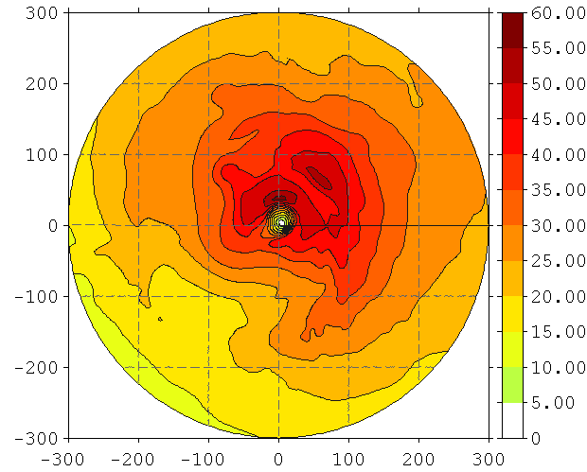
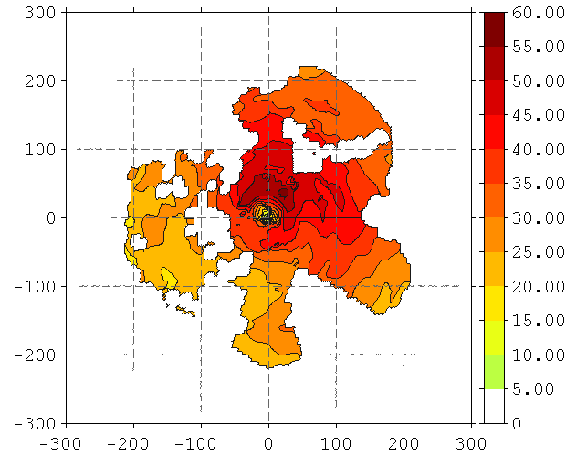
2010 HEDAS Semi-Real-Time Runs for HFIP: Comparison of Structures (Earl 08/30 12Z)
Wind Speed at 1 km (m/s)
Analysis
Radar
Distance from Center (km)
Distance from Center (km)

Slide 13
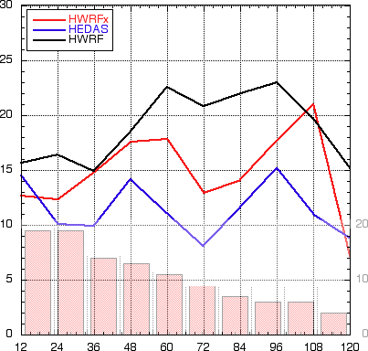
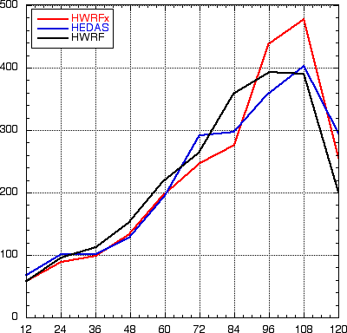
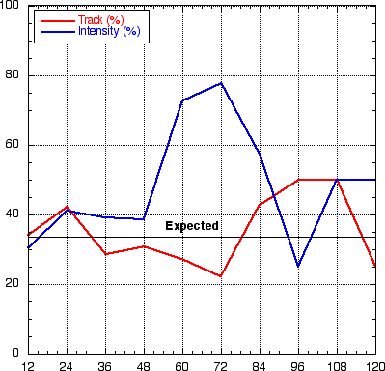
2010 HEDAS Semi-Real-Time Runs for HFIP: Summary of Forecast Performance
Intensity Error (kt) & Number of Cases
Track Error (km)
Frequency of Superior Performance (%)
Forecast Time (hour)
HEDAS (in blue) performs better in intensity and comparably in track (to HWRF and HWRFx)

Slide 14
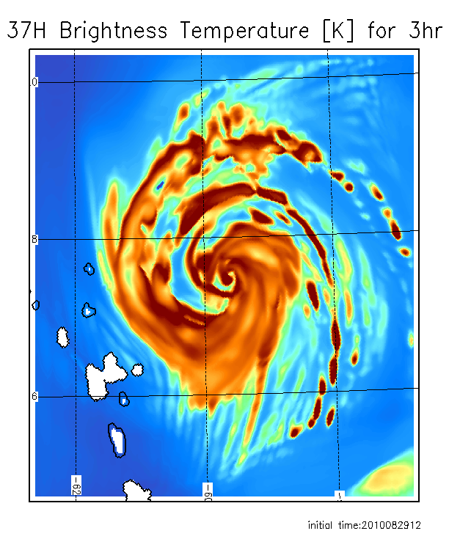
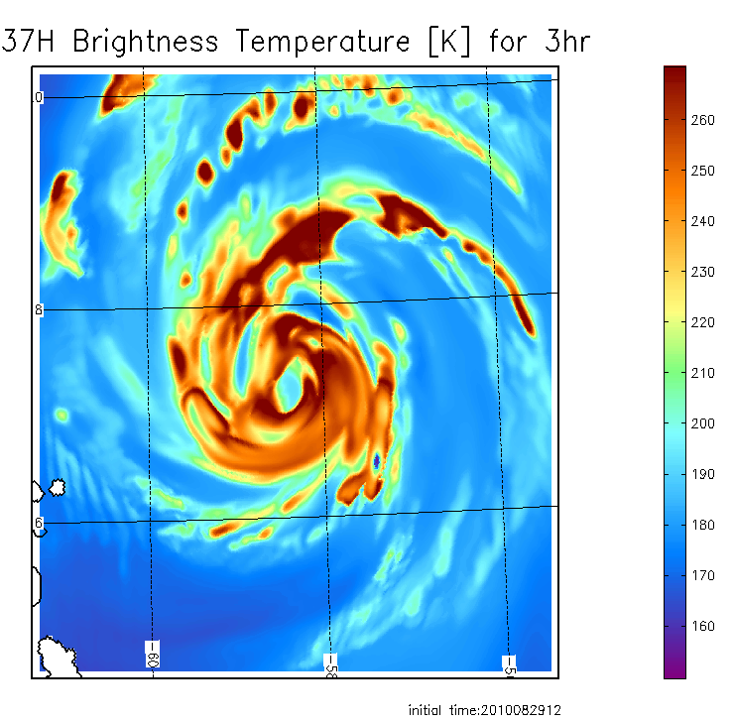
Relevance to assimilation of satellite cloud and precipitation observations
36 GHz observed AQUA closest time within 1 h
3h 37 GHz forecast from HEDAS IC
3h 37 GHz forecast from HWRF IC
Forecast initial time 12:00Z, 08/29/2010

Slide 15
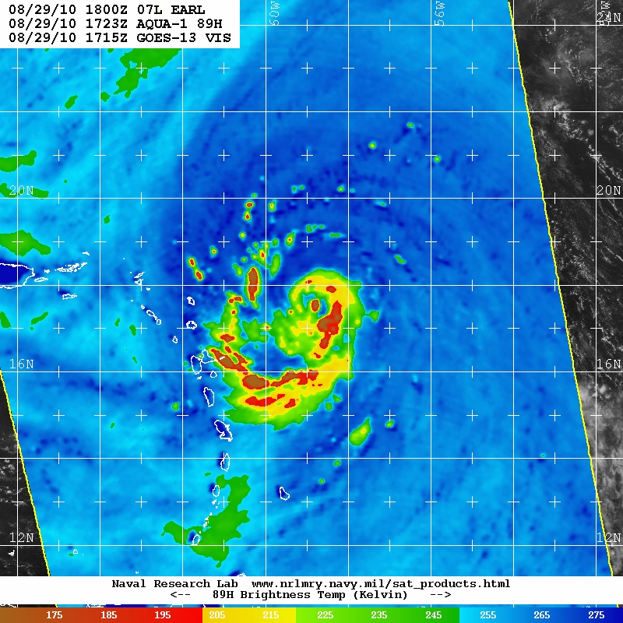
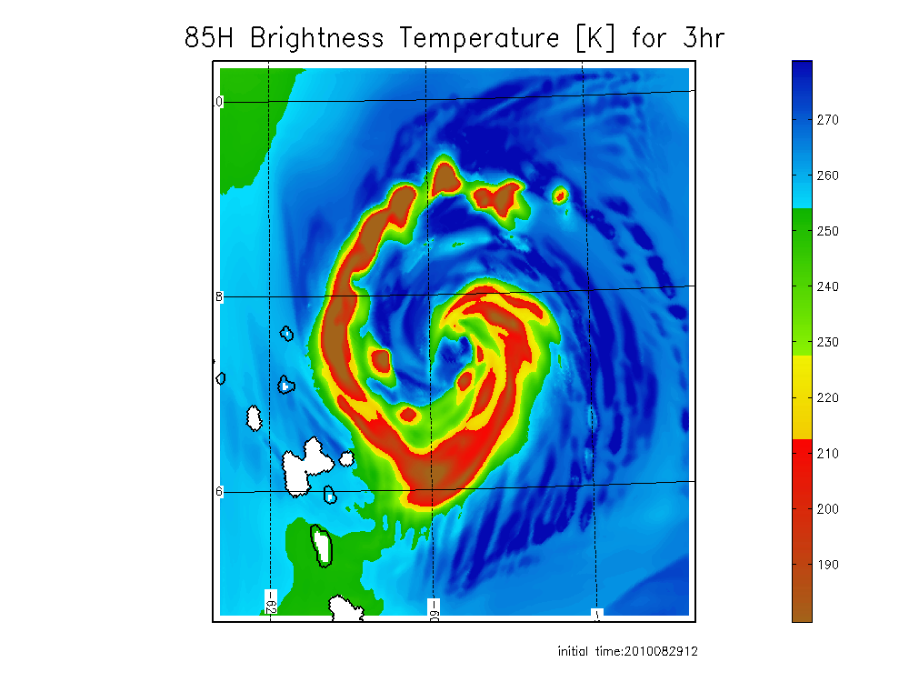
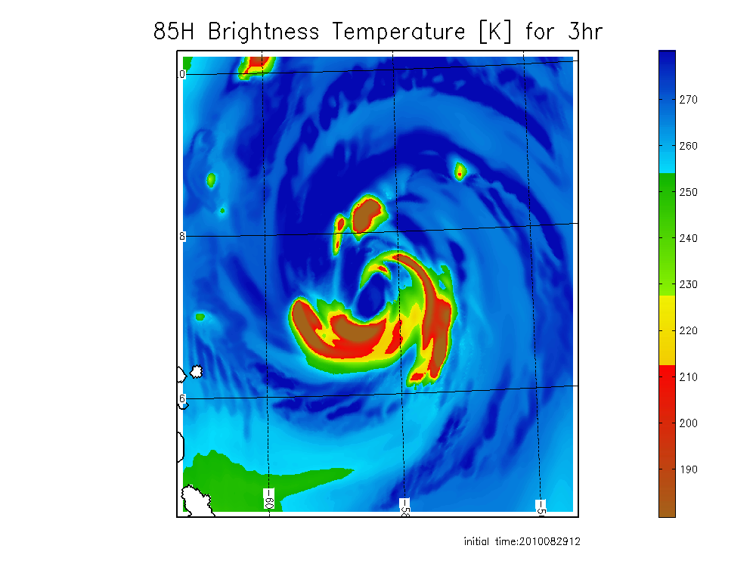
Comparison of observed and forecast images for hurricane Earl from HEDAS and HWRF ICs
89 GHz observed AQUA closest time within 1 h
3h 85GHz forecast from HEDAS IC
3 h 85 GHz forecast from HWRF IC
Forecast initial time 12:00Z, 08/29/2010

Slide 16
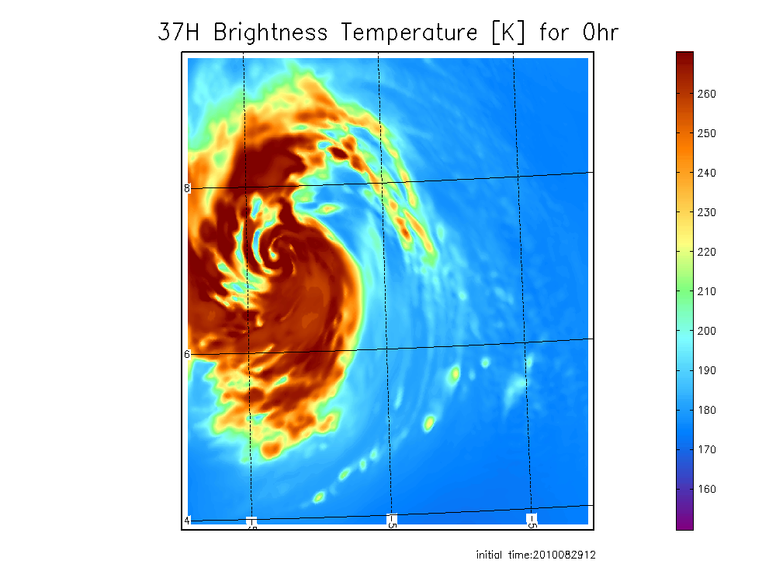
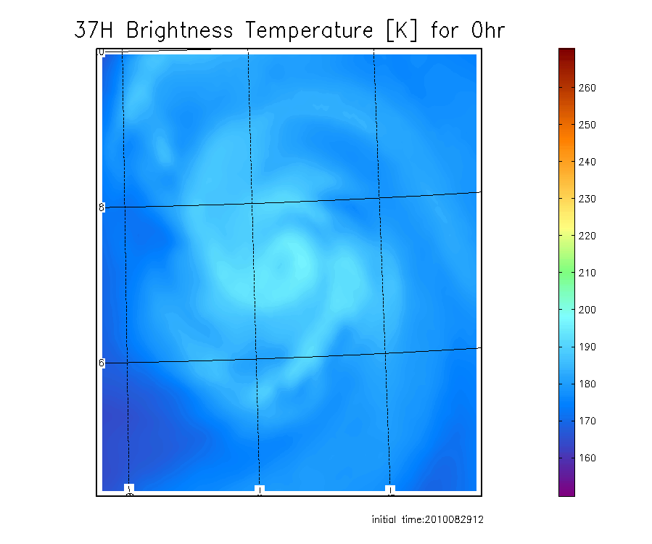
Coupling of cloud and dynamic state variables in HEDAS
37 GHz from HEDAS IC
37 GHz from HWRF IC

Slide 17
Ensemble based correlations on vortex scale

Slide 18
Summary
Hurricane background forecasts in high resolution may be skilled enough to enable successful assimilation of satellite cloud and precipitation observations
Joint assimilation of high resolution 3D wind and satellite observations is likely necessary for success, together with using 4DDA techniques with dynamic coupling in space and time dimensions
Planned updates in HEDAS, before the 2011 season:
Satellite data assimilation in the core (Vukicevic)
Representation of model error in surface and PBL physics (Aksoy and J. Zhang)
Improved parallelization
All of HEDAS forecast case results can be found at the following link: https://storm.aoml.noaa.gov/realtime

