Slide 1
The Infrastructure of Observations
Ryan Honeyager, Stephen Herbener, Many JEDI Developers
18th JCSDA Technical Review Meeting and Science Workshop
June 9, 2021

Slide 2
JEDI’s Observation Data Flow
Converters
Joint Effort for Data assimilation and Integration
BUFR (WMO and NCEP)
R2D2
ODB
GSI ncdiags
IODA
UFO
OOPS
Marine
Diagnostics
Models
METARs

Slide 3
Different Classes, Similar Tasks
Use Case | Description | Language
Data ingest | Creation of Observation Spaces | Python, Fortran
Bias Correction | Read and update data | C++
GeoVaLs | Perform interpolation to align observations and models | Fortran / (C++)
Operators | Read and update data | C++, Fortran
ObsDiagnostics | Store ancillary data produced by an operator | Fortran / (C++)
Filters | Assign QC flags and update observation error estimates | C++, Fortran
ObsFunctions | Calculate derived quantities from data in the ObsSpace, HofX, diagnostics, or GeoVaLs | C++
Diagnostics | Condense data and generate plots | Python
R2D2 | Track metadata associated with on-disk ObsSpaces | Python

Slide 4
Observations Need Infrastructure
Data contract:
a formal agreement between a service (IODA) and users that abstractly describes both the data to be exchanged and the API for accessing data.
Users want:
Easy and efficient access to observation data.
To isolate science from data storage technicalities (separation of concerns).
We aim for a:
Uniform programming interface,
Uniform data layout, and
Flexible, object-oriented, and generic design.

Slide 5
IODA 2: Abstract Interfaces
Steve Herbener Tuesday at 9:05
IODA v2 Release (this week)
After Release (Summer)
Planned / Potential
Extension of JEDI’s abstract interfaces and separation of concerns to IODA.
HDF5
ObsStore
BUFR
ODC
YAML
NetCDF
User-facing classes
IODA: Groups, Variables, Dimensions, Attributes, Type System
ObsSpace
Bias
Converters
Diagnostics
Other Containers
Cross-language bindings (C++, C, Python)
Multidimensional data support

Slide 6
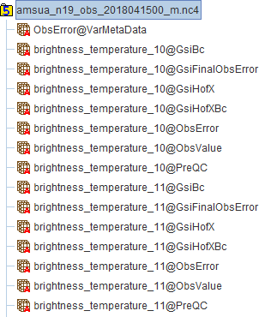
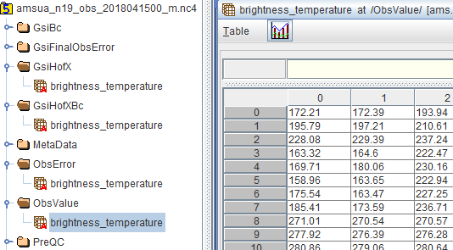
IODA 2: Client-Side Data Layout
IODA 1.0 Observation Files
IODA 2.0 Observation Files
ioda-upgrade.x old_file new_file

Slide 7
IODA 2: Variable Naming
Greg Thompson Today at 10:30
JCSDA OBS project is working on defining consistent IODA layout and variable naming conventions.
Summer code sprint – apply conventions to converters and UFO
Name | Units | Data Type
brightnessTemperature | Kelvin | 32-bit float
radiance | W m⁻¹ sr⁻¹ | 32-bit float
instrumentIdentifier | None | Variable-length string
sensorChannelNumber | None | Unsigned 32-bit integer

Slide 8
IODA 2: Data Storage Implementations
Implementation | Data source | I/O support
Current
ObsStore | Memory | Read / write
HDF5 | Memory | Read / write
HDF5 | File | Read / write
Potential (network-optimized)
HDF5 | S3 bucket / Hadoop | Read only
ODC | Database / file | Read / write
NetCDF | File | Read / write
NetCDF | HTTP / S3 | Read only
NetCDF | Zarr | Read / write

Slide 9
Observations and Filters
Hui Shao Friday at 8:05
Abstract “observation filters” are run before and after an observation operator.
Filters are written once and used with many observation types. They are configurable via YAML.
Observation filters have access to:
Observation values and metadata
Model values at observations locations (GeoVaLs)
Simulated observation value and diagnostics (for post-filter)
Their own private data

Slide 10
QC Example for IASI
A process of observation Screening, Error Inflation, and *Error Bound Tightening from their original values
Wavenumber
Obs BT Check
Cloud Detection
Surface Jacobian Check
Check
tzr_qc=0
No Cloud Detected
Near SST
Check
Topography
Check
Surface Sensitivity Check
tzr_qc=1
*Model Top Transmittance Check
Gross Check
Source: Emily Liu, NOAA/EMC
*Latitude Check
Minimization

Slide 11
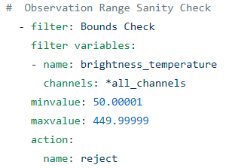
QC Example for IASI
A process of observation Screening, Error Inflation, and *Error Bound Tightening from their original values
Wavenumber
Obs BT Check
Cloud Detection
Surface Jacobian Check
Check
tzr_qc=0
No Cloud Detected
Near SST
Check
Topography
Check
Surface Sensitivity Check
tzr_qc=1
*Model Top Transmittance Check
Gross Check
Source: Emily Liu, NOAA/EMC
*Latitude Check
Minimization

Slide 12
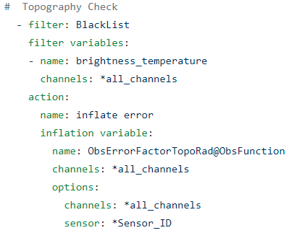
QC Example for IASI
A process of observation Screening, Error Inflation, and *Error Bound Tightening from their original values
Wavenumber
Obs BT Check
Cloud Detection
Surface Jacobian Check
Check
tzr_qc=0
No Cloud Detected
Near SST
Check
Topography
Check
Surface Sensitivity Check
tzr_qc=1
*Model Top Transmittance Check
Gross Check
Source: Emily Liu, NOAA/EMC
*Latitude Check
Minimization

Slide 13
QC Example for IASI
A process of observation Screening, Error Inflation, and *Error Bound Tightening from their original values
Wavenumber
Obs BT Check
Cloud Detection
Surface Jacobian Check
Check
tzr_qc=0
No Cloud Detected
Near SST
Check
Topography
Check
Surface Sensitivity Check
tzr_qc=1
*Model Top Transmittance Check
Gross Check
Source: Emily Liu, NOAA/EMC
*Latitude Check
Minimization

Slide 14
Future QC Capabilities
Permanent storage of derived data
Derived data: any data not provided directly by ioda converters / quantities calculated in UFO.
We should store ObsFunction results. Ex: conversion of winds from speed and direction to u and v.
Expanded QC data storage
QC steps should be able to return more than just a “pass/fail” flag.
Both 1 and 2 depend on further rollout of the IODA 2 changes to UFO.

Slide 15
Final Remarks
JEDI’s observation infrastructure is maturing and is highly adaptable.
IODA 2.0 release
Next steps:
Update converters and diagnostic codes to use IODA 2’s new Python interface
Extend UFO filtering capabilities
Continuous, agile performance optimization

