Slide 1
Development of a Global Ensemble-based Data Assimilation System using JEDI for Aerosol Forecasting in NOAA’s GEFS-Aerosols Model
Bo Huang^{1,2}, Mariusz Pagowski^{1,2}, Cory R. Martin^{3,4},
Samuel Trahan^{1,2}, Dan Holdaway⁵, Andrew Tangborn^{4,6},
Daryl T. Kleist⁴, Shobha Kondragunta⁷
Collaborators: Benjamin Johnson⁵, Georg A. Grell²,
Arlindo da Silva⁸, Virginie Buchard⁸,
Li Zhang^{1,2}, Judy Henderson², Haiqin Li^{1,2},
Sarah Lu^{5,9} and Shih-Wei Wei⁹
¹CIRES, CU Boulder
²NOAA/ESRL/GSL
³RedLine Performance Solutions at NCEP EMC
⁴NOAA NWS NCEP EMC
⁵Joint Center for Satellite Data Assimilation
⁶IMSG
⁷NOAA NESDIS STAR
⁸NASA/GMAO
⁹State University of New York at Albany
Acknowledgements: “Development of the National Global Data Assimilation Ensemble-based System for Forecasting of Aerosols” funded by NOAA/OAR/WPO/Air Quality program
18th JCSDA Technical Review Meeting and Science Workshop, June 9, 2021

Slide 2
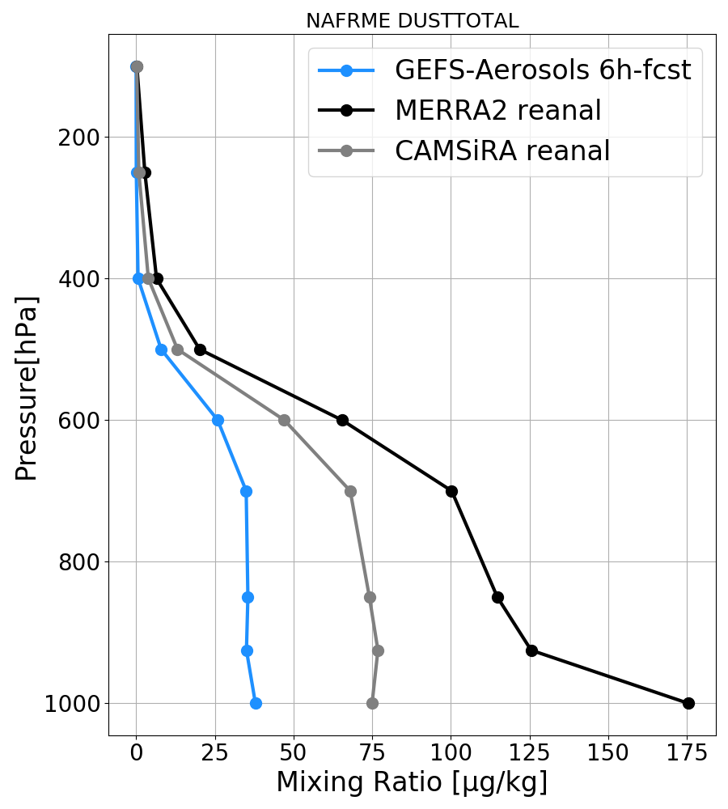
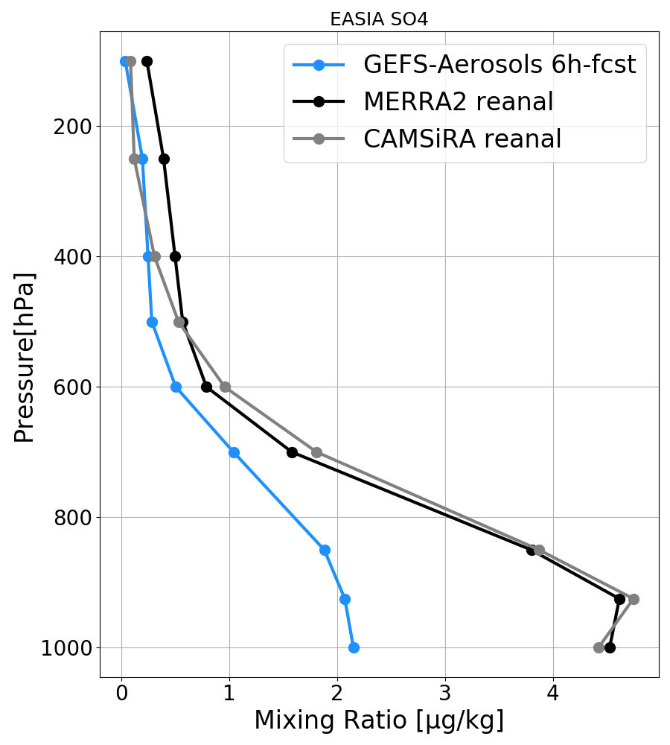
Background and objective
The operational Global Ensemble Forecast System - Aerosols (GEFS-Aerosols) at ESRL and NCEP relies on the Finite-Volume Cubed-Sphere (FV3) dynamical core, Global Forecast System (GFS) physics and the aerosol parameterization based on the Goddard Chemistry Aerosol Radiance and Transport (GOCART) model.
Aerosol forecasts from GEFS-Aerosols are currently not constrained by observations and show large differences compared to NASA-MERRA-2 and ECMWF-CAMSiRA aerosol reanalyses.
Mixing ratio vertical profiles averaged in June 2016
Dust over the North Africa and Middle East
Sulfate over
the East Asia
Dust and sea salt (five size bins), hydrophobic and hydrophilic black and
organic carbon (BC and OC) and sulfate (SO₄).
Emission, advection, convection, diffusion, dry/wet deposition and chemical reactions.
Natural and anthropogenic emissions including daily updated Blended Global Biomass Burning Emissions Product and Fire Radiative Product.
Objective:
Develop global aerosol ensemble-variational (EnVar) data assimilation capability within the Joint Efforts for Data assimilation Integration (JEDI) led by the Joint Center for Satellite Data Assimilation (JCSDA) for operational aerosol forecasting at NOAA with the GEFS-Aerosols model.

Slide 3
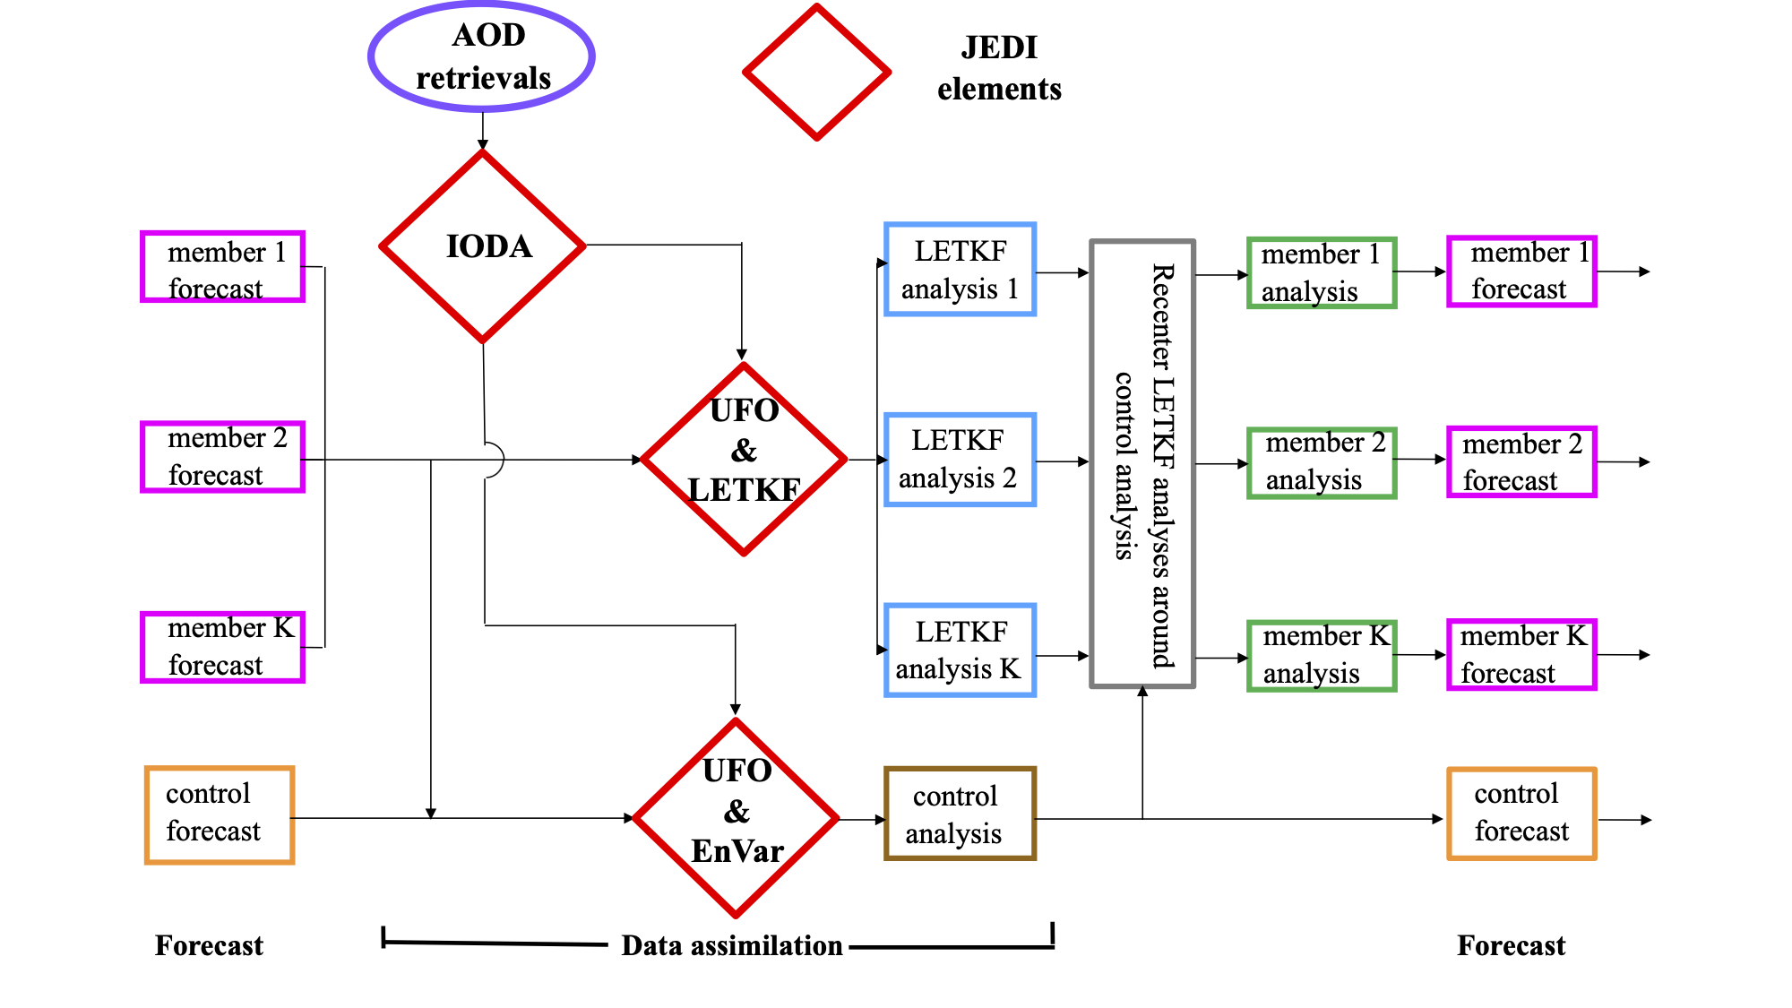
JEDI-based global aerosol EnVar DA system
AOD: VIIRS aerosol optical depth (AOD) at 550 nm;
JEDI: Joint Effort for Data assimilation Integration -- a collaborative effort led by JCSDA;
IODA: Interface for Observation Data Access;
UFO: Unified Forward Operator;
LETKF: Local Ensemble Transform Kalman Filter
EnVar: Ensemble-Variational solver.

Slide 4
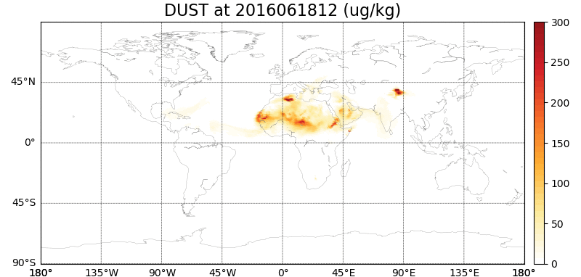
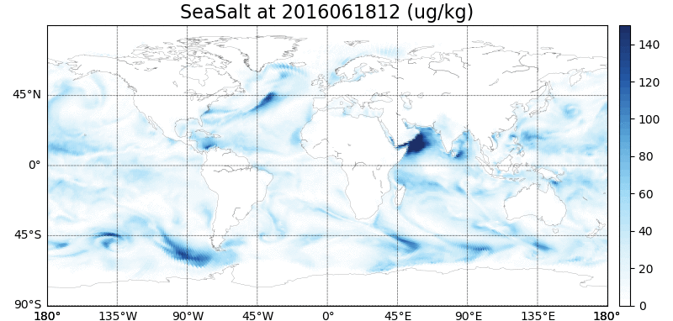
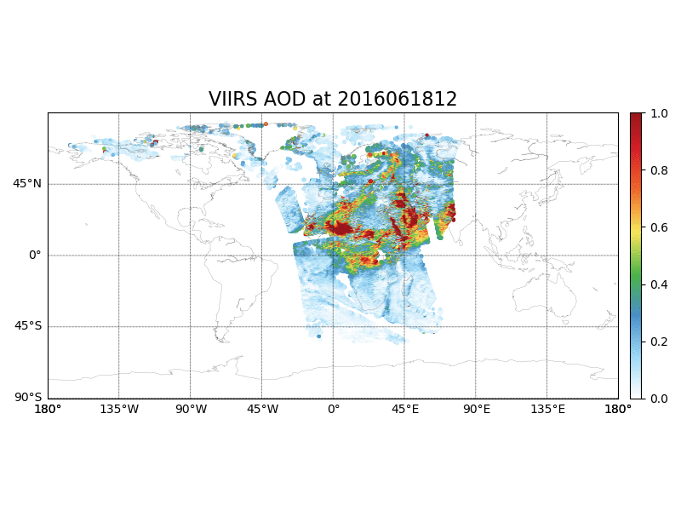
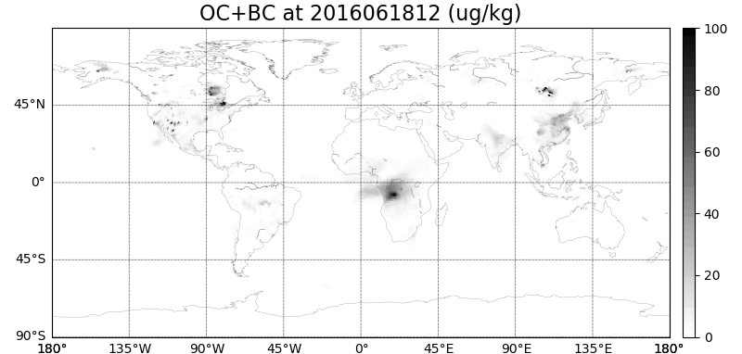
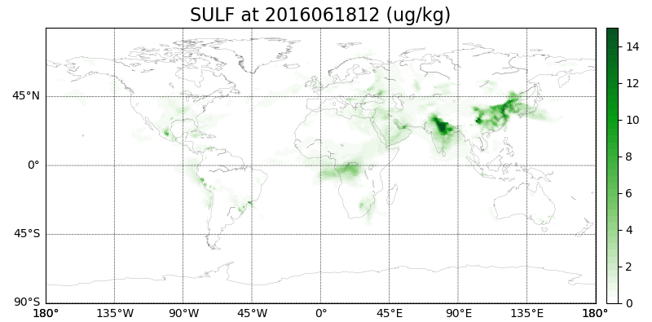
NOAA S-NPP VIIRS AOD retrievals at 550 nm
Column-integrated AOD calculation (Eq.1 of Randles et al. 2017):
GEFS-Aerosols 6-hour aerosol mixing ratio forecast at lowest model level
𝞽: column-integrated AOD
x_{i}: mass mixing ratio of aerosol species
b_{ext,i} :species-specific extinction coefficients as a function of wavelength (λ) and relative humidity (RH)
𝛿z: layer depth
Dust
Sea salt
NOAA S-NPP VIIRS AOD retrievals at 550 nm
(~ 50 km resolution)
Simulation
Total black and organic carbon
Sulfate
Correction
AOD bias and uncertainty estimate:
bias = ab + bb*AOD
uncertainty = au + bu*AOD
Notes:
(1) AOD represent column-integrated aerosol extinction of solar radiation expressed as a summation of species concentrations multiplied by their distinct extinction coefficients and the layer depths.
(2) Assimilated VIIRS AOD level?
(3) VIIRS bias/error estimate
case (10) ! case dark land high quality ab = -0.0138969; bb = 0.157877; au = 0.111431; bu = 0.128699 case (20) ! case bright land high quality ab = -0.0107621; bb = 0.150480; au = 0.0550472; bu = 0.299558 case (0) ! case water high quality ab = 0.0151799; bb = 0.0767385; au = 0.00784394; bu = 0.219923

Slide 5
Improved AOD forward operator calculation using NASA Look-Up Tables (LUTs) compared to Community Radiative Transfer Model (CRTM) in JEDI
NOAA S-NPP VIIRS AOD retrievals at 550 nm at 20160619
Better representation of aerosol optical properties in NASA-LUTs likely due to
including non-spherical dust particles;
accounting for relative humidity’s effects on radius growth of hydrophilic aerosols.
CRTM-simulated AOD
at 550 nm at 20160619
NASA-LUTs-simulated AOD
at 550 nm at 20160619

Slide 6
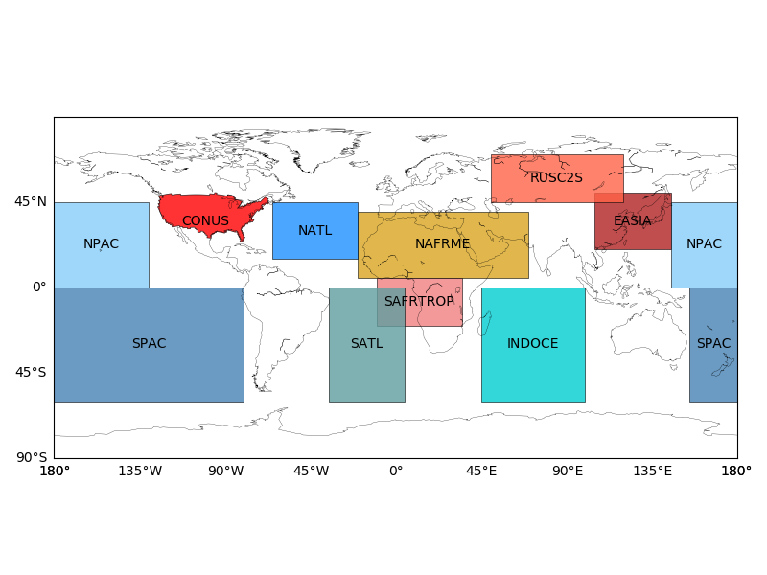
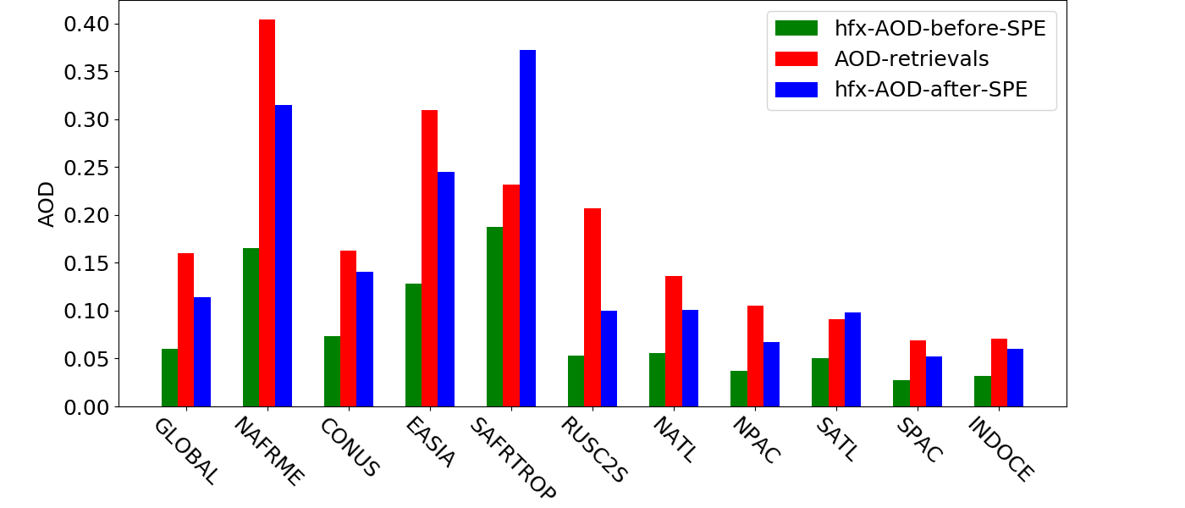
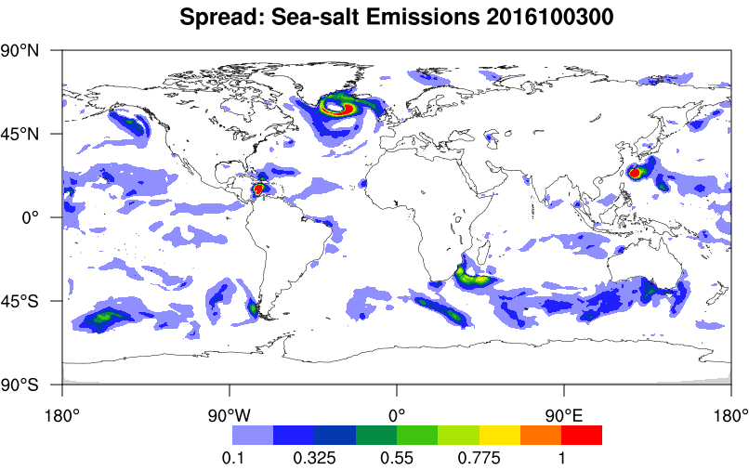
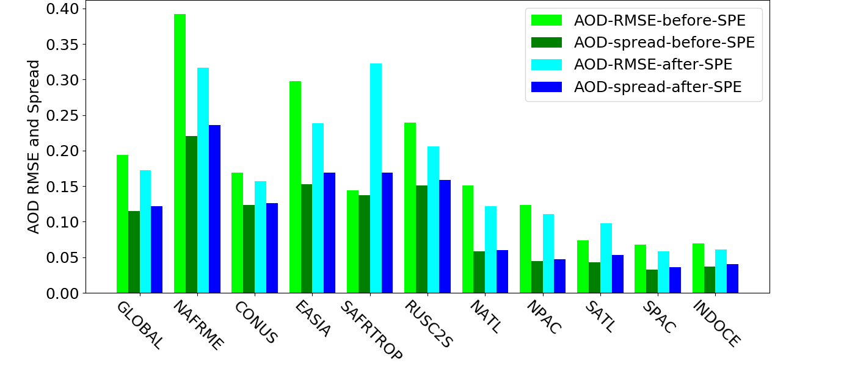
Stochastically-Perturbed Emissions (SPE) based on ECMWF’s Stochastically Perturbed Parametrization Tendency (SPPT) scheme to alleviate modeled AOD bias and ensemble spread deficiency
Dominated Emission source
Dust
Anthro.
Wildfires
Sea salt
Simulated VIIRS AOD vs VIIRS AOD retrievals
(used to define emission scaling factors (=2.0) to correct modeled AOD bias and increase background ensemble spread)
Simulated VIIRS AOD error and spread
(20 members, used to define emission perturbation standard deviation (=2.0) to increase background ensemble spread)
Notes:
(2) SPPT seed generator: auto-regressive AR(1) pattern generator in spectral space
(3) Variational bias correction is not ready in JEDI.

Slide 7
Experiment design
Six-hourly assimilation of AOD retrievals at 550 nm derived from NOAA VIIRS onboard the Suomi-NPP satellite;
3D-EnVar and LETKF for aerosol update;
LETKF analysis recentered around EnVar analysis
NASA-LUTs for AOD forward operator calculation;
Meteorological variables corrected by adding regridded increments from operational GDAS analyses.
1-control plus 20-member ensemble at C96 (~100km) using GEFS-Aerosols model
One-month cycled VIIRS AOD DA experiments in June 2016 after three-week free model run in May 2016
Statistics were performed for June 8-30, 2016.
 | AOD DA | Ensemble size in EnVar solver | Stochastically-perturbed emissions
NODA | No | N/A | No
DA | Yes | 20 | No
DA-SPE | Yes | 20 | Yes emission scaling factors = 2.0 emission perturbation SD= 2.0
DA-SPE3 | Yes | 20*3 by including ensemble forecasts at +/- 3-hour valid times (Huang and Wang 2018) | Yes emission scaling factors = 2.0 emission perturbation SD= 2.0

Slide 8
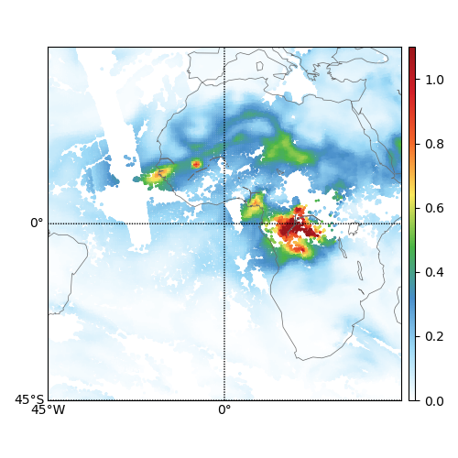
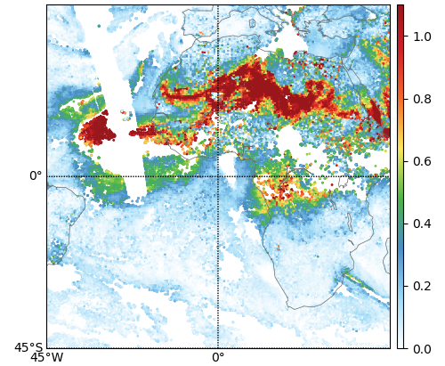
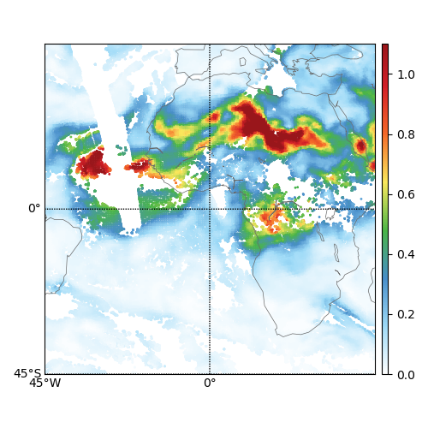
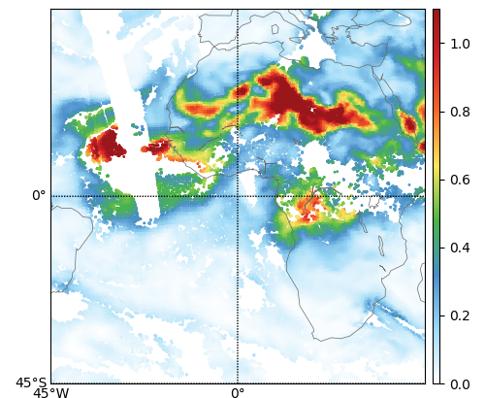
AOD DA impact on the Saharan dust storm
in June 21 2016
Dust emission dominates.
NODA 6-hour fcst
VIIRS AOD at June 21 2016
Wildfire emission dominates.
DA analysis
DA-SPE analysis

Slide 9
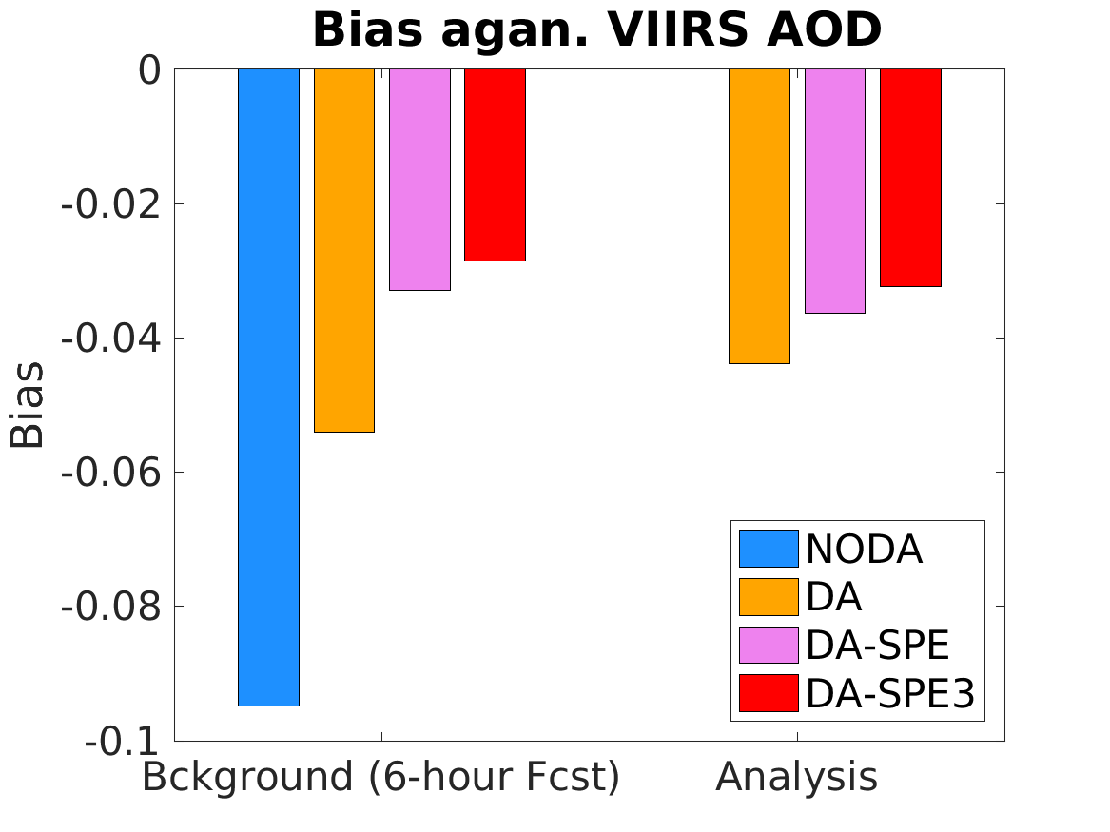
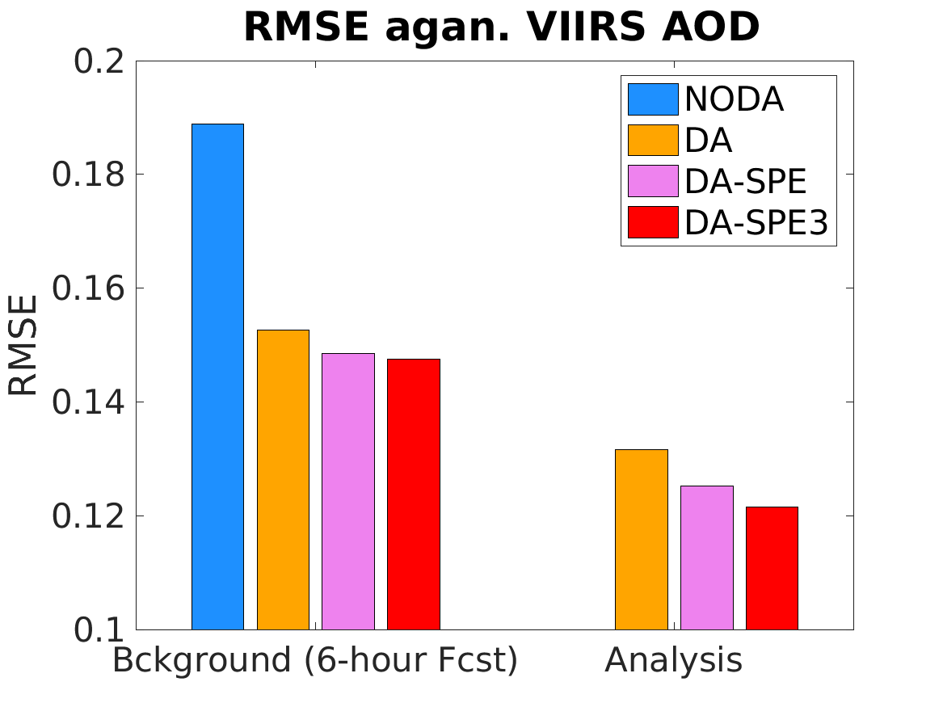
Innovation Statistics of VIIRS AOD at 550nm
Averaged bias against VIIRS AOD
Averaged RMSE against VIIRS AOD
Assimilation of AOD at 550 nm efficiently reduces negative bias and error of simulated AOD, especially when SPE is applied.
When available in JEDI, variational bias correction is expected to further reduce bias in AOD data assimilation experiments.
Similar statistics are shown, when verified against independent AOD retrievals at 550 nm from the Moderate Resolution Imaging Spectroradiometer (MODIS).
Notes:
SPE-analysis show slightly larger bias than background.

Slide 10
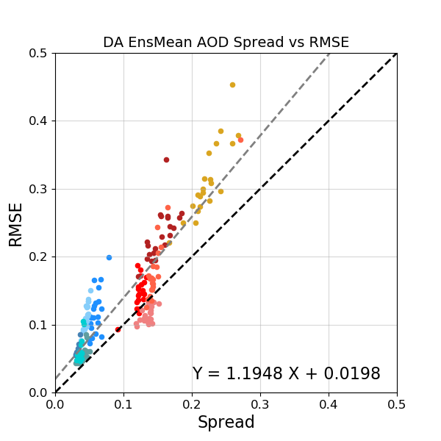
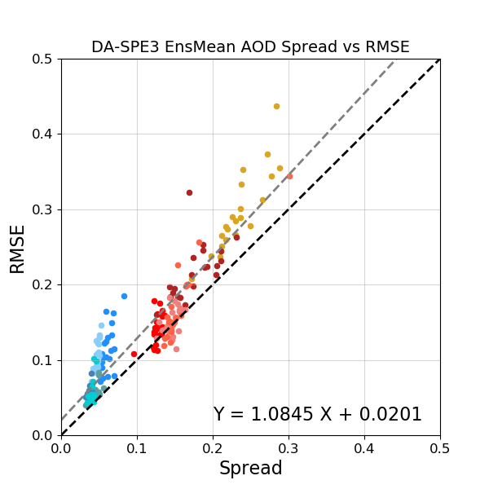
Background ensemble error-spread consistency in AOD DA experiments
DA
DA-SPE
DA-SPE3
Improved background error-spread consistency

Slide 11
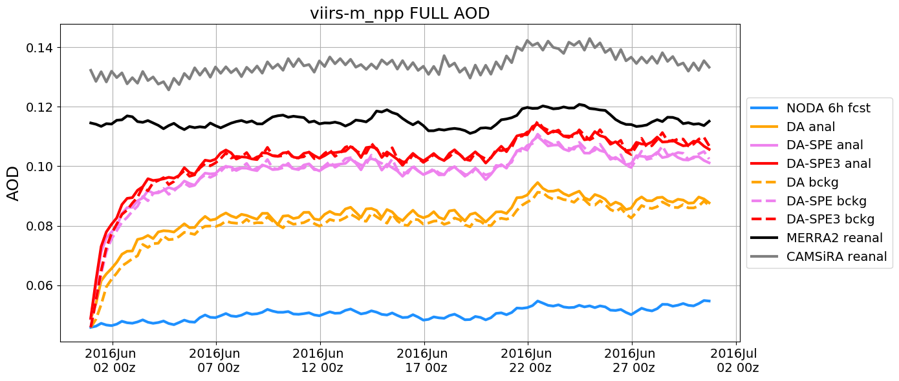
Globally averaged AOD compared to NASA-MERRA2 and ECMWF-CAMSiRA reanalysis

Slide 12
Monthly averaged AOD bias against NASA-MERRA2 and ECMWF-CAMSiRA reanalysis
NODA
6-hour fcst
DA
analysis
DA-SPE analysis
Bias agan. NASA-MERRA2 reanalysis
Bias agan. ECMWF-CAMSiRA reanalysis
Analysis from DA-SPE3 (not shown here) shows similar bias patterns as DA-SPE but with slightly further reduced bias over coastal areas.

Slide 13
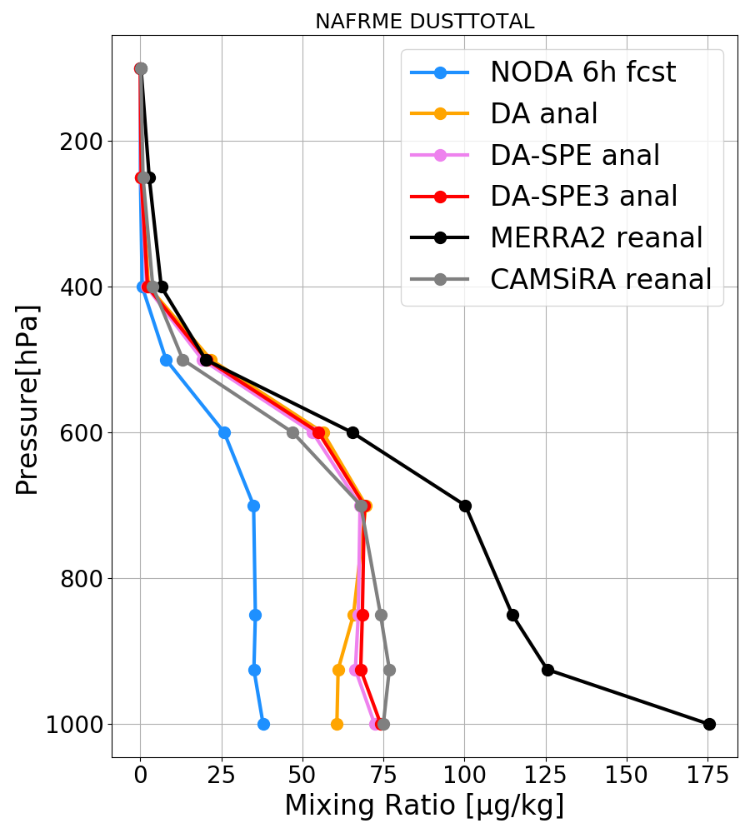
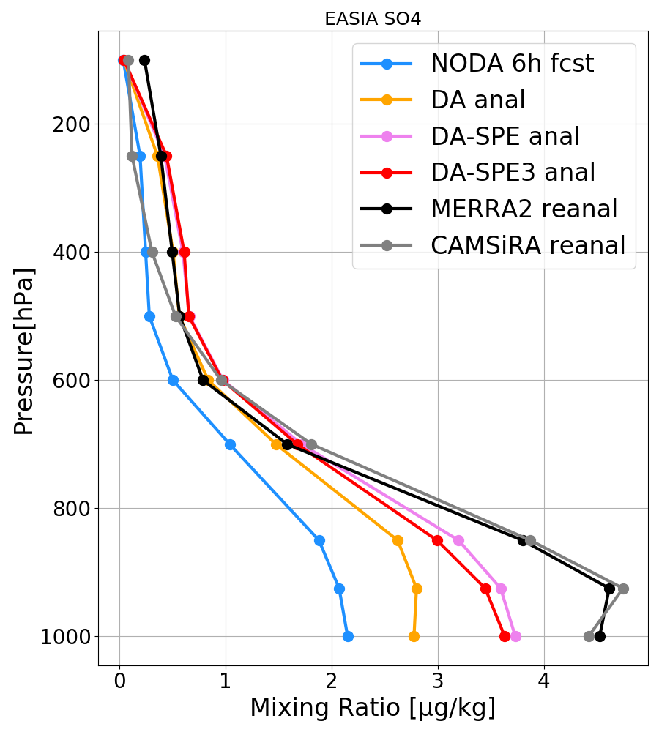
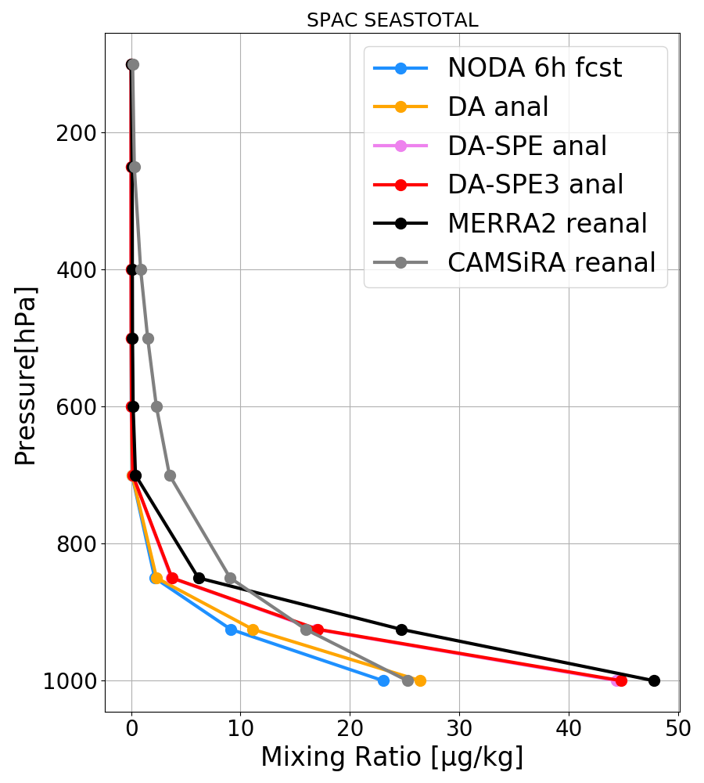
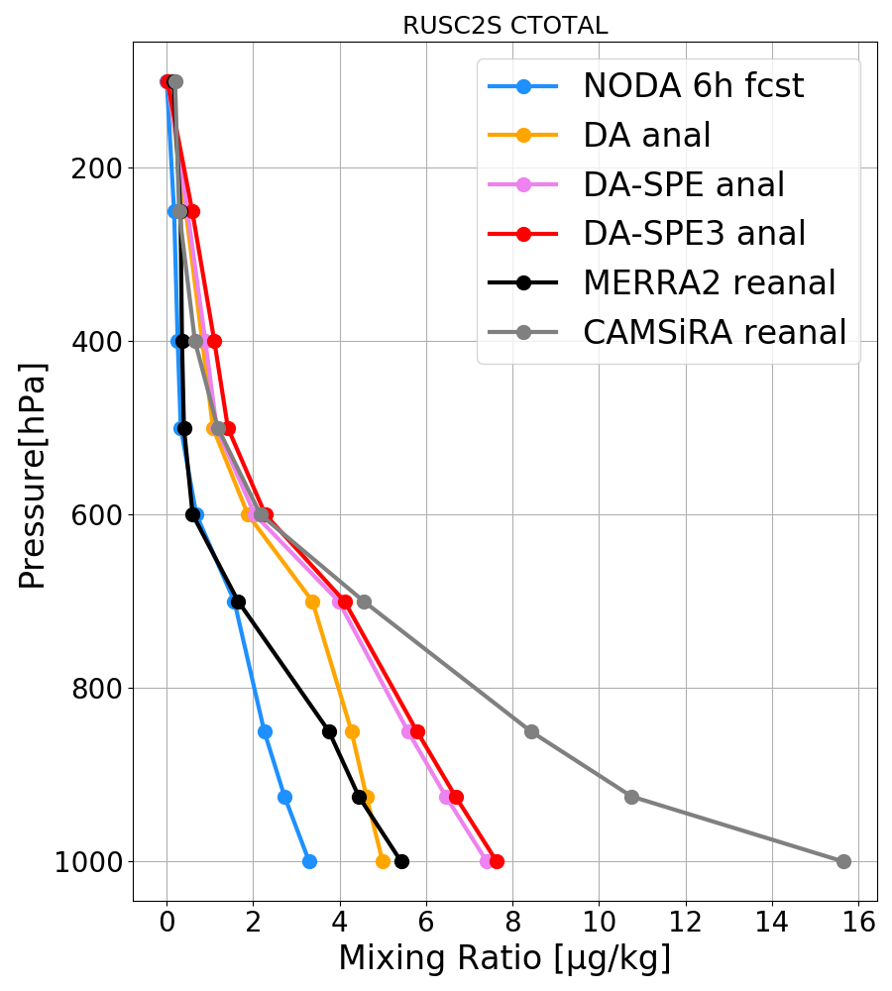
Regionally averaged aerosol mixing ratio profiles compared to NASA-MERRA2 and ECMWF-CAMSiRA reanalysis
Dust
at NAFRME
Sulfate
at EASIA
Sea salt
at SPAC
Total black and organic carbon at RUSC2E

Slide 14
Conclusion and ongoing/future work
JEDI-based DA system is being developed for operational aerosol forecasting at NOAA with the GEFS-Aerosols model. Stochastically-perturbed emissions are developed to alleviate modeled AOD bias and background ensemble spread deficiency.
Cycled experiments show that assimilation of AOD retrievals reduces bias and root-mean-square error of simulated AOD, and improves agreement of global aerosol analyses and forecasts with aerosol reanalyses from NASA and ECMWF. Leveraging ensemble forecasts at different valid times to populate background ensembles suggests additional benefits.
Ongoing and future work includes
implementing AOD data assimilation for near-real-time run at NOAA/ESRL/GSL and transitioning to NCEP/EMC for operations.
tuning emission scaling factor and emission perturbation standard deviation in DA-SPE experiment.
verifying modeled AOD against the AErosol RObotic NETwork (AERONET) observations at different wavelengths.
developing dual-resolution capability for ensemble and control.
developing static B-matrix for aerosol species.
employing variational bias correction when available in JEDI.
accounting for the non-Gaussian error distribution of AOD.

Slide 15
Reference
Huang, B., and X. Wang, 2018: On the use of cost-effective valid-time-shifting (VTS) method to increase ensemble size in the GFS hybrid 4DEnVar system. Mon. Wea. Rev., 146, 2973–2998, https://doi.org/10.1175/MWR-D-18-0009.1.
Randles, C. A., and Coauthors, 2017: The MERRA-2 aerosol reanalysis, 1980 onward, Part I: System description and data assimilation evaluation. J. Climate, 30, 6823–6850, doi:10.1175/JCLI-D-16-0609.1.
Thanks for your attention!
Questions?
bo.huang@noaa.gov

