Slide 1
Progress Toward Cycling EDA and All-sky IR Radiance Assimilation with MPAS-JEDI
JJ Guerrette, Jake Liu, Chris Snyder, Junmei Ban, BJ Jung, Steve Vahl, Yali Wu
National Center for Atmospheric Research, Boulder CO, USA
Mesoscale and Microscale Meteorology Laboratory (MMM)
JCSDA Workshop, June 2021
Special thanks to the JEDI core team and Clementine Gas for OOPS-EDA contributions

Slide 2
Short intro of Leave-One-Out EDA experiments
“Cross validation” investigated by Buehner (2020) for EnSRF and LETKF in ECCC’s NWP system, following initial work by Houtekamer and Mitchell (1998) for stochastic EnKF
In the context of an EDA of EnVar minimizations:
The i^{th} analysis excludes the i^{th} background perturbation in ensemble B
I.e., for an n-member cycling EDA experiment, B contains n-1 members
The intention is to avoid inbreeding between x_{b} and B, reducing the need for inflation and subsequent tuning
Our experiments use
MPAS quasi-uniform 120km mesh
“baseline” configuration from C. Snyder’s MPAS-JEDI presentation

Slide 3
RTPP Inflation versus Leave-One-Out
Radiosonde T
Degrades
baseline: 3denvar, GEFS ens.
eda80: 80% RTPP inflation
eda85: 85% RTPP inflation
eda-leave: leave-one-out ensemble B, no inflation
baseline
Improves
00Z+12Z 10-day forecasts, 20 days in 2018
Radiosonde U
RTPP-80% inflation is close to optimal. Many values tested.
Some degradation, some improvement over GEFS ensemble baseline
Leave-One-Out is comparable to RTPP-80%, without any tuning
Note: zero inflation EDA-3DEnVar experiments yields much worse performance

Slide 4
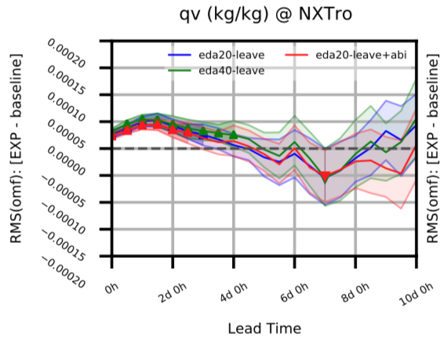
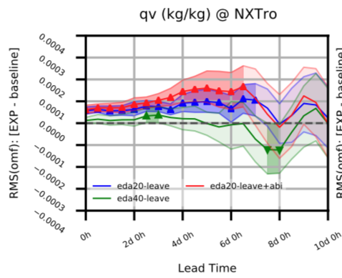
Effects of more members and assimilating all-sky ABI
eda20-leave: 20 members
eda40-leave: 40 members
eda20-leave+abi: 20members, all-sky ABI
Radiosonde
Specific Humidity
Aircraft
Specific Humidity
40 members sometimes improves over 20 members
EDA mean analysis smooths convective features
All-sky ABI water vapor DA degrades conventional qv, improves some cloud-sensitive MW/IR channels/locations
NOAA-19
MHS
Channel 1
(cloud-
sensitive)
00Z+12Z 10-day forecasts over 20 days in 2018

Slide 5
Takeaways
Leave-one-out reduces need for tuning in expensive experiments
Why does EDA with 40 members not improve much over 20 members?
Next Steps
Remove mean from observation perturbations during the analysis (technical+workflow development)
Re-center ensemble analyses around a higher/dual-resolution mean analysis (workflow development)

