Slide 1
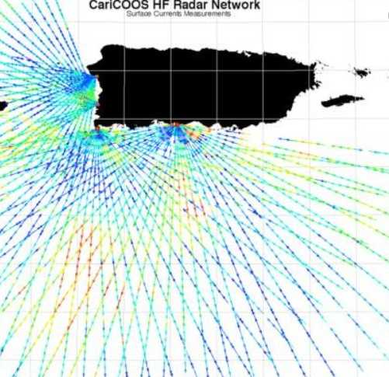
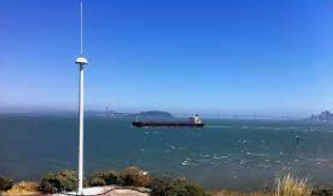
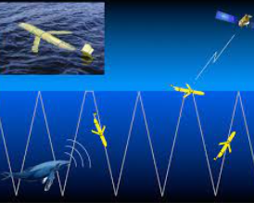
Assimilating marine observation in JEDI SOCA
Glider data thinning algorithm design
HF radar UV background assimilation using identity operator
Ling Liu
IM Systems Group, Inc. @
Environmental Modeling Center
Marine Data Assimilation Team
3dvar + u/vocn.yaml
radar UV detide
identity interpolation(UFO)
Things to do:
error covariance
thinning (UFO)
With Acknowledgements to:
EMC oversight managers: Daryl Kleist, Avichal Mehra, Rahul Mahajan;
Marine DA group: Jong Kim (Team Lead); Cameron Book
Special thanks to: JCSDA SOCA team- Guillaume Vernieres, Travis Sluka,
Kriti Bhargava; NOAA AOML- Hyun-Sook Kim, HeeSook Kang and many others
GTS: HF radar and glider launch site

Slide 2
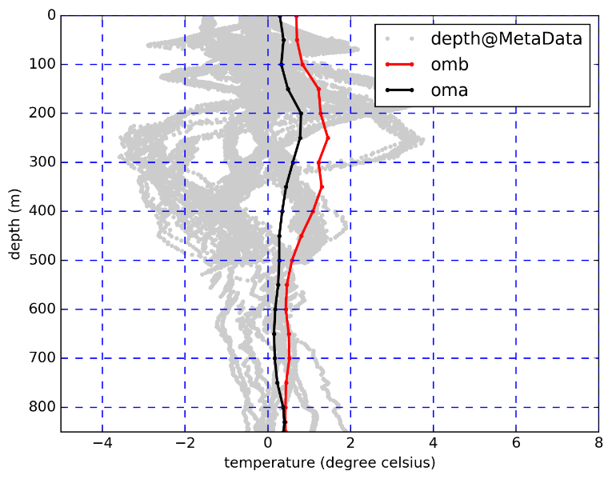
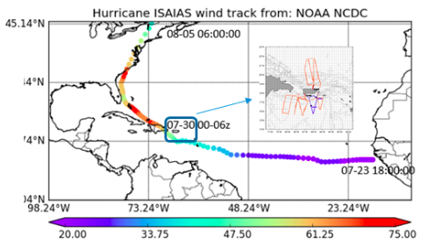
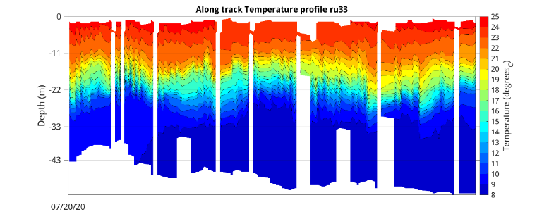
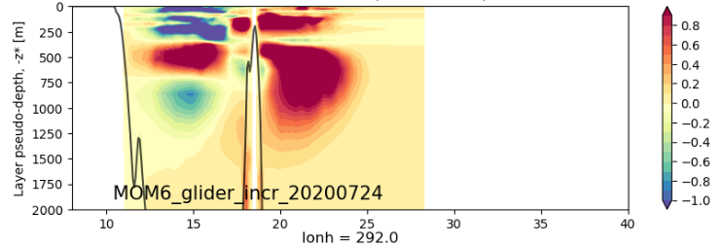
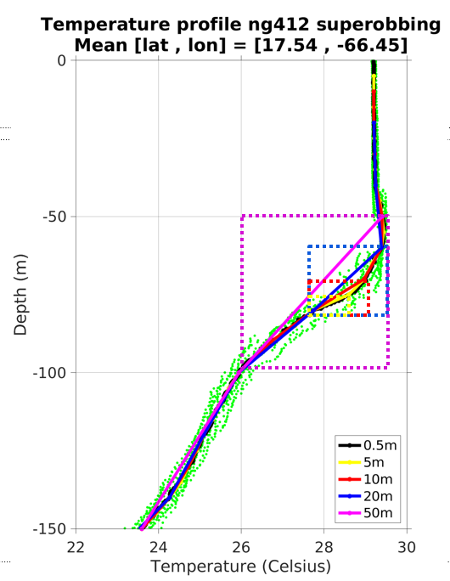
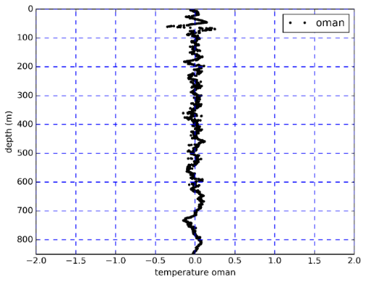
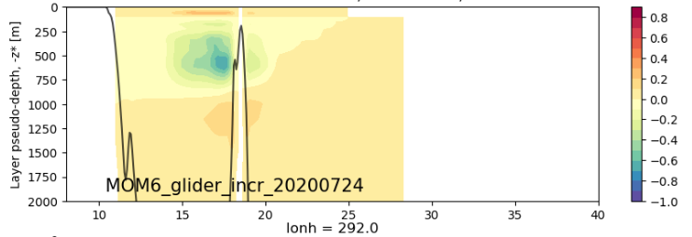
3dvar: Glider thinning experiment
Best Track: Isaias, 2020
Glider profiles
increment
omb, oma
Thinning boxes resemble mom6 vertical resolution have led to improved omb, oma

Slide 3
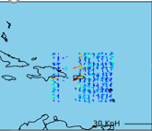
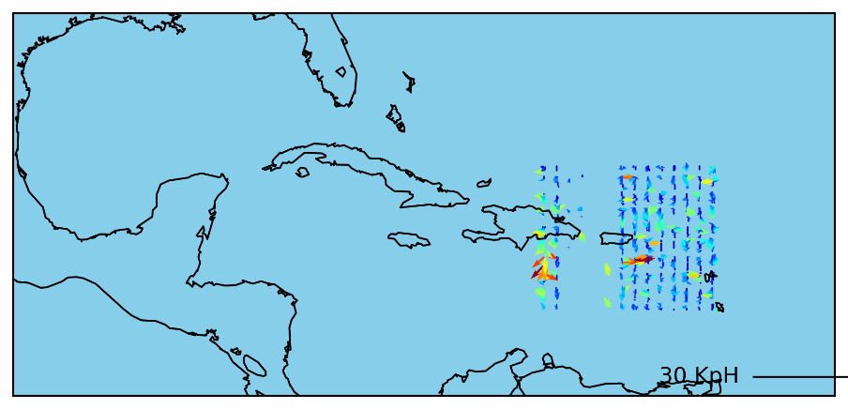
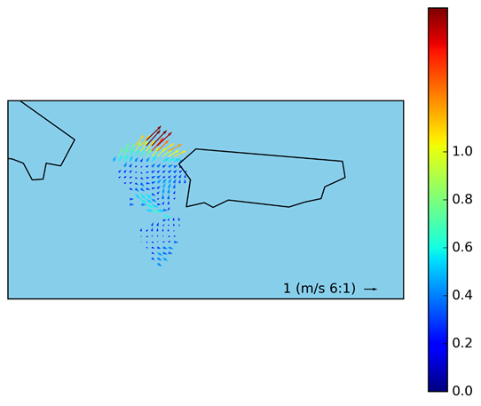
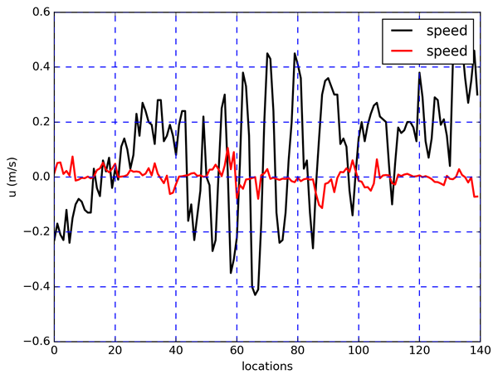
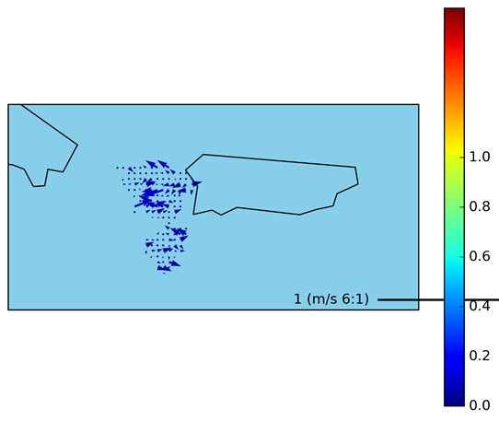
HF radar in regional MOM6
Radar velocity: omb +
hofx
Background surface current: With radar
Without radar
3D Gaussian detide +
Ioda2

