Slide 1
A JEDI-Based Regional Ocean Data Assimilation System for HAFS
Kriti Bhargava
Core Team:
Guillaume Vernieres, Travis Sluka, Hamideh Ebrahimi
NOAA In-Kind Contributors:
Ling Liu, Cameron Book

Slide 2
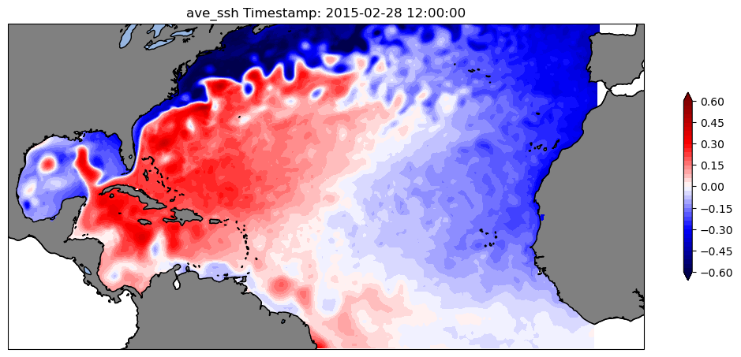
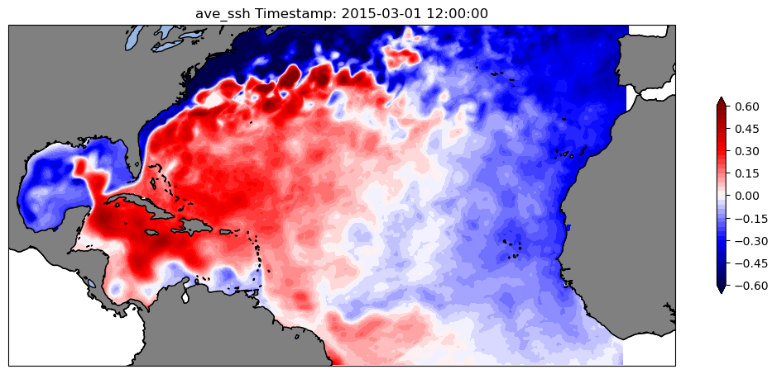
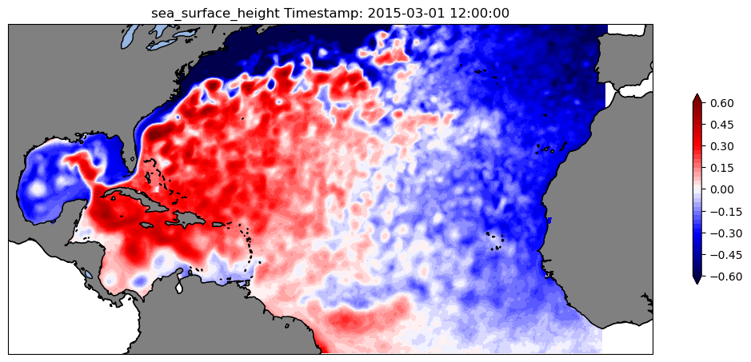
Regional ocean DA for HAFS: Results from baseline 3d Var experiment
SSH (m) After 1 month: 2015030112
Time average sea surface height
Time average sea surface height
NoDA
3dVar
Domain and resolution
Regional North Atlantic HAT10 domain
Horizontal resolution: 1/12th degree
Vertical levels: 50 from depths 5.05 to 5895 m
Observations assimilated
ADT: Jason2, CryoSat2 and SARAL
SST: NOAA19, MetOpA
SSS: SMAP
Insitu: World Ocean Database
Sea Surface Height
RTOFS

Slide 3
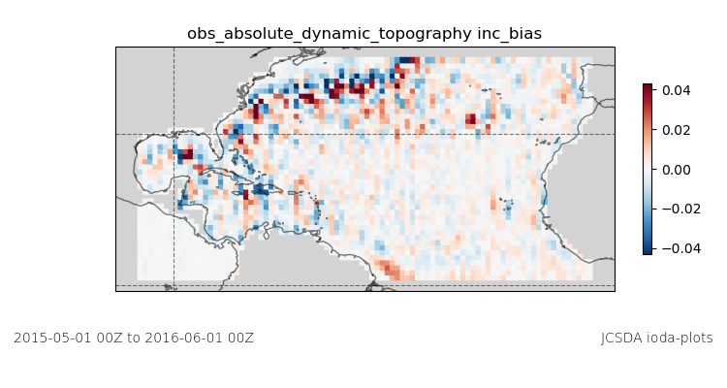
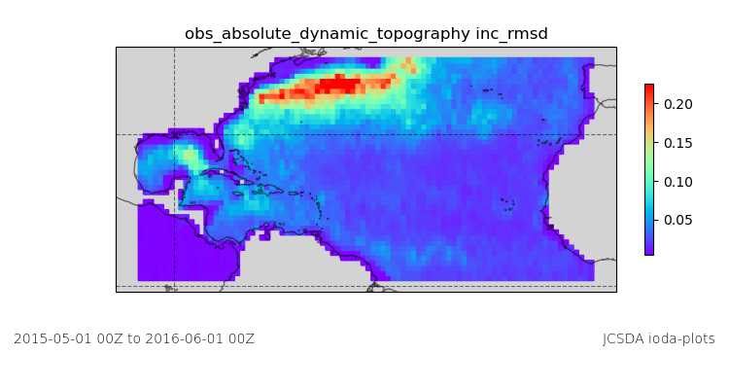
Regional ocean DA for HAFS: Results from baseline 3d Var experiment ...
SSH (m) increments statistics for 1 year run

Slide 4
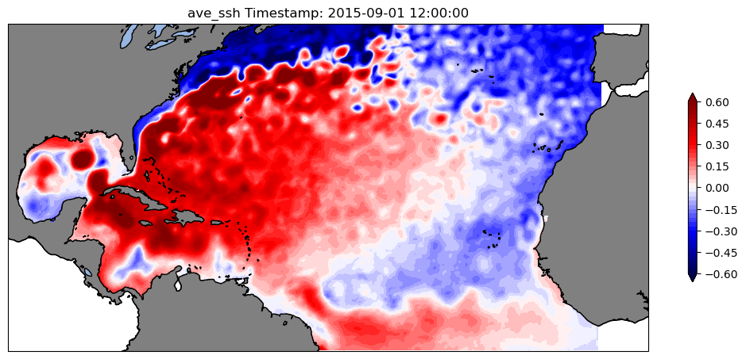
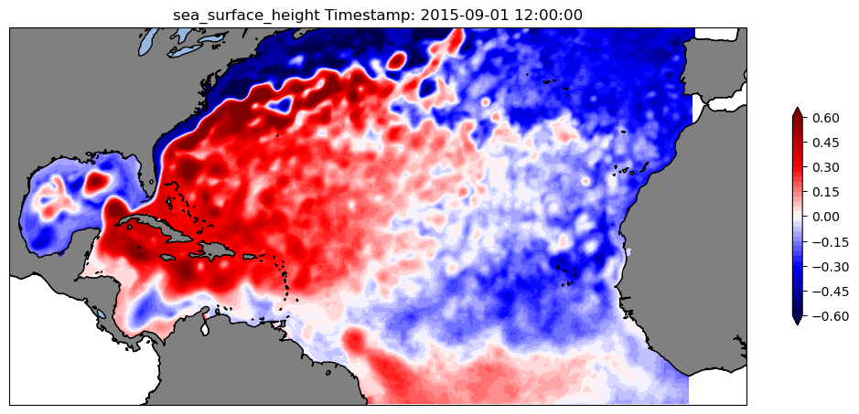
Regional ocean DA for HAFS: Results from baseline 3d Var experiment ...
SSH (m) After 7 months: 2015090112
Time average sea surface height
Sea Surface Height
3dVar
RTOFS

