Slide 1
Progress and Plans for MPAS-JEDI
Chris Snyder¹, Jake Liu¹, Junmei Ban¹, Jamie Bresch¹, Jonathan Guerrette¹, B.-J. Jung¹,
Craig Schwartz¹, Steve Vahl¹, Yali Wu¹, Yannick Trémolet², Thomas Auligné²
¹National Center for Atmospheric Research, Boulder CO, USA
²Joint Center for Satellite Data Assimilation
‹#›
Notes:
‹#›

Slide 2
PANDA-C Project
PANDA-C = Prediction and Data Assimilation for Cloud
USAF funded
Joint NCAR-JCSDA project
Coordination with Met Office Next Generation Model System (NGMS) project
‹#›
Notes:
‹#›

Slide 3
Cloud Analysis and Forecasting (CAF)
CAF is the top weather priority for US Air Force
Important challenges for data assimilation
Multivariate: Can’t analyze cloud in isolation from other fields
Multiscale: Fast/small scales with sensitive dependence on slower, larger scales
Reliance on remotely sensed observations with strongly nonlinear forward operators
Errors in both forecast models and observation operators, esp. related to hydrometeors
Not a priority application for existing operational global DA systems
‹#›
Notes:
‹#›

Slide 4
PANDA-C Project
Phase I (May 2018-August 2021)
Prepare AF Weather for shift to next-gen forecast models and DA systems
Credible MPAS-JEDI prototype
Phase II (September 2021-August 2024)
R&D aimed at CAF (all-sky DA, rapid cycling, uncertainty in RT and model)
Deliver improved CAF relative to MPAS-JEDI baseline
‹#›
Notes:
‹#›

Slide 5
PANDA-C 2021
Cycling EnVar at 30-km resolution, including all-sky MHS
3DVar and static background covariances, within SABER and via BUMP
Further refinements in cloud verification
Some results with all-sky IR observations
EDA cycling (see JJ Guerette “lightning talk”)
Technical developments
RTTOV interfaces
increments, ensemble at lower resolution
‹#›
Notes:
‹#›

Slide 6
Month-Long Cycling Experiments
6-hourly cycling for 15 April-15 May 2018
Observations from NCEP/EMC
“Baseline” observations include conventional obs + clear-sky radiances from 5 AMSU-A
Processing, “pre-QC,” and bias correction of radiances from GSI
Radiance DA using CRTM
EnVar at 30-km resolution
ensemble of 20 6-h forecasts from GEFS ICS
‹#›
Notes:
‹#›

Slide 7
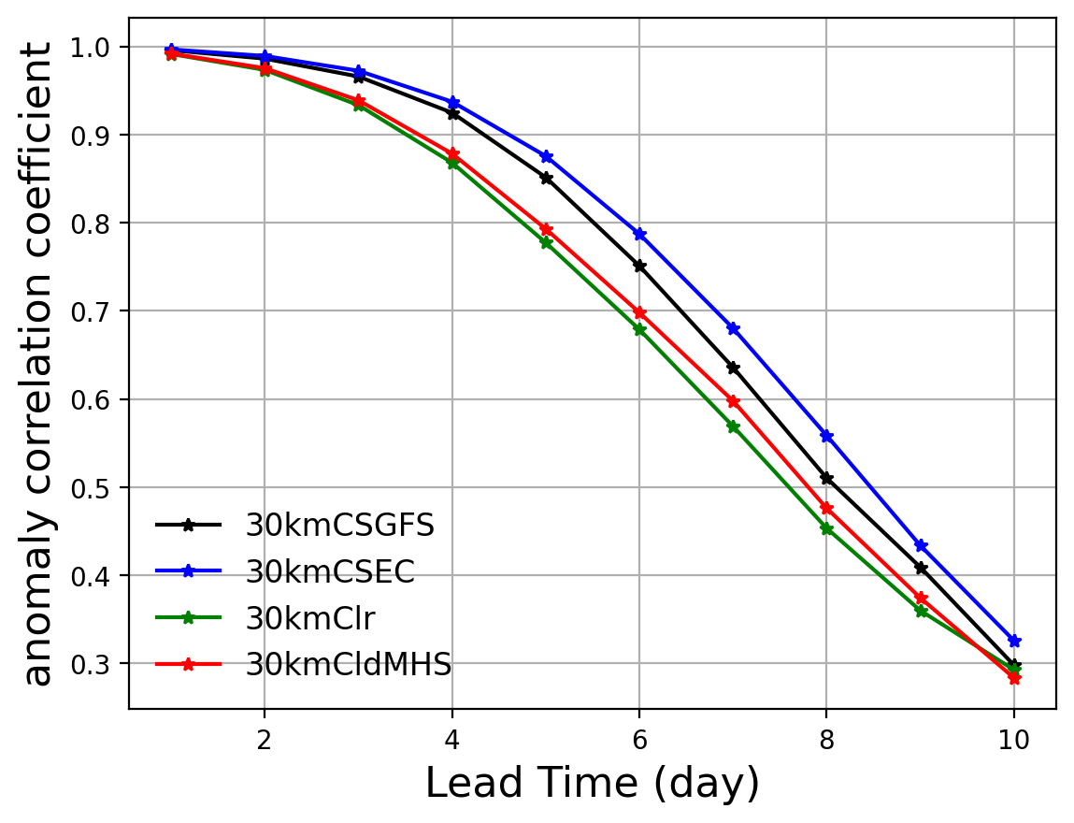
Month-Long Cycling Experiments
6-hourly cycling for 15 April-15 May 2018
Observations from NCEP/EMC
“Baseline” observations include conventional obs + clear-sky radiances from 5 AMSU-A
Processing, “pre-QC,” and bias correction of radiances from GSI
Radiance DA using CRTM
EnVar at 30-km resolution
ensemble of 20 6-h forecasts from GEFS ICS
500-hPa anomaly correlation
Cold start from GFS analysis
Cold start from ECMWF
Cycling DA (AMSU-A + conventional)
Cycling DA (… + MHS all sky)
‹#›
Notes:
‹#›

Slide 8
Static Background Covariances
Follow GSI and WRFDA
univariate correlations for 𝜓, specific humidity, along with “unbalanced” 𝜒, T, surface pressure
“balanced” contributions of 𝜓 to full 𝜒, T, and surface pressure via linear regression in columns
Generic elements from BUMP
univariate correlations, but with BUMP-derived length scales retuned
regressions for statistical balance relations, with pseudoinverse of estimated 𝜓-𝜓 autocovariance
Computation of velocity from 𝜓, 𝜒 is specific to MPAS mesh
‹#›
Notes:
‹#›

Slide 9
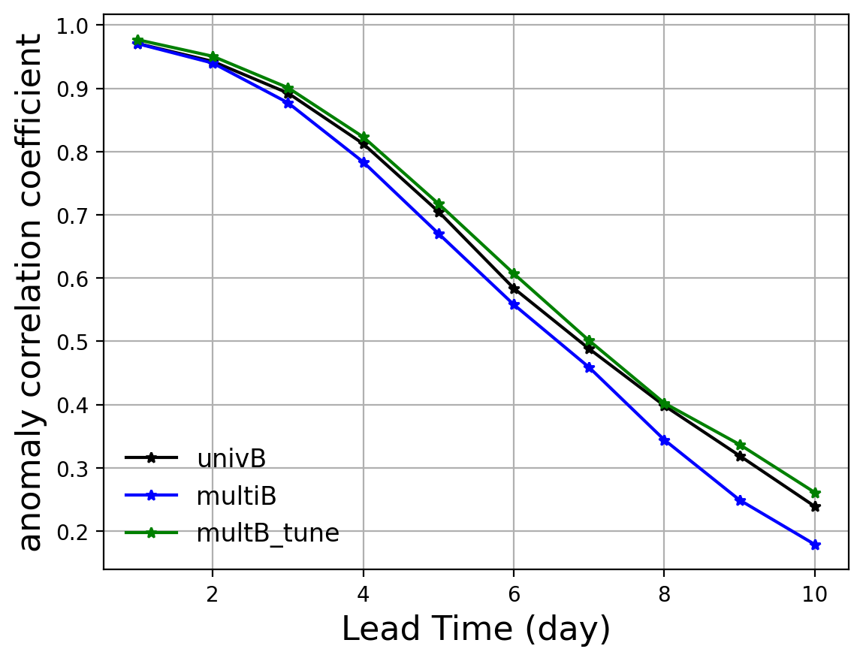
Static Background Covariances
Follow GSI and WRFDA
univariate correlations for 𝜓, specific humidity, along with “unbalanced” 𝜒, T, surface pressure
“balanced” contributions of 𝜓 to full 𝜒, T, and surface pressure via linear regression in columns
Generic elements from BUMP
univariate correlations, but with BUMP-derived length scales retuned
regressions for statistical balance relations, with pseudoinverse of estimated 𝜓-𝜓 autocovariance
Computation of velocity from 𝜓, 𝜒 is specific to MPAS mesh
500-hPa anomaly correlation
… from 1 month of 3DVar cycling, 120-km resolution
‹#›
Notes:
‹#›

Slide 10
Cloud Verification
Use multiple reference datasets for cloud fraction, cloud top
observations: CALIPSO, EPIC
cloud retrievals: SATCORPS, WWMCA
reanalysis: ERA-5
Direct verification of brightness temperature
binning on presence or absence of cloud
Binning on cloud height
multi-category contingency table
distinguish displacement errors from other errors
‹#›
Notes:
‹#›

Slide 11
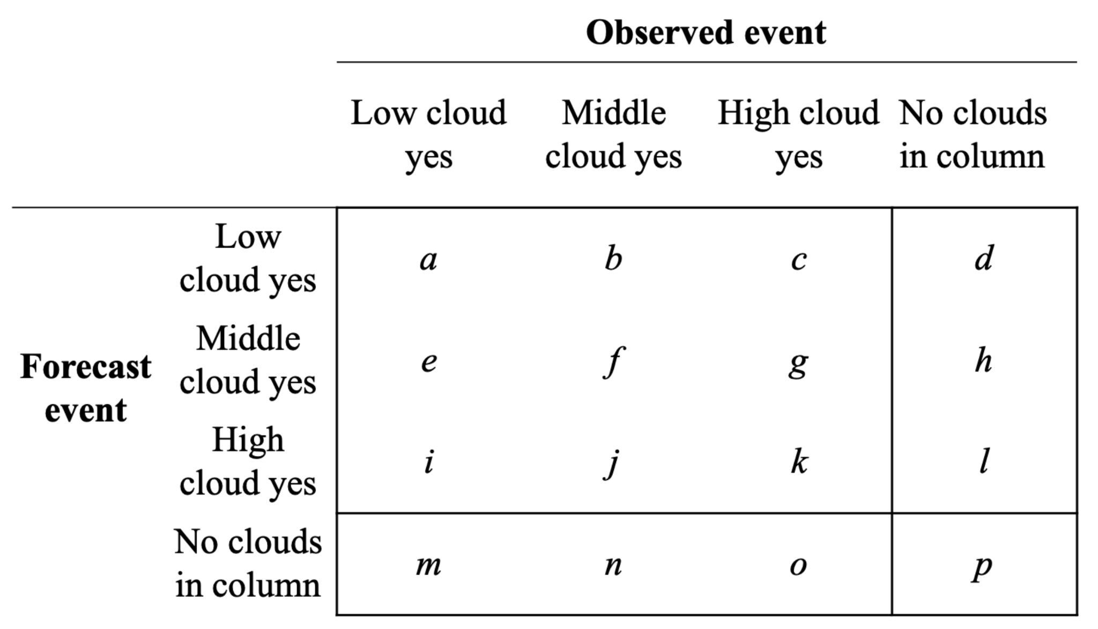
Cloud Verification
Use multiple reference datasets for cloud fraction, cloud top
observations: CALIPSO, EPIC
cloud retrievals: SATCORPS, WWMCA
reanalysis: ERA-5
Direct verification of brightness temperature
binning on presence or absence of cloud
Binning on cloud height
multi-category contingency table
distinguish displacement errors from other errors
‹#›
Notes:
‹#›

Slide 12
All-Sky DA with Himawari
Water-vapor channels from AHI
Symmetric error model of Okamoto et al. (2014)
Initial coarse-resolution testing (at 120 km)
Including 4DEnVar with hourly resolution over 6-h window

Slide 13
All-Sky DA with Himawari
Water-vapor channels from AHI
Symmetric error model of Okamoto et al. (2014)
Initial coarse-resolution testing (at 120 km)
Including 4DEnVar with hourly resolution over 6-h window
forecast fits to AHI ch13, ½ to 3-d lead times
rms (with AHI) - rms (without AHI)

Slide 14
In Addition to PANDA-C
… initial steps for:
variable-resolution and regional MPAS-JEDI
cycling DART + JEDI H(x)
‹#›
Notes:
‹#›

Slide 15
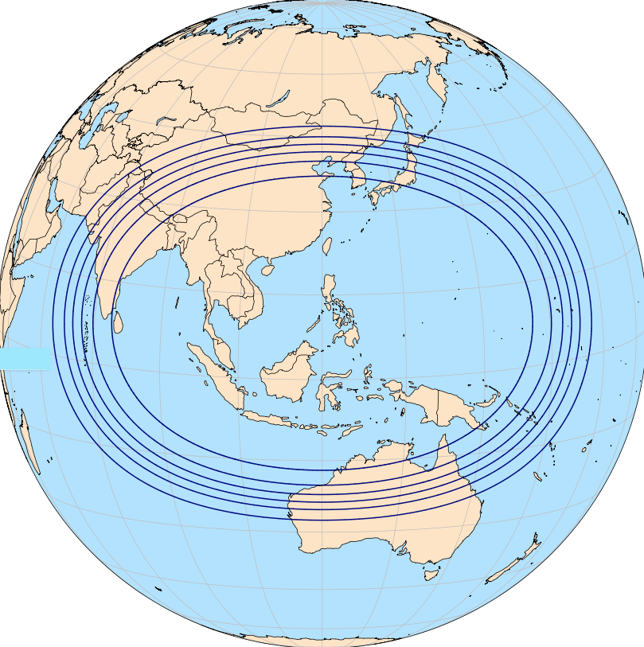
Variable-resolution MPAS-JEDI
Global, variable-resolution mesh
~15 km over most of globe, smoothly transitioning to ~3 km over SE Asia and tropical western Pacific
contours show user-specified mesh density
MPAS-JEDI with variable resolution
runs identically to quasi-uniform mesh
mesh information read from standard MPAS files

Slide 16
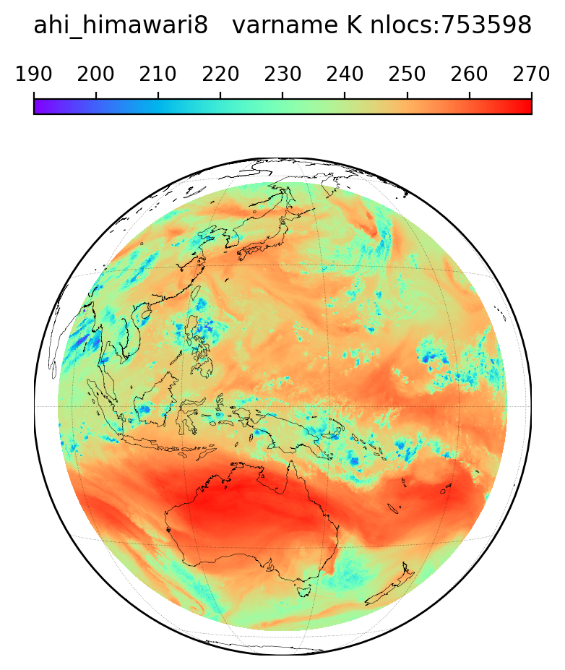
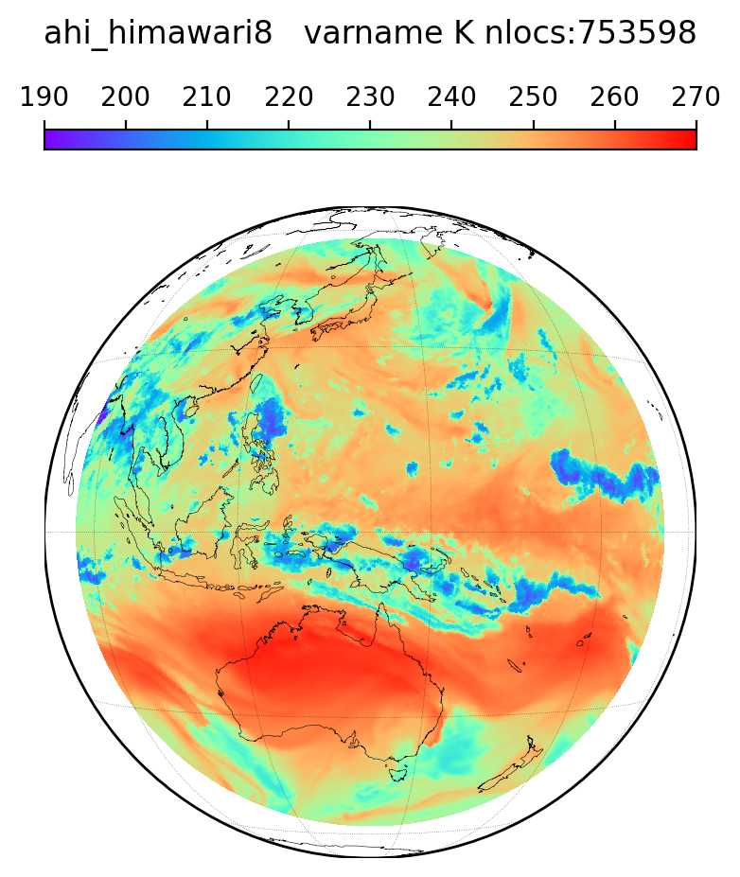
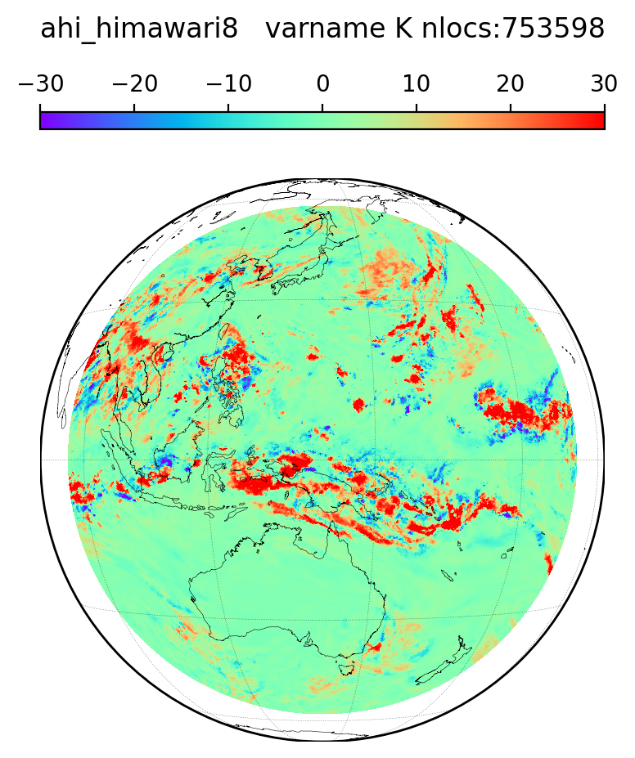
Variable-resolution MPAS-JEDI
AHI channel 9, 00Z 15 August 2020: obs, forecast (cold start from GFS), departures
obs
forecast
o - f

Slide 17
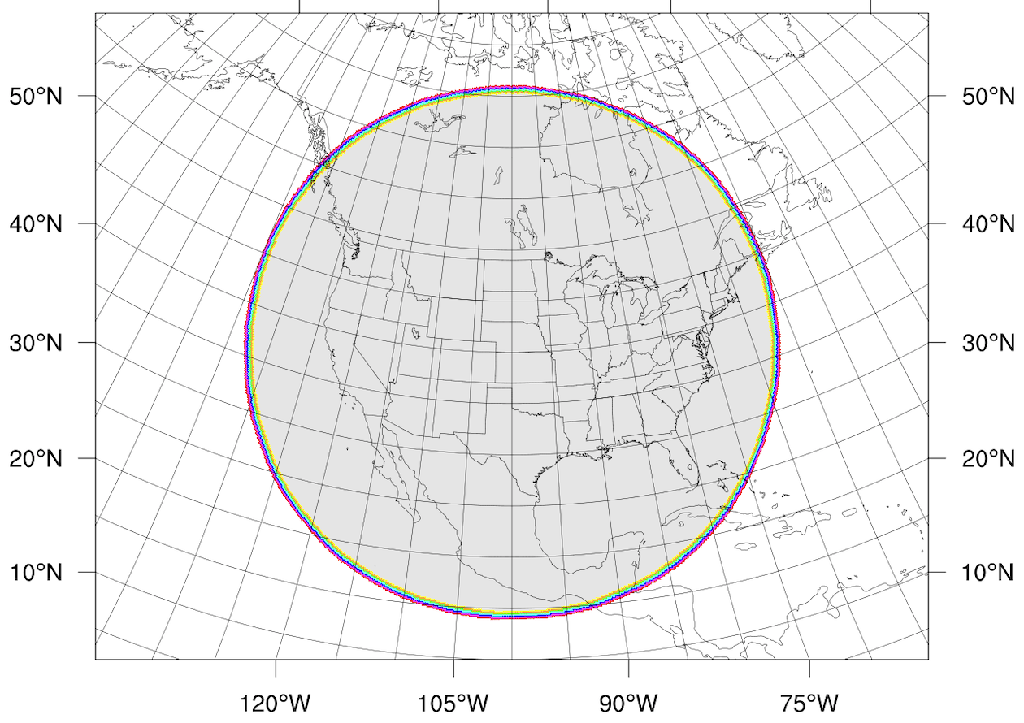
Regional MPAS-JEDI
Regional mesh
~15 km resolution
colours indicate boundary cells
As with variable resolution,
runs identically to quasi-uniform mesh
mesh information read from standard MPAS files

Slide 18
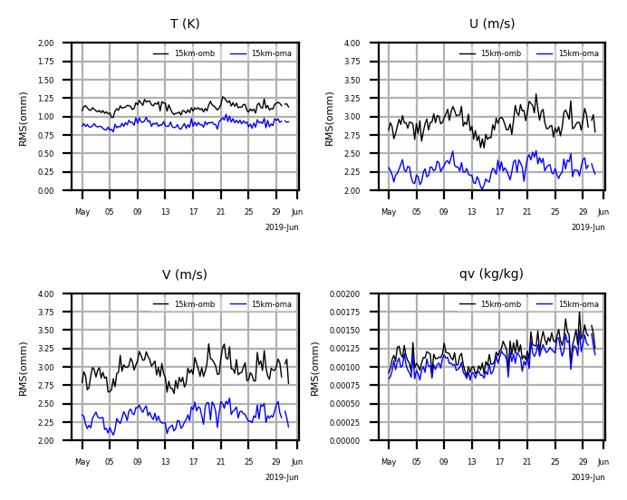
Regional MPAS-JEDI
Cycling results, 1-30 May 2019
Conventional obs only
RMS fits to aircraft

Slide 19
Elements of MPAS-JEDI Workflow (today)
Convert obs from NCEP BUFR, prepBUFR, other formats to IODA
stand-alone fortran code calling NCEP BUFR libraries, netCDF etc
Cycling DA
MPAS runs separately from JEDI analysis step; read/write files
controlled by cylc
“in core” execution of MPAS and JEDI together works, but not efficient w/ NCAR HPC queuing
Extensive python diagnostics
in observation space; in model space, vs e.g. analyses; ensemble/probabilistic
for cloud, with dependency on MET

Slide 20
Next Steps
PANDA-C phase II
begins September, with goal of delivering improved CAF
focus on all-sky DA, more rapid cycling, uncertainties in RT and model
MPAS-JEDI release
Aim to adopt and integrate with additional JEDI capabilities
direct obs read via IODAv2
diagnostics
experiment configuration via ewok
MPAS app
‹#›
Notes:
‹#›

