Slide 1
Assimilation of Ocean Wave Data
at ECMWF
18th JCSDA Tech. Rev. Mtng & Sci. W/S, 7 – 11 June 2021
Saleh Abdalla & Jean Bidlot
ECMWF, Shinfield Park, RG2 9AX, UK
Saleh.Abdalla (AT) ECMWF.INT

Slide 2

Akcnowledgements
This work was carried out within the scope of both:
  European Union Copernicus Sentinel-3 Mission Performance Centre (S3MPC); and
  European Union Horizon 2020 Project CEASELESS.
Union, European Space Agency or EUMETSAT.

Slide 3
Outline
Introduction
Verification of Altimeter Significant Wave Height Data & Bias Correction
Assimilation of Altimeter Significant Wave Height
Conclusions

Slide 4
Introduction

Slide 5
ECMWF Wave Model (ECWAM)
Component of ECMWF Integrated Forecasting System (IFS).
Third generation spectral wave model.
Traces the development of the wave spectrum using conversation of wave action density.
(Assuming that the wave phase is not important.)

Slide 6
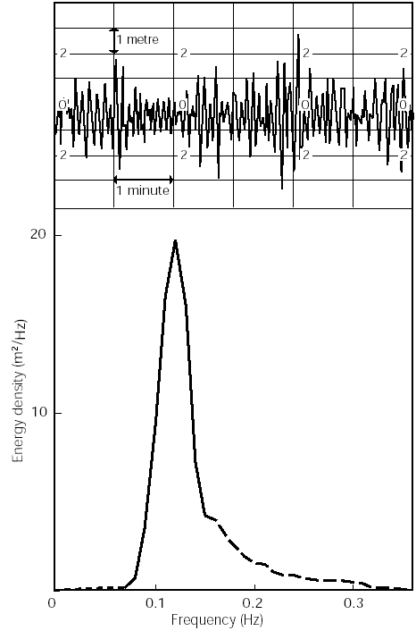

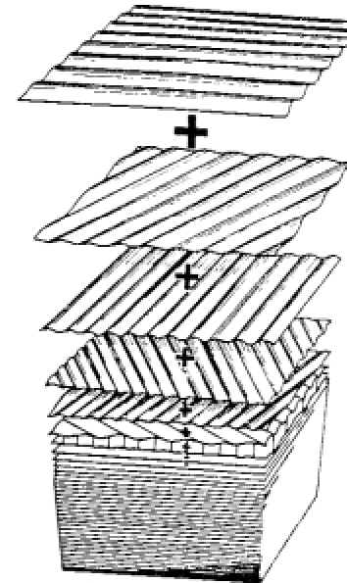
Concept of wave spectrum
Physical space
swell
Wavy ocean surface
1D
Water surface elevation
Water surface elevation
windsea
Time (or distance)
=
Time (or distance)
Spectral space
swell
(in)finite number of sinusoidal waves
windsea

Slide 7
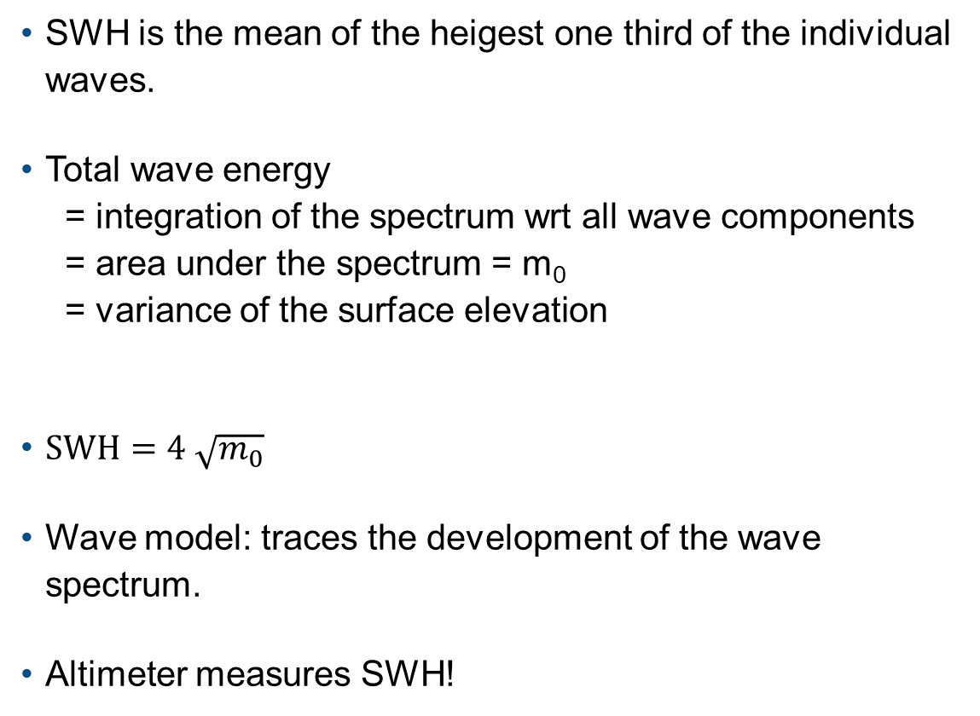

Significant wave height (SWH)
SWH is the mean of the heigest one third of the individual waves.
Total wave energy
= integration of the spectrum wrt all wave components
= area under the spectrum = m₀
= variance of the surface elevation
$SWH=4 \sqrt{m_{0}}$
Wave model: traces the development of the wave spectrum.
Altimeter measures SWH!
Water surface elevation
Time (or distance)
m₀ = ∫ spectrum
$$SWH=4 \sqrt{m_{0}}$$

Slide 8
Wave Data Assimilation
Data assimilation is the process of merging model information with observations in order to:
  obtain the best state; and
  initialise the model forecasts.
Wave data assimilation is not as advanced as the atmospheric one since it is not as crucial due to:
  wave forecast is strongly constrained by wind forcing;
  atmospheric conditions are very sensitive to their initial conditions;
  the initial wave sate loses its influence after a short time (several hours – few days depending on data volume, basin size, sea state conditions, wind strength and on atmospheric dynamical time scale);
  before the advent of satellites (1990’s), only in-situ wave data were available and they were mainly limited to coastal areas ➔ they are of little use in global wave data assimilation.

Slide 9
Wave Data assimilation method
Assimilation method for wave data:
  Wave data go through a quality control process
  (including “super-obbing” for altimeter data).
  Bias correction is applied.
  Simple optimum interpolation (OI) scheme on SWH.
  The SWH analysis increments ➔ wave spectrum adjustments... (several assumptions)

Slide 10
Schematically:
FC
altimeter
alt. data
Prepro.
& BC.
alt. SWH
data assimilation
SWH increment
?
analysis spectrum
model
wave spectrum
model SWH
initial spectrum
wind, ...
?
Distribution of the SWH increment over the whole spectrum is a big challenge. Possible solution:
  for windsea ➔ use wave evolution laws.
  for swell ➔ use the assumption that the mean wave steepness is invariant!
  for combined cases, the part with higher energy dominates!

Slide 11
Verification of
Altimeter Significant Wave Height

Slide 12
Comparison between Sentinel-3
& in-situ SWH
(1 Jan. - 18 Sep. 2019)
Sentinel-3A
Sentinel-3B

Slide 13
Mean Sentinel-3A SWH (1 Apr. - 31 Jul. 2019)

Slide 14
Sentinel3A–ECMWF model SWH bias (12 Feb. –11 Jun. 2019)

Slide 15
Global SWH bias (altimeter – model) and standard deviation of the difference between various altimeters data and ECMWF model first-guess.

Slide 16
Global comparison between Sentinel-3 & ECMWF model first-guess SWH (12 Feb. - 11 Jun. 2019)
Sentinel-3A
Sentinel-3B

Slide 17
SWH bias and standard deviation of difference (SDD) between Sentinel-3 and ECMWF model w.r.t. SWH (12 Feb.-18 Sep. 2019)

Slide 18
Assimilation of
Altimeter Significant Wave Height

Slide 19
Experiments for assessing the impact of assimilating Sentinel-3 wave height data.
Exp. ID | Experiment | Deviation from default configuration
h4kh | No-Data (ND) | Model hindcast with data assimilation switched off.
h4ki | Sentinel-3B (S3B) | Assimilating SWH from Sentinel-3B altimeter only.
h4kj | Sentinel-3A (S3A) | Assimilating SWH from Sentinel-3A altimeter only.
h4kk | Sentinel-3A&B (S3AB) | Assimilating SWH from Sentinel-3A and Sentinel-3B altimeters only.
h4kl | Five Altimeters (ALL5) | Assimilating SWH from five altimeters: Sentinel-3A, Sentinel-3B, Jason-2, CryoSat-2 and SARAL/AltiKa. Note that Jason-3 is not included.
h4km | Three Non-Sentinel (NS3) | Assimilating SWH from three altimeters: Jason-2, CryoSat-2 and SARAL/AltiKa. Note that Semtinel-3A, Sentinel-3B and Jason-3 are not included.

Slide 20
Daily coverage of NRT altimeter significant wave height data from five satellites on 1 May 2017

Slide 21
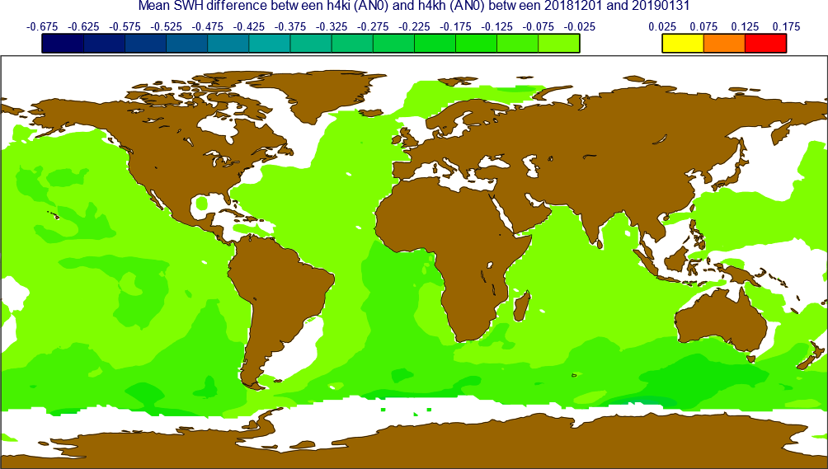
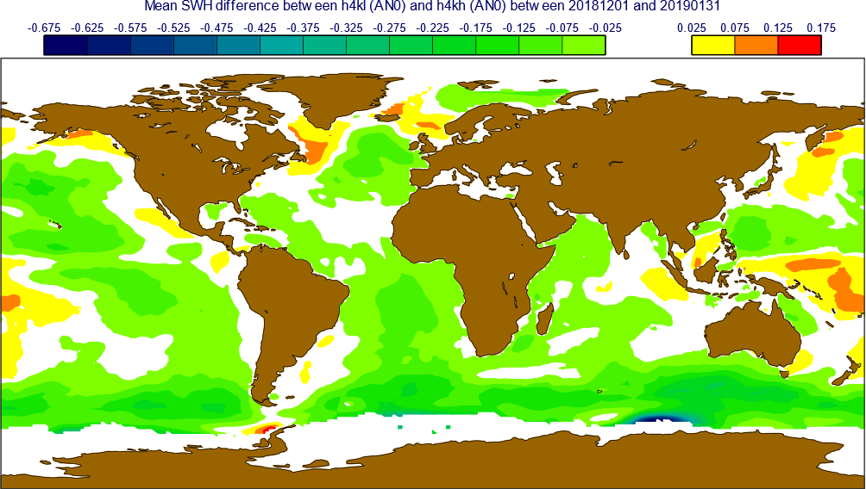
Impact of assimilating SWH –
Mean difference (metres) over the period from 1 Dec. 2018 to 31 Jan. 2019:
• Sentinel-3B (experiment S3B) and
• five satellites (exp. ALL5) compared to the no-data (ND) experiment.
S3B - ND
ALL5 - ND

Slide 22
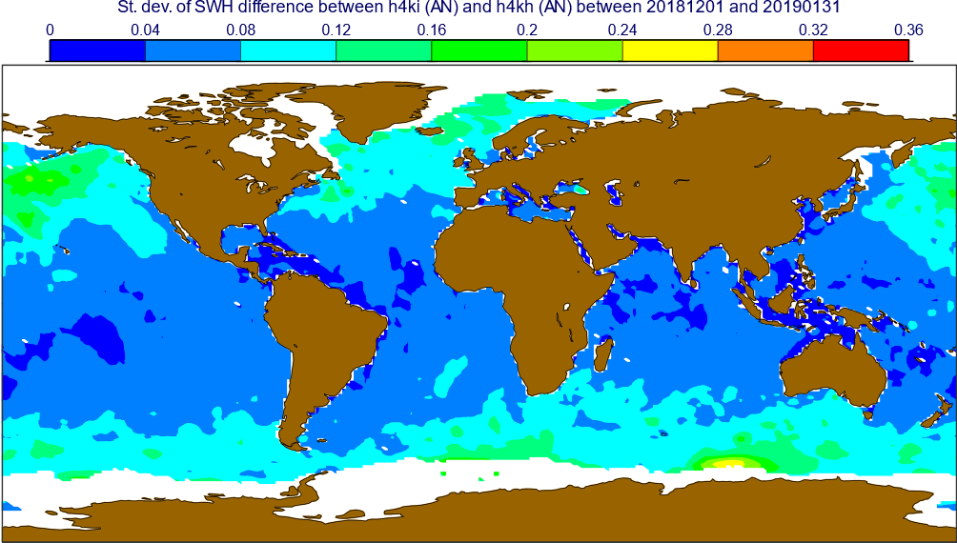
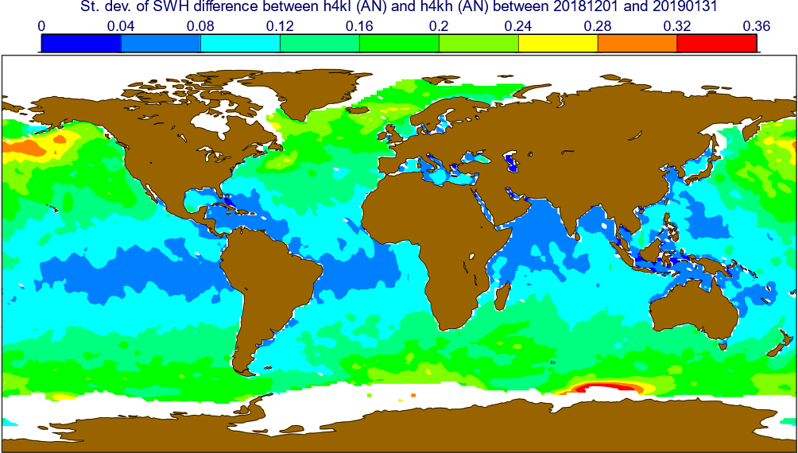
Impact of assimilating SWH –
Standard deviation of diff. (m) over the period from 1 Dec. 2018 to 31 Jan. 2019:
• Sentinel-3B (experiment S3B) and
• five satellites (exp. ALL5) compared to the no-data (ND) experiment.
S3B - ND
ALL5 - ND

Slide 23
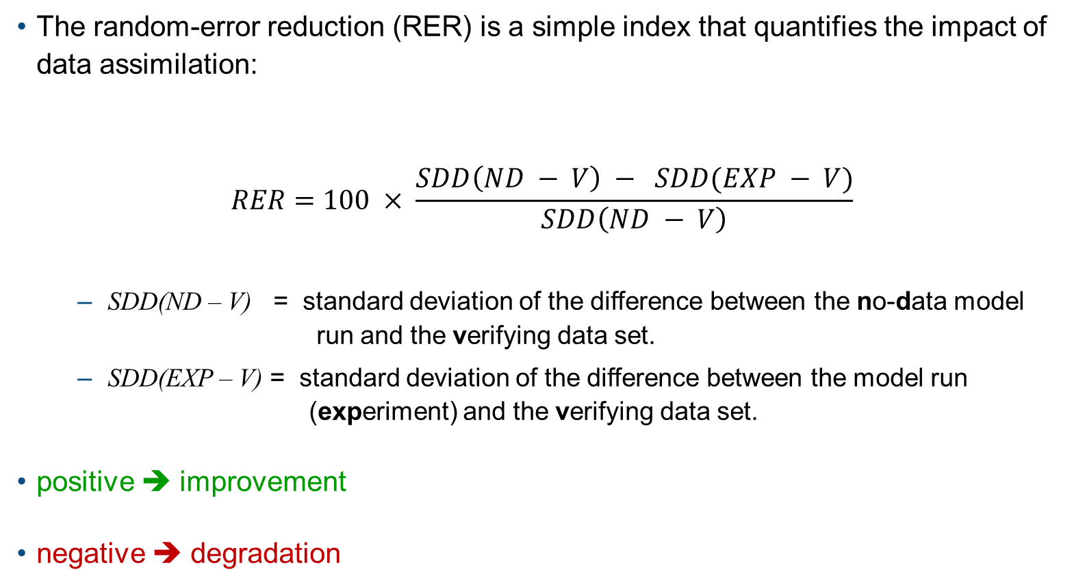
Random-Error Reduction
The random-error reduction (RER) is a simple index that quantifies the impact of data assimilation:
$$RER=100 × \frac{SDD\left(ND − V\right) − SDD(EXP − V)}{SDD\left(ND − V\right)}$$
  SDD(ND – V) = standard deviation of the difference between the no-data model
  run and the verifying data set.
  SDD(EXP – V) = standard deviation of the difference between the model run
  (experiment) and the verifying data set.
positive ➔ improvement
negative ➔ degradation

Slide 24
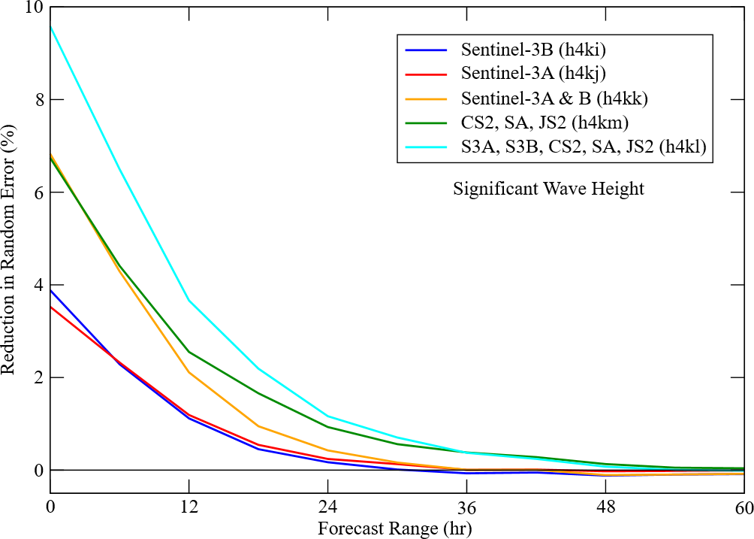
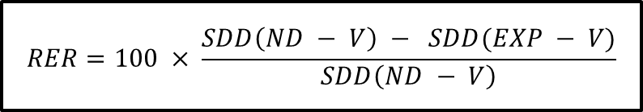
Random error reduction of SWH AN (@ FC range 0) and FC’s compared to in-situ measurements (1 Dec. 2018 - 31 Jan. 2019)
$$RER=100 × \frac{SDD\left(ND − V\right) − SDD(EXP − V)}{SDD\left(ND − V\right)}$$

Slide 25
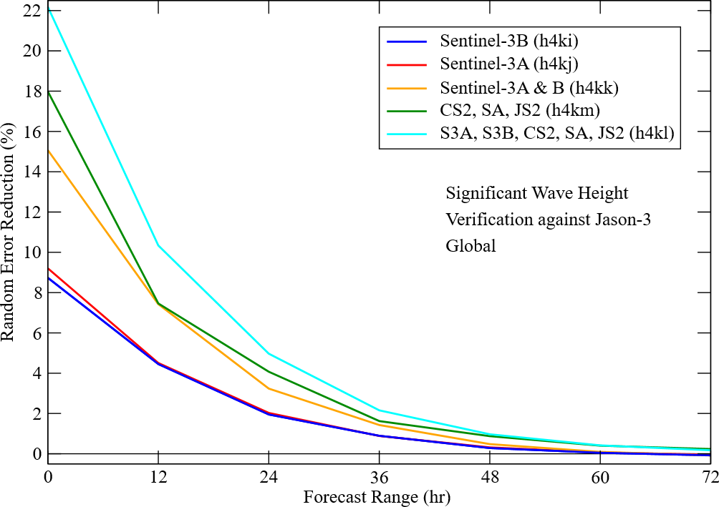
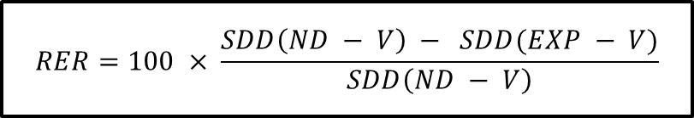
Random error reduction of SWH AN and FC’s compared to Jason-3 data over global oceans visited by Jason-3 (1 Dec. 2018 – 31 Jan. 2019)
$$RER=100 × \frac{SDD\left(ND − V\right) − SDD(EXP − V)}{SDD\left(ND − V\right)}$$

Slide 26
Conclusions
Space-borne radar altimeters provide high quality significant wave height (SWH) data.
ECWAM (the wave model component of ECMWF IFS) is a third-generation spectral wave model.
Assimilation of SWH data into a spectral model involves a challenge of distributing SWH increment over the whole wave spectrum.
Assimilation of radar altimeter SWH data show positive impact on model analysis and forecasts.
Impact of altimeter SWH assimilation lasts between 48 hours (in extra-tropics) to 120 hours (in tropics or when data from “several altimeters” are used) ➔ Coupled DA will help
Data from more altimeter missions enhance the positive impact and improve the robustness of altimetry observing system.

