Slide 1
Deriving observation impact measures through the FV3-JEDI interface
F. Diniz, R. Todling, D. Holdaway, F. Vandenberghe, D. Kleist
2021 JCSDA Technical Review Meeting and Science Workshop

Slide 2
Forecast Sensitivity-based Observation Impact
Recap of Basics
Forward Data Assimilation–Forecast Procedures
Input:
Observations and Background
Analysis System
Initial State
Forecast Model
Output: Forecast
Forecast Error Reduction due to Analysis
e
e_{b}
e_{a}
t
t_{b}
t_{a}
t_{v}

Slide 3
Forecast Sensitivity-based Observation Impact
Recap of Basics
Forward Data Assimilation–Forecast Procedures
Input:
Observations and Background
Analysis System
Initial State
Forecast Model
Output: Forecast
Output:
FSOI
Adj. of Analysis System
Forecast Sensitivity to Initial State
Adj. of Forecast Model
Input: Forecast (aspect)
Backward Data Assimilation–Forecast Procedures
Forecast Error Reduction due to Analysis
e
e
e_{b}
$$\frac{\text{de}\text{b}}{\text{dx}}$$
e_{a}
$$\frac{\text{de}\text{a}}{\text{dx}}$$
t
t
t_{b}
t_{a}
t_{v}
t_{b}
t_{a}
t_{v}

Slide 4
Forecast Sensitivity-based Observation Impact
What about JEDI? Let’s see for FV3…
Forward Data Assimilation–Forecast Procedures
Input:
Observations and Background
Analysis System
Initial State
Forecast Model
Output: Forecast
Output:
FSOI
Adj. of Analysis System
Forecast Sensitivity to Initial State
Adj. of Forecast Model
Input: Forecast (aspect)
Backward Data Assimilation–Forecast Procedures
Abstract Layer (OOPS)
Generic
applications
H(x)
Var
EDA
EnKF
LETKF
…
Uses
Interface layer
TL/AD
Model
Model
State
…
Covariance
Obs Operator
Implements
Specific implementations
FV3TL
FV3AD
…
FV3
…
SABER
UFO
Linear Model
Model
Error Covariance
Observation Use

Slide 5
Forecast Sensitivity-based Observation Impact
What about JEDI? Let’s see for FV3…
Forward Data Assimilation–Forecast Procedures
Input:
Observations and Background
Analysis System
Initial State
Forecast Model
Output: Forecast
Output:
FSOI
Adj. of Analysis System
Forecast Sensitivity to Initial State
Adj. of Forecast Model
Input: Forecast (aspect)
Backward Data Assimilation–Forecast Procedures
Abstract Layer (OOPS)
Generic
applications
H(x)
Var
EDA
EnKF
LETKF
…
Uses
Interface layer
TL/AD
Model
Model
State
…
Covariance
Obs Operator
Implements
Specific implementations
FV3TL
FV3AD
…
FV3
…
SABER
UFO
Minimize
MinimizeAD
Linear Model
Model
Error Covariance
Observation Use

Slide 6
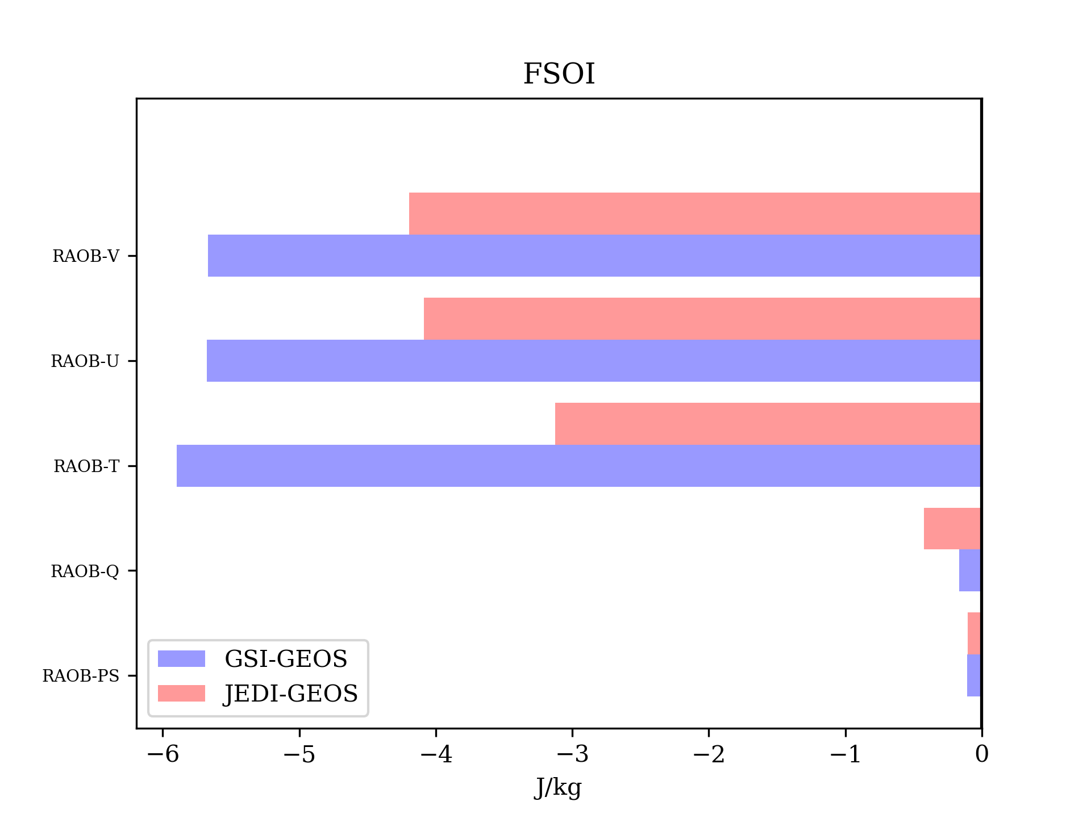
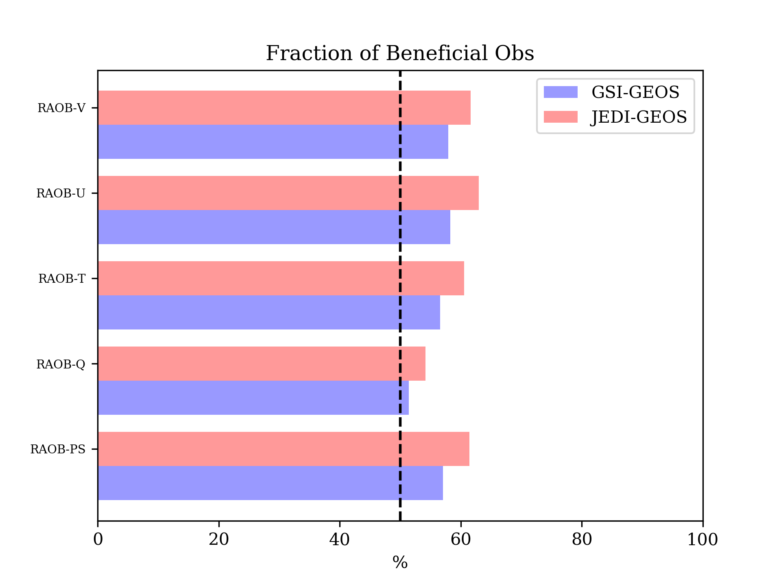
Forecast Sensitivity-based Observation Impact
What about JEDI? Let’s see for FV3…
Forward Data Assimilation–Forecast Procedures
Input:
Observations and Background
Analysis System
Initial State
Forecast Model
Output: Forecast
WARNING: Preliminary Results!
Output:
FSOI
Adj. of Analysis System
Forecast Sensitivity to Initial State
Adj. of Forecast Model
Input: Forecast (aspect)
Backward Data Assimilation–Forecast Procedures
Abstract Layer (OOPS)
Generic
applications
H(x)
Var
EDA
EnKF
LETKF
…
Uses
Interface layer
TL/AD
Model
Model
State
…
Covariance
Obs Operator
Implements
Observations are seen to impact more the GSI-based system than JEDI’s (JEDI’s background error covariance matrix is not well tuned in this initial testing; not shown).
As typical, fraction of beneficial impact is around 50% or slightly higher in both systems, with JEDI’s showing largest percentages.
Specific implementations
FV3TL
FV3AD
…
FV3
…
SABER
UFO
Minimize
MinimizeAD
Linear Model
Model
Error Covariance
Observation Use

