Slide 1
Cooperative exploitation of GSICS and NWP Level 1 bias monitoring
Lightning Talk by L. Flynn (NOAA Lawrence.E.Flynn@noaa.gov)
with material taken from GSICS Meetings
18th JCSDA Technical Review Meeting and Science Workshop
June 9, 2021
Notes:
Cooperative exploitation of GSICS and NWP Level 1 bias monitoring and performance alerts
Lightning Talk
As GSICS Coordination Center Director, one of my tasks is to assist in broadening the user base for the GSICS products. We have been discussing the similarity of GSICS Level 1 bias corrections and NWP bias adjustments in various venues (e.g., ITSC, ECMWF/EUMETSAT NWP SAF Workshop) and exploring opportunities to combine the information to improve both. See the attached presentation from our GSICS annual meeting.
GRWG Sub-group chairs are willing to commit to having JCSDA participation with an NWP collaboration topic in one of their future monthly work sessions.
http://gsics.atmos.umd.edu/bin/view/Development/20200618
NWP community wants to understand the root causes. Engaging with the NWP community will enable the discussion to take place on why there is a bias, how can it be corrected, for NWP - mutually discuss the best way to address a correction. Give good examples. -- if we found a bias that can be accounted for by shifting the SRF, then we would provide the shift so the CRTM can account for this. Instead of a bias adjustment to the observations.

Slide 2
GSICS Activity Areas for Cooperation
GSICS Catalog with bias product times series, updates, notices, a plotting tool and documentation
Establishment of GEO Ring of inter-calibrated sensors with respect to reference instruments
Interaction with Level 1 personnel responsible for calibration maintenance and adjustments
Examination of the consistency of bias estimates between GSICS and NWP
Investigation of more complex relationships
Resource and information links and a longer talk with discussion topics from the GSICS annual meeting are in the backup slides and note pages.
Notes:
The GSICS catalog at https://www.star.nesdis.noaa.gov/smcd/GCC/ProductCatalog.php provides links to the bias monitoring products and ATBDs and Users Guides. You can sign up for notices on the status of products.
GSICS products are used to estimate and remove biases for GEO instruments. Do the NWP teams agree with the choice of references?
GSICS experts and their colleagues are responsible for maintaining Level 1 product calibration. Need good communication on the timing and purpose of Level 1 changes.
Examination, analysis and comparisons of GSICS and NWP bias estimates can provide confidence or identify inconsistencies.
Identification of more complex relationships can be used to guide examination of measurement errors and direct resolution at the physical process root cause level.

Slide 3
GSICS Example – Spectral Response Function (SRF) Updates
GSICS was instrumental in refining SRFs for IR channels of GOES & AMI imagers
  By optimising differences in inter-comparison with hyperspectral reference instrument
  During Commissioning
  Important test
GSICS investigating SRF retrievals
  Based on comparison with hyperspectral references
  At least for non-window channels
GOES-13 Imager Channel 6 SRFs, (blue) original and (red) revised from the instrument vendor, and (green) NOAA-recommended SRF, superimposed on (black) AIRS spectral radiance.
From Wu & Fu 2013, 10.1109/TGRS.2012.2236100

Slide 4
Backup information

Slide 5
Summary / Resources
GSICS develops algorithms and provides products to estimate and monitor biases among measurements from satellite instruments
https://www.star.nesdis.noaa.gov/smcd/GCC/ProductCatalog.php
The GSICS Research Working Group (GRWG) is organized into subgroups by instrument and spectral divisions. The GSICS wiki pages at
http://gsics.atmos.umd.edu/bin/view/Development/WebHome
http://gsics.atmos.umd.edu/wiki/Home
provide good starting points.
You can also access our quarterly newsletters at
https://www.star.nesdis.noaa.gov/smcd/GCC/newsletters.php
The most recent issues provide articles with annual updates on the status of reference instruments and products.
The talks for the 2021 Annual Research meeting can found through links at
http://gsics.atmos.umd.edu/bin/view/Development/Annual2021
See especially, 2.e. Cooperation between GSICS and NWP (appended); Tim Hewison (EUMETSAT) and
7.c. Summary of outcomes from the ECMWF/NWP-SAF workshop on the treatment of random and systematic errors in satellite data assimilation; Niels Bormann (ECMWF)
Notes:
Cooperative exploitation of GSICS and NWP Level 1 bias monitoring and performance alerts
Lightning Talk
As GSICS Coordination Center Director, one of my tasks is to assist in broadening the user base for the GSICS products. We have been discussing the similarity of GSICS Level 1 bias corrections and NWP bias adjustments in various venues (e.g., ITSC, ECMWF/EUMETSAT NWP SAF Workshop) and exploring opportunities to combine the information to improve both. See the attached presentation from our GSICS annual meeting.
Are all GRWG Sub-group chairs willing to commit to having JCSDA participation with an NWP collaboration topic in one of their future monthly work sessions?
http://gsics.atmos.umd.edu/bin/view/Development/20200618

Slide 6

2.e. Feedback between GSICS and NWP Community on Radiometric and Spectral Biases
Tim Hewison (EUMETSAT)
On behalf of
GSICS Research Working Group
Notes:
I know that the planning for the for this year's 2021 JCSDA Science Workshop in June is well under way (https://www.jcsda.org/news) but I'm hoping that there is enough interest so that it is not too late to schedule a talk on GSICS emphasizing where the Calibration and NWP communities intersect and can work together.

Slide 7
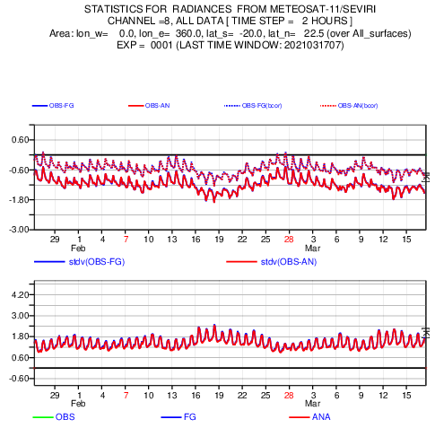
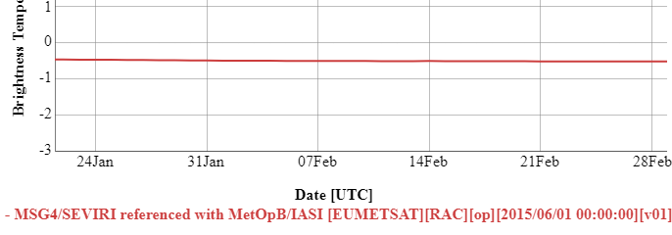
Compare GSICS and NWP Bias Monitoring
GSICS Plotting Tool
for Standard Bias wrt IASI-B for
Meteosat-11/SEVIRI IR13.4 (Channel 8)
Both GSICS and NWP provide systematic Bias monitoring
  Based on comparisons with reference radiances

Slide 8
GSICS-NWP Commonalities
Function | GSICS | ECMWF
Bias Monitoring Systematic Comparisons of L1 data v. reference Bias Correction Radiance-dependent Airmass-, VZA-, Latitude, … | GEO IR Meteosat-8 to -11, GOES-13, -15, -16, -17 Himawari-8 INSAT-3D | GEO IR Meteosat-8, -11, GOES-16, Himawari-8
 | LEO IR Sounders - HIRS-A | LEO IR Sounders - AIRS, CrIS, HIRS, IASI, IRAS
 | LEO MW Sounders - ? | LEO MW Sounders - AMSUA, MHS, ATMS, MSU, MWHS, MWHS2, MWTS, SSMIS, SSU
 | LEO MW Imagers In development | LEO MW Imagers SSMI, Windsat, GMI, SAPHIR, AMSR2
Change Alerts | No? (only prototype) | Yes – hard + soft limits - Email alerts + others via NWPSAF
Maintain Block lists | No | Yes – instruments + channels

Slide 9
Radiometric Calibration Dependences
For GEO imagers, GSICS corrections only depend on scene radiance and time
  Vary slowly based on ~monthly rolling window
In general the radiometric biases can also be functions of
  date, time of day,
  instrument scan and solar geometry, latitude, longitude,
  radiance, airmass, water vapour burden, scene type (including polarisation),
  …
Diagnose the sensitivity of instrument’s calibration to these
  Based on analysis of sufficient collocations
Similar to NWP bias correction schemes
Some bias variations may be due to the instrument’s calibration
  Or reference instrument, inter-calibration algorithm, or NWP and/or RTM
  Comparison of GSICS results and NWP biases can provide valuable insight

Slide 10
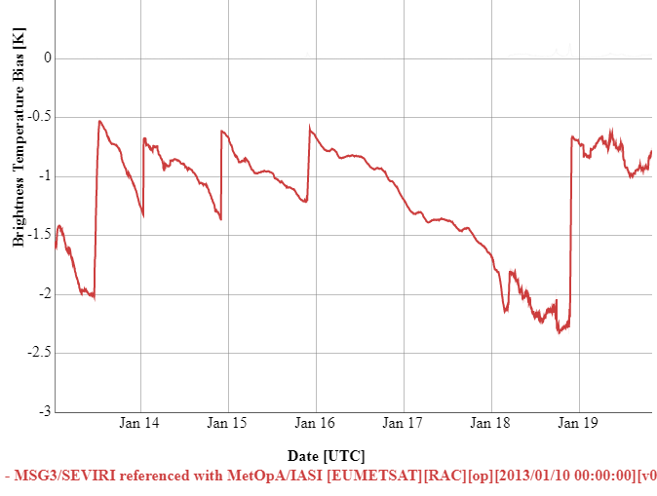
Radiometric – or Spectral Errors?
GSICS focused on characterising errors as radiometric biases
Some cases better explained as errors in spectral space
  e.g. due to modification of SRF
  (Spectral Response Function)
e.g. Meteosat/SEVIRI 13.4µm bias
Varies with time
Due to ice contamination
Ice libration band modifies SRF
Appears as radiometric bias
Users preferred correction in radiance-space (still?)
  No need to update RTMs
Time Series of Bias in Meteosat-10/SEVIRI IR13.4 channel from GSICS Re-Analysis Correction for standard scene (267K)
based on inter-calibration with Metop-B/IASI.
From GSICS Plotting Tool: gsics.tools.eumetsat.int/plotter

Slide 11
GSICS – SRF Updates
GSICS was instrumental in refining SRFs for IR channels of GOES & AMI imagers
  By optimising differences in inter-comparison with hyperspectral reference instrument
  During Commissioning
  Important test
GSICS investigating SRF retrievals
  Based on comparison with hyperspectral ref
  At least for non-window channels
GOES-13 Imager Channel 6 SRFs, (blue) original and (red) revised from the instrument vendor, and (green) NOAA-recommended SRF, superimposed on (black) AIRS spectral radiance.
From Wu & Fu 2013, 10.1109/TGRS.2012.2236100

Slide 12
Outcomes of ECMWF/NWP SAF Error Workshop
ECMWF/EUMETSAT NWP SAF Workshop on treatment of random and systematic errors in satellite data assimilation
2-5 Nov 2020 – online
Tim Hewison represented GSICS RWG – collected inputs at web meeting on 2020-06-18
The workshop encourages community efforts to better analyse and address observation-related biases, through:
  inter-comparison of bias corrections from different centres (incl. bias models used),
  open sharing of databases with feedback information, and
  better dialogue between NWP centres, GSICS and instrument designers.
  Continued effort should be made to identify biases at source.
Bias Correction
  Bias corrections and model predictor bias definitions could be exchanged between centers
  and compared for the different types of instruments,
  including with other independent estimates (e.g. GSICS)
Anchor Observations
  Can be assimilated without bias correction – help identified model errors
  GNSSRO, CLARREO
  Potential GSICS Corrected observations in future?
  Recommendation: Explore the use of hyperspectral infrared satellite data as anchor measurements
Recommendation: establish greater dialogue between NWP centres and GSICS leading to a systematic data exchange system for biases and alerts.

Slide 13
Discussion
GSICS and NWP can provide information on satellite instruments’ biases
  Radiometric – or Spectral
Comparing GSICS and NWP results can help understand biases causes
  and ultimately improve them at source
Cooperative framework between GSICS and the NWP community
What to exchange?
  Satellite instrument biases, alerts, block lists
How to exchange?
  Define standards? Or start with ad-hoc informal emails?
  (ECMWF can also share values – not just plots)
Who? How to set up dialogue with NWP Community?
  NWP-SAF – currently assigning new coordinator
  International TOVS Working Group
  Others?

