Slide 1
Developments Towards a Unified Naming Convention for Observations Used in JEDI
Greg Thompson, Ryan Honeyager, Stephen Herbener, Hui Shao

Slide 2
Existing group/variable names
Groups
Variables
ObsValue
MetaData
VarMetaData
hofx
ObsError
PreQC
ObsErrorData
ObsType
PreUseFlag
…
latitude
longitude
datetime
air_temperature
air_pressure
specific_humidity
eastward_wind
northward_wind
brightness_temperature
aerosol_optical_depth_4
solar_zenith_angle
solar_azimuth_angle
sensor_channel
…etc

Slide 3
Purpose/Objectives
Create a unified set of variable names, meta data names, group names, etc. that is used throughout JEDI: IODA, UFO, OOPS, etc.
This will be particularly helpful for data input and QC steps of UFO filters, ObsFunctions, and variable transformations.
Document and manage the naming conventions as guidance for agency partners.

Slide 4
Existing draft document
https://docs.google.com/spreadsheets/d/1EQmJdkqsL3u2-SdpKSA4gkDLd6fCt3iAQ-XNcjz_2M0
with a goal towards aligning all names to WMO element table:
https://confluence-test.ecmwf.int/display/ECC/WMO%3D35+element+table
refractivity
refractivityDifferential
albedo | unitless (zero to one)
reflectivity | dBZ
reflectivityDifferential | dBZ
radialVelocity | m s-1
differentialPhase
crossCorrelation
lidarBackscatter
lidarExtinction
backscatterDistance
temperatureAir | K
temperatureSoil | K
temperatureWater | K
temperatureIce | K
temperatureSnow | K
temperatureSeaSurface | K
temperatureSkin | K
temperatureDewpoint | K
relativeHumidity | unitless (zero to one)
specificHumidity | kg kg-1
waterVaporMixingRatio | kg kg-1
soilMoisture | kg m-3
soilMoistureVolumetric | m-3 m-3
soilMoistureNormalized | unitless (zero to one)
windEastward | m s-1
windNorthward | m s-1
windUpward | m s-1
windDirection | degrees
windSpeed | m s-1
windGustHorizontal | m s-1
Groups
Variables
ObsValue
ObsQualityMark
ObsPreUseFlag
ObsStdDeviation
InverseObsError
UsageFlag
FinalQualityRank
BiasCorrection
QCWeight
TestReference
UnadjustedForecast
AdjustedForecast
DepartureBackground
DepartureAnalysis

Slide 5
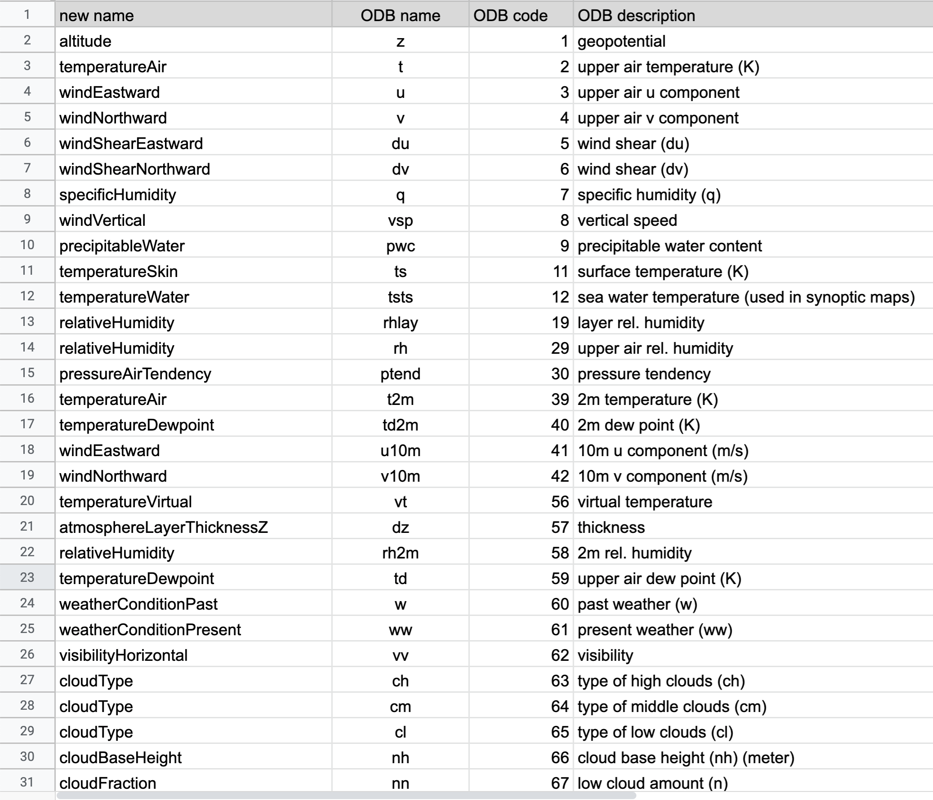
Legacy variable names remapped (ODB->IODA)

