Slide 1
Develop and Evaluate Assimilating AIRNow Observation with JEDI for RRFS-CMAQ
Youhua Tang^{1,2}, Cory Martin^{3,4}, Mariusz Pagowski^{5,6}, Tianfeng Chai^{1,7}, Hongli Wang^{5,6}, Daryl Kleist⁴, Barry Baker^{1,2}, Patrick Campbell^{1,2}, Rick Saylor¹, Daniel Tong^{1,2}, Catherine Thomas⁴, Ivanka Stajner⁴
1. NOAA/ARL; 2. George Mason University; 3. RedLine Performance Solutions, LLC; 4. NOAA/NCEP/EMC; 5. University of Colorado, Boulder; 6. NOAA/GSL; 7. University of Maryland, College Park
Acknowledgement: This work is sponsored by the NOAA JTTI FY20 Funding #NA20OAR4590352.

Slide 2
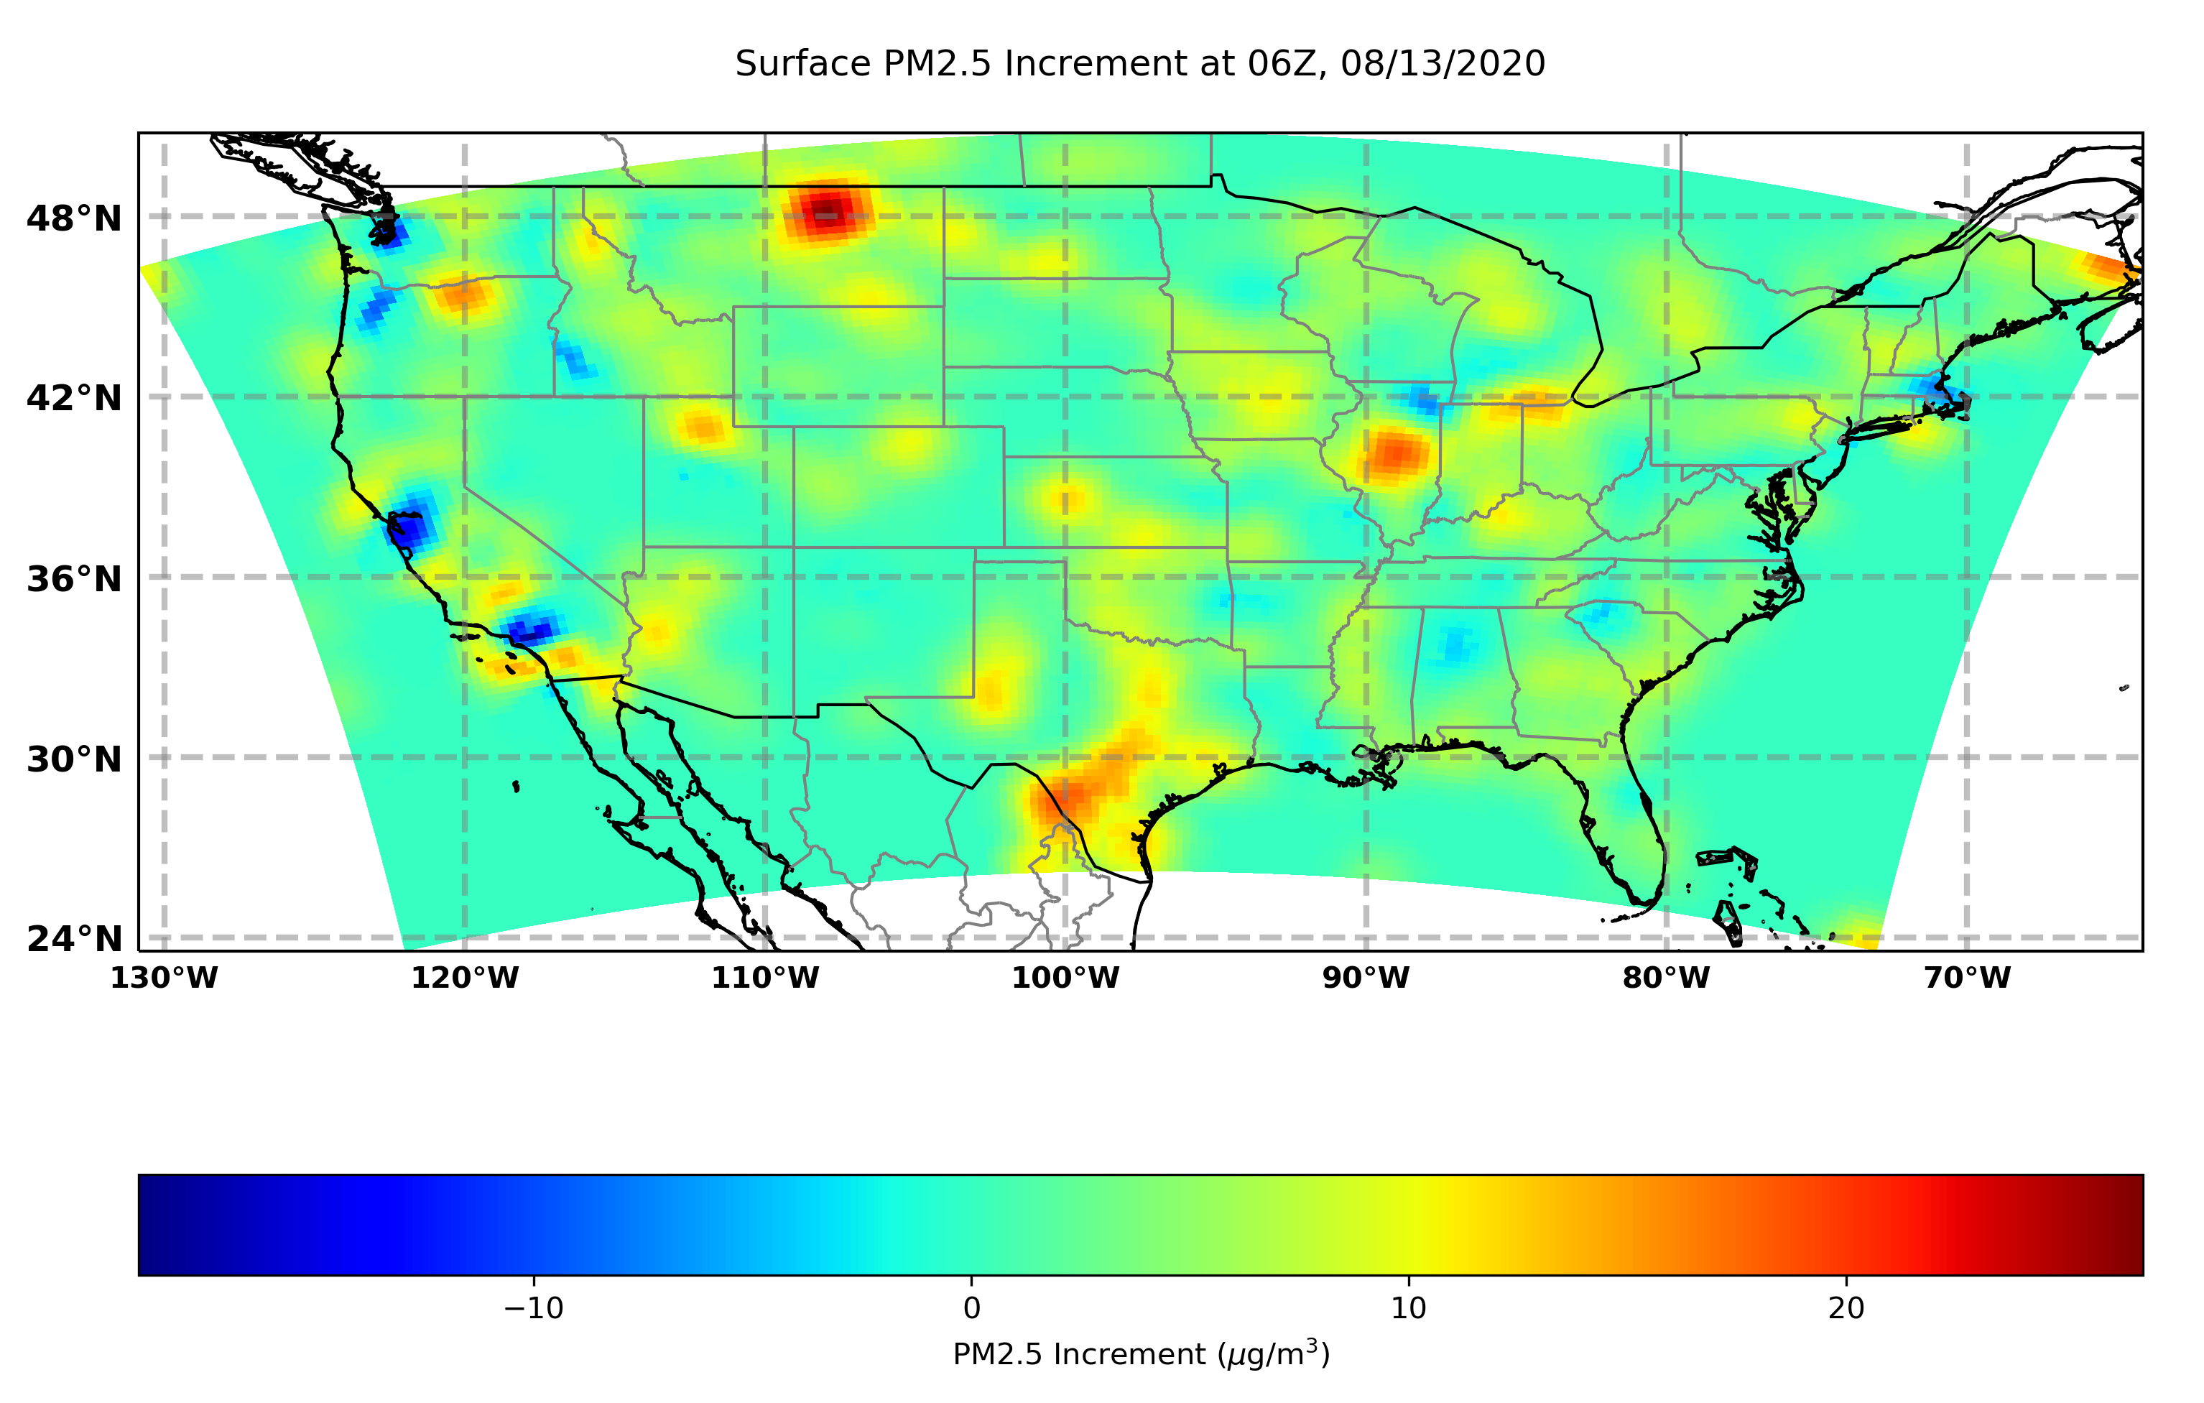
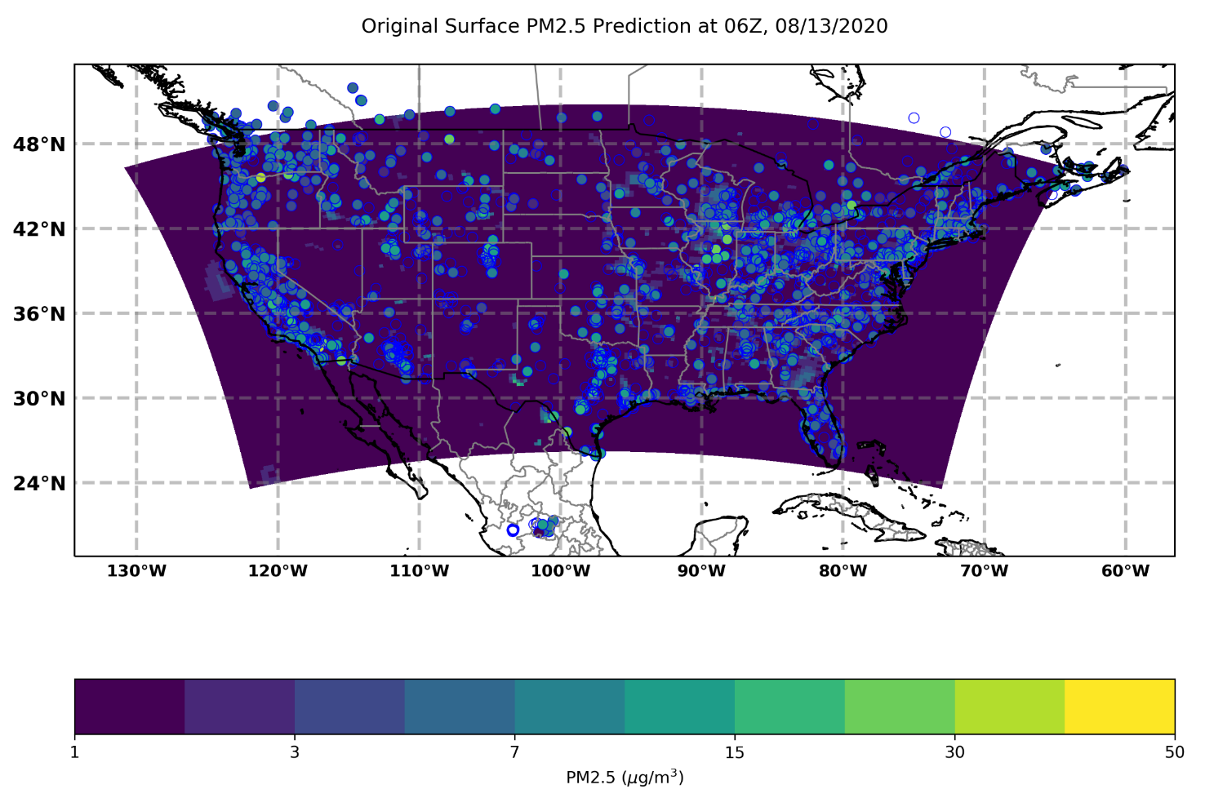
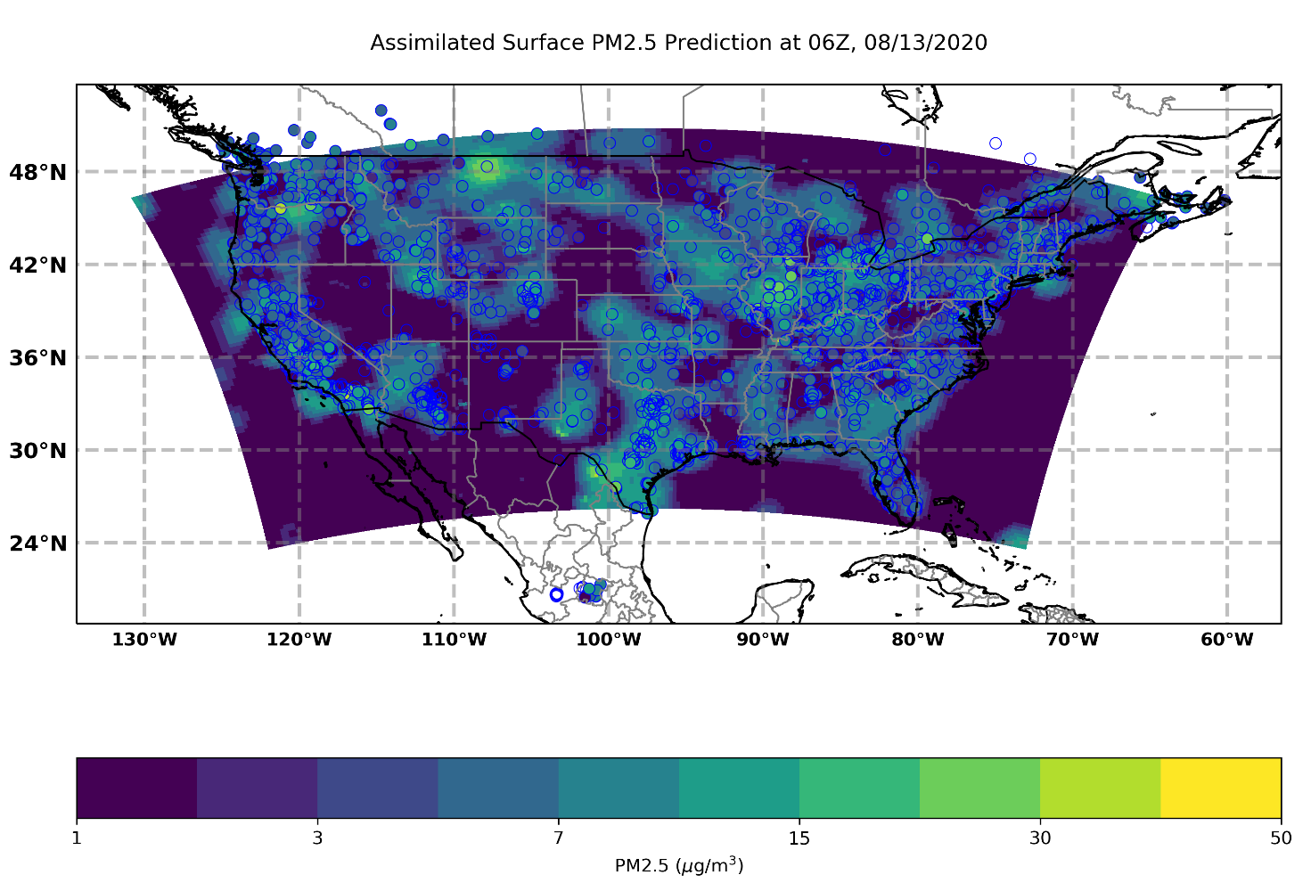
JEDI AIRNow Data Assimilation Test for RRFS-CMAQ at 06Z, 08/13/2020
EPA AIRNow surface hourly monitoring data is available in near-real-time, which was widely used in prediction verifications. Insider JEDI, we developed a method to utilize this data for aerosol data assimilation (DA) for Rapid Refresh Forecast System with CMAQ mechanism (RRFS-CMAQ) model. This aerosol DA serves two purposes: one is DA directly adjusting aerosol near surface, and the other is calibrating the AOD DA.

Slide 3
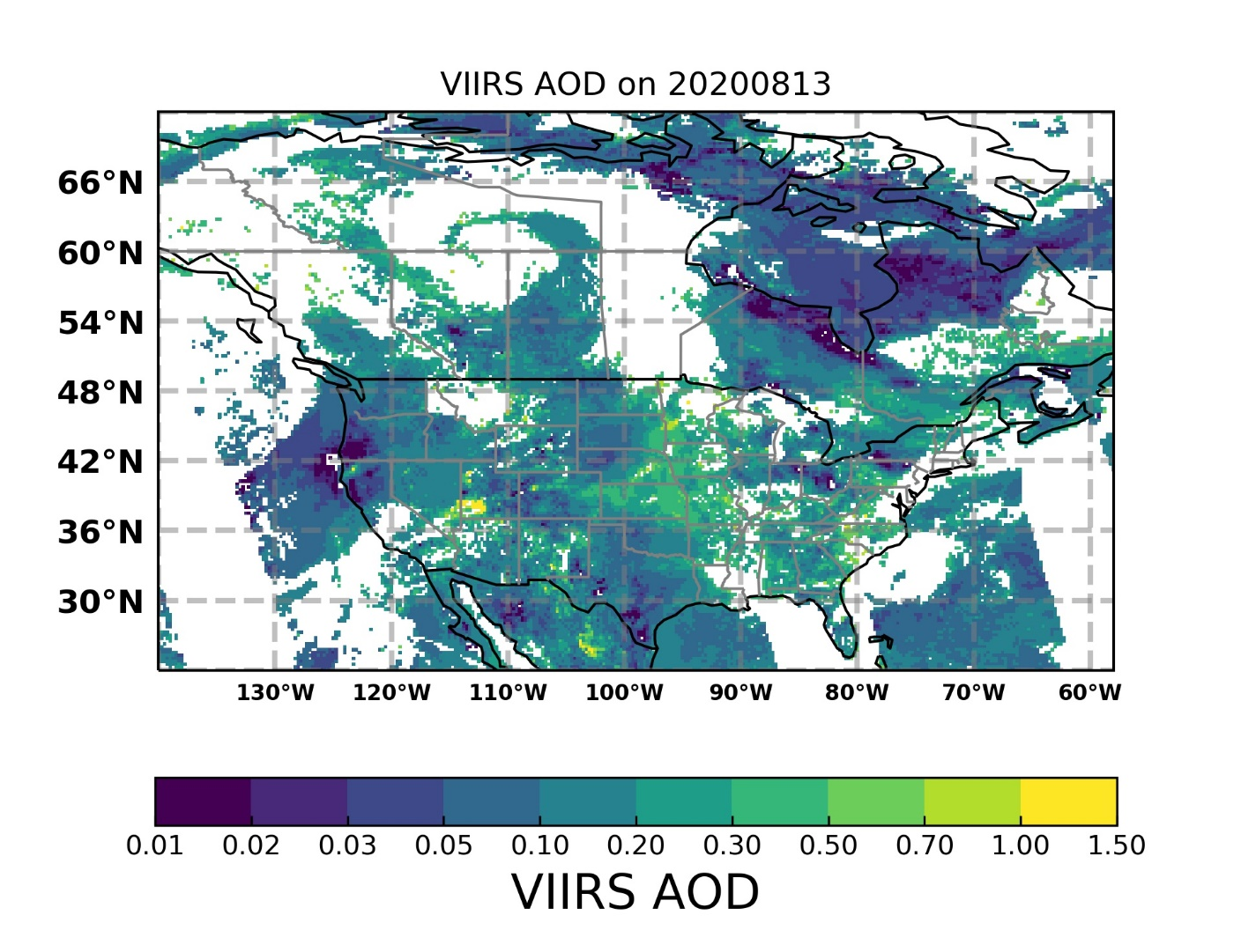
The aerosol data assimilation with the in-situ measurements can still work well when AOD is not available due to cloud cover etc.

