Slide 1
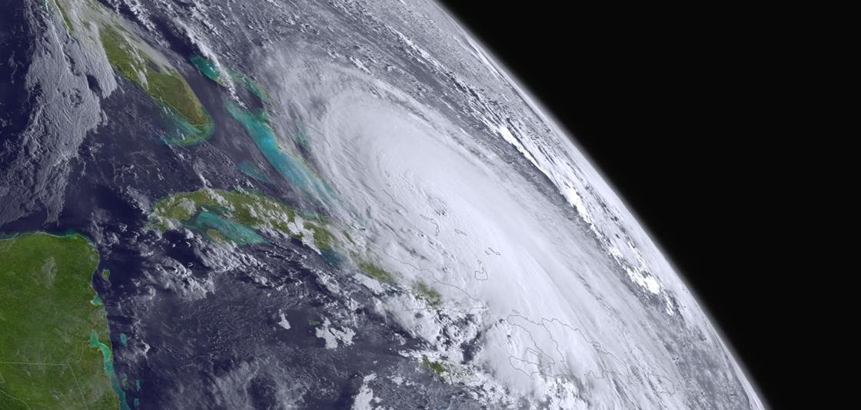
Regional NO₂ DA for RRFS-CMAQ using JEDI
Cory R Martin - RedLine @ NOAA NWS NCEP EMC
(and thanks to the RRFS, air quality, and data assimilation groups at NOAA/EMC as well as JCSDA core staff)
National Weather
Service

Slide 2
RRFS-CMAQ is the planned next-generation inline coupled high resolution air quality prediction forecast system for the U.S.
Support has been added to the JEDI repositories for regional FV3 configuration, and for observations that use an averaging kernel (including unit tests)
Regional 3DVar cycling experiments have been conducted using FV3-JEDI on a test 25km RRFS-CMAQ CONUS domain.
BUMP for static background covariance
NO₂ as the only control variable
Assimilation of TROPOMI NO₂ tropospheric column observations (on polar orbiting satellite S5P)

Slide 3
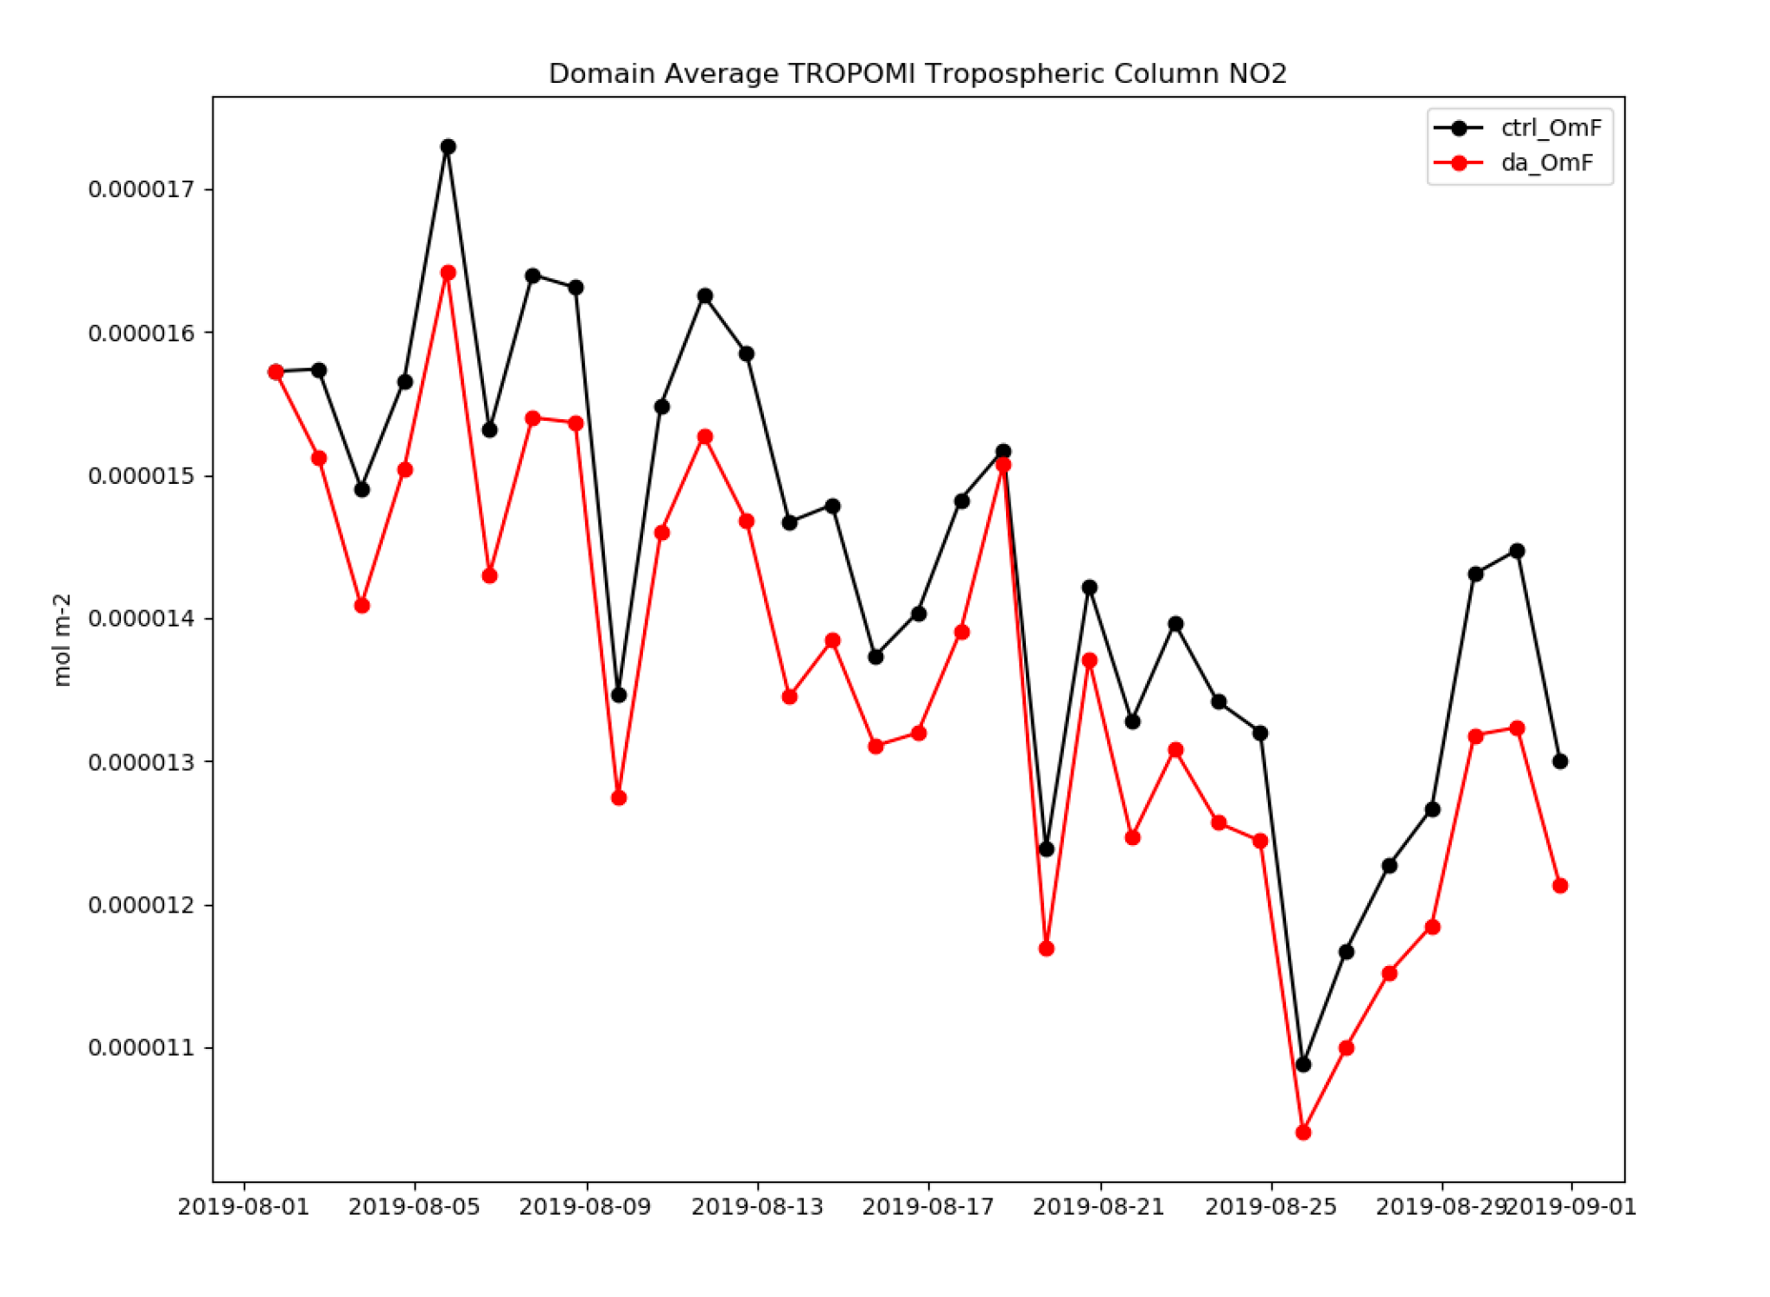
Reduction in mean O-F values of tropospheric column NO₂ with DA compared to without.
H(x) values seem to be too low, and there is likely a (recently discovered) bug in the way the avgkernel UFO converts from molecules / m³ to molecules / cm² (the dz of the model layers needs to be interpolated to the dz of the averaging kernel)
Future work may include inclusion of additional near-surface and space-based observations as well as simultaneous adjustment of mixing ratio and surface emissions

