Slide 1
Overview of the Sea ice Ocean Coupled Assimilation (SOCA) project
Core Team:
Kriti Bhargava, Hamideh Ebrahimi, Travis Sluka, Guillaume Vernieres
GMAO in-Kind Collaborators:
Min-Jeong Kim, Yuri Vikhliaev, Eric Hackert, Santha Akella
NOAA In-Kind Contributors:
Rahul Mahajan, Jong Kim, Yan Hao, JieShun Zhu, Shastri Paturi, Xiao Liu, Yi-Cheng Teng, Sergey Frolov, Ling Liu, Cameron Book

Slide 2
SOCA: JEDI based Marine data assimilation system
Our Focus: Developing a scientifically sound end to end marine DA system
Replace GODAS at NOAA-EMC
Initialization of S2S systems (EMC, GMAO)
High resolution initialization of marine models (regional and global)
Model interfaces
MOM6 (JCSDA, EMC)
CICE6 (EMC, JCSDA)
ROMS (Rutgers, JCSDA)
Analysis to model change of variables
CICE4 (GMAO, JCSDA)
SIS2 (JCSDA)
Wavewatch III (EMC)

Slide 3
DA implementations and workflow(s): Current Cycling Status
Global workflow (rocoto, ecflow)
Python scripts
Shell scripts
Shell scripts
EWOK
JCSDA/soca
JCSDA/soca-realtime
JCSDA/soca-science
JCSDA/soca-workflow
NOAA-EMC/GODAS
A JEDI based Ocean Sea ice Data Assimilation System for the UFS
status as of 06-09-2021 (more or less in developmental freeze )
 | Global UFS (MOM6-CICE6) | Global GEOS (MOM6-CICE4-FV3) | Global GFDL (MOM6-SIS2) | Regional (MOM6-SIS2)
h(x) | ✅ | ✅ | ✅ | ✅
3DVAR | ✅ | ✅ | ✅ | ✅
LETKF | ✅ | ✅ | ✅ | In progress
Hybrid-EnVAR | ✅ | ✅ | ✅ | In progress
Read file (MOM6-CICE6) | MOM6 “solo” (MOM6 only)
In progress | In progress
In progress | In progress

Slide 4
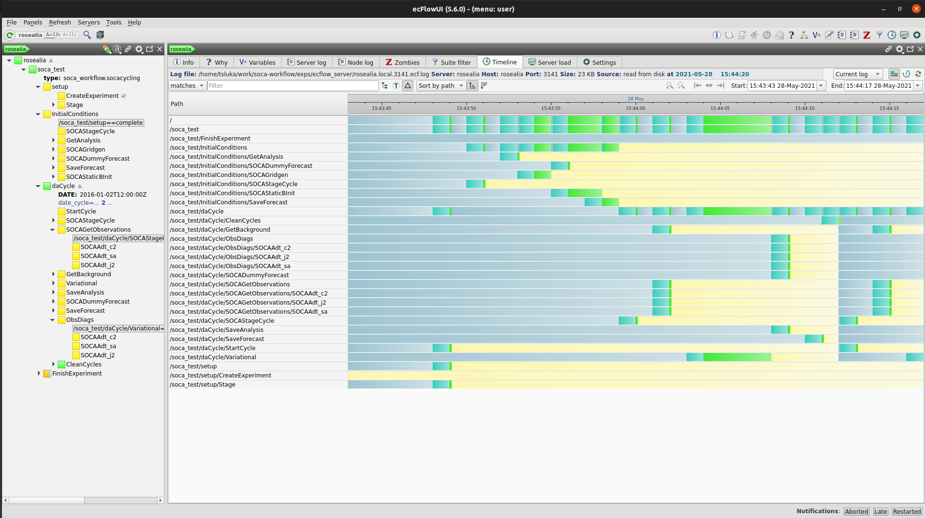
DA implementations and workflow(s): 3DVAR with EWOK! (Travis Sluka)
Workflow update: EWOK

Slide 5
B matrix development: Current Status
Current static B matrix implementation
Physically based balance operators
Background error amplitude based on the vertical background temperature gradient and surface climatology of SST OMB’s
Vertical convolution operator
BUMP based horizontal correlation operator (Benjamin Menetrier):
Rossby radius dependent
Same for all model levels and variables
BUMP
2D only

Slide 6
B matrix development: Ensemble based 3D correlation operator (Benjamin Menetrier, Guillaume & Travis)
Ensemble based Static B
Physically based balance operators
Background error amplitude based on the vertical background temperature gradient and surface climatology of SST OMB’s
BUMP 3D correlation operator (Benjamin Menetrier):
Ensemble based for scales
Differ for each model levels and variables

Slide 7
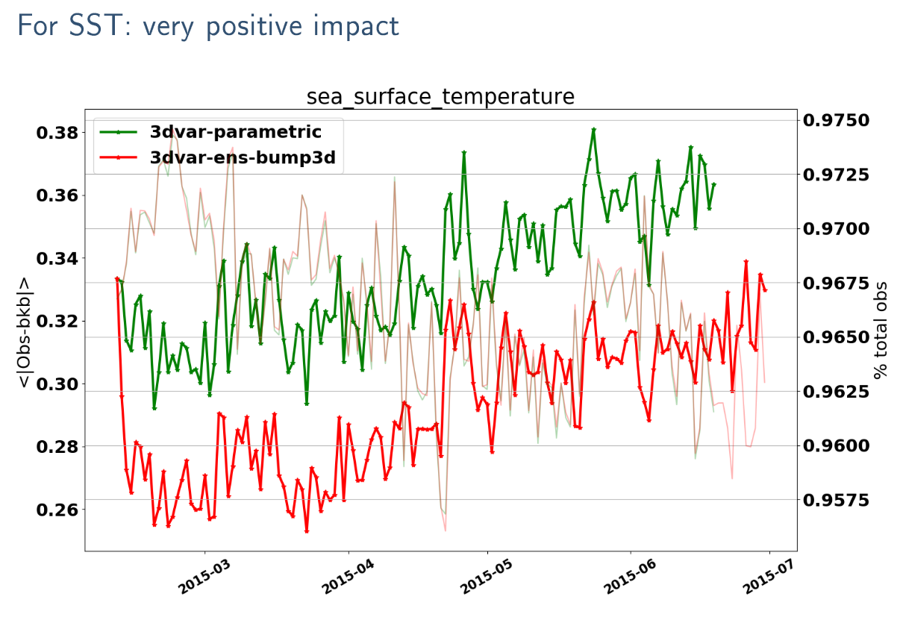
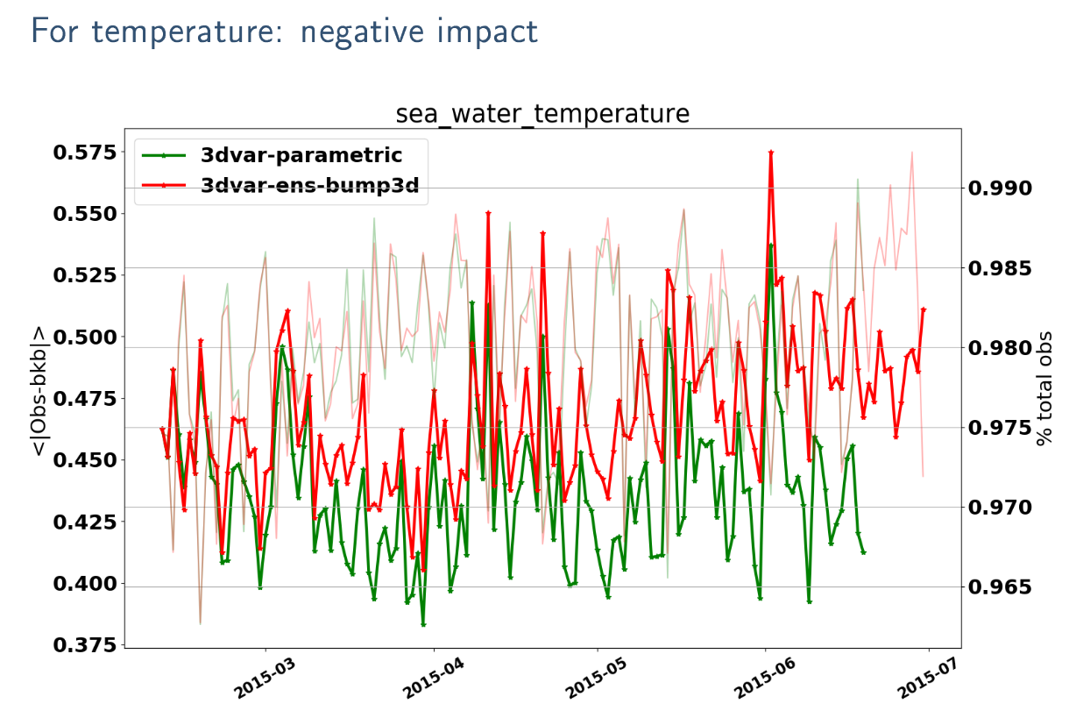
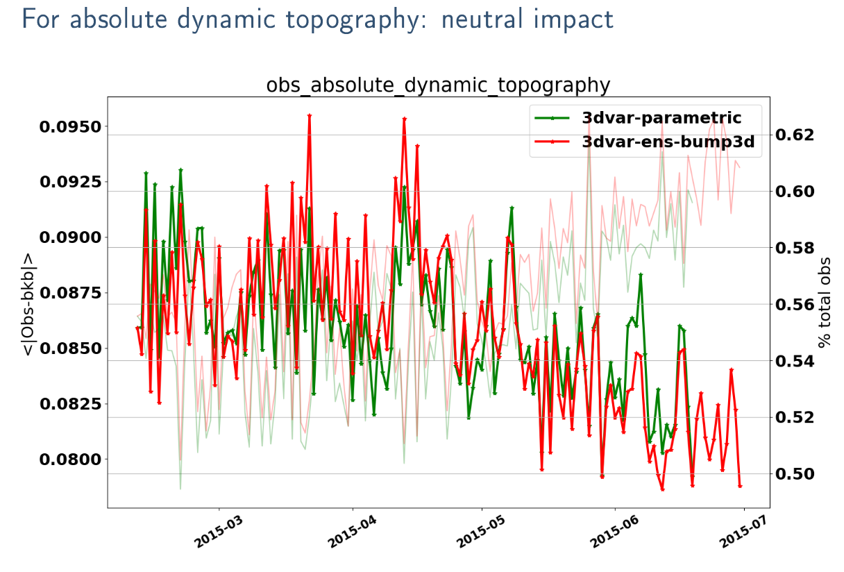
B matrix development: Ensemble based 3D correlation operator (Benjamin Menetrier, Guillaume & Travis)
Ensemble based Static B
Physically based balance operators
Background error amplitude based on the vertical background temperature gradient and surface climatology of SST OMB’s
BUMP 3D correlation operator (Benjamin Menetrier):
Ensemble based for scales
Differ for each model levels and variables

Slide 8
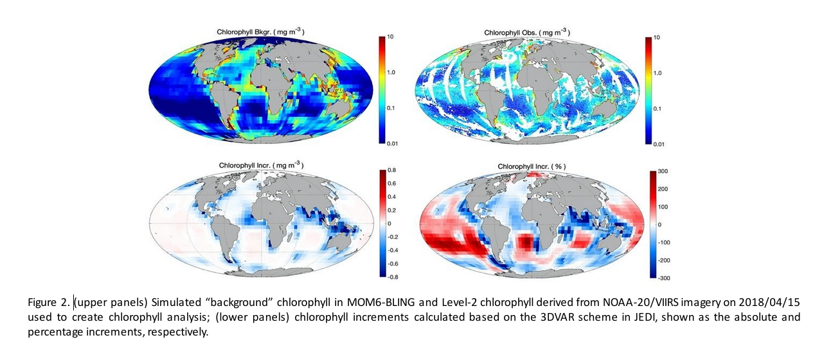
Application development: Biogeochemistry (Xiao Liu, EMC)
More details in Xiao’s talk
BLING coupled to MOM6
Chlorophyll tracers
ocean color observations
from VIIRS and MODIS

Slide 9
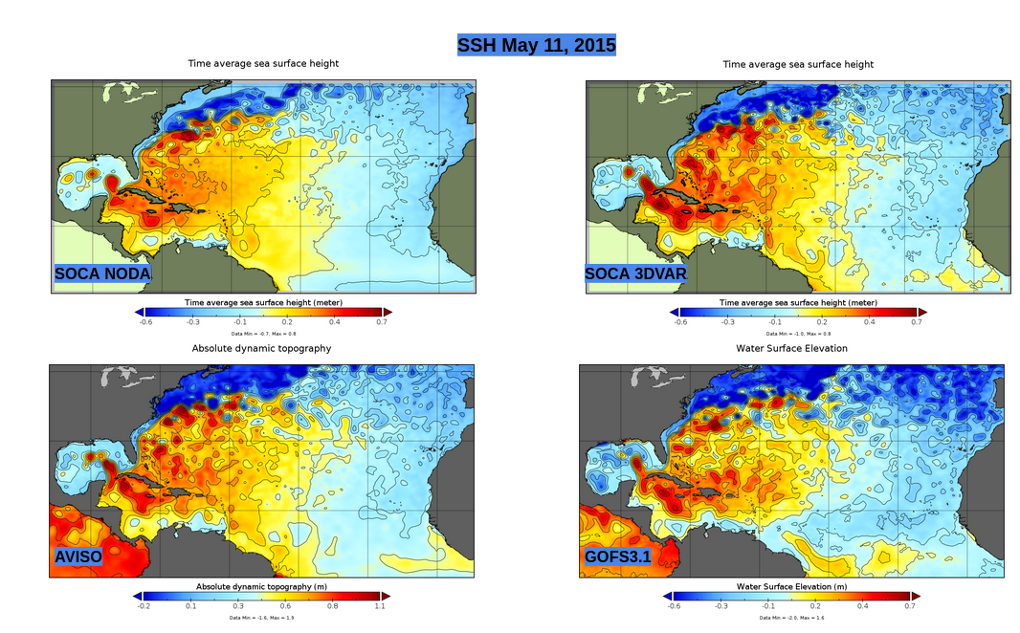
Application development: Regional ocean DA for HAFS (Kriti Bhargava, Ling Liu’s & Cameron Book)
See Kriti and Ling’s talk for more details

Slide 10
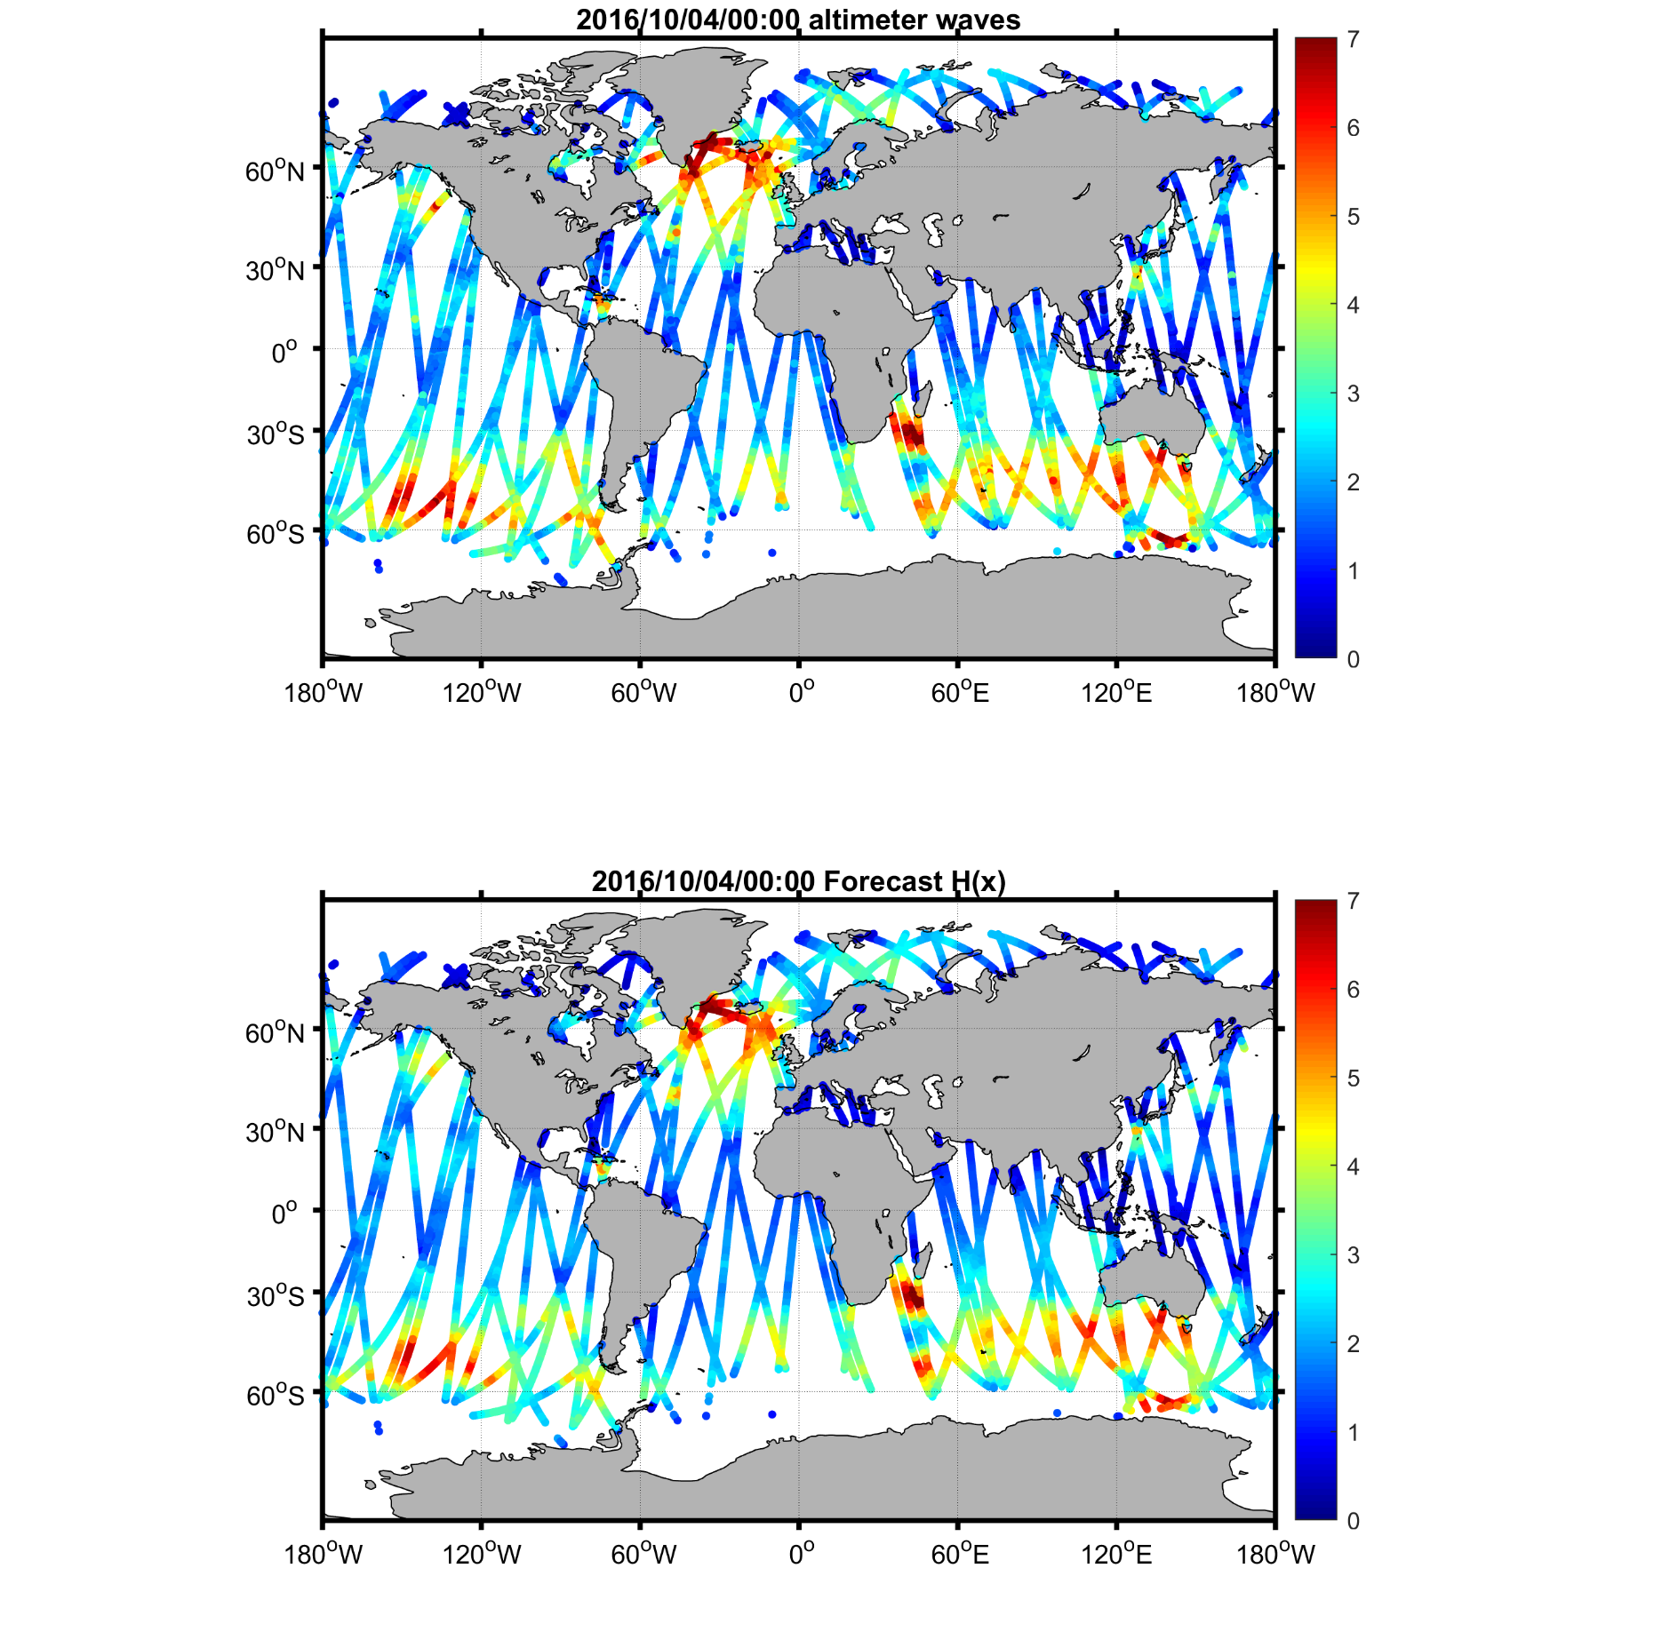
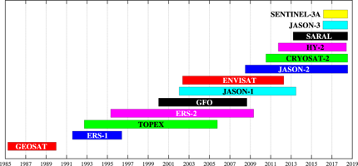
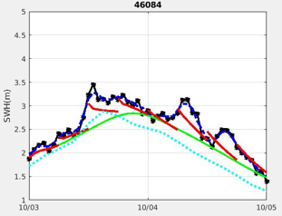
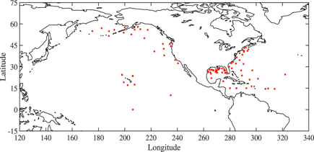
Application development: Wave DA for the initialization of WWIII (Yi-Cheng Teng, EMC)
Assimilated Observations: SWH
Altimeters: Jason-2, CryoSat-2, SARAL, Jason-3, Sentinel-3A, Sentinel-3B
In-situ Data: NOAA NDBC buoys
Blue: GWES; Green: no da; red: da

Slide 11
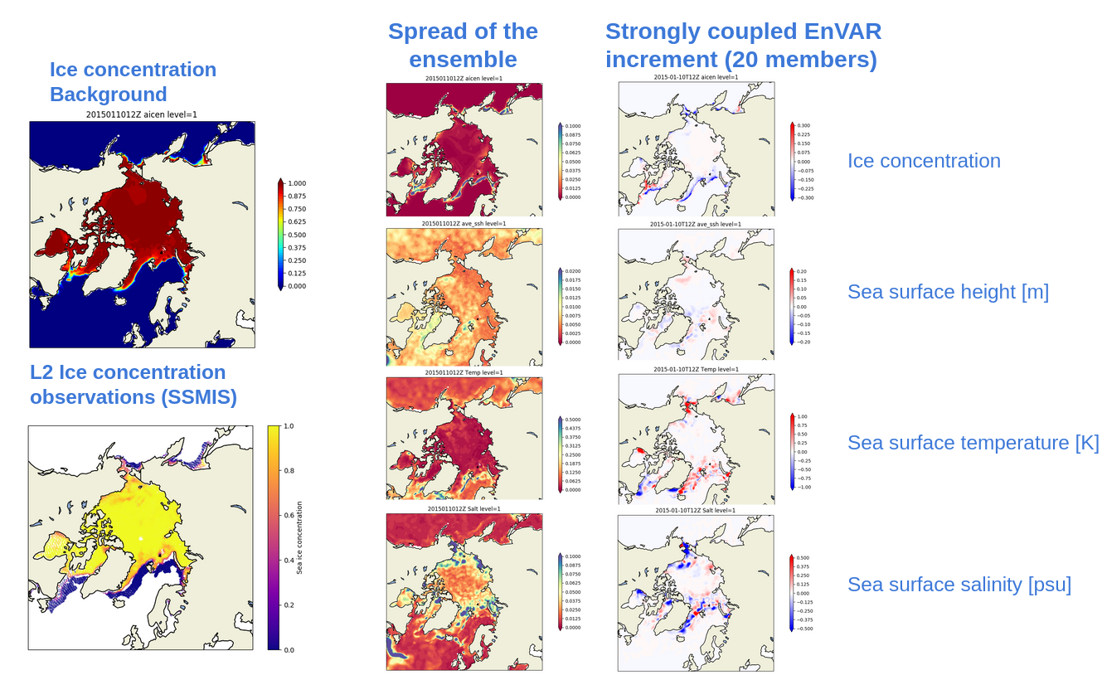
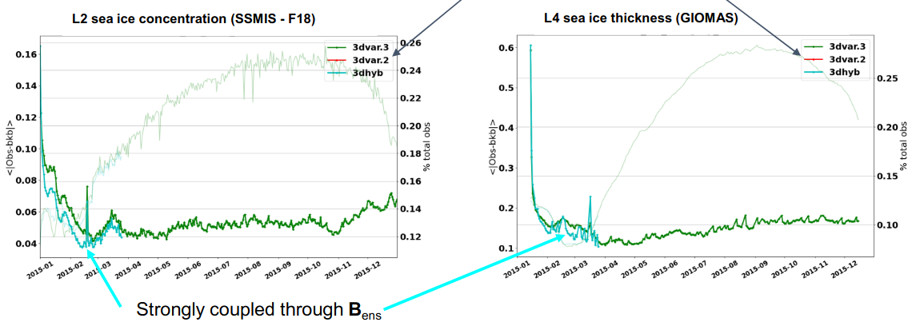
Application development: Ocean Sea ice strongly coupled DA
Ensemble based coupled B matrix
20 members
LETKF perturbations
BUMP localization

Slide 12
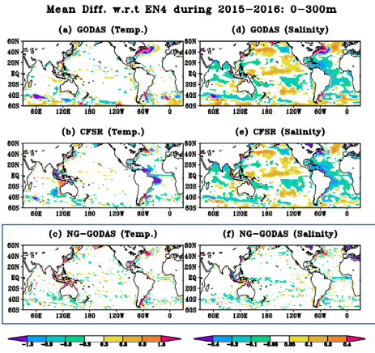
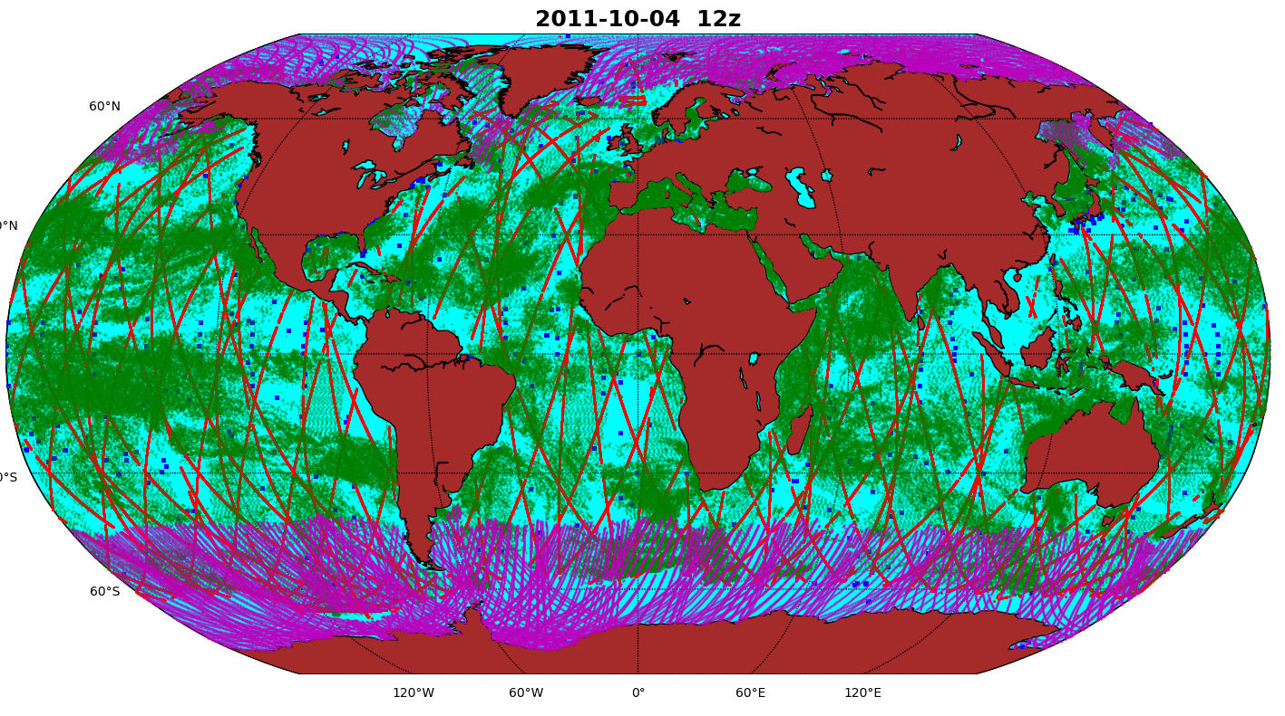
Application development: NG-GODAS, joint JCSDA/EMC/CPC implementation
An ocean sea ice reanalysis system for the UFS
3DVAR with parametric background error and balance operators
Sanity check for covariance modeling: Hybrid EnVAR
Observations:
Insitu: Argo (T,S), Conductivity TD (T,S), XBT (T), TAO (T), PIRATA (T,S), RAMA (T,S) , Ship tracks (SST)
Satellite retrievals
24H DA window
Analysis by JieShun Zhu, CPC

Slide 13
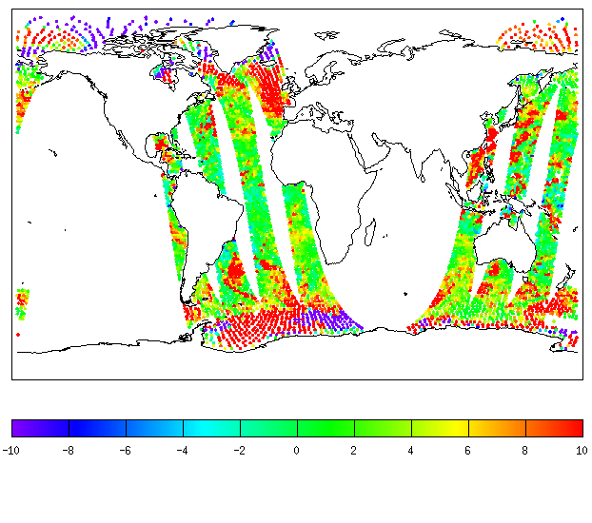
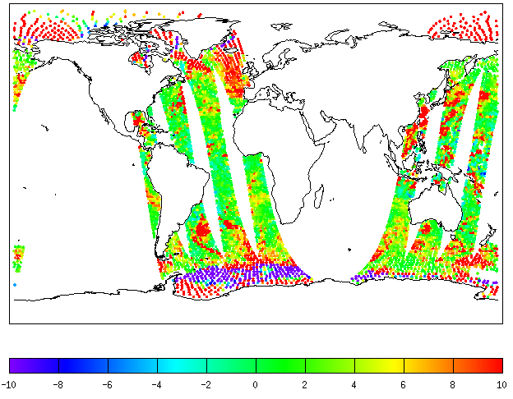
Application development: Multi-domain observing operators for GEOS (Min-Jeong Kim, Hamideh Ebrahimi)
Workflow summary for the Marine 3DVAR and Atmospheric h(x) with the coupled GEOS (MOM6-FV3-CICE4-...)
C90 FV3 (replaying atm analysis), 1 degree MOM6-CICE4
6 hr window for the Atmospheric h(x)
24 hr window for the marine 3DVAR
FV3-JEDI
h(x)
Observations
Atmosphere and ocean surface (SST, SSS) background
Atm background interpolated at observation locations (GeoVaLs)
GEOS Forecast
MOM6-CICE4-FV3
SOCA
3DVAR
METOP-B AMSU-A CH2 (31 GHz) Brightness Temperature
12/4/2020
Cold start IC
FV3-JEDI O-B
GEOS_GSI O-B
ocean sea ice analysis
JEDI IC: Only MOM6 & CICE4 for now
METOP-B AMSU-A CH2 (31 GHz) Brightness Temperature 12/4/2020 ( implementation by Min-Jeong Kim)
‹#›

Slide 14
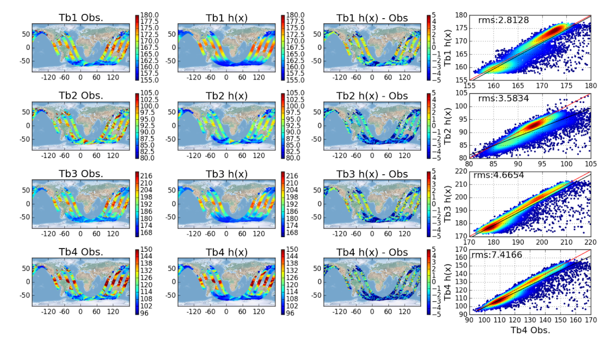
Application development: Multi-domain observing operators for GEOS (Hamideh Ebrahimi)
Multi domain UFO
Simulation of GMI and SMAP using the CRTM UFO
Background input from MOM6, CICE4 and FV3
Work in progress for direct radiance assimilation

Slide 15
Application, what’s next? JEDI-GODAS (JCSDA-EMC)
JEDI-GODAS what is it?
A JOINTLY designed/developed replacement for the global marine DA at EMC with a viable path to operations
Meets the JCSDA requirement for CI/CD, collaborative work and workflow infrastructure
Built on past experiences: the JEDI-GODAS is a natural evolution of NG-GODAS
Multiple use:
Replacement of the marine DA systems for climate reanalysis
S2S initialization
High resolution ocean forecast
Extendable to regional systems (JEDI-MDAS?)
Covers the initialization of all the marine components of the UFS

