Slide 1
Family of local volume solvers in the JEDI data assimilation framework
Sergey Frolov
In collaboration with:
Travis Sluka, Anna Shlyaeva, Wei Huang, Jeff Whitaker, Rahul Mhadgan, Tseganeh Gichamo, Clara Draper, Bo Huang, and Mariusz Pagowski
Presented at: JCSDA technical meeting June 2021

Slide 2
Local Volume Solvers
Local grid points stored
on this PE
Family of local volume solvers:
OI (Gandin 1963), LETKF (Ott et.al 2007), GETKF (Bishop et.al 2017), Potthast et.al (2019), Nerger et.al (2013) LETKF-OI (Frolov et.al in prep.).
All share the same workflow:
For each grid point produce local analysis based on neighborhood observations.
Ensemble localization is computed through a combination of observation localization (LETKF) and modulated ensembles (GETKF).
Computational characteristics:
Highly scalable (can be done without MPI communication).
Need to distribute observations on PE in overlapping sets (Halo obs. distribution).
Observation distance search can be expensive with ~1M obs. (kd-tree search algorithm).
Observation
Analysis point
L
Observation volume
Halo region containing all obs. relevant to local grid points

Slide 3
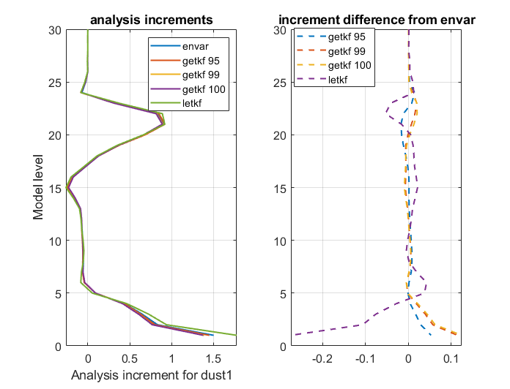
Supported localization options
Dust increment from assimilation of a single AOD ob.
Horizontal localization:
Observation localization through R-inflation (choice GC99 or SOAR).
Vertical localization:
No-localization: LETKF in SOCA and FV3-JEDI.
Modulated ensembles: GETKF in FV3-JEDI.
Terrain-dependent localization for land DA.
Example:
LETKF and GETKF can produce increment similar to EnVAR.
Increments are not identical due to difference in localization.

Slide 4
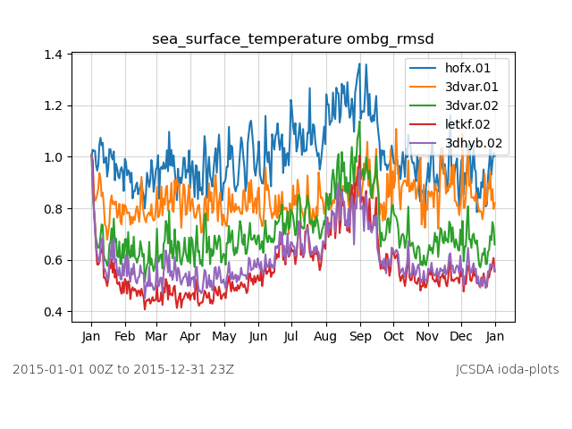
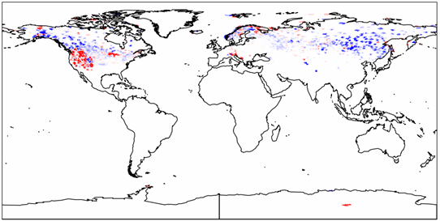
Applications to date
Ocean LETKF
RMSE(sst)
Snow-depth increment
Existing applications: ocean, aerosol, and snow-depth assimilation.
In the works: verifying the JEDI GETKF against operational GSI GETKF.

Slide 5
Next steps
Computational optimization and enhancements:
Using Jacobian to observe ensemble members (CY21).
FGAT for EnKF (CY21).
GETKF extension to the ocean (CY21-22).
Coupled DA and localization (FY22→).
Transitions:
Replacement of GSI ENKF in GEFS v13 (FY 24).
LETKF-OI for land assimilation and SOCA LETKF for ocean-ice in GEFS reanalysis (FY23).
Unfunded improvements (looking for contributions):
Integration with sequential filters (e.g. particle filters).
Iterative Kalman filter.

