Slide 1
Interactive JEDI Diagnostic Notebooks in the Cloud
Rachel Schweiker, Joint Center for Satellite Data Assimilation
2021 JCSDA Technical Review Meeting and Science Workshop

Slide 2
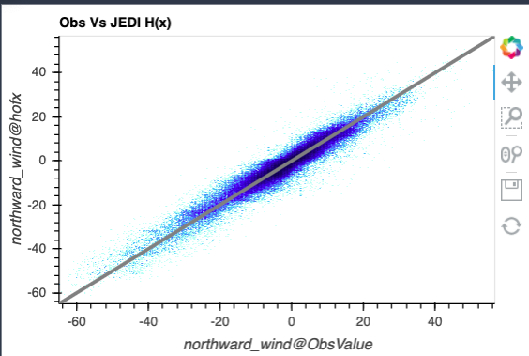
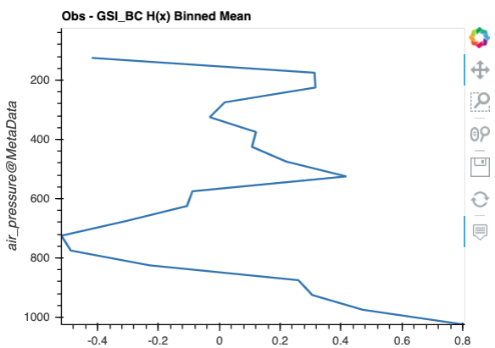
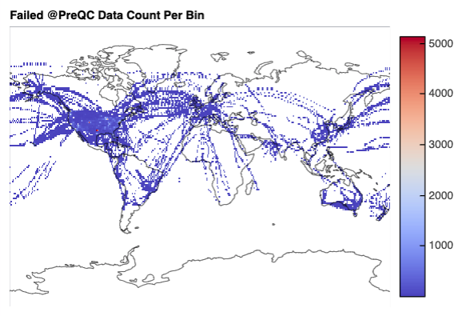
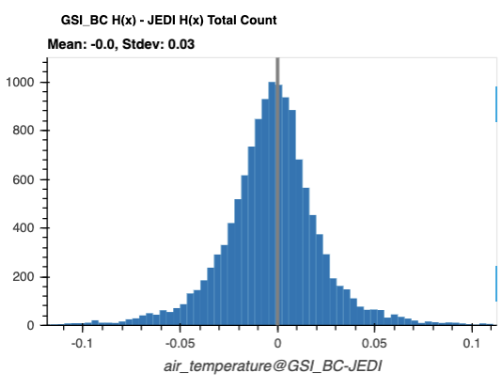
On demand plots
Model & experiment comparison
Interactive JEDI Diagnostic Notebooks in the Cloud

Slide 3
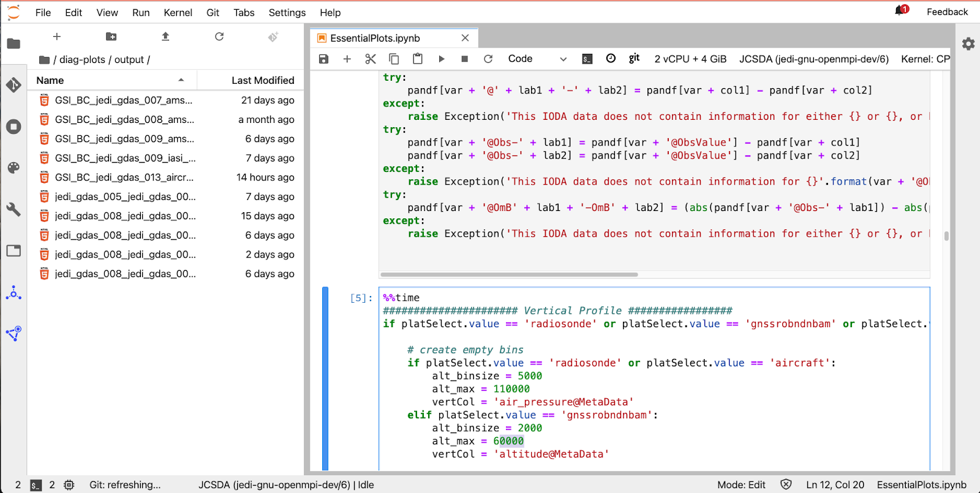
Editable & shareable Jupyter notebooks
Interactive JEDI Diagnostic Notebooks in the Cloud

Slide 4
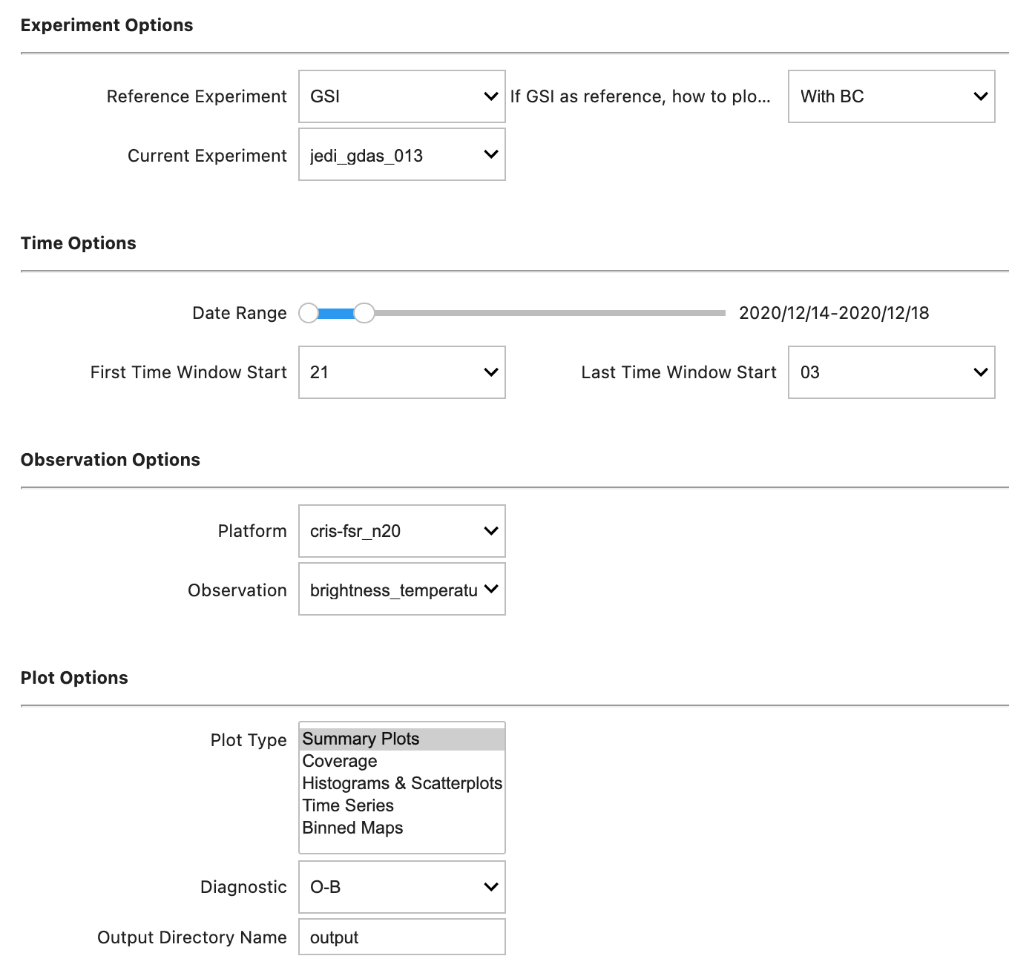
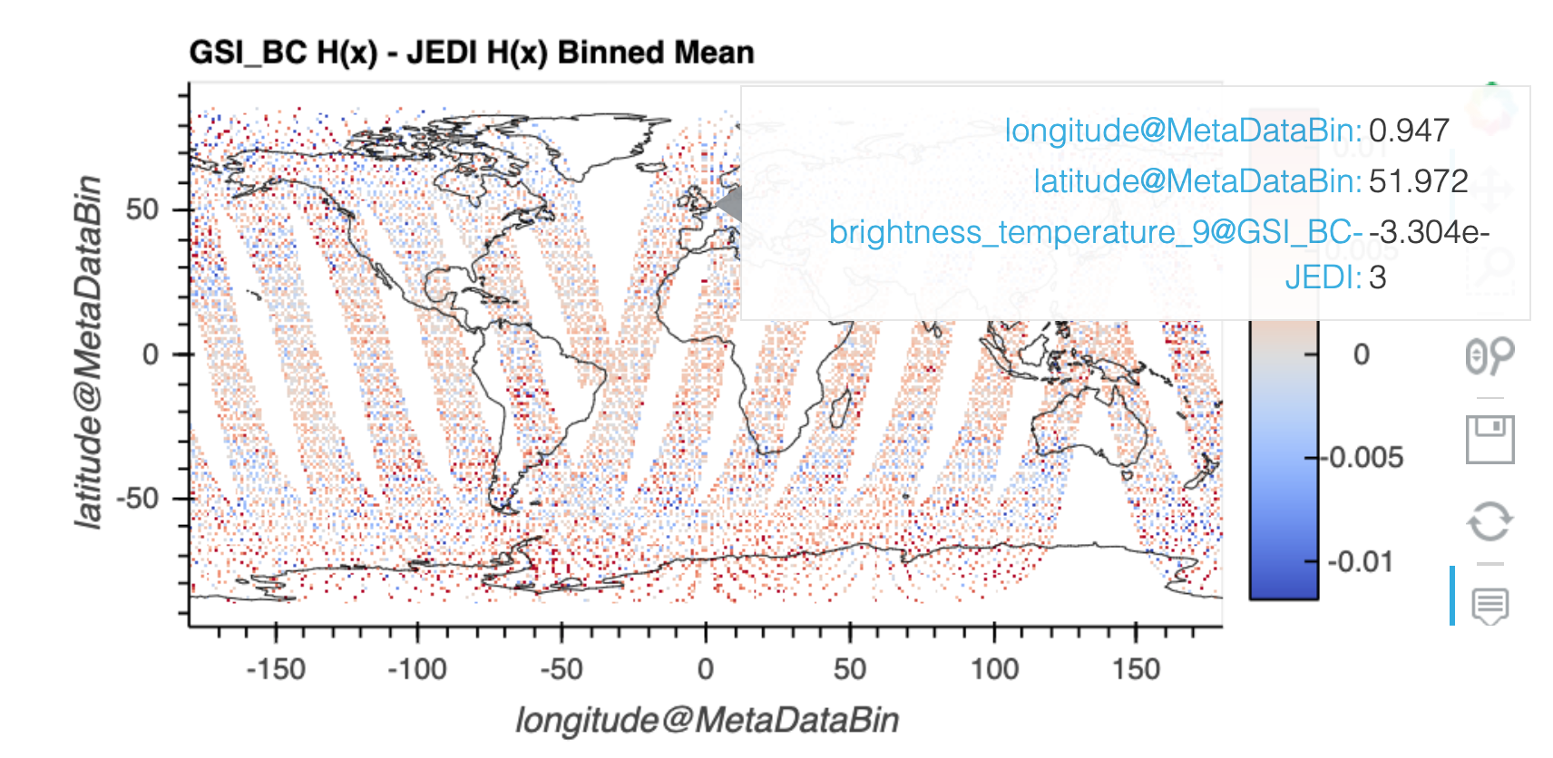
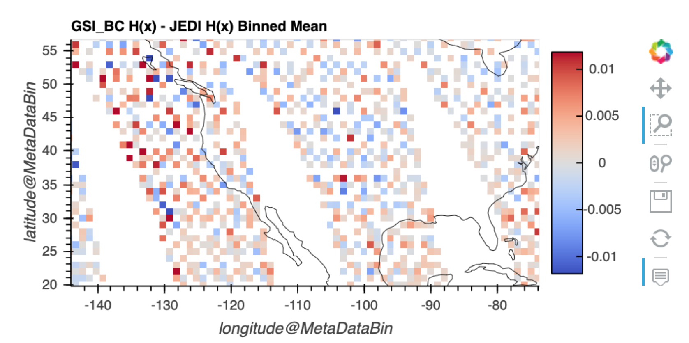
Widgets to select data
Hover, zoom and save tools
Interactive JEDI Diagnostic Notebooks in the Cloud

Slide 5
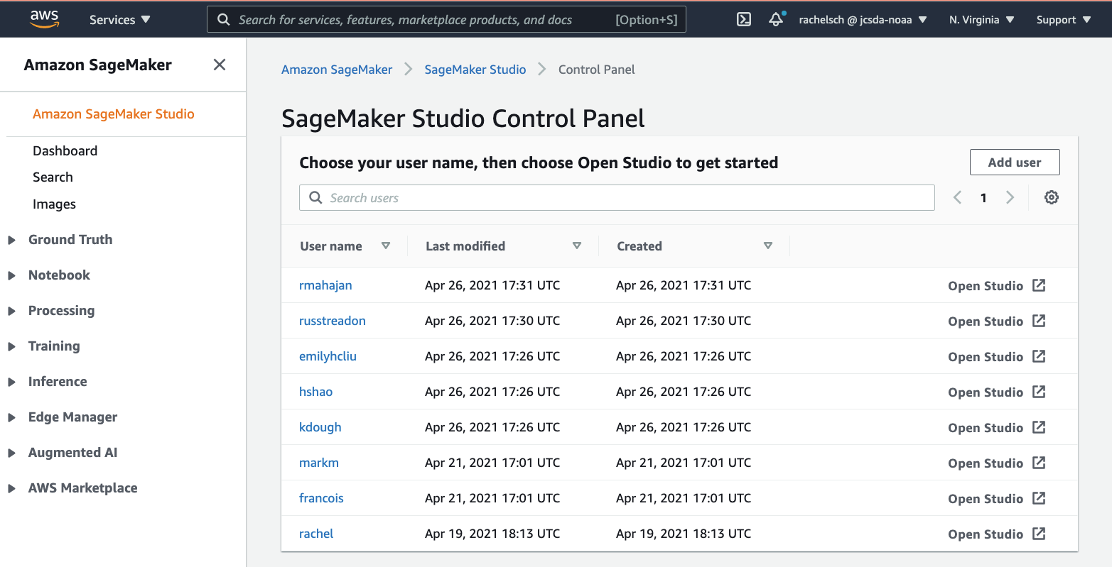
Hosted on AWS SageMaker Studio
Supports multiple users
Access to S3 data
Upgrade instance from inside the studio
Interactive JEDI Diagnostic Notebooks in the Cloud

Slide 6
Contact
rachelsch@ucar.edu
to get involved

