Slide 1

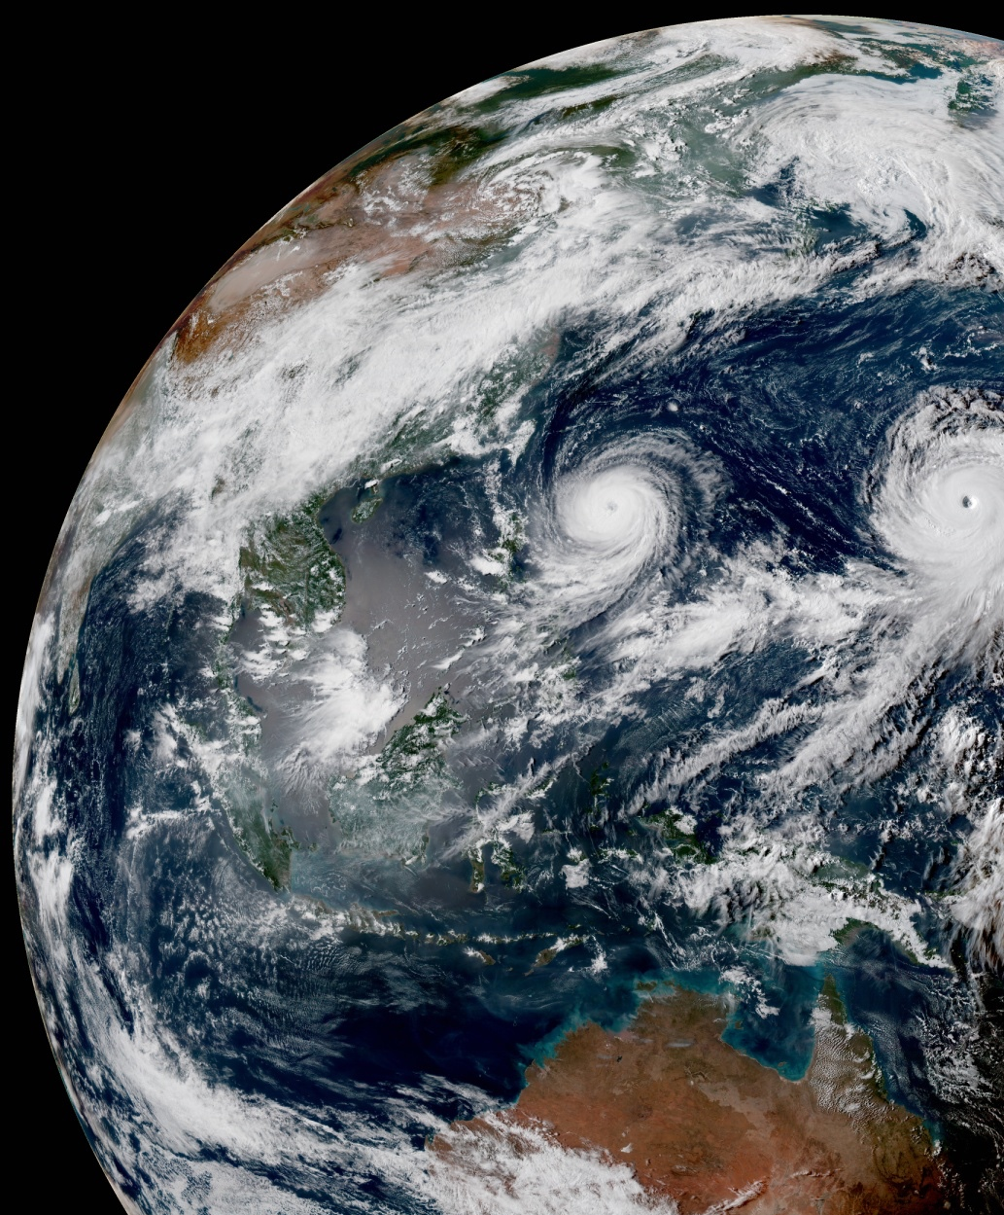
A Shared Infrastructure for Exploring and Diagnosing Observations and Their Impact
F. Vandenberghe, H. Zhang, F. Diniz & R. Schweiker
Joint Center for Satellite Data Assimilation (JCSDA)
18th JCSDA Technical Review Meeting and Science Workshop, June 8th, 2021

Slide 2
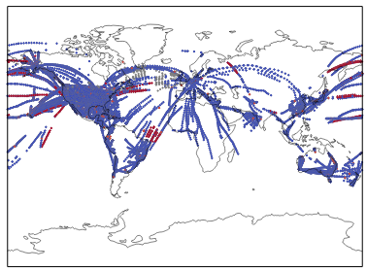
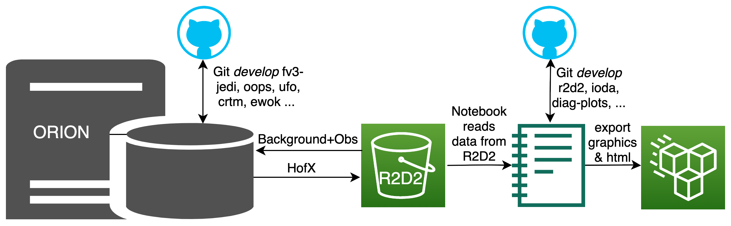
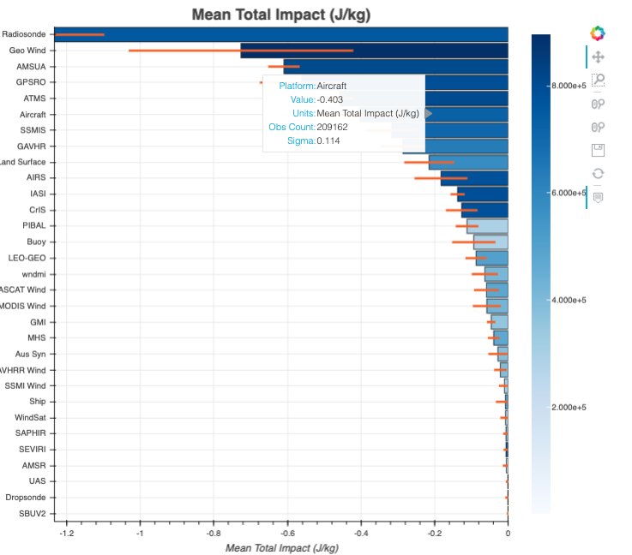
Impact of Observing Systems (OBS2)
Shared Diagnostic tools (see Rachel’s talk coming after).
NRT obs monitoring.
Data impact assessment (next slide).
FSOI development (See Fabio’s talk Wednesday).
Commercial data assessment. (See Hailing’s talk Friday).
HPC/
AWS

Slide 3
Ensemble-based observation impact assessment tools
0.1mb
13mb
Initial spread
60mb
208mb
Spread after asim
operational
+commercial
Difference spread oper+commercial - oper
522mb
Spread after assim
operational obs
836mb
Difference
+/-commercial
987mb
7 analyses (Dec. 22 06Z – Dec. 23 18Z)

Slide 4
Questions vandenb@ucar.edu

