Slide 1
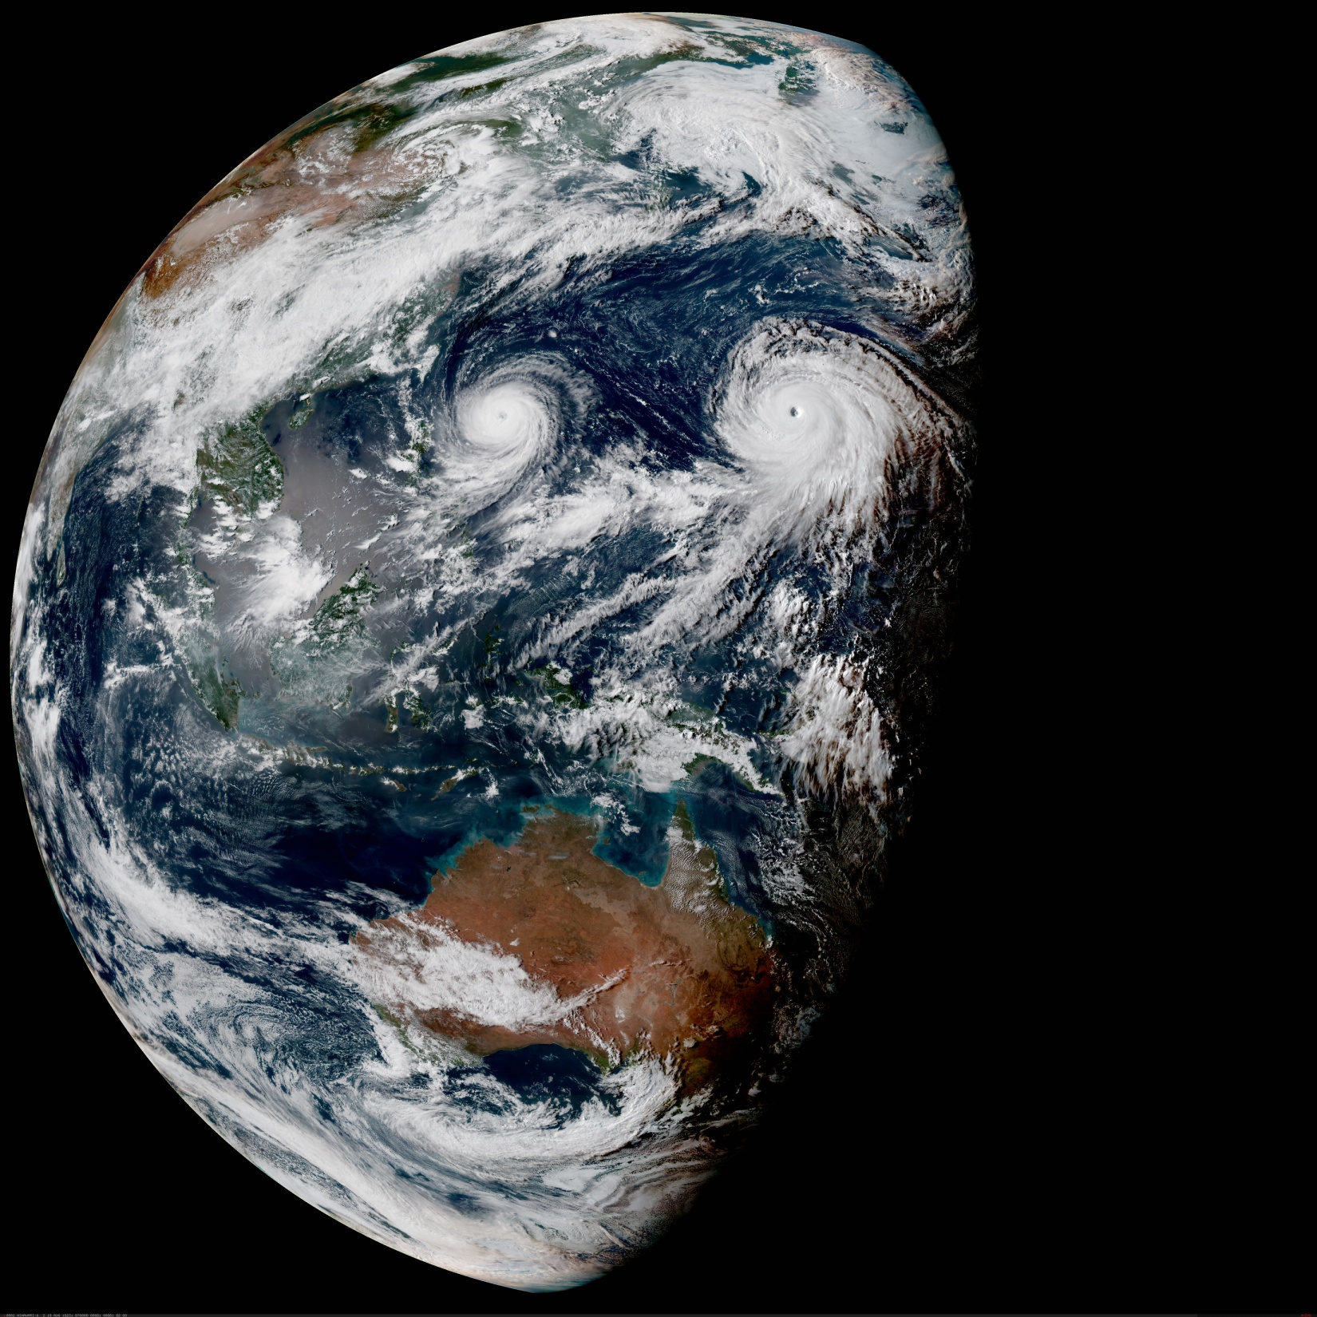
The Joint Effort for Data assimilation Integration (JEDI)
Yannick Trémolet
Joint Center for Satellite Data Assimilation (JCSDA)
18th JCSDA Technical Review Meeting and Science Workshop
7-11 June 2021

Slide 2
JEDI Objectives
The Joint Effort for Data assimilation Integration (JEDI) is a collaborative development between JCSDA partners
Develop a unified data assimilation system:
From toy models to Earth system coupled models
Unified observation (forward) operators (UFO)
For research and operations (including O2R2O)
Share as much as possible without imposing one approach
Design driven by scientific vision for data assimilation
Not trying to salvage old codes at any cost

Slide 3
JEDI is a Joint Effort
JEDI core-team: A. Shlyaeva, B. Ménétrier, C. Gibert, C. Gas, D. Holdaway,
E. Lingerfelt, M. Miesch, M. Olah, M. Abdi-Oskouei, R. Grubin, R. Honeyager, S. Herbener, S. Vahl, Y. Trémolet
JEDI contributors (2020): A. Weinbren, B. Johnson, BJ Jung, C. Pelley, C. Harrop, C. Martin, C. Thomas, D. Davies, D. Simonin, E. Liu, F. Diniz, F. Vandenberghe, G. Vernières, G. Thompson, H. Zhang, H. Ebrahimi, H. Kershaw, H. Shao, I. Genkova, J. McCreight, J. Rosinski, J. Guerrette, J. Ban, M. Wlasak, M. Pagowski, M. Cooke, N. Bowler, O. Lomax, R. Mahajan, R. Todling, S. King, S. Frolov, S. Sandbach, T. Sluka, V. Buchard, W. Śmigaj, X. Zhang, and more…
JEDI collaborators: C. Snyder, D. Kleist, D. Dee, N. Baker, R. Gelaro, T. Auligné, …
Representing: JCSDA, NOAA/EMC, NOAA/ESRL, NASA/GMAO, NRL, USAF, NCAR, UKMO
And more than 200 padawans who attended five JEDI Academies (more soon)

Slide 4
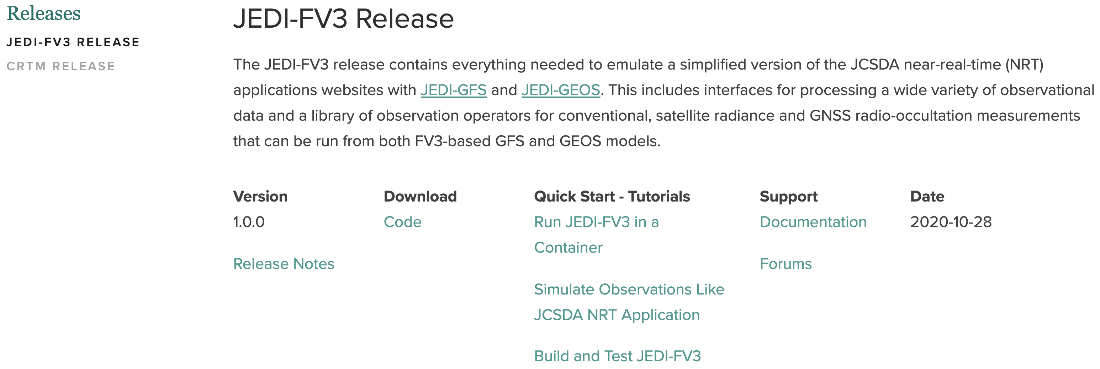
October 2020: First JEDI Release
Next release coming soon!
Available at https://www.jcsda.org/jedi-fv3-release

Slide 5
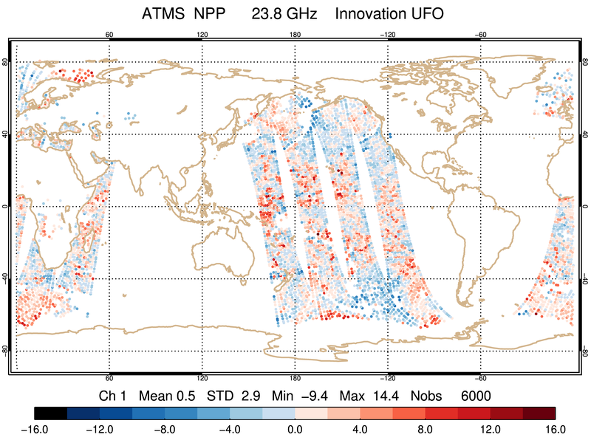
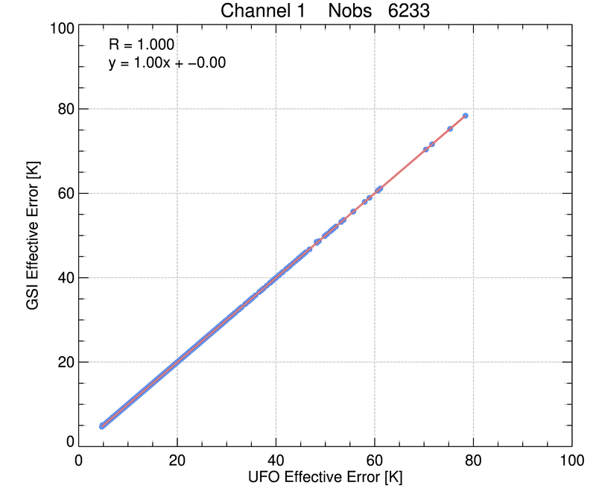
JEDI-FV3 Release 1.1 on Friday (June 11th)
HDF5
ObsStore
BUFR
ODB
yaml
More…
IODA-Engines: Groups, Variables, Dimensions, Attributes, Type System
IODA V2.0.0
Leverages HDF5 data model for improved organization, management, extensibility, metadata
Enhanced support for multi-dimensional data sets
C++/python interoperability
ObsSpace
Bias
Converters
Diagnostics
Containers
User-facing classes
IODA v2 Release
After Release
Planned / Potential
JEDI UFO for ATMS
UFO V1.1.0
H(x), Bias correction, and QC for NCEP operational instruments following GSI implementations
Good agreement with GSI in most cases; validation work continues
UFO

Slide 6
JEDI Working Practices
Project methodology inspired by Agile/SCRUM
Adapted to distributed teams and part time members
Work in small manageable increments with constant feedback
Collaborative environment
Easy access to up-to-date source code (github)
Easy exchange of information (zenhub)
Weekly meetings by video (40 to 60 developers from at least 7 organizations)
Code sprints (8-10 developers working together on a specific topic, virtual in 2020/21)
Enforce software quality
Automated testing: correctness, coding norms, efficiency
Code reviews (all developers actively involved)
Portability is part of the development
Automatic tests with several compilers
JEDI available in containers (docker, singularity, charliecloud)
Modern programming technologies (generic, object oriented)
JEDI is active:
> 200 PR merged / month on average

Slide 7
JEDI: Abstraction and Genericity
Abstract Layer
Generic Algorithms
Forecast
4D-Var
EDA
EnKF
…
Abstract, model-agnostic DA system
Uses
Abstract Interfaces
State
Model
Covariance
…
Obs. Operator
Obs. Space
OOPS is complemented by generic (shared) components.
Generic Layer
Generic Implementations
Implements
SABER
UFO
IODA
Specific Implementations
MOM6
FV3
NEPTUNE
…
CRTM
GNSSRO
…

Slide 8
JEDI Structure
NEPTUNE
UFO (Unified Forward Operator)
The ‘app-store’ of model-agnostic observation operators,
QC, bias correction
OOPS (Object Oriented Prediction System)
State-of-the-art data assimilation generic algorithms
CRTM (Community Radiative Transfer Model)
Accurately and efficiently simulate satellite radiances
UFS
CRTM
GEOS
OOPS
UFO
MPAS
IODA (Interface for Observation Data Access)
Performs all the I/O of the observations
IODA
LFRic
SABER (System-Agnostic Background Error Representation)
Generic background error covariance (incl. BUMP)
SABER
NWM
MOM6
Abstract interfaces and generic codes eliminate duplication of code and effort,
including across Earth-system components.
CICE6

Slide 9
GEOS in-core Data Assimilation
Model runs in-core with FV3-JEDI.
States can be exchanged from the model and be passed back to the model.
Model can be rewound and used in outer loops.
Figures below show the in-core four-dimensional observation simulations for GMAO’s production system. This is part of a continuously running near real time workflow.
GPM GMI Channel 6 h(x)
2020-10-17T09:00:00 - 2020-10-17T15:00:00
AQUA-AIRS Channel 1371 h(x)
2020-10-17T09:00:00 - 2020-10-17T15:00:00

Slide 10
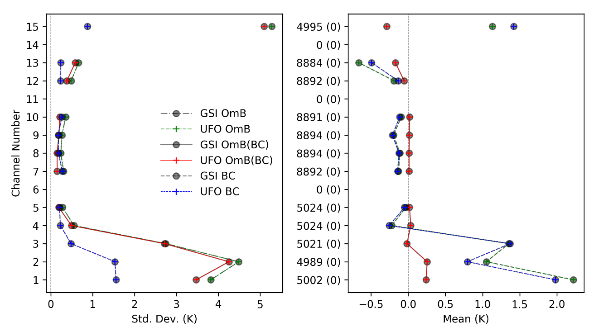
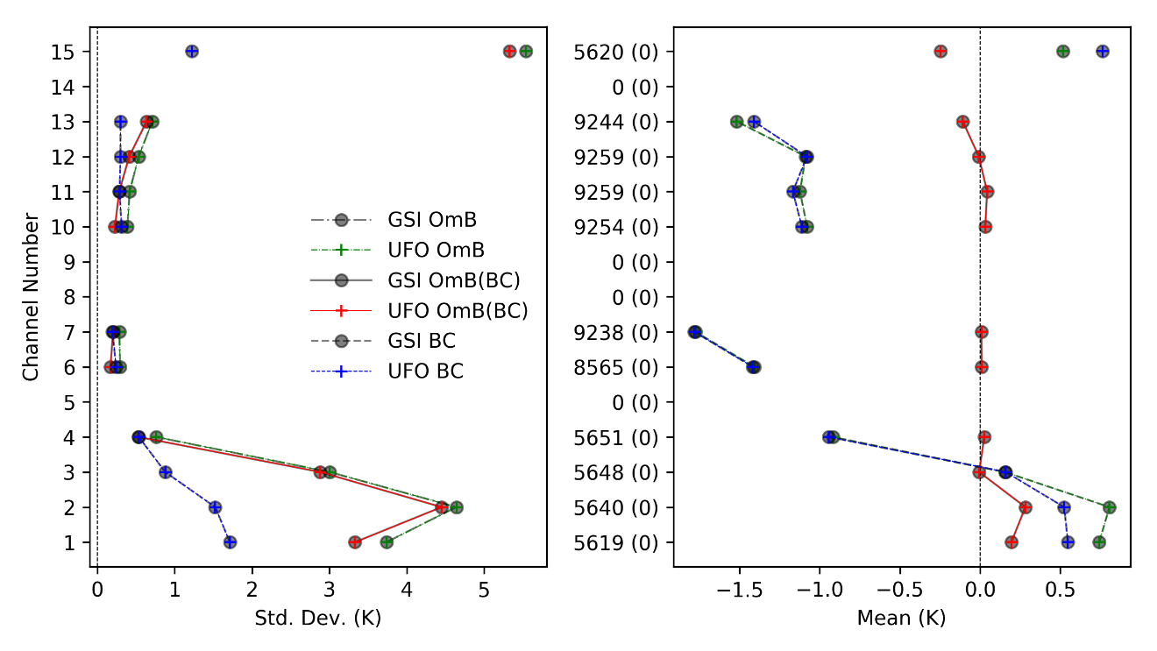
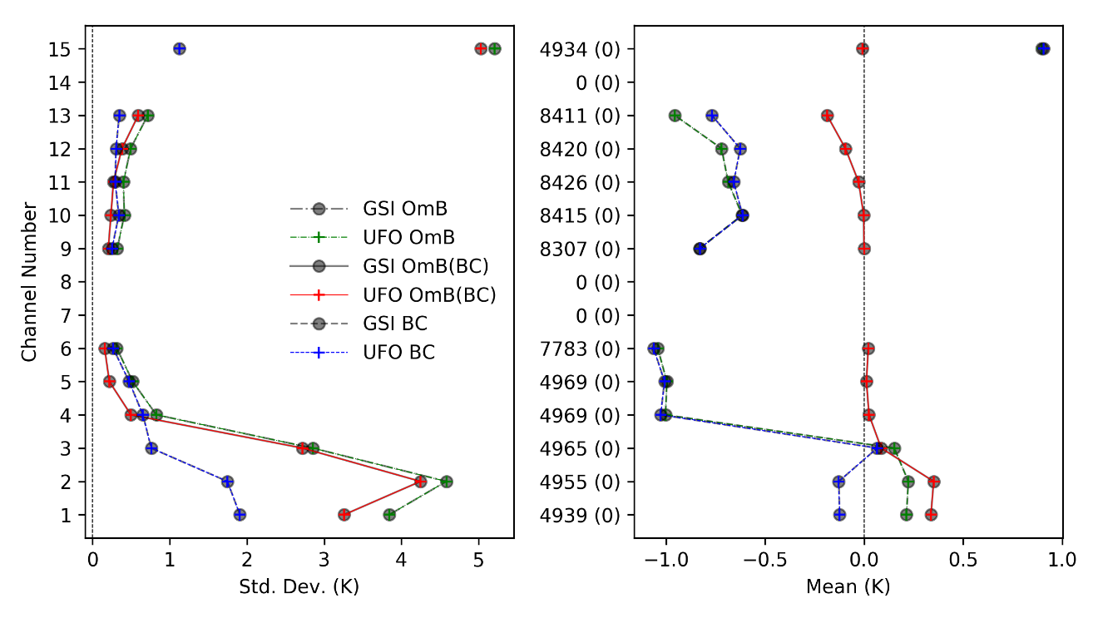
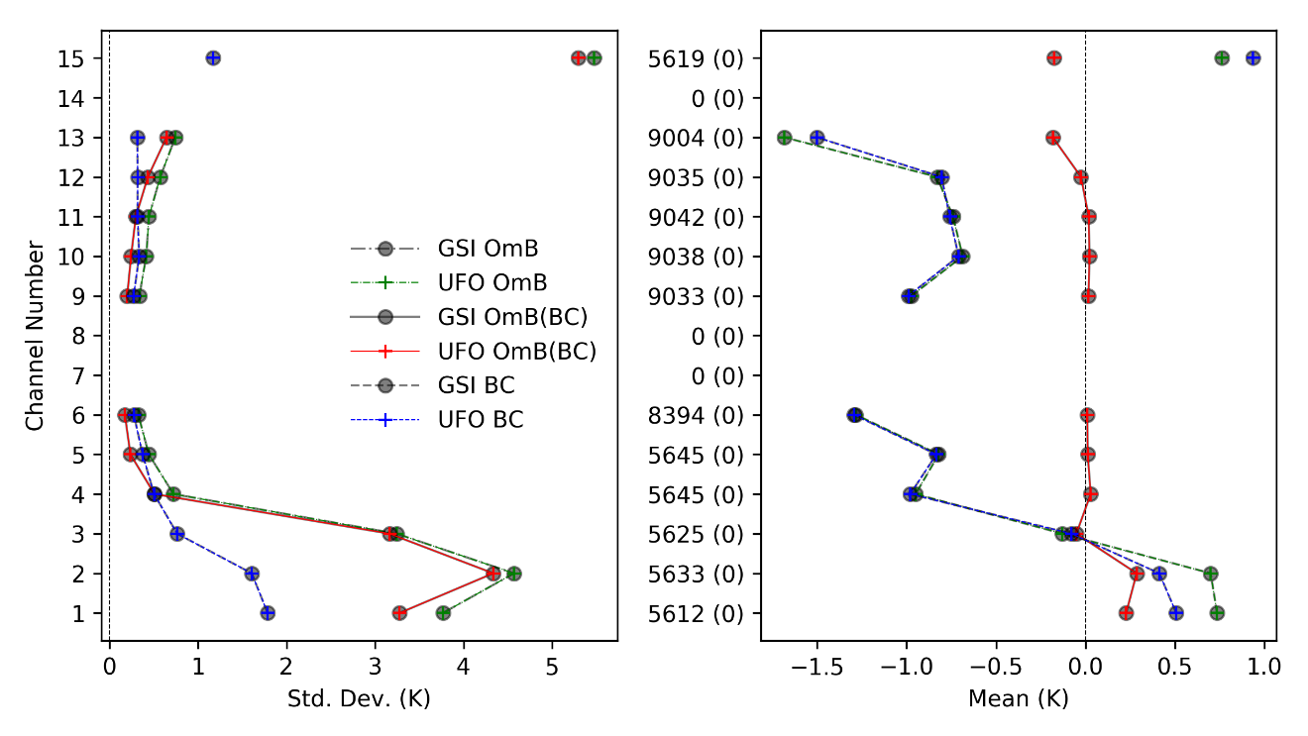
UFO Validation against GSI (ASMU-A)
NOAA-15
NOAA-18
Std. Dev.
Mean
GDAS operational platforms/sensors (~GFSv15.3) were tested by JCSDA for one cycle using EMC provided obs and geovals
Code/configurations are in github repo (develop)
NOAA-19
METOP-A
Figures from JCSDA OBS team (H. Shao et al.)
GSI and UFO values on top of each other
Obs # passed GSI QC
# difference between JEDI and GSI Qced observations

Slide 11
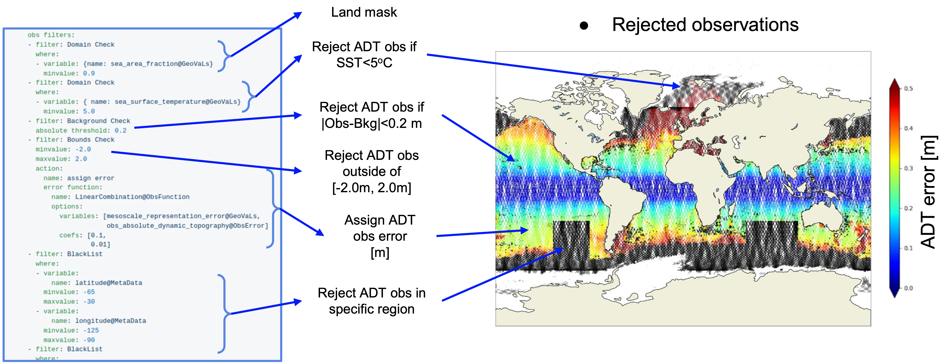
JEDI-GODAS: Observations
Generic Quality Control: No Coding!
Figures from SOCA team

Slide 12
JEDI-GODAS: Covariance Modeling
More in talk later in this session

Slide 13
JCSDA Workflow Requirements
Models
FV3-GFS / FV3-GEOS
MOM6 / SOCA
UFS
MPAS
Neptune
LFRic
…
Systems
HPC (NOAA, NASA, Navy, USAF, NCAR, Met Office…)
Cloud (AWS, …)
Workstations, laptops (Linux, OSX)
Workflow engines
ecFlow
Cylc
Airflow…
In addition to all normal operational and research requirements

Slide 14
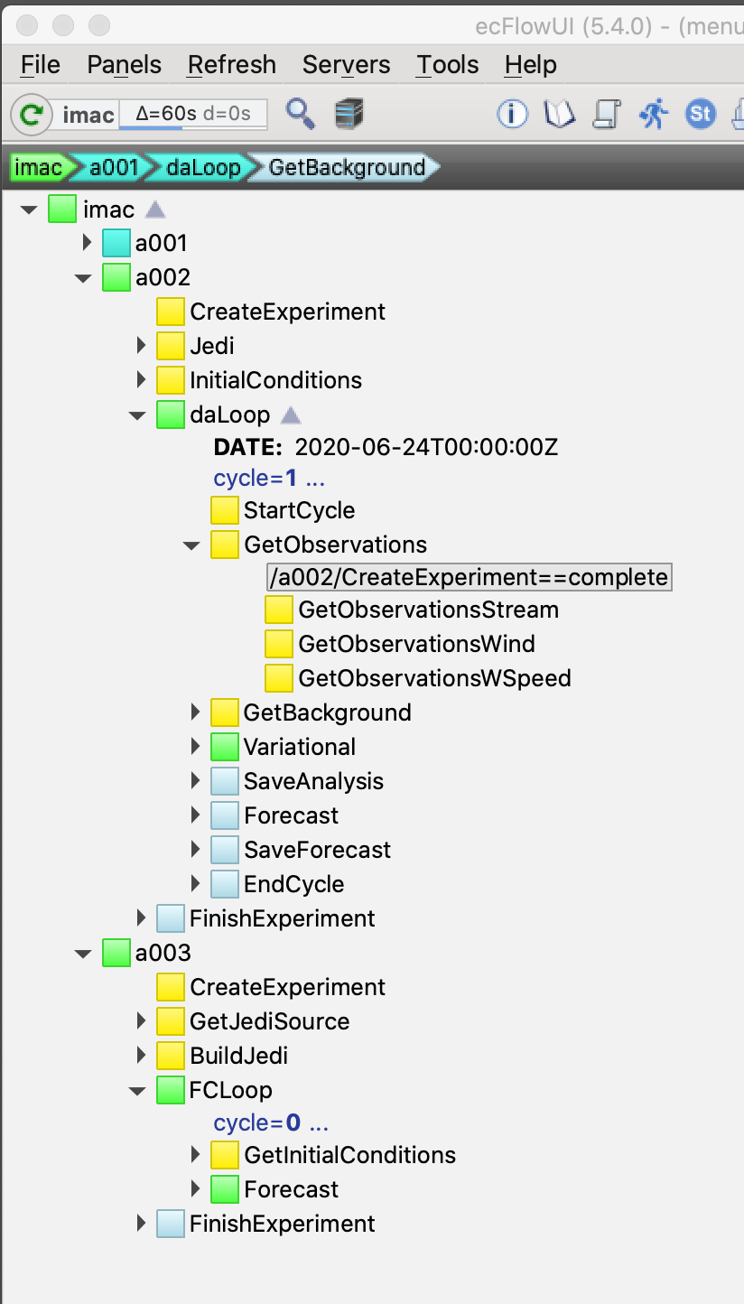
EWOK + R2D2
EWOK provides generic tools to describe suites = abstract algorithms (same concepts as OOPS/JEDI).
Tasks are generic, with model specific implementations only when required (same concepts as OOPS/JEDI).
Given specific parameters (experiment configuration) a suite is generated for a target model (UFS, GEOS), workflow engine (ecflow, cylc) and machine (Orion, Discover).
Data access is a major obstacle to portability and genericity,
R2D2 abstracts storage from the workflow:
Data is managed and accessed by key/values (not path or filename).
Easy access for experiments (HPC, cloud) and diagnostics (desktop, cloud).
It can store/fetch data in the cloud (S3) and locally, or a combination of both (local data store first, then remote).
Cycling
QG 4D-Var
FV3-JEDI
forecasts

Slide 15
Generic Diagnostics
Output of EWOK experiments are stored in R2D2 on AWS:
Jupyter notebooks for interactive diagnostics
Immerse scientists into the data
Collective scientific diagnostics and inter-comparisons
Easy interfacing with ML tools (SageMaker…)

Slide 16
Final Comments
JEDI is becoming more mature:
“H(x)” computed in near real time for monitoring
The system will evolve in non-cycling, then cycled data assimilation applications with more models
Next steps:
Environment for running and managing experiments (HPC and cloud)
Cloud-based interactive diagnostic tools
Scientific validation (operational-grade cycling experiments)
Coupled DA (Coupled H(x), Coupled B, Coupled algorithms)
Investigate integration of AI/ML

