Slide 1
OLCI total column water vapour UFO in JEDI
Roger Saunders
Met Office Fellow

Slide 2
Rationale:
NWP models only assimilate a limited amount of water vapour information at low levels over land areas:
Radiosondes (sparse global coverage)
GNSS total zenith delay (only over Europe and US at present)
Aircraft profiles of humidity (E-AMDAR) limited over Europe and US, and recently declined
Geostationary Imager 7.3µm channel radiances

Slide 3
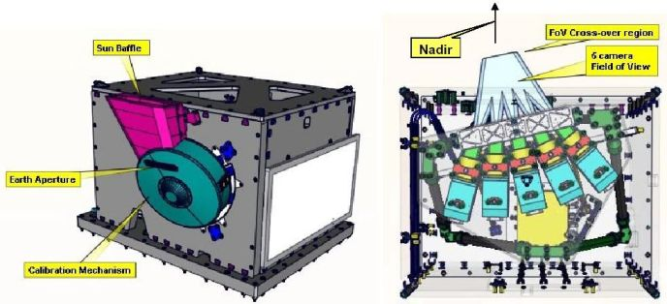
Ocean and Land Colour Imager
OLCI = Ocean and Land Colour Imager
21 channels in wavelength range 400-1020 nm
Total column water vapour retrieved from reflected radiances from surface in 885 and 900 nm channels. Plan to use more channels.
Also measures cloud top pressure.
Products only over clear areas during daylight
Data received in NRT via EUMETCAST

Slide 4
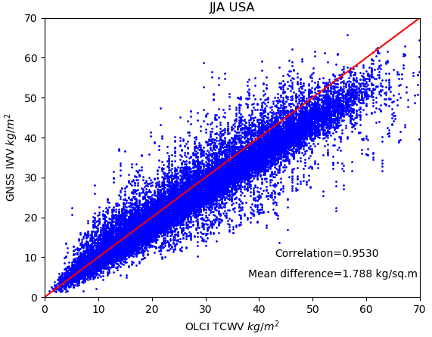
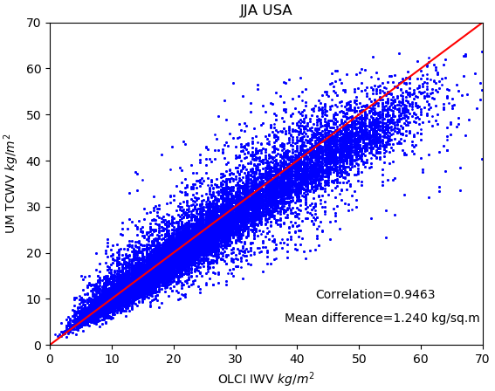
OLCI TCWV vs GB-GNSS and Model
GNSS sites
GNSS ZTD comparison
UKMO Model comparison
OLCI TCWV values show a moist bias for high
total column amounts, this is being fixed in a new version of retrieval.

Slide 5
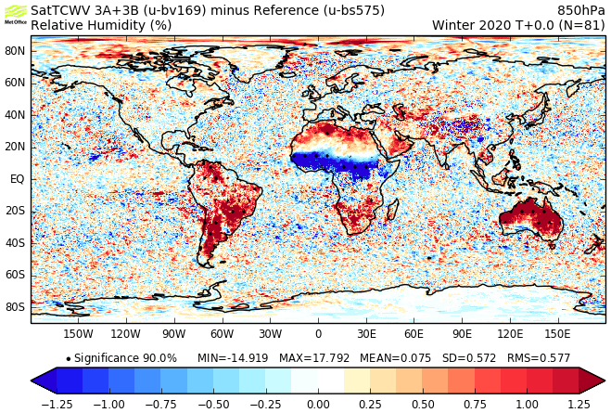
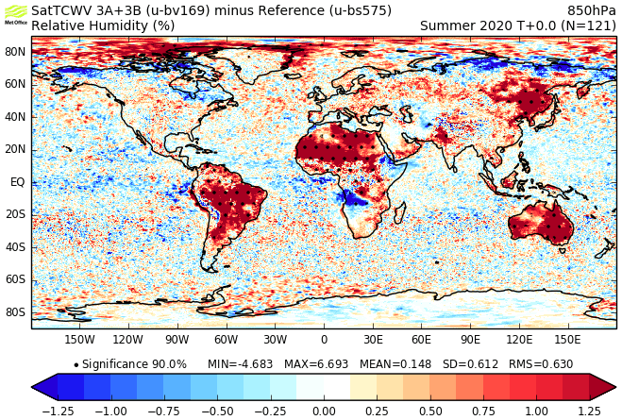
Changes made to the model water vapour at 850 hPa after TCWV assimilation
FebMar
JunJul
Reduced q
Increased q

Slide 6
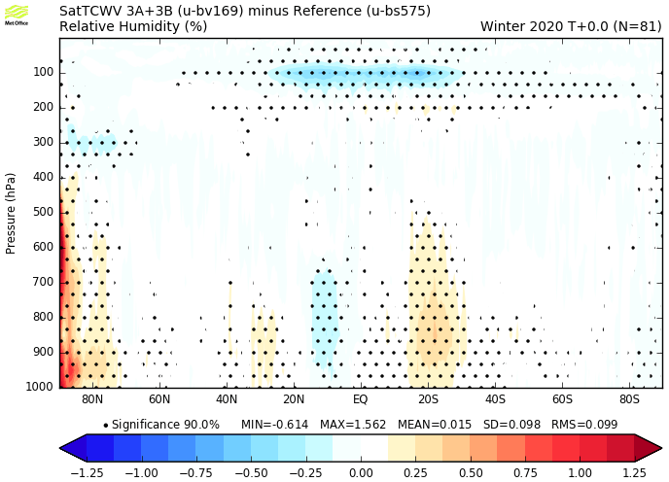
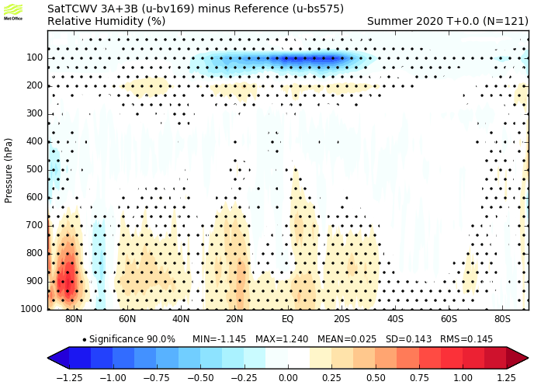
Changes made to the model water vapour after TCWV assimilation
FebMar
JunJul
Increased q
Increased q
Reduced q
Reduced q

