Slide 1
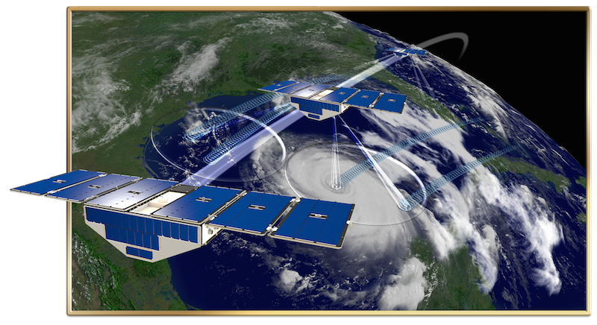
Assessing impacts of CYGNSS data on predicting
landfalling hurricanes with NCEP HWRF model
and GSI-based 3DEnVar system
Zhaoxia Pu, Xin Li, Ying Wang
University of Utah
Chris Ruf
University of Michigan
Li Bi and Avichal Mehra
NCEP/EMC
Contact: Zhaoxia.Pu@utah.edu
CYGNSS = Cyclone Global Navigation Satellite System
18th JCSDA Annual Technical Review Meeting

Slide 2
CYGNSS vs. ASCAT
Compared with ASCAT data, CYGNSS satellite data assimilation leads to equally positive impacts on HWRF hurricane forecasts (e.g., Track, intensity, and structure).

Slide 3
Evaluation of CYGNSS V3.0 vs. V2.1 Ocean surface Winds
The optimal thinning distances and error variances for two versions of the data are different for obtaining better data assimilation results.
With proper thinning distance and error variances, both CYGNSS V2.1 and V3.0 data can lead to improved hurricane forecasts. However, their relative impacts are complicated.

