Slide 1
Recent Developments in
CRTM Aerosol Simulations
Cheng Dang*, Patrick Stegmann, Benjamin Johnson (JCSDA/NOAA)
Yingtao Ma, Quanhua Mark Liu (NOAA/JCSDA)
Cheng-Hsuan Sarah Lu, Shih-Wei Wei (JCSDA/University at Albany, SUNY)
Jeff Reid, Xian Peng (Naval Research Laboratory)
*Presenting | dangch@ucar.edu

Slide 2
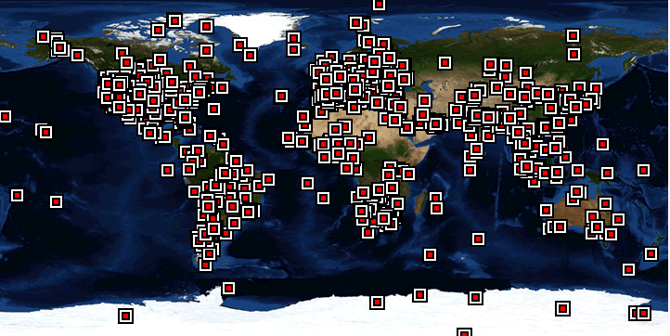
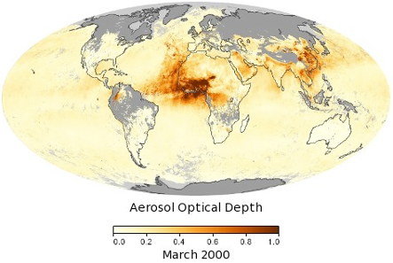
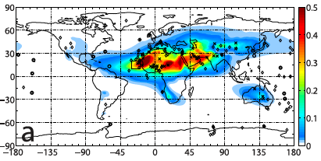
Motivations
AERONET sites
MODIS
CESM
Dust AOD (Figure 4, Kok et al, 2014)
Model State
Observations
(Liu et al., 2011)
Data Assimilation
Estimate the optimal atmospheric states
Observation Operator
Community Radiative Transfer Model (CRTM)

Slide 3
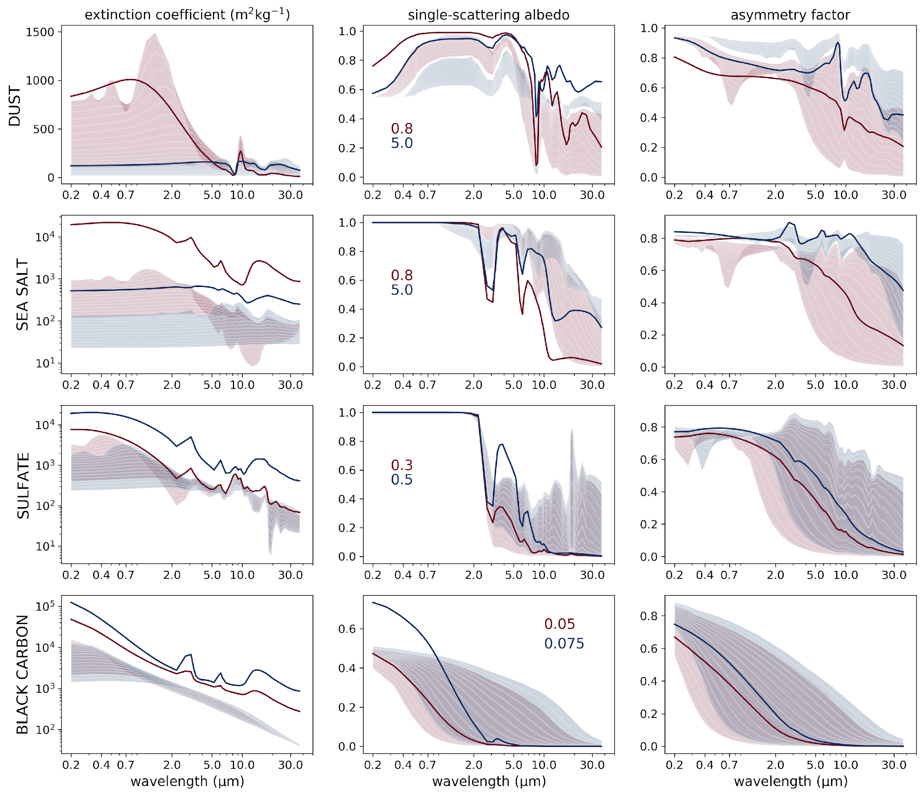
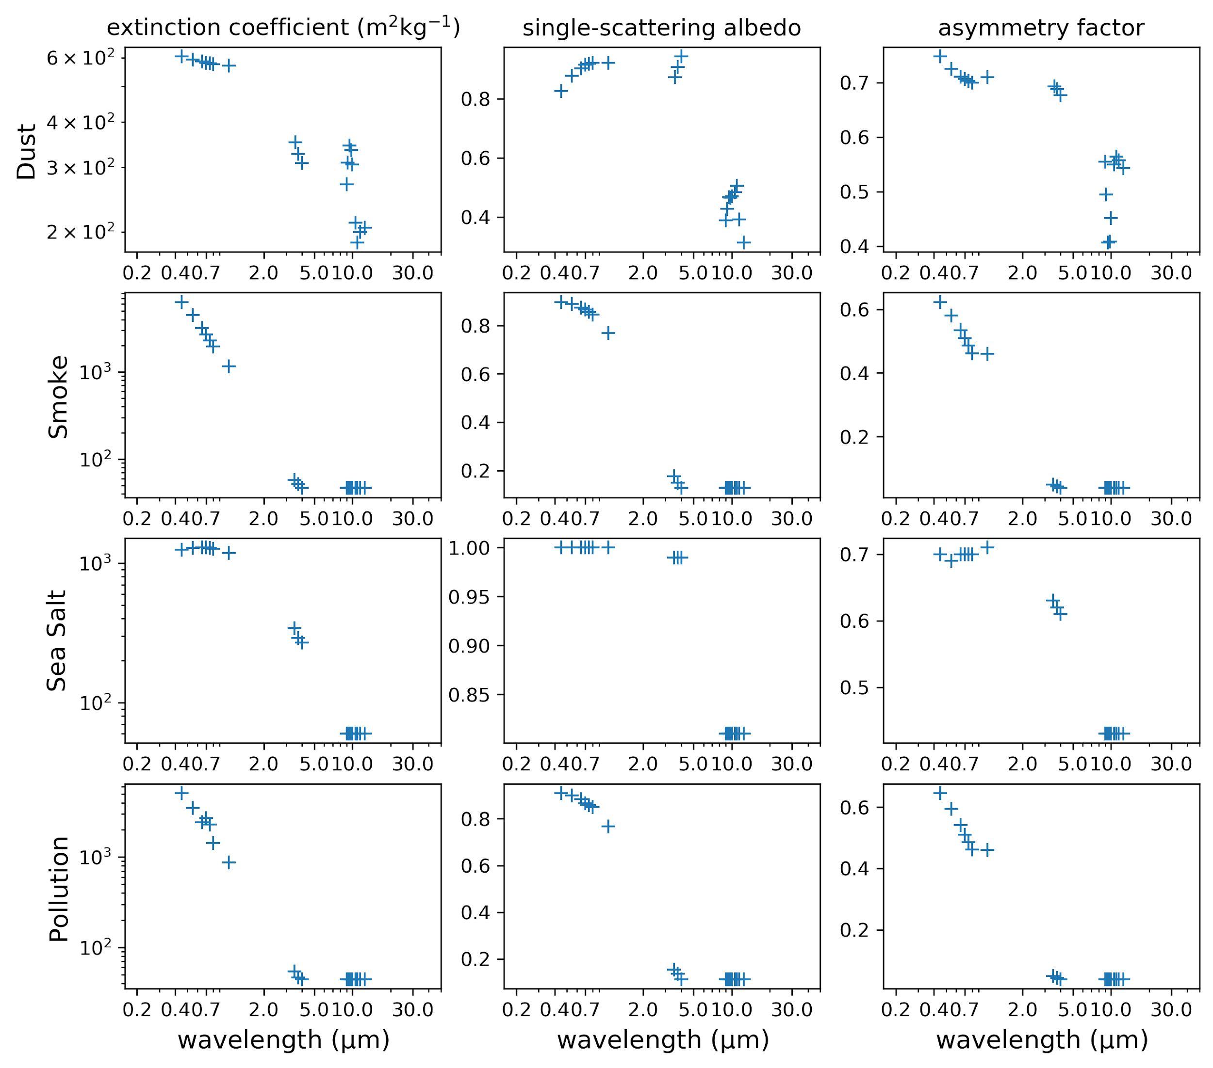
CRTM Aerosol Updates
Version 2.4
https://www.jcsda.org/crtm-release
Sensor information
Default
CMAQ
GOCART-GEOS5
NAAPS
Given aerosol profiles
CRTM_Init( SENSOR_ID, &
chinfo, &
Aerosol_Model, &
AerosolCoeff_Format)
Binary I/O
Requested CRTM calculation
Net CDF I/O
Default vs. CMAQ
Default vs. GOCART-GEOS5
NAAPS
[Pink to green] the default LUT with increasing radius
[Dashed] GOCART-GEOS5
[Red to blue] GOCART-GEOS5 LUT with increasing relative humidity
[Curves] the default LUT
[Shade] CMAQ LUT with the similar effective radii but different size variances

Slide 4
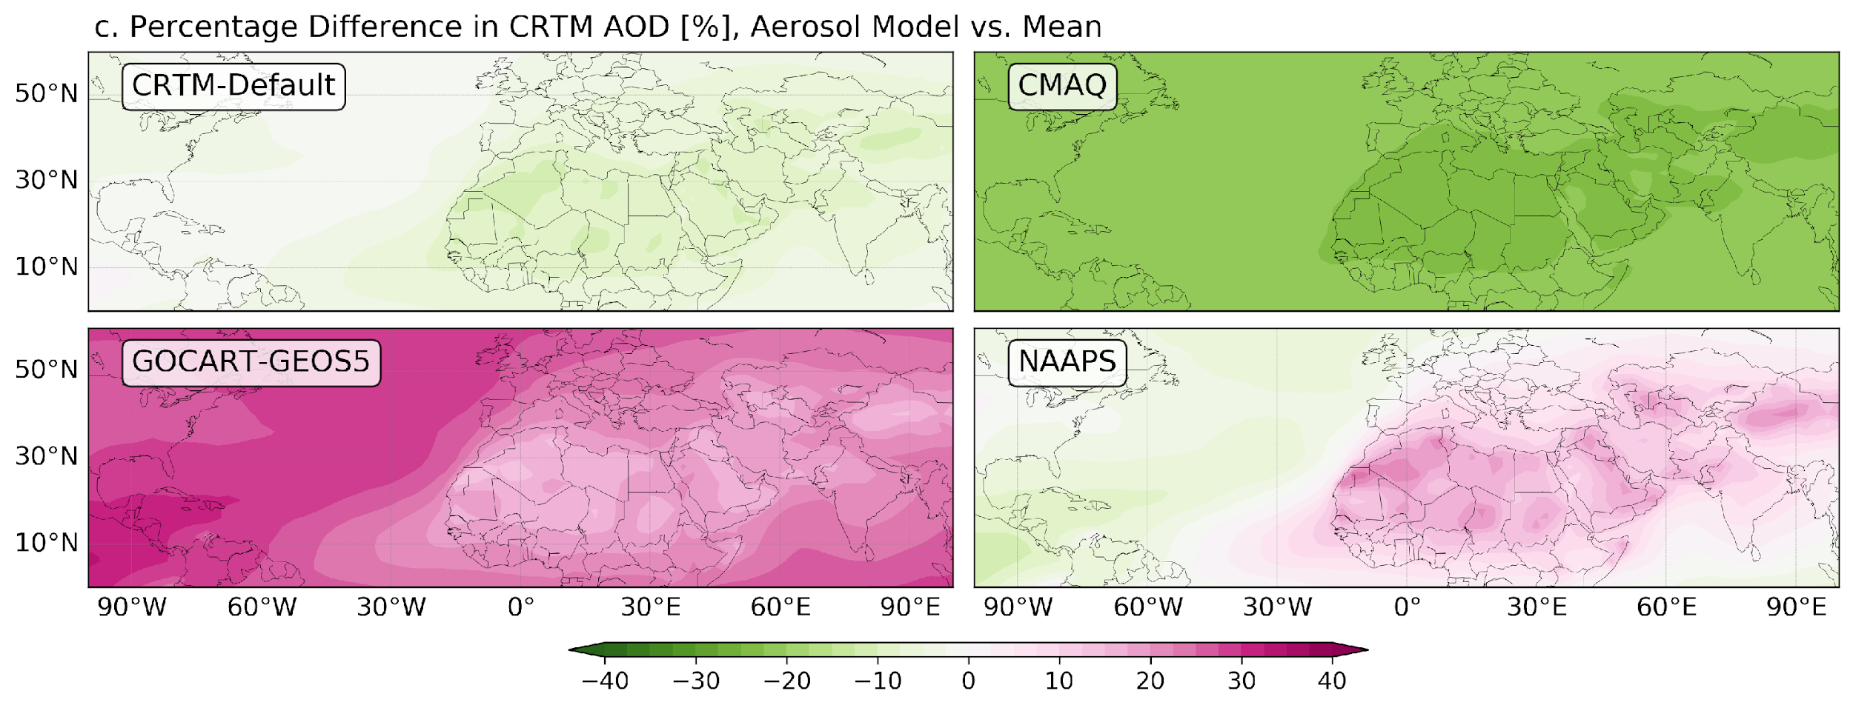
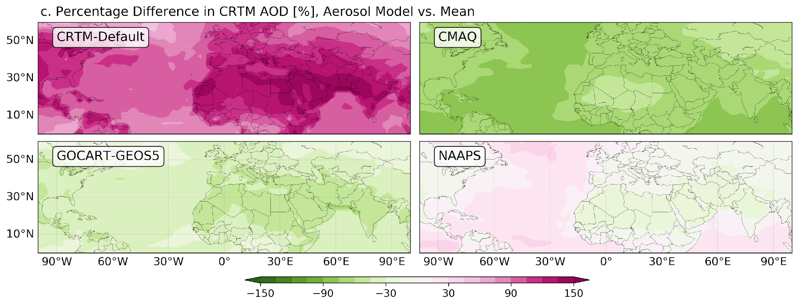
Aerosol Optical Depth
Dust
Sea Salt
Figure a. Column total aerosol concentration of May (MERRA-2 climatology data courtesy of Dr. Cheng-Hsuan (Sarah) Lu and Dr. Arlindo M da Silva) and Figure b. the corresponding AOD simulated using CRTM, averaged over four aerosol schemes. Figure c. shows the percentage differences in AOD computed using each aerosol scheme currently available in a CRTM developing version.
Notes:
‹#›

