Slide 1
An Overview of the CRTM Transmittance Regression Process
Patrick Stegmann*, Cheng Dang, Benjamin Johnson
* Presenter
18th JCSDA Technical Review Meeting and Science Workshop
June 10, 2021

Slide 2
Acknowledgement
Invaluable contributions have been made by members of NASA GMAO and EMC:
Isaac Moradi
Bryan Karpowicz
Will McCarty
Liu Haixia
Liu Quanhua
Jim Rosinski

Slide 3
Purpose of the Transmittance Coefficient Package
Enable CRTM expert-level users to integrate and test their own instruments.
Enable further development and improvement of the CRTM transmittance algorithms by the CRTM team.
Simplify the Coefficient Generation Workflow.
Transform the package into open source software.

Slide 4
Gaseous Transmittance in the CRTM

Slide 5
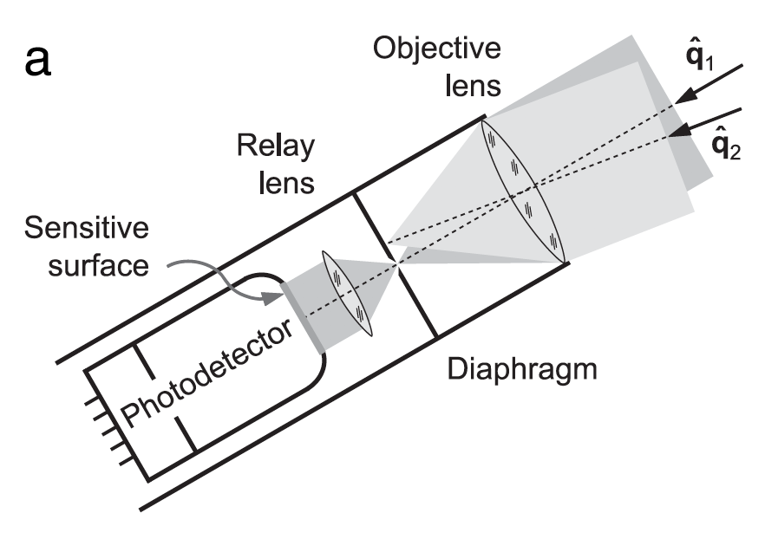
Why do we need Instrument Coefficients? 1. Instrument Effective Transmittance
Satellite instruments are well-collimated radiometers. They apply a measurement principle to transform radiance into power. This the instrument needs to integrate over a finite frequency bandwidth.
Diagram by M. Mishchenko

Slide 6
Why do we need Instrument Coefficients? 2. Theoretical Background
The CRTM Emissivity Radiative Transfer solver finds an approximate solution to the Schwarzschild Equation:
Solving this integral equation requires knowledge of the spectral transmittance:

Slide 7
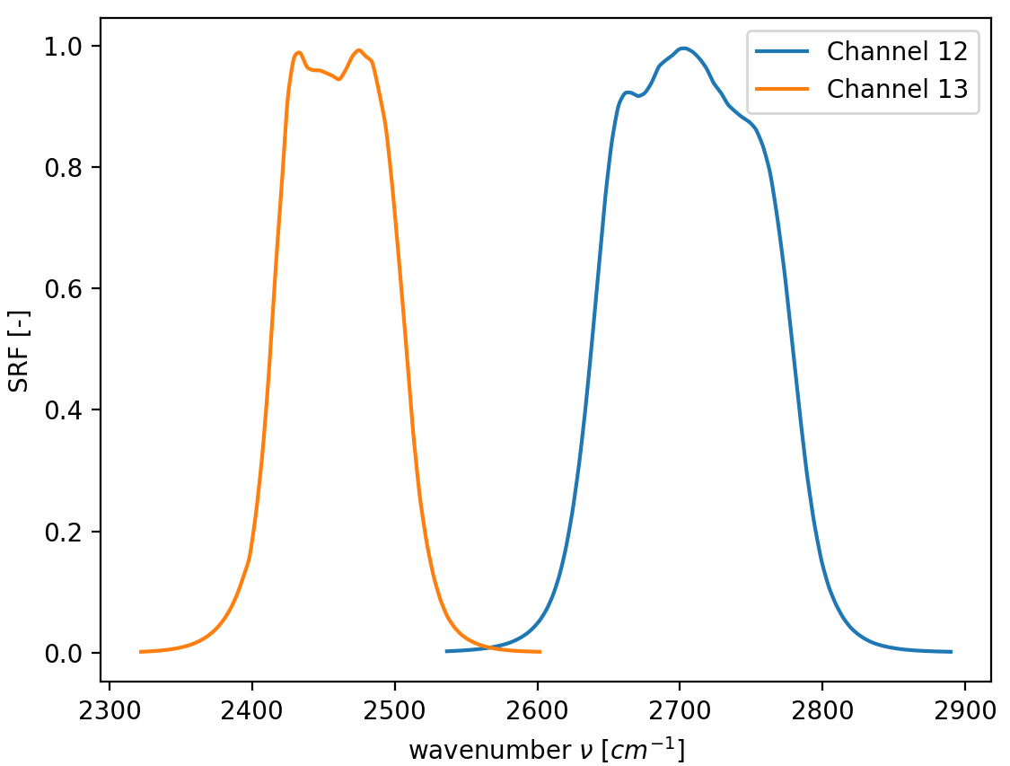
SRF Example VIIRS-M NPP Channels 12 & 13.
A smooth, integrable
function defined over a moderate spectral range.

Slide 8
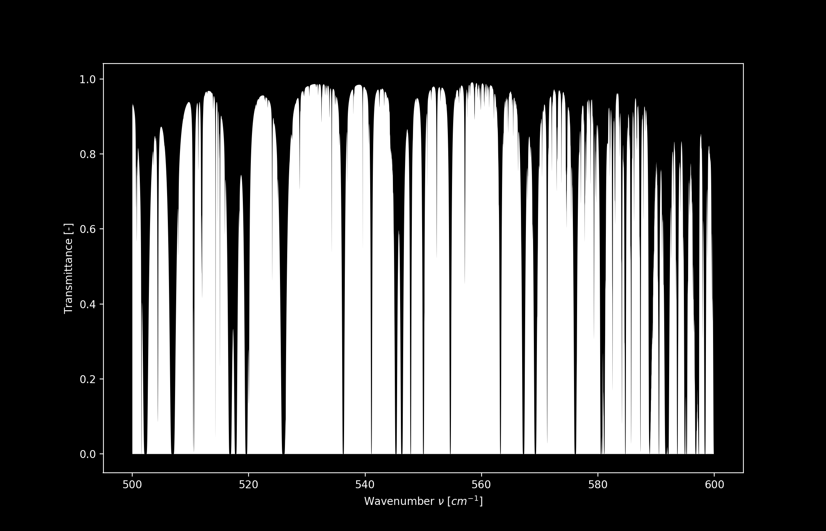
The Monochromatic Transmittance

Slide 9
Coefficient Generation Overview

Slide 10
CRTM Regression High Level Process Overview
The CRTM transmittance coefficient generation process is conceptually easy and straightforward.
Optical Depth in Absorber Space
(ODAS)
Generate Synthetic Transmittance Data Set
Convolve Transmittance with Instrument SRF
Fit Data with Regression
Optical Depth in Pressure Space
(ODPS)

Slide 11
Coefficient Generation Flowchart
Instrument Type
MW
IR
VIS / UV
monoRTM
Rosenkranz03
„Moderate Resolution“
Fourier Spectrometer
LBLRTM
SRF Convolution
LBLRTM
LBLRTM
SRF Convolution
SRF Convolution
Apodization
ODPS
ODAS
ODPS
ODPS

Slide 12
Microwave Computations

Slide 13
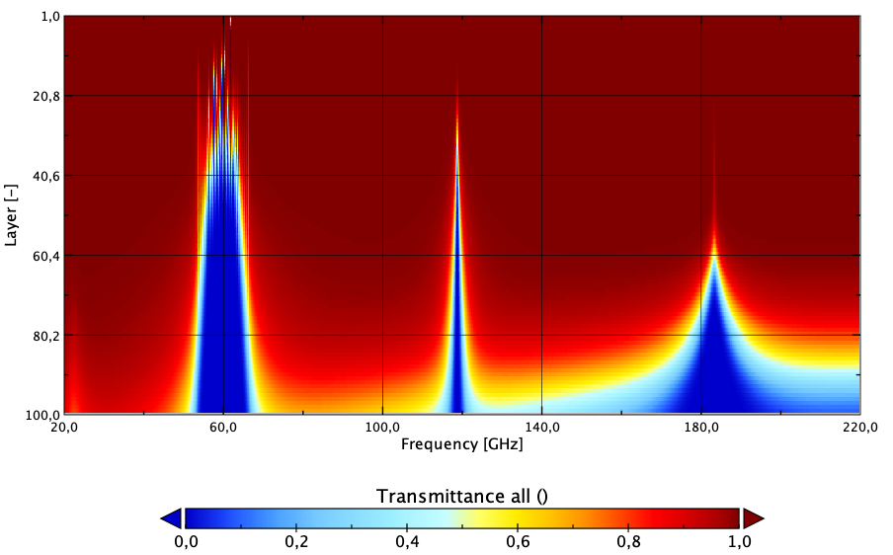
Monochromatic Microwave Transmittance (1)
Total monochromatic layer-to-space transmittance from Rosenkranz03 model in the Microwave region.

Slide 14
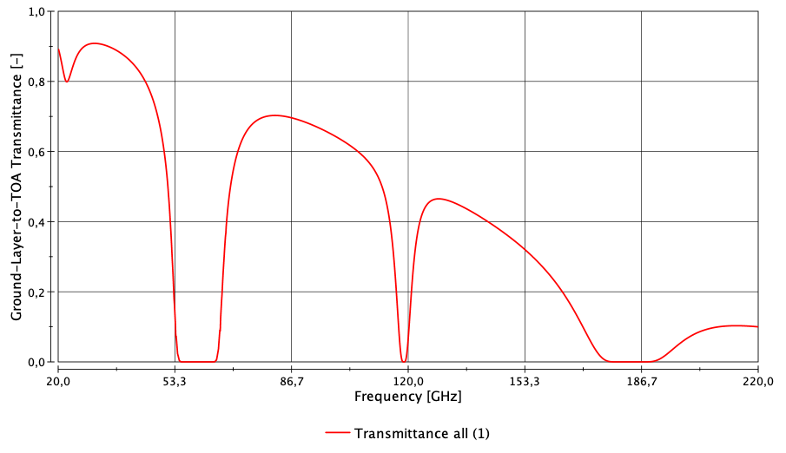
Monochromatic Microwave Transmittance (2)
H₂O
Total monochromatic ground-to-space transmittance in the Microwave region from Rosenkranz03 model.
Oxygen
Oxygen
Ground => TOA
H₂O

Slide 15
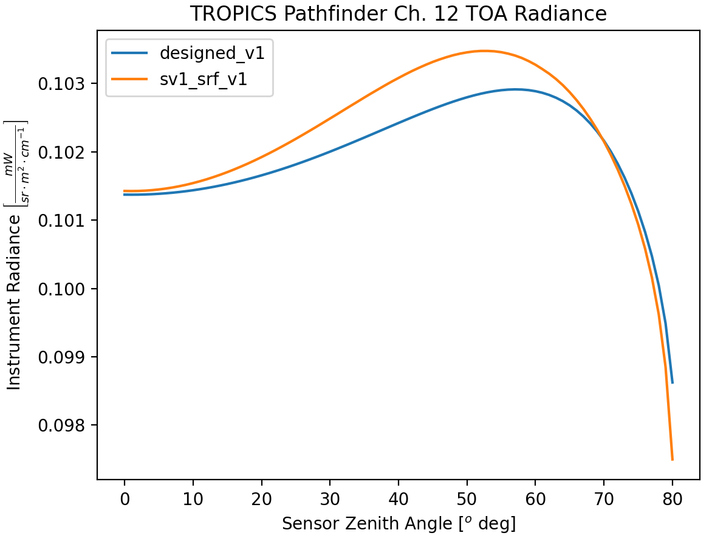
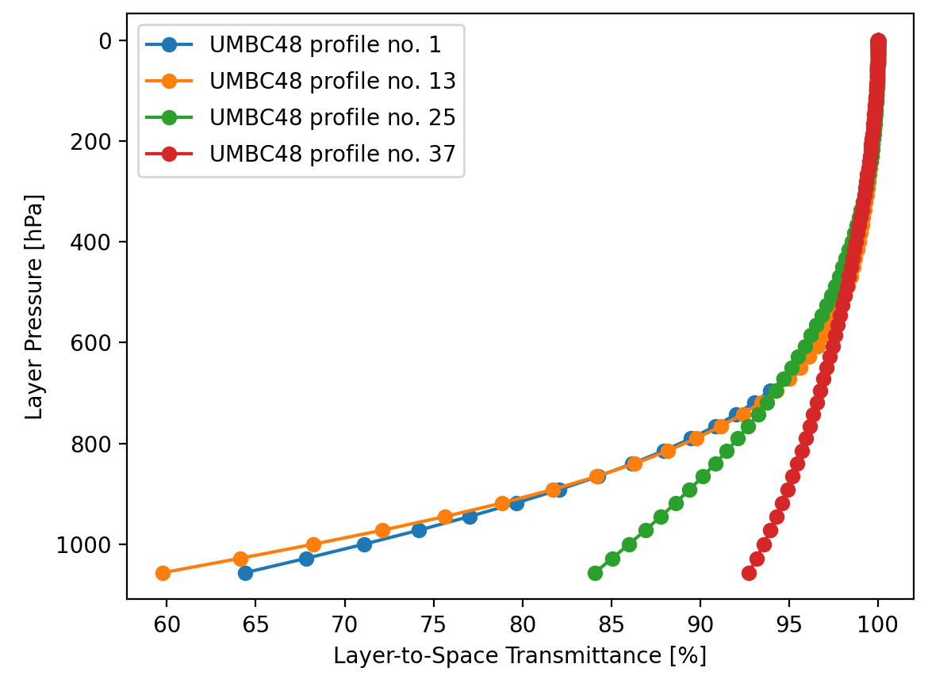
Example Results: TROPICS Pathfinder (1)
Fig. 1: TROPICS Channel 12 Angular Dependence of TOA Radiance.
Fig. 2: TROPICS Channel 1 Layer-to-space transmittance.

Slide 16
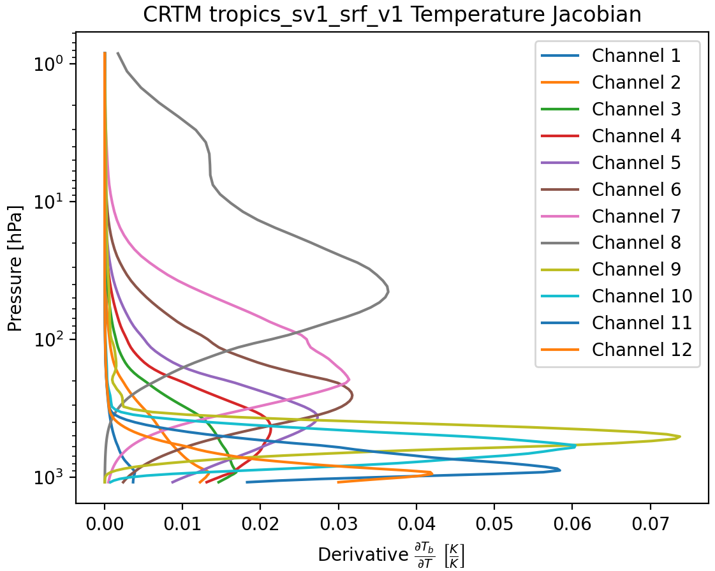
Example Results: TROPICS Pathfinder (2)

Slide 17
The IR Process, Step by Step
Part 1: Generating the Predictands

Slide 18
CRTM Coefficient Training Process in more Detail:
HITRAN Spectroscopy
Line-by-Line Step
Regression Models
ODPS
ODAS
IR & VIS
TAPE5
LBLRTM
LNFL
Channel Effective Transmittance
Regression Coefficients
TAPE3
MW
MonoRTM
TAPE20
TAPE5
Liebe-95 / Rosenkranz-03 .F90
Layer-to-Space Transmittance
Atmospheric Training Profiles (ECMWF83)
Satellite Channel Sensor Response Function (SRF)
Data Preparation Step

Slide 19
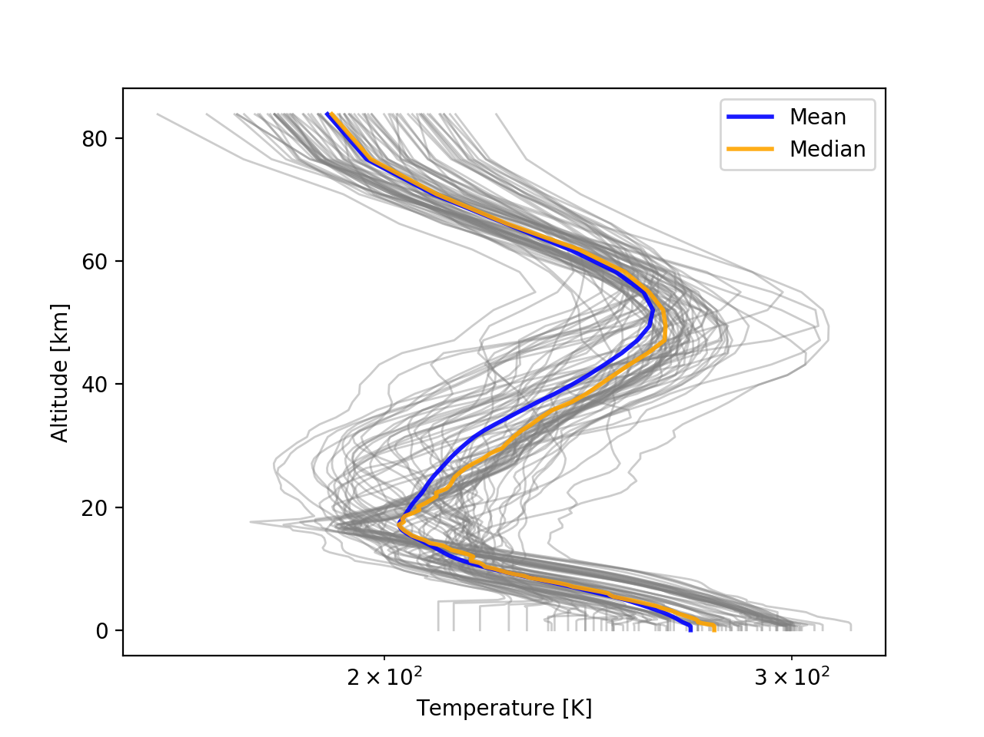
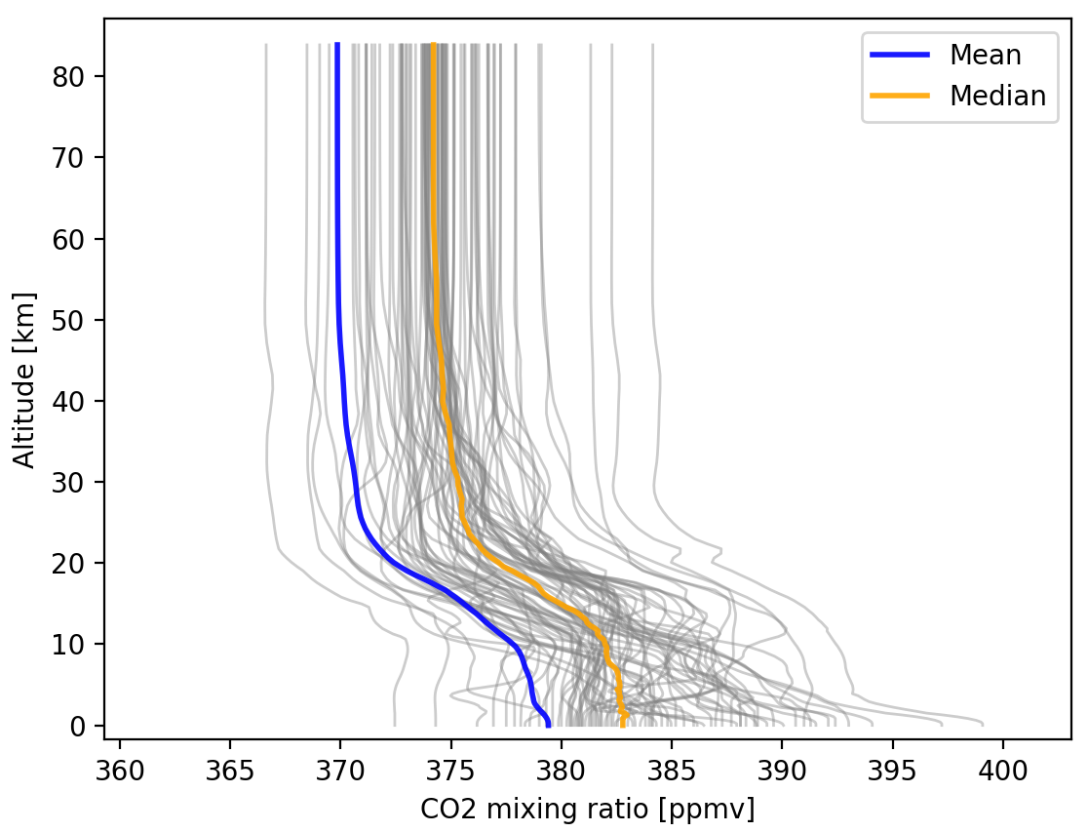
Predictor Training Profile Set (ECMWF83)

Slide 20
Atmosphere Profile Layering Scheme
Level 0
Layer 1
Level 1
Level i-1
Layer i
Level i
Altitude
Level N-1
Layer N
Level N

Slide 21
Atmosphere Profile Layering Scheme
Example: AIRS science team level pressure definition (101 levels):
Layer pressure definition:

Slide 22
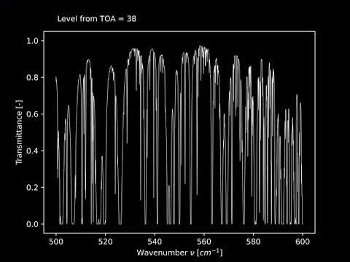

Slide 23
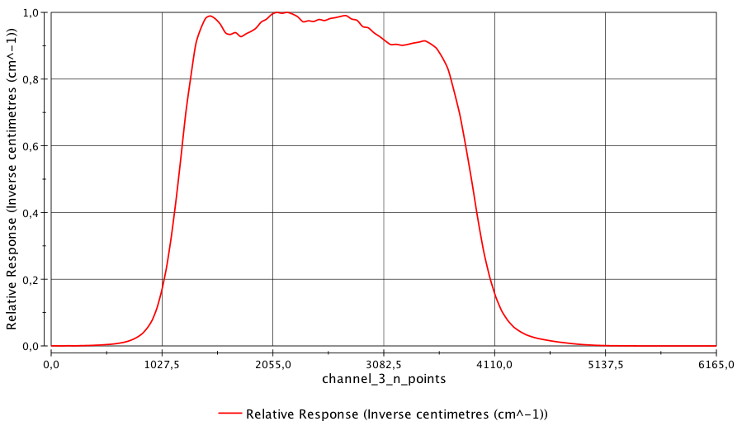
SRF Example: AVHRR3-NOAA19, Channel 3

Slide 24
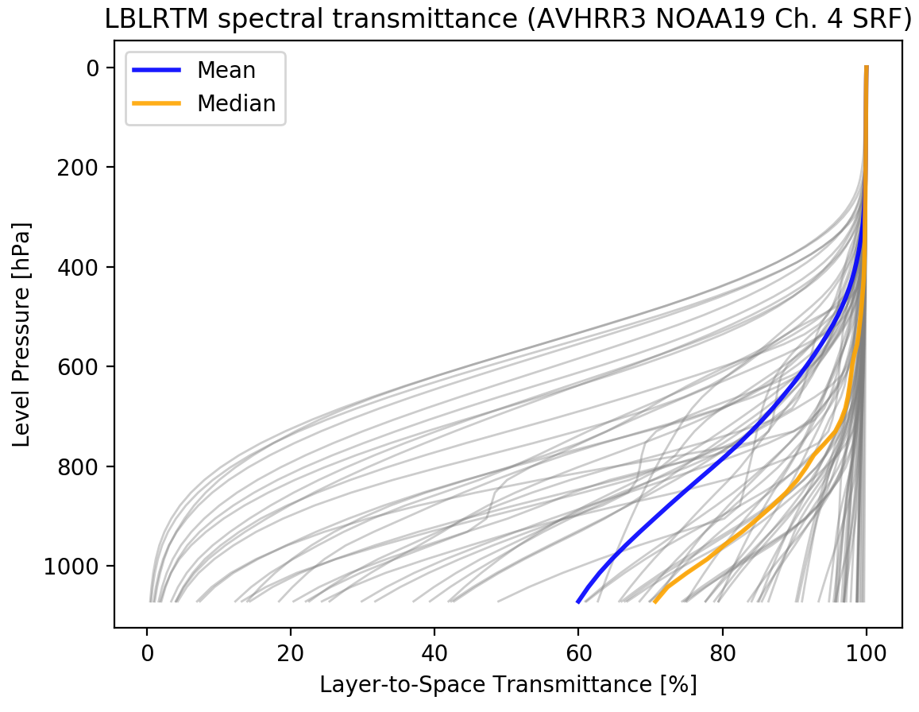
LBLRTM Spectral Layer-to-Space Transmittance

Slide 25
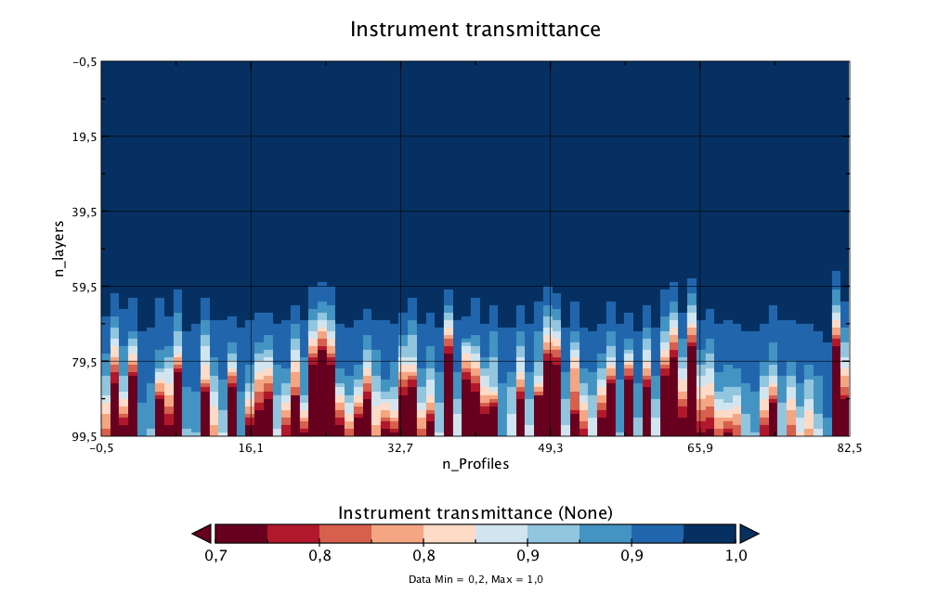

Slide 26
The IR Process, Step by Step
Part 2: Spectrometers

Slide 27
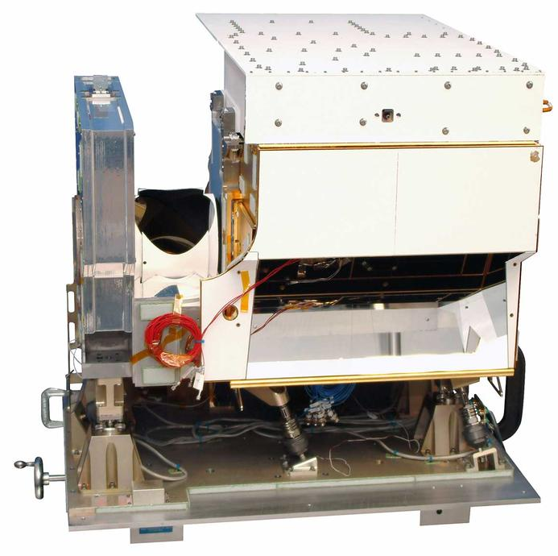
Apodization for Spectrometers (IASI, CrIS)
Fourier-transform spectrometers measure interferograms and in the CRTM the Convolution Step is not applied to them. Instead, the transmittance spectra are apodized with an Apodization Function. The intensity detected by the interferometer for a single frequency is a function of the optical delay p:
The total detected intensity is the integral over all frequencies:
CrIS instrument

Slide 28
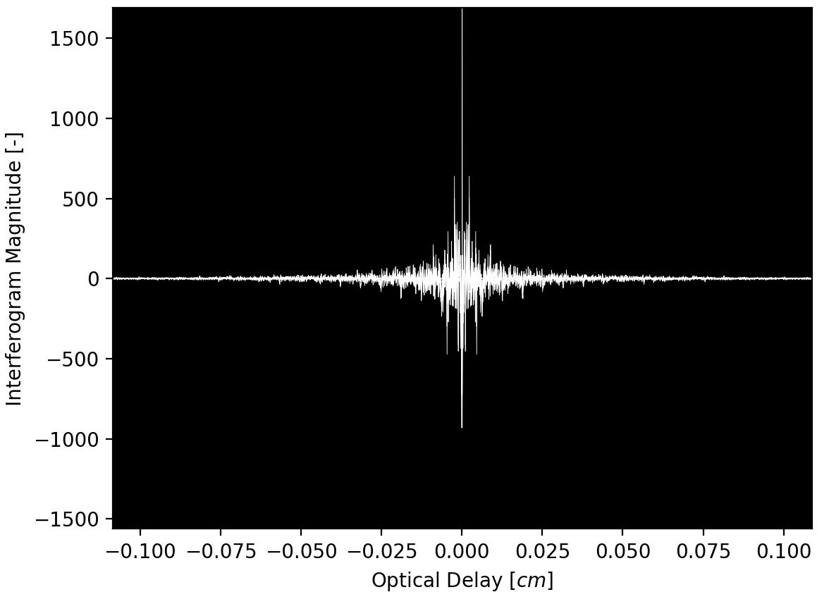
Apodization in Fourier Space for Interferometers

Slide 29
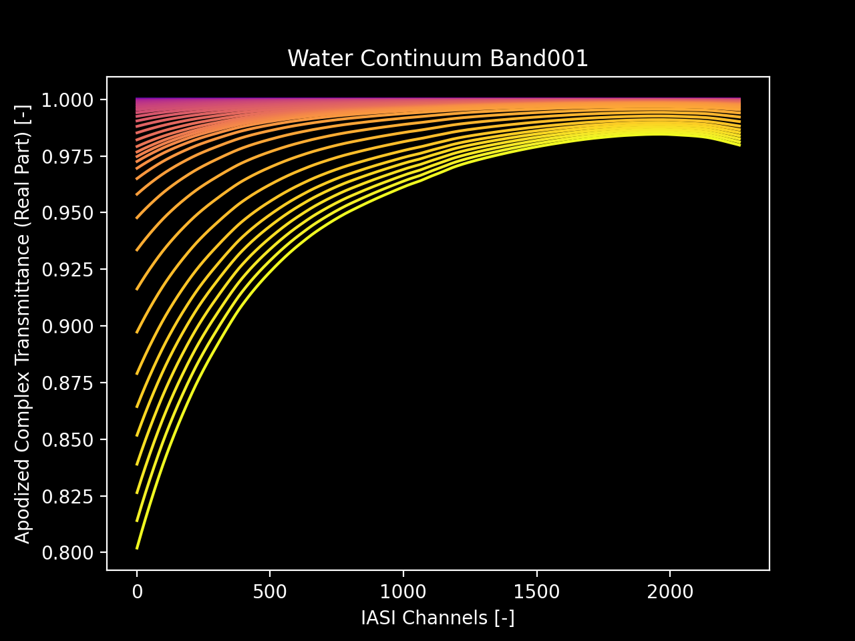
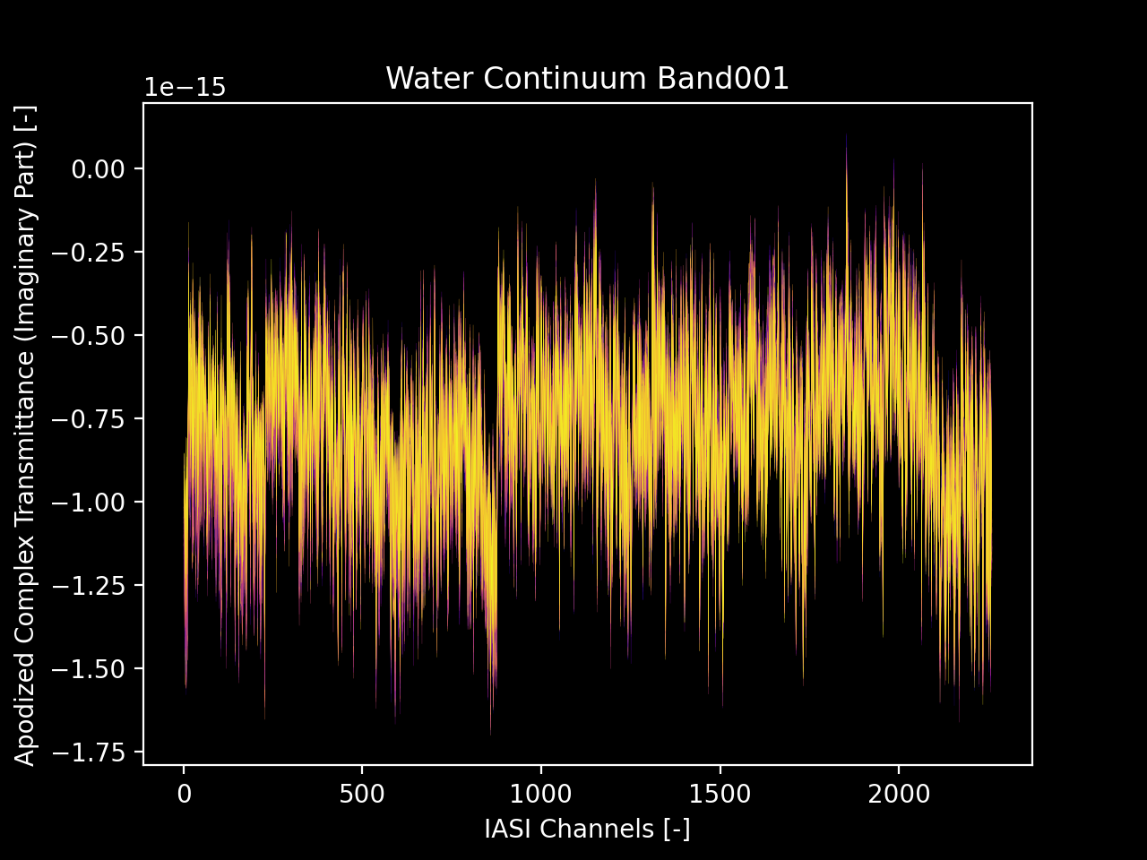
Apodized Transmittance for IASI
Real Part
Imaginary Part

Slide 30
Preliminary CRTM Brightness Temperatures for IASI-NG

Slide 31
The IR Process, Step by Step
Part 3: Performing the Regression

Slide 32
Gaseous Transmittance Model 1 (AtmAbsorption) Compact OPTRAN (ODAS)
Polynomial Regression:
TOA
Level 0
A₀
Level 1
A₀
with:
Level N-1
A_{n-1}
Effective layer transmittance:
Level N
A_{n}
Surface
Integrated Absorber Amount:
+ Low memory requirement
+ Smooth Jacobians constraint
Only H₂O and O₃ as variables absorbers
No atmospheric refraction

Slide 33
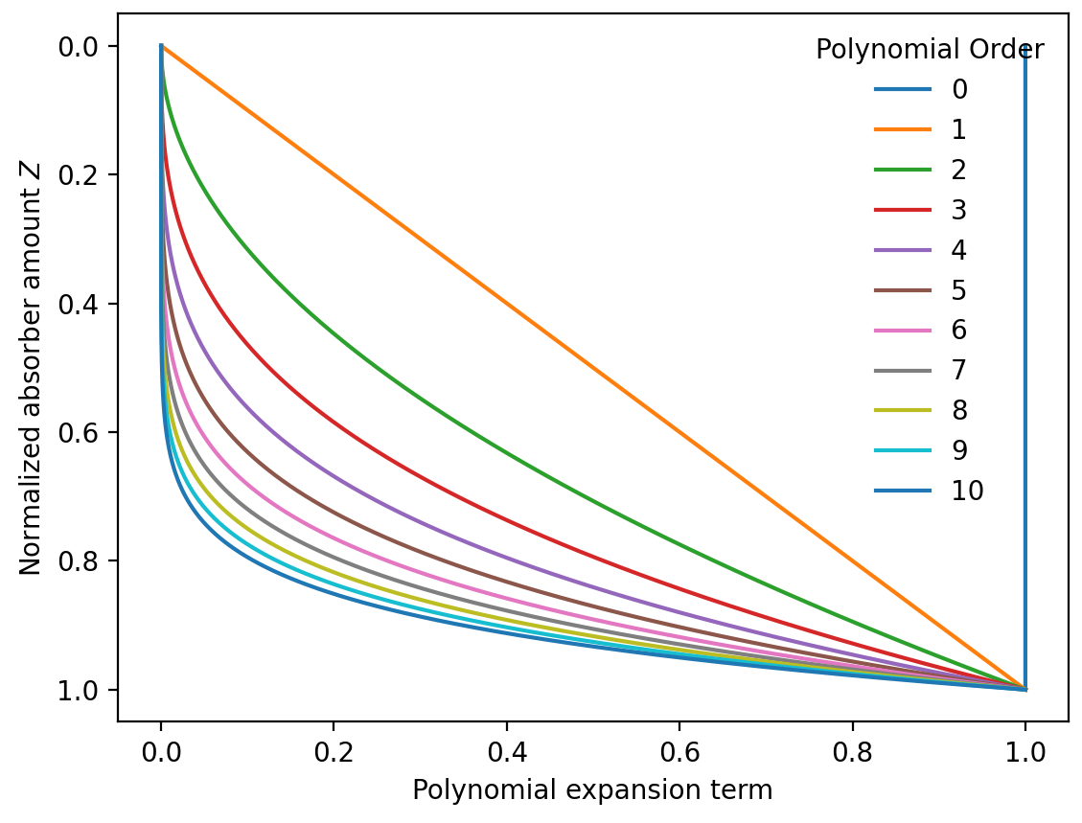
ODAS Polynomial Constraints
The graph to the left illustrates the polynomial regression equations from the previous slides. As mentioned in the original publication the expansion polynomials are a function of the normalized cumulative absorber amount Z, with 0 < Z < 1.

Slide 34
Gaseous Transmittance Model 2 (AtmAbsorption) ODPS (Optical Depth in Pressure Space)
Simple Linear Regression on the Pressure Grid:
Variable gases H₂O, CO₂, and Ozone
More absorbers for hyperspectral instruments
Water-line absorption can be computed using ODAS

Slide 35
Comparison ODAS / ODPS
Property | ODAS | ODPS
No. of Absorbers | 2 (H₂O & O₃) | 3 to 6
Atmospheric Refraction | no | yes
Pressure Grid | no | yes
Visible Instruments | yes | no
Smooth Jacobians | yes | no

Slide 36
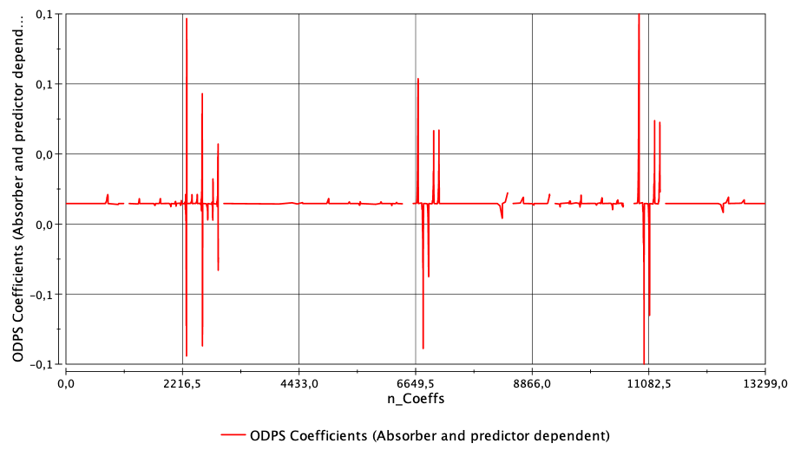
Check ODPS coefficient output. (AVHRR3N19)

Slide 37
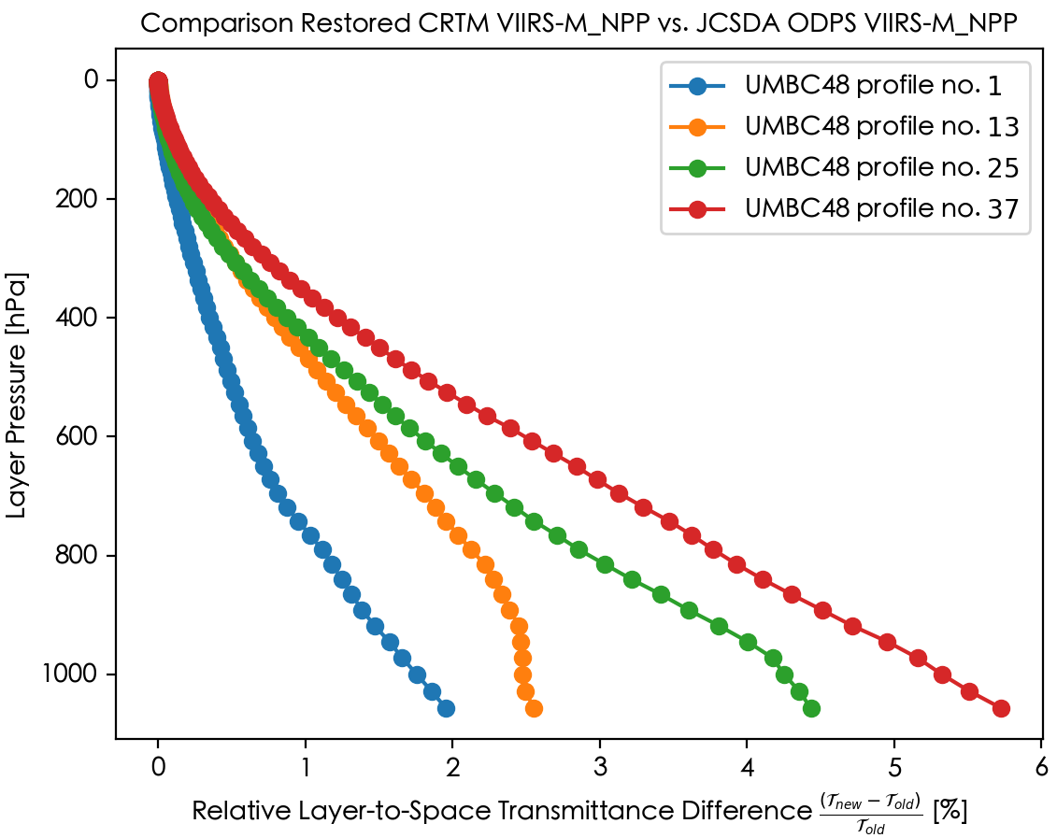
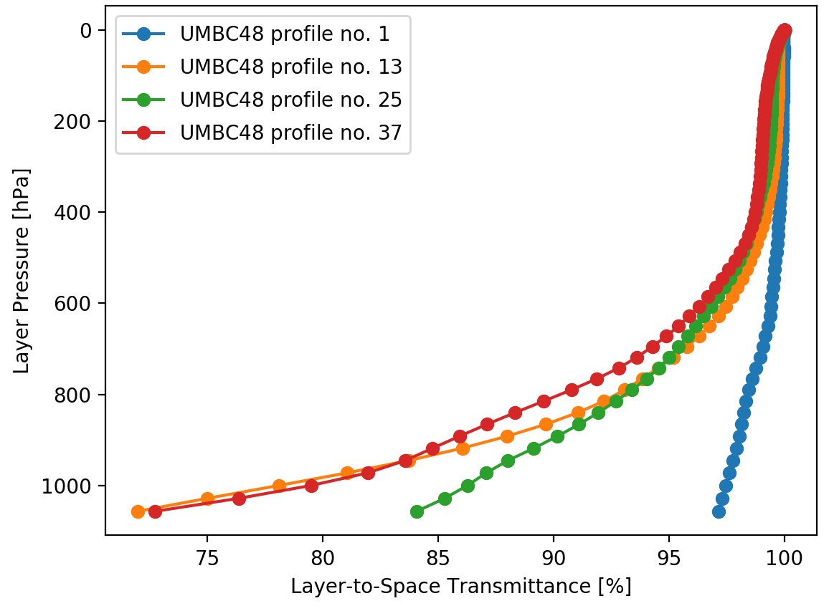
Check CRTM Integration of Coefficients: VIIRS-M_NPP

Slide 38
Repository Overview

Slide 39
The GitHub Repository CRTM_coef
The current CRTM transmittance coefficient generation package is available to expert users as a GitHub repository.

Slide 40
Folder Structure (1/2)
Step 2: Polynomial Regression on the synthetic data
Step 1: Producing the synthetic data
CRTM_coef/src
TauProd
TauRegress
Liebe & Rosenkranz for MW transmittance
LBLRTM I/O code for IR
ODPS regression
ODAS regression

Slide 41
Folder Structure (2/2)
Working directory CRTM_coef/workdir
Documentation in CRTM_coef/doc/UserGuide
Contains a list of known errors

Slide 42
Thank you.

