Slide 1
Databases of the optical properties of snow, graupel, ice clouds, and dust aerosol in support of CRTM
Dr. Ping Yang, University Distinguished Professor
Dr. Tong Ren, Mr. James Coy, Dr. Jiachen Ding, Dr. Masanori Saito
Department of Atmospheric Sciences
Texas A&M University
In collaboration
Kevin Garrett, Benjamin Johnson, and Patrick Stegmann
6/10/2021

Slide 2
Project Background
Challenges:
Radiances in the UV/Vis are not currently assimilated
Cloudy radiances in the IR are not currently assimilated
Precipitation-affected radiances in the microwave are not currently assimilated
CRTM is advancing to fully polarized radiative transfer (requires vectorized RT for the atmosphere including hydrometeor scattering and surface properties)
Next generation sensors contain channels in spectral regions not simulated by CRTM
Model capabilities allow for more detailed mapping between microphysics and optical properties, which currently cannot be handled by CRTM

Slide 3
Project Background
Other CRTM Limitations
The MODIS Collection-6 (MODIS C6) ice cloud optical property model has been implemented in CRTM
From UV to Far-IR, snow and graupel particles are treated as solid ice crystals
  The ice models are not applicable to snow and graupel due to smaller ice mass density values.
  We need to develop realistic graupel/snow optical property models.
  The microphysical properties based on the MODIS C6 model are not consistent with measurements

Slide 4
Project 1: Optical property database for snow and graupel – Accomplishments
A wide particle size range (in terms of particle’s maximum dimension): 2–100,000 µm with 131 size bins for snow, and 2-250,000 µm with 70 size bins for graupel.
Consideration of the mass density ratio defined as the ratio of graupel mass density to pure ice crystal mass density.
Temperature dependence of ice refractive index from 190–270 K with a resolution of 20 K (for microwave)
Based on observations reported in the literature, graupel particles are assumed to be conical, whereas snowflakes are assumed to be a mixture of roughened columns and dendrite aggregates with porous structures.

Slide 5
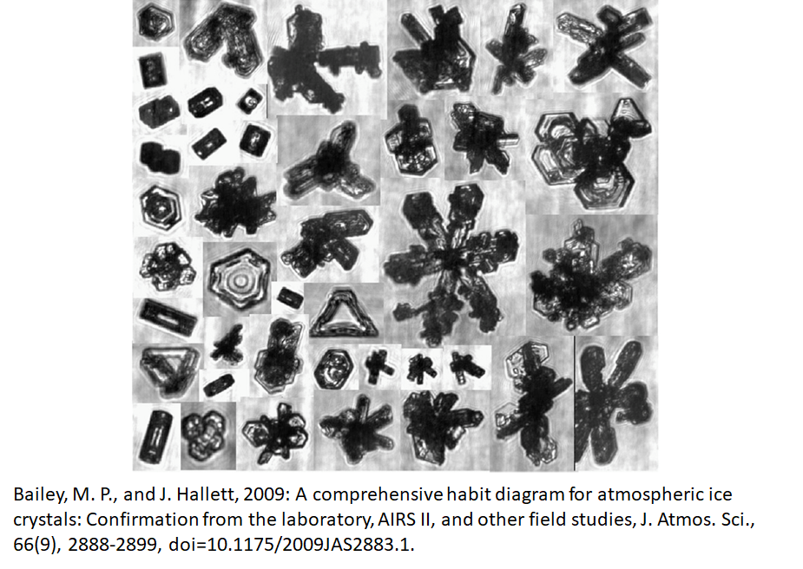
Ice Particle Habit Types

Slide 6
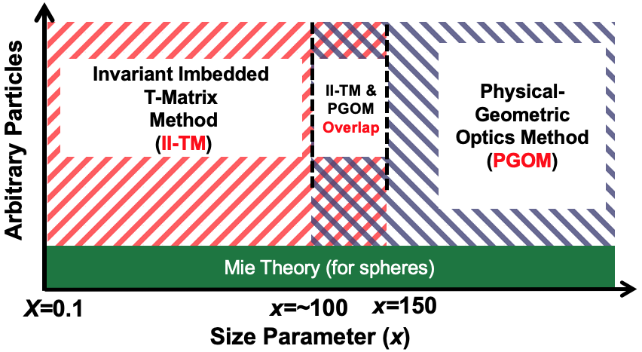
State-of-the-art Light Scattering Capabilities
II-TM: applicable to small-to-moderate particles
PGOM: applicable to moderate-to-large particles
Schematic illustration of the applicability of a synergistic combination of II-TM and PGOM to the entire size parameter range (Yang et al., 2019)

Slide 7
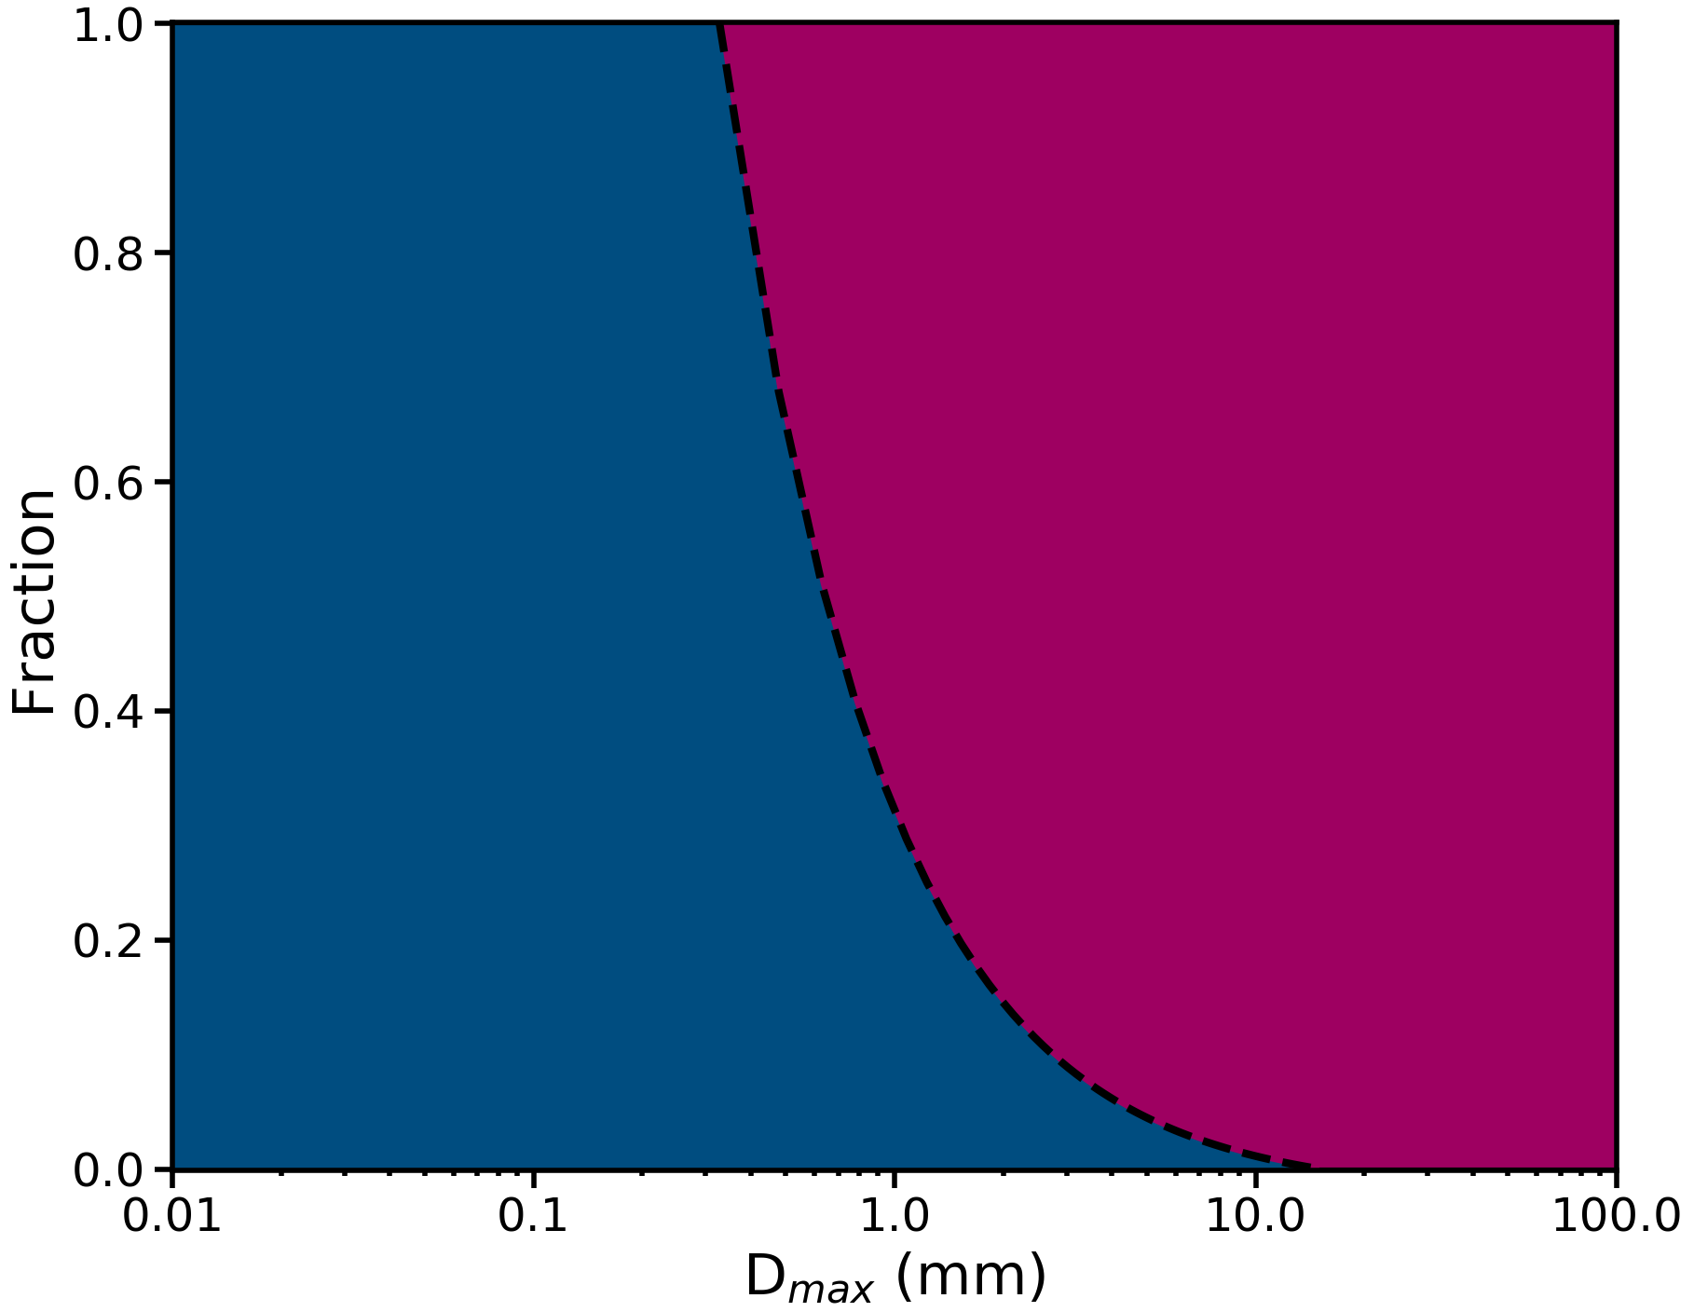
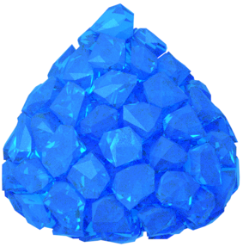
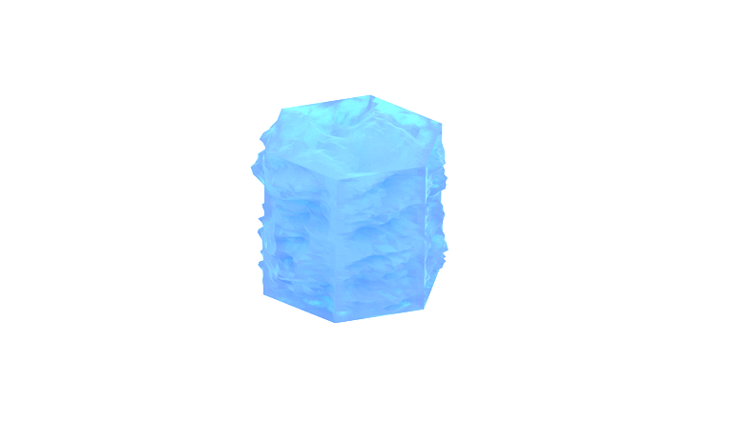
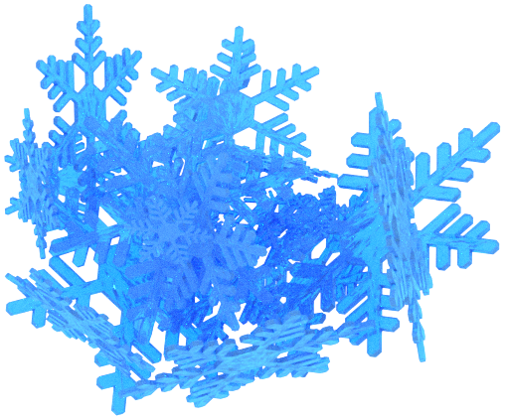
Modeling of snow and graupel shapes
Snow
Graupel
Roughened column + dendrite aggregate
Cone

Slide 8
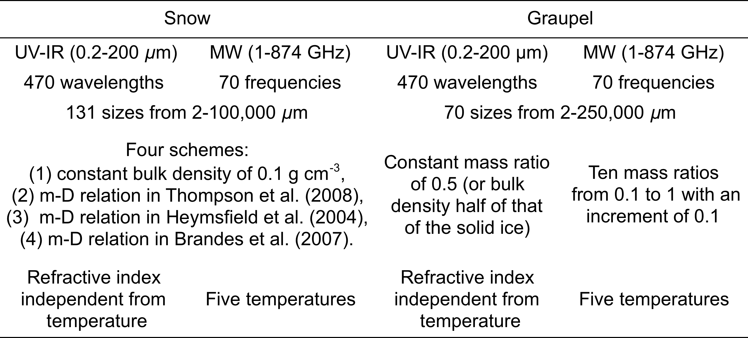
Snow and graupel database

Slide 9
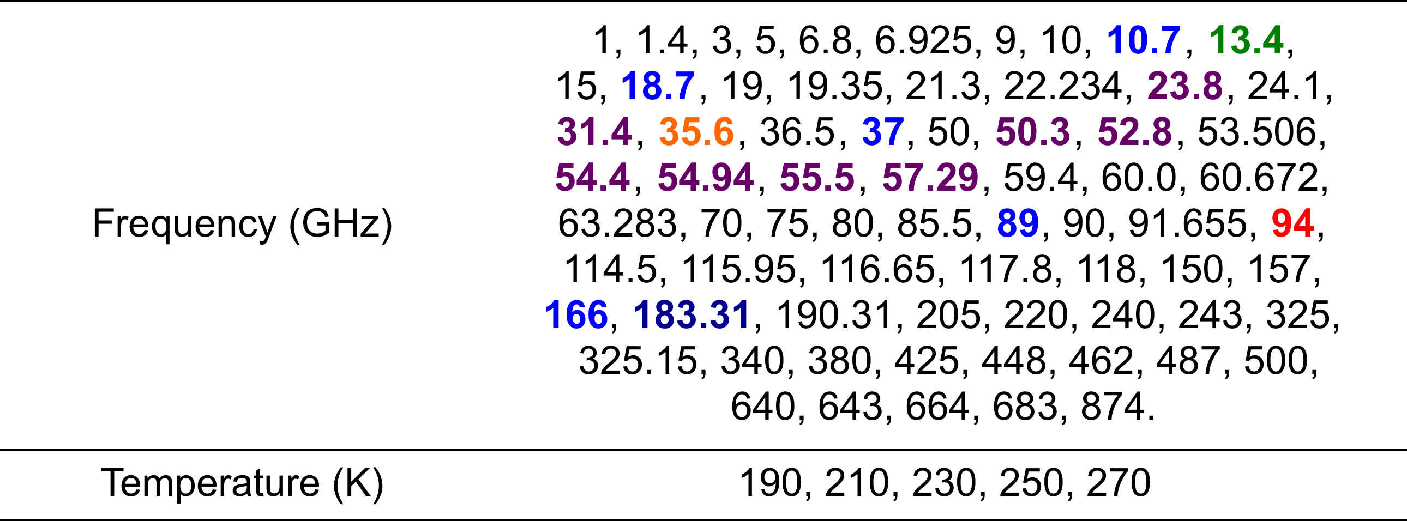
Available frequencies and temperatures in the MW region
(CPR W-band, DPR Ka-band, DPR Ku-band, GMI, ATMS, GMI/ATMS)

Slide 10
The four schemes in the snow database show close single scattering albedos in the UV-IR spectrum region with D_{max} = 2 mm

Slide 11
Graupel extinction efficiency increases with increasing bulk density at 230 K at 13.4 and 35.6 GHz
Mass ratio: Ratio of the mass of graupel to the mass of solid ice with the same volume
Mass ratio

Slide 12
Project 2: Utilizing geostationary satellite observations to develop a next generation ice cloud optical property model in support of JCSDA Community Radiative Transfer Model (CRTM) and JPSS CAL/VAL
Project Goals
Develop a next-generation ice optical property model that will be geolocation-dependent and temperature-dependent
Implement the next-generation ice optical property model into CRTM with a focus on GOES-16/17 ABI, JPSS VIIRS, and CrIS channels.
Milestones
Computations of individual ice crystal optical properties (07/31/2021).
A next-generation ice cloud optical property model (07/31/2022)
An improved version of CRTM that incorporates the next-generation ice cloud optical property model (07/31/2023).

Slide 13
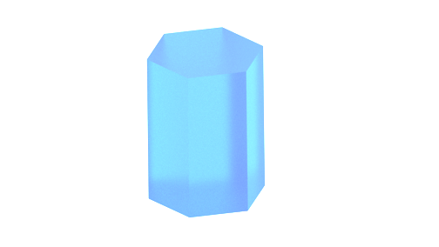
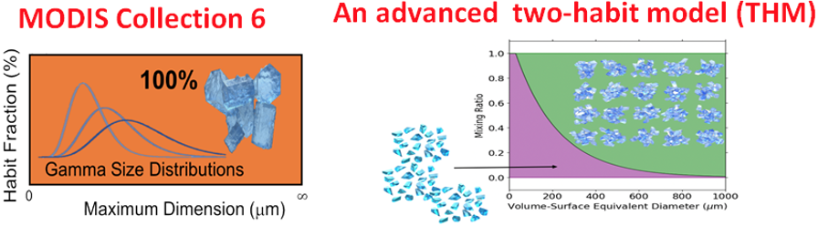
Ice Cloud Microphysical Models
D_{max}
Fu Model

Slide 14
Cloud ice mass-D_{max} relations

Slide 15
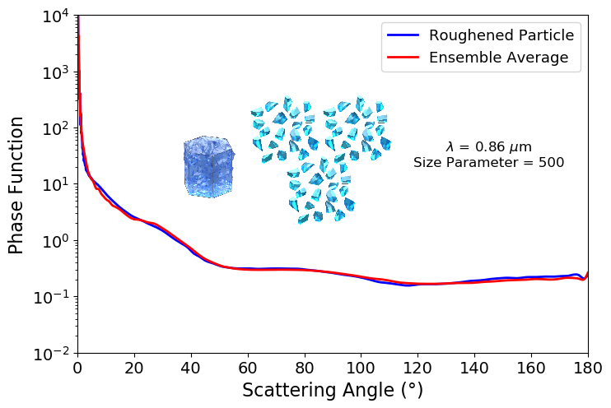
An ensemble mean as a surrogate for a roughened particle for light scattering computation

Slide 16
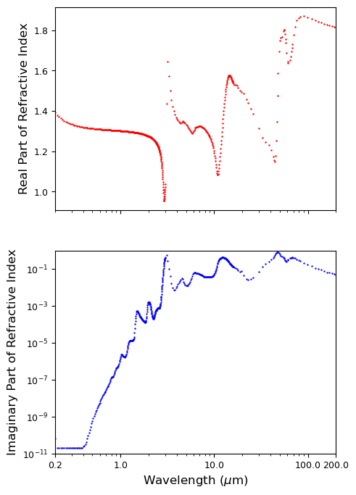
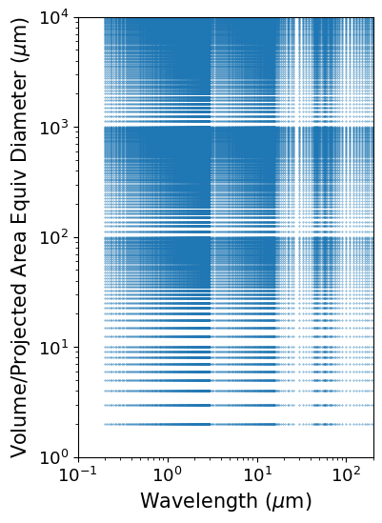
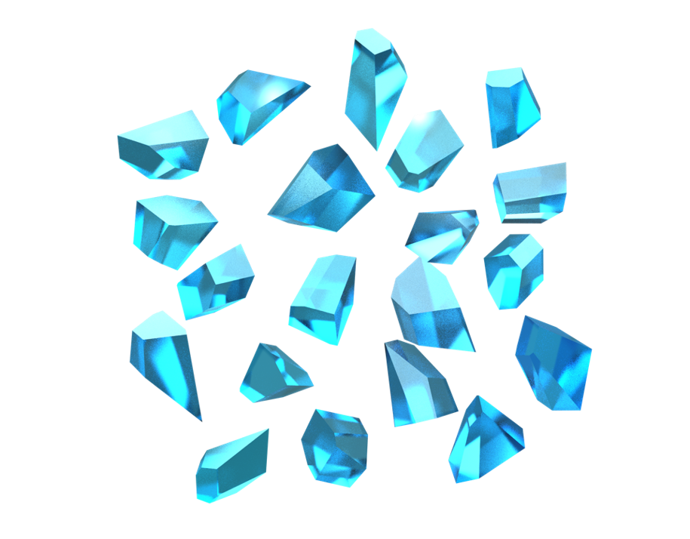
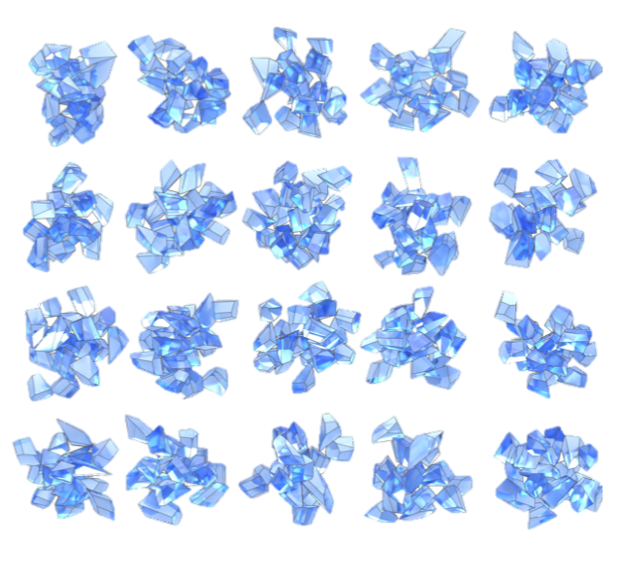
The development of a novel two-habit model
60-particle irregular single column and 20-particle irregular 20-column aggregate ensembles.
Volume-projected area equivalent sphere diameter size characterization.
Same wavelength and size resolution and range as previous THM.
For size parameters > 25, a simplified PGOM was used.
 | New THM (Version 3)
Wavelength | 470 bins (0.2 – 200 µm)
Size | 189 bins (2.0 – 10000.0 µm)
7b
7c
7a
THM Computation Methods
Invariant Imbedding T-Matrix Method (II-TM)
Improved Geometric Optics Method (IGOM)
0.1
~25
1000
Size Parameter (kD)
Notes:
Quality check: 15 µm < IIR CER < 35 µm; IIR optical solution; over ocean; CALIOP single-layer cloud; CALIOP CTT < -40°C; and CALIOP transparent.

Slide 17
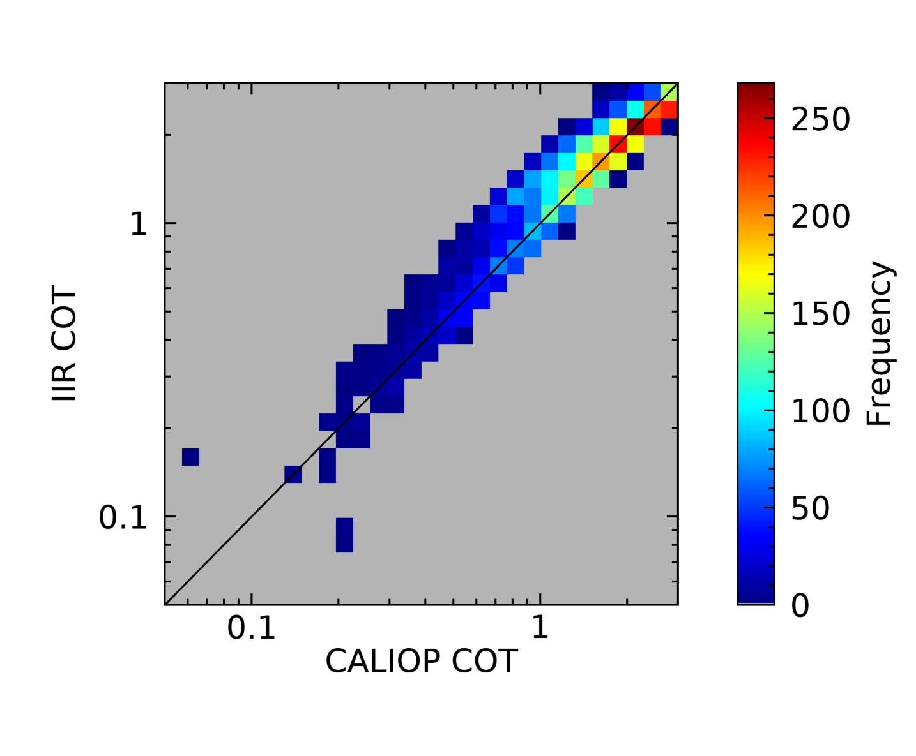
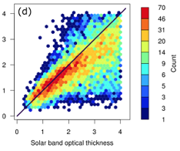
Illustration of: 1) spectral consistency (i.e., consistency between the retrievals based on infrared channels and solar channels, 2) consistency between active (lidar based) and passive (imager based) remote sensing applications

Slide 18
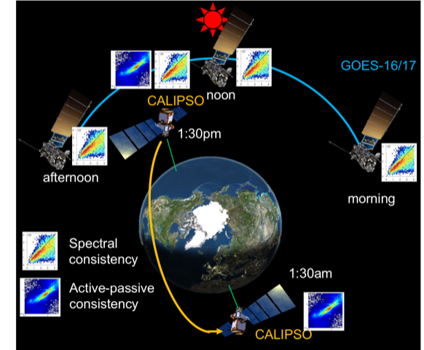
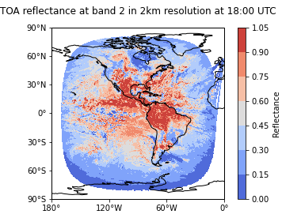
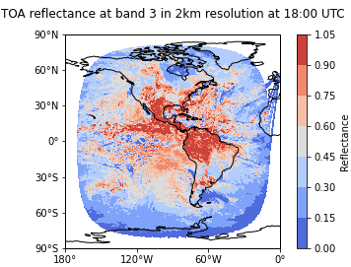
GOES-16/17 cloud retrieval system for ice model development
ABI/GOES-16/17
Nakajima-King COT retrievals
Split-window COT retrievals
CALIOP/CALIPSO observations
Backscatter based COT retrievals
→ Check spectral and active–passive consistency in COT retrievals.

Slide 19
Project 3: Development of vector Radiative Transfer Capability that can be incorporated into CRTM

Slide 20
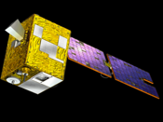
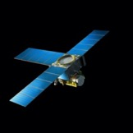
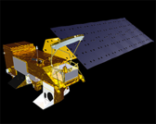
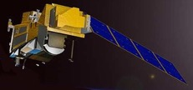
Recent Satellite Missions with Polarimetric Capability
PARASOL (2005-2013)
OTB-2 (2022-)
PACE (2023-)
METOP-SG-A (2023-)
Satellite Missions:
Polarimetric Instruments:
POLDER
MAIA
SPEXone, HARP2
3MI

Slide 21
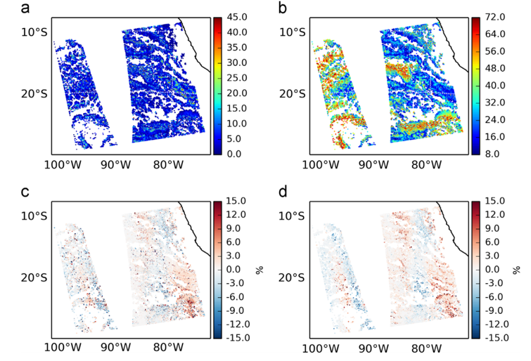
Retrieval Errors without Considering Polarization
Retrieved water cloud optical thickness (a) and effective diameter (μm) (b) and the relative differences (c, d) between the “vector case” and “scalar case” using MODIS observation
(Yi, Huang, Yang, Baum, and Kattawar, 2014)

Slide 22
Near IR Reflectance
Thermal IR brightness temperature
Near IR Polarization

Slide 23
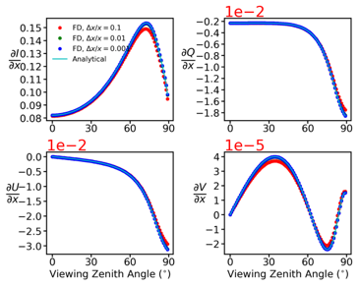
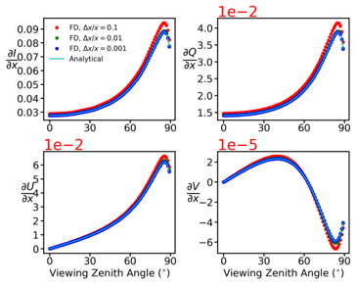
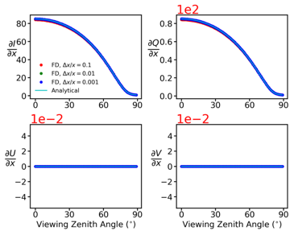
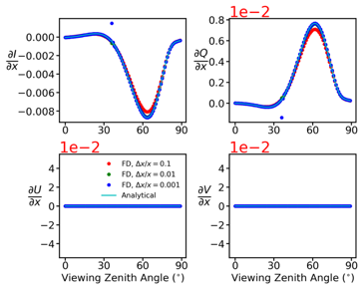




Analytical (Tangent-linear/Adjoint) and Finite Difference (FD) Comparison
Cloud Optical thickness, $x=τ$
Single-scattering albedo, $x=π$
Sea surface emissivity $x=ε$
Sea surface wind speed $x=w$

Slide 24
A list of state variables can be considered
Atmospheric layer optical thicknesses;
Atmospheric layer single-scattering albedos;
Atmospheric layer scattering phase matrix;
Atmospheric layer temperatures;
Surface albedo/emissivity;
Surface temperature;
Sea surface wind speed and direction;
Oceanic layer optical thicknesses;
Oceanic layer single-scattering albedos;
Oceanic layer scattering phase matrix.
Cloud and aerosol microphysical properties, gas concentration, …
Ocean/land surface properties
Oceanic inherent optical properties

Slide 25
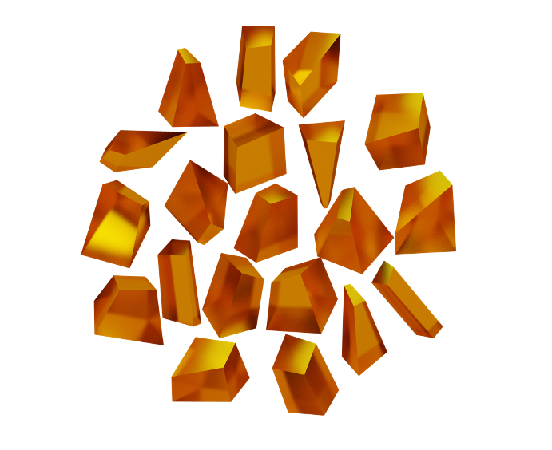
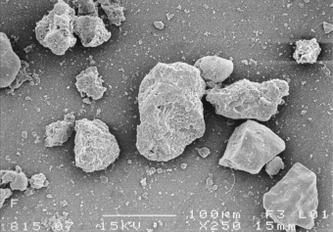
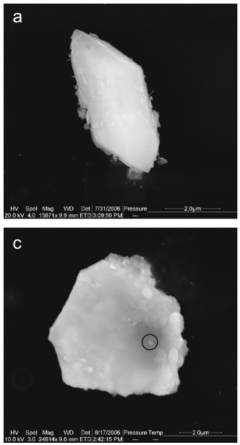
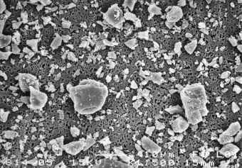
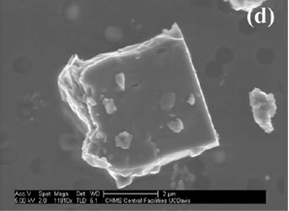
Dust optical database (Saito, Yang et al., 2021): New Shape model
Reid et al., 2003; Volten et al., 2001; Kandler et al. 2007

Slide 26

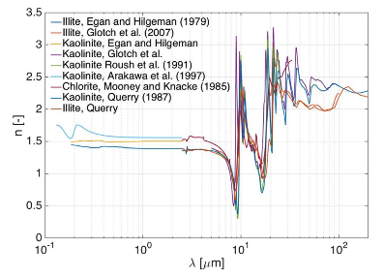
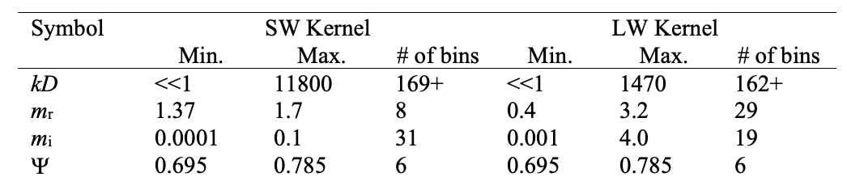
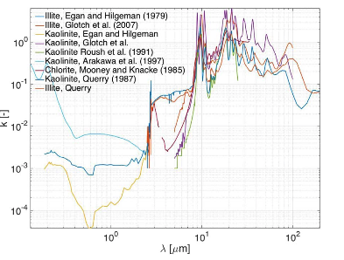
New dust optical property database (Saito, Yang et al. 2021): Broad coverage
m_{r}
The database covers particle diameters ≤375 µm for wavelengths 0.2–200 µm.
The database covers almost an entire possible range of the spectral complex refractive index.
→ Useful for almost all remote sensing applications and radiative transfer calculations involving dust.
m_{i}
Stegmann and Yang, 2017

Slide 27
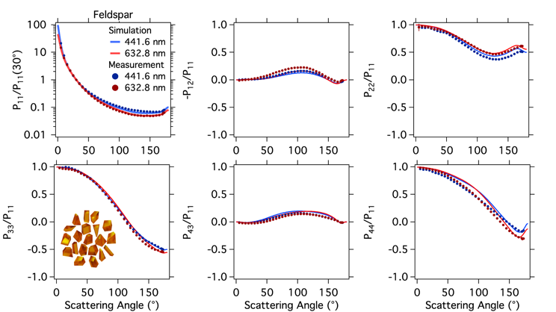
Theoretical dust optical properties in comparison with laboratory measurements
Comparison of measured and theoretical results for the phase matrix of feldspar particles at two wavelengths, and an illustration of the ensemble of randomly distorted hexahedral model (lower left panel).

Slide 28
Summary
We have developed and delivered a database of the optical properties of snow and graupel.
We are currently computing individual ice crystal optical properties.
After we complete the optical computations, we will test the spectral consistency and active-passive remote sensing consistency regrading the application of the new ice cloud optical property datasets .
We are finishing the adjoint model of a vector radiative transfer model .
A comprehensive database of dust optical properties has been developed
Follow-up effort: collaborate with NOAA researchers to incorporate the new advances into CRTM.

