Slide 1
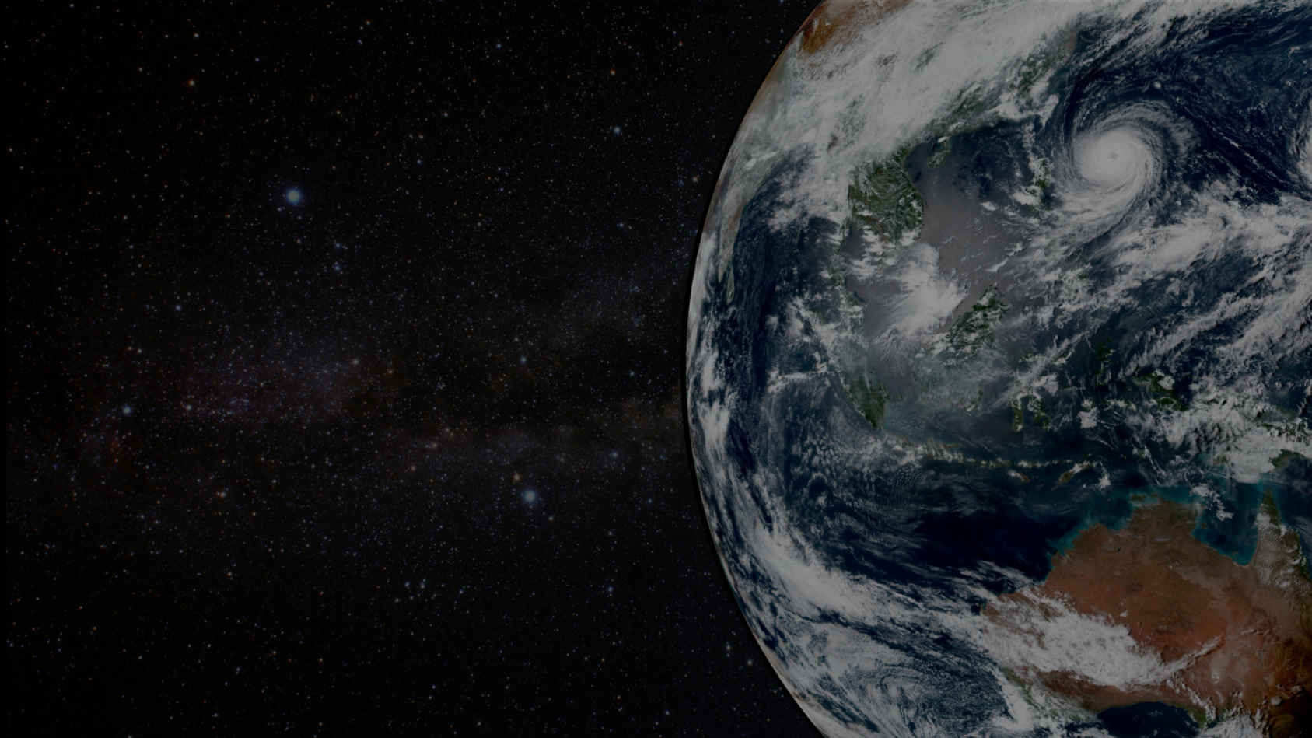
The Community Radiative Transfer Model
CRTM Team:
Benjamin T. Johnson (Project Lead, UCAR/JCSDA)
Patrick Stegmann (UCAR / JCSDA)
Cheng Dang (UCAR/JCSDA)
Jim Rosinski, Yingtao Ma, Ming Chen, Isaac Moradi, Haixia Liu, Nick Nalli, Cory Martin, Daniel Abdi, Tom Greenwald, Emily Liu, Barbara Scherllin-Pirscher, Quanhua ”Mark” Liu, Sarah Lu, Ping Yang, Will McCarty, Bryan Karpowicz, Yanqiu Zhu, and many others.

Slide 2
CRTM Vision
CRTM is a Community Model
Open Source and Open Access
Version Control (git) and code review
Distributed Collaboration (GitHub, Zenhub, Google)
https://github.com/JCSDA/crtm
Modern Fortran (2003+)
Public Domain License (CC0)
Education and Outreach
CRTM User/Developer Workshop(s)
JCSDA Summer Colloquium
Code Sprints
Seminars / Colloquia
JCSDA.org website
NOAA
NESDIS
NASA
GMAO
NCAR
UCAR
NOAA
OAR
JCSDA
CRTM
Team
Air Force
International
Partners
NOAA
NWS
Navy

Slide 3
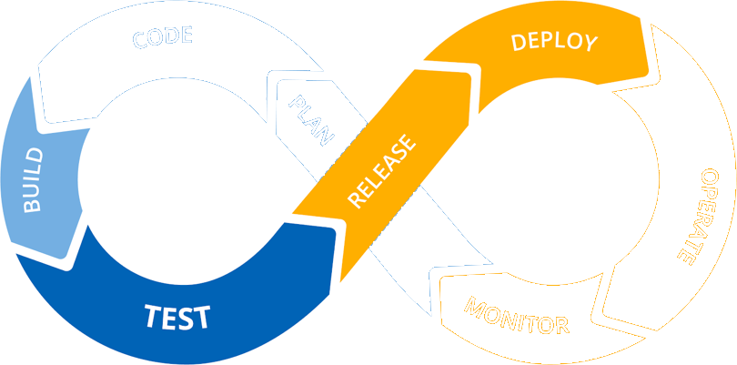
Project Organization
CRTM1: Software Management and Workflow

Slide 4
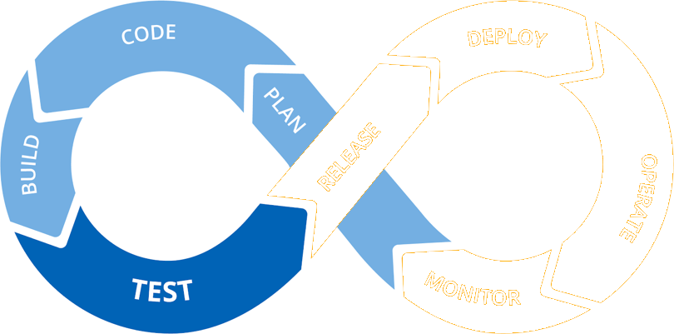
Project Organization
CRTM1: Software Management and Workflow
CRTM2: Model and Application Development

Slide 5
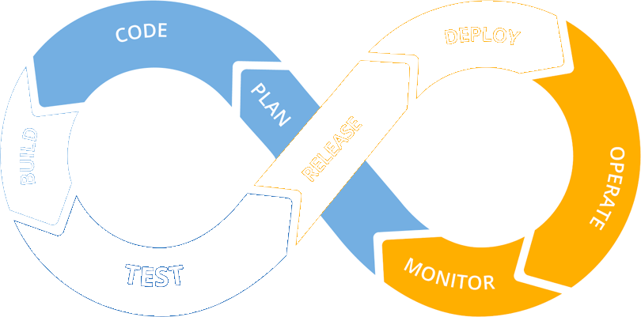
Project Organization
CRTM1: Software Management and Workflow
CRTM2: Model and Application Development
CRTM3: Science Development and Application Outcomes

Slide 6
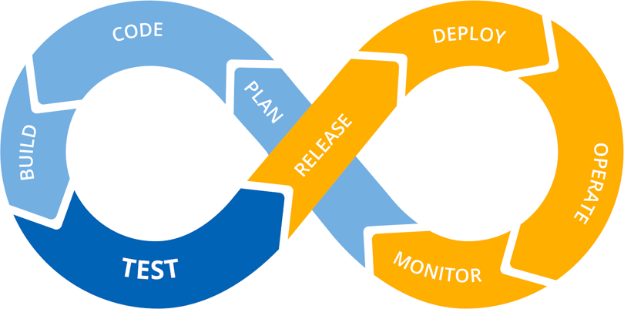
Project Organization
CRTM1: Software Management and Workflow
CRTM2: Model and Application Development
CRTM3: Science Development and Application Outcomes

Slide 7
CRTM1: Software Management and Workflow
CRTM Task 1 Activities
Bi-weekly technical meetings, quarterly reviews, 1-on-1 discussions. Meeting minutes posted internally.
Robust Data management implementation for netCDF and legacy binary files
Workflow for automated regular builds out of development branches per application
CI/CD pipeline for automated testing
Code reviews and User support issues tracked through Github
Publicly accessible (web/repository) documentation, training tools, online / self-guided tutorials
Code Sprint 1: CRTM v3.0 development
Code Sprint 2: SimObs Application development
Release: CRTM v3.0 code + associated files
Release: SimObs v1.0 code + associated files
Release: CRTM Trans. Coef. Package v1.0 code + associated files
Release: CRTM-AI utilities + associated files

Slide 8
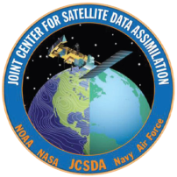
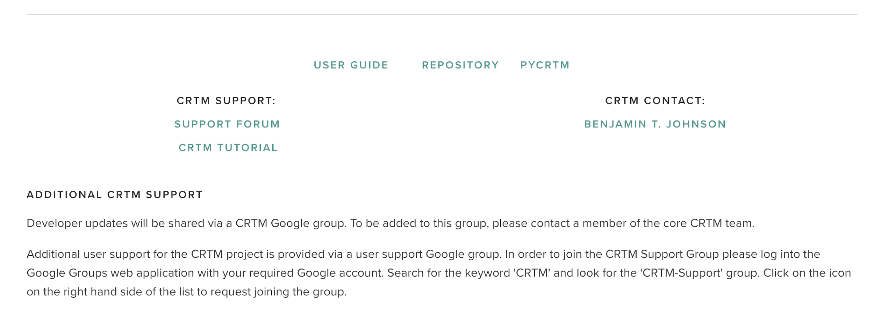
Expanded Presence on JCSDA website with regular updates
https://www.jcsda.org/jcsda-project-community-radiative-transfer-model
Updated links on CRTM project website, including pyCRTM repo, release information, support forum, and current tutorial repo.

Slide 9
CRTM v2.4.0
CRTM v2.4.0
https://github.com/JCSDA/crtm
Released October 28, 2020
New Features:
1. Support for netCDF4 file format reading: CloudCoeff.nc4 and AerosolCoeff.nc4
2. OpenMP optimization (vs. profiles)
3. Experimental Cloud Coefficient tables (see `fix/CloudCoeff`) in binary and netcdf4 formats
4. Added 81 regression and 4 unit tests, see `README.md`.
5. Updated: CMAQ-based (v4.x) Aerosols and Radiance/AOD simulation
6. Improved loop-level performance: 4 to 5 times native improvement by optimizing loops.
Multiple bugfixes vs. v2.3.x (see release notes)
Multiple new sensors added:
EON MW, Sentinel3a SLSTR, Meteosat-11 Seviri. GOES-17 ABI 81K fix, Metop-C: AVHRR, IASI, SMAP/SMOS, TEMPEST-D, MI-LCOMS.v2, JPSS-2 VIIRS, GEOKOMPSAT-2a AMI, Metop-SG-A1 MWS, FY4a-GIIRS

Slide 10
CRTM v2.4.1
CRTM v2.4.1 (under development, expected July 2021)
https://github.com/JCSDA/crtm
New features + bugfixes vs. v2.4.0:
openMP extended, now supports both channel and profile loops (D. Abdi)
Fix: Snow cover emissivity when bad/missing observation data present (M. Chen)
Updates to compiler-specific configuration files
Updated support for Aerosol Coefficient files: CMAQ, GOCART, NAAPS (C. Dang)
Implemented two new aerosol coefficient look-up tables based on GOCART-GEOS5 and NAAPS aerosol specifications(New aerosol species: nitrate and smoke) (C. Dang)
Binary files / netCDF files hosted via git-LFS, gzipped for storage / speed.
Test codes updated to reflect/test new coefficient files
Sensors added:
Corrections to internal sensor naming issues of abi_g17-81K
IASI-NG (testing), TROPICS_sv1_srf_v1, OMS GEMS-1/2 (in progress)
v2 ACCoeff and SpcCoeff for Metop-C / AMSU-A / MHS
ATMS-NG (in progress)
GOES-T ABI (testing/STAR)

Slide 11
CRTM v3.0 Goals and Work Plans
Cloudy Radiance (B. Johnson)
< Backscattering coefficients for CRTM active sensor capability (Moradi, Johnson, Stegmann)
< Produce (Polarized) CRTM Scattering Coefficients from BHMIE and T-Matrix spheroids in binary and NetCDF
< Start systematic investigation of “optimal” single-scattering properties for CRTM applications
< Update of CHYM for microphysical consistency with NWP (B. Johnson, G. Thompson, Y. Lu, E. Clothiaux)
Surface (M. Chen, Y. Zhu)
< Test CRTM-CSEM in GFS/GSI, focusing on the comparisons among model options.
< Analyze and document the tests of CRTM-CSEM in GFS/GSI.
< Initial implementation of MW ocean surface BRDF model.
< Ocean Surface Emissivity improvements IR (IRSSE, N. Nalli)
Full Polarization Solver Capability (Q. Liu, T. Greenwald, B. Johnson, C. Cao)
< UV capable solver + polarization support under evaluation (CRTM v3.0-beta)
SW / IR improvements in CRTM
< Cloud, surface, and aerosol impacts on visible channels C. Dang)
Aerosols update (Johnson, Stegmann, S. Lu, M. Pagowski, B. Scherllin-Pirscher, others).
< Improved aerosol indices of refraction (via D. Turner, J. Gasteiger, C. Dang)
< Update of CRTM using initial CMAQ specifications (C. Dang, Y. Ma)
< Improve Lidar backscattering and attenuation calculations (Pagowski, Scherllin-Pirscher)

Slide 12
CRTM v3.0 Beta Focus
Cloud-impacted radiance and physical model simulation improvements (UV, VIS, IR, MW)
Community Hydrometeor Model (CHYM)
Development continuing, and creating new polarized MW, IR, and VIS integrated cloud and aerosol scattering tables that are more closely linked with model assumed microphysical properties.
netCDF transition and conversion.
Updating Space-based radar support with linear polarization capabilities
Coefficient tool development e.g.:
https://github.com/PStegmann/INSPECT_CloudCoeff
https://github.com/JCSDA/CRTM_coef
Community Surface Emissivity Model (Ming Chen)
Extension of CSEM capabilities to support fully polarized surface BRDFs for ocean and land

Slide 13
AOP 2021 CRTM2: Model and Application Development
CRTM Task 2 Activities
CRTM v3.0 Code with expanded openMP directives
CRTM v3.0 Code with optimized structure for vectorization and minimal I/O overhead (potential GPU port)
Code that fully supports netCDF4 for all input files (CRTM + Applications)
Generic, modular/OO code interfaces for each input data type
Code for SIMOBS application, supports CRTM1.10
Python Code/Utilities in support of CRTM3.9 - CRTM3.11
Code/Utilities in support of CRTM transmittance coefficient generation

Slide 14
Testing Framework
.
├── application
├── regression
│ ├── adjoint
│ │ ├── test_ClearSky
│ │ └── test_Simple
│ ├── forward
│ │ ├── test_Aircraft
│ │ ├── test_AOD
│ │ ├── test_ChannelSubset
│ │ ├── test_ClearSky
│ │ ├── test_ScatteringSwitch
│ │ ├── test_Simple
│ │ │ └── coefficients
│ │ ├── test_SOI
│ │ ├── test_SSU
│ │ ├── test_VerticalCoordinates
│ │ └── test_Zeeman
│ ├── incsrc
Start 1: get_crtm_coeffs
1/92 Test #1: get_crtm_coeffs ... Passed 39.84 sec
Start 2: test_check_crtm
2/92 Test #2: test_check_crtm ... Passed 3.30 sec
Start 3: test_check_crtm_random
3/92 Test #3: test_random ... Passed 25.27 sec
Start 4: Unit_TL_TEST
4/92 Test #4: Unit_TL_TEST ... Passed 0.10 sec
Start 5: Unit_test_spc_io
5/92 Test #5: Unit_test_spc_io ... Passed 0.09 sec
<...>
Start 91: test_tangent_linear_ClearSky_v.abi_gr
91/92 Test #91: test_tangent_linear_ClearSky_v.abi_gr ... Passed 0.18 sec
Start 92: test_tangent_linear_ClearSky_modis_aqua
92/92 Test #92: test_tangent_linear_ClearSky_modis_aqua ... Passed 0.10 sec
0 tests failed out of 92
│ ├── k_matrix
│ │ ├── test_AOD
│ │ ├── test_ChannelSubset
│ │ ├── test_ClearSky
│ │ ├── test_ScatteringSwitch
│ │ ├── test_Simple
│ │ ├── test_SOI
│ │ ├── test_SSU
│ │ ├── test_VerticalCoordinates
│ │ └── test_Zeeman
│ └── tangent_linear
│ ├── test_ClearSky
│ └── test_Simple
└── unit
├── input_output
│ └── test_SpcCoeff
└── Unit_Test

Slide 15
CRTM v3.0 Code Restructuring
Focus on v3.0 merge with v2.4.1 codes
v3.0-beta core integration in to JCSDA github (in progress)
solver core provided by Quanhua Liu
Documentation Updates
Integration of v2.4.1 openMP updates
Update of testing framework
Enhanced FWD/TL/AD codes
Pre-defined reference output
Expanded Unit and Regression testing (multiple tiers)

Slide 16
AOP 2021 CRTM3a: Science Development
CRTM Task 3 Activities
Non-spherical particle properties database for aerosols and clouds
Expanded aerosol coefficients: radius, species
UV/Visible/NearIR radiative transfer model improvements for surface properties
Zeeman code updates
Non-local thermodynamic equilibrium (NLTE) updates across instruments
CSEM expansion to support polarized BRDFs across all surfaces & spectral bands
External methods for Validation

Slide 17
CRTM v2.3 vs. v2.4 Testing / Evaluation (H. Liu, M. Chen)
Evaluate the ABI_G17_81K coeff
Largest differences seen on channel 16 (0.6K), and large differences seen on channels 8, 9, 12 and 14.
Compare CRTM v2.4.0 and v2.3.0 using GSI
Simulated brightness temperatures between the 2 versions are the same, but the surface emissivity Jacobian bug fix (Common_RTSolution.f90) affects quality control and bias correction. And generally, more observations pass quality control for most instruments.
There are up to 2.5K differences on simulated brightness temperature for AMSU-A under all-sky condition. Continue investigate reasons that cause the differences

Slide 18
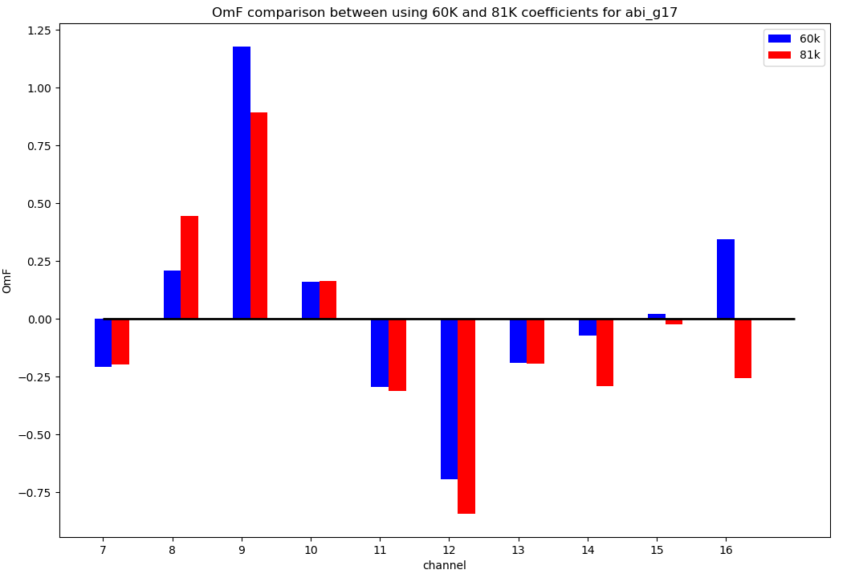
GOES-17 ABI 81K fix, Testing / Evaluation (H. Liu)
OmF comparison between using G17 ABI at 60K (old) and 81K (new)

Slide 19
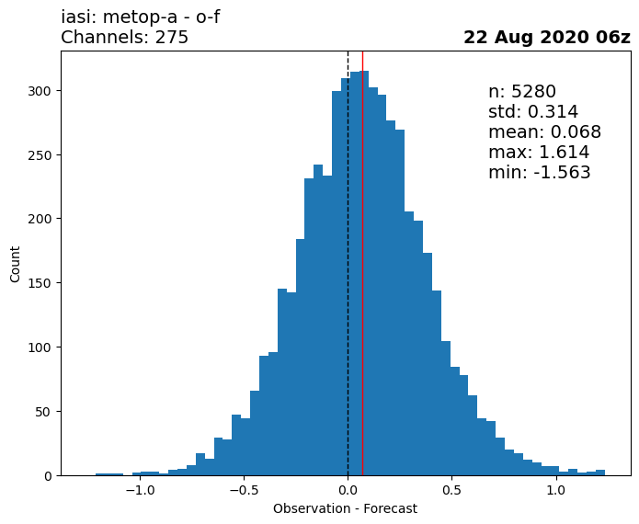
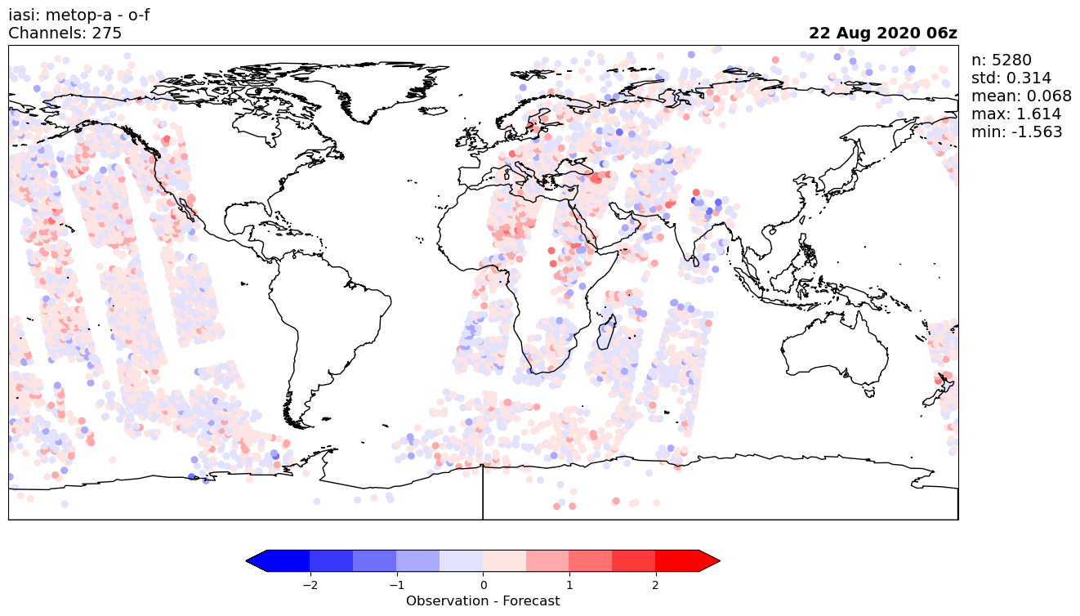
CRTM v2.4.0 Testing / Evaluation (H. Liu)
CRTM v2.3
IASI
Nobs:
5280 v2.3.0
5357 v2.4.0
CRTM v2.4

Slide 20
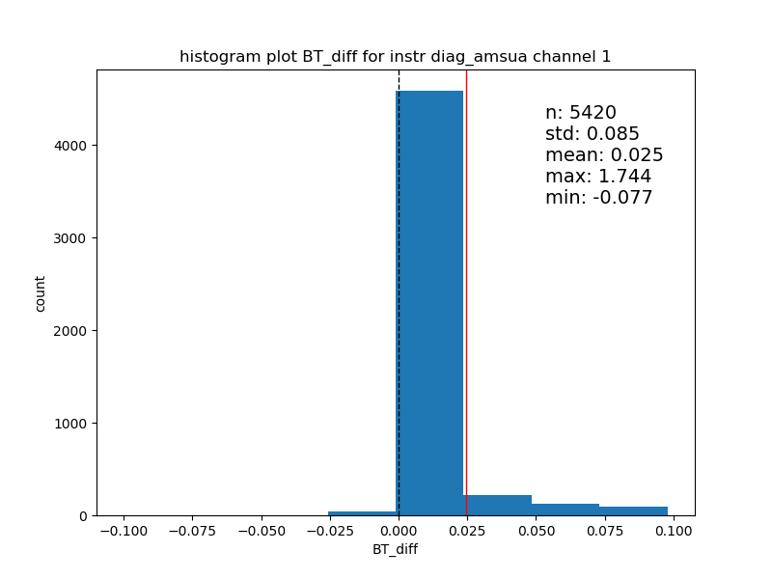
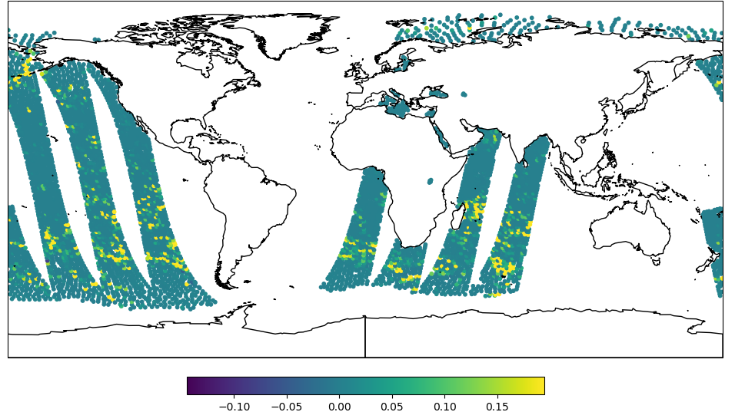
CRTM v2.4.0 Testing / Evaluation (H. Liu, M. Chen)
AMSU-A BT simulations show differences over sea (all-sky simulation), no differences over land, ice, snow, or mixed (clear-sky simulation).
BT Simulation diff v230-v240

Slide 21
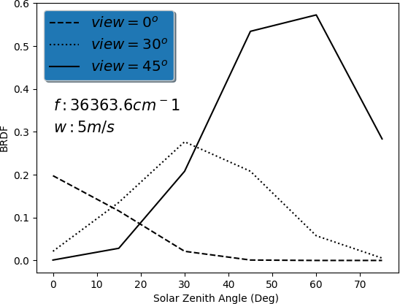
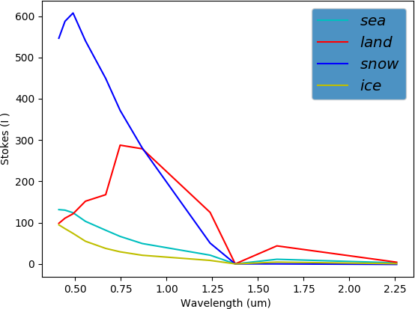
Updates on CSEM Development and Improvement
Community Surface Emissivity Model (M. Chen)
The Visible-UV ocean surface BRDF model from Mark Liu’s CRTM 3.0beta package has been implemented into CSEM to support the CRTM 3.0 beta release. This model is similar to the IR ocean surface BRDF model, but with the extended water refractive index from 2.9um to 0.27um.
A new Visible-UV surface reflectivity model was developed by using the NPOESS type-based spectral LUT to replace the constant value in the CRTM 3.0beta.
The updated IR ocean surface emissivity LUTs from Nick Nalli have been implemented into CSEM. The CSEM package with these LUTs was delivered and is currently used to address the bias zonal dependency in GSI.
The ATMS snow emissivity model has been improved to handle the invalid model inputs.

Slide 22
Updated Aerosol properties (C. Dang)
Overview of CRTM aerosol updates
CRTM default
CMAQ
GOCART-GEOS5
NAAPS
CRTM_Init ( SENSOR_ID, &
chinfo, &
Aerosol_Model, &
AerosolCoeff_Format, …)
Binary I/O
NetCDF I/O
Implemented two new aerosol coefficient look-up tables based on GOCART-GEOS5 and NAAPS aerosol specifications (New aerosol species: nitrate and smoke).
Performed more tests on CRTM-AOD simulations with different aerosol schemes.
Supported CMAQ AOD data assimilation.
Next: develop aerosol coefficient generation packages.
Next: evaluate CRTM simulations with different aerosol schemes.

Slide 23
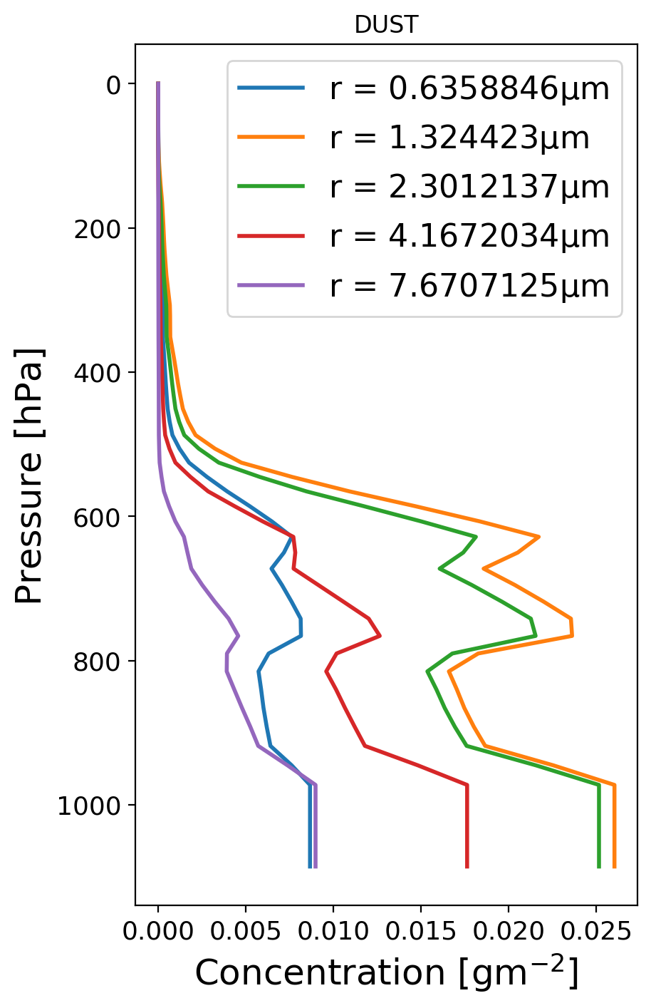
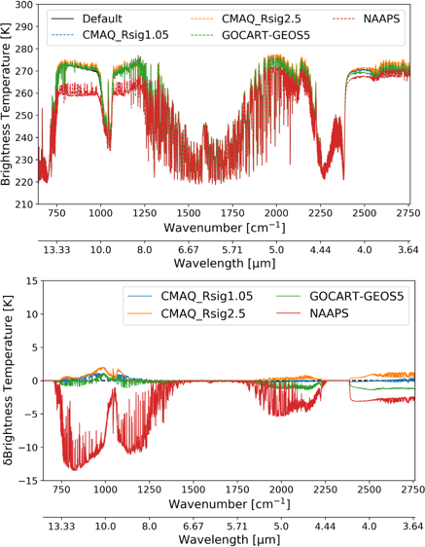
Updated Aerosol properties (C. Dang)
CRTM T_{B}
difference
vs. default
CRTM T_{B}

Slide 24
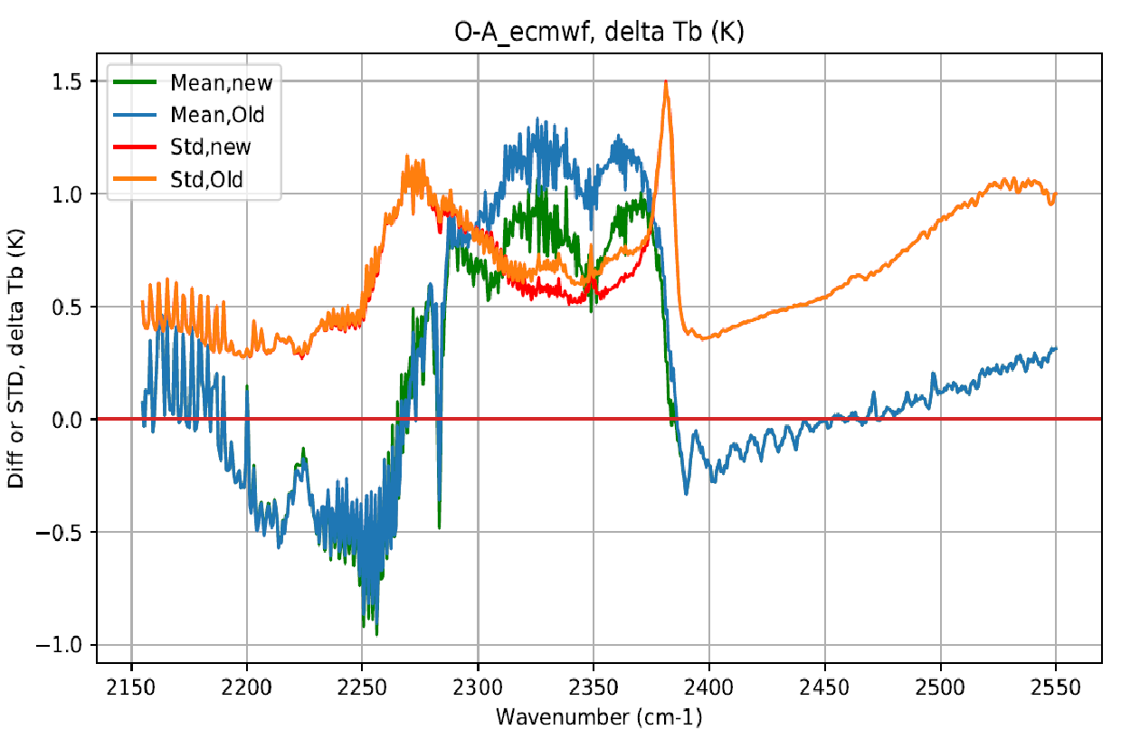
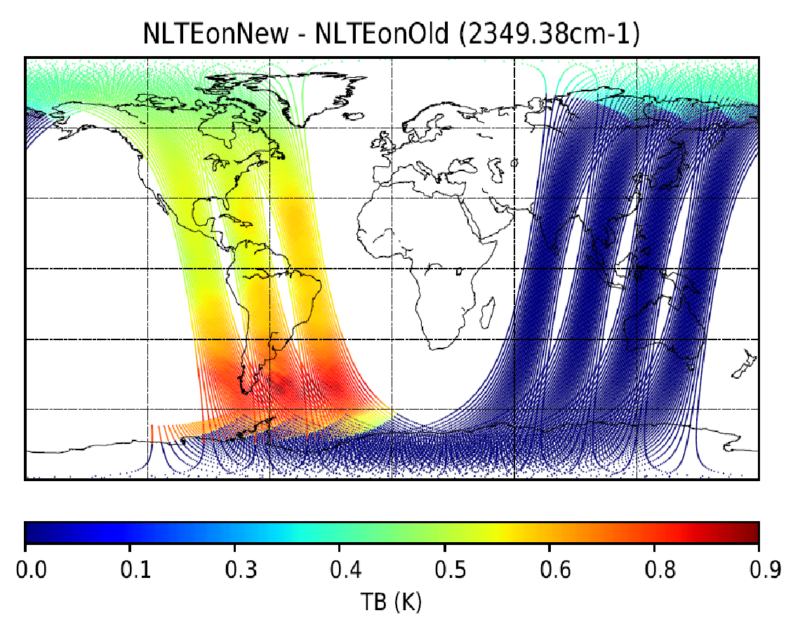
NLTE (Y. Ma)
Updated the Non-LTE correction coefficients for CrIS instruments on NOAA-NPP and NOAA_N20 based on the newly available vibrational temperature profiles for CO2 in 4.3 um band from M. López-Puertas et al. (Milestone# CRTM3.3.3)
Worked with Haixia from EMC on assessing the impact of temperature induced SRF change with ABI-G17. (Milestone# CRTM3.3)
Left: Mean bias and standard deviation of O-A over the mid-latitude ocean after non-LTE correction. Right: Spatial distribution of the difference between the old and the new corrections.

Slide 25
Spectral expansion of CRTM radiance and sensor simulation capabilities
IASI-NG
TROPICS_sv1_srf_v1
OMS GEMS-1/2 (under development)
v2 ACCoeff and SpcCoeff for Metop-C / AMSU-A, and MHS
Initial NLTE corrected CrIS coefficients (Y. Ma) for n20, npp:
cris-fsr431_n20.SpcCoeff.bin
cris-fsr431_npp.SpcCoeff.bin
cris-fsr_n20.SpcCoeff.bin
cris-fsr_npp.SpcCoeff.bin

Slide 26
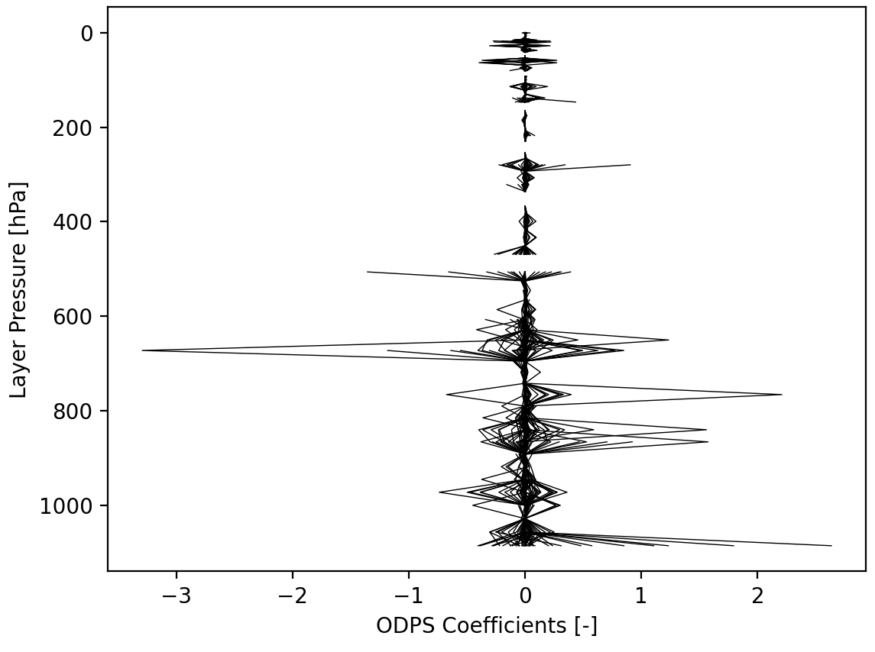
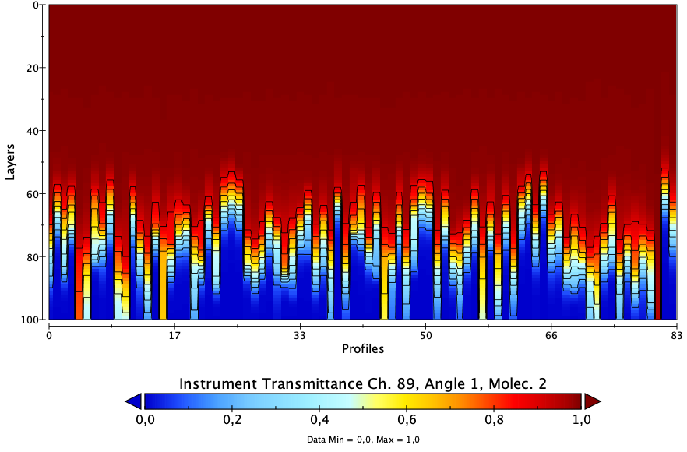
Spectral expansion of CRTM radiance and sensor simulation capabilities (P. Stegmann)
IASI-NG coefficients created, under evaluation
Vertical profile of ODPS coefficients for IASI-NG Layer-to-space transmittance for Ch 89, IASI-NG
for each training profile from the ECMWF-83 set

Slide 27
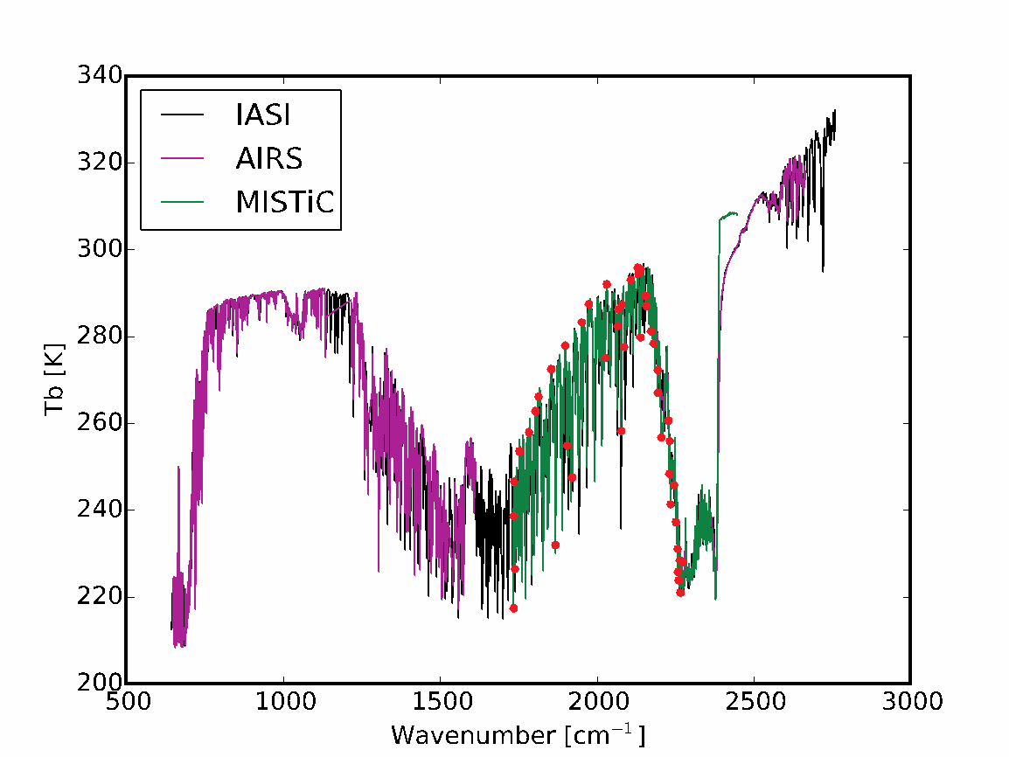
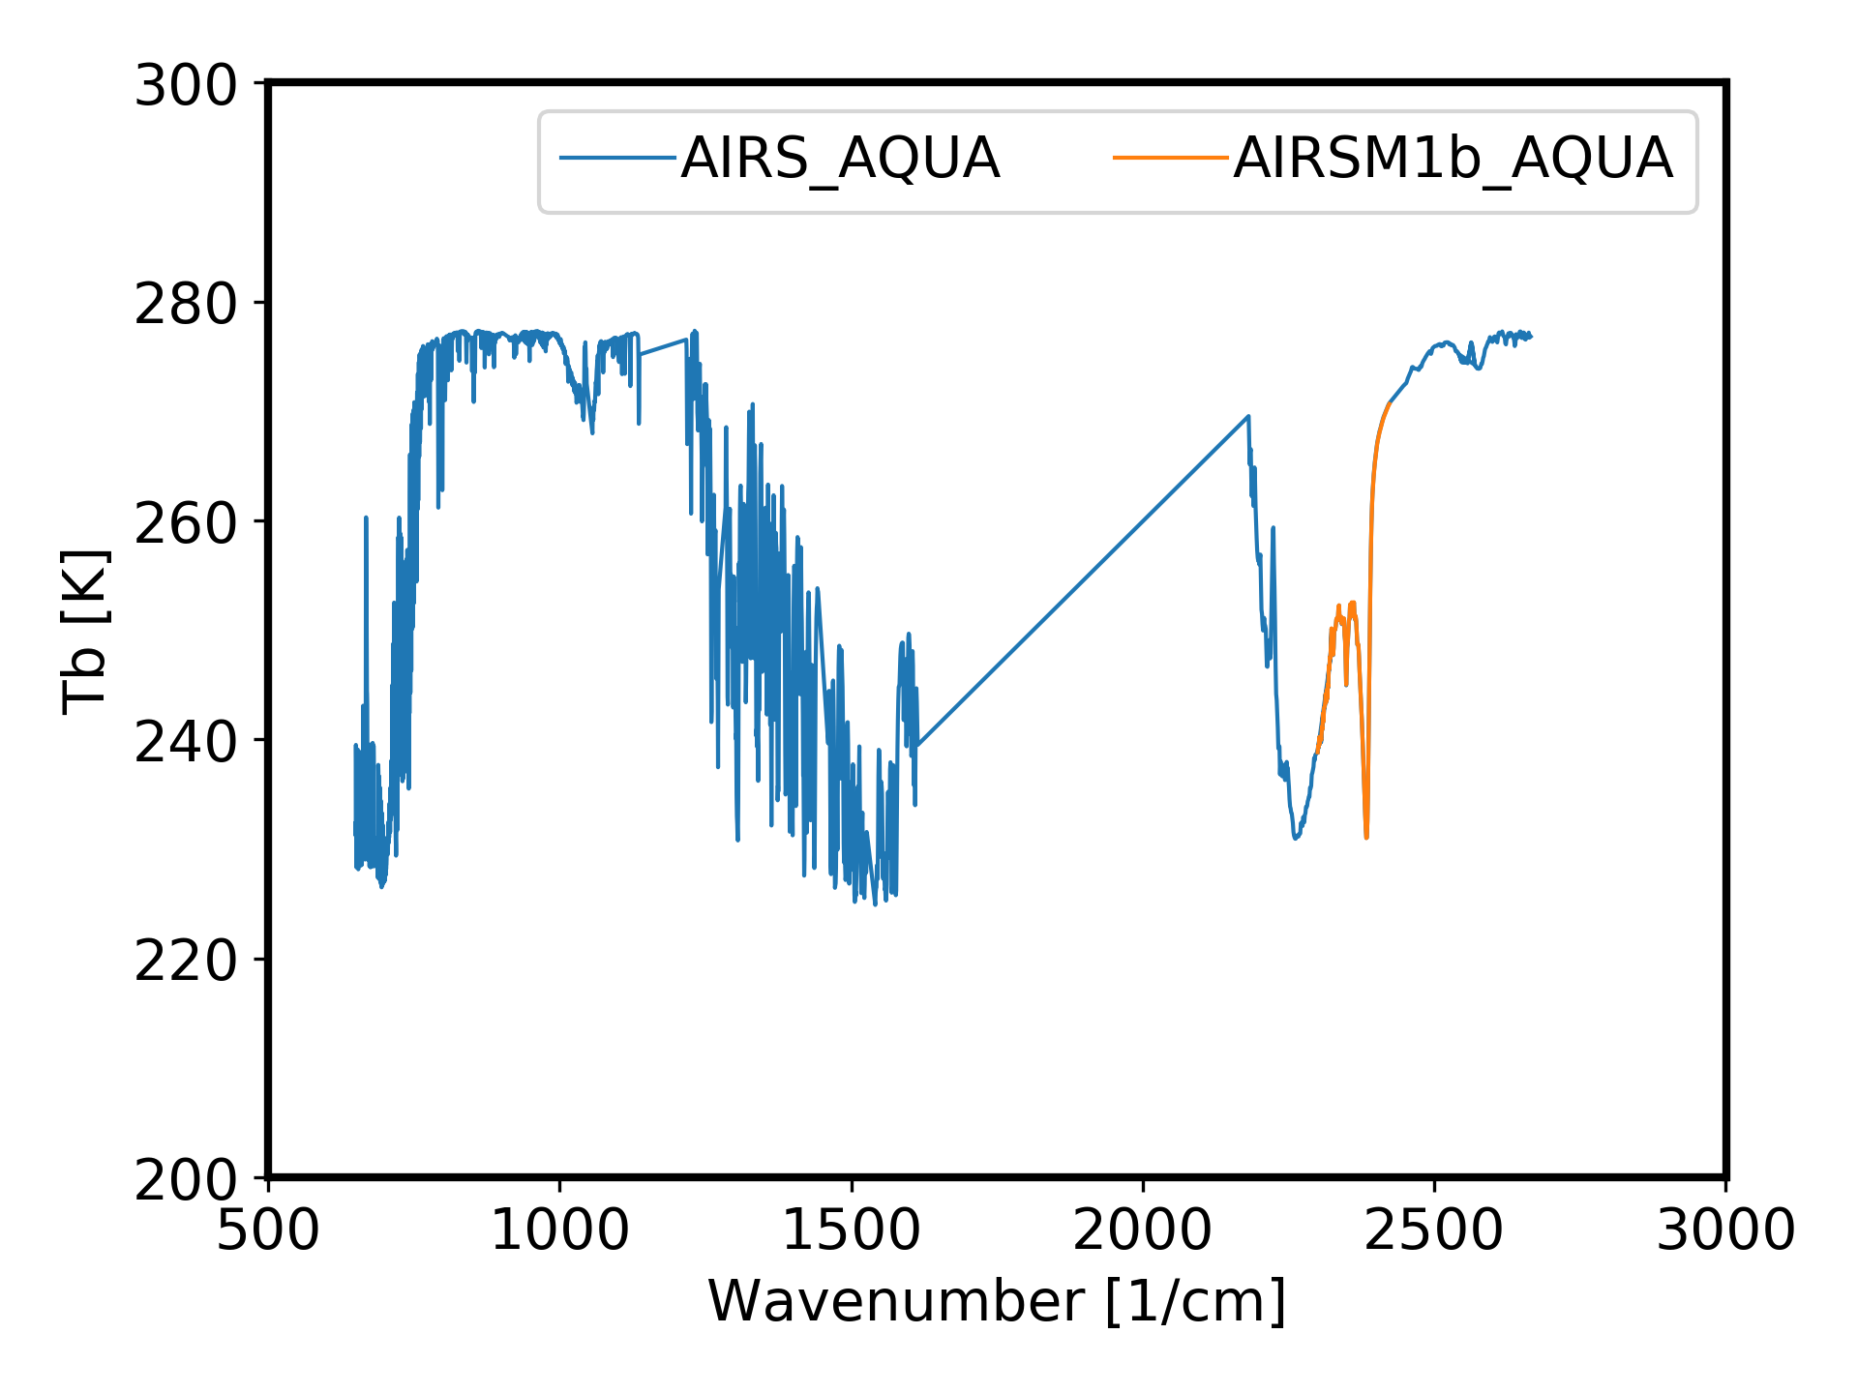
Spectral expansion of CRTM radiance and sensor simulation capabilities (I. Moradi)
Generating CRTM Coefficients Hyperspectral Infrared Instruments
Some discrepancies exist between coefficients generated using available CRTM coefficient generation package and previous operational coefficients. After an extensive evaluation, the problem is caused by some inconsistencies in the bash files that are used to process Tape5 files. Although this issues was solved for 2500 1/cm but later it was found that the problem still exist for the higher frequencies (next slide).

Slide 28
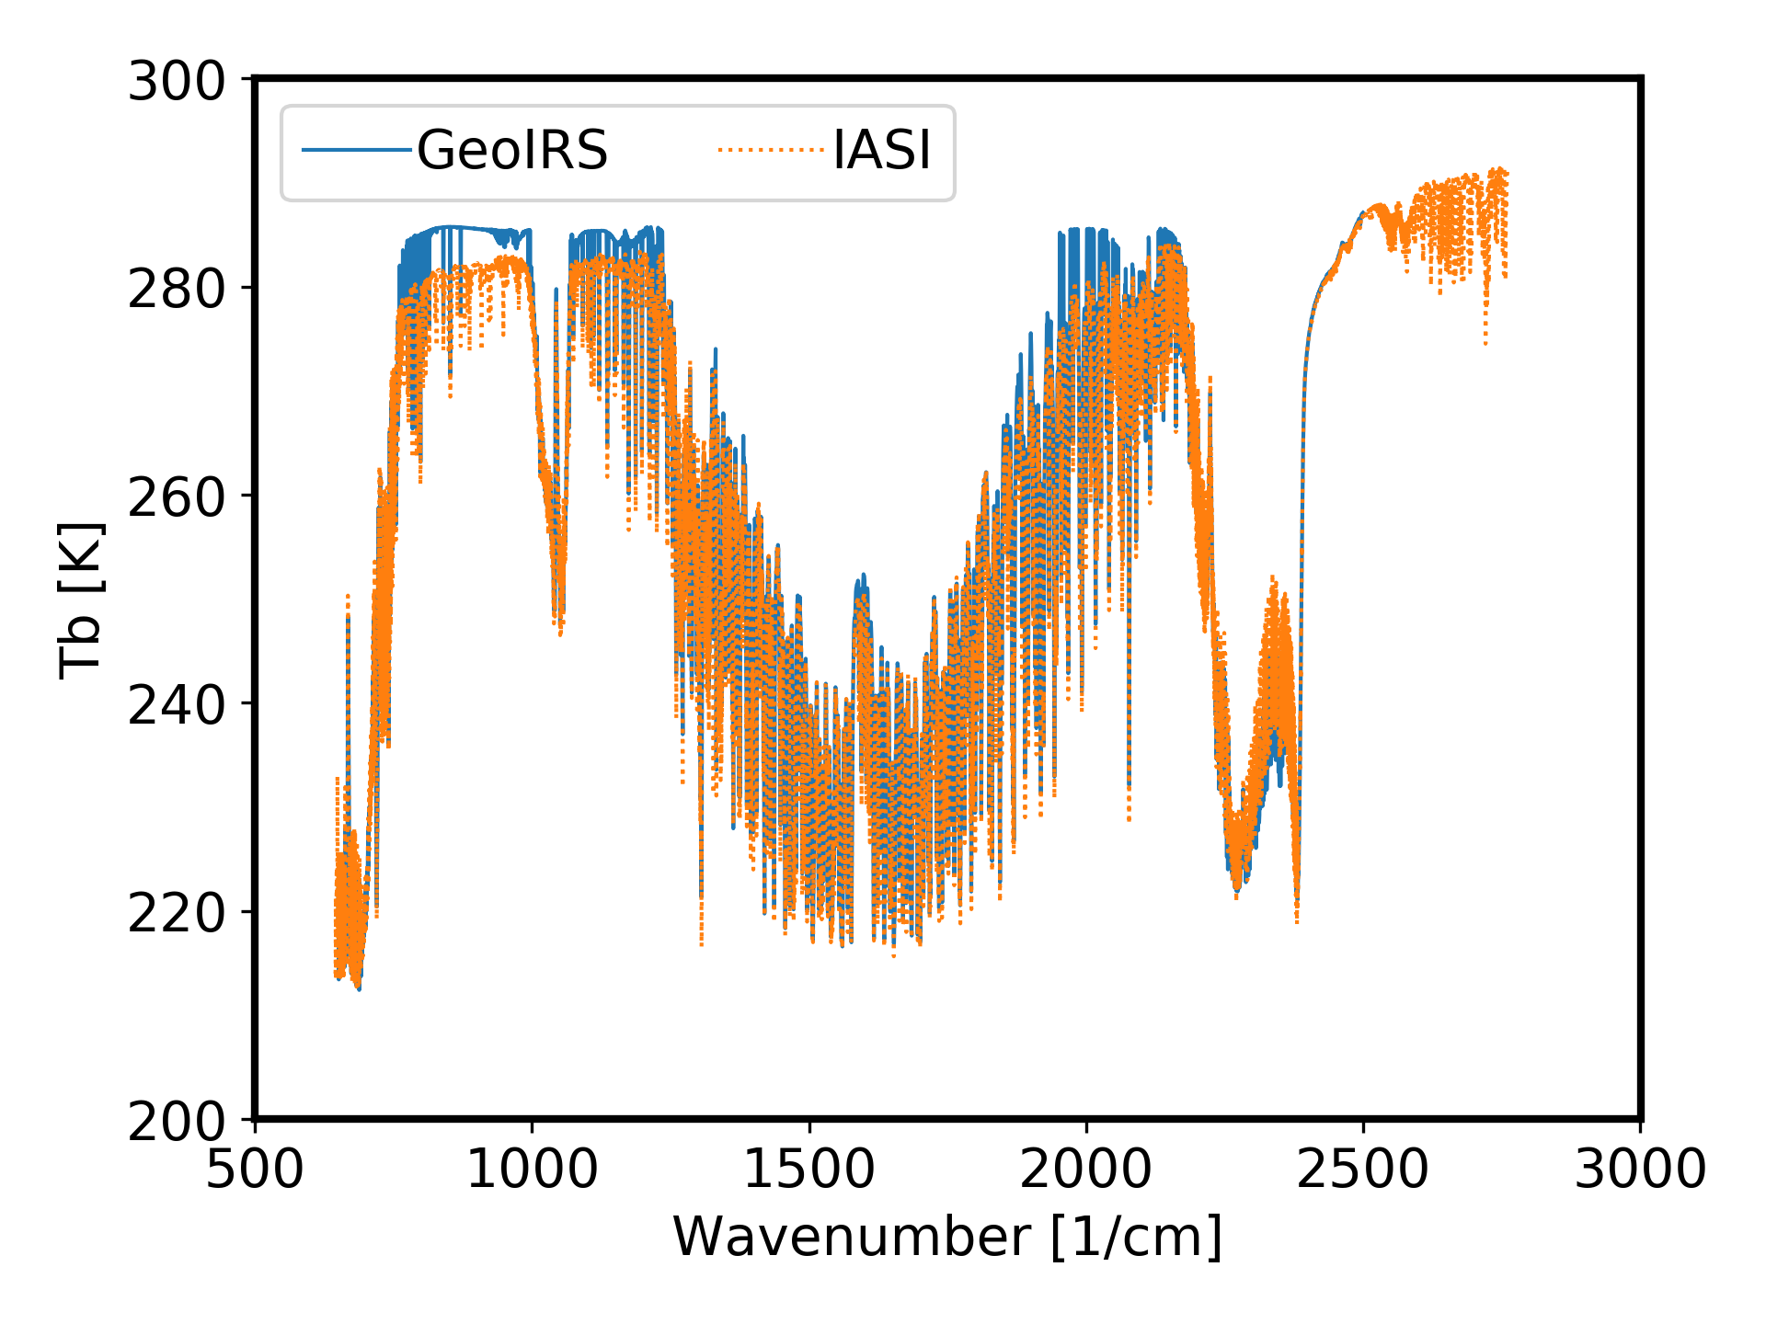
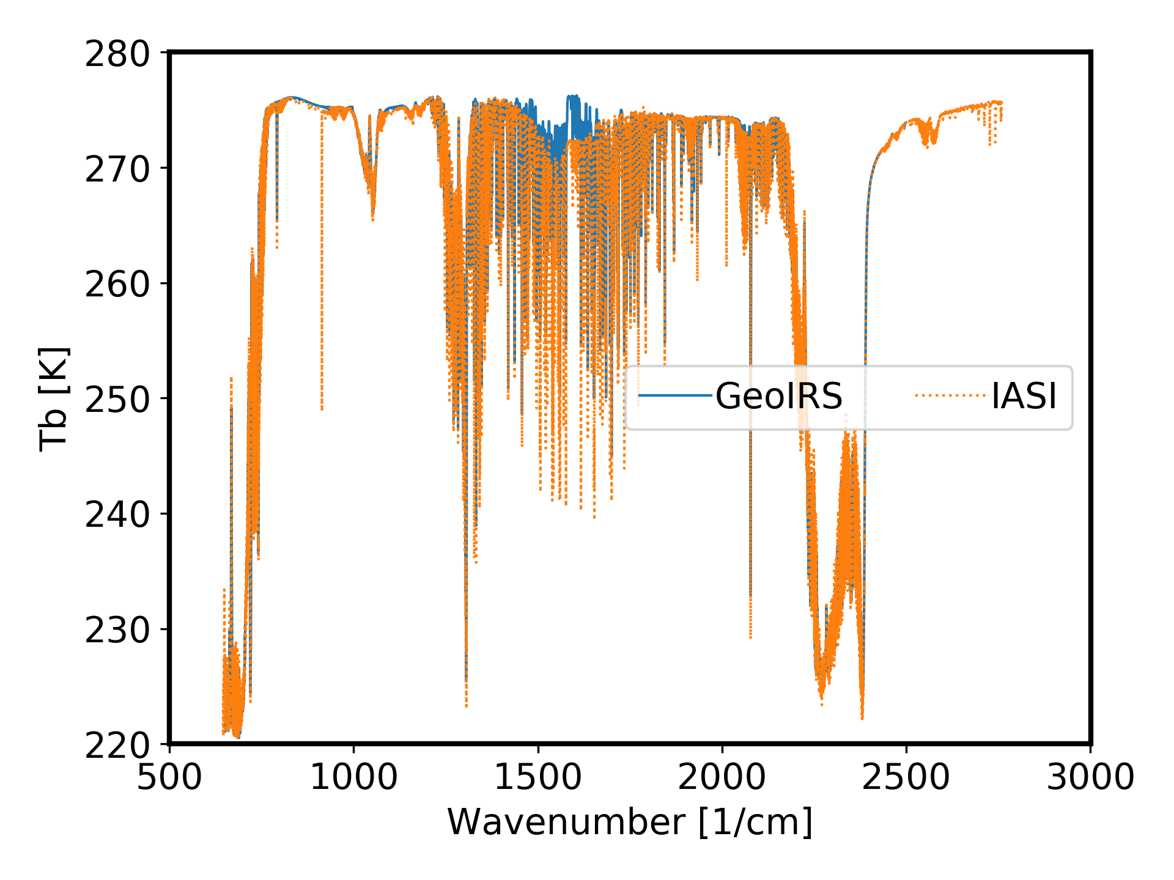
Spectral expansion of CRTM radiance and sensor simulation capabilities (I. Moradi)
Generating CRTM Coefficients Hyperspectral Infrared Instruments
The problem seems to depend on the profiles used to run CRTM. The left image was created using Era profiles as input and right image using FASCOD profiles as input. GeoIRS is an instrument similar to MSG IRS and IASI shows the operational coefficients.

Slide 29
AOP 2021 CRTM: Application Outcomes
Task
SimObs: H(x) + Jacobians
SimObs: Statistical Analysis
SimObs: Instrument Analysis / Monitoring
Analyze CRTM v3.0: Cloud/Aerosol Interactions
Create CRTM v3.0: Polarization vs. non-Polarized Impact Statistics
Generate CRTM Transmittance Package Coefficients
Evaluate AI-based replacements for regression methods and LUTs.

Slide 30
AOP 2021 Summary
1. Transmittance Coefficient Package for v2.x and v3.0
2. Cloud / Aerosol Coefficient Package and updated coefficient files for v2.4.x and v3.0
3. Ocean Surface Coefficients (LUTs) in support of v3.0
4. Land Surface Coefficients (LUTs) in support of v3.0
5. CRTM v3.0 release (Code + LUTs)
6. SIMOBS application + Utilities
7. CRTM AI: Transmittance
Science

Slide 31
Support / Contact
Website: https://www.jcsda.org/jcsda-project-community-radiative-transfer-model
Support:
https://groups.google.com/forum/#!forum/crtm-support
Support email:
crtm-support@googlegroups.com
Email: Benjamin.T.Johnson@noaa.gov for direct support, questions, and comments

