Slide 1
– Next Generation – Observation processing & Data Assimilation
Chiara Piccolo,
David Simonin and Stefano Migliorini

Slide 2
− NG Observation processing & Data Assimilation −
Content
Projects introduction
NG-OPS
Scope
Timeline
Achievements & Progress
NG-DA
Scope
Timeline
Achievements & Progress

Slide 3
− Projects introduction −
To reformulate and redesign our complete weather, climate research and operational systems to fully exploit future generations of supercomputer for the benefits of society, the MO has launched in October 2017 the Next Generation Modelling Systems program (~14 projects).
Next Generation Modelling Systems
Exec: Chiara Piccolo
PM: David Simonin
PM: Stefano Migliorini
NG Observation Processing System
NG Data Assimilation

Slide 4
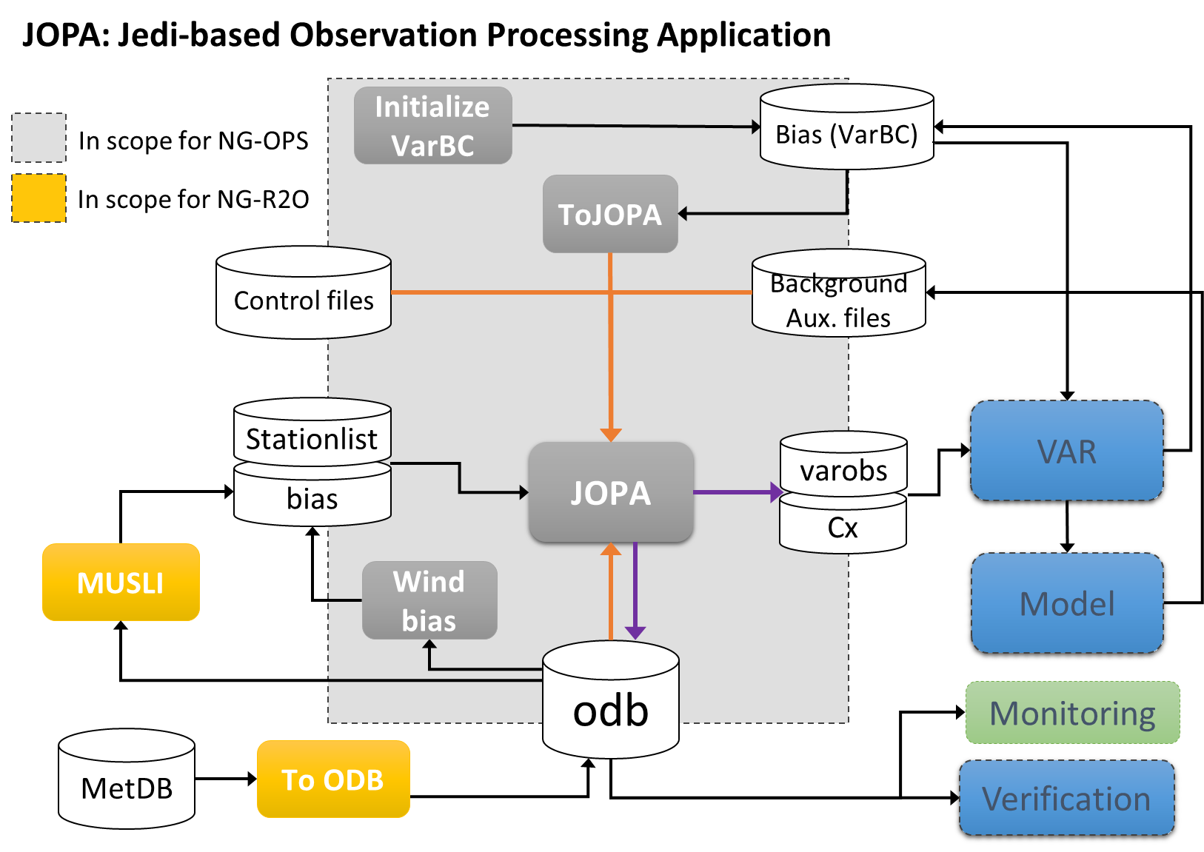
− Observation Processing System: Scopes −
NG-OPS
Delivering the Next Generation Observation Processing System within JEDI
Replicate our current Observation Processing science for atmospheric data assimilation.
Provide a system suitable for both global and regional domains.
Provide a system to allow the Met Office and its partners to fully exploit the opportunity provided by the future generations of supercomputer.
Compatible with our current NWP model and DA system.

Slide 5
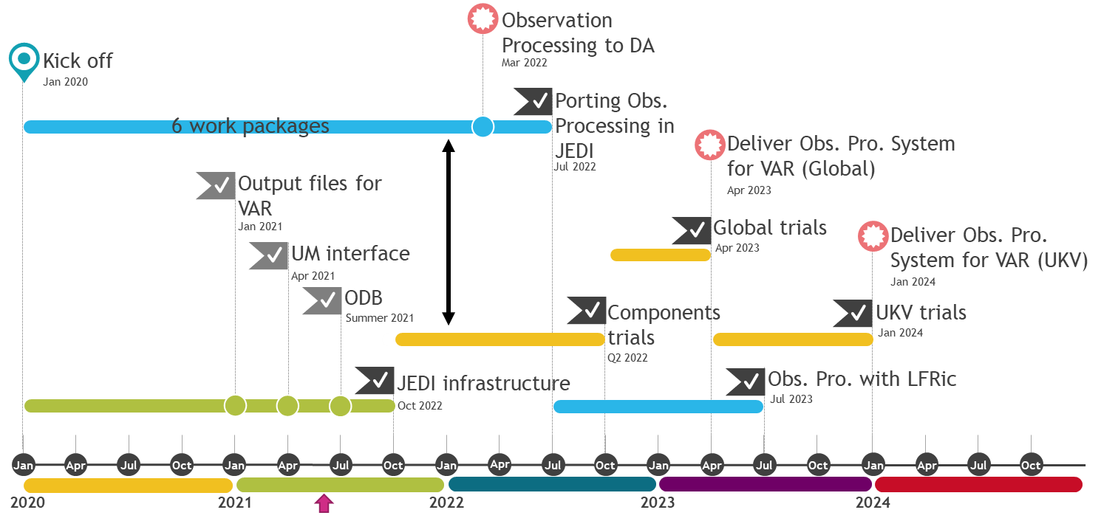
− Observation Processing System: Timeline −
NG-OPS

Slide 6
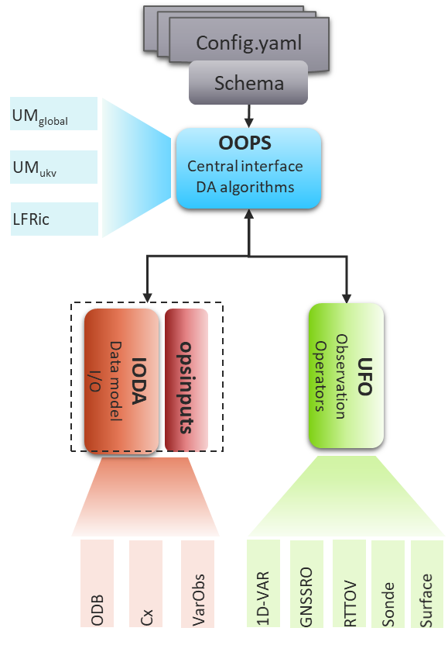
Interface to our current DA system
Various filters (QC, thinning, variable transform)
JSON-Schema-based validation of YAML configuration files
Composite operator (simulation of different variables with different operators)
Comprehensive suite of QC filters for radiosonde observations
Observation operators and TL/AD ported for GNSS-RO and ground-based GNSS
1DVar for GNSS-RO ported
Comprehensive suite of QC filters for radiosonde observations
1D-var and RTTOV interface are ready → ATMS
Varbc predictors and Static bias correction
More generic UFO filters
ODB full backend to IODA
Extending the automatic Schema
Auxiliary files interface (obs error, bias, station list, etc)
Improved UM interface (Background error / time interpolation)
Porting specific observation processing
− Observation Processing System: Achievements −
Achievements
Upcoming
In progress
Global UM interface (incl. background error, time interpolation )
Interface to our current DA system (VarObs/CX interface to IODA)
JSON-Schema-based validation of YAML configuration files
Multiple generic UFO filters (QC, thinning, shiptrack, variable transforms, where, etc …)
Composite operator (simulation of different variables with different operators)
Varbc predictors and Static bias correction.
1D-VAR and RTTOV interface are ready → Chawn’s talk on Radiances
Comprehensive suite of QC filters for radiosonde observations
Observation operators for GNSS-RO and ground-based GNS
Done
In progress
ODB backend to IODA
More UFO filters under way to port current observation processing science
Improving UM interface to handle variable grid
Improving station list conversion to Yaml and csv files

Slide 7
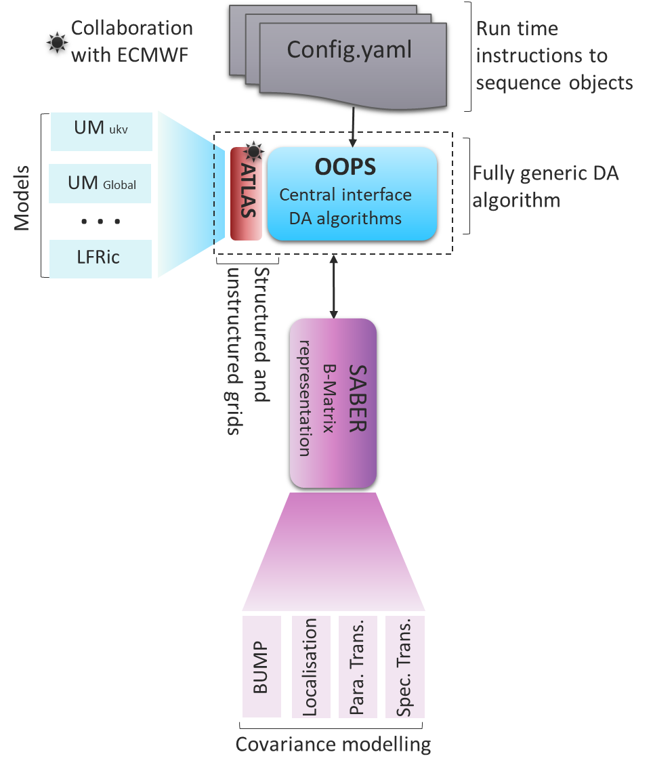
− Data Assimilation System: Scopes −
NG-DA
New science and innovation strategy: “putting ensembles at the heart of everything we do”
Delivering the Next Generation Data Assimilation system for the LFRic model within JEDI
Development of background error covariance model (in spectral space).
Development of alpha control variable for hybrid 4d-Var.
Development of a TL / Adj model for GungHo dynamic core and a localized ensemble tangent linear model (LETLM) for the physics
Review requirements and solutions for land surface DA.
Provide a system to allow the Met Office and its partners to fully exploit the opportunity provided by the future generations of supercomputer.

Slide 8
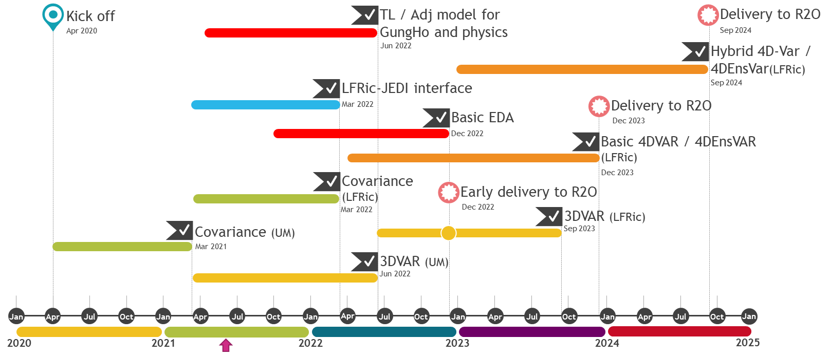
− Data Assimilation System: Timeline −
NG-DA

Slide 9
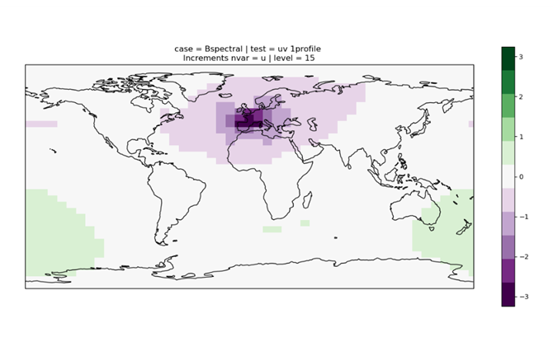
− Data Assimilation: Achievements & Progress −
Background Error Covariance
B matrix for the UM, based on Atlas for EndGame grid stagger (theta and rho levels)
$$B=U_{p}U_{h}U_{v}U_{v}^{T}U_{h}^{T}U_{p}^{T}$$
Parameter Transform ($U_{p}$) in UM-JEDI interface (stream function, velocity potential, unbalanced pressure and linear humidity variable)
Spatial transform ($U_{h}U_{v}$) based on spectral transform of background errors using ECMWF’s Trans library
In progress
Production of the TL/AD of GungHo dynamic core.
In collaboration with STFC within the LFRic framework (i.e., PSyclone).
LFRic-JEDI interface
Currently completing the cubed sphere implementation in Atlas
Comparing Operational B with JEDI-based B using 3D-VAR and the UM
U - component
Single observation test using the new Background Error covariance
(Low resolution run)
Notes:
(To project the increments – HV or VH) Trans library: spherical harmonic and FFT (FFTW)

Slide 10
Thank you very much

