Slide 1
U.S. Air Force Global Weather
Modeling: Status Update and Future Vision
Major Kurtis Schubeck
Chief, Weather Prediction Strategy
Air Force Weather

Slide 2
Overview
USAF Modeling Modernization
Current Global Air Land Weather Exploitation Model (GALWEM) Status
Modernization and the JCSDA

Slide 3
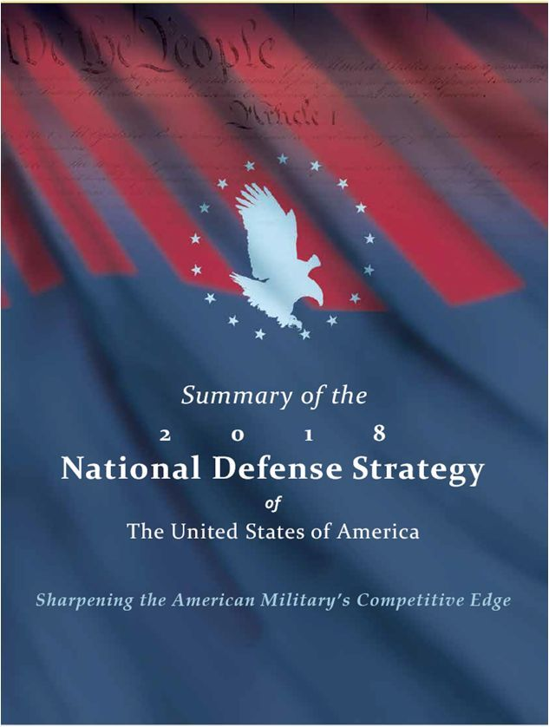
AF Weather Strategic Vision based on the National Defense Strategy
Lethality and Readiness
  Improve Integration
  Enhance Resiliency
  Realign Our Force
Alliances & Partnering
  DoD & Government Agencies
  Allies & Trusted Coalition Partners
  Industry & Academia
Reform for Performance and Affordability
  Rapidly Modernize
  Attack our inefficiencies
  Redesign our Force

Slide 4
Objectives
Improve/Evolve/Sustain Existing Capability to Fully Meet Current User Needs
Provide Modeling Capability to Meet Gaps
Add Resilience To Our Modeling System

Slide 5
Challenge
The future challenge of near-peer conflict and the needs of future weapons systems to compete in that conflict will not be met by our current modeling approach
Operational needs are not always aligned with strategic goals in a constrained environment
The USAF does not have an in-house research lab dedicated to RDT&E for weather modeling capabilities

Slide 6







Interagency Modeling Partnerships
USAF is a core partner in several interagency consortia
  Joint Center for Satellite Data Assimilation (JCSDA)
  Developmental Testbed Center (DTC)
  National Earth System Prediction Capability (ESPC)
USAF also leveraging bilateral and group partnerships
  UK Met Office: Unified Model (UM)
  DOE/ORNL: HPC, model optimization, inundation mapping
  NCAR: WRF (legacy), NWP improvements for clouds
  NASA/GSFC: Land Info System (LIS)
  USACE/ERDC: Streamflow prediction, dust modeling

Slide 7
Current GALWEM Status

Slide 8
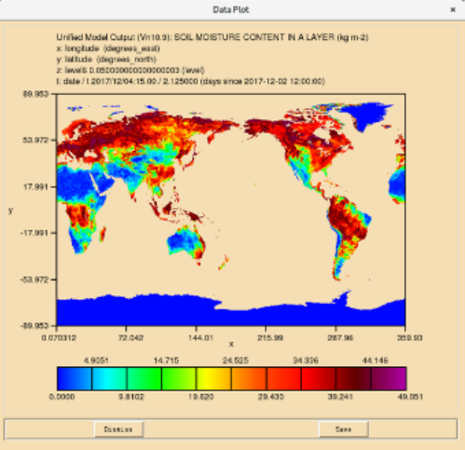
Current GALWEM Status
Global Air-Land Weather Exploitation Model (GALWEM)
  Primary numerical model input for all AF and Army operations
  Runs 4x/day to 240 hours at ~17 km horizontal resolution
    Upgrade to 10 km horiz res planned on System 11
  Unified Model V. 10.9 based, fed with UK Met Office initial data
  Hybrid 4DVAR DA based on a combination of 557 WW organic and UKMO observation data
  Products/gridded data available via web services/web pages

Slide 9
GALWEM Global Ensemble >>
Global Ensemble Prediction Suite
Global Ensemble Prediction Suite (GEPS)
  Currently populated by NWS, CMC, USN global ensembles
    21 members each = 63 members
  Tailored by USAF to create products for probability of exceedance of thresholds for key ops parameters
New GALWEM Global Ensemble (GE) 16-day forecast
  21 members; 40 km horizontal res; 70 vertical levels
  Added GALWEM Global Ens to all GEPS products
    21 GE members + 63-member suite = 84-member suite
    Initial testing showed improvements w/GALWEM added
    84-member suite in ops for Tropical Tracker; others to follow
    Inclusion in National ESPC ensemble pending (2021)

Slide 10
USAF Regional Modeling
Current regional modeling system based on WRF model
  No separate mesoscale DA; initialized directly from global model
Mesoscale Ensemble Prediction System (MEPS)
  4-km horiz res; run every 2 hours; forecast to 84 hours
  GALWEM/GFS/GEM for IC/LBC and LIS/GALWEM for lower BCs
  6 current static domains; ~5-10 relocatable floating domains
Deterministic High-res WRF
  Most windows at 1.67 km horiz res; a few large domains at 5-km
  Run every 6 hours; forecast to 30 hours
  IC/LBCs are GALWEM and Lower BC is GFS
  Currently eight 1.67-km domains, two 5-km domains; some over routine areas (e.g., Alaska), others cover special focus areas

Slide 11
Modernization and the JCSDA

Slide 12
Lines of Effort
Objective: Improve/Evolve/Sustain Existing Capability to Fully Meet Current User Needs
  Pursue Explicit Cloud Forecast Capabilities
  Land Modeling (LIS)
Objective: Add Resilience To Our Modeling System
  Cloud Computing
  Classified Computing
  Non-Traditional/Commercial Data Sources
  Modeling Operations with Limited Data Sets
  Multiple Model Ingest for Model Blending

Slide 13
Final Thoughts

Slide 14
Questions?

