Slide 1
NOAA/OAR Overview and Plans on Data Assimilation Stan Benjamin NOAA / ESRL / GSD OAR representative for JCSDA Executive Team
18th JCSDA Technical Review and Science Workshop
on Satellite Data Assimilation 7-11 June 2021 - virtual
Ongoing work contributions From:
ESRL/GSD – Ming Hu, Guoqing Ge, Haidao Lin, Steve Weygandt
Eric James, Ravan Ahmadov, Mariusz Pagowski
Terra Ladwig
NSSL –Thomas Jones,
ESRL/PSD – Jeff Whitaker, Sergey Frolov, Clara Draper
OAR DA | Coupled DA | CAM-scale | Satellite

Slide 2
Ocean-Atmosphere DA
Development of the local volume solvers in JEDI
Development of the generic LETKF/GETKF solver completed (see talk by Frolov et.al on Tuesday 7 June)
Computational optimization (underway)
Verification against GSI EnKF (underway)
Developing of advanced localization options specific to land and ocean DA (underway)
Coupled Data Assimilation:
Development of the cycling coupled ensemble system (underway)
Prototype of the strongly coupled DA in sparse input configuration (later this year)
OAR DA | Coupled DA | CAM-scale | Satellite
Jeff Whitaker, Sergey Frolov, Wei Huang - PSL

Slide 3
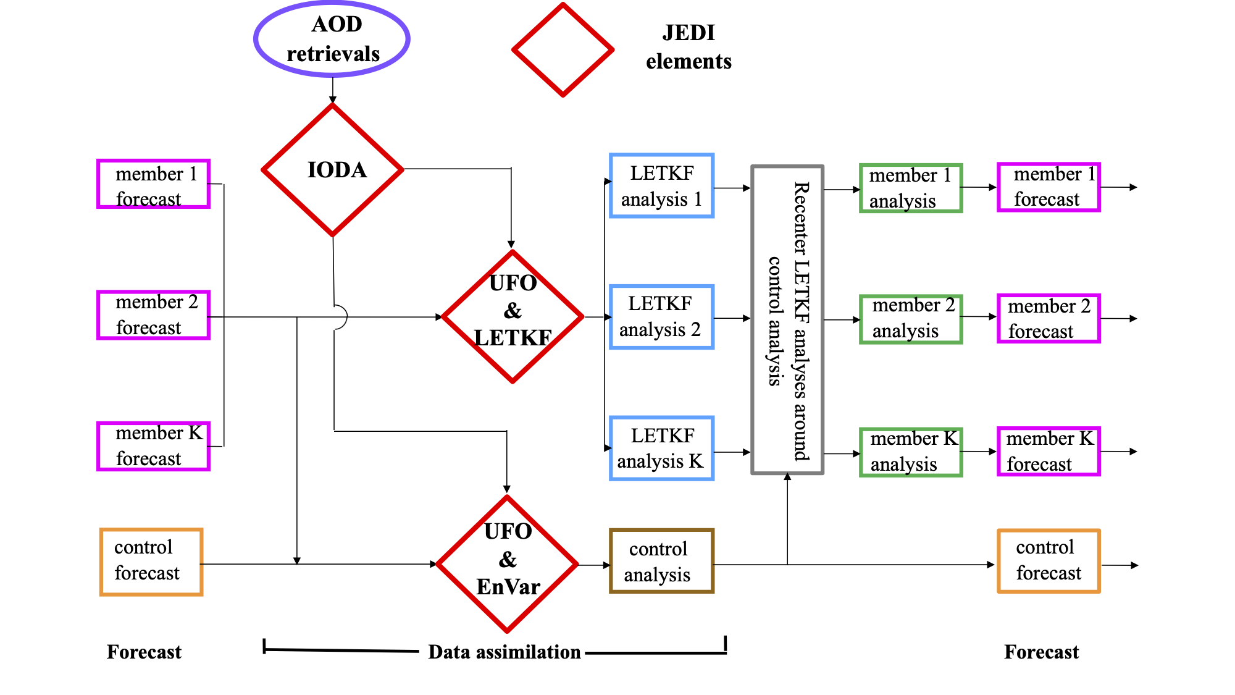
JEDI-based global aerosol EnVar DA system
AOD: VIIRS aerosol optical depth (AOD) at 550 nm;
JEDI: Joint Effort for Data assimilation Integration -- a collaborative effort led by JCSDA;
IODA: Interface for Observation Data Access;
UFO: Unified Forward Operator;
LETKF: Local Ensemble Transform Kalman Filter
EnVar: Ensemble-Variational solver.
Mariusz Pagowski, Sam Trahan - GSL,
Cory Martin, Andrew Tangborn, Daryl Kleist – EMC
OAR DA | Coupled DA | CAM-scale | Satellite

Slide 4
NOAA Research
- GSI / DA
Dec 2020 NCEP implementation - RAPv5/HRRRv4
Satellite-related
Data Assimilation | Model | Land-surface / post
Merged with GSI trunk – 2019 New Observations for assimilation: GOES-16 radiances, new full-res channels for CrIS/ATMS TC vitals for trop cyclone location/ strength Aircraft/raob moisture obs for p<300 hPa VIIRS/MODIS fire radiative power Assimilation Methods: HRRR - 3km ensemble DA (36 mems out to 1h) HRRRDAS mean for HRRR IC and BEC | WRF-ARWv3.9+ incl. physics changes Physics changes: MYNN PBL update – better sub-grid clouds, improved EDMF mixing - remove limit for subgrid qc/qi - decrease subgrid qc/qi radii RRTMG modifications for subgrid clouds Aerosols sources/sinks – fire/smoke, dust - Add smoke with VIIRS/MODIS FRP Improved land-surface/snow model including better 2m T/Td diagnostics Latest Grell-Freitas conv (RAP only) Lake model for small lakes Enhanced gravity-wave drag Numerics changes: Reduced 6th order diffusion inc. hydrometeors Removal of mp_tend_lim Explicit-Implicit vertical advection | Switch to MODIS albedo (higher), replace 1-deg albedo. Add zenith-ang albedo adjustment 15” resolution land-use data Fractional sea/lake ice concentration FVCOM data for Great Lakes lake temp/ice concentration VIIRS/MODIS/GOES fire radiative power 2018 – VIIRS greenness veg fraction added to HRRR and RAP
OAR DA | Coupled DA | CAM-scale | Satellite

Slide 5
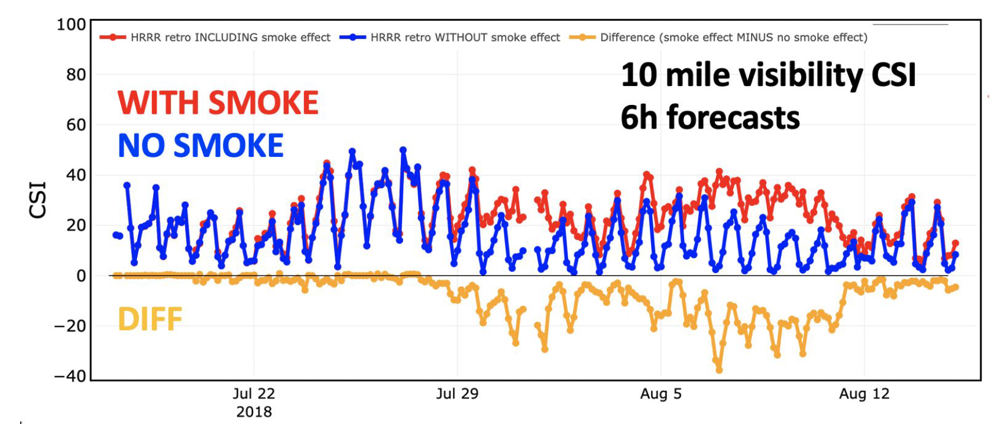
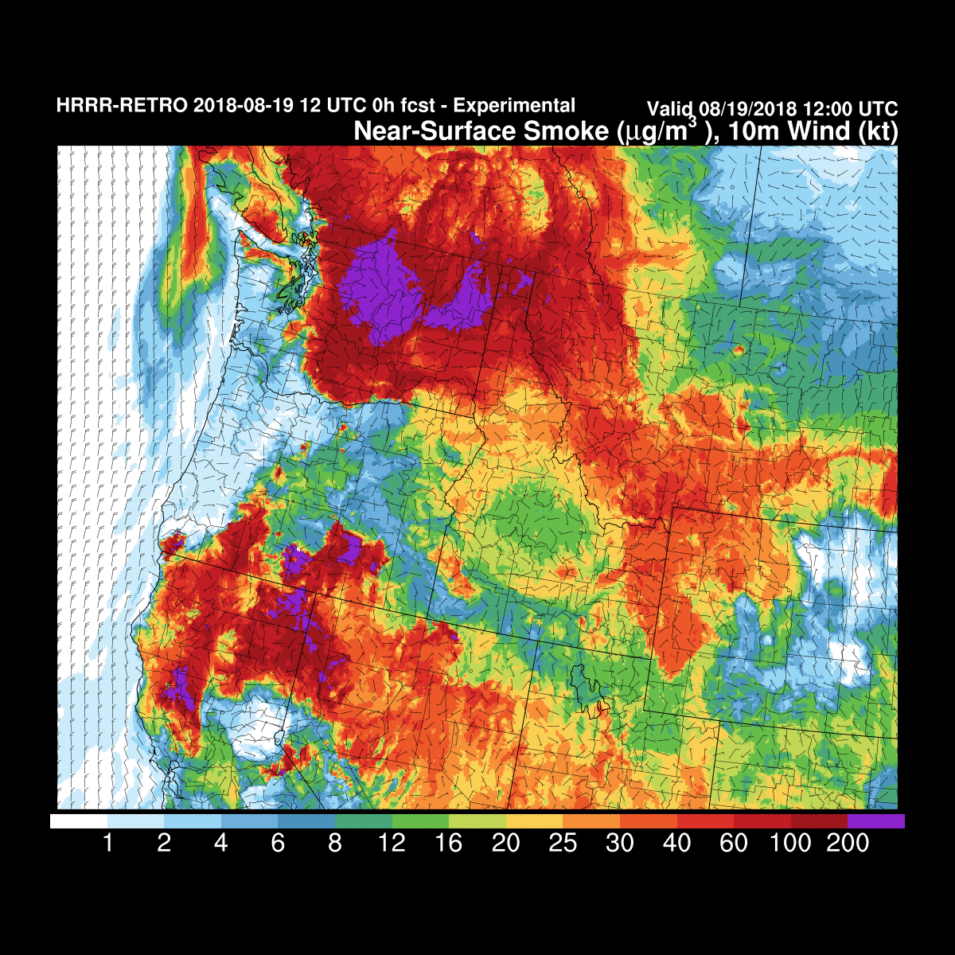
Verification of Surface Visibility Forecasts by HRRR-Smoke - Western US
HRRR minus HRRR-Smoke
CSI - critical success index (%)
The measurements from over 400 weather stations are included in this verification
HRRR-Smoke - first NWP model in the US to include interactive aerosols (via sat-obs fire-radiative power) and impact on radiation and visibility diagnostics.
2021 Global Systems Laboratory Science Review
OAR DA | Coupled DA | CAM-scale | Satellite
Ravan Ahmadov, Eric James - GSL
Notes:
By including smoke into our weather forecast models we can improve weather and visibility forecasting. These time series plot shows 2 lines - one the previous version of the HRRR model (in blue) and the other HRRR with smoke (in red). The time series plot shows significant improvement in the visibility forecasting over the NW US over the regular HRRR model. In some cases the regular model w/o smoke doesn’t show forecast skill at all. Real-time visibility data from ~450 weather stations in the western US are used in this verification.
Similar improvement for temperature. CSI (Critical Success Index), for surface visibility < 10 miles, forecast length: 6 hours, average over the domain;
CSI= X/(X+Y+Z) X- true alarm, Y- miss, Z- false alarm; CSI is an indicator of warning skill used in weather forecasting.

Slide 6
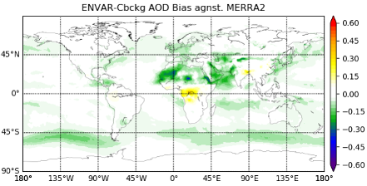
Assimilation System for Aerosol Analysis and Forecasting
Satellite based observations of Aerosol Optical Depth (AOD) at 550 nm are assimilated with JEDI software and enable aerosol prediction.
High AOD indicates large aerosol concentrations that can impact radiation, cloud and rain formation, and air pollution.
Assimilating VIIRS AOD Retrievals in Action:
Dust Storm over North Africa June 15-25, 2016
Evaluation Statistics
June 2016
Observations
Background
Analysis
Free Forecast Bias
Reanalysis Bias
Regional variational assimilation (GSI-based) of hourly in-situ PM2.5 measurements and AOD for RRFS-CMAQ under development.
2021 Global Systems Laboratory Science Review
OAR DA | Coupled DA | CAM-scale | Satellite

Slide 7
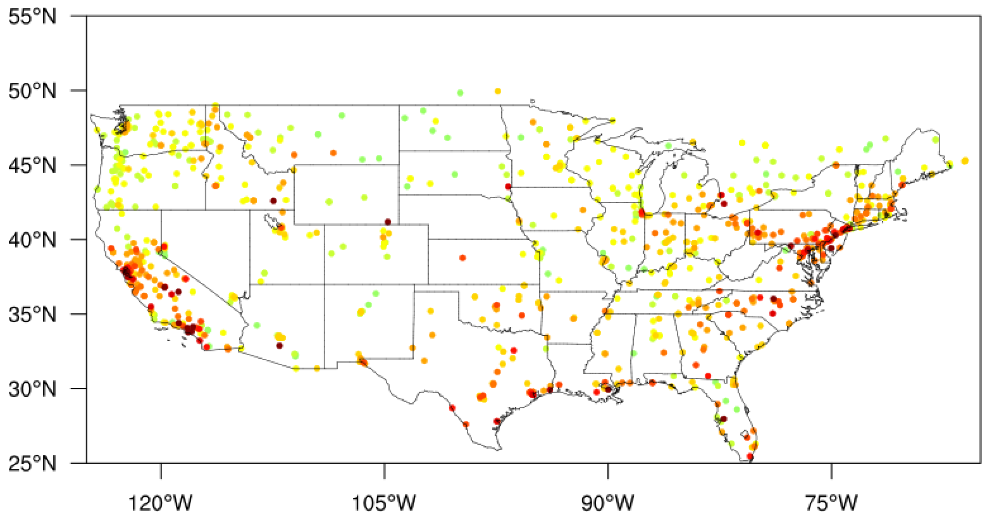
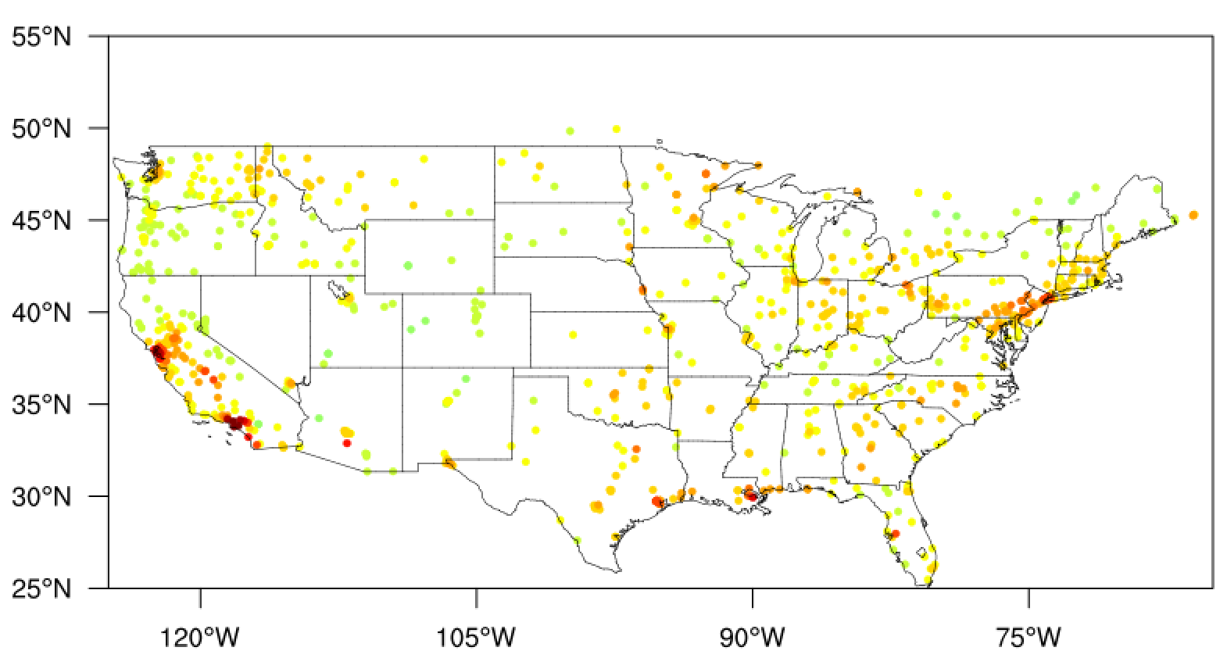
Regional Assimilation System for Air Quality Analysis and Prediction
The objective is to improve operational analysis and prediction of wildfire smoke and emissions and their impacts on air quality over CONUS with RRFS-CMAQ (Community Multi-scale Air Quality Model).
GSL is collaborating with EMC, ARL, JCSDA and planning its operational implementation in 2021.
Variational assimilation (GSI based) of hourly in-situ PM2.5 measurements and Satellite retrievals of Aerosol Optical Depth (AOD) at 550 nm for RRFS-CMAQ is under development and preliminary assimilation capability has been established.
Analysis of PM2.5 is more close to observation after GSI analysis.
Case: 19UTC 15 Aug 2019
PM2.5 Obs (ug/kg): avg= 7.31659
Background: avg= 5.36948
Analysis: avg= 6.30807
Earth System Prediction: Advanced Data Assimilation
Hongli Wang, Ruifeng Li - GSL
OAR DA | Coupled DA | CAM-scale | Satellite

Slide 8
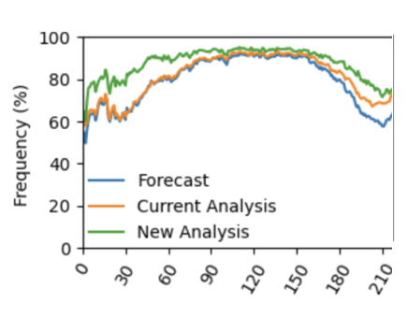
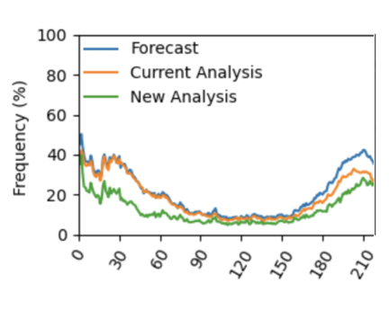
Modernizing the GFS/GDAS snow DA
Currently, snow fields are updated by ingesting AFWA’s SNODEP gridded snow analysis (QC’ed with IMS snow cover obs) using a simple rule-based method
To replace this, PSL (Tseganeh Gichamo) has developed an Optimal Interpolation snow depth analysis based on the schemes used at other NWP centers
Modern DA algorithm, directly ingests station-based snow depth and IMS snow cover observations
Tests in cycling UFS (GFSv16) show it improves snow states, and T2m over snowy regions
Current status: converting to JEDI, updating to GFSv17/Noah-MP, before testing for final UFS implementation (with EMC partners)
Hit Rate [%]
Miss Rate [%]
Difference in T2m Mean Absolute Error [K]
Clara Draper, Tseganeh Gichamo - GSL
OAR DA | Coupled DA | CAM-scale | Satellite

Slide 9
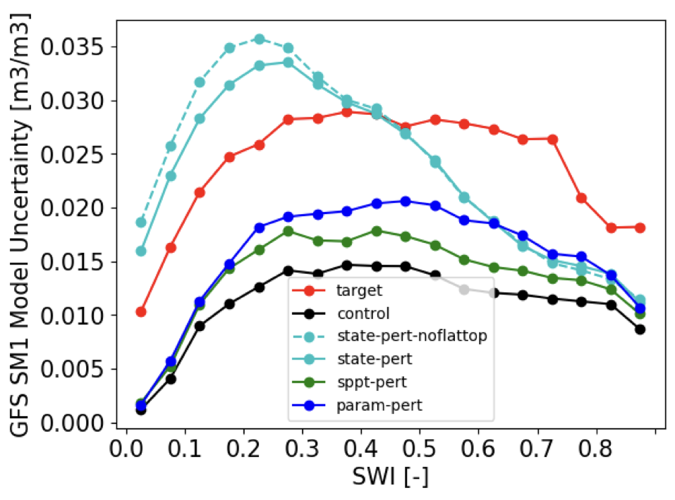
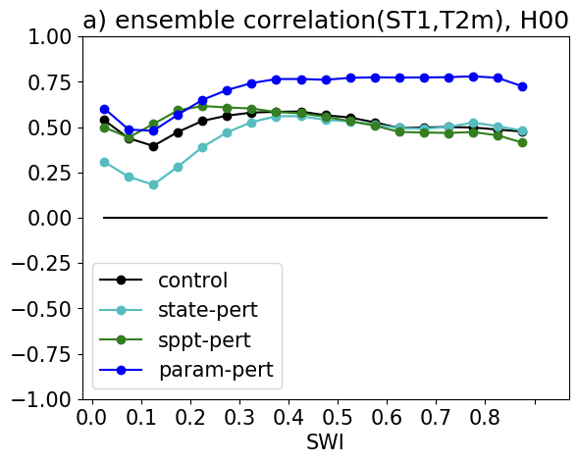
Adding soil state DA to the GFS/GDAS
Developing a coupled land/atmosphere Ensemble Kalman Filter (EnKF) to update model soil moisture and temperature from 2m temperature and humidity obs, using same EnKF and ensembles used by GSI atmos DA.
First step: NWP ensembles are under-dispersed at the land surface. Developed a scheme to enhance GFS ensemble spread, by perturbing parameters controlling the land/atmosphere fluxes
Creates ensemble with reasonable spatial patterns of ensemble spread, and land/atmosphere error covariance estimates representative of errors in those fluxes)
Status: Land perturbation method being updated to Noah-MP, EnKF coded but needs significant refining and testing
Surface soil moisture forecast error estimates,
from various ensemble experiments, and an obs.-based target (red), plotted by Soil Wetness Index.
Nighttime error correlation between soil temperature and T2m, from various ensemble experiments, plotted by Soil Wetness Index.
OAR DA | Coupled DA | CAM-scale | Satellite
Draper (2021), J. Hydromet, JHM-D-21-0016
Notes:
Currently, no direct constraint on soil moisture or soil temperature using observations (GLDAS retrospectively corrects soil states with observed precipitation)
All other major NWP centers assimilate 2m obs (& often satellite soil moisture), use simpler DA algorithms called separately from atmospheric DA

Slide 10
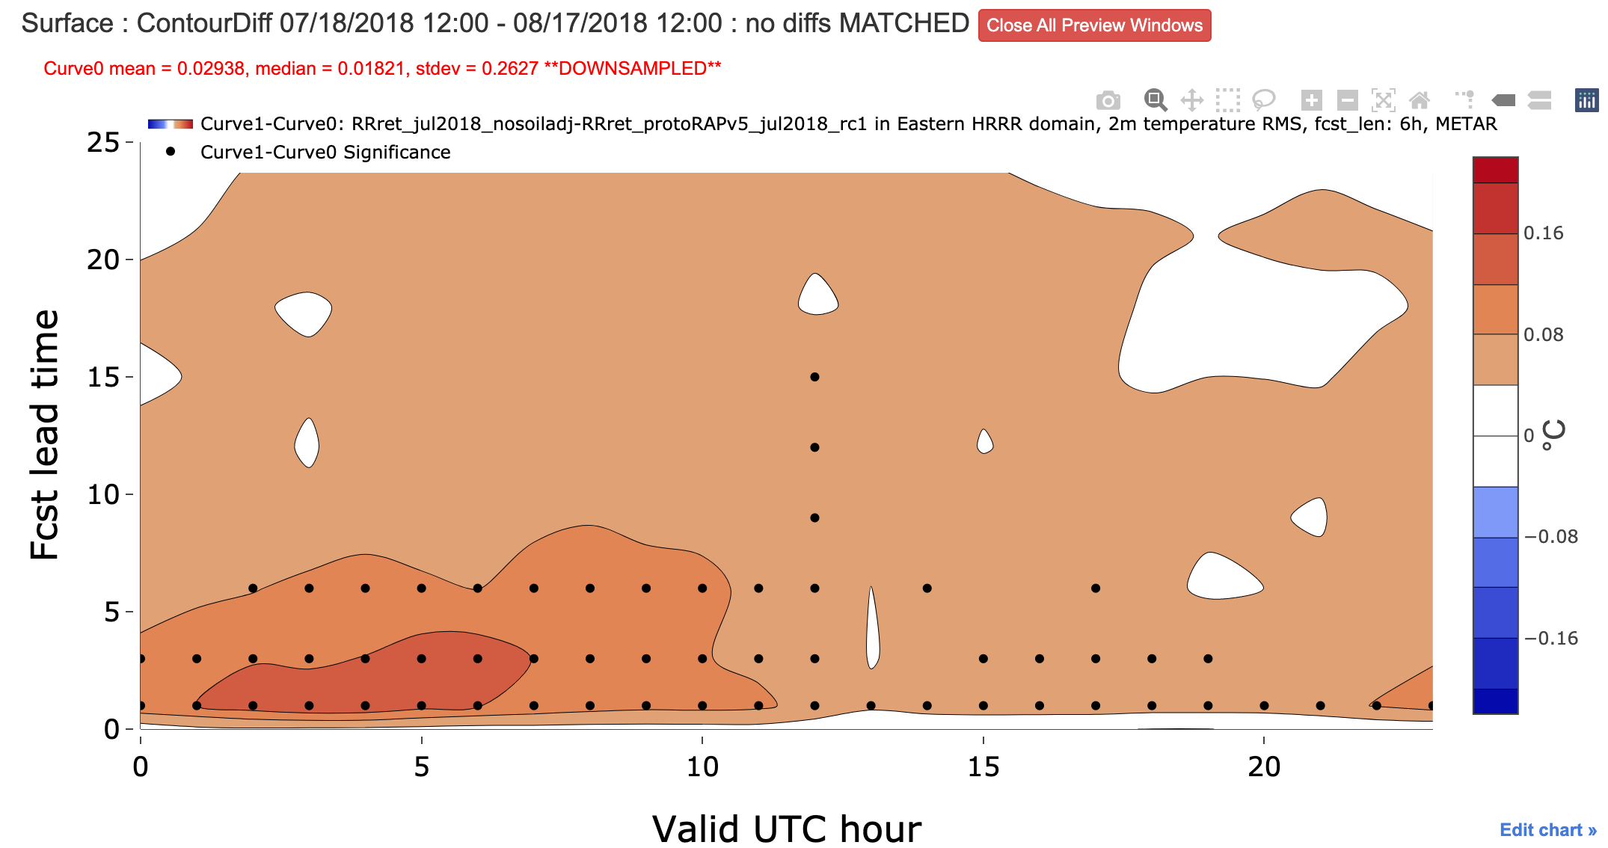
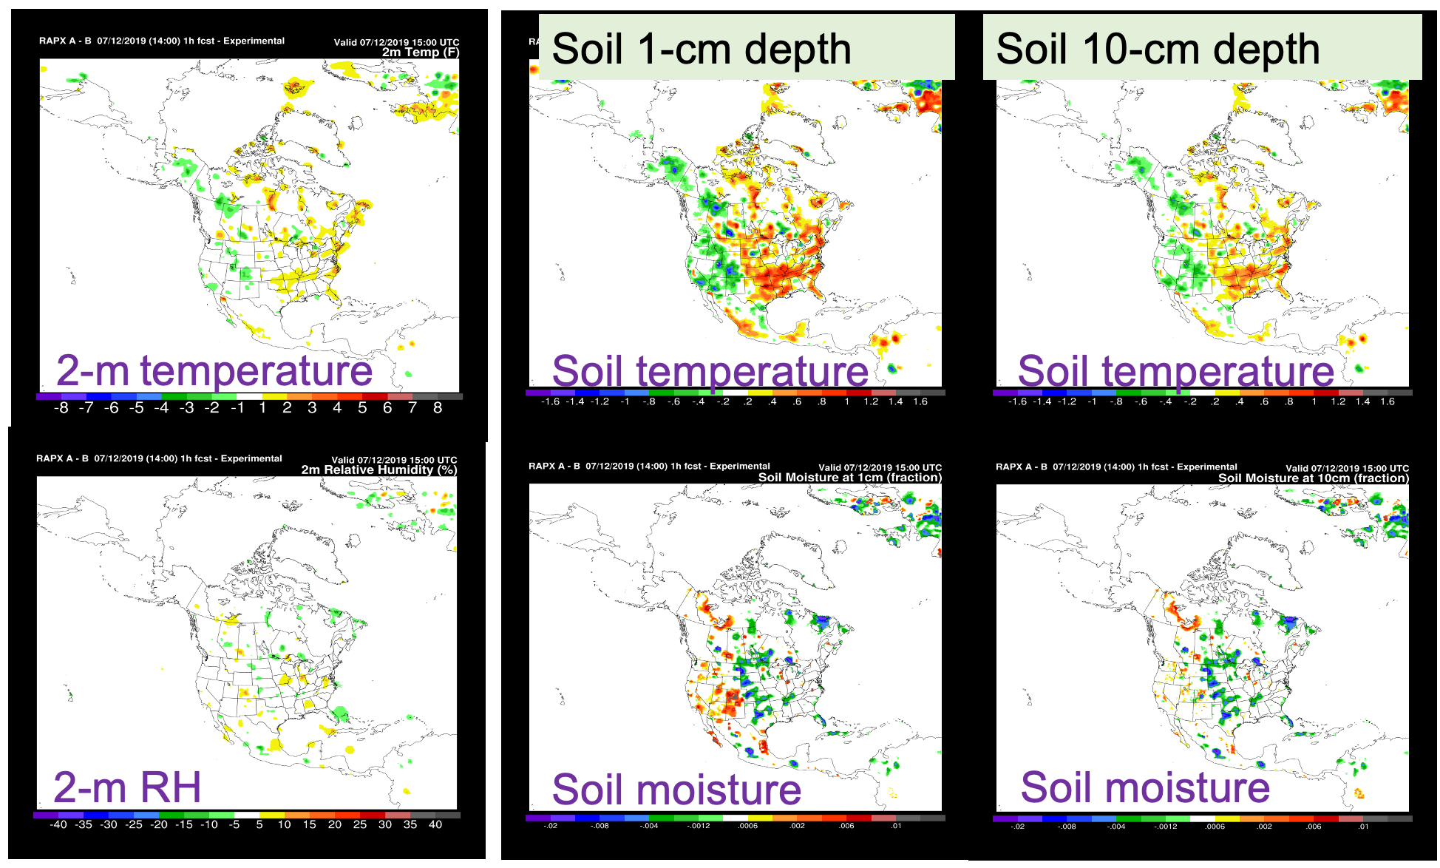
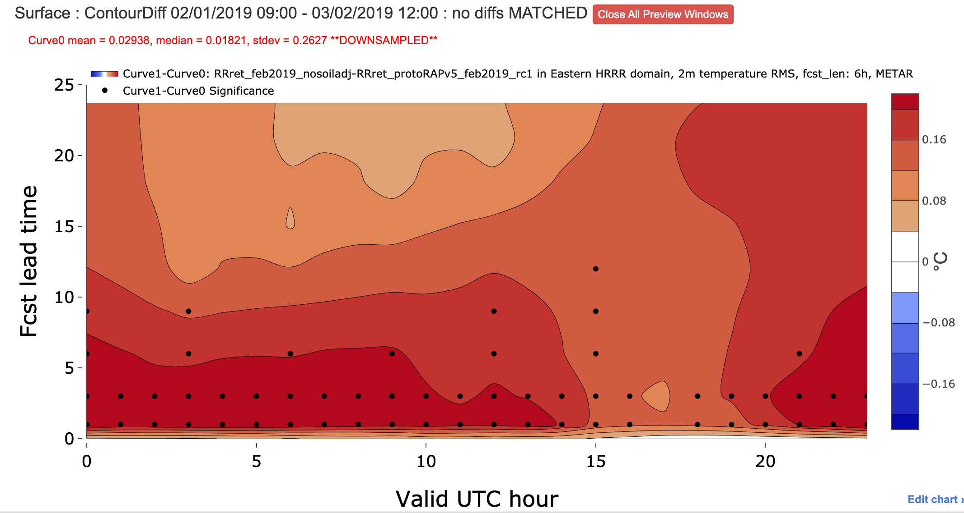
30-day RAP experiments without/with soil DA – 2m temp skill
1-way atmos-to-soil coupled DA with RAP
- New parallel tests
Summer – without minus with
2m RMS error – eastern US
Dots – 95% signif
Winter – without minus with
Significant improvement for 2m temps out to 6-12h for summer and especially winter
OAR DA | Coupled DA | CAM-scale | Satellite
Benjamin et al 2021 – manuscript in preparation

Slide 11
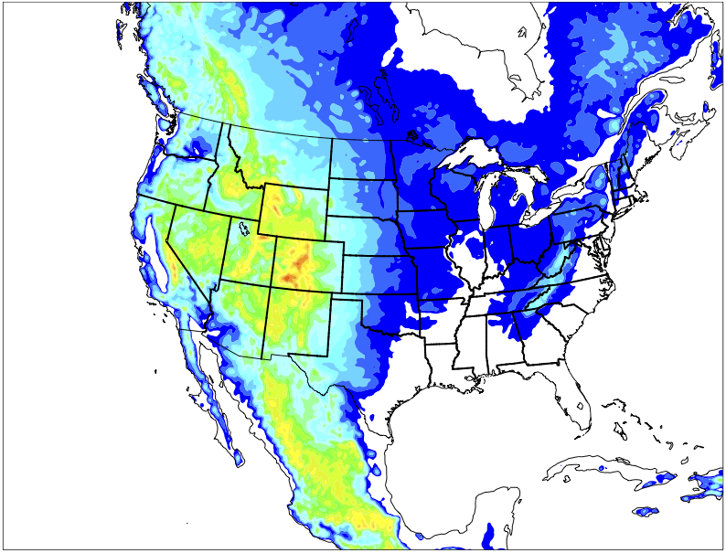
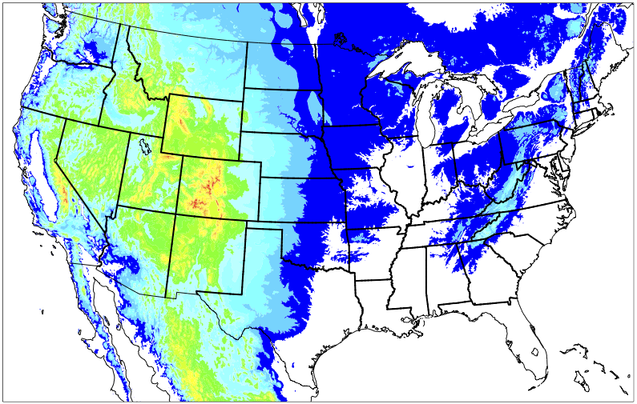
Convective-Scale Ensemble Based Assimilation
Ensemble covariances provide temporal and flow dependent information, which is especially important near small scale nonlinear phenomena.
Convective-scale ensemble assimilation has improved initial conditions for the HRRR and is a foundation for future implementations.
operational
Deterministic HRRRv4
Initial conditions
Background Error Covariances
HRRR-Data Assimilation System (HRRRDAS)
research
HRRR-Ensemble (HRRRE)
Storm-Scale Ensemble Forecasts
Δx = 3 km
Δx = 3 km
Δx = 3 km
Δx = 3 km
Δx = 3 km
Δx = 3 km
Δx = 15 km
Δx = 3 km
Δx = 15 km
Δx = 3 km
Δx = 15 km
Δx = 3 km
Δx = 15 km
Δx = 3 km
Δx = 15 km
Δx = 3 km
Δx = 15 km
Δx = 3 km
Three-Dimensional Real-Time Mesoscale Analysis
(RTMA-3D)
Background Error Covariances
Storm-Scale Analysis Uncertainty
RAP/HRRR
Soil Moisture Perts
Δx = 15 km
Δx = 3 km
Δx = 15 km
Δx = 3 km
Δx = 15 km
Δx = 3 km
Δx = 15 km
Δx = 3 km
Δx = 15 km
Δx = 3 km
Δx = 15 km
Δx = 3 km
Δx = 15 km
Δx = 3 km
Δx = 15 km
Δx = 3 km
Δx = 15 km
Δx = 3 km
Δx = 15 km
Δx = 3 km
Δx = 15 km
Δx = 3 km
Δx = 15 km
Δx = 3 km
Δx = 15 km
Δx = 3 km
Δx = 15 km
Δx = 3 km
Δx = 15 km
Δx = 3 km
Δx = 15 km
Δx = 15 km
Δx = 15 km
Δx = 15 km
Δx = 15 km
Δx = 15 km
Warn-On-Forecast (WoF) System
Initial Conditions
Boundary Conditions
Dowell et al. 2021, W&F - to be submitted June
2021 Global Systems Laboratory Science Review
OAR DA | Coupled DA | CAM-scale | Satellite

Slide 12
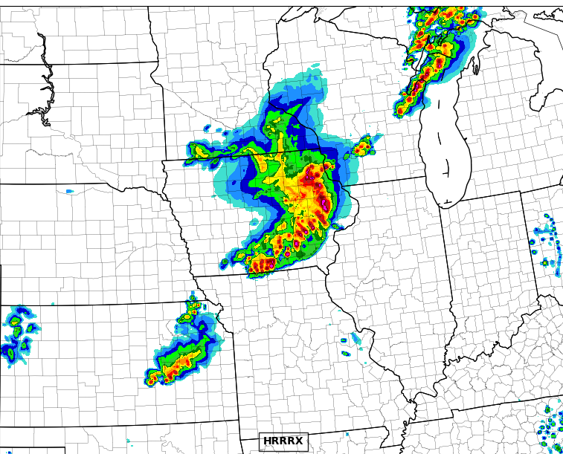
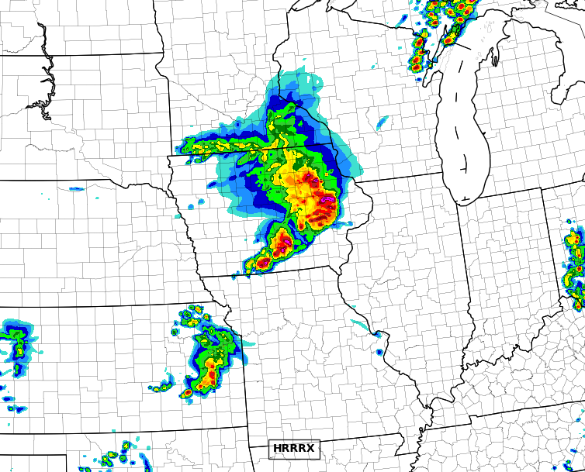
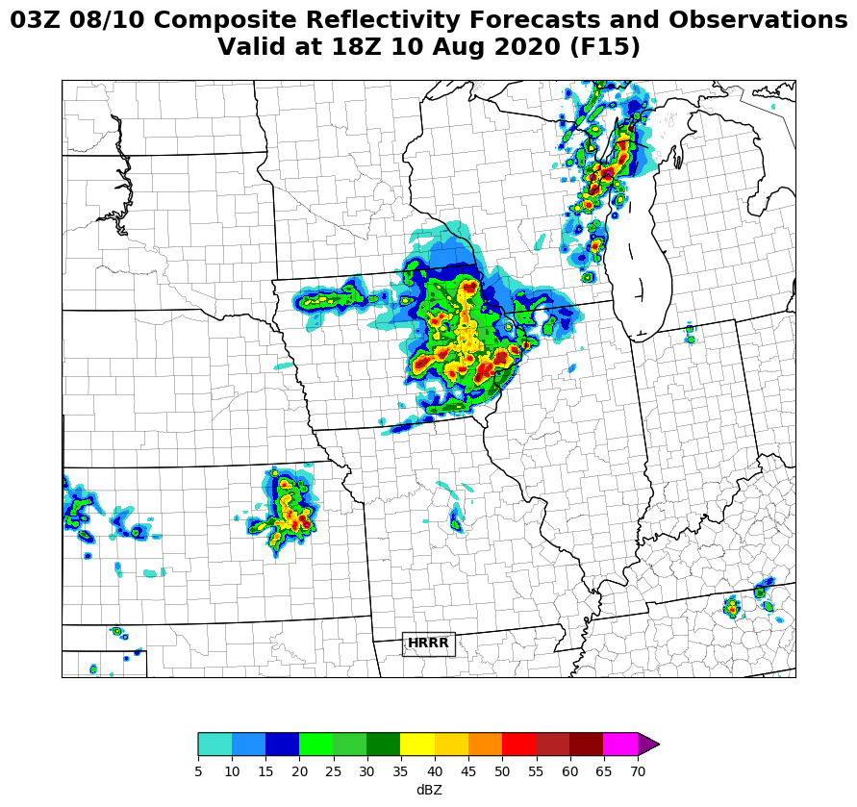
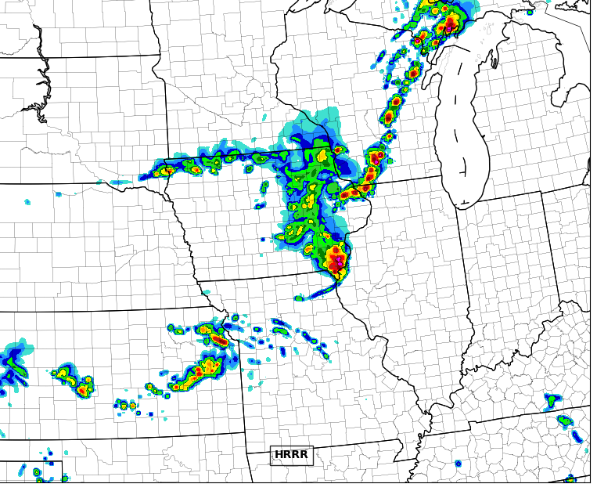
HRRRDAS Initial Conditions Improves HRRRv4
Case Study 18 UTC 10 August 2020
Challenging forecast of very damaging derecho
15 hour forecast
13 hour forecast
Radar observations
HRRRv4 w/HRRRDAS
HRRRv4 consistently shows a more organized and accurate convective system due to improved initial conditions from HRRRDAS.
HRRRv3
HRRRDAS uses hourly assimilation cycles to incorporate both conventional and radar observations and the ensemble mean provides convective scale motions and thermodynamics to HRRRv4.
2021 Global Systems Laboratory Science Review
Dowell et al. 2021, to be submitted June
OAR DA | Coupled DA | CAM-scale | Satellite

Slide 13
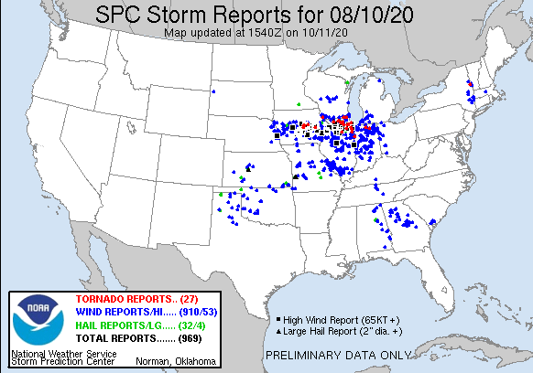
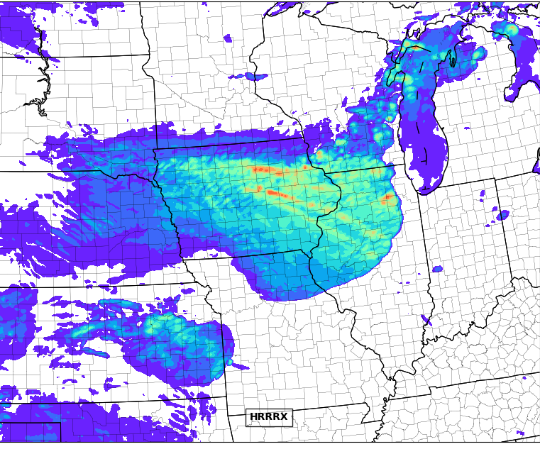
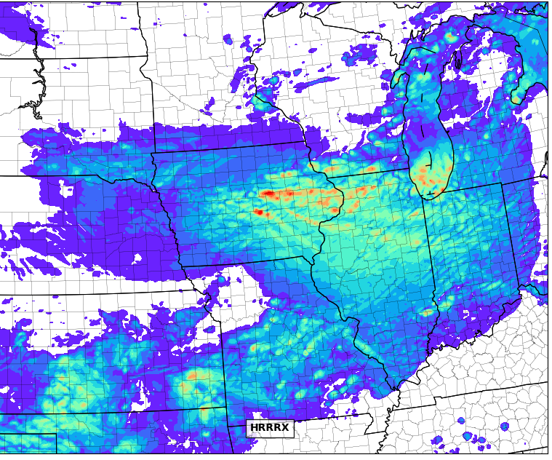
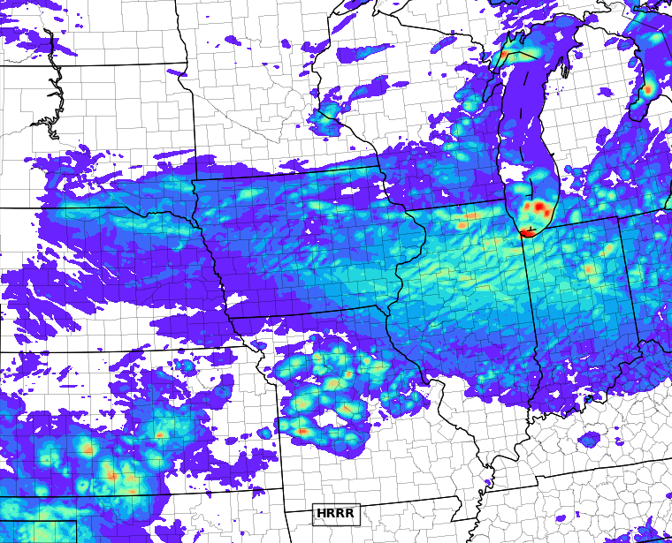
HRRRDAS Initial Conditions Improves HRRRv4
10m Max Wind Speed 10-11 August 2020
18 hour Forecasts
Valid at 21 UTC
18 hour Forecasts
Valid at 3 UTC
SPC Storm Reports
HRRRv4 w/HRRRDAS
The HRRRv4 wind solutions correctly have:
stronger overall winds and more coverage further east
stronger winds starting earlier in the system’s life over central Iowa
narrow corridors of very intense winds over eastern Iowa
HRRRv3
2021 Global Systems Laboratory Science Review
Dowell et al. 2021, to be submitted June
OAR DA | Coupled DA | CAM-scale | Satellite

Slide 14
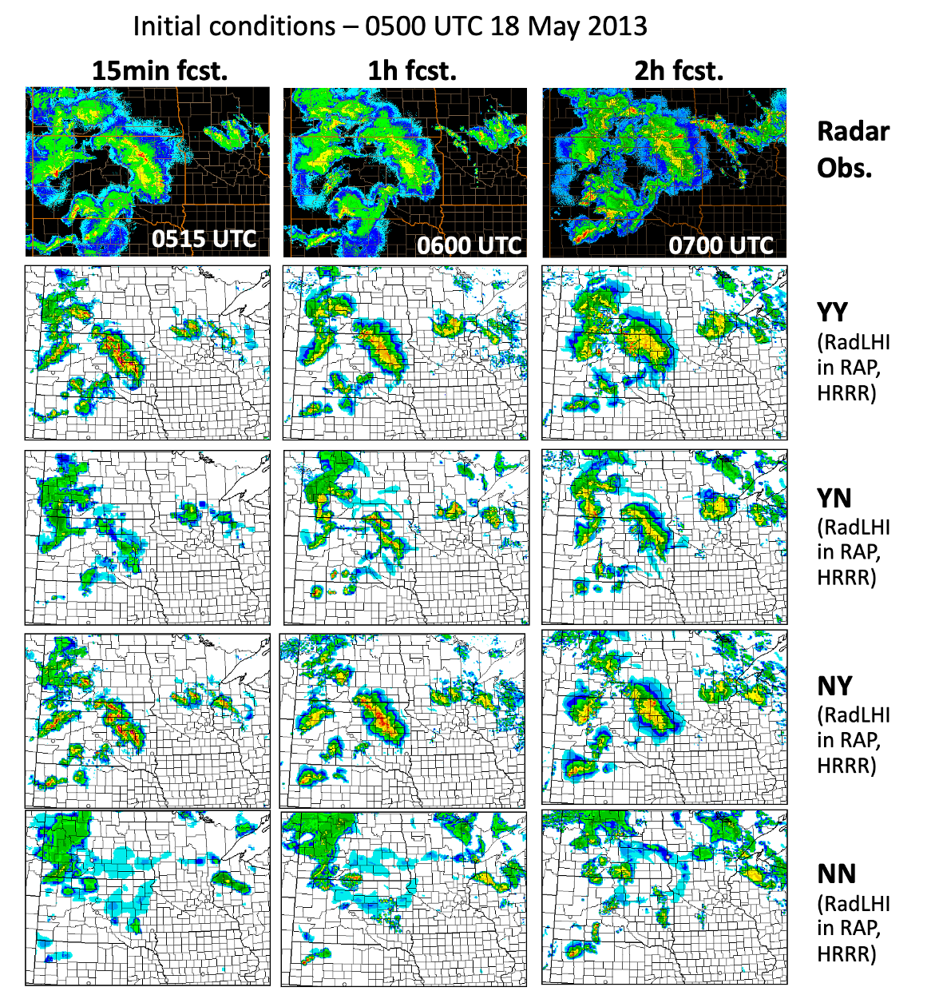
Latent-Heating Based Radar/Lightning Assimilation
HRRR forecasts
Assimilation of precipitation-related observations, especially for convection is essential to the success of HRRR/RAP short-term forecasts.
Radar reflectivity observations, as well as lightning (flash centroid density), are mapped to latent-heating temperature tendencies that are applied to the model physics to force convection (or absence of convection).
Weygandt et al. 2021, W&F -to be submitted June
2021 Global Systems Laboratory Science Review
OAR DA | Coupled DA | CAM-scale | Satellite

Slide 15
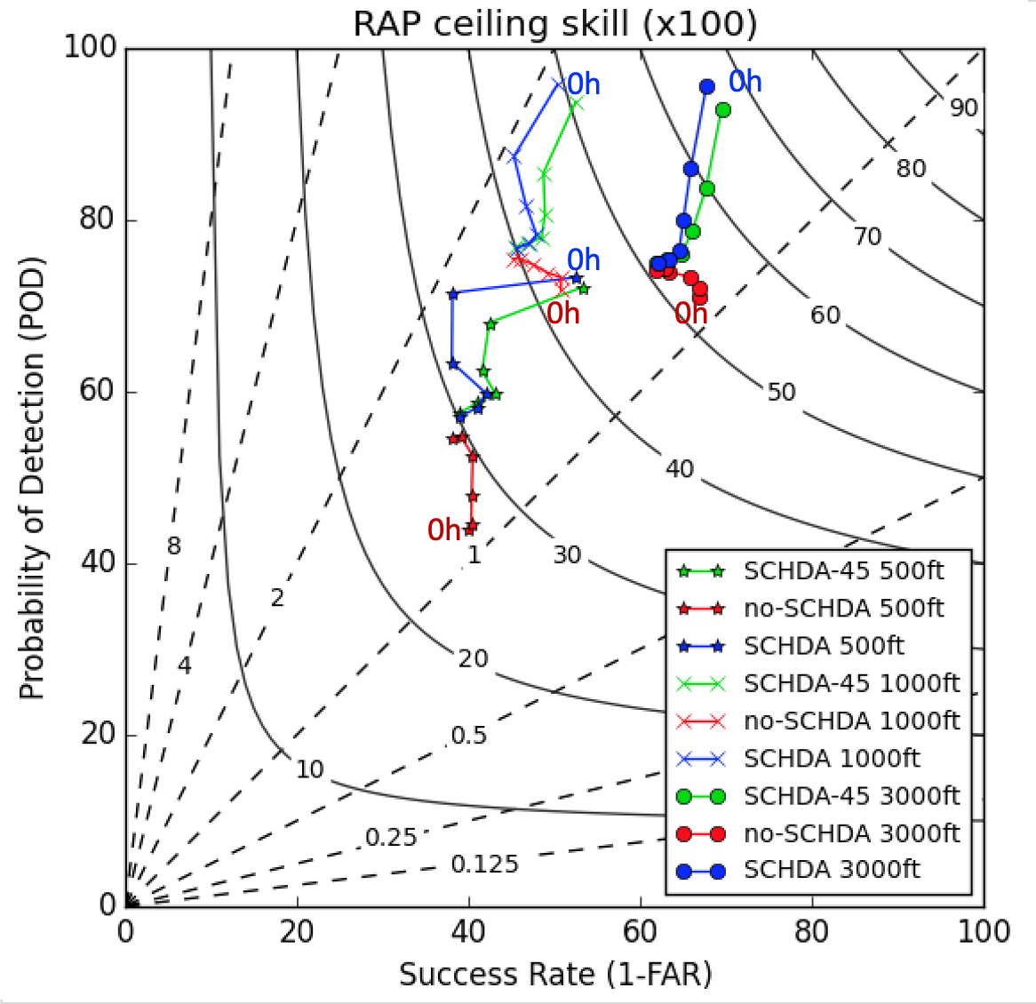
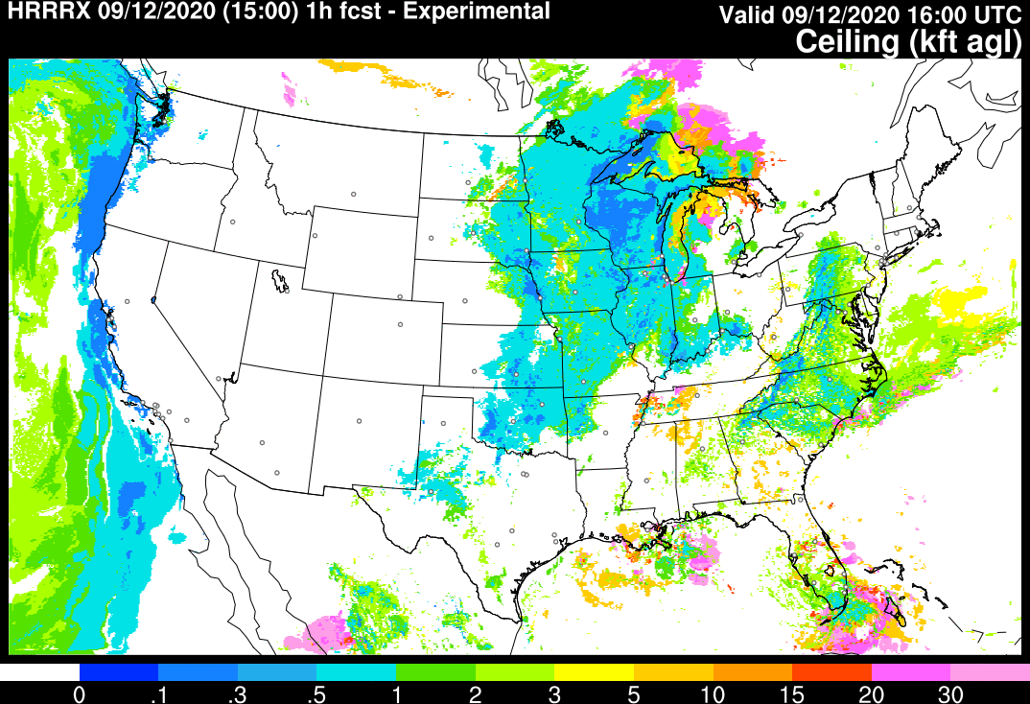
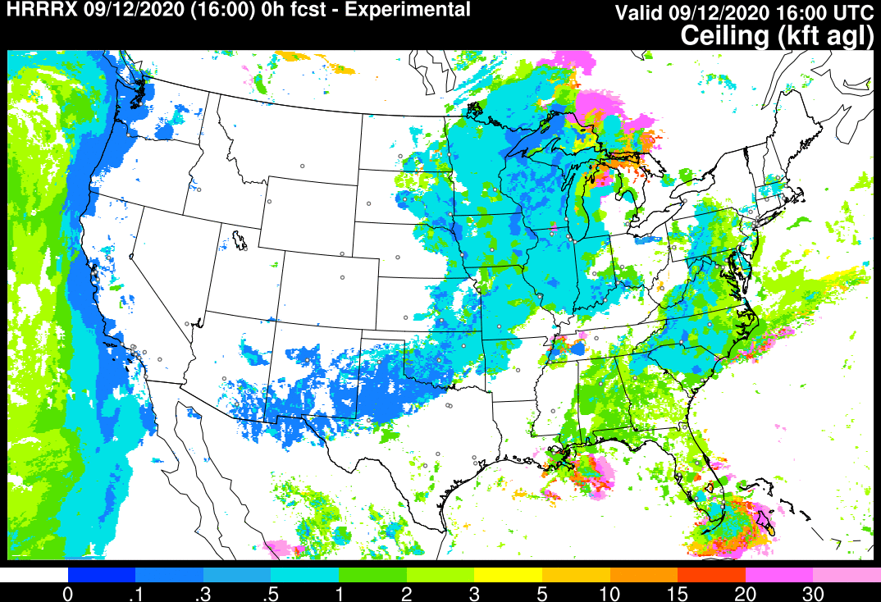
Stratiform Cloud-Hydrometeor Assimilation
Performance Diagram
Accurate cloud and precipitation initialization is fundamental to short-range prediction systems such as RAP & HRRR.
Stratiform cloud-hydrometeor DA improves retention of observed cloudy and clear 3D volumes in subsequent model forecasts.
Cloud ceiling, visibility, PBL forecasts have more skill due to the cloud assimilation.
Introduced using subgrid-scale cloud fraction to refine cloud building - beneficial
1-Hour Forecast (Background) Ceiling
Analysis Ceiling
Analysis captures low ceilings in several locations.
Benjamin et al. 2021, MWR.
2021 Global Systems Laboratory Science Review
OAR DA | Coupled DA | CAM-scale | Satellite

Slide 16
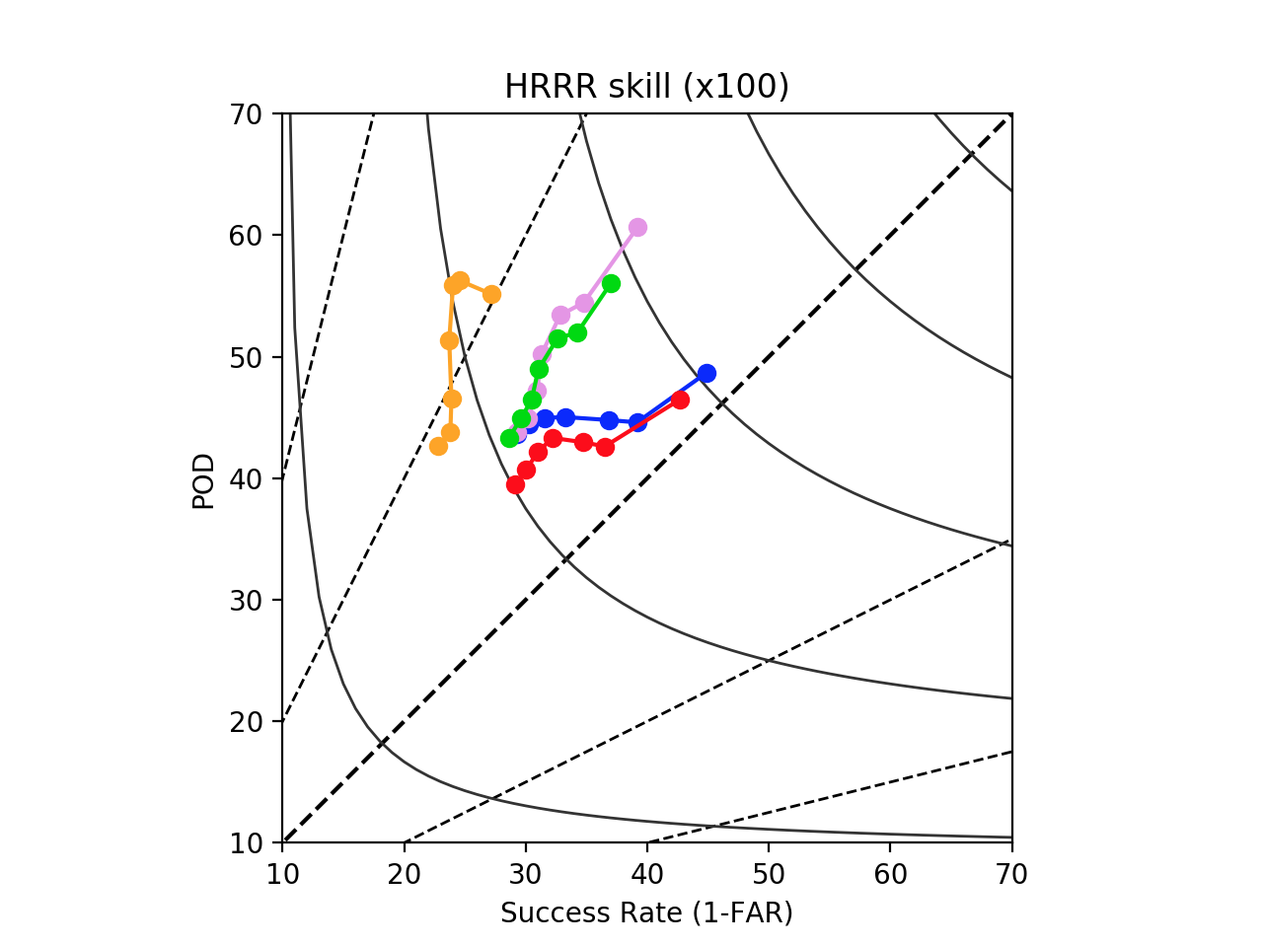
Ongoing Improvements in HRRR Forecasts
Performance Diagram for HRRR Reflectivity
Pre-
HRRR
Performance diagram shows CSI / bias
Illustrates five generations of HRRR skill
Pre-HRRR: very high bias, low CSI
HRRRv1: better bias, improved CSI,
HRRRv2: CSI even better, bias still high
HRRRv3: bias much better (reduced), some reduction in CSI
HRRRv4: better CSI, similar bias
HRRR-v1
HIGH CSI
4.0
2-h
HRRR-v2
3-h
1-h
High Bias
HRRR-v3
0.40
6-h
9-h
HRRR-v4
12-h
15-h
0.30
2.0
CSI = 0.20
Bias = 1.0
0.5
0.10
Low Bias
0.25
2021 Global Systems Laboratory Science Review
OAR DA | Coupled DA | CAM-scale | Satellite

Slide 17
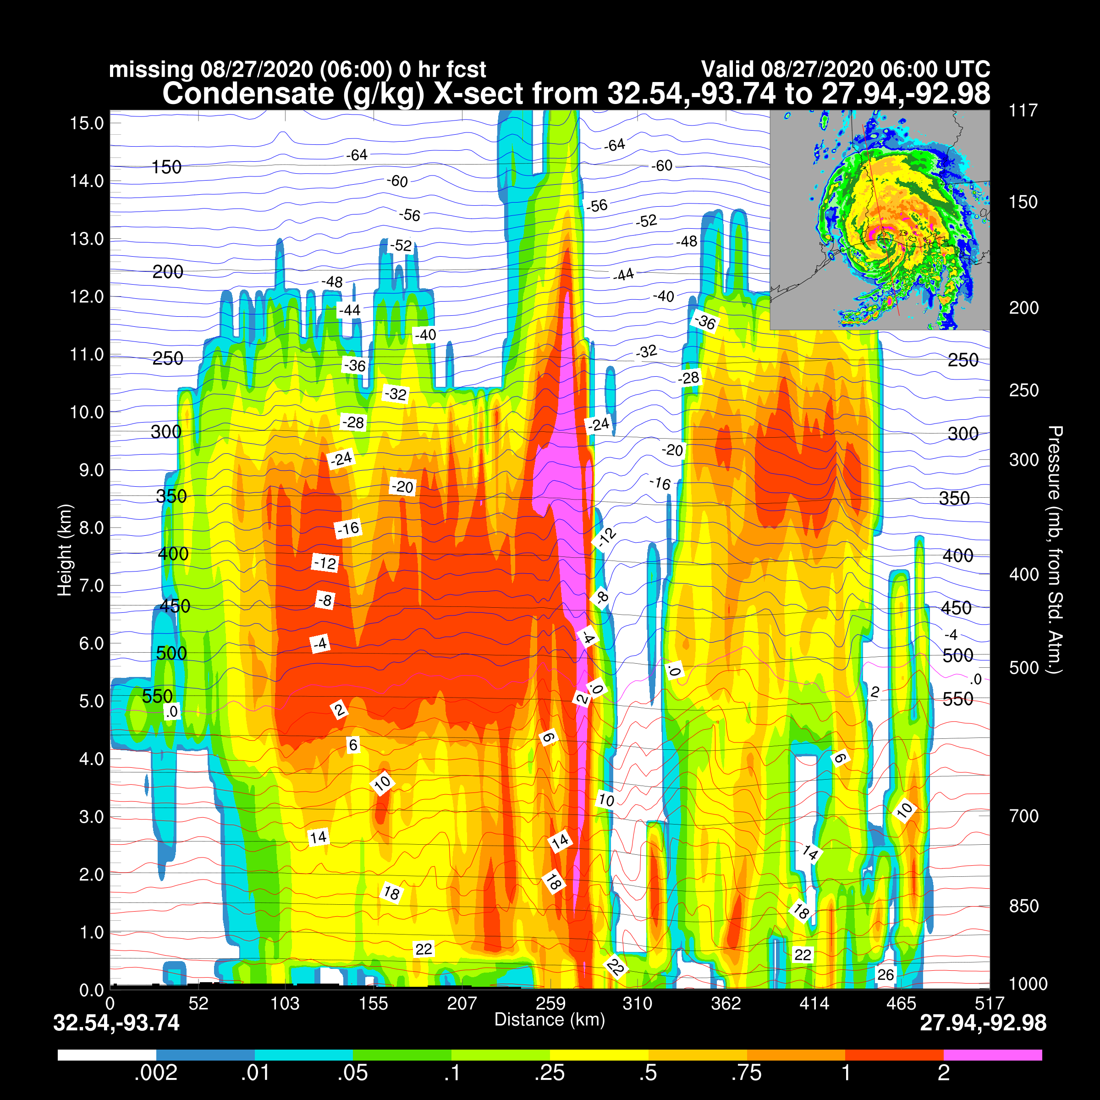
NOAA Unified Analysis: RTMA-3D Nowcast/Analysis of Record
GOAL: Record the best estimate of the convective-scale Earth system state.
Collaborative development with EMC (JTTI & UFS R2O)
RTMA-3D is not constrained by the need to initialize a forecast (close fit to obs; model behavior not considered)
RTMA-3D provides 15 min gridded analysis of 3D atmospheric fields with application in multiple areas:
General analysis and reanalysis applications
Severe weather; targeting replacement of Mesoanalysis System (SPC)
Aviation parameters; targeting 3D cloud coverage/ceiling grids (AWC)
Hydrodynamical modeling input and water in all forms - snow cover, soil moisture, lake forecasts, heavy rainfall
Model verification ‘truth’ dataset
Operational implementation planned for 2024
Experimental RTMA-3D during
Hurricane Laura 27 Aug 2020
2021 Global Systems Laboratory Science Review
OAR DA | Coupled DA | CAM-scale | Satellite

Slide 18
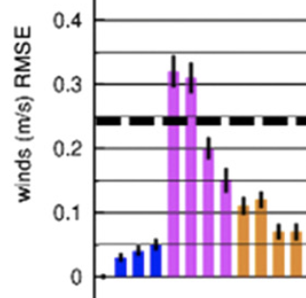
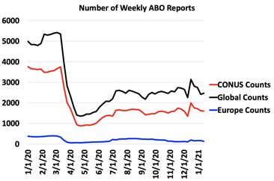
OSEs – New aircraft vs. raobs study including COVID-19 decrease in aircraft observations
Conducted partial data denial experiments which exclude ~80% of aircraft observations, similar to what happened at the peak of COVID-19 lockdowns.
Wind forecast impacts for winter (Feb 2019)
raobs
all aircraft
80% of aircraft obs
Across seasons / variables, 30% higher errors without any aircraft obs and 12% higher errors without 80% of aircraft obs
Eric James et al 2020 – JAMC - GSL
2021 Global Systems Laboratory Science Review
OAR DA | Coupled DA | CAM-scale | Satellite

Slide 19
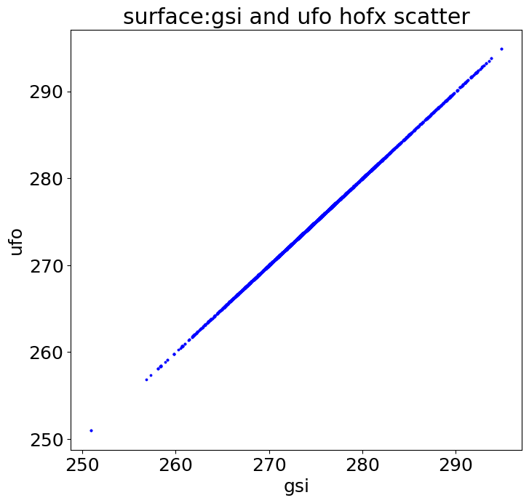
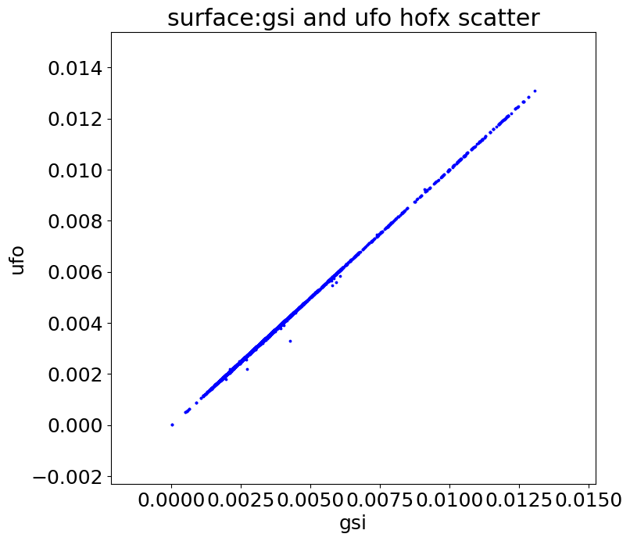
JEDI Development Contributions
2m Temp
2m Specific Humidity
New JEDI UFO
Successfully Matched H(x)
Successfully
Matched H(x)
Assimilation of regional conventional observation
Development of Unified Forward Operators (UFOs) i.e. H(x)
Legacy GSI Observer
Ming Hu, Guoqing Ge – GSL, JEDI core staff (Greg Thompson, etc.)
2021 Global Systems Laboratory Science Review
Notes:
We contribute development to the Joint Effort for Data Assimilation Integration, or JEDI, which is an architectural cornerstone of the UFS. We helped create JEDI Unified Forward Operators, or UFOs, with a focus on conventional observations.
CLICK
This table shows the progress, illustrated as the green cells, of JEDI’s ability to process various types of observations.
CLICK
The bottom plots focus on two types of observations: two-meter temperature and specific humidity from METARs. The scatterplots indicate an excellent match between the forward operators between the emerging JEDI and the GSI, which is encouraging as it will allow the adoption of JEDI in upcoming UFS configurations.

Slide 20
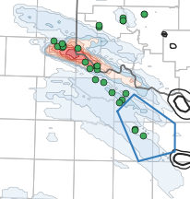
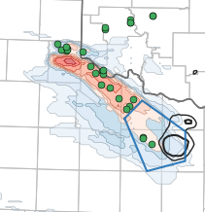
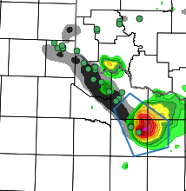
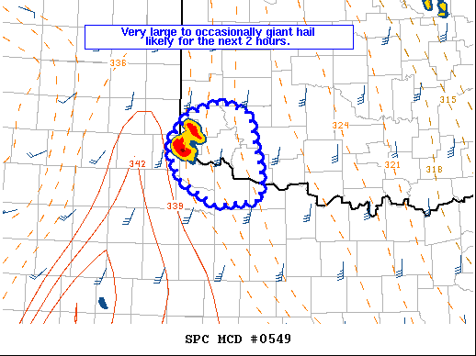
Impact of Satellite DA in WoFS: 7 May 2020
0- 3 h forecast of 2-5 UH > 60 m²s⁻² initialized at 2200 UTC and valid at 0100 UTC
Radar-only
Radar + Satellite
MRMS (0100 UTC)
SPC Mesoscale Discussion
Hail reports
No forecast storm in warning area
Severe T-storm warning valid at 0100 UTC
A supercell near Childress has recently split with the left split moving northeastward in southwest Oklahoma. This storm split was well advertised by the NSSL Warn-on-Forecast system while most other short term guidance including the HRRR and HRRR-P suggest storm initiation should just be getting started now. … In addition, the WoFS suggests the strongest updraft helicity may occur in the next 1 to 2 hours. MCD 0549 at 2304 UTC
Assimilating GOES-16 clear-sky water vapor radiances and CWP retrievals substantially improved the forecast of a high visibility event in southern OK and northern TX
OAR DA | Coupled DA | CAM-scale | Satellite
Thomas Jones - NSSL

Slide 21
GOES-R Satellite Observations Assimilated into WoFS All data are assimilated at 15 minute intervals over a regional domain
Real-time system:
Clear-sky water vapor channel radiances (6.2, 6.9, 7.3 um)
Cloud Water Path (CWP) retrievals from the NASA product
Experimental (real-time capability exists):
All-sky water vapor radiance assimilation
Improves CI skill, but results in over-forecasts of mature precipitation
Atmospheric motion vectors
Used in 2020 real-time runs - impact was inconclusive
GLM lightning flash data
Future:
Aerosol optical depth as part of a WoFS-smoke development
Visible spectrum data ???
OAR DA | Coupled DA | CAM-scale | Satellite
Thomas Jones - NSSL

Slide 22
POES legacy impacts for hourly cycled regional DA
Radiance |  |  | Control | POES legacy denial
Satellite | Sensor | # of channels | All radiance assimilated | Remove N15/N18/N19
aqua | airs | 66 | 3206 | 3158
n15 | amsua | 10 | 2468 | 0
n18 | amsua | 9 | 9441 | 0
metop-a | mhs | 5 | 11 | 9
metop-a | amsua | 9 | 8586 | 8408
aqua | amsua | 3 | 403 | 403
f17 | ssmis | 3 | 2976 | 2965
metop-a | iasi | 98 | 72,807 | 72,809
n19 | amsua | 10 | 15,136 | 0
n19 | mhs | 4 | 3126 | 0
metop-b | amsua | 3 | 8480 | 8480
metop-b | mhs | 5 | 10,227 | 10,055
metop-b | iasi | 98 | 115,258 | 115,109
npp | atms | 18 | 6764 | 6719
n20 | atms | 18 | 9748 | 9688
npp | cris-fsr | 72 | 48,776 | 50,153
n20 | cris-fsr | 72 | 49,505 | 49,412
GOES-16 | ABI | 3 | 10,450 | 10,456
TOTAL |  |  | 377,370 | 347,820
(percent) |  |  | (100%) | (92.1%)
One month retro run (1-31 May 2020)
Verify over 735 runs
Hourly averaged counts of assimilated obs.
2 Experiments
Control (all radiance assimilated)
POES Legacy denial
RAP model with configuration
matching RAPv5 (operational Dec. 2020)
Partial cycling 2x per day (9z, 21z) brings in GFS fields with enhanced radiance DA
RARS
DB
DB/RARS
Assimilated
Denied
OAR DA | Coupled DA | CAM-scale | Satellite
Haidao Lin, Steve Weygandt - GSL

Slide 23
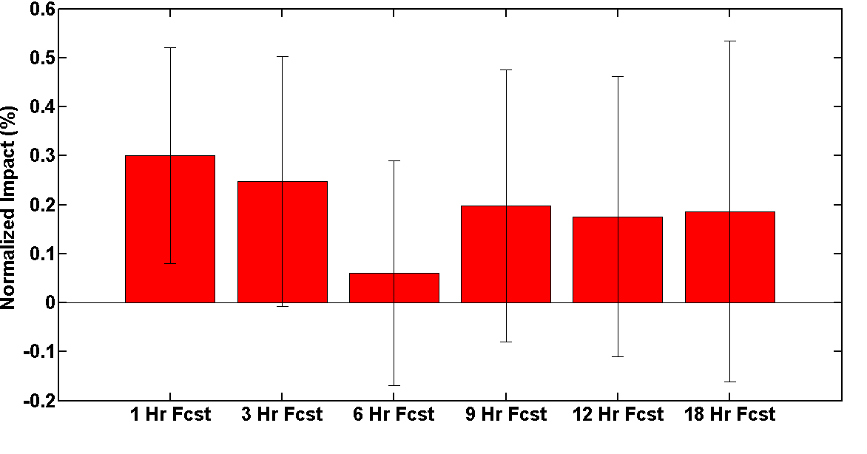
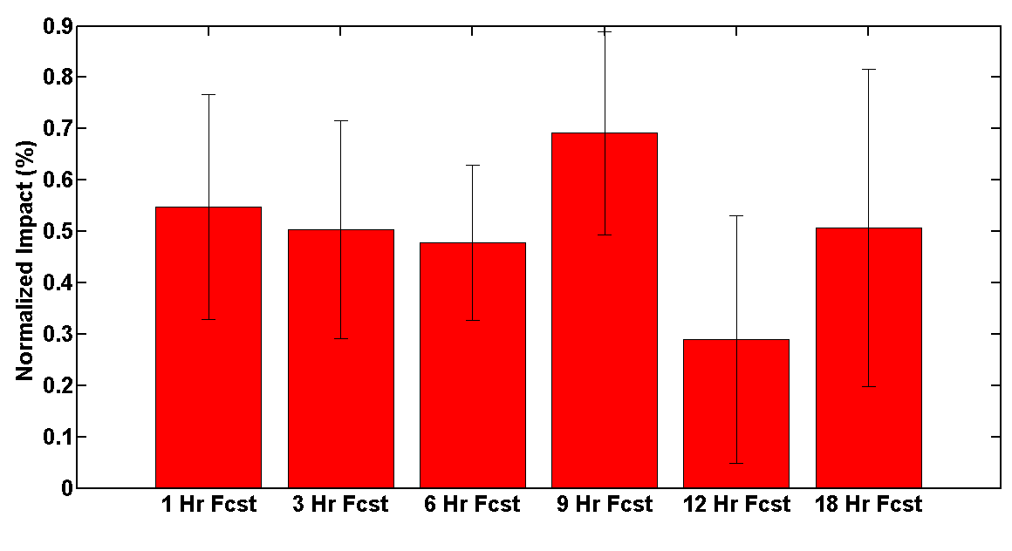
% improvement in forecast skill within RAPv5 from
use of POES legacy radiance data (N15/N18/N19)
+1%
Temperature
+0.3%
Relative Humidity
1-hr 3-hr 6-hr 9-hr 12-hr 18-hr
1-hr 3-hr 6-hr 9-hr 12-hr 18-hr
POES legacy impact in RAP is
10-20% of overall satellite
radiance data impact in RAP
+0.7%
Wind
100-1000 hPa RMS mean
Radiosonde verification
1-hr 3-hr 6-hr 9-hr 12-hr 18-hr
Normalized Errors
E_{N} = (EXPT – CNTL)
CNTL
One-month hourly RAP retro runs averaged 1-31 May 2020.
OAR DA | Coupled DA | CAM-scale | Satellite
Haidao Lin, Steve Weygandt - GSL

Slide 24
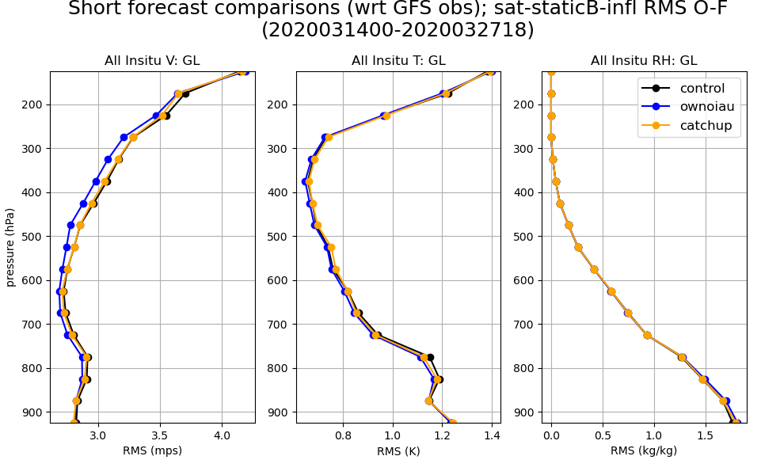
Hourly cycling for global data assimilation
(toward a Global Rapid Refresh)
Overlapping windows improves over both control and catch-up in wind, temp.
Catch-up improves very slightly over control in wind and lower-level temp.
Jeff Whitaker, Laura Slivinski – PSL
Curtis Alexander, Ming Hu - GSL
Notes:
Control: alpha=250, infl = .75,.25
Ownoiau and catchup: alpha = 150, infl = .9, .4

Slide 25
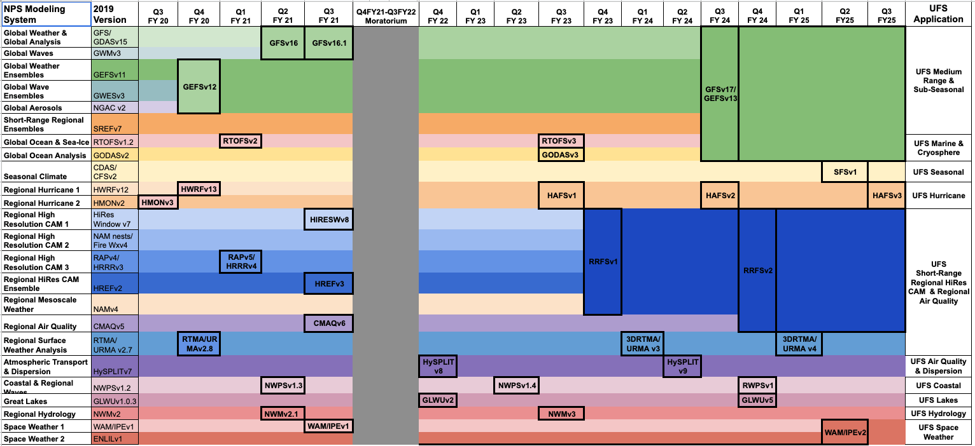
OAR Research efforts
PSL, GSL, NSSL, EMC, JCSDA –
joint efforts on global/regional DA
-- Major radiance DA upgrade in RAPv5
(Dec 2020) (add N20 CrIS-FSR, ATMS,
GOES-16 ABI WV channels, more DB)
-- Aerosol DA - VIIRS fire radiative power- HRRR-Smoke
-- Cloud analysis: proxy water vapor innovations from GOES, METARs
-- 3km ens DA – HRRRDAS (linked WoF)
-- Improved DA of GOES water vapor channels (NSSL)
-- Improved assimilation of cloud water path (NSSL)
-- OSSE of sat data, especially GPS-RO (AOML)
-- OSE of all regional obs including aircraft/COVID decreases (GSL)

Slide 26
OAR Research Plans
NOAA UFS implementation plan
Current and upcoming DA development
all based on JEDI –
regional, global, aerosol, surface, cloud
Convection-allowing-model (CAM) scale DA
(including land/ocean/tropical-cyclone)
Hourly updating DA – regional and global
Coupled DA (atmosphere/ocean/land/snow/lake/aerosol)
Initial demonstrations using EWOK for regional Rapid Regional Forecast System (RRFS-FV3)
Goals
Higher accuracy for regional and global NOAA model forecasts with improved DA.
Faster implementations of new observations/ new DA methods using JEDI. Increased understanding of physical processes via DA.
Improved earth-system prediction via increasingly effective coupled DA

