Slide 1
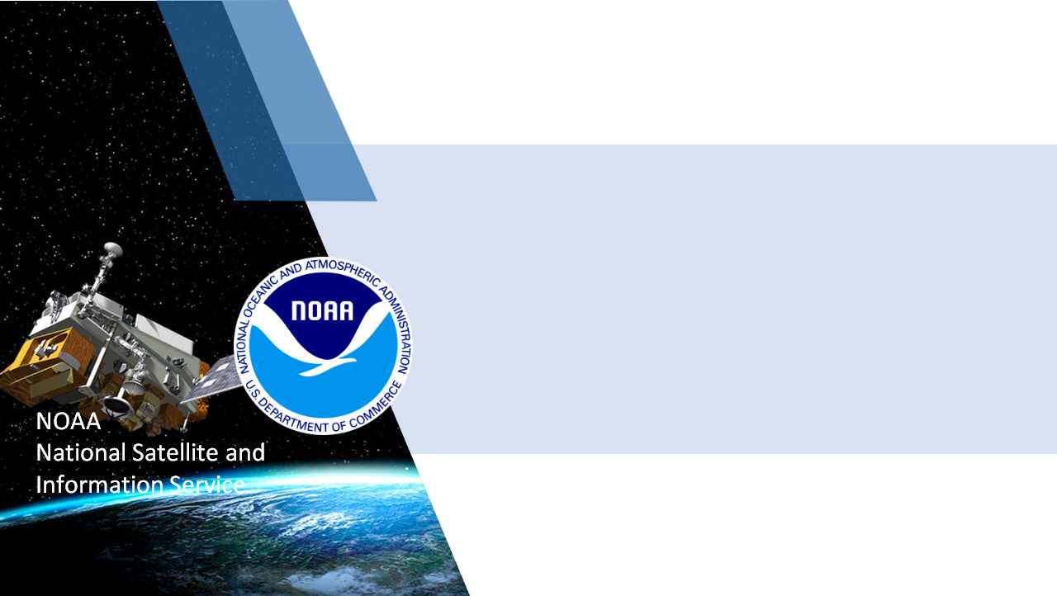
NESDIS Overview
JCSDA / DA Activities, Plans, Priorities
Kevin Garrett
NESDIS Center for Satellite Applications and Research (STAR)
JCSDA Associate Director for NESDIS
18th JCSDA Technical Review and Science Workshop
June 7-11, 2021

Slide 2
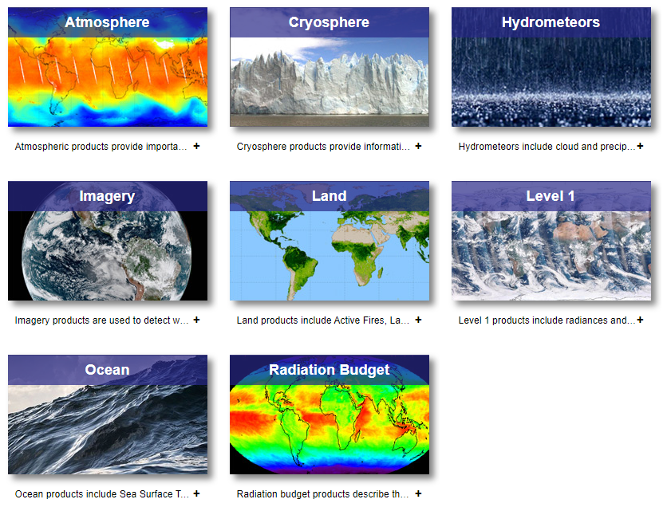
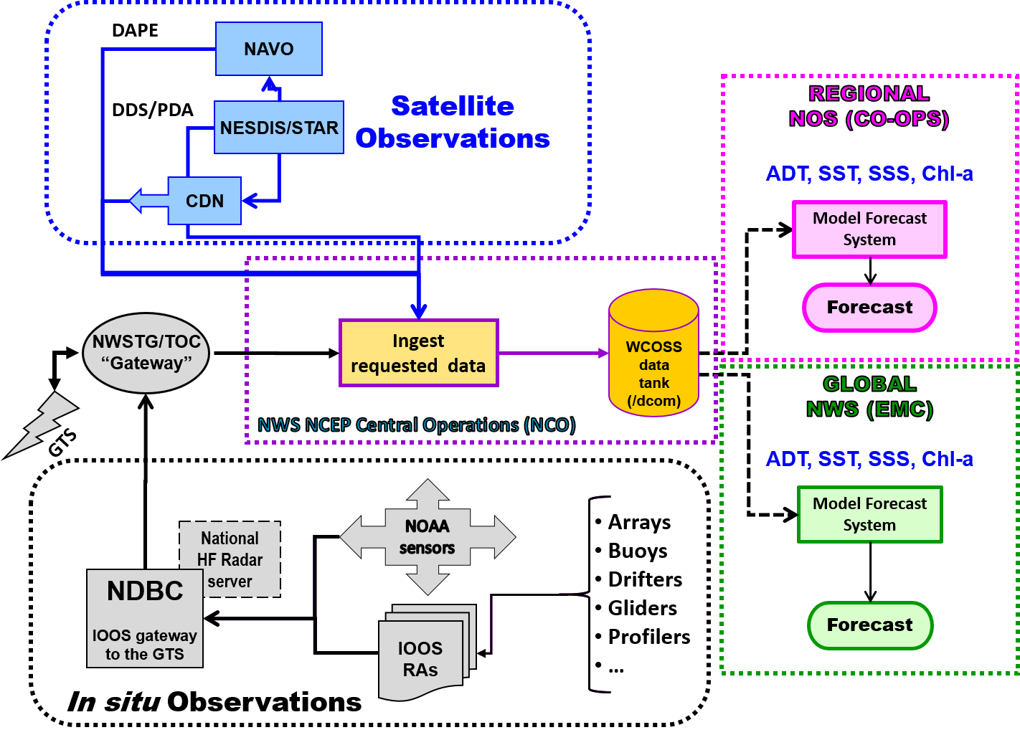
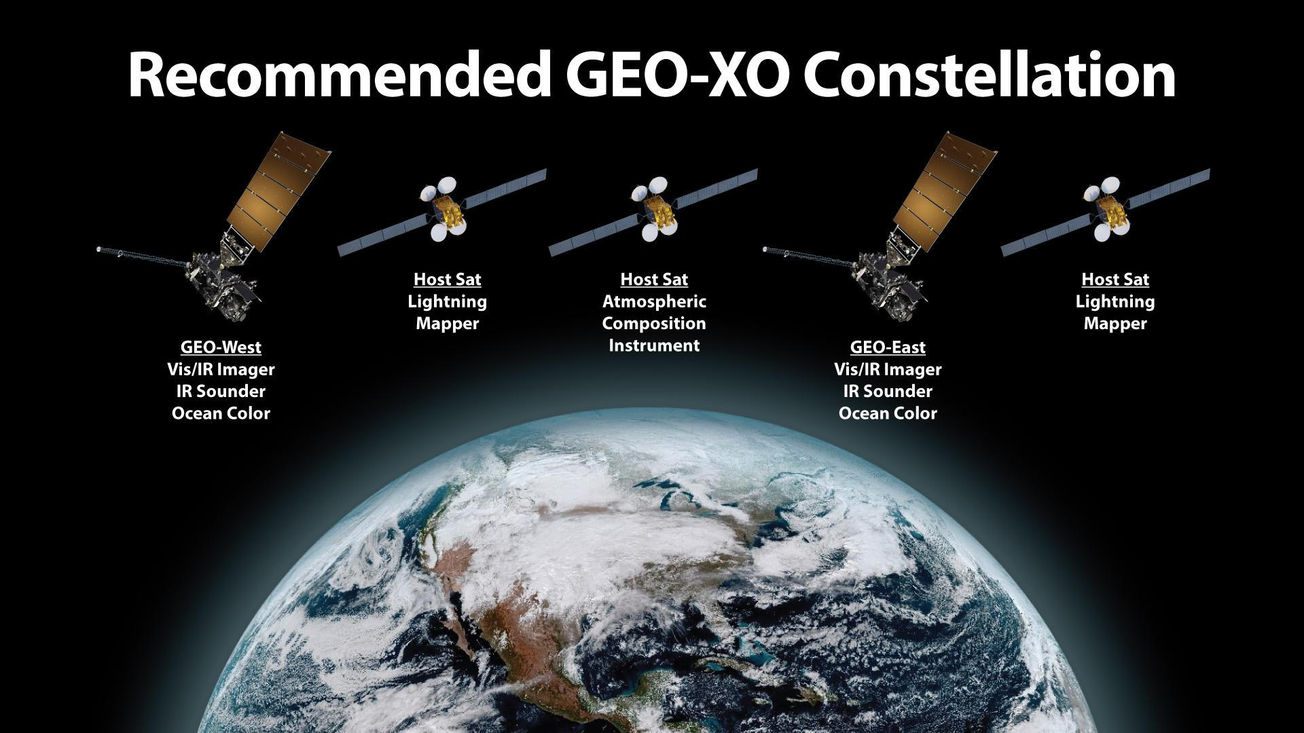
NESDIS Functions
Provide secure and timely access to global environmental data and information from satellite and other sources to promote and protect the Nation’s security, environment, economy, and quality of life.
Products and Development
Data Distribution and Services
Planning
Satellite instrument cal/val (L1)
Level 2-4 product development and R2O
Data assimilation/observation operators (OSEs)
Operational processing and dissemination
Data stewardship and archive
Assessments (State of the Climate)
Quality Assurance/Control (QA/QC)
NRT monitoring (CoastWatch/OceanWatch)
Outreach and user-engagement
Requirements definition
Architecture studies (value assessments, OSEs, OSSEs)
Cross-cutting theme: Improving the use and impact of satellite observations
Notes:
Provide mission critical observations to inform environmental analysis and prediction
Explore methodologies to increase the value and impact of environmental satellite data (latency, QA/QC, models and algorithms, data assimilation)
Design and implement future satellite architectures to meet evolving model application/user needs (OSSEs)

Slide 3
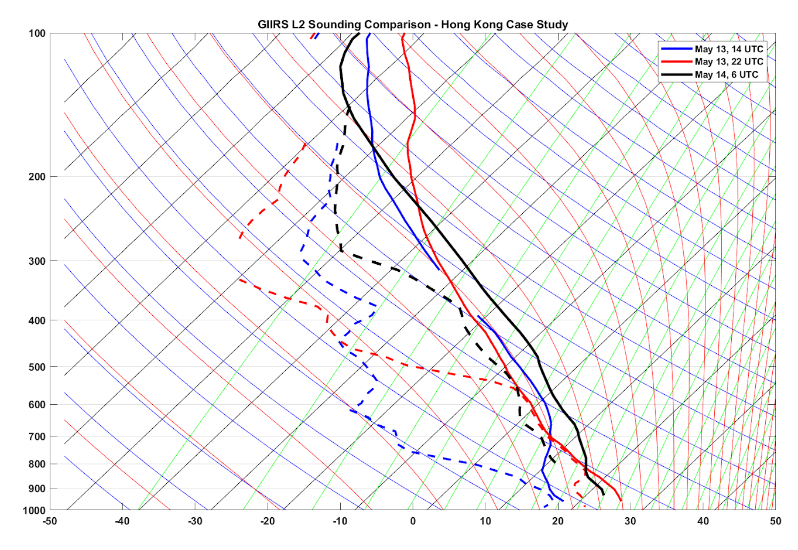
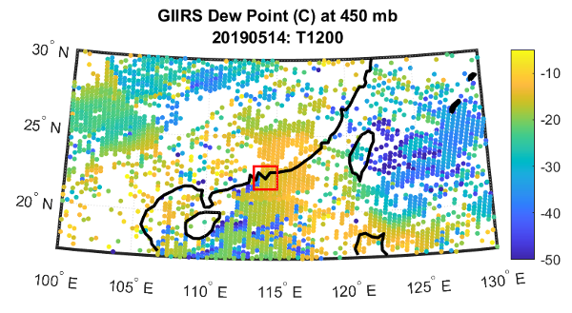
Key NESDIS-JCSDA Contributions
Community Radiative Transfer Model/Community Surface Emissivity Model (CRTM/CSEM), ~3 in-kind FTE
FY18 Disaster Relief Appropriates Supplemental, ~7 core FTE
High Performance Computing (s4)
Priorities and Opportunities
Transition to JEDI development
JEDI, CRTM applications
GIIRS moisture sounding May 13-14, 2019 (R. Knuteson, CIMSS).

Slide 4
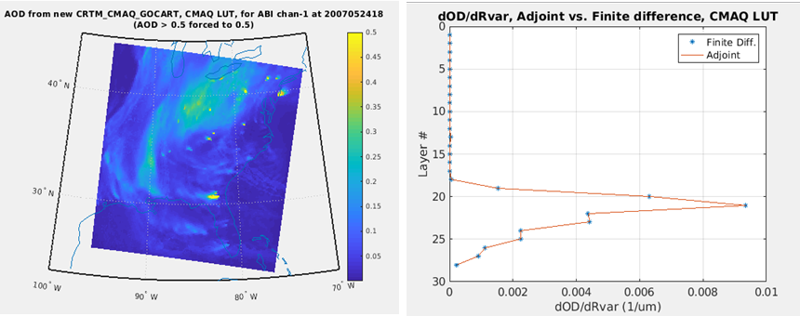
CRTM Advancements
CRTM 2.4
porting CMAQ capability
CRTM 3.0 integration
UV/Vis, full polarization
Updated CrIS non-LTE
CSEM integration, IRSSE update
CRTM 3.x
Polarized IR/MW
Updated Sea-ice/Snow Emissivity (MW)
Updated/spectral expansion Fastem/Fast-BRDF (MW)
Scalar/polarized snow/graupel optical properties UV-Far IR-MW (see P. Yang Thursday AM)
ABI estimated Aerosol Optical Depth and Jacobians (Y. Ma, STAR/CISESS).

Slide 5
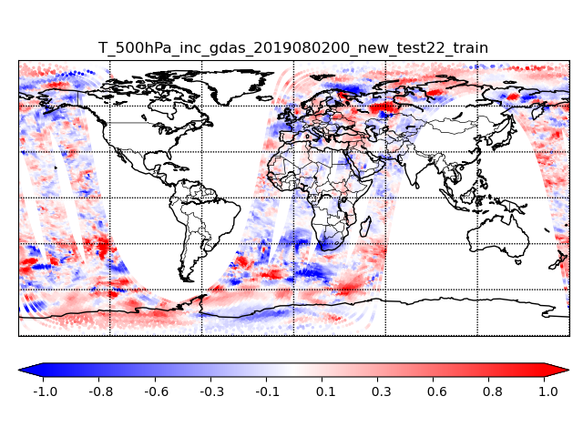
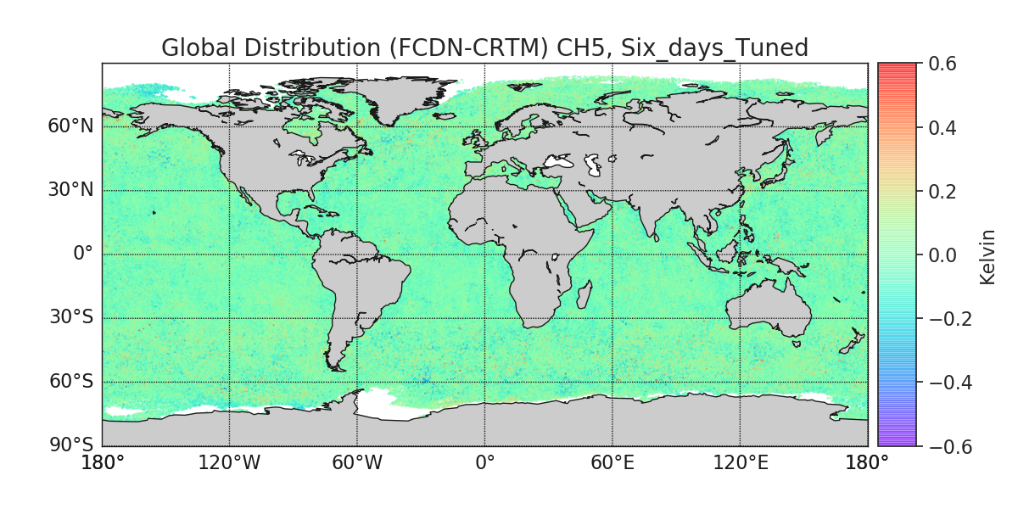
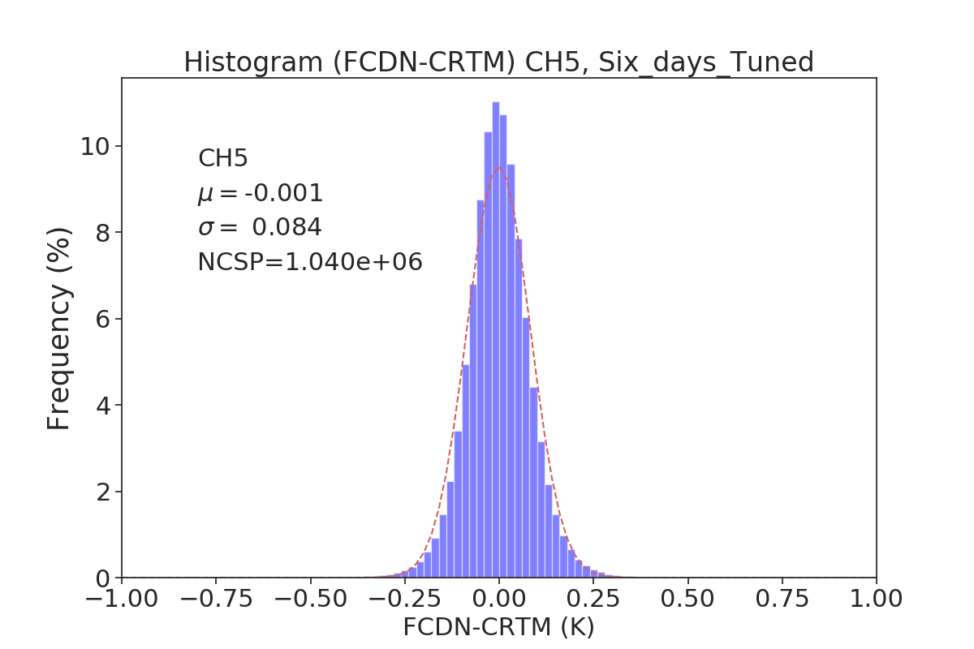
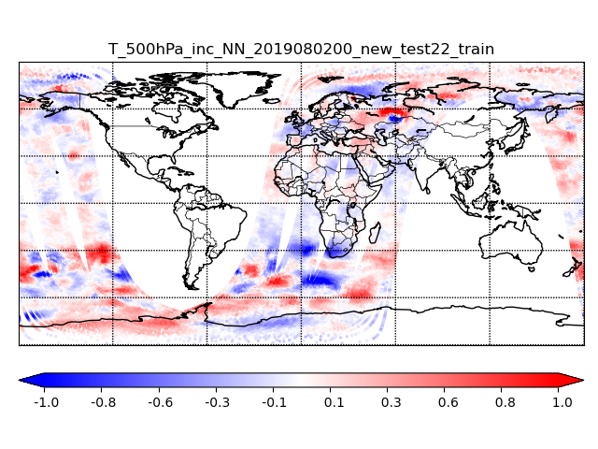
AI Exploitation (ATMS)
Intelligent Data Selection
AI Radiative Transfer
GSI 500 hPa Temperature Increment
DNN 500 hPa Temperature Increment
 | CH5 | CH6 | CH7 | CH8 | CH9 | CH10 | CH11 | CH12 | CH13 | CH14 | CH15
Mean | -0.0014 | -0.0068 | -0.0034 | 0.0 | 0.0023 | 0.0034 | 0.0042 | 0.0015 | -0.0039 | -0.0057 | -0.0042
STD | 0.0838 | 0.0678 | 0.0639 | 0.0592 | 0.0665 | 0.0669 | 0.0683 | 0.0701 | 0.0748 | 0.0727 | 0.0787
Replace uniform thinning with dynamic thinning based on predicted impact of observations. (N. Shahroudi, STAR/RTi)
Performances of AI-based radiative transfer model targeting CRTM ATMS simulation. Significant progress in regularization of models, surface/water vapor channel performance, and comparison of DNN gradients (Jacobians). (X. Liang, STAR/CISESS)

Slide 6
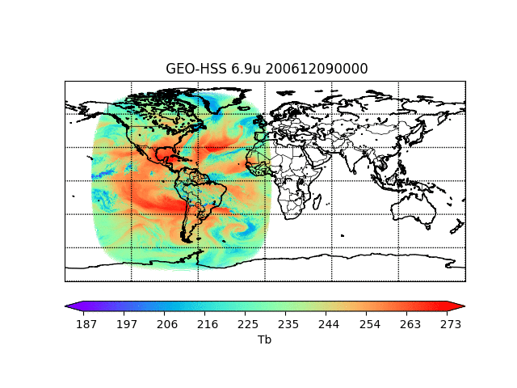
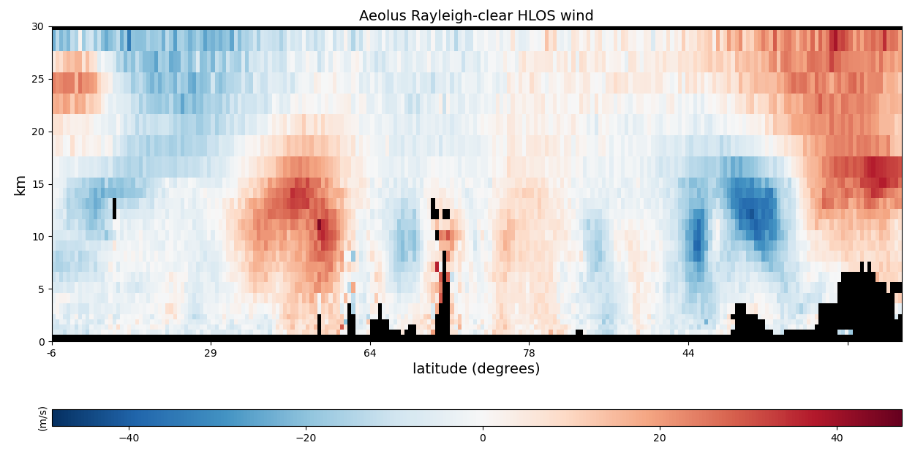
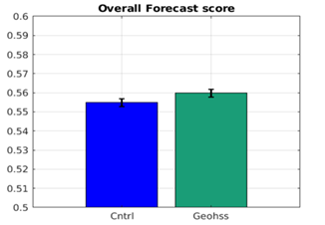
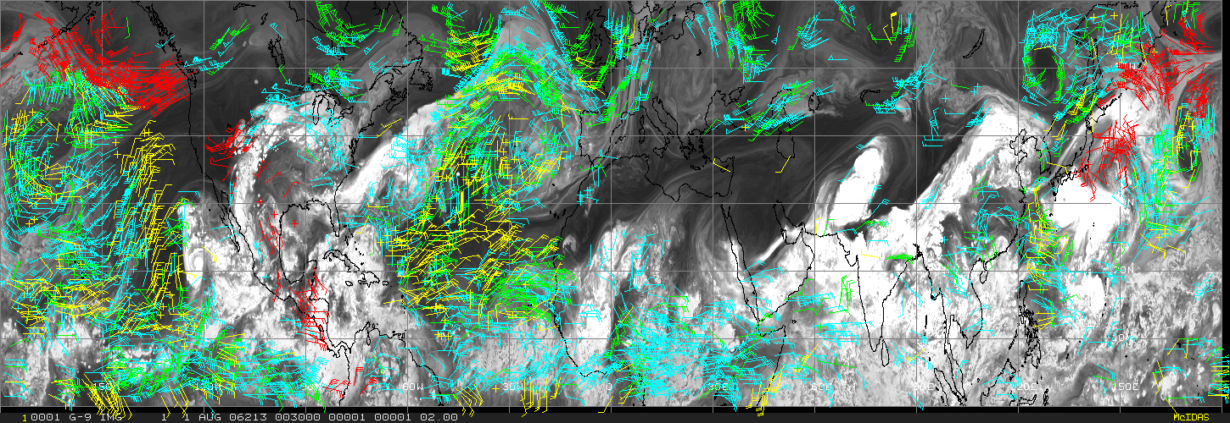
NOAA Next Generation Satellite Architecture
OSSEs
GEO IR Sounder OSSE
Active vs. Passive 3DWinds OSSE
Simulated Aeolus HLOS using LIPAS and GEOS-5 NR. (A. Lim, CIMSS)
Global OSSE demonstrating significant impact from assimilation of a single GEO IR Sounder in GOES-E. (N. Shahroudi/L. Wang, STAR)
Simulated passive 3DWinds locations (Red) and LEO/GEO AMV (G/Y/B) from the GEOS-5 NR. (D. Santek, CIMSS)

Slide 7
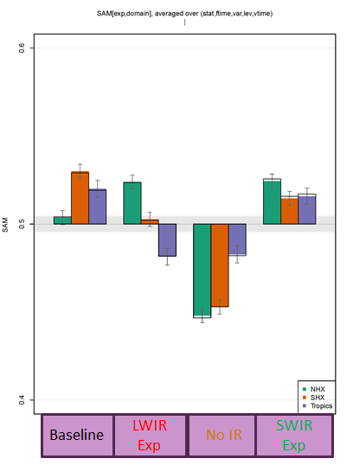
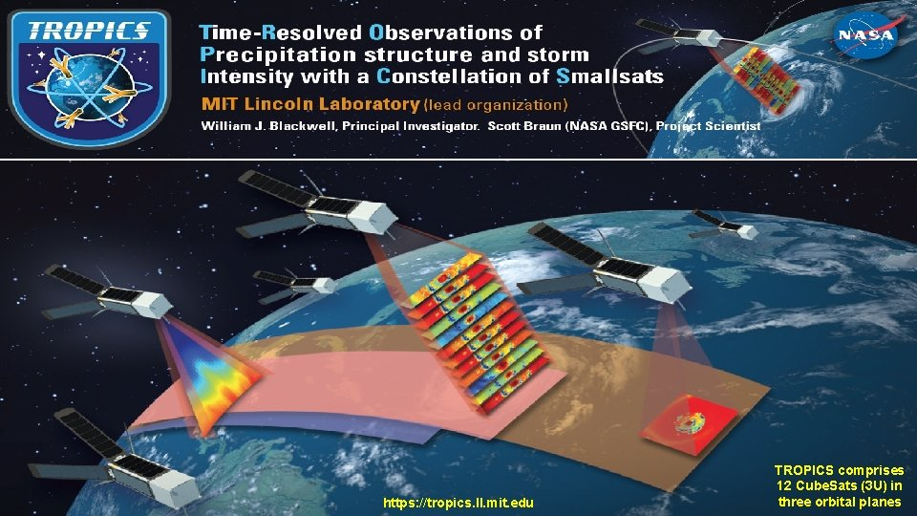
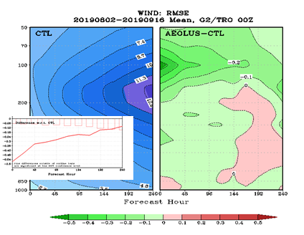
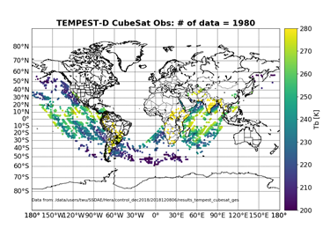
NOAA Next Generation Satellite Architecture
Missions of Opportunity
Aeolus Value Assessments
CrIS Shortwave IR Assimilation
Smallsat Exploitation
Optimization of Aeolus DA. Synergy with AMVs. Data quality assessments.
Value of CrIS SWIR radiances. Assimilation of both SW/LW channels.
Assessment and exploitation of TROPICS
Assessment and exploitation of TEMPEST (STP-H8)
(figure courtesy A. Kliewer, CIRA)
Overall forecast scores for CrIS global DA experiments. (E. Jones, STAR/CISESS)
CTL and Aeolus-CTL Wind RMSE vs. forecast hour and height. (H. Liu, STAR/CISESS)

Slide 8
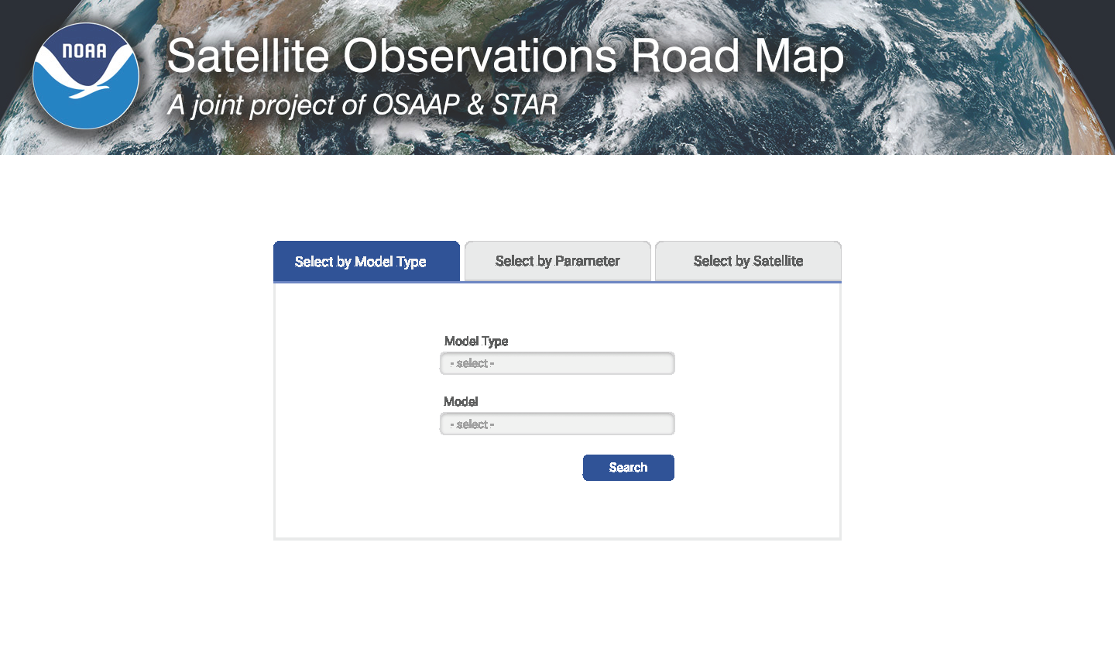
User/Stakeholder Engagement
Requirements/User Needs Formulation
Concept/Design
Testing/Implementation
Continuity/M&S
1
2
3
4
SAT
SPRWG
CGMS
ICAMS
UFS
XORWG
NESDIS is developing a Satellite Observations Roadmap to link current and future mission data to the NOAA modeling suite use and needs.
Available/used, available not used
Not available/gaps
Timelines (2040+)
NOAA/non-NOAA/commercial/demonstration
Satellite Proving Grounds
JCSDA
GORWG
SNWG
LORWG

Slide 9
Near-term Priorities/Focus
Increase Impact
Increasing satellite data impact in NWP
Preprocessing, forward operators, new technologies
Architecture studies
Transitioning to JEDI
Infrastructure/O2R2O
Meeting data needs
Marine/Land/Coupled DA
Inter/intra-agency collaboration
It is a dark time for the Rebellion. Although the Death Star has been destroyed, Imperial troops have driven the Rebel forces from their space….
Satellite Architecture
collaboration
New products/
innovation
Data/Product Delivery
JEDI IODA/UFO
*Not in order/size of importance

Slide 10
Thank you!
With contributions from:
Eric Bayler, Chris Barnet, Ming Chen, Kevin Gallo, Mitch Goldberg, Erin Jones, Anton Kliewer, Bob Knuteson, Xingming Liang, Agnes Lim, Hui Liu, Mark Liu, Yingtao Ma, Joe Pica, Igor Polonsky, Dave Santek, Narges Shahroudi

Slide 11
The NESDIS strategy for
providing the information that NWP centers need
Agile
Cost-effective
Space architecture
Needs, requirements, gaps
Roadmap
User Engagement / Assessment
Ground Systems
Efficiency
Big Data
Efficiency
QA/QC
Cloud
Maximize impact, utility, value
Modeling and Data Assimilation
Modeling and Data Assimilation
Operational processing / Dissemination
Product Development/
Innovation
Satellite Proving Ground
WCOFS Pathfinder
JCSDA
NOAA/NASA Modeling Team
Notes:
Increase efficiency in satellite data processing, forward modeling, data assimilation
Explore Machine Learning
Merging of remote sensing and modeling/DA
Data availability/distribution
QA/QC
SME integration with model developers
User engagement (NCCOS, HRRR, GFS)
OSE/OSSEs
Value chain?
Future architectures (cubesats, spectral coverage/trades, accelerated use) and associated challenges
Kevin’s TPs:
NOAA-NASA Modeling Team: Coupled Data Assimilation, Joint OSSEs, Enabling models for future satellite mission data
JCSDA: Focus on building next generation data assimilation infrastructure. Flexibility for model interfaces, observation operators, and assimilation schemes. Separation of concerns (software engineering vs. scientific R&D and transition).
NESDIS ensures not just delivery of high quality observational data, but also expertise supporting the development of data assimilation systems to maximize the use and impact of satellite data in NOAA’s modeling enterprise.
User engagement- how to use the data better. Architecture studies to meet future requirements. Partnerships to build next generation observing systems (e.g. Joint Venture)
Mitch TPs:
NESDIS strategy is that Modeling Board is a good vehicle for communication. We need to know the needs, requirements, and gaps - especially in regards to future data/observations.
GeoXO is a good example. In this area, we work closely with NOAA and define challenges for 2030 and beyond. The NOAA input was invaluable in that endeavor. With GeoXO, we are expanding beyond weather forecasting, although doing that too.
We will work with the Board to emphasize how current data can be used to improve forecasting and modeling.
NESDIS strategy includes working with the Joint Center, NOAA-NASA Modeling Team, and other parts of NOAA to try to improve areas of modeling data assimilation.
E.g. Elsayed will brief NOAA-NASA Modeling Team on that.
We are also pursuing modeling through OSSEs, OSEs, OSCCs, assisting other LOs (e.g. helped OAR assimilate VIRS obs)
NOAA-NASA 3 Goal Areas:
Goal Area 1: Coupled Modeling and Data Assimilation
NASA (GMAO/GEOS) and NOAA (EMC/UFS) are both developing coupled data assimilation systems that include several common Earth system components (atmospheric dynamics, ocean model, sea ice) and are jointly investing in coupled data assimilation through the JCSDA (e.g., JEDI SOCA, NIO).
Goal Area 2 – Joint Studies of Observation Impacts for Applications
Enhance the use of new observations from traditional and commercial sources
Goal Area 3: Enabling NOAA & NASA Models for Assimilating Future Mission Data
Joint OSSE to assess ability of PACE data to inform AQ forecasts;
Continued dialogue on ocean biogeochemistry modeling and data assimilation.
Collaboration on implementation of ocean color DA capabilities within JEDI.
Connect PACE data products with fisheries users.
Land
Expanded collaboration on SMAP soil moisture data assimilation.
Goal 2: Initiate collaboration focused on current generation albedo, LAI assimilation in preparation for PACE.
Goal 3: Develop LIS-based testbed for new observational data assimilation

