Slide 1
NASA/GMAO Update and JCSDA Activities
Ron Gelaro
GMAO
JCSDA Executive Team
for the GMAO team
18th JCSDA Technical Review Meeting and Science Workshop
7 – 11 June 2021, Virtual Meeting

Slide 2
GMAO key systems development 2021-2022
GEOS-FP
  Updates to current real-time NWP (this presentation)
JEDI-GEOS Application
  Focusing vehicle for JEDI-based development (this presentation)
MERRA-2 Ocean Reanalysis / GEOS S2S-V3
  40-yr ocean DA with MERRA-2 atmospheric forcing from1982, plus 9-month reforecasts, for initialization and calibration of S2S-V3 and decadal forecasts, predictability studies
  Coupled GEOS AGCM (0.5º) + MOM5 (0.25º) + CIC4 (0.25º), static ocean LETKF
  Began May 2021, with expected completion of reanalysis and reforecasts by Mar 2022
GEOS R21C Atmospheric Reanalysis
  25-yr+ atmospheric DA from 2000, as modern baseline for future MERRA-3 coupled reanalysis
  GEOS (0.25º) hyb-4DEnVar with aerosol DA, plus off-line components - GEOS R21C-Chemistry and PolarMERRA downscale
  Expected start in Jan 2022, three parallel streams, with replays to begin after NRT single stream
Notes:
MERRA-2 Ocean / S2S V3
forecasts use 40 ensemble members for 3 months, do a clustering, and the run only 10 of the ensemble members out to 9 months.
Static LETKF is like ensemble OI inessence

Slide 3
GEOS-FP updates since last JCSDA workshop
Apr 2020 (model physics)
Grell-Freitas deep convection
UW shallow convection
PBL retuned (for above)
RRTMG SW radiation
Microphysics update (Bergeron w/aerosol)
Land model update (hydrology, BCs, ...)
Ensemble stochastic physics (SPT)
Feb 2021 (observing system)
All-sky MHS and AMSR-2
Ozone radiances for all IR
Metop-C: AMSU-A, MHS, GRAS
COSMIC-2
CrIS FSR for SNPP and NOAA-20, with channel-correlated observation errors
VarBC for aircraft observations
Modified operator for GNSSRO
Updated A-O interface layer (for coupled)
Notes:
Updates to both the model and assimilation in the last year

Slide 4
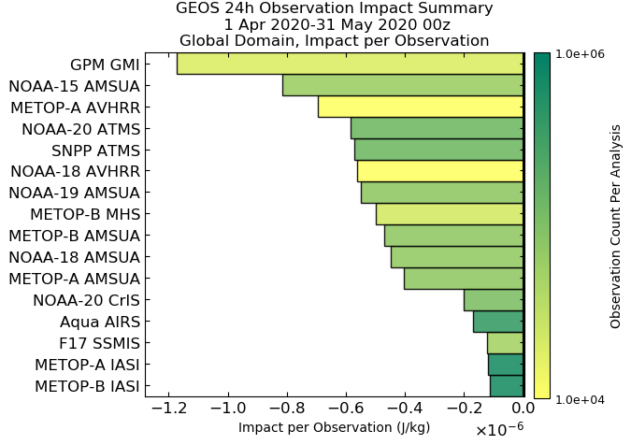
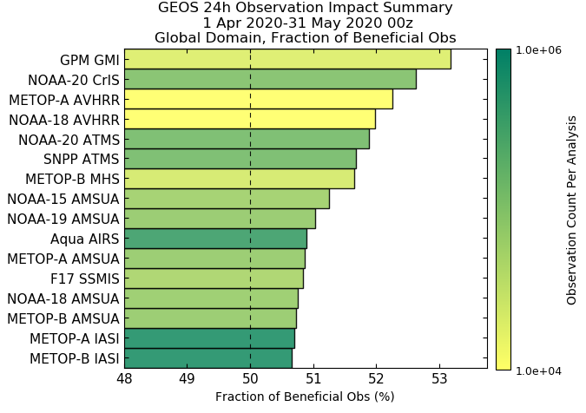
FSOI for satellite radiances in GEOS-FP
Apr-May 2020
= all-sky MW
Impact per Observation
Fraction of Beneficial Observations
24-h global moist energy norm

Slide 5
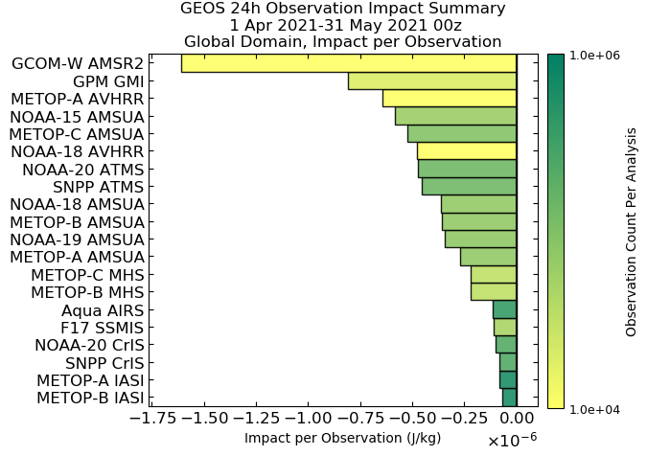
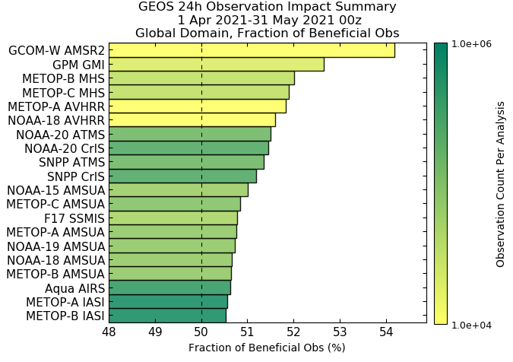
FSOI for satellite radiances in GEOS-FP
Apr-May 2021
= all-sky MW
Impact per Observation
Fraction of Beneficial Observations
24-h global moist energy norm
Notes:
More instruments and more all-sky.

Slide 6
GEOS-FP updates in the near-future
Q3 2021 (observing system)
All-sky ATMS (high-freq channels)
GNSSRO (KOMPSAT, Paz, commercial)
Metop-C IASI
CRTM 2.3.0
Q4 2021 (dynamics/physics)
181 vertical levels
Nonhydrostatic dynamics
GFDL cloud microphysics
Physics updates for turbulence, deep and shallow convection
Gravity wave drag update
Improved aerosol model performance – GOCART-2

Slide 7
NASA investments JCSDA AOP 2021
GMAO In-kind
JCSDA Core Staff
Total Core Staff
4.0
Total 7.8 WYE
(up from 5.9 in 2020)
Total In-kind
3.8

Slide 8
JEDI-GEOS Application: GMAO’s development vehicle for coupled DA
GMAO is developing a configurable unified coupled data assimilation system based on the GEOS model and JEDI to achieve its science and production objectives in weather analysis and prediction, reanalysis, composition forecasting, and S2S prediction.
The focusing vehicle for this effort is the JEDI-GEOS application – a continuously evolving, continuously functional testbed encompassing the configuration files, workflows, and data access capabilities for instantiating end-to-end tests of new developments and establishing trusted baselines.
An important objective of JEDI-GEOS is to produce the first JEDI-based candidates for replacing current-generation GEOS production systems, and the MERRA-3 system.

Slide 9
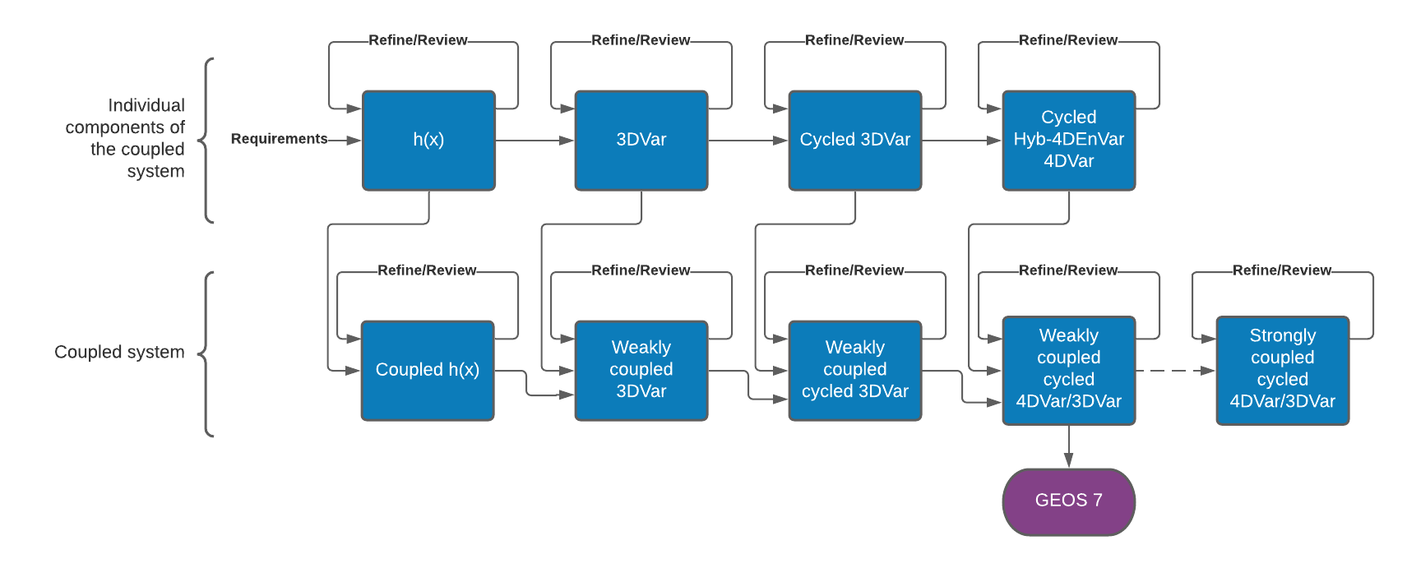
JEDI-GEOS roadmap
Contemporaneous development/refinement of uncoupled and coupled capabilities will ensure an appropriate and flexible design...and more likely meet GMAO timelines

Slide 10
Current work on convergent subprojects
1. GEOS-configured unified forward operator (UFO)
Produce the JEDI-based observing system configurations for GEOS systems, beginning with GEOS-FP for real-time NWP
2. Prototype weakly coupled atmosphere+ocean DA system
Based on the coupled GEOS-MOM6-CICE model currently operating within the SOCA framework, and with atmospheric inputs from (1)
3. JEDI-GEOS application workflow environment
Based on EWOK and R2D2, into which (1) and (2), and their extensions, will be incorporated

Slide 11
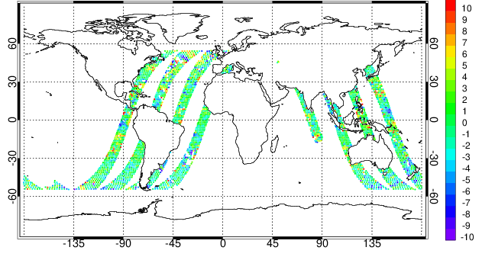
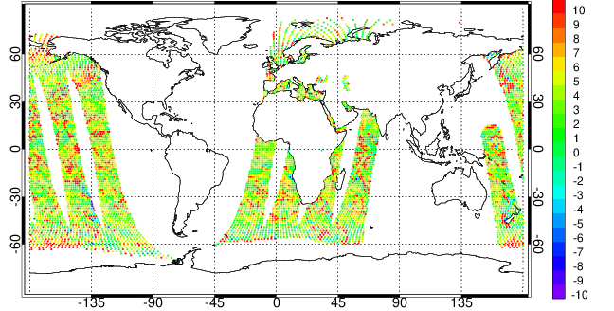
GMI and AMSR-2 all-sky radiance assimilation in JEDI
GMI 23 GHz O-F 15 Nov 2020 00UTC
All-sky radiance assimilation is a NASA priority for JEDI development
Assimilation infrastructure added to JEDI/UFO
Updated operator to account for GMI channel-dependent physical views
Control variables for rain, snow (plus cl_{liq}, cl_{ice})
All-sky observational error functions, plus other UFO filters
QC configurations
Results show O-F departures before bias correction for GMI (top) and AMSR-2 (bottom). GMI values generally less biased than AMSR-2 values.
Jianjun Jin, GMAO
(see talk Thur 9:15 MT)
[K]
AMSR-2 23 GHz O-F 15 Nov 2020 00UTC
[K]

Slide 12
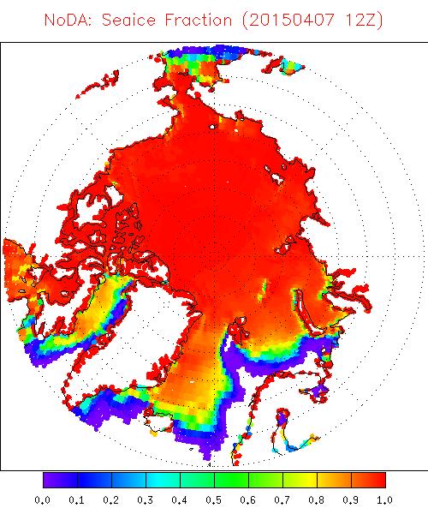
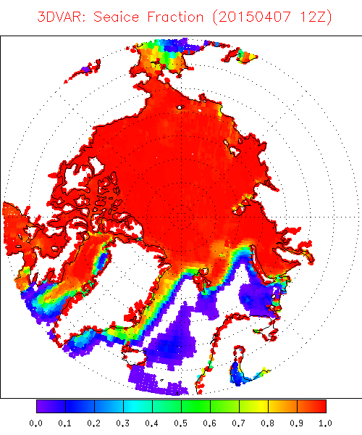
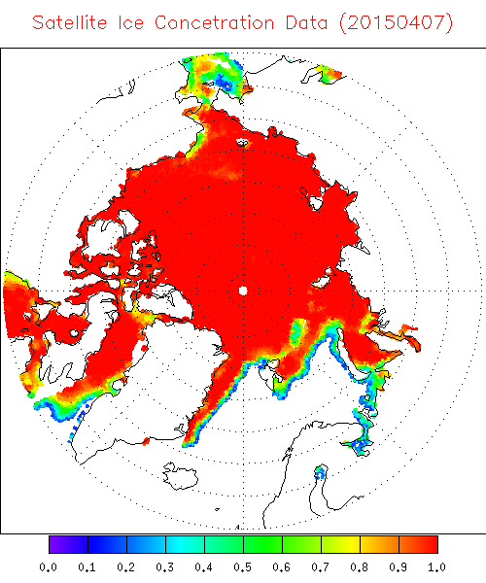
GEOS coupled assimilation of SSMIS sea-ice concentration in JEDI
3DVar assimilation of SSMIS retrieved sea-ice concentration
GEOS-MOM6 Control – No DA
Observations
7 April 2015
7 April 2015
7 April 2015
Cycled GEOS-MOM6-CICE4 coupled model with SOCA 3DVar, MERRA-2 atmosphere replay
Experiment initialized 1 Apr 2015, 1º coupled model resolution, 24-h assimilation window
Min-Jeong Kim, GMAO

Slide 13
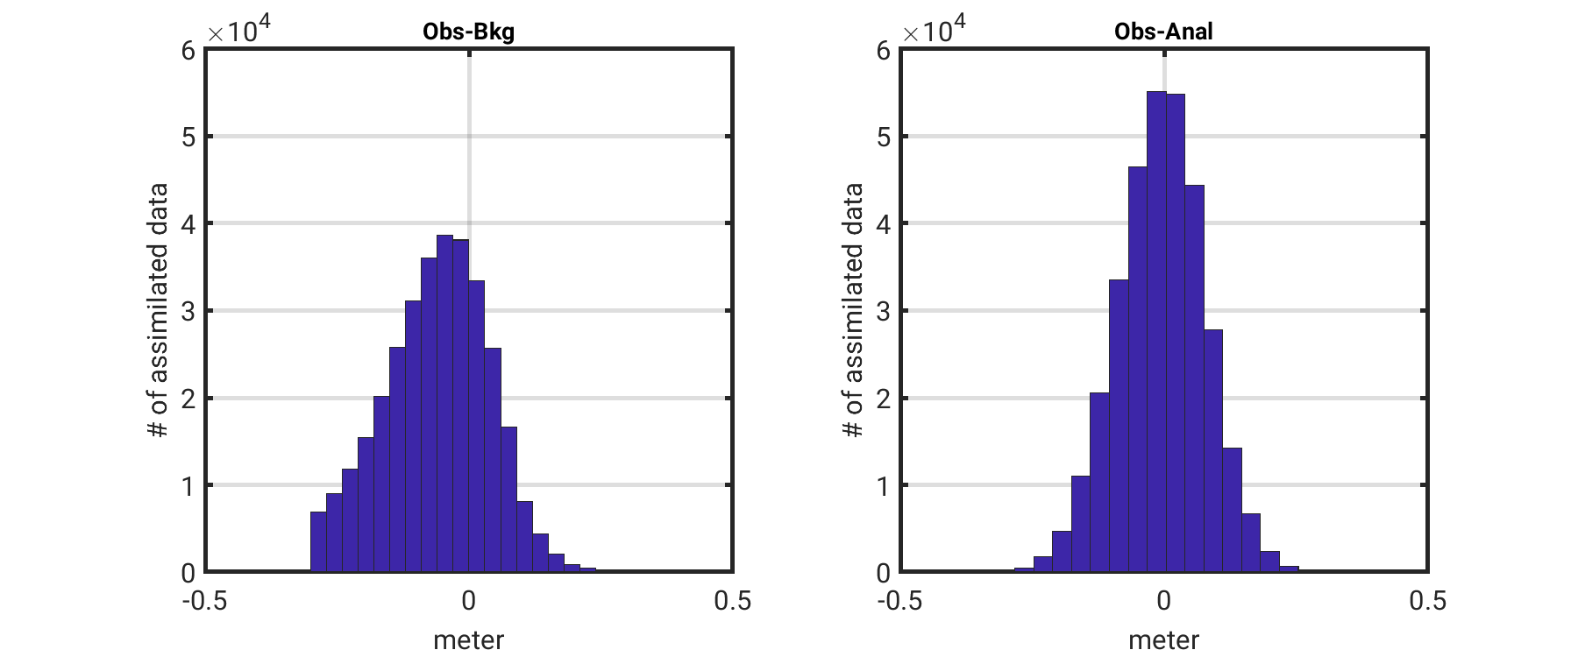
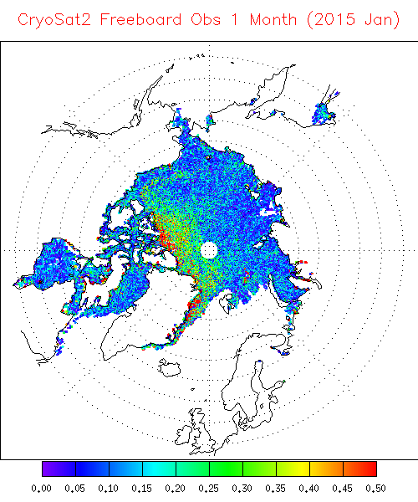
GEOS coupled assimilation of CryoSat2 freeboard in JEDI
CryoSat2 Freeboard Observations
Obs − Forecast
Obs − Analysis
January 2015
GEOS-SOCA 3DVar as in previous slide but for Jan 2015
Improved forward operator and QC procedure yield a more normal O-F distribution with reduced bias
Assimilation moves GEOS coupled model forecast closer to observations
Min-Jeong Kim, GMAO

Slide 14
Thank you.

