Slide 1
NWS - Agency Partner Overview
18th JCSDA Technical Review Meeting and Science Workshop
7-11 June 2021
Daryl Kleist (NOAA/NWS/NCEP/EMC, JCSDA ET Representative for NWS)
On behalf of the entire EMC Data Assimilation and Quality Control Group

Slide 2
Recent and Planned Upgrades to the GFS
GFSv15.1 (June 2019)
Initial implementation of FV3-based GFS
Increase analysis increment & ensemble resolution
GFSv15.2 (November 2019)
GOES-17 AMVs, KOMPSAT-5 GPS, METOP-C AMSU-A and MHS
NSST Updates
GFSv15.2.12 (April 2020)
TAMDAR, Canadian AMDAR, and LATAM
GFSv15.3 (May 2020)
COSMIC-2
GFSv16 (March 2021)
127 Layers, ~80km model top
Modulated-ensemble LETKF & 4DIAU
Correlated observation errors
VarQC re-design, Hilbert Curve
Metop-C GNSSRO
Geostationary CSR
HDOB
GFSv16.1 (May 2021)
Commercial GPSRO
GFSv16.x (TBD)
Leo-Geo AMVs
GMI, Precipitation affected MW
NPP OMPS-LP, N20 OMPS-NP/TC

Slide 3
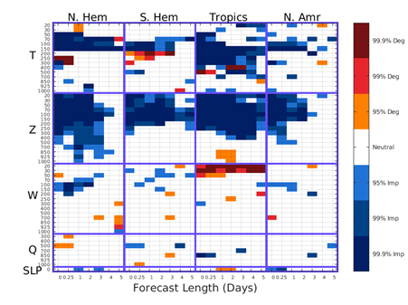
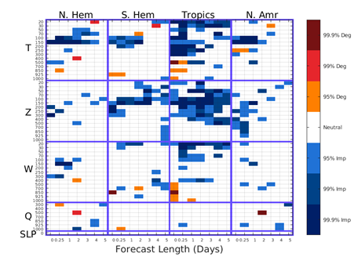
Forecast Impacts of COSMIC-2
Hui Shao, Kristen Bathmann, Lidia Cucurull
Bias
RMSE
The COSMIC-2 data are showing qualitative positive (blue) impacts on forecasts for most fields.
The results are verified against in-situ observations
Blue indicates COSMIC-2 reduced forecast errors
Red indicates COSMIC-2 degraded forecast errors

Slide 4
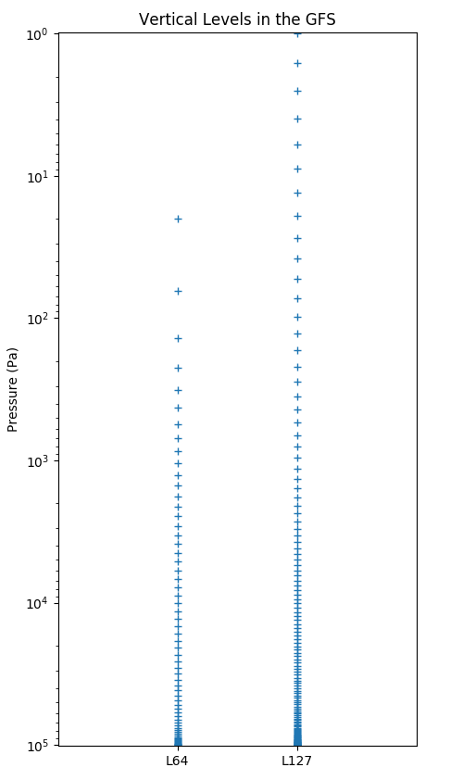
GFSv16 Data Assimilation Upgrades (3/2021)
The GFSv16 evolved from 64 layers to 127 layers, raising the model top from 55 km to 80 km.
New background error, ensemble, balance related changes
4D Incremental Analysis Update (IAU)
Replace EnSRF with LETKF (including model space localization and linearized obs operator)
Correlated observation errors for radiances
Additional channels
Variational Quality Control update
New observations
“GLDAS”
Reduced humidity increments in stratosphere
Improved NSST

Slide 5
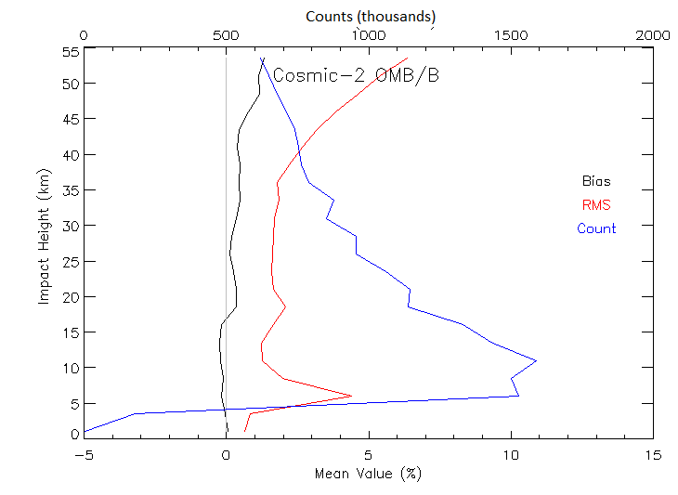
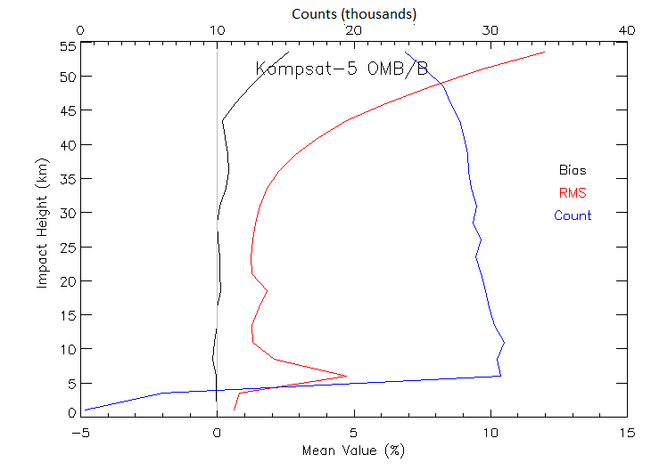
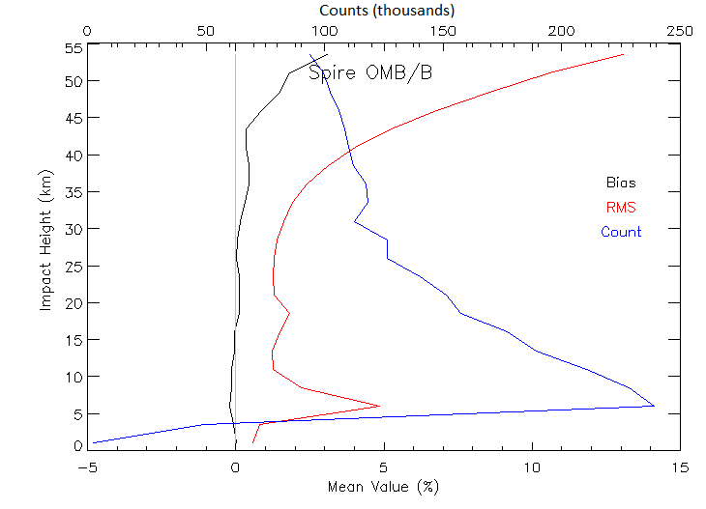
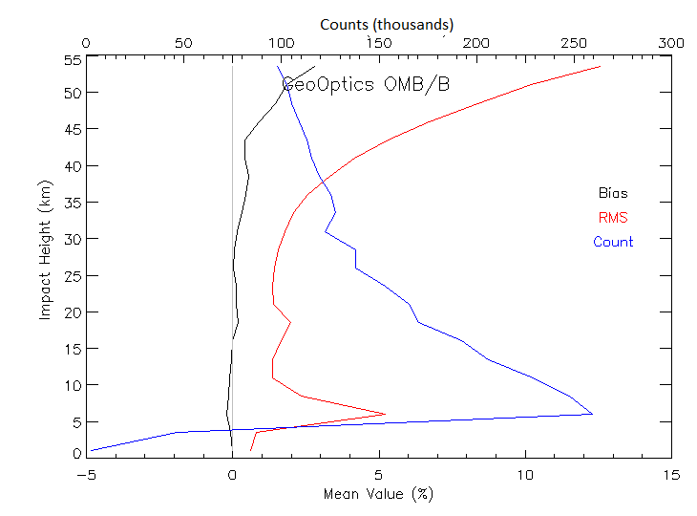
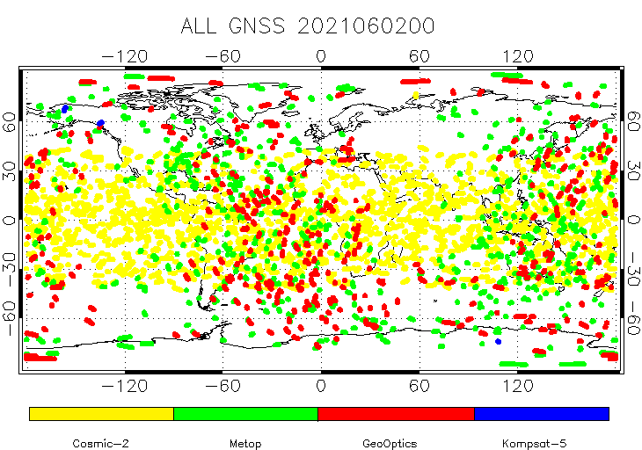
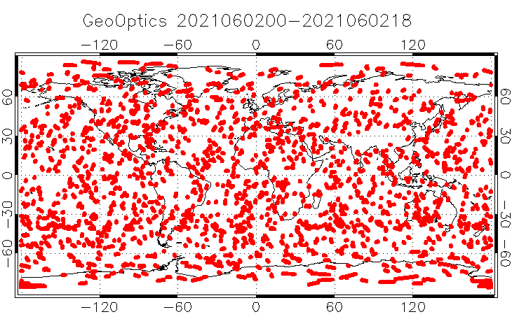
Commercial RO
EMC partnered with JCSDA on several aspects
Bias
RMS
Count
GeoOptics and Spire occultations are found to have similar quality and error characteristics as other operationally assimilated RO data.
Six month delivery order started on March 17 (1300 profiles/day from GeoOptics). Active assimilation began in GFS on May 20.

Slide 6
Looking Ahead (GFS/GDAS)
Observations explored for future GFS implementations (GFS v16.x+)
GOES-17 ABI CSR
NPP OMPS-LP (UV and VIS blended)
NOAA-20 OMPS-TC (OMPS-NP retrievals not consistent with those from NPP in tropics)
Use top 5 layers retrieved ozone due to extended model layers and top.
Revised correlated observation errors for IASI over land/sea and CrIS over land
Assimilate antenna-corrected AMSU-A, MHS, and ATMS brightness temperature (SDR)
Precipitation-affected AMSU-A & ATMS radiances
All-sky assimilation of GMI
Stereo AMVs (GOES/GOES, GOES/Himawari)
Leo-Geo AMVs
GOES-17 mitigated AMVs
VIIRS and AVHRR for near sea surface temperature (NSST) analysis with revised thinning
Updated utilization of ASCAT winds
Joint Effort for Data assimilation Integration (JEDI) and the Unified Forward Operator (UFO): GFSv17+ (~2023)

Slide 7
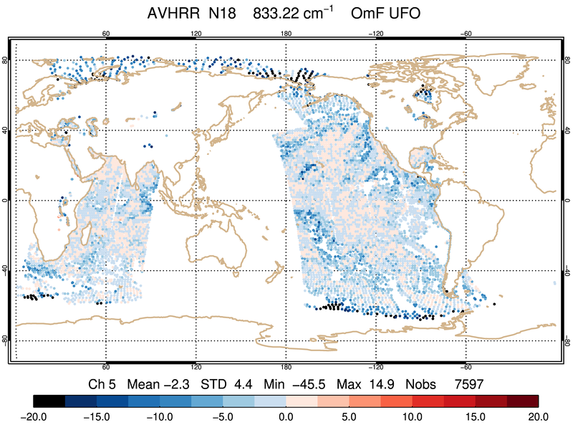
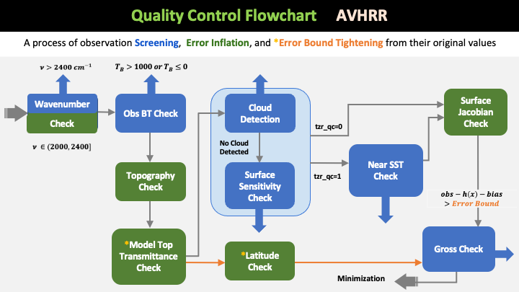
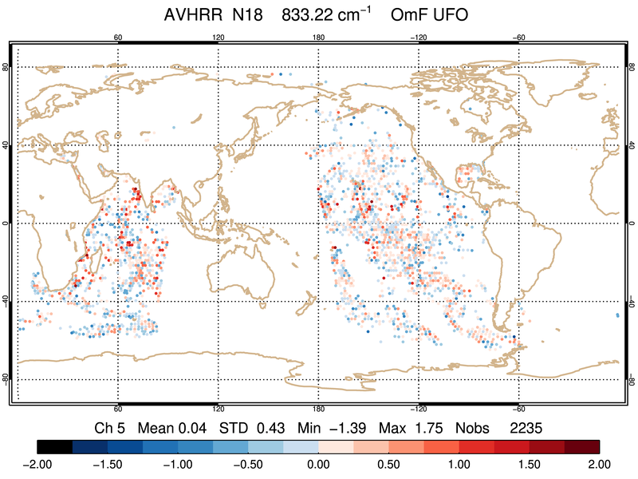
EMC In-kind contributions - GDAS QC for AVHRR
Unfiltered
UFO Filtered
Data filtering using combination of generic filters and obs functions
Parameters defined in GSI resource file (satinfo) for radiances are implemented in YAML
Each QC action implemented has an associated test in UFO
100% replication of GSI result in terms of error inflation, error bound adjustment, and number of observation passed QC filters
GSI Filtered (Reference)
GSI
Filtered
Reference

Slide 8
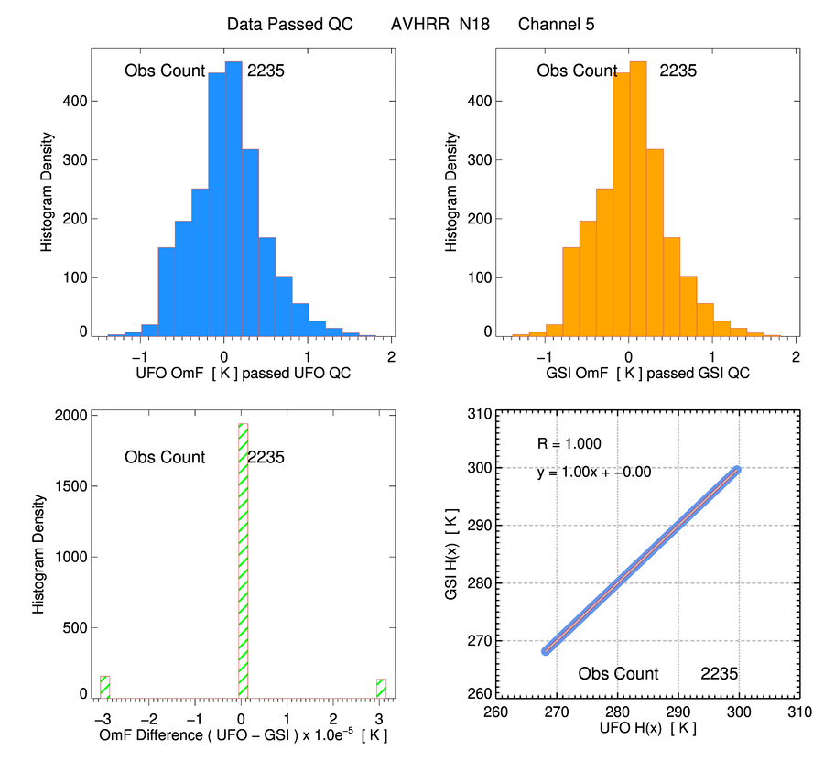
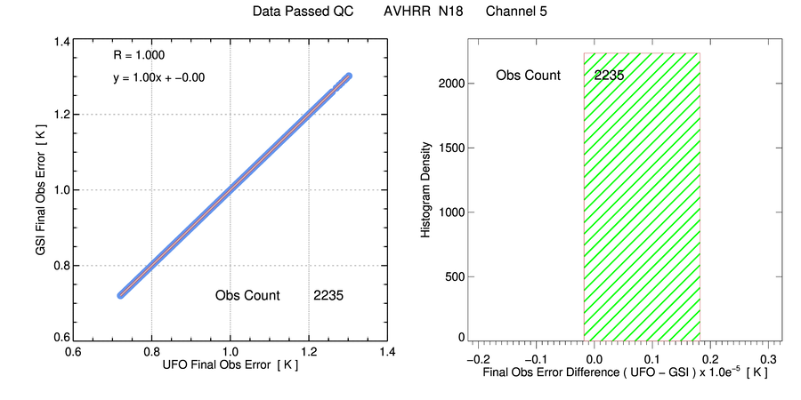
Validation of AVHRR with GDAS GSI - 10 Days
UFO OmF Histogram
(after QC)
GSI OmF Histogram
(after QC)
Final Observation Error Comparison (UFO vs. GSI)
Obs Error Scatter Plot
GSI vs. UFO
Obs Error Difference Histogram (UFO-GSI)
Validation of QC Filter for AVHRR
(One-cycle Result)
H(x) Difference (UFO-GSI) Histogram
H(x) Scatter Plot
GSI vs. UFO
8

Slide 9
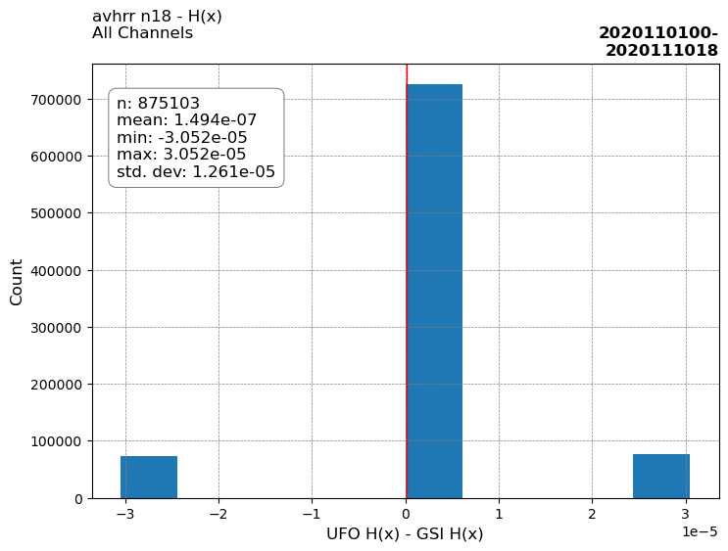
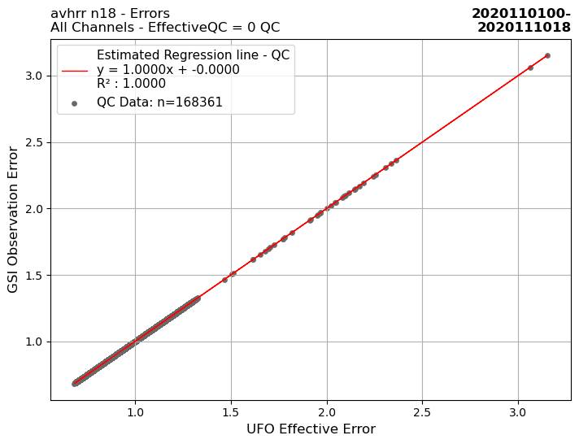
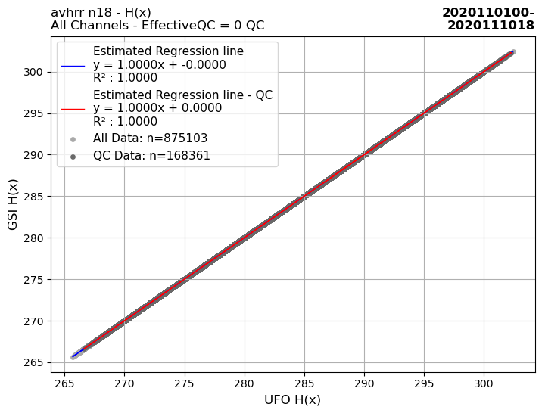
Validation of AVHRR with GDAS GSI - 10 days
H(X) Difference (UFO-GSI) Histogram
(All Channels)
Validation of QC Filter for AVHRR - 10-day Result
Final Obs Error
Scatter Plot
GSI vs. UFO
(All Channels)
H(X)
Scatter Plot
GSI vs. UFO
(All Channels)
H(X) Scatter Plot
GSI vs. UFO
(All Channels)
9

Slide 10
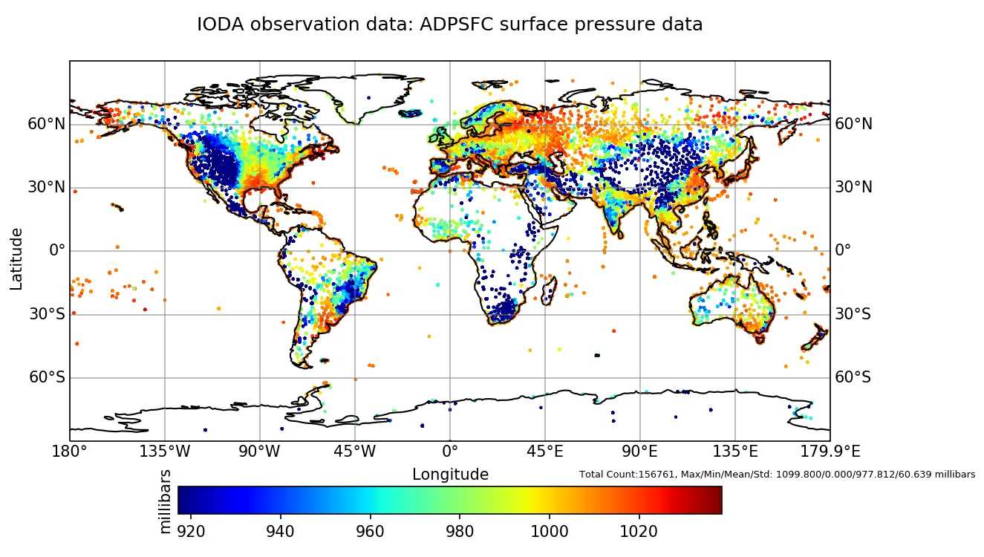
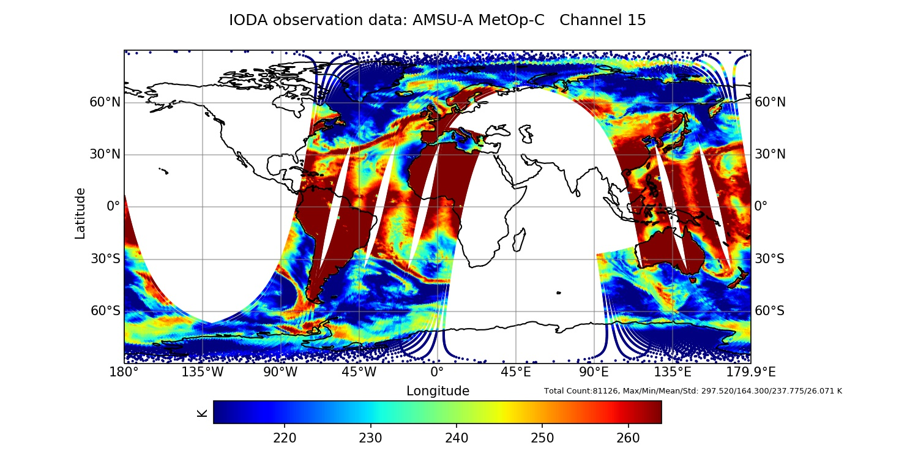
EMC In-kind Contributions - BUFR-to-IODA Converter
C++ tool that converts BUFR file to IODA ObsGroup object (e.g. NetCDF)
YAML file is used to describe the mapping between the input and the output
Supports simple transformations of “export” data so that the units of the data can be converted to the desired representation
Compiles to a library that can be used by other applications
The Surface Pressure field from IODA file
converted from prepBUFR ADPSFC subset
AMSU-A MetOp-C Channel 15
BUFR
to
IODA
GSI NC Diag
to
IODA
( reference for validation )
Figure from Nicholas Esposito, EMC ObsProc Reengineering Team

Slide 11
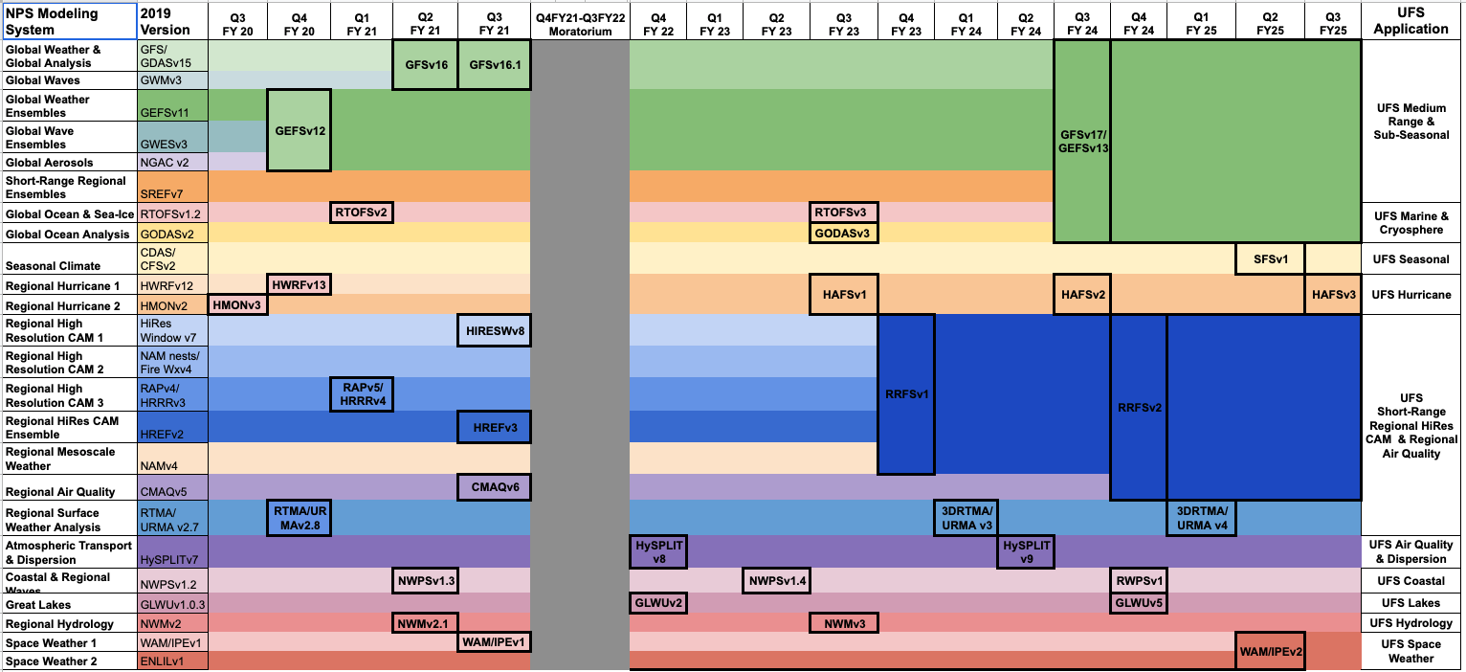
Notional Schedule for Production Suite
Evolution

Slide 12
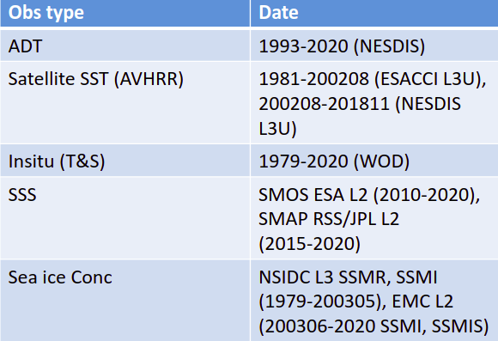
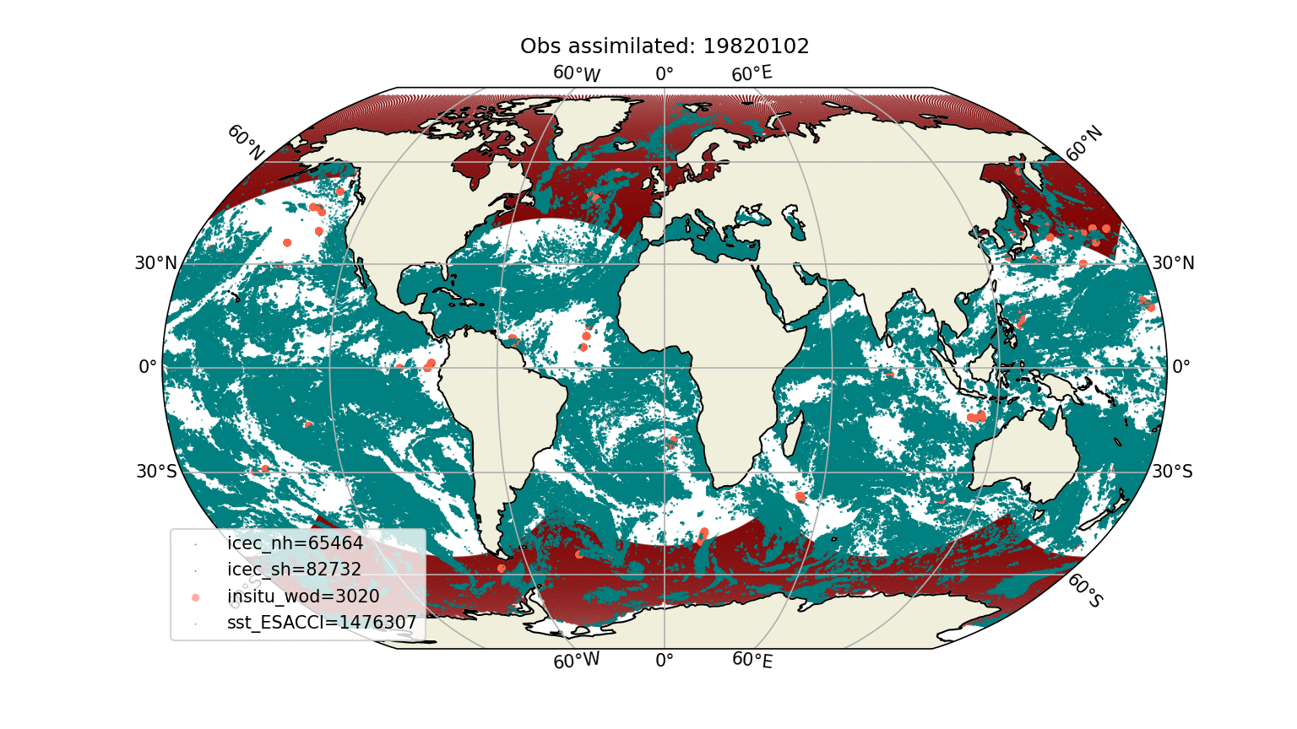
NG-GODAS Interim Reanalysis (J. Kim, G. Vernieres et al.)
DATM-MOM6-CICE6: 1-degree in JEDI-SOCA 3DVar framework
~40 year ocean reanalysis at ¼ degree, to be completed by July 2021
Provide ocean ice benchmarks for UFS S2S GEFS v13
Over 1 Million Observations per day

Slide 13
Global Operational Target – FY 2024
Global Forecast System (GFS) v17
Global Ensemble Forecast System (GEFS) v13:
First fully coupled system from weather to sub-seasonal scales
Integrated GFS and GEFS systems
FV3 + MOM6 + CICE6 + WW3 + NOAH-MP
JEDI-based Weakly/Quasi-strongly coupled DA
30+ ensemble members
Coupled reanalysis & reforecast requirement

Slide 14
Looking ahead to AOP2021 & Beyond
NWS providing ~11.5 FTEs worth of in-kind contributions across the spectrum of projects.
Critical year for JEDI development and integration to meet future operational targets
GDAS/GFS/SFS (Coupled), RRFS, HAFS, and 3D-RTMA
Priorities: Complete UFO acceptance, Background Error for FV3-based GFS, LETKF, higher resolution SOCA with hybrid DA, initial land capabilities
Still looking for balance between agile development practices and things necessary to facilitate T2O
Many new (or re-initiated) areas of development that are leveraging and contributing to JEDI:
Aerosol/Chemistry, Land, Ocean Color/Biogeochemistry

Slide 15
EMC In-Kind Contributors
Additional NWS Contributions
Kristen Bathmann^{1,2}, Mike Barlage¹, Cameron Book^{1,2}, Jiarui Dong^{1,2}, Kevin Dougherty^{1,2}, Nick Esposito^{1,2}, Iliana Genkova^{1,2}, Azadeh Gholoubi^{1,2}, Zhichang Guo^{1,2}, Yan Hao^{1,2}, Jong Kim^{1,2}, Daryl Kleist¹, Louis Kouvaris^{1,2}, Praveen Kumar^{1,2}, Ting Lei^{1,2}, Emily Liu¹, Haixia Liu^{1,2}, Ling Liu^{1,2}, Xiao Liu^{1,2}, Rahul Mahajan¹, Cory Martin^{1,3}, Ron McLaren^{1,2}, Dagmar Merkova^{1,2}, Shastri Paturi^{1,2}, Mark Potts^{1,3}, Scott Sieron^{1,2}, Andy Tangborn^{1,2}, Yi-Cheng Teng^{1,2}, Catherine Thomas¹, Youlong Xia^{1,2}, Xiaoyan Zhang^{1,2}
¹NOAA/NWS/NCEP/EMC
²IMSG
³Redline
Stylianos Flampouris (STC@NWS/OSTI), Jim Yoe (NWS/NCEP), Jieshun Zhu (NWS/NCEP/CPC),

Slide 16
Thank You!
Contact: daryl.kleist@noaa.gov

