Slide 1

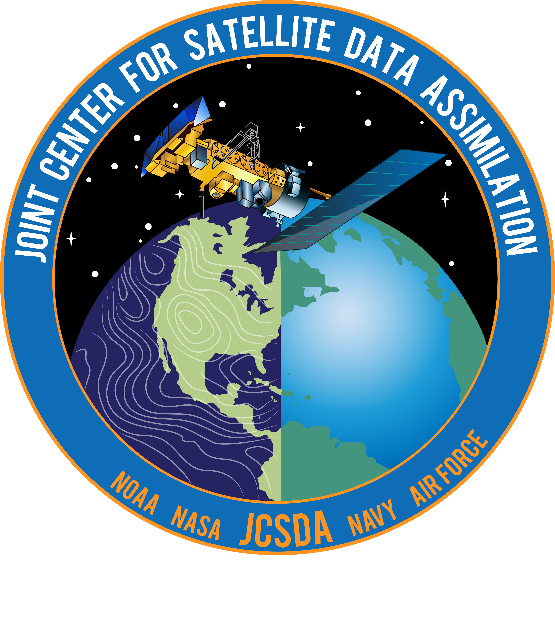
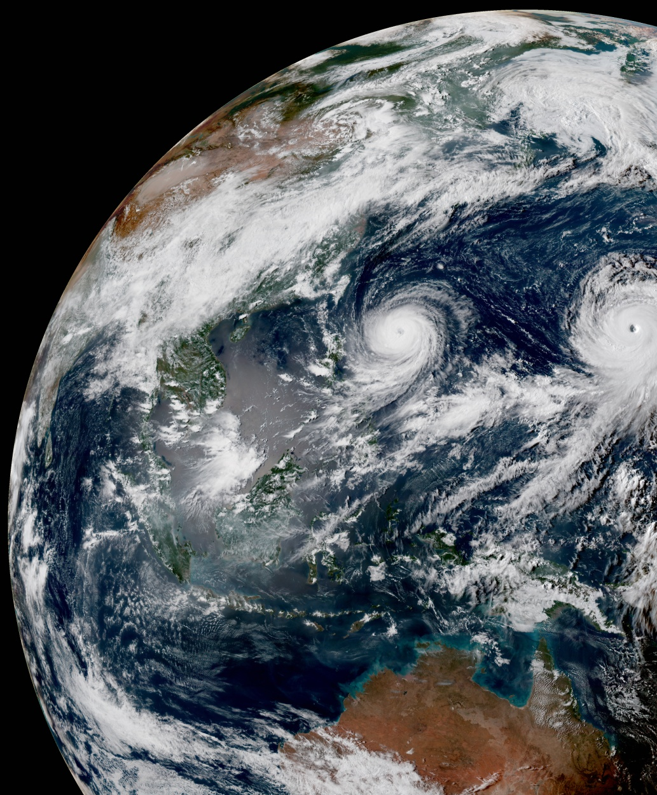
Joint Center for Satellite Data Assimilation
JCSDA Overview
Tom Auligné, Director, Joint Center for Satellite Data Assimilation
JCSDA Technical Review Meeting and Science Workshop:: June 7 2021:: Virtual Exchange

Slide 2
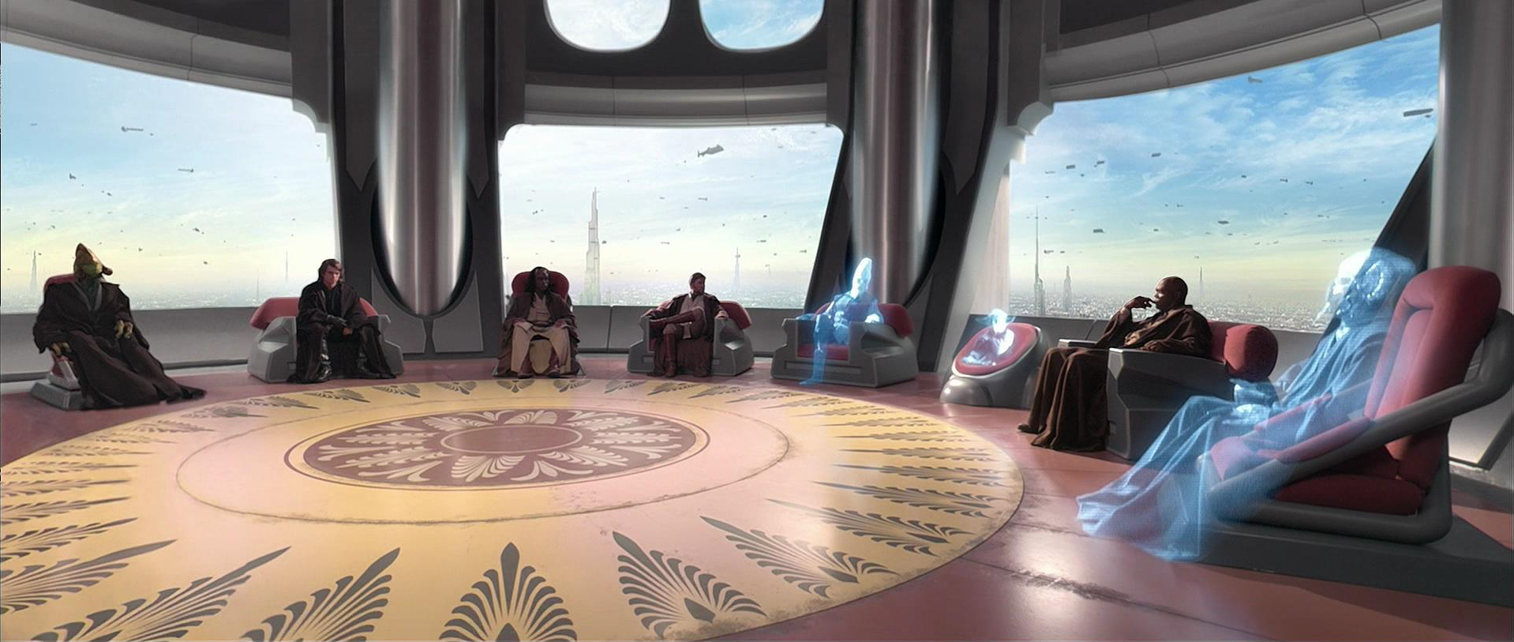
Joint Center for Satellite Data Assimilation
NOAA
NESDIS
NASA
GMAO
Mission: to accelerate and improve the quantitative use of research and operational satellite data in weather, ocean, climate and environmental analysis and prediction systems.
NCAR
UCAR
NOAA
OAR
JCSDA
Team
Air Force
Academia, private sector &
international
partners
NOAA
NWS
Navy
WHO HOW WHAT
Distributed staff Joint operating plan Critical path to operations

Slide 3
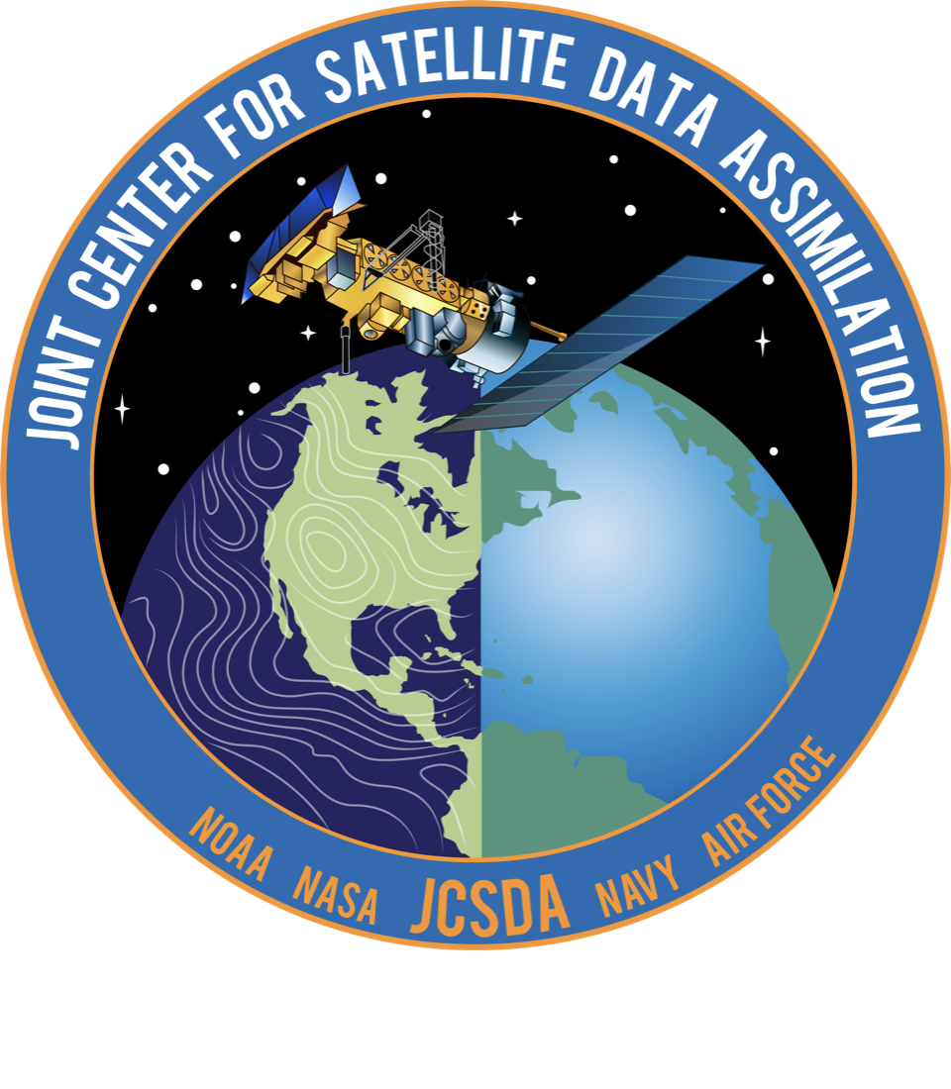
Oper
Software Components
Collaborative Infrastructure
Applications

Slide 4




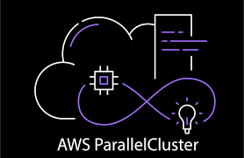
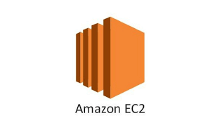



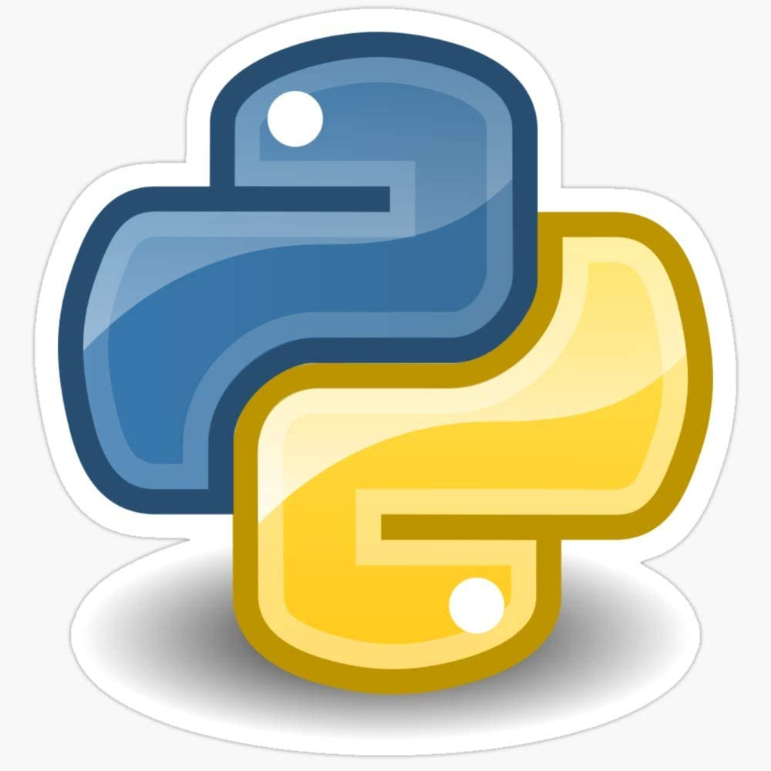

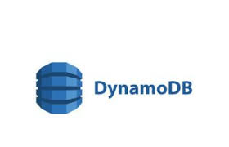



JCSDA Collaborative Infrastructure
  Open-source code management
  Agile/SCRUM project methodology
  Unified build system
  Automated Testing & Containers
  Training, Interactive Diagnostics
Travis-CI
DockerHub
AWS CodeBuild
AWS ECR

Slide 5


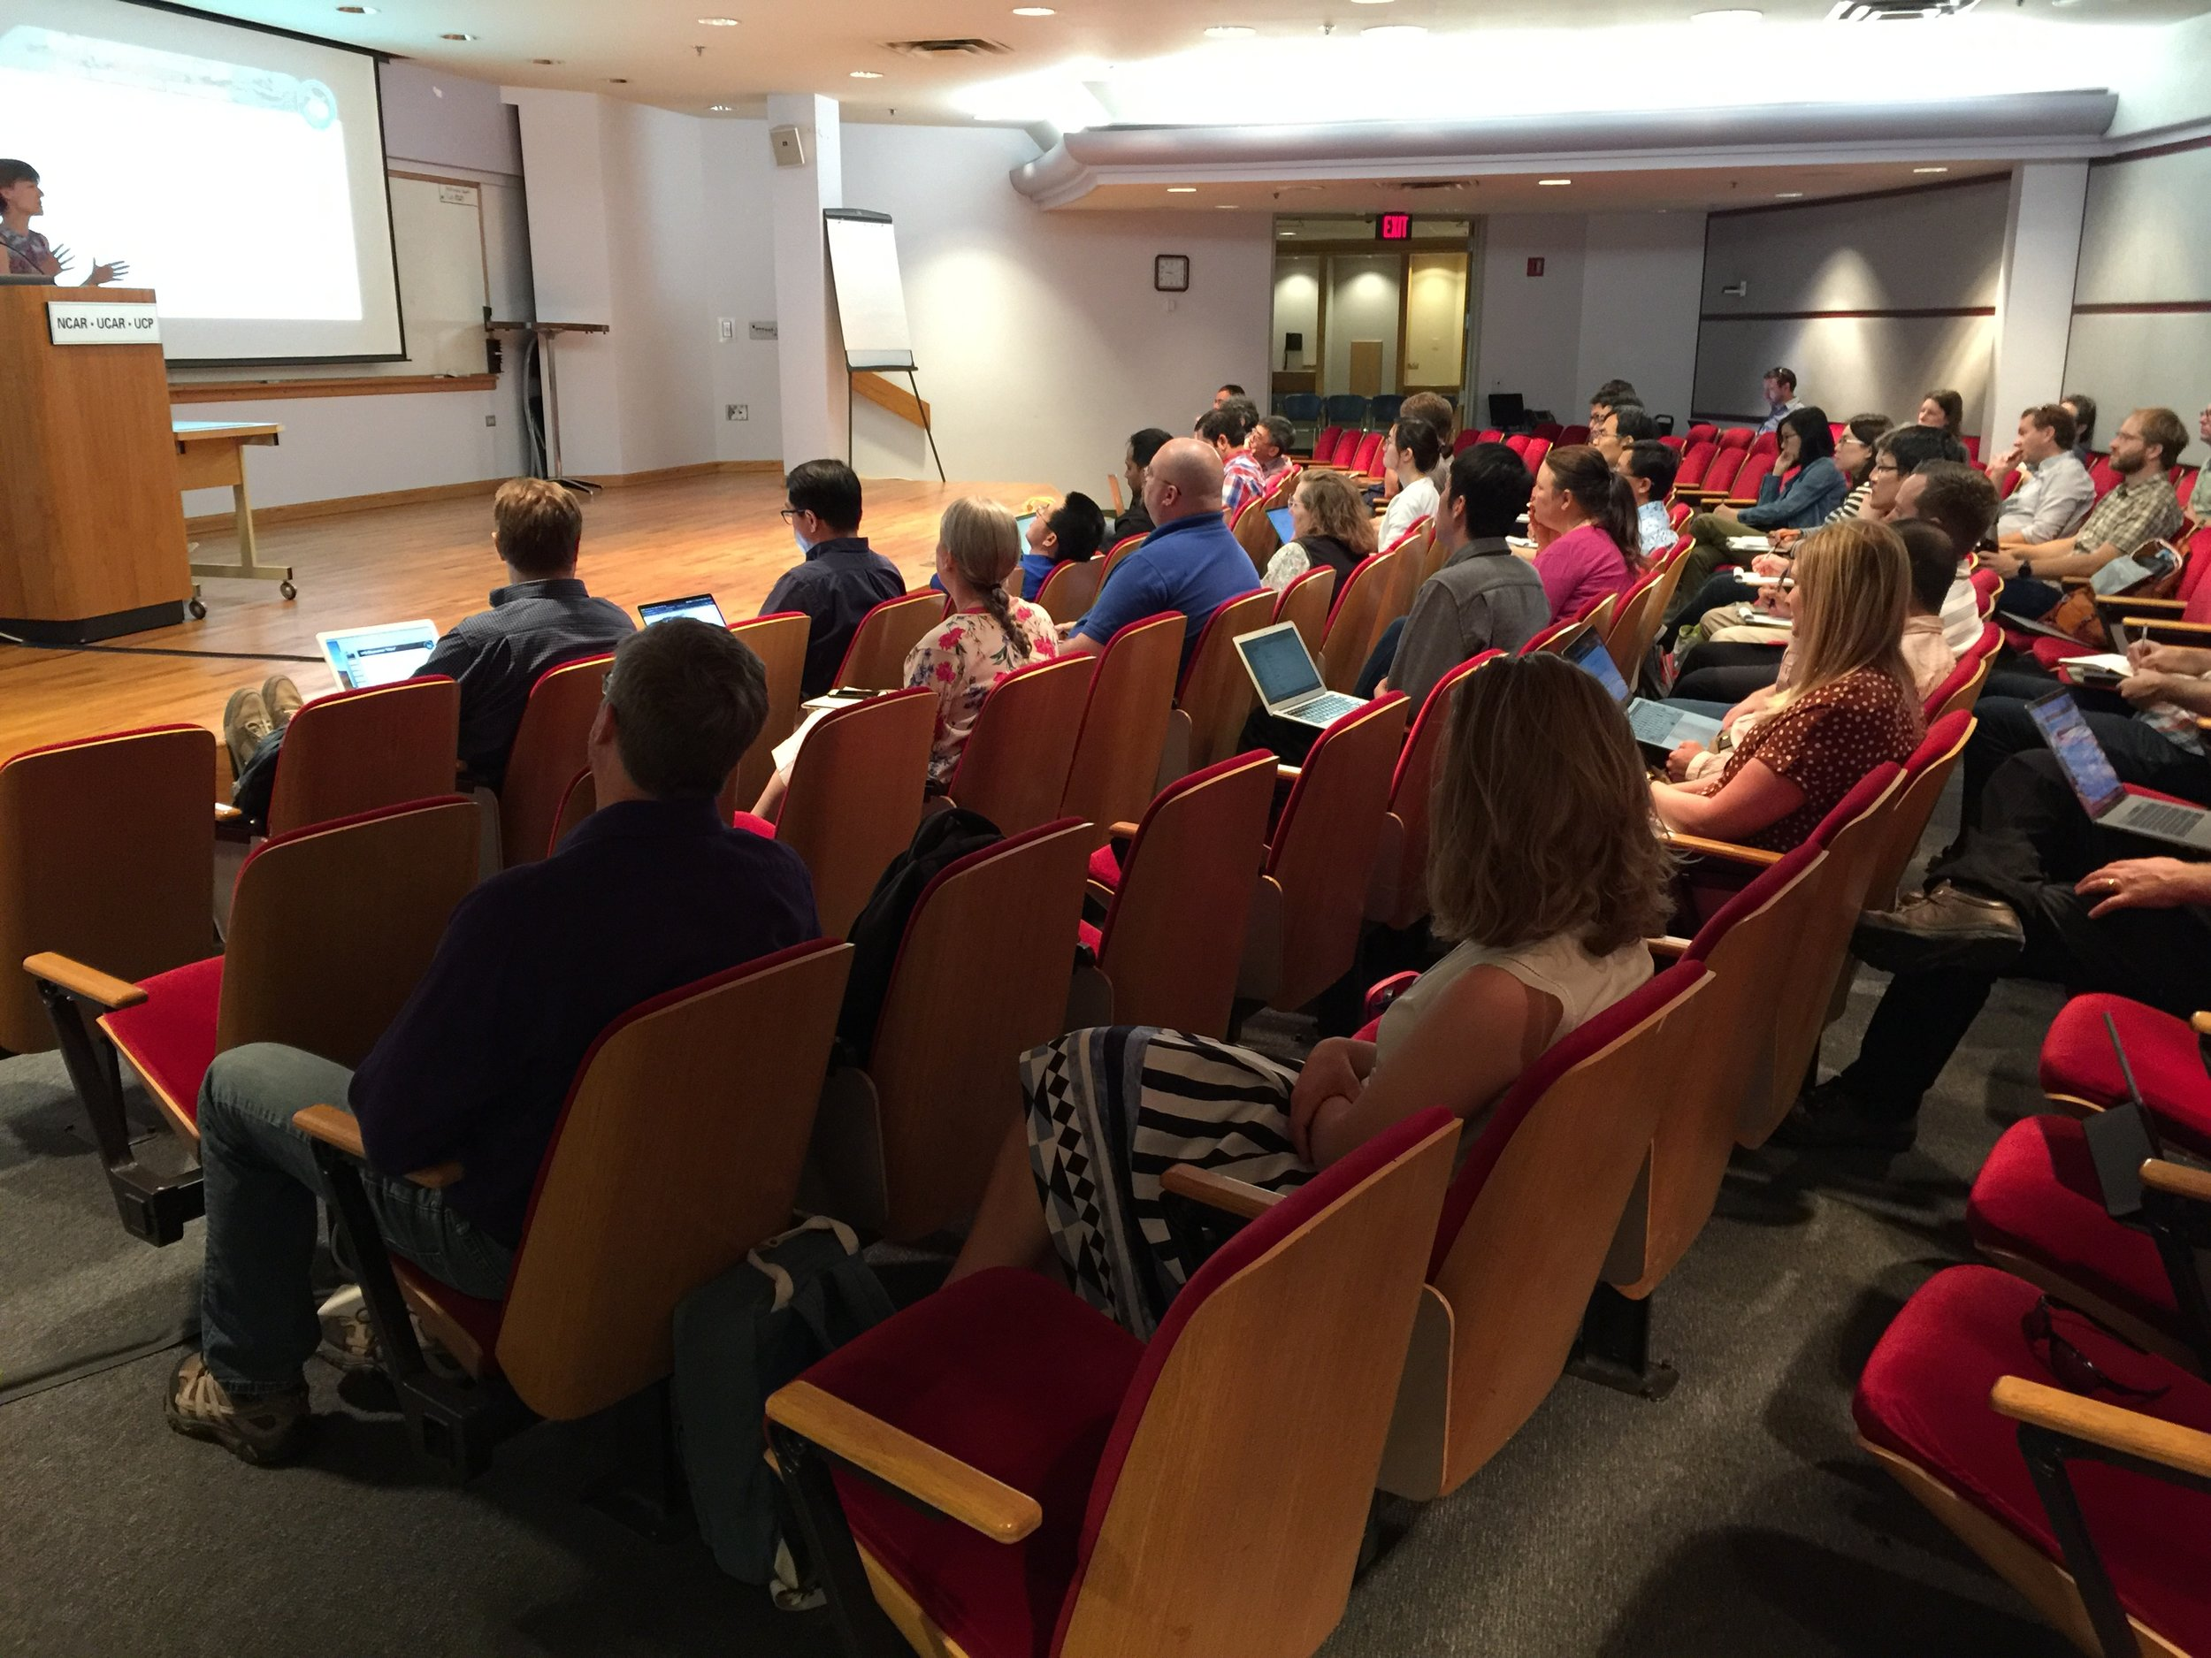
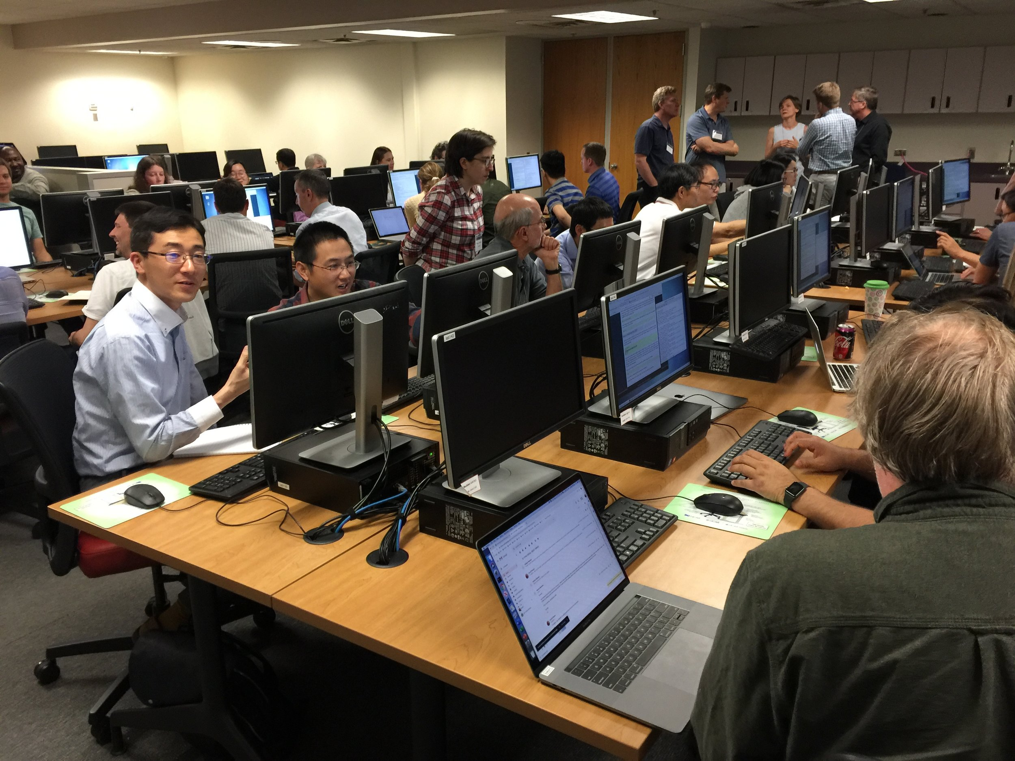
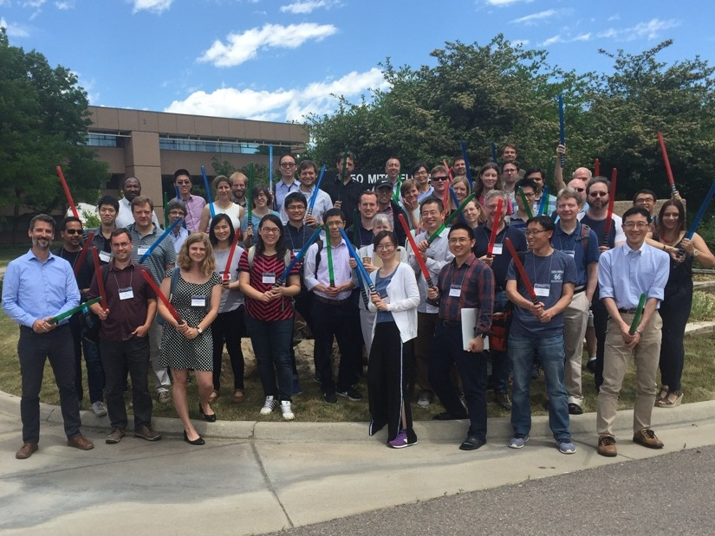
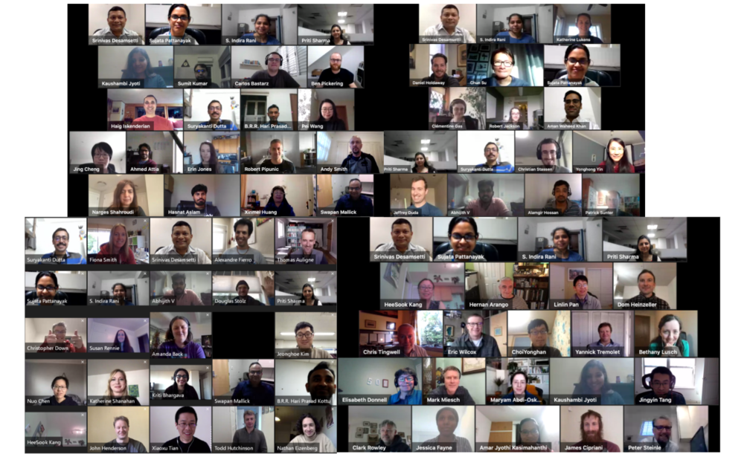
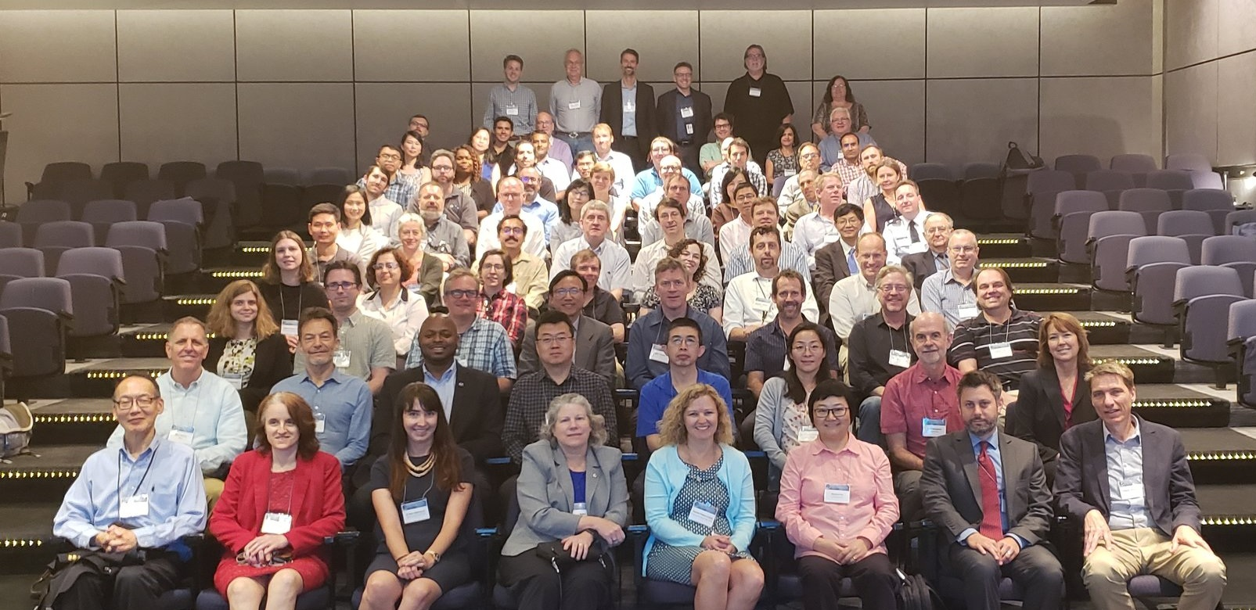
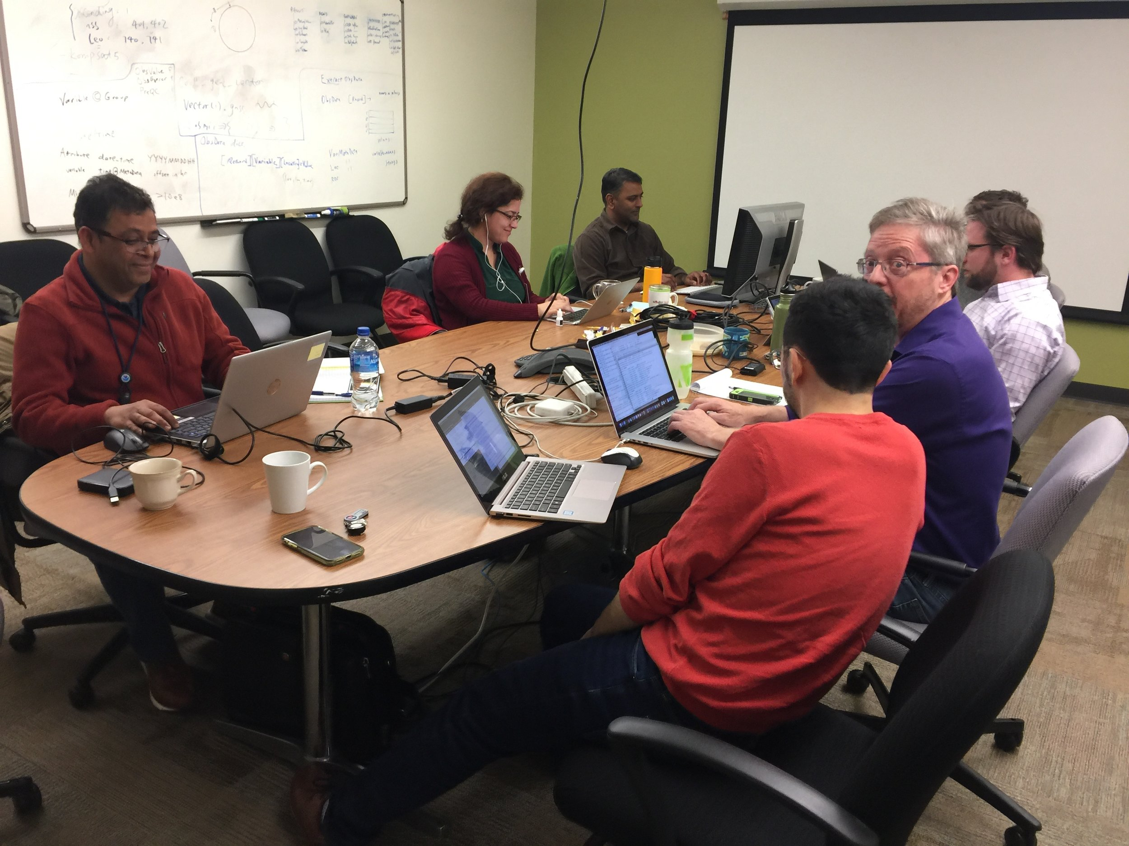
Community Engagement and Support
JEDI Academy
JCSDA Annual Science Workshop
Code Sprints

Slide 6
Oper
Software Components
Collaborative Infrastructure
Applications

Slide 7
Joint Effort for Data assimilation Integration (JEDI)
Definitions
One system with multiple configurations for Earth system DA
UCAR & Community
WRF
MPAS
ROMS
GFS
MIT GCM
Air Force & Met Office
UM
SAR
LFRic
HAFS
JEDI
NEPTUNE
Navy
MOM6
MERRA
GOCART
CICE5
NOAA
WW3
GEOS-Chem
NWM
RTMA
GEOS
NASA
Share as much as possible, without imposing a single approach

Slide 8
System Agnostic Background Error Representation
SABER: Generic background error covariance tools (Ménétrier, 2018)
Atmosphere
Ocean (land-aware)
(note: values near zero were blanked out to visually highlight regions with stronger impact.)

Slide 9

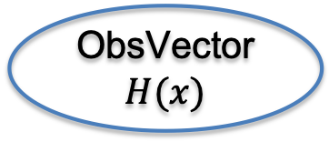
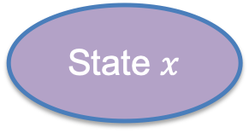
Unified Forward Operator (UFO)
State $x$
ObsOperator $H$
ObsVector $H(x)$
Observation operator computes model equivalent in the observation space. With this interface, it is model-specific.

Slide 10
Unified Forward Operator (UFO)
State
Model 1
ObsVector
ObsOp 1
State Model 2
ObsVector ObsOp 2
…
…
State Model N
ObsVector ObsOp M
With this design, each model would have to implement all observation operators it needs: duplication of work

Slide 11
Unified Forward Operator (UFO)
State
Model 1
ObsVector
ObsOp 1
State Model 2
GeoVaLs
ObsVector ObsOp 2
…
(model-aware
observation-agnostic)
(model-agnostic
observation-aware)
…
State Model N
ObsVector ObsOp M
Observation operators are independent of the model
and can easily be shared, exchanged, compared (’App Store’)

Slide 12
Oper
Software Components
Collaborative Infrastructure
Applications

Slide 13
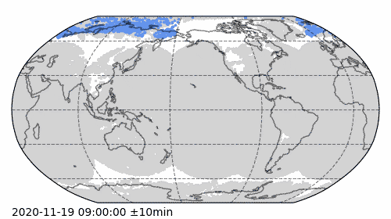
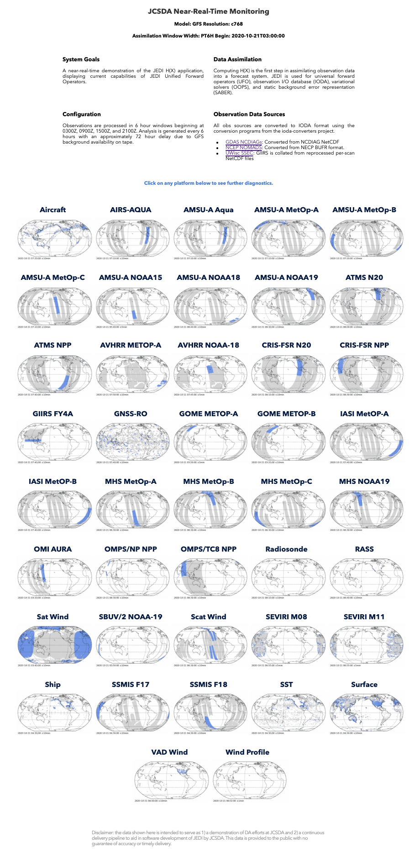
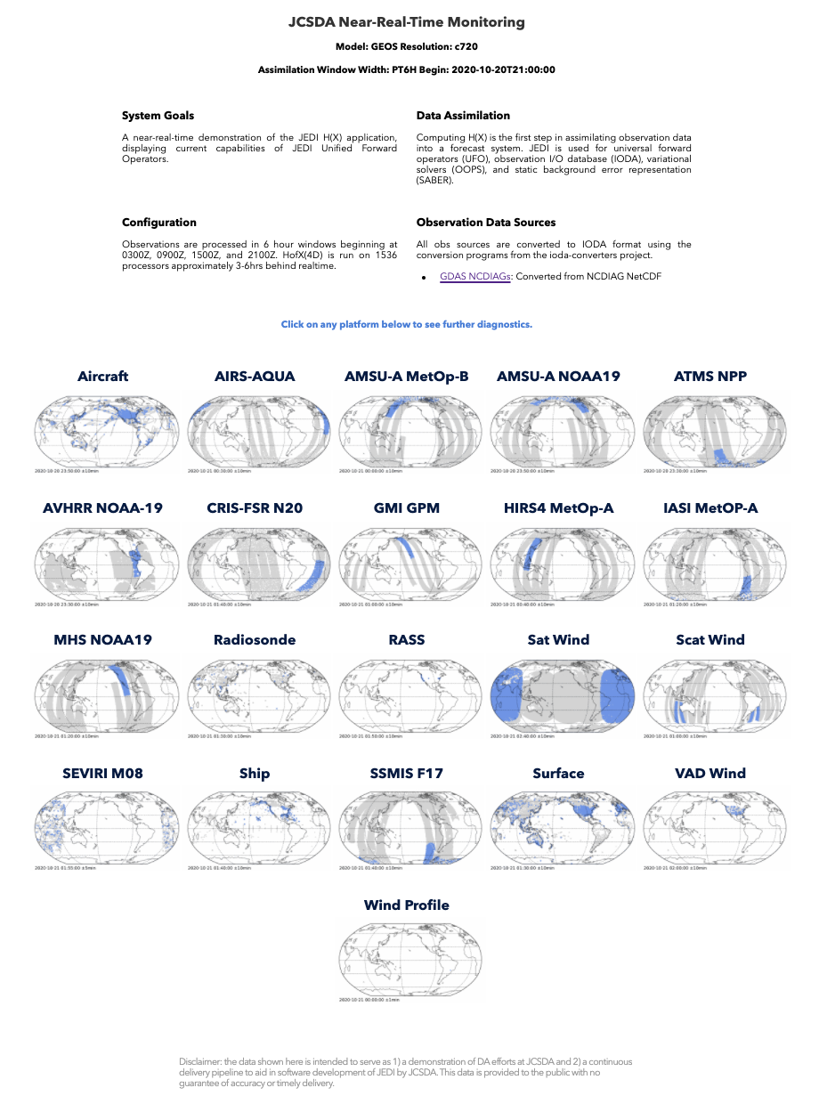
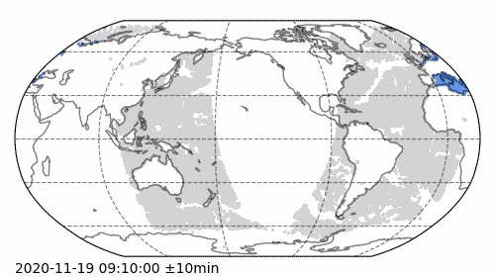
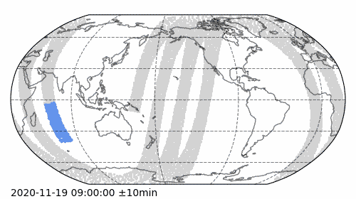
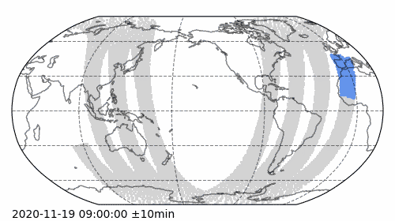
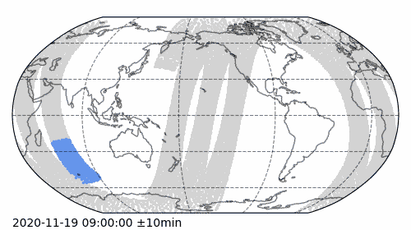
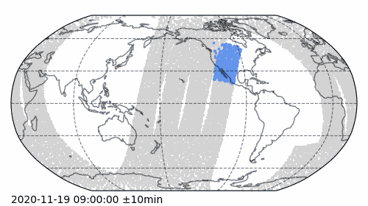
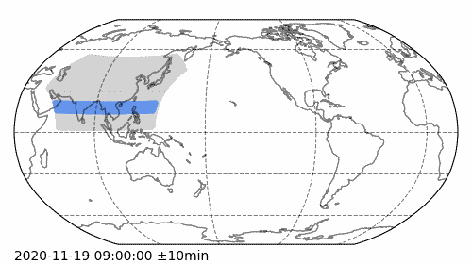
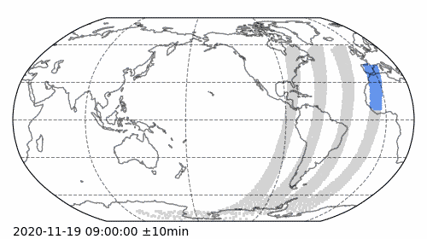
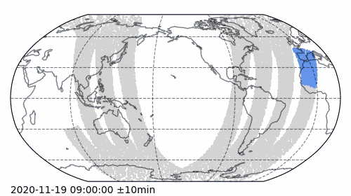
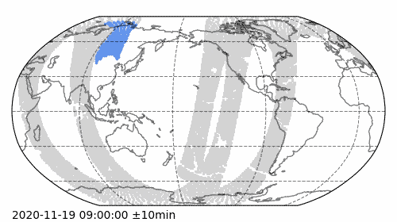
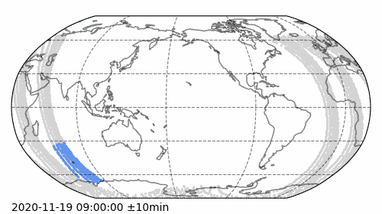
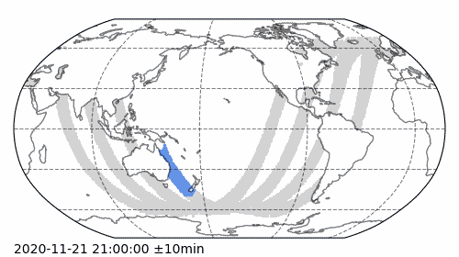
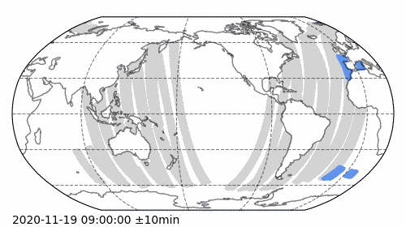
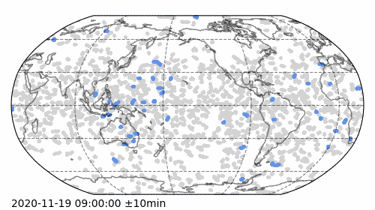
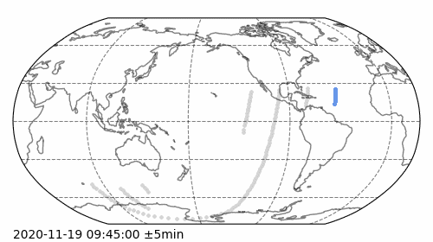
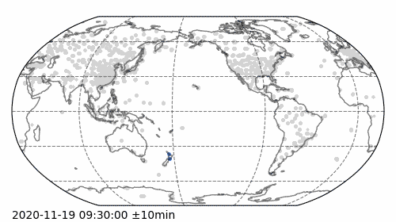
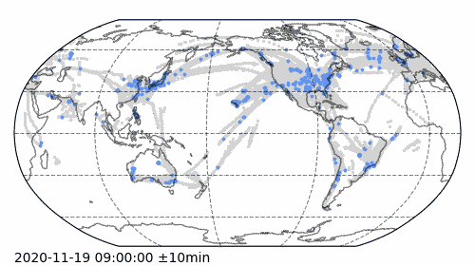
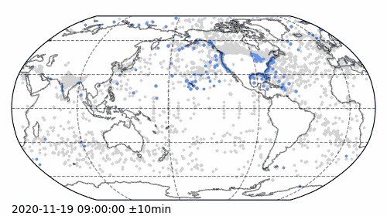
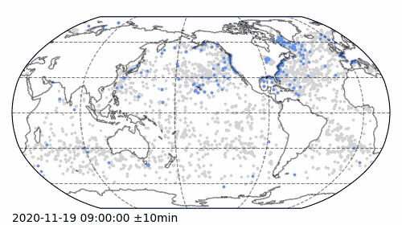
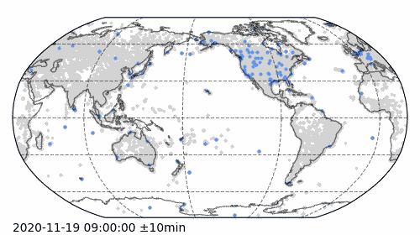
Joint Testbed Applications
nrt.jcsda.org
soca.jcsda.org
Satwind
AIRS-Aqua
AMSUA MetOp-A
ATMS NPP
AVHRR NOAA-18
Rapid prototyping & testing via CI/CD
Goal = end-to-end “pseudo-operational” suite
Efficiency gains leveraging JCSDA IaC:
- Common repos & agile boards for code and config files
- Common workflow & experiment manager (EWOK)
- Common data store (R2D2)
- Common diagnostics tools
CriS FSR N20
GIIRS FY4A
GOME METOP-A
IASI METOP-B
SSMIS F18
OMI AURA
GMI GPM
Scat Wind
GNSSRO
SBUV/2 NOAA-19
Radiosonde
Aircraft
Ship
SST
Surface
Notes:
Application = end-to-end system instantiated with specific partner configuration
Continuously test all components in pseudo-operational environment
Leverages JCSDA open-source and agile working practices, and generic infrastructure
Continuously evolves, yet continuously functional (CI/CD)
Testbed = focusing vehicle for collaborative development
Turn-key ecosystem to spin-up research experiments
Rapid testing with near-instantaneous feedback, multi-tier to optimize HPC resources
Joint = effort spent in developing the application benefits everyone
Co-owned, co-developed and co-branded between JCSDA and partner agency
Results are transparent to everyone and can be replicated & compared by everyone

Slide 14
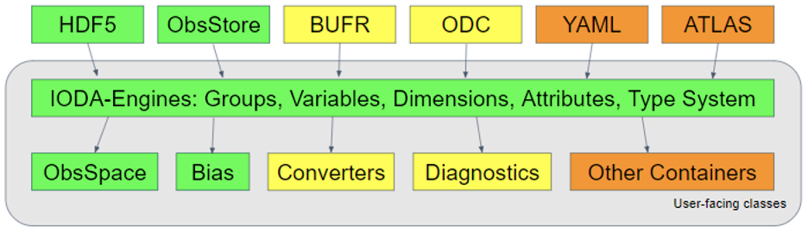
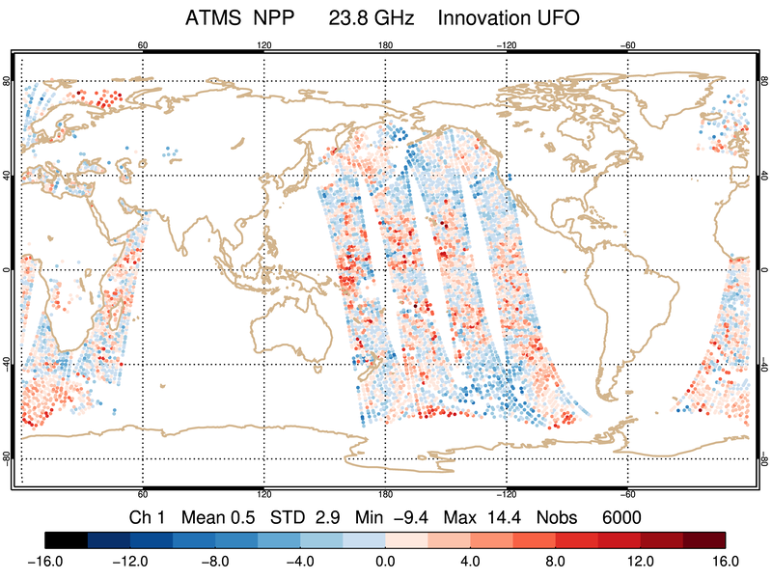
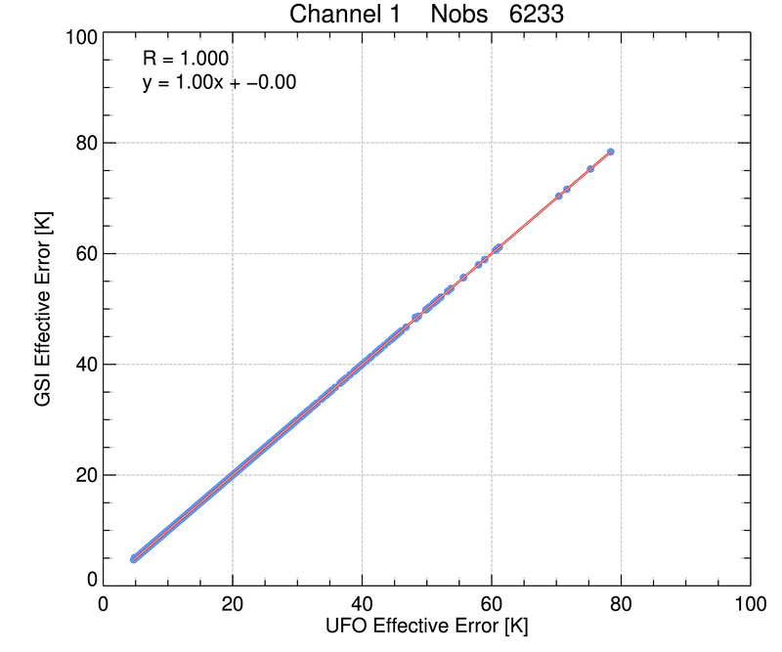
JEDI-FV3 v1.1 Public Release: Friday June 11
IODA V2.0.0
Leverages HDF5 data model for improved organization, management, extensibility, metadata
Enhanced support for multi-dimensional data sets
C++/python interoperability
IODA v2 Release
After Release
Planned / Potential
JEDI UFO for ATMS
Obs error after GSI/UFO QC
UFO V1.1.0
H(x), Bias correction, and QC for NCEP operational instruments following GSI implementations
Good agreement with GSI in most cases; validation work continues
GSI
O-B for ATMS ch1 using UFO
UFO

Slide 15
Next-generation DA for research and operations
- Facilitate innovation and optimize code performance
Reduce duplication of effort between JCSDA partners
- Implementing new DA algorithms (OOPS)
- Adding new observations (CRTM, UFO and IODA)
- Background error covariances (SABER and VADER)
Enable future coupled Earth-system DA developments
- Bring atmosphere/land/cryosphere/ocean/aerosols/constituents components into one DA system
Final Remarks: JCSDA Investments are Paying Off

Slide 16
Discussion

