Slide 1
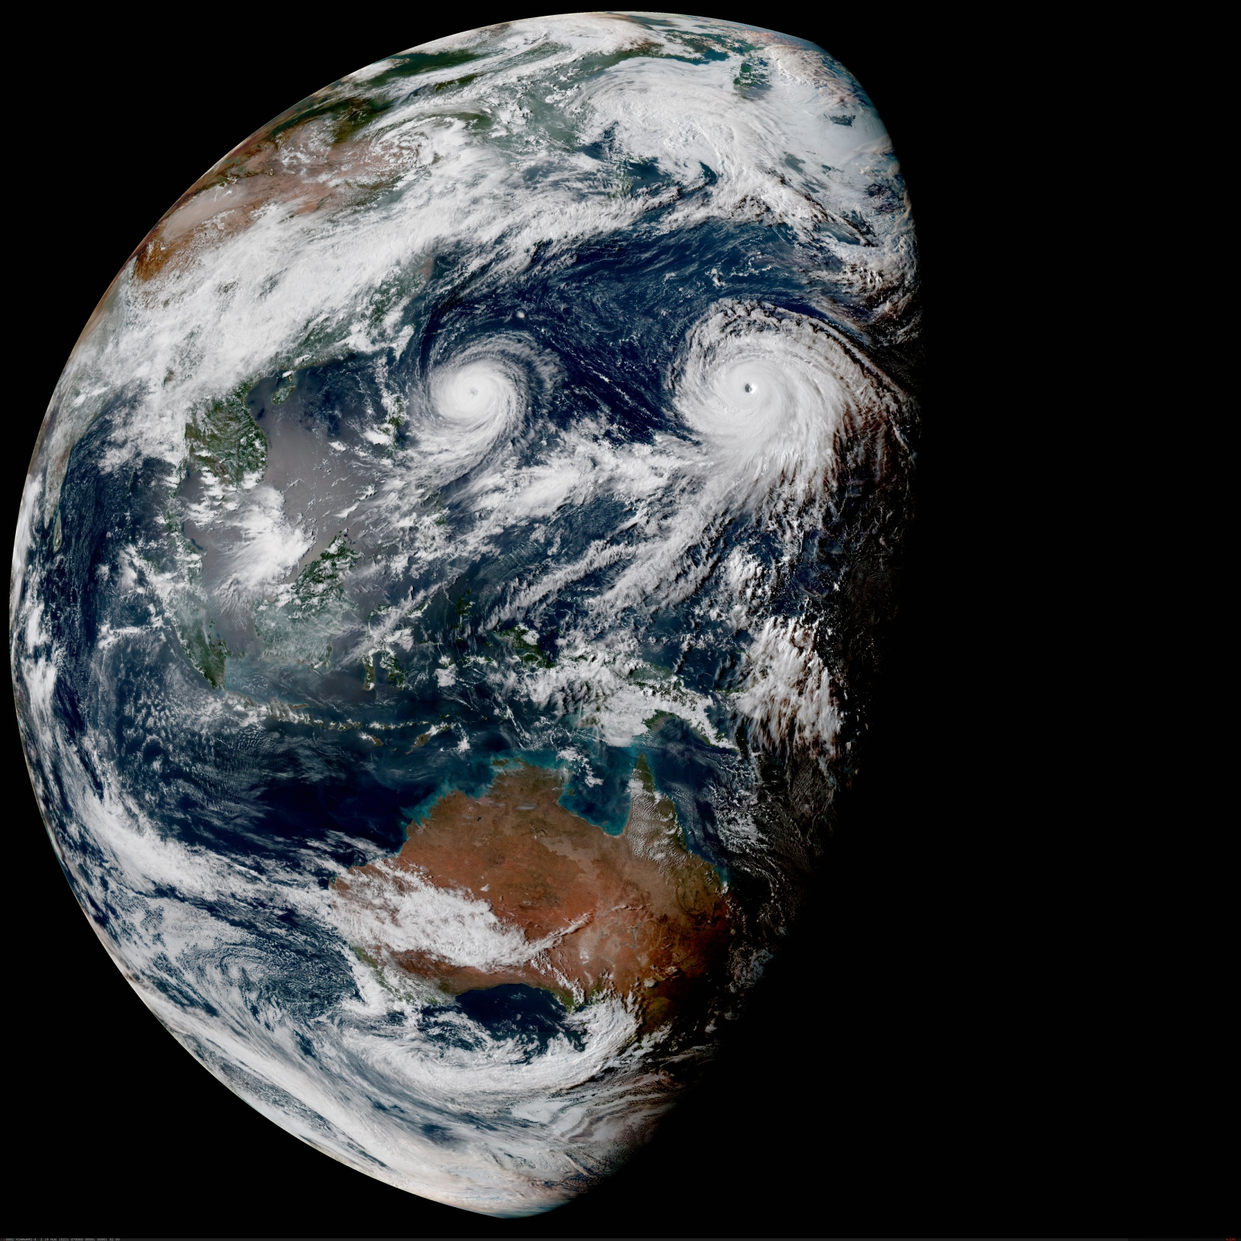

Evaluation and Assimilation of GeoHIS in JEDI:
Progress and Future Perspective
GeoHIS: Geostationary Hyperspectral InfraRed Sounders
Wei Han
In collaboration with OBS team and SSEC calibration team
With support of the JEDI/CRTM Core Teams
Acknowledgement:
Robert Knuteson (SSEC)
Hank Revercomb(SSEC)
18th JCSDA Technical Review Meeting and Science Workshop
7-11 June 2021
weihan@ucar.edu

Slide 2
Outline
GIIRS project
WHY GeoHIS
  HIGH temporal, 3D temperature and moisture (trace gases)
  Targeted Observing for high impact weather
Progress on GIIRS evaluation and assimilation in JEDI
  NEW methods
    ISSEC, A fast and accurate spectral bias estimation algorithm
    OOPS, On Orbit Parameter eStimation using data assimilation methodology
  NEW findings
    Diurnal and seasonal variation
    Possible root cause: sensor parameter estimation based on NWP
What’s NEXT
  Best use of the high temporal Geo. sounder data (4D-Var)
  CRTM refinement and UFO improvement
  Towards assimilation of global ring of Geo. sounders in “active mode” : THORPEX forward
Cal
SSEC
DA
JCSDA

Slide 3
WHY GeoHIS: Opportunities and Challenges
Convective scale analysis and forecast
  Fast evolving weather
  Pre-convection monitoring
Targeted observing for HIW in geo. orbit (Han,2019)
  Hurricane
  Convection
  Strong precipitation
Large detector array challenges in geo. orbit
  Calibration (spectral , radiometric)
  Bias correction
  Observation error estimation
Han W. et al, 2019: Assimilation of high temporal resolution GIIRS in 4D-var , 2019 Joint Satellite Conference, Boston, Sept.28-Oct.4,2019.
https://ams.confex.com/ams/JOINTSATMET/videogateway.cgi/id/505317?recordingid=505317

Slide 4
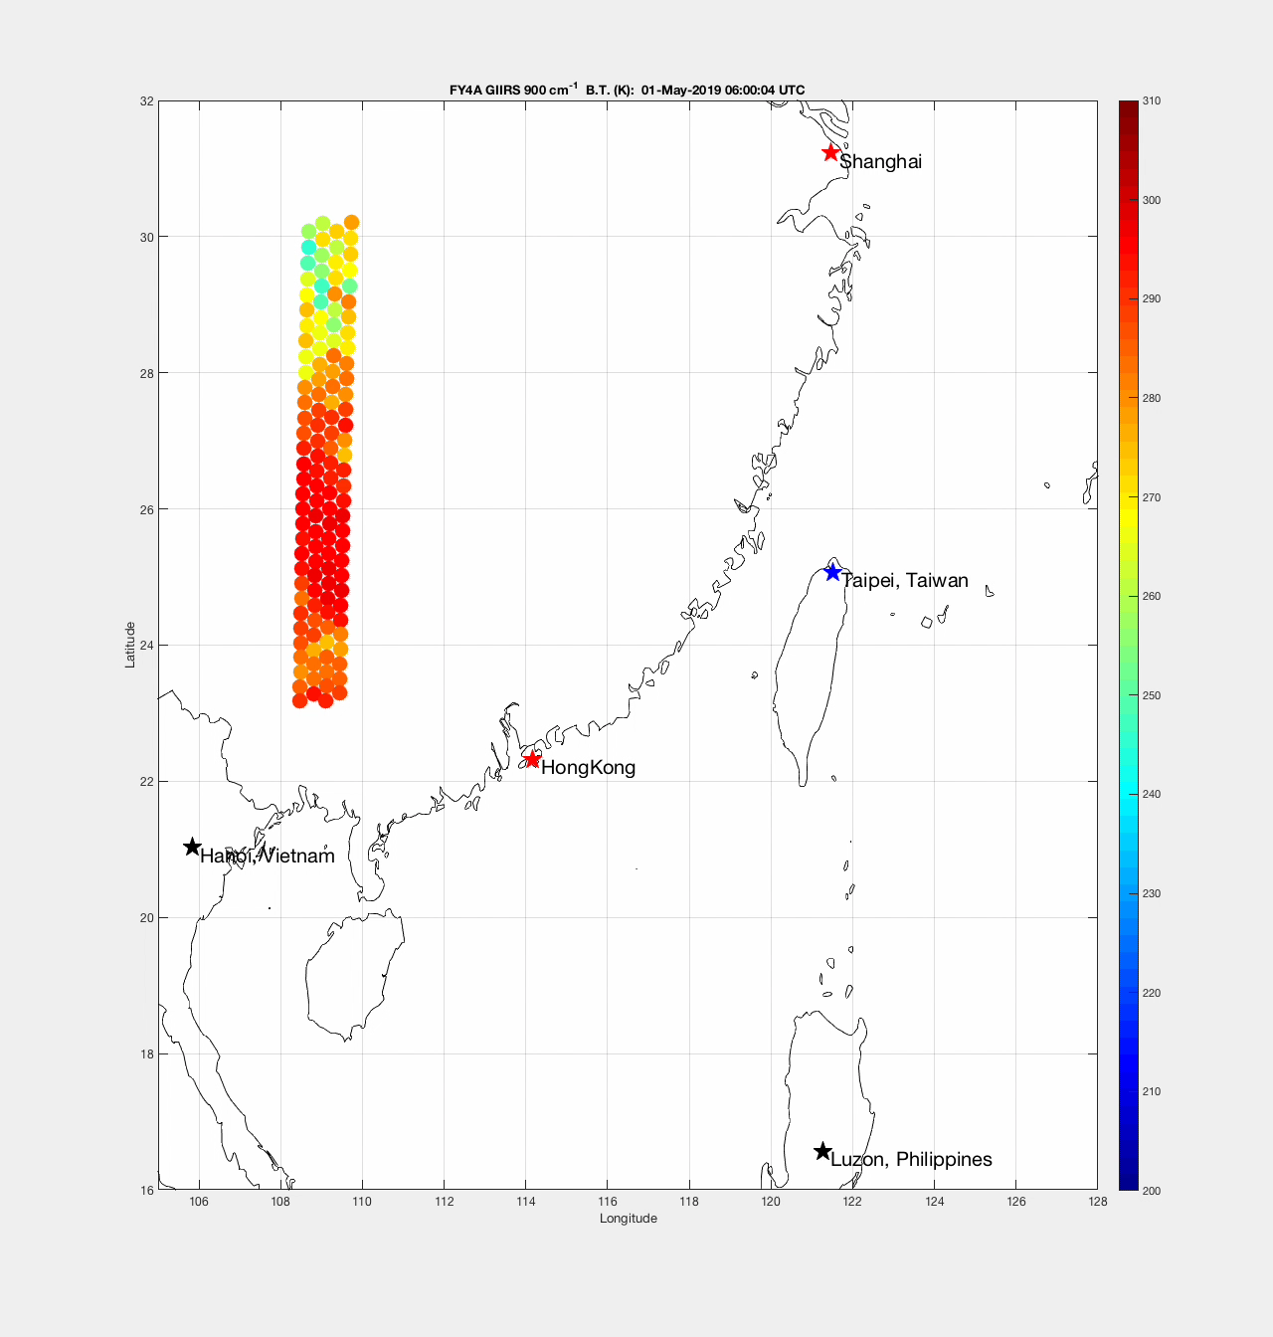
Targeted Observing
LW Window
Geo. platform is flexible for selected region
FY4A GIIRS Quick Scan Mode.
Test data 5 minute repeat time near Hong Kong, 1 May 2019.
This animation shows the footprints of the FY4A GIIRS LW focal plane array as it covers the region using “stop and stare” spatial sampling.
The ”stare” dwell time is between 10 and 11 seconds. During this time repeated samples are co-added to reduce noise on the GIIRS spectra.
Each of the 128 LW and 128 MW detectors are measured simultaneously during a dwell period.
Larger arrays will reduce repeat times.
Notes:
Note that in future GIIRS sensor there will be a larger focal plane array which will allow for more rapid area coverage.
The MTG IRS sensor has a much larger focal plane array planned.

Slide 5
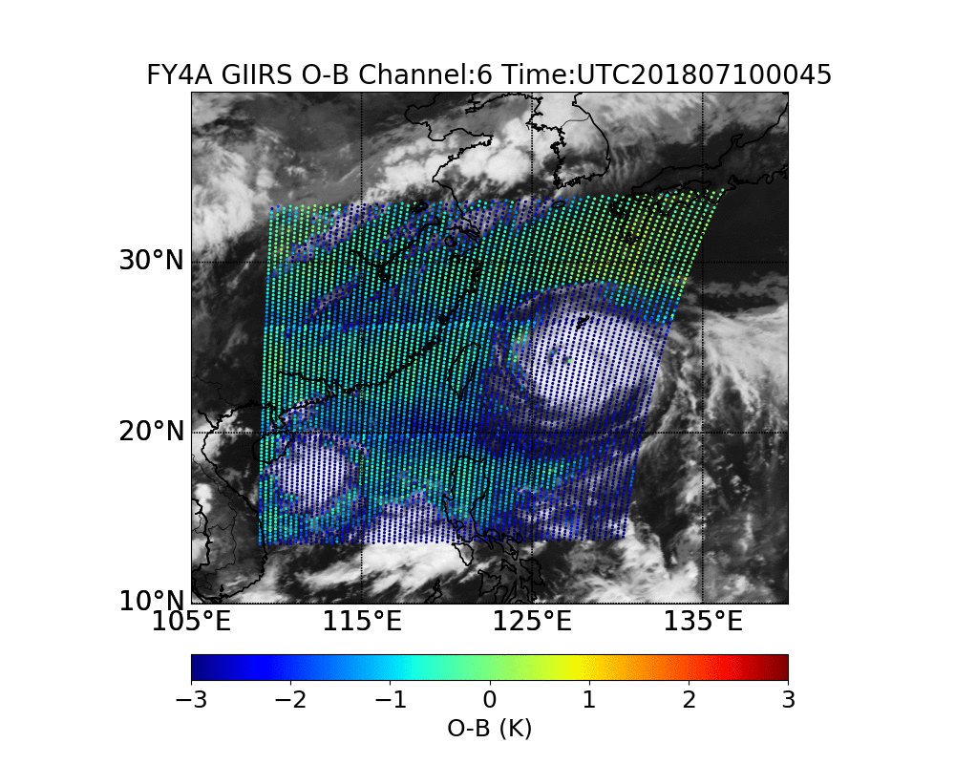
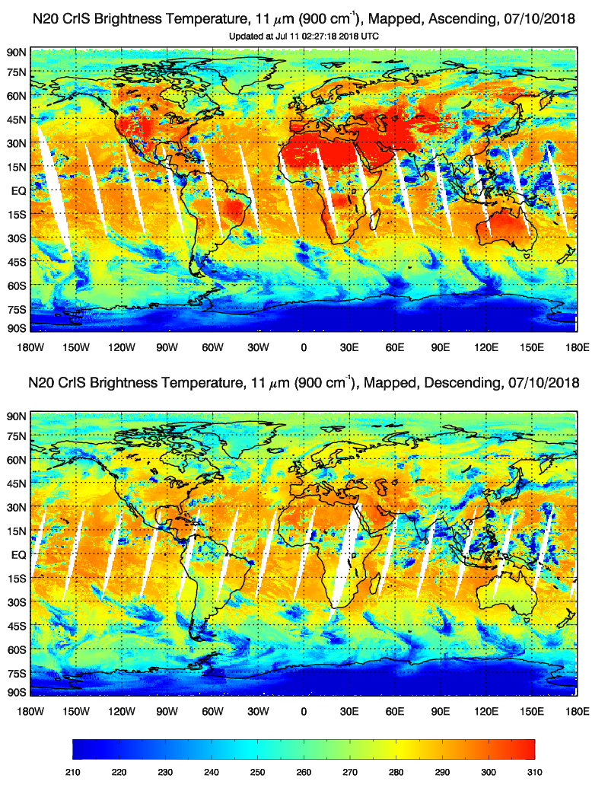
Geo Sounder and Leo Sounder: Hurricane sounding
Geo Sounder: FY-4A GIIRS
Leo Sounder: N20 CrIS
Typhoon Maria (2018)
Notes:
https://www.star.nesdis.noaa.gov/icvs/status_N20_CrIS.php

Slide 6
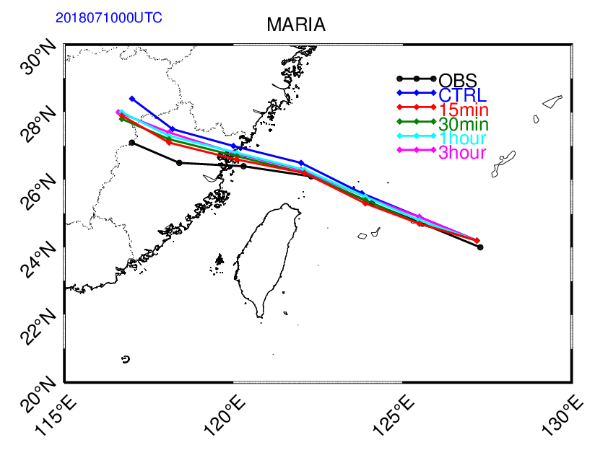
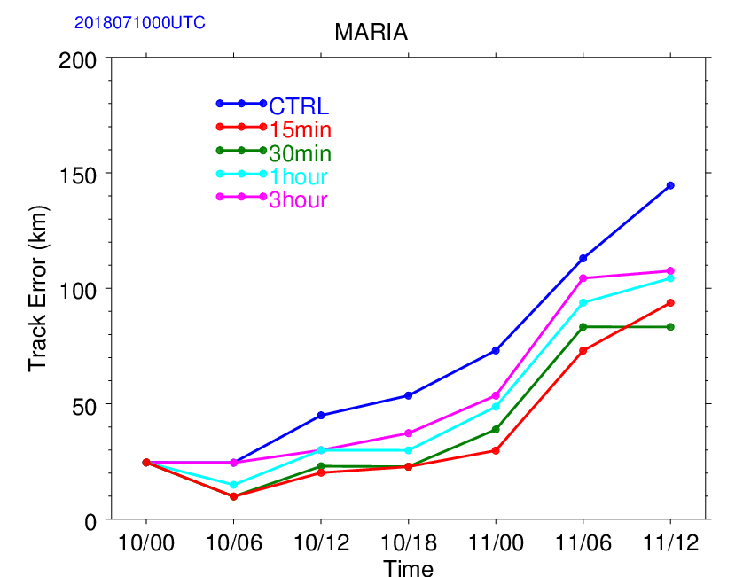
Impact of GIIRS targeted observing on Typhoon Maria forecasts
Han W. et. al.,Assimilation of high temporal GIIRS radiance in GRAPES,ITSC22, Québec, Canada, 31 October – 6 November 2019

Slide 7
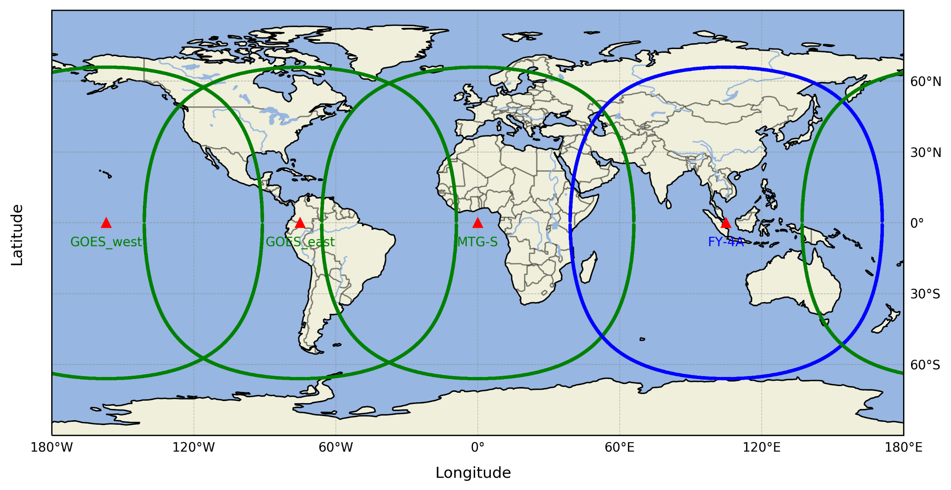
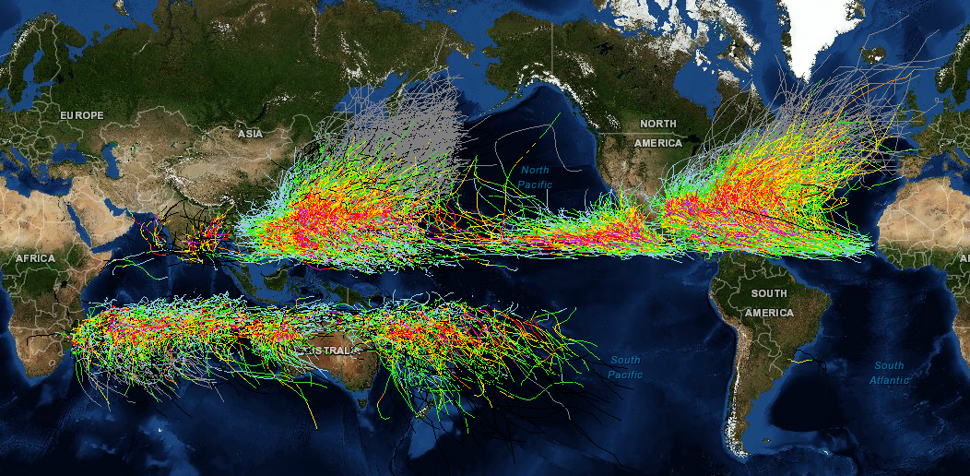
Global Ring of geo. sounders in global observing system
User driven Target Observing to improve High Impact Weather (HIW)

Slide 8
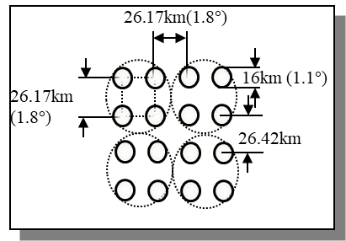
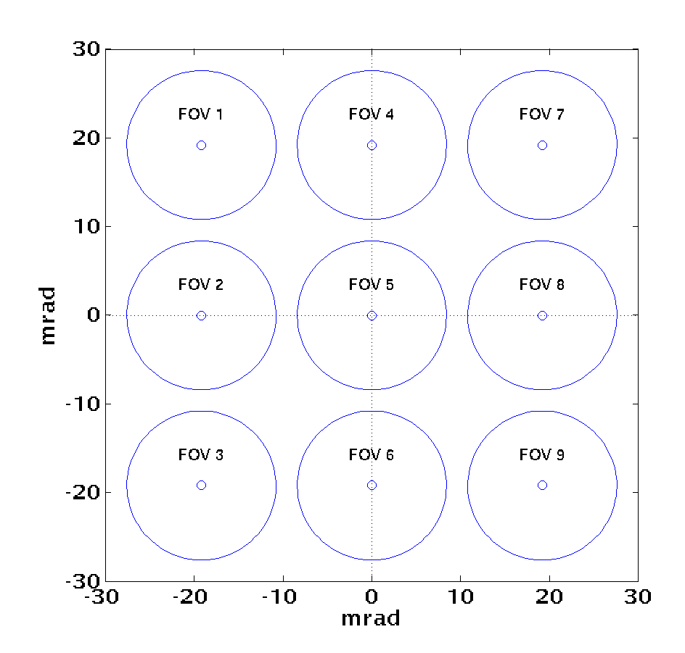
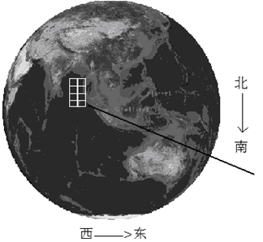
Large detector array of FY-4A GIIRS: Uniformity (spectral and radiometric)
Detector Array:112kmX648km
FOV: 16km
2 hour（15N-65N ,75E-135E）
MTG IRS: 160X160
32X4
648km×112km
FY-3D HIRAS:2X2
CrIS:3X3
Spectral bias of the off-axis FOV is an important issue
North
South
West
East

Slide 9
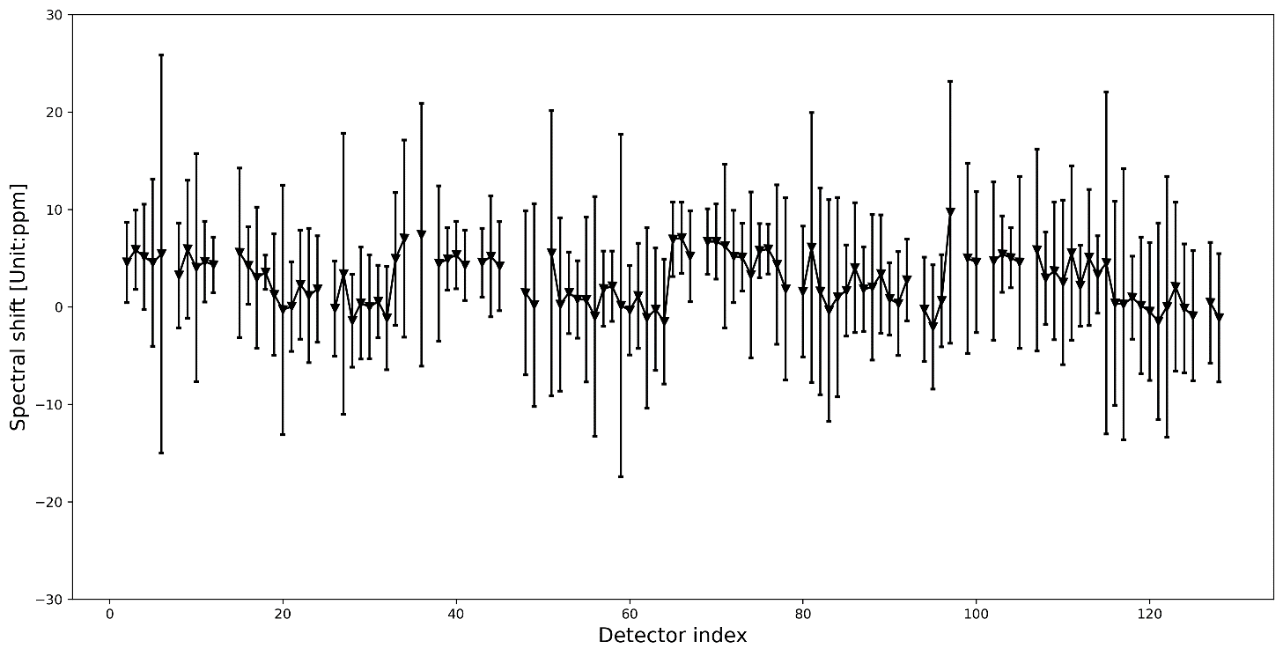
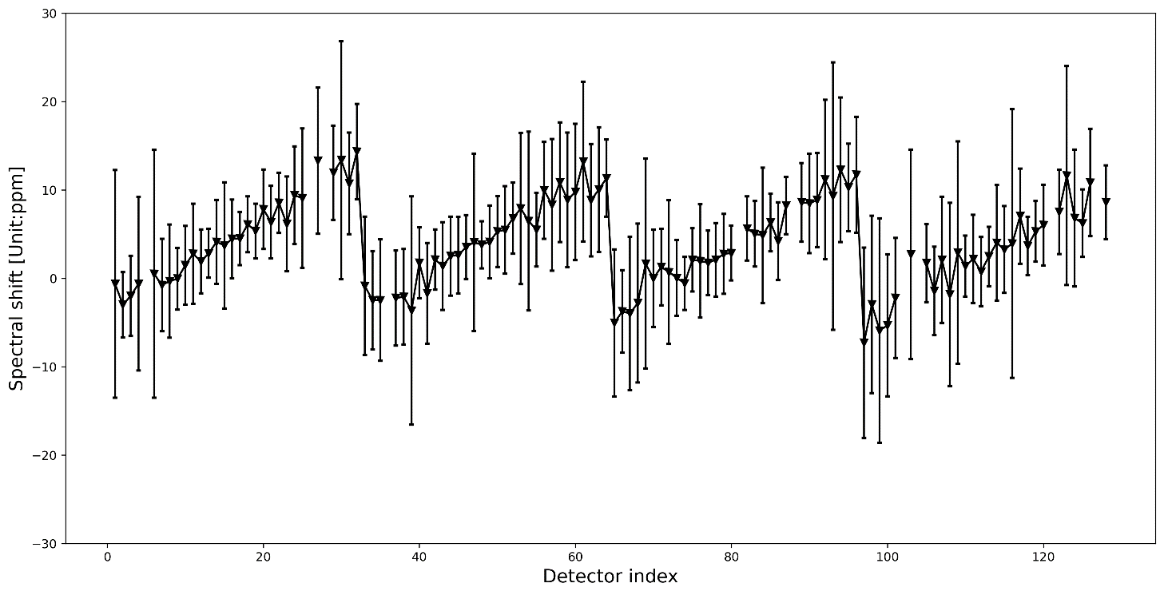
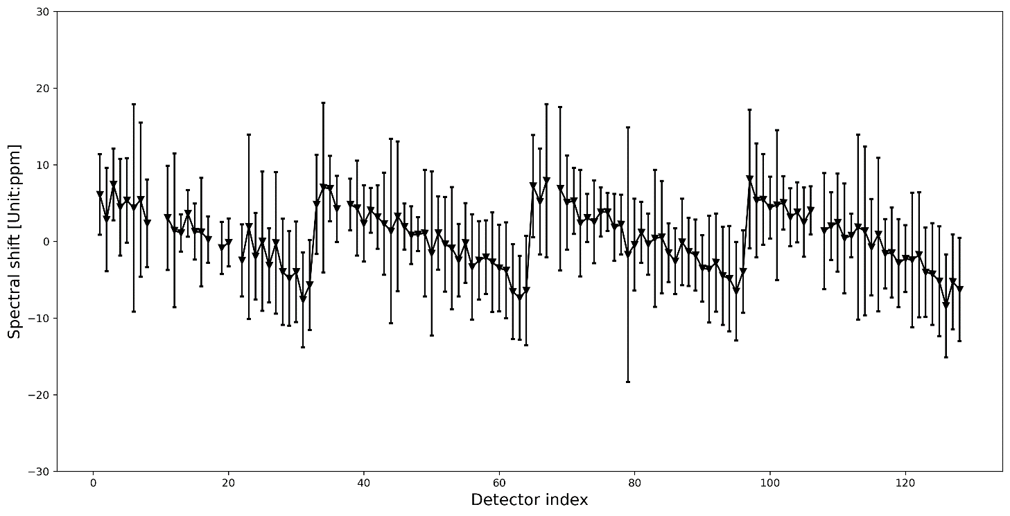
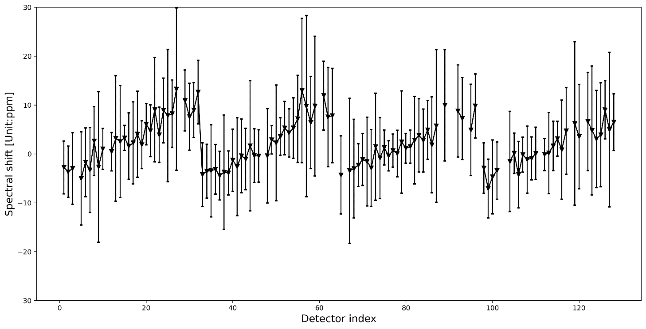
Questions:
WHY the spectral shift estimations are different using GIIRS_IASI and GIIRS_CrIS SNOs?
WHY the pattern change over time?
GIIRS-IASI
Period: 20191107-20191130
Period: 20200507-200530
GIIRS-CrIS

Slide 10
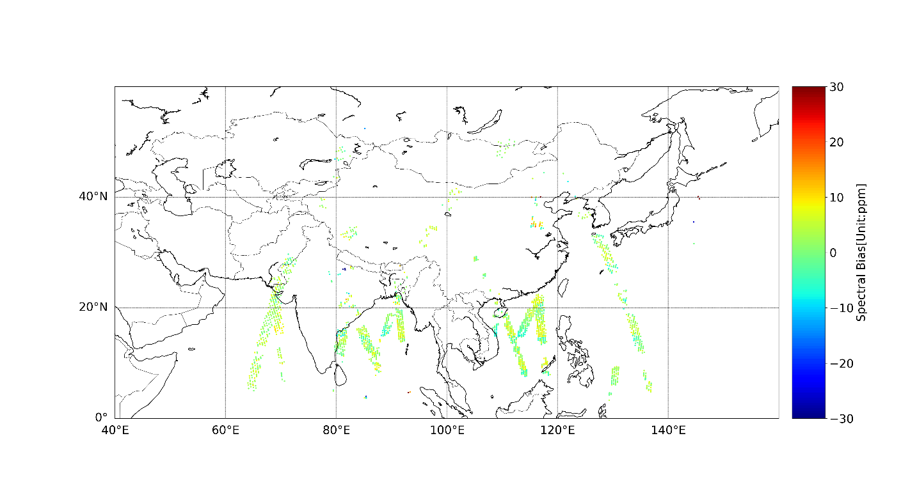
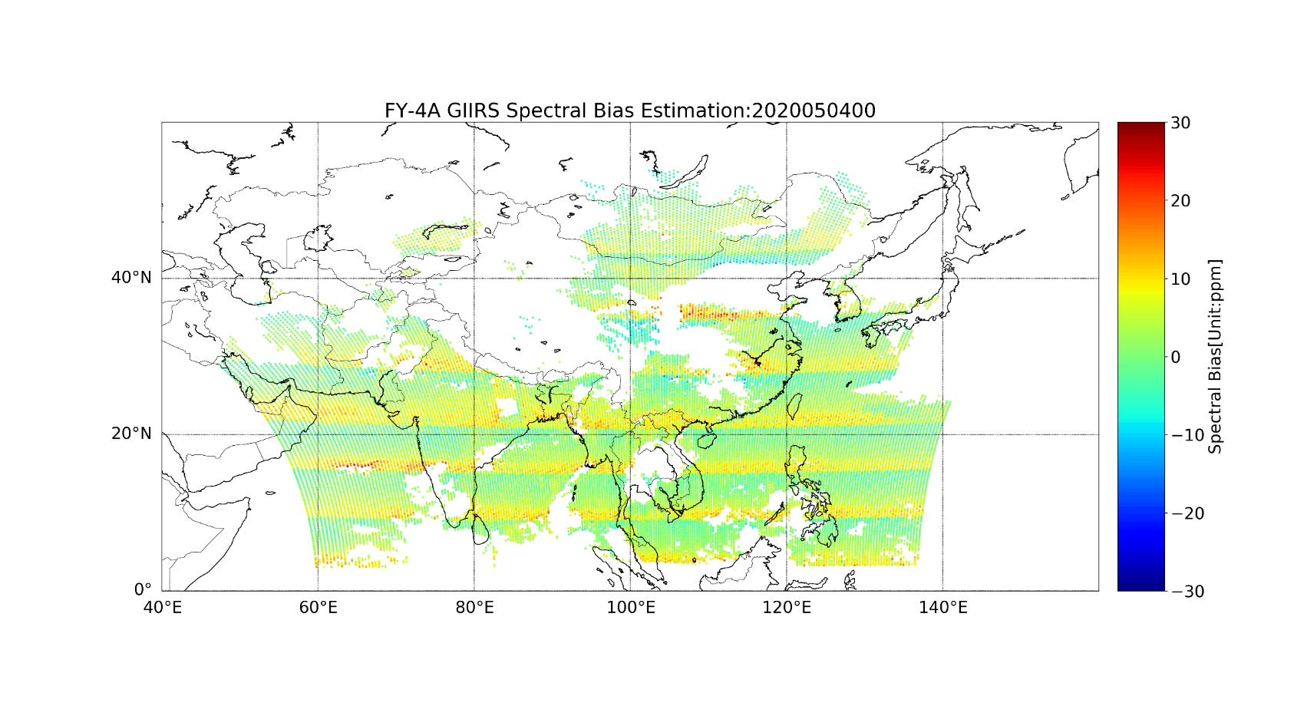
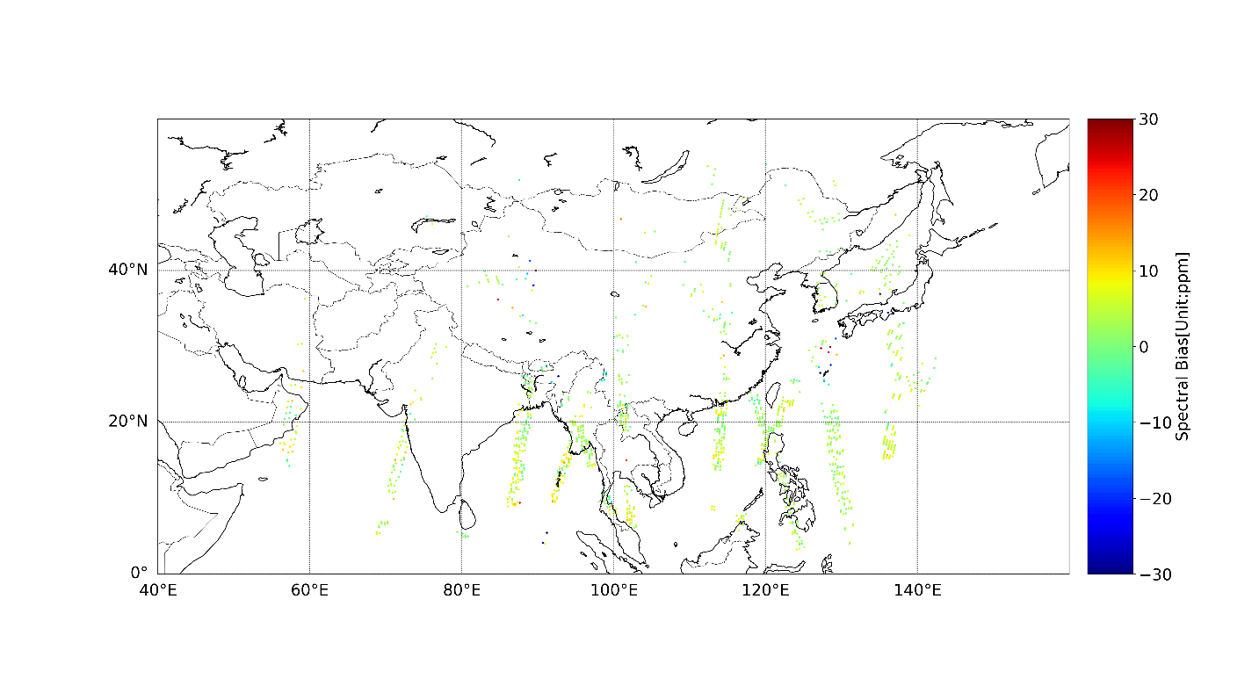
Spectral shift estimation using JEDI and SNOs
CrIS_GIIRS SNOs
Using NWP simulation as reference
IASI_GIIRS SNOs

Slide 11
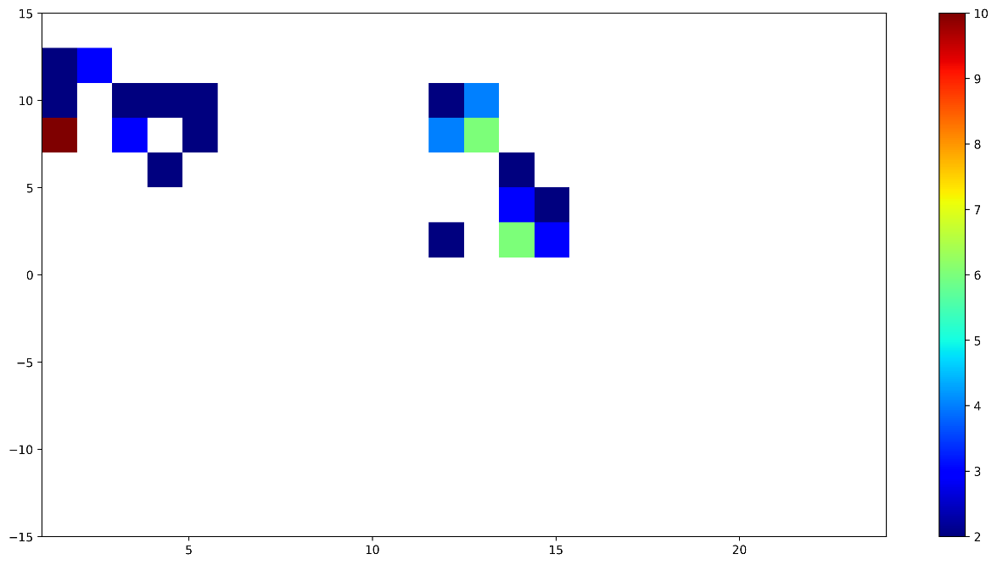
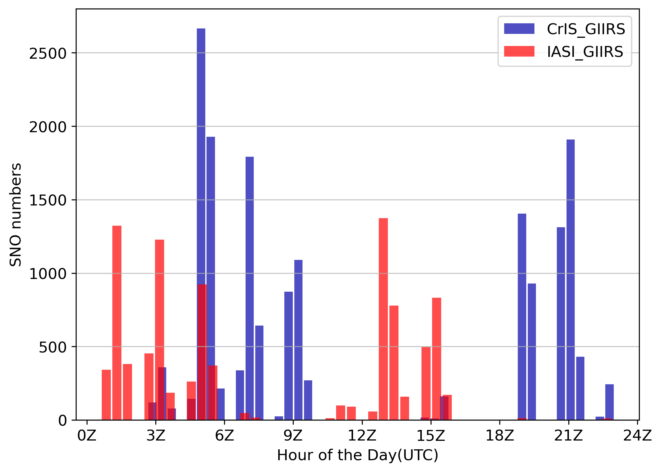
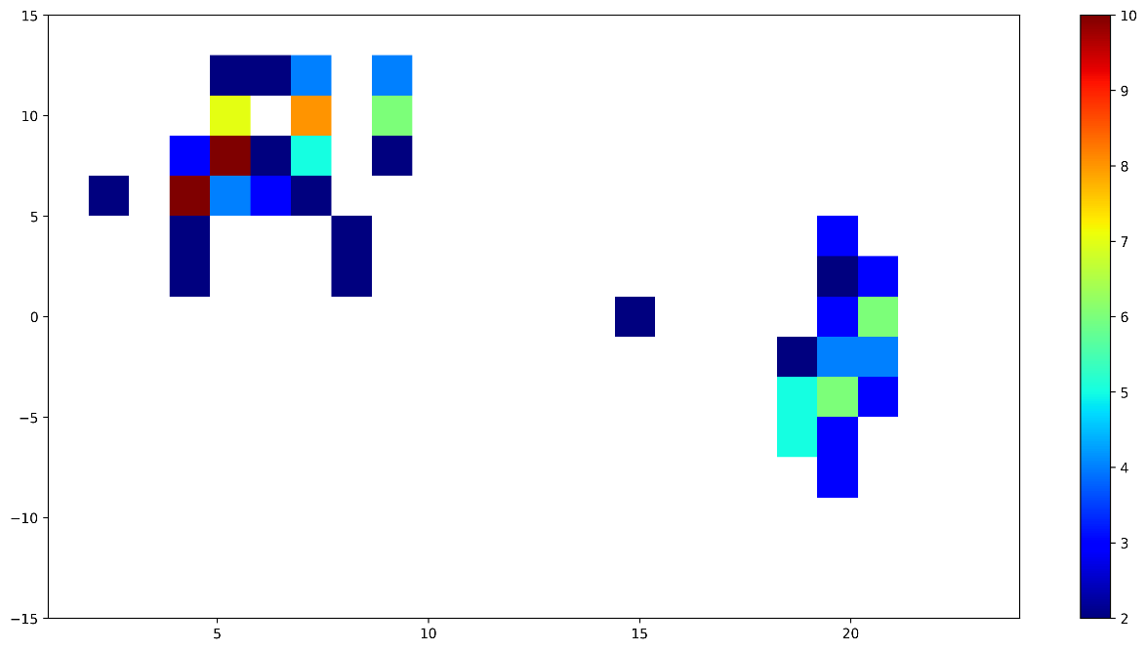
CrIS_GIIRS and IASI_GIIRS SNOs : Hour of the day
2020050100-20200510, 10 days sample for all the detectors
Spectral Shift(ppm)
Number
IASI_GIIRS_SNOs, detector=96
Spectral Shift(ppm)
CrIS_GIIRS_SNOs, detector=96
Lessons learned: consider time of the day!
Hour of the Day(UTC)

Slide 12
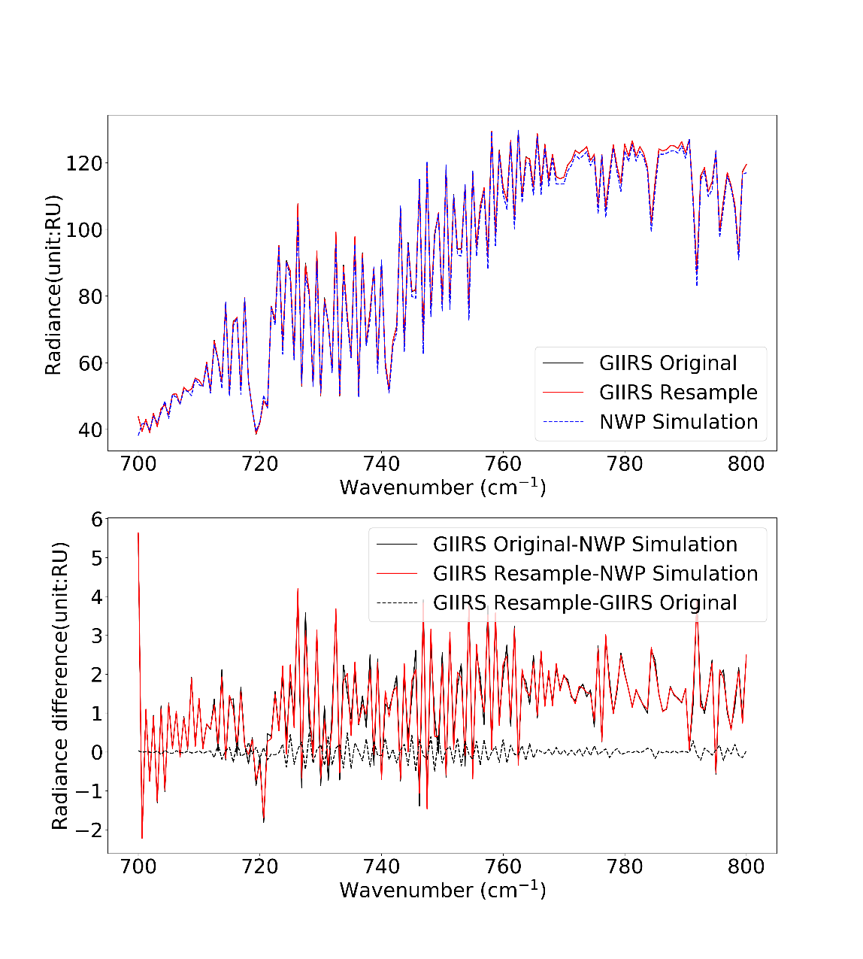
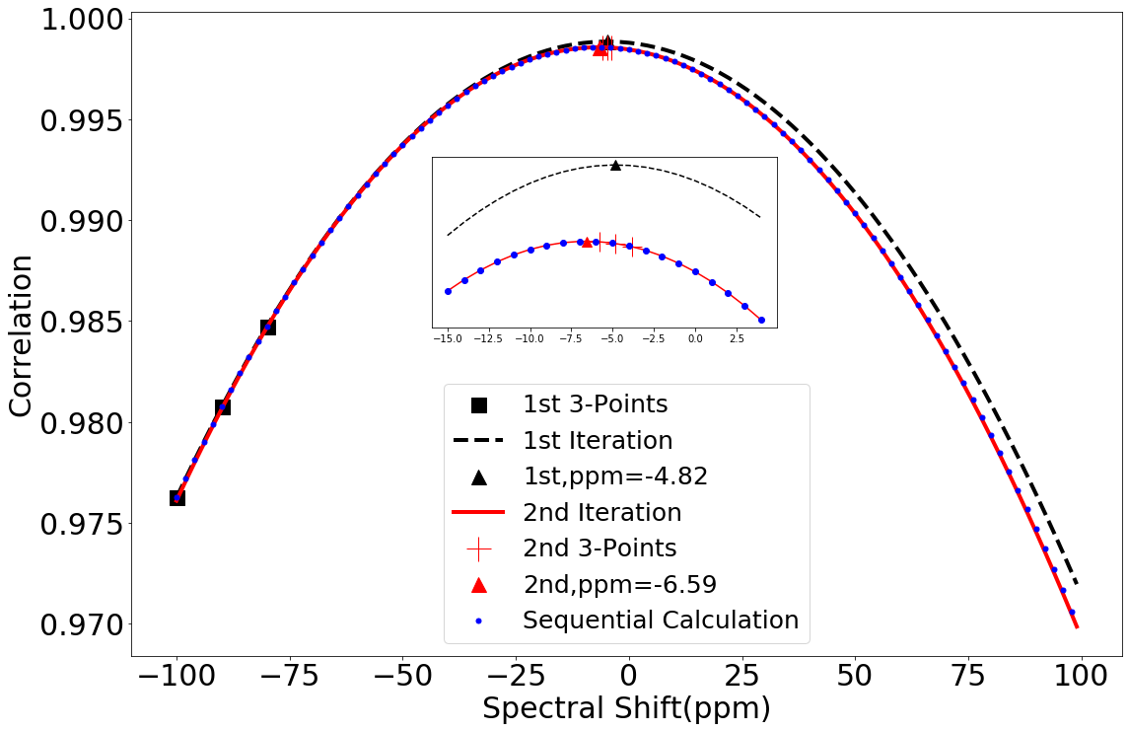
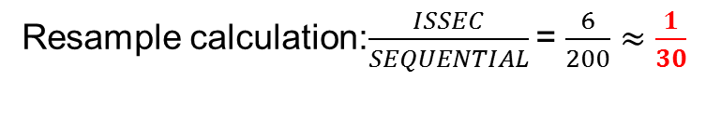
    Iterative Spectral Shift Estimation and Correction using local quadratic approximation (ISSEC)
Resample calculation:$\frac{ISSEC}{SEQUENTIAL}$ = $\frac{6}{200}≈\frac{1}{30}$
Han W. et. al., ISSEC: An fast and accurate algorithm for hyperspectral infrared sounder spectral shift estimation and correction with application on FY-4A GIIRS, to be submitted.

Slide 13
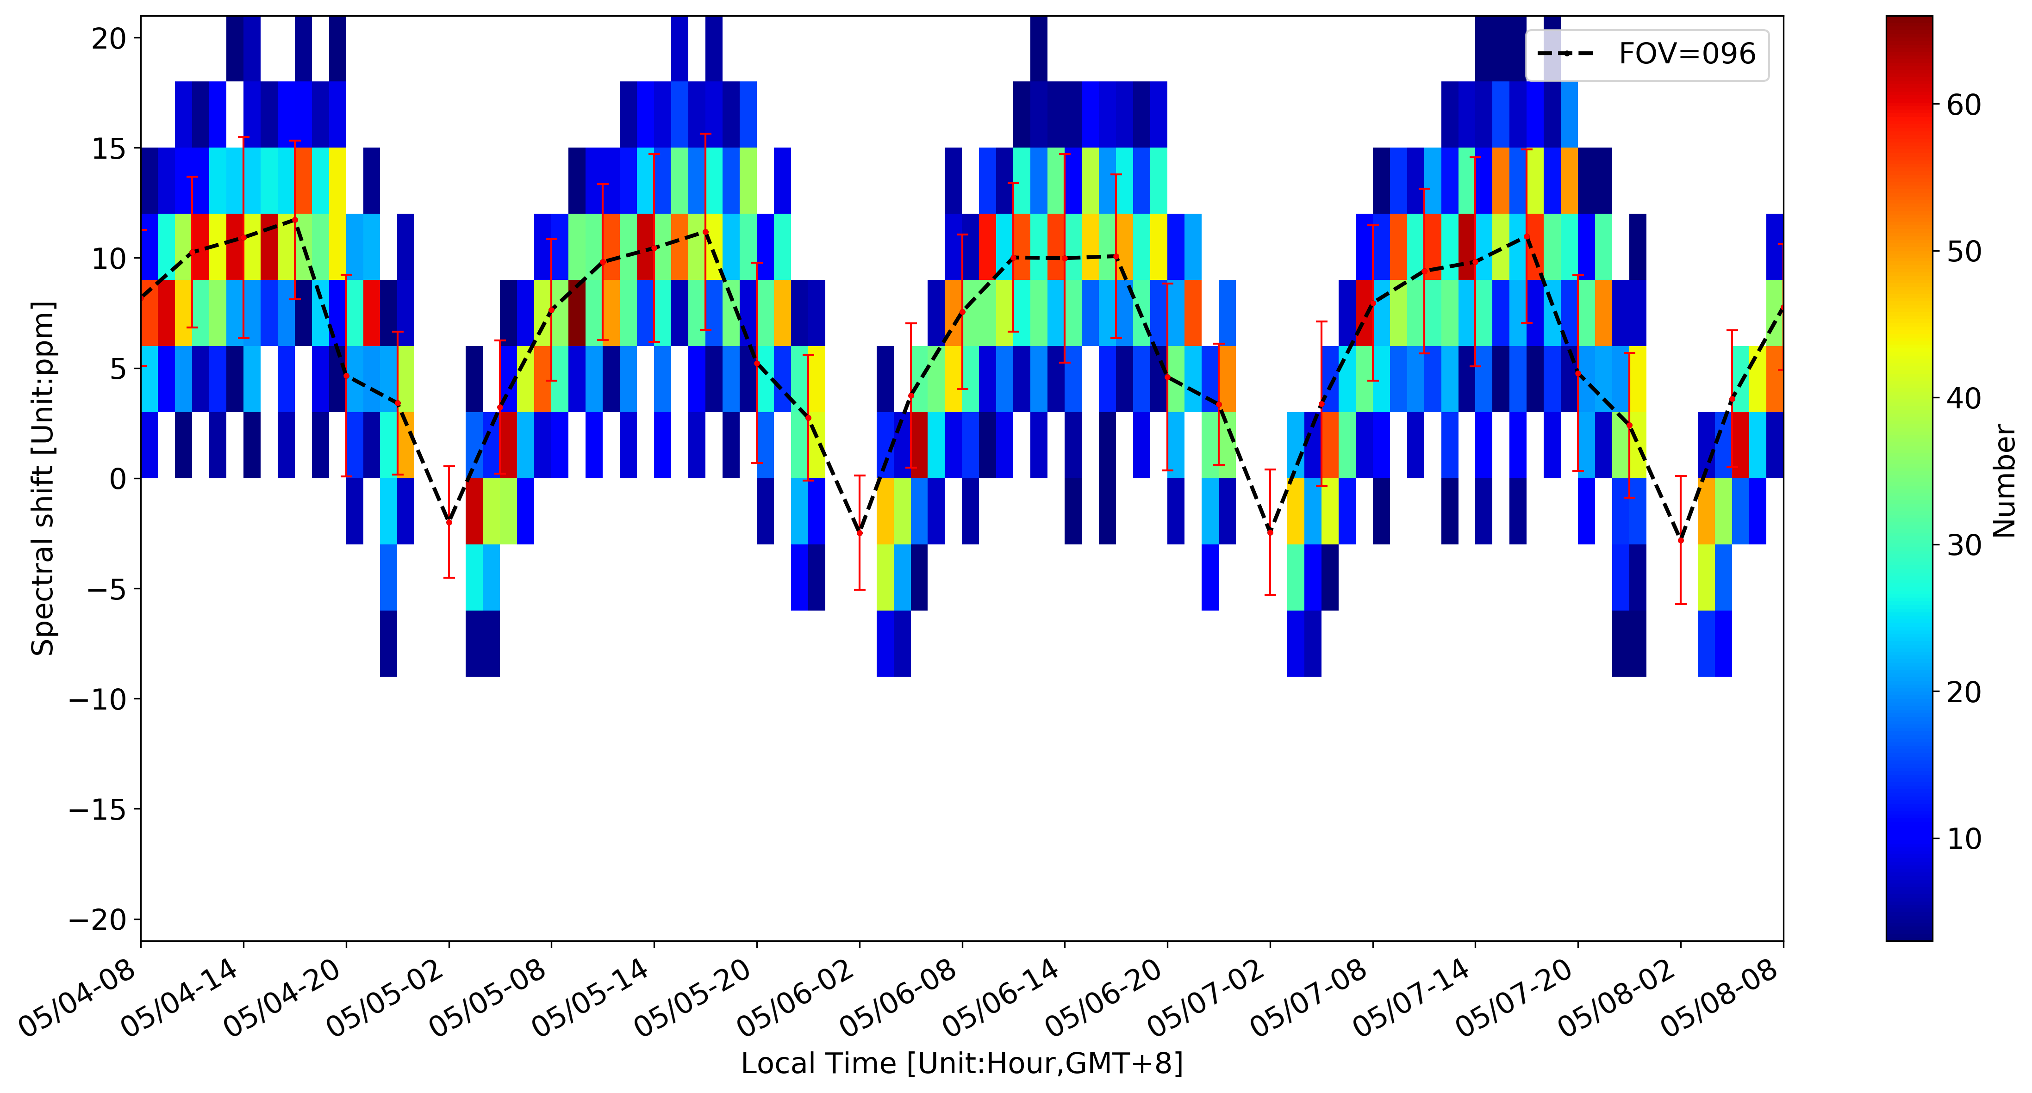
Spectral diurnal variation estimation using NWP simulation as reference

Slide 14
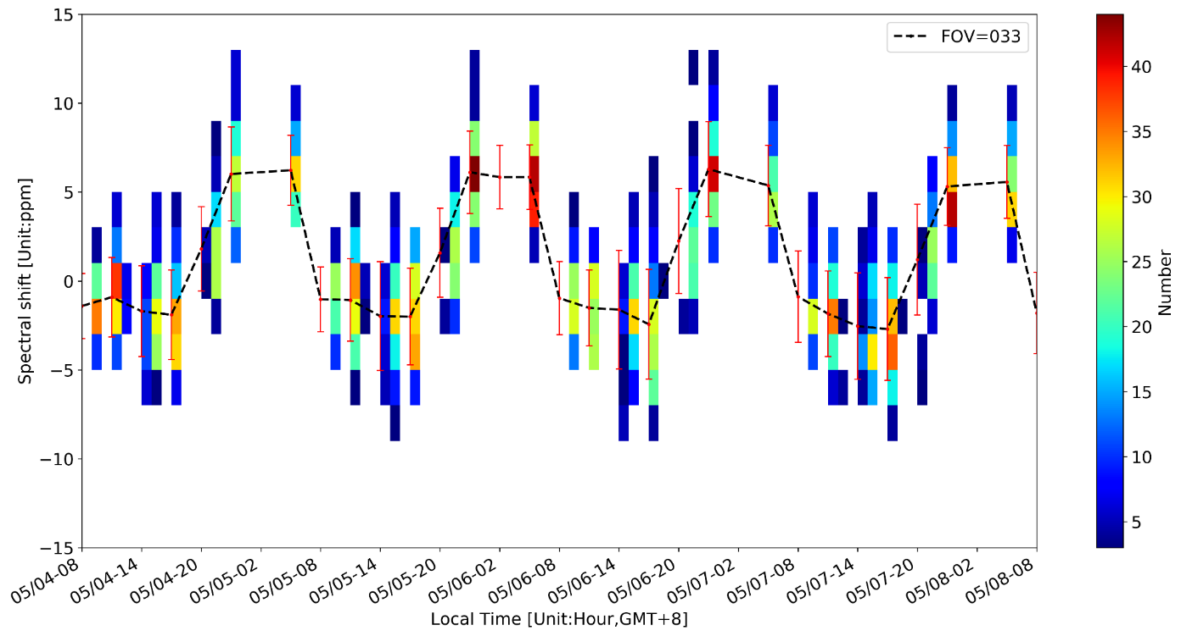
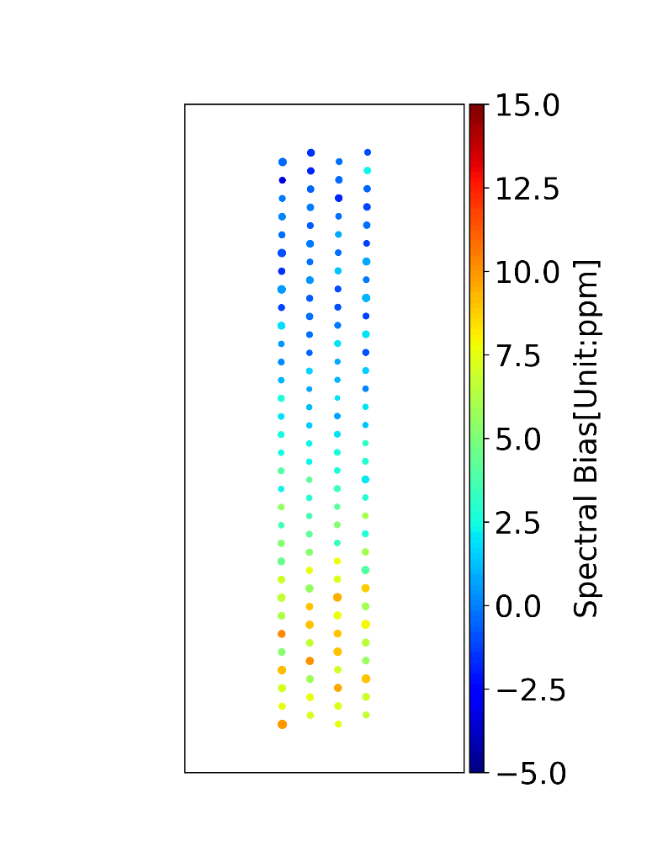
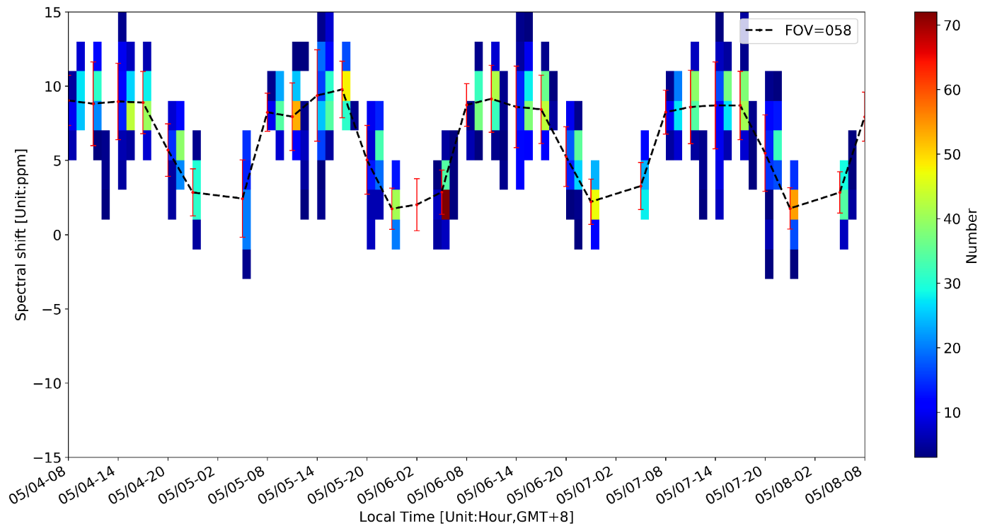
Spectral bias diurnal variation (using JEDI UFO)
FOV33 and 58
33
58
32x4=128 detectors
What’s the root cause of this diurnal variation?

Slide 15
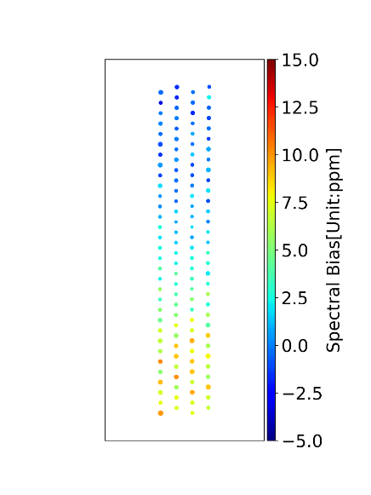
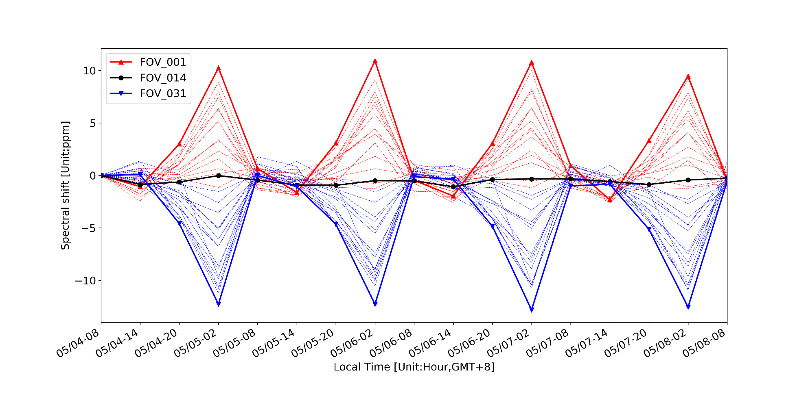
Spectral shift relative change
(difference to 00z)
{
{
The spectral shifts are predicable and could be corrected.
08H
14H
20H
02H
Local time

Slide 16
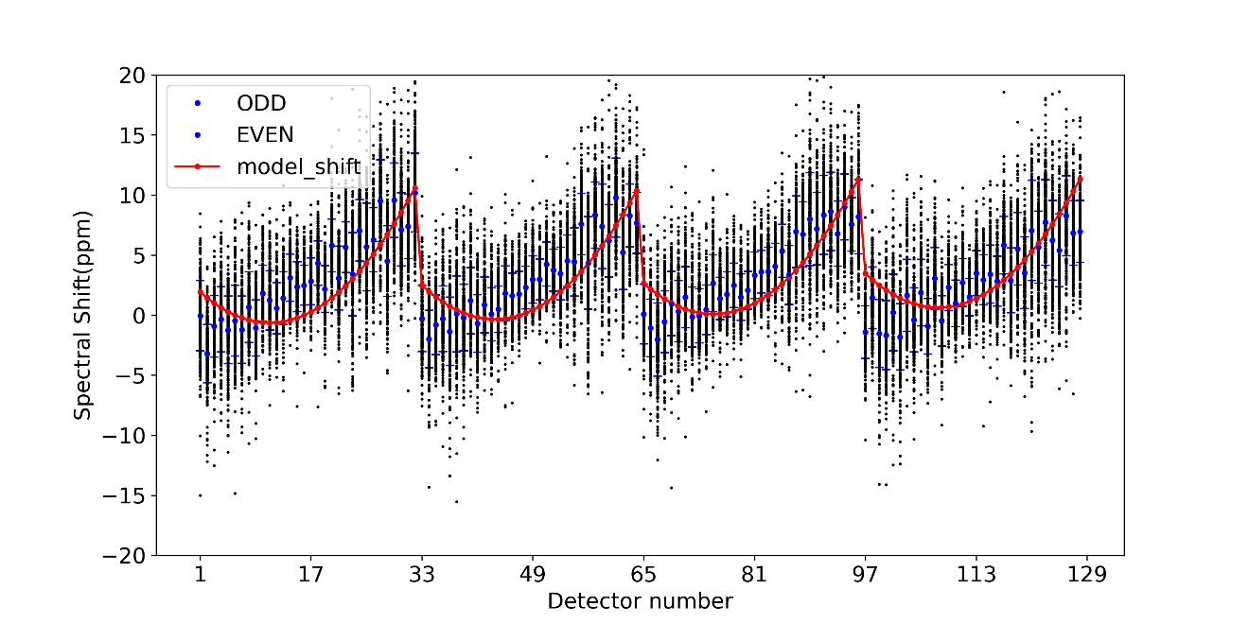
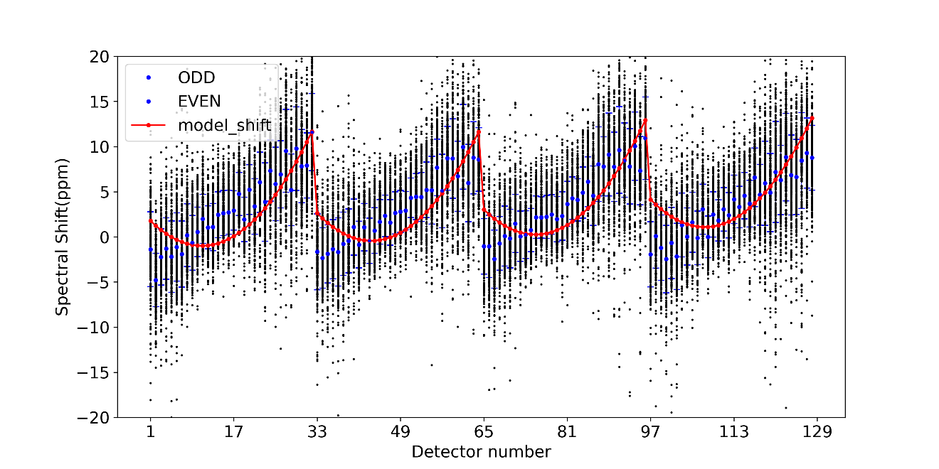
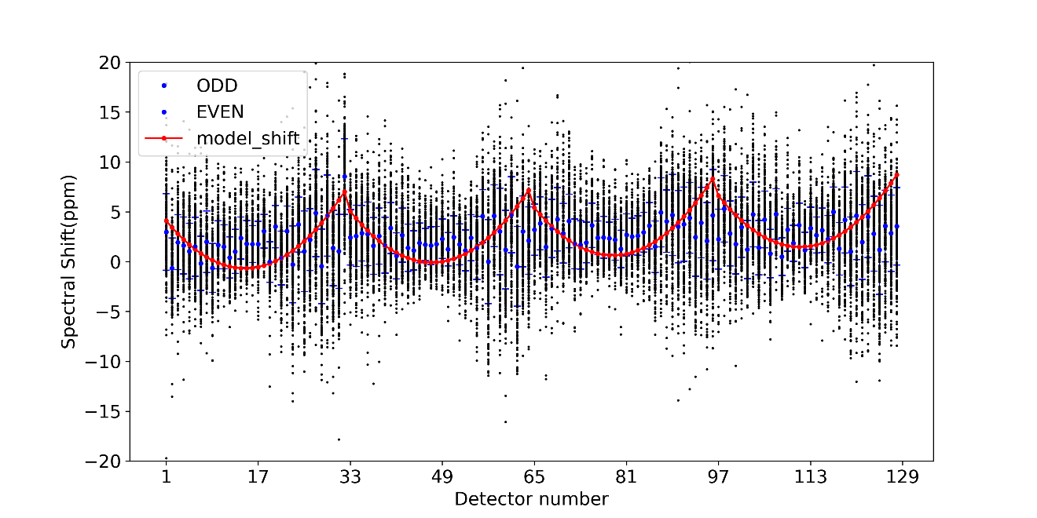
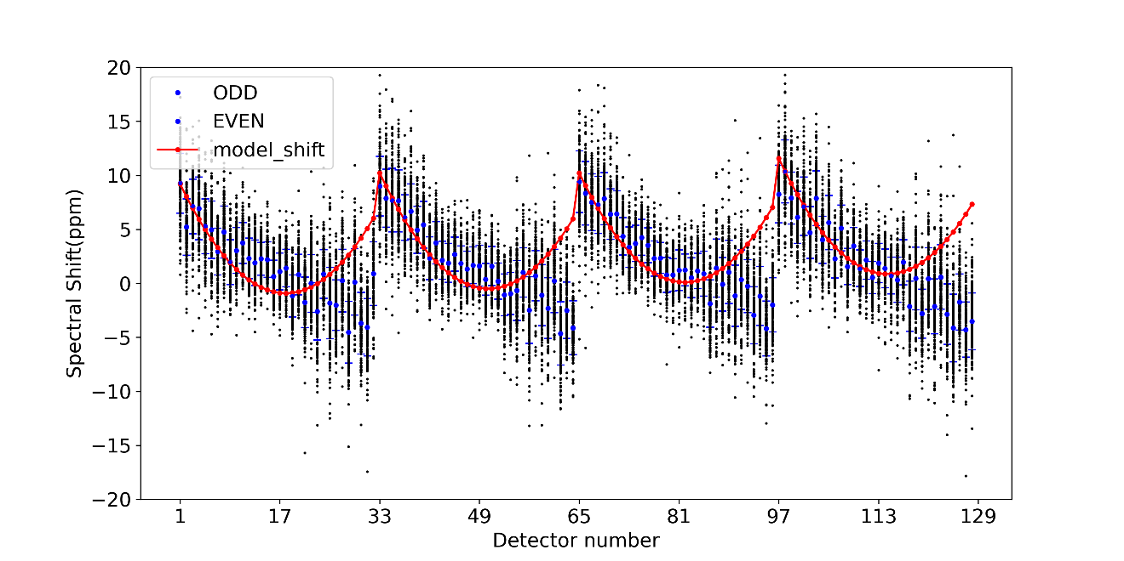
Spectral shift diurnal variation estimated using JEDI
00Z,2020050400
06Z,2020050406
12Z,2020050412
18Z,2020050418 (19-20)

Slide 17
QUESTIONS:
What’s the root cause of the diurnal variation?
Is there a physical model with limited unknown parameters ?
How to estimate the unknown parameters?
How to do the correction?

Slide 18
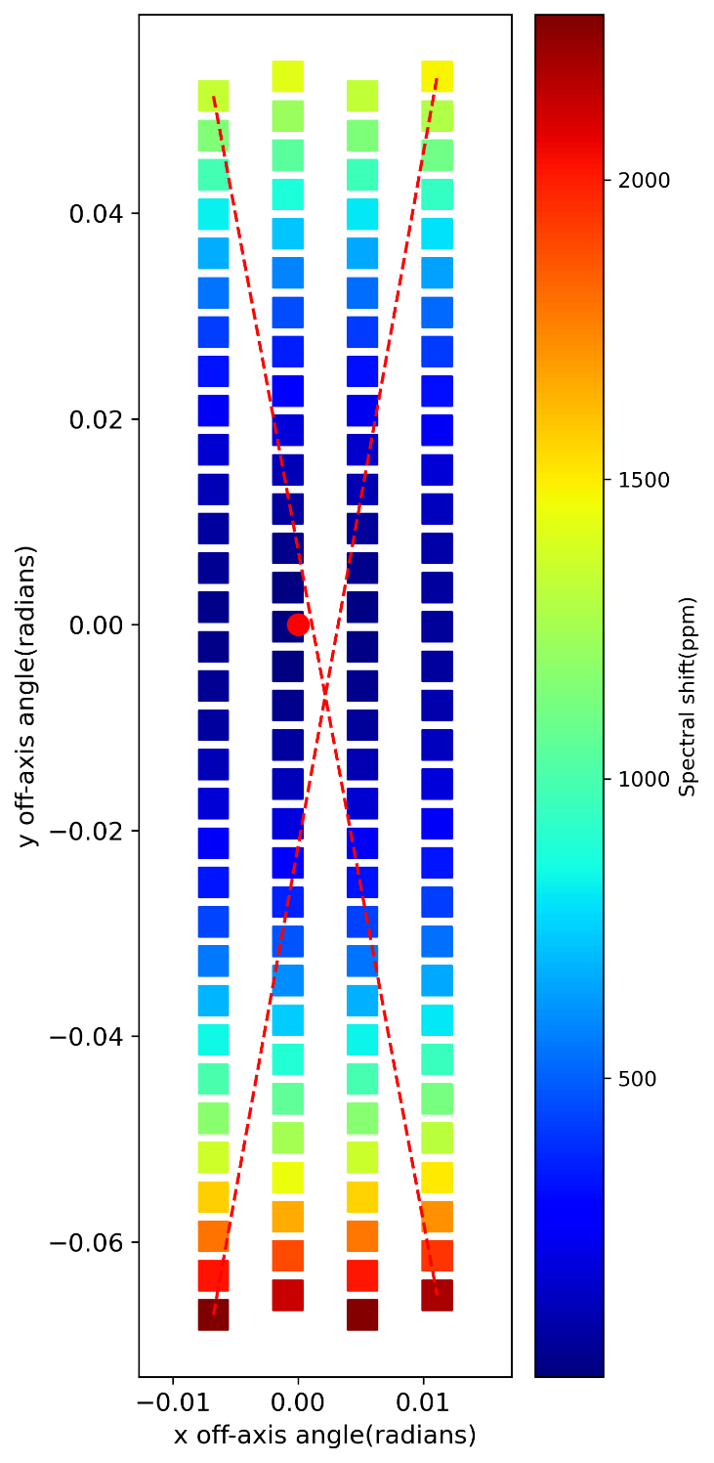
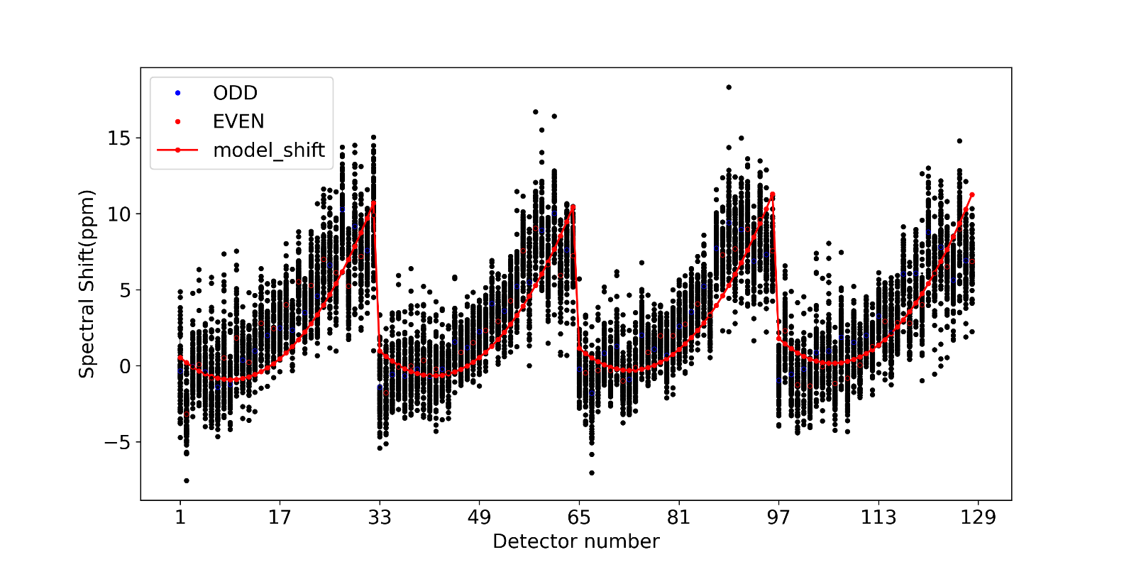
OOPS: On Orbit Parameter eStimation of satellite sensor using data dssimilation methodology
Parameters: focal center (Xc,Yc), afocal ratio, and others
Model: Optical geometry model and its perturbed model
Observations: Spectral shift estimation using NWP or SNOs
2020050400
Application of data
assimilation
ideas in calibration

Slide 19
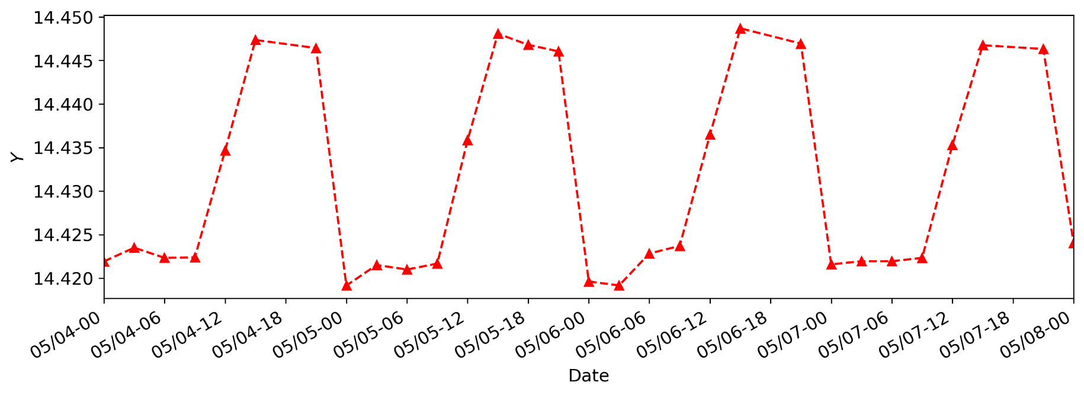
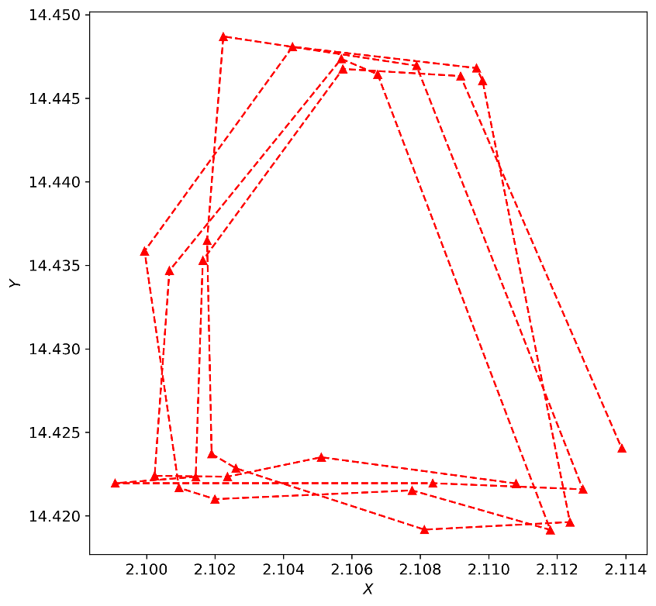
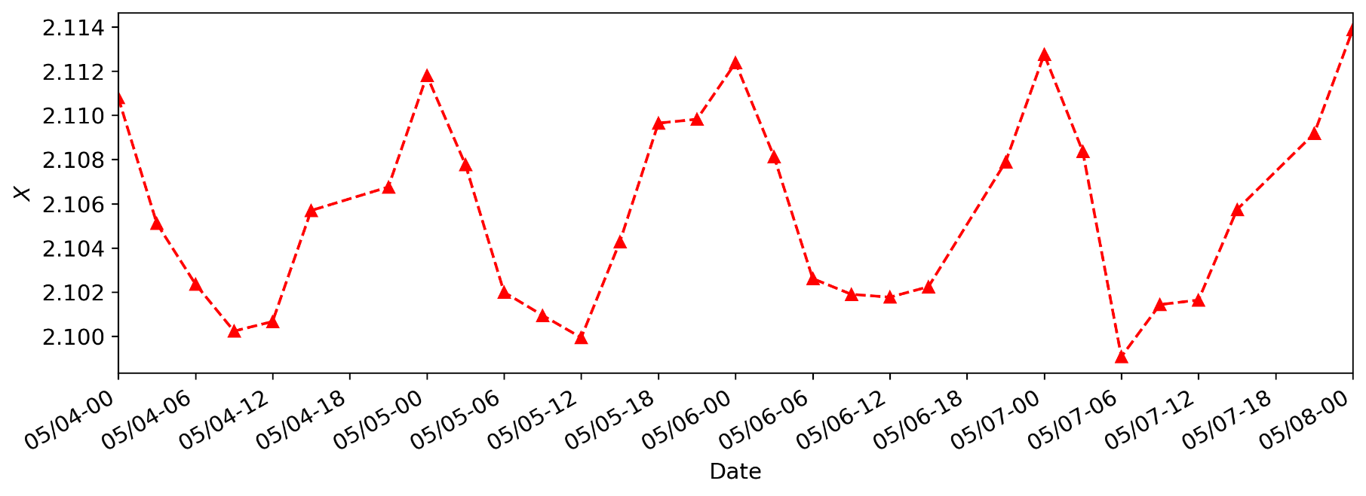
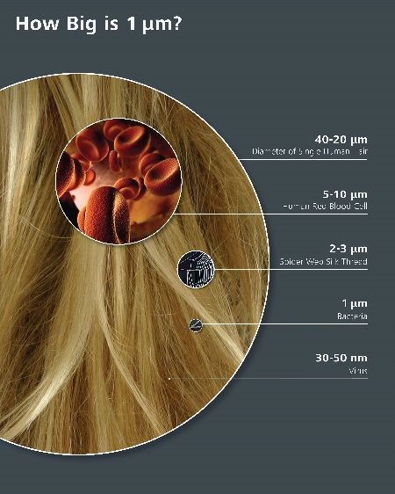
SOLVE Mysteries: tidy variations of the optical center (5% FOV,6um)
05
20
14
08
Local Time

Slide 20
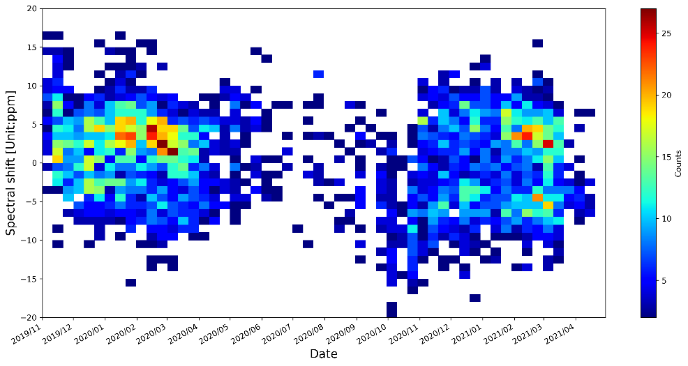
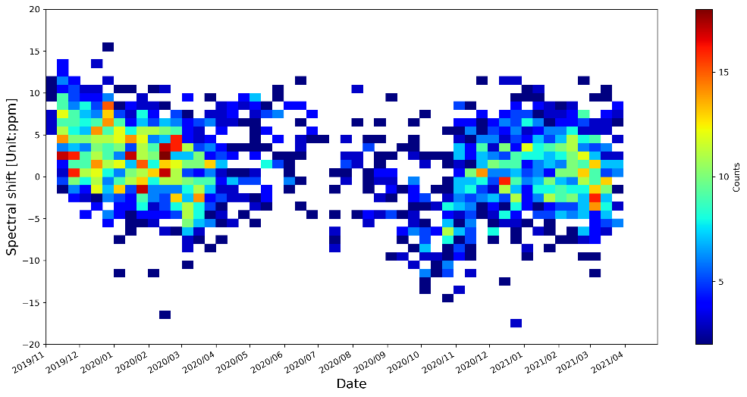

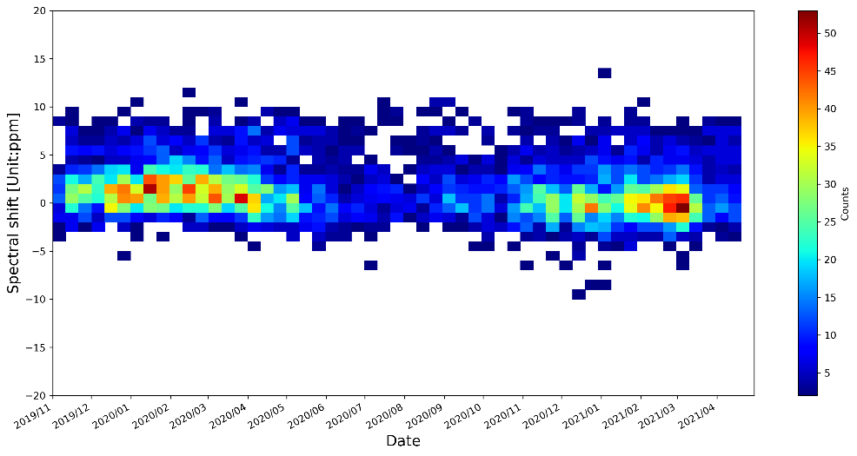
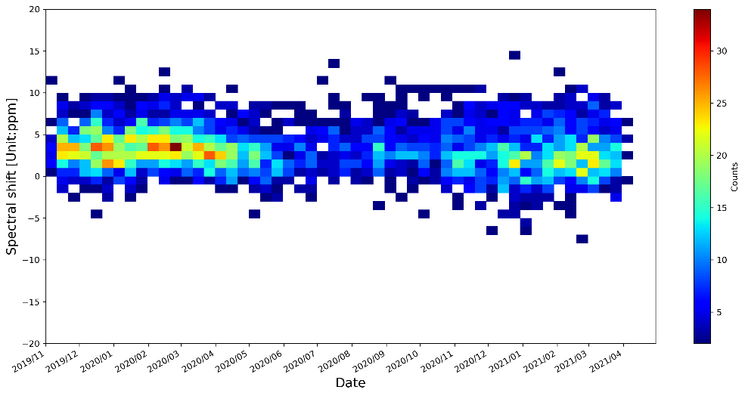
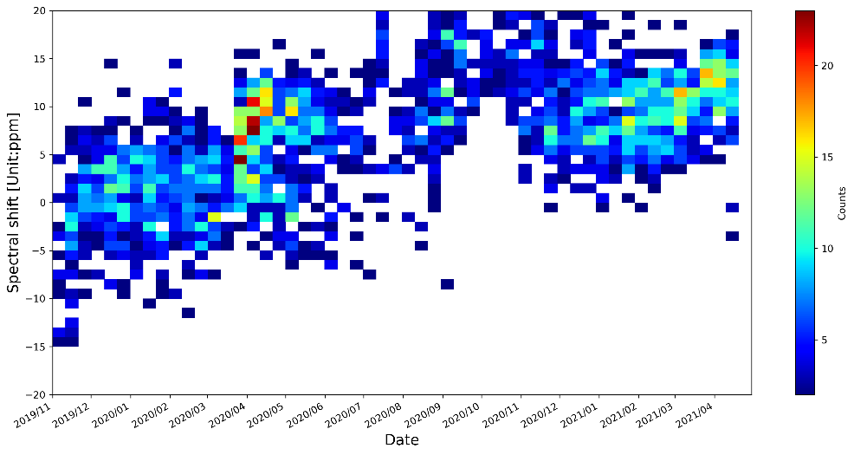
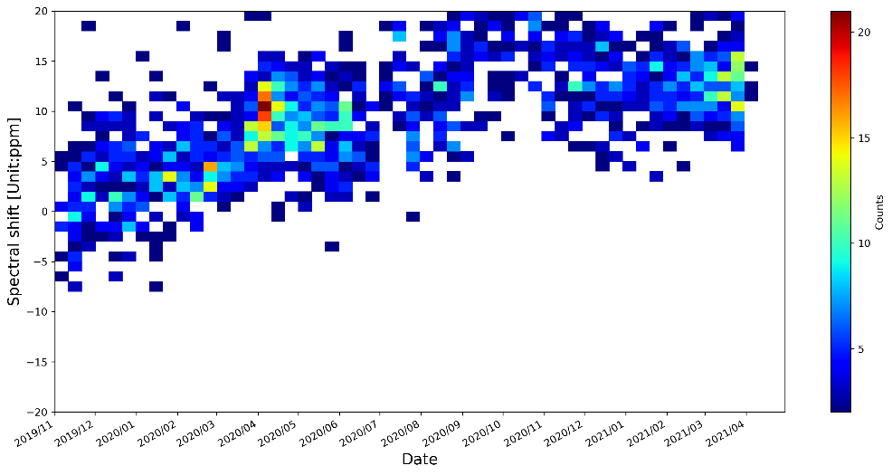
Long term spectral variation
Detector=1
CrIS and GIIRS SNOs
IASI and GIIRS SNOs
Detector=16
Detector=32

Slide 21
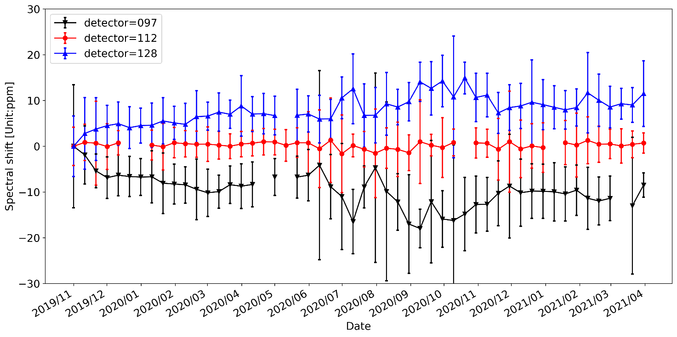
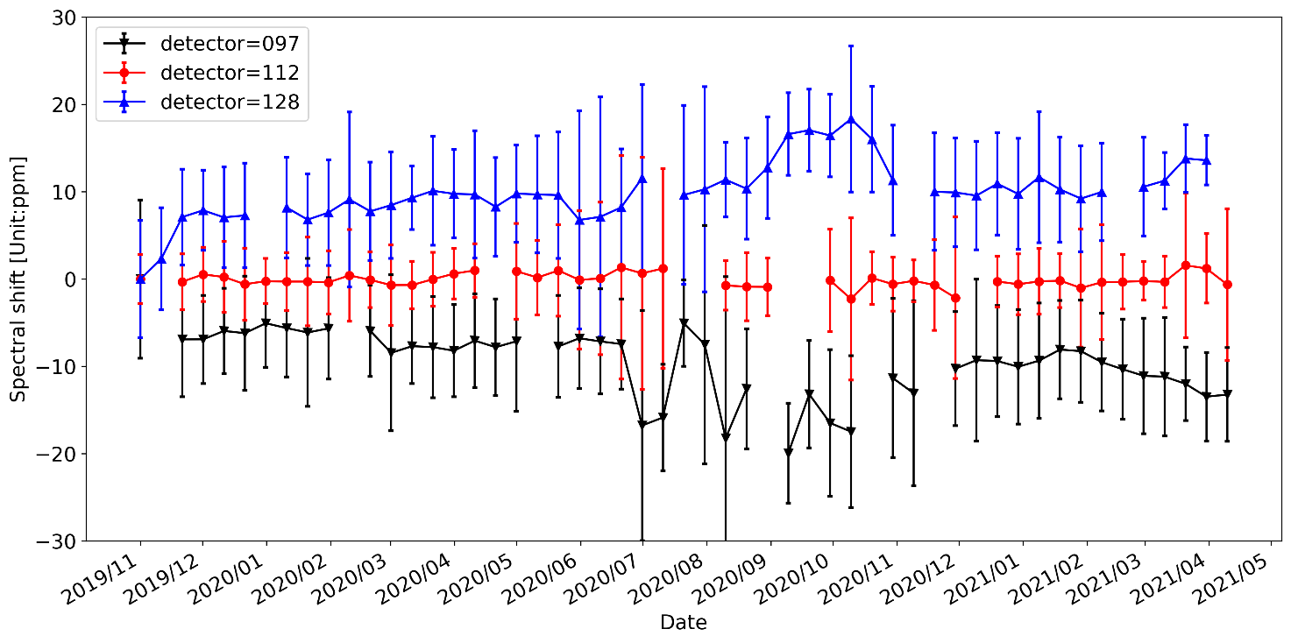
GIIRS spectral longer term variation
Estimated using IASI_GIIRS SNOs
Estimated using CrIS_GIIRS SNOs

Slide 22
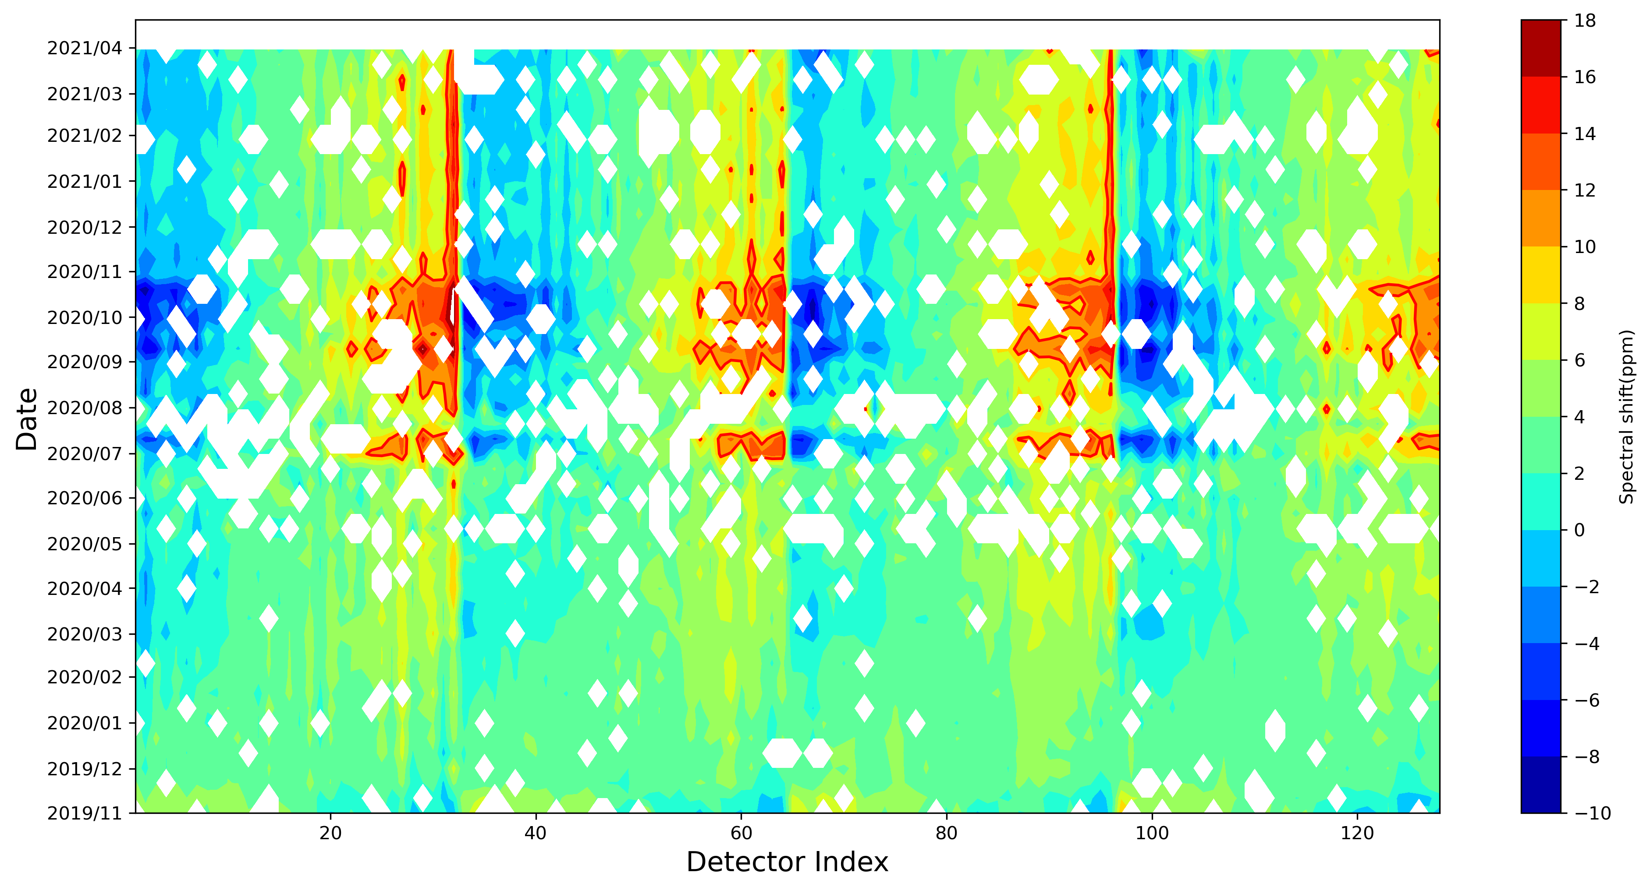
Spectral shift estimation using GIIRS and IASI SNOs

Slide 23
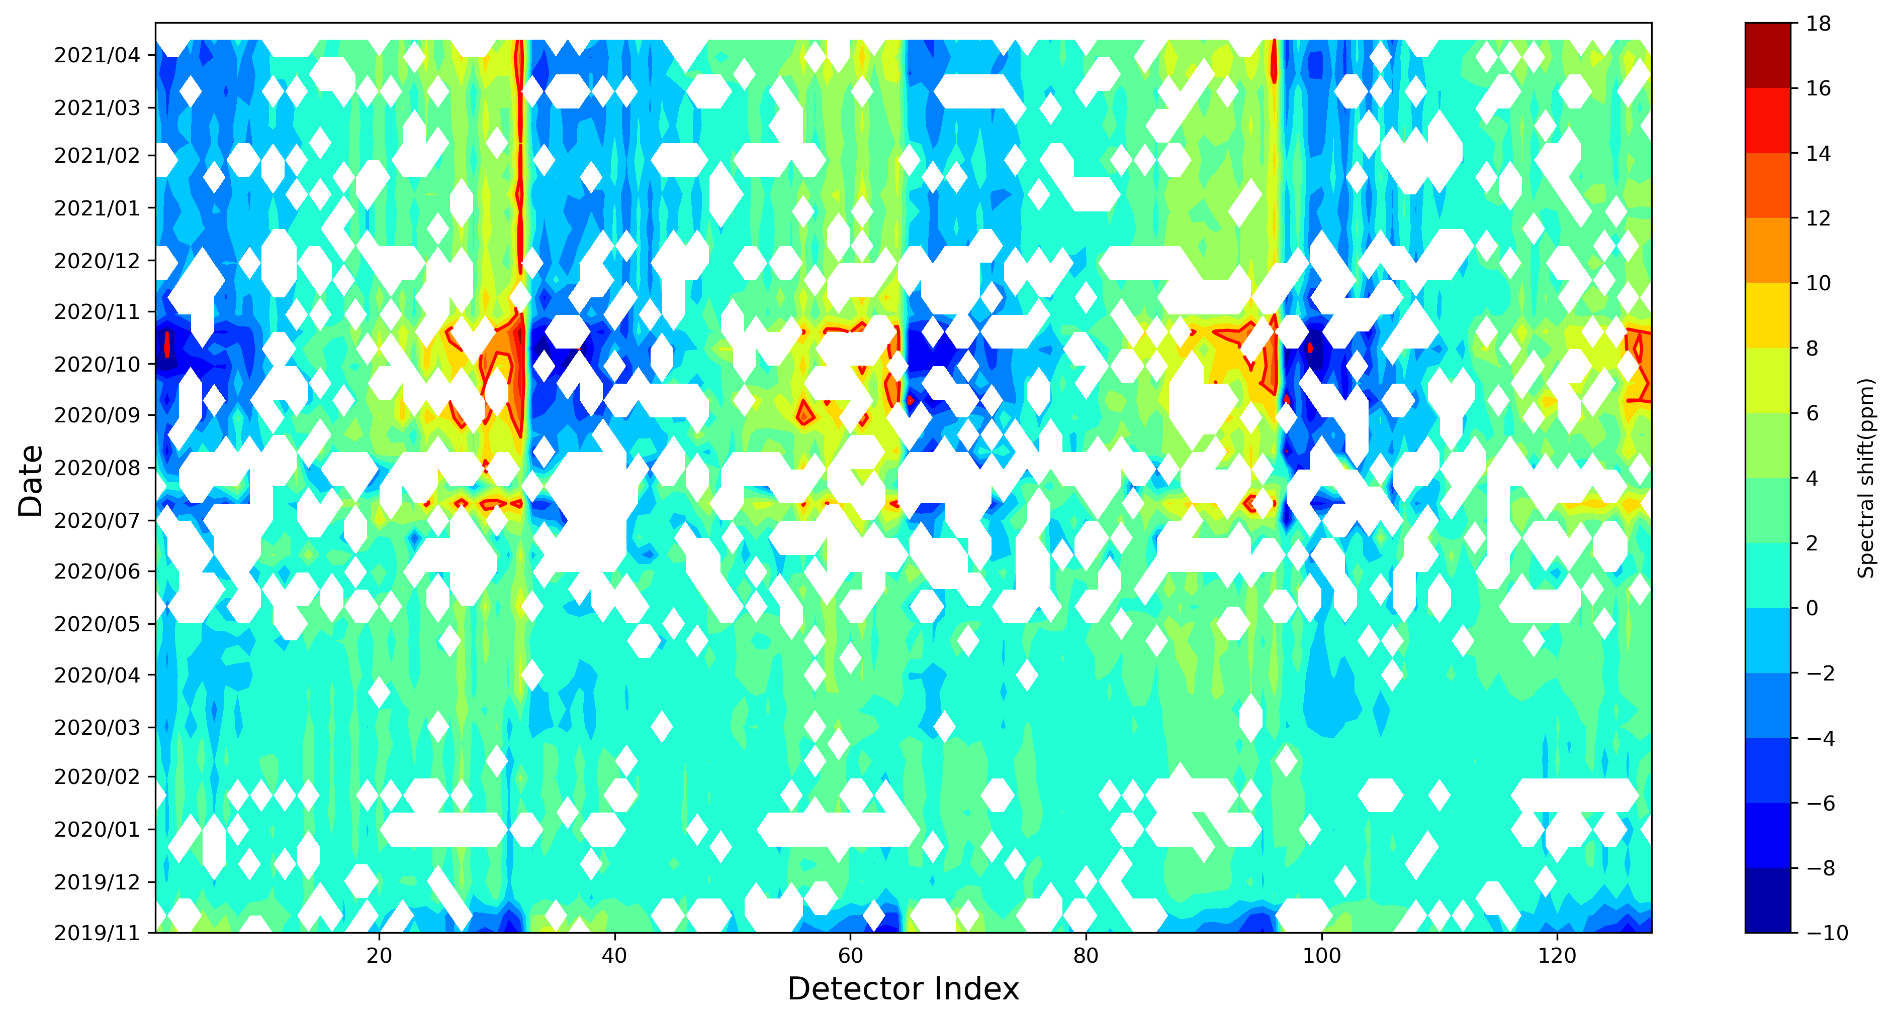
Spectral shift estimation using GIIRS and CrIS SNOs

Slide 24


Estimaiton of focal center and afocal ratio variation using GIIRS-IASI and GIIRS-CrIS SNOs
nvc0 = 14.438
nhc0 = 2.134

Slide 25

Suggestions for NWP user community on FY-4A GIIRS QC
Suggestion on the use of current FY-4A GIIRS L1 (V3):
Best detectors: 14,47,48,79,112
Detector selection: 3-25,36-57,67-89,102-123
Time selection: 00Z-09Z
Reference focal center
nvc0 = 14.438
nhc0 = 2.134

Slide 26



GIIRS O-B on 06Z, May 17 2020 (Super Cyclonic Storm Amphan)
Added value of geostationary high-temporal, high-spectral
vertical sounding to improve NWP initial condition

Slide 27

Winds FY-4A GIIRS humidity sounding(15min )
Retrieve wind information using 4D-Var
Retrieve winds using traditional AMV methods
Retrieve winds using AI techniques
water vapor “tracer effects”
3D winds information
through 4D-Var or
retrieval
There are 961 channels in water vapor band

Slide 28

Assimilation of GIIRS 4D Winds
Han W., Yin R.,Di D.,Ma Z., Li J. and Knuteson R.,2021:Assimilation of four-dimensional winds from high temporal geostationary hyperspectral infrared sounder radiances, EUMETSAT 2021 conference (submitted).
Li J., Ma Z., Han W., Di D., Li Z., Yin R., Menzel P., and Schmit T., 2021: Four-dimensional wind field from geostationary hyperspectral infrared sounder radiances with high temporal resolution – Typhoon Maria case , EUMETSAT 2021 conference (submitted).

Slide 29
Summary
Close collaboration between data assimilation and calibration
  Satellite data monitoring
  Understand well , use well (uncertainty information is also important)
NEW methods
  ISSEC, A fast and accurate spectral bias estimation algorithm
  OOPS, On orbit parameter estimation using data assimilation methodology
NEW findings
  Diurnal and seasonal variation
  Possible root cause: sensor parameter estimation based on NWP
  The spectral accuracy and stability could be improved
Impact study in JEDI with refined GIIRS L1 data
  4D-Var
  4DENVAR

Slide 30
References
Han W.,et al:Assessment and Integration of the Geostationary Hyperspectral Infrared Sounder(GIIRS) in JEDI,2021 AMS
Han W.,et al: Assimilation of Geostationary Hyperspectral Infrared Sounders: Challenges and Opportunities ,2021AMS
Han W., Assessment of Geostationary Hyper-spectral Sounders in JEDI,7th WMO workshop on the Impact of Various Observing System in NWP, Nov-Dec 2020
Han W. and N. Bormann, 2020: Constrained Variational Bias Correction, ECMWF/EUMETSAT NWP SAF Workshop on the treatment of random and systematic errors in satellite data assimilation for NWP, November 2-5,2020, ECMWF, https://events.ecmwf.int/event/170/contributions/1530/
Han W., Yin R., Wang H.,Wang J., and Shen X., 2019: Assimilation of high temporal GIIRS radiance in GRAPES, ITSC22, Québec, Canada ,31 October – 6 November 2019.
Han W. et al, 2019: Assimilation of high temporal resolution GIIRS in 4D-Var, 2019 Joint Satellite Conference, Boston, Sept.28-Oct.4,2019. https://ams.confex.com/ams/JOINTSATMET/videogateway.cgi/id/505317?recordingid=505317
Han W. et al, 2019: Target observing experiments using high temporal geostationary sounder : Typhoon Ambil case, the 99th AMS Annual Meeting, Phoenix, Arizona, 6-10 January 2019.
Han W. and N. Bormann, 2016: Constrained adaptive bias correction for satellite radiances assimilation in the ECMWF 4D-Var, ECMWF Technical Memorandum, 783. https://doi.org/10.21957/rex0omex

Slide 31


What do you find ?
O2R
R2O
HoFx, BC and QC
ObsNum_GSI(UFO-GSI)
ECMWF
amsua_n19
2020110112
AMSUA-NOAA19
Possible over bias corrected
For channels 1 and 2
Notes:
https://www.ecmwf.int/en/forecasts/charts/obstat/atovs_amsua__rmsplot_0001_plot_o_rmsplot_atovs_amsua?facets=Parameter,Radiances%3BData%20type,Microwave%20radiances&time=2021011800&Satellite=NOAA-19

Slide 32



Radiometric Uncertainty
upper bounds of
observation uncertainty
Meteosat-10/SEVIRI IR
2013-03-01/2017-03-01
Himawari-8/AHI IR
2015-07-01/2017-06-30
Tobin et al ,2013
Tim Hewison,ITSC21
GSICS
GPS RO as reference
STAR
ICVS ,ATMS-GPS
Calibration update
Notes:
https://www.star.nesdis.noaa.gov/icvs/status_NPP_ATMS.php

Slide 33

Methodology: Constrained Variational Bias Correction (CvarBC)
Constrain the total size of
bias correction to each channel using radiometric uncertainty estimation
(Weak Constraint)
Han,2014,ITSC19; Han and Bormann,2016; Han,2020

Slide 34
CVarBC (since 5 June 2018, IFS CY45R1)
From Andy Brown,2018
https://confluence.ecmwf.int/display/FCST/Implementation+of+IFS+cycle+45r1

