Slide 1
Multiple GNSSRO operators in JEDI UFO
Hailing Zhang, François Vandenberghe, Hui Shao Joint Center for Satellite Data Assimilation
*GNSSRO - Global Navigation Satellite System Radio Occultation
2021 JCSDA Technical Review Meeting and Science Workshop

Slide 2
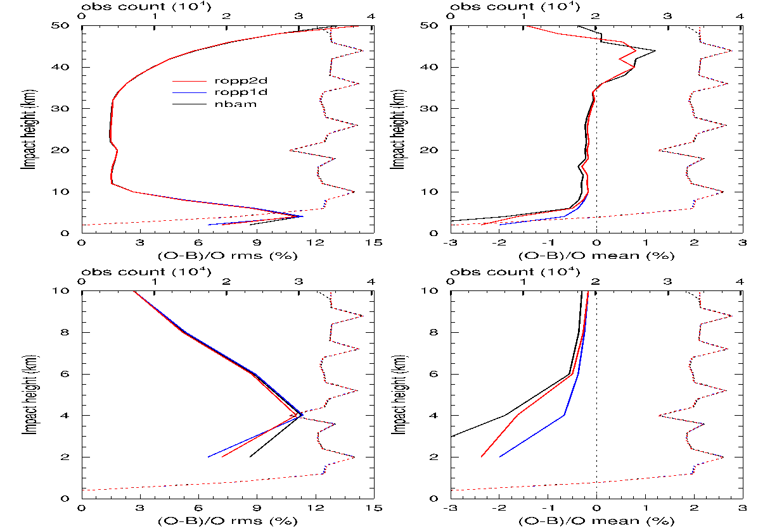
Multiple GNSSRO operators in JEDI UFO
https://github.com/JCSDA-internal/ufo/tree/develop/src/ufo/gnssro
Ref – implementation of NCEP GSI refractivity operator
RefMetoffice – UK Met Office refractivity operator
BndNBAM – implementation of the NCEP Bending Angle Model
BndROPP1D – in collaboration with NRL
BndROPP2D – in collaboration with ECMWF
BndMetoffice – UK Met Office bending angle operator
ROPP – the radio occultation processing package (https://www.romsaf.org/)
https://github.com/JCSDA-internal/ropp-ufo
BA OMB statistics of Sentinel-6 (preliminary RO observations processed by JPL)

Slide 3
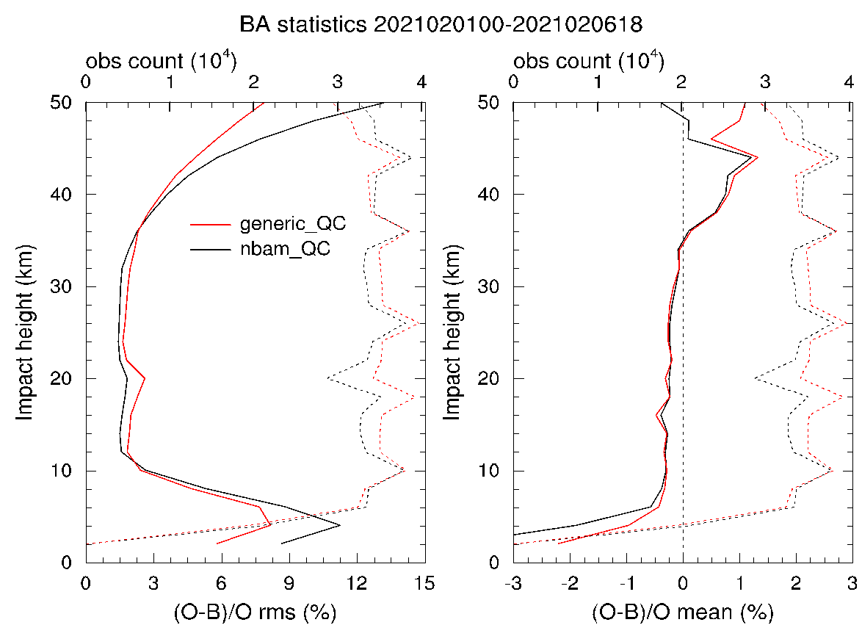
Implementation of GSI NBAM in JEDI UFO
HofX JEDI vs. GSI diag
Various configurations:
QC:
OMB check – generic/GNSSRO specific
Super refraction – NBAM/ROPP
Obs error:
NCEP/ECMWF/NRL/MetOffice
Sentinel-6 OMB with 2 QCs
QC: JEDI vs. GSI diag

