Slide 1
An Evaluation of the INSAT Radiances: Past - Present - Future
S. Indira Rani, Priti Sharma, and John P. George
National Centre for Medium Range Weather Forecasting (NCMRWF)
Ministry of Earth Sciences, India

Slide 2
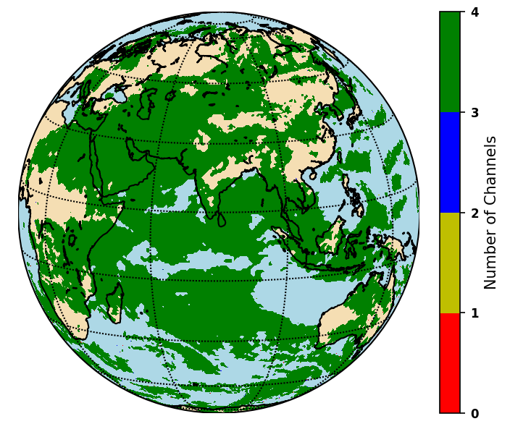
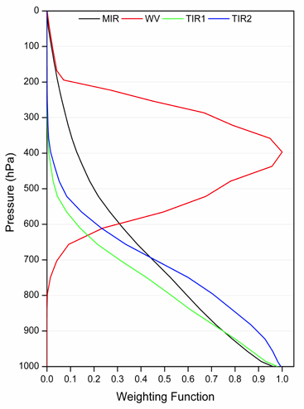
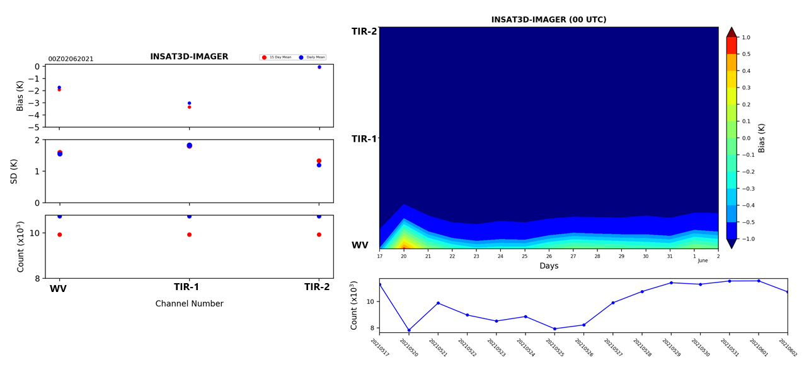
Reception and Monitoring of INSAT Imager Radiances
Coverage
Weighting Function
Monitoring
Assimilates only WV channel

Slide 3
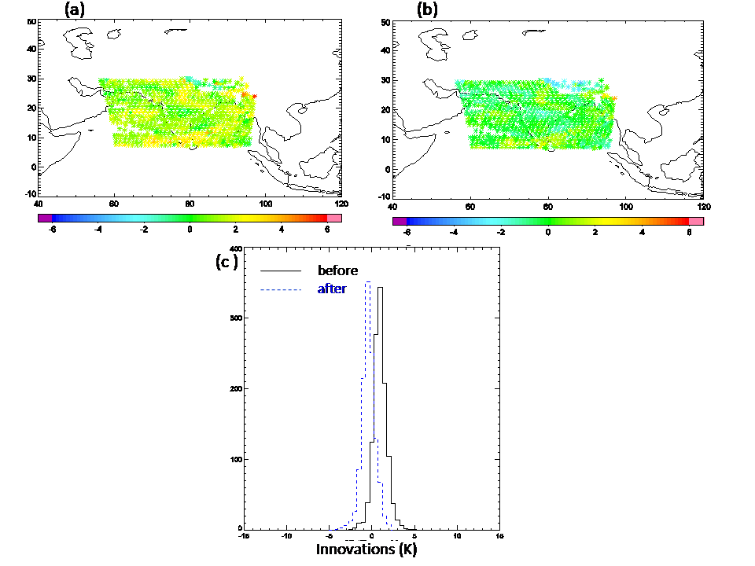
Bias correction
O - B
C - B
(a) Observation –Background (O-B), (b) Corrected Observation – Background (C-B), and (c) the distribution of innovations without and with bias correction.

Slide 4
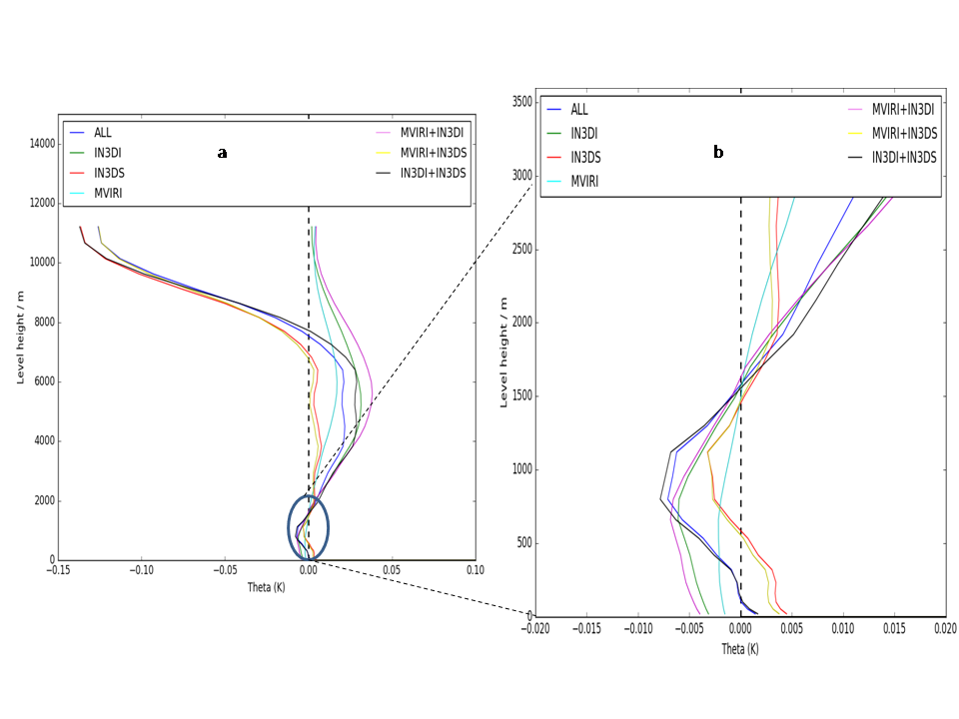
Assimilation: Comparison with existing instruments
Analysis increment in potential temperature : Single Observation experiment

Slide 5
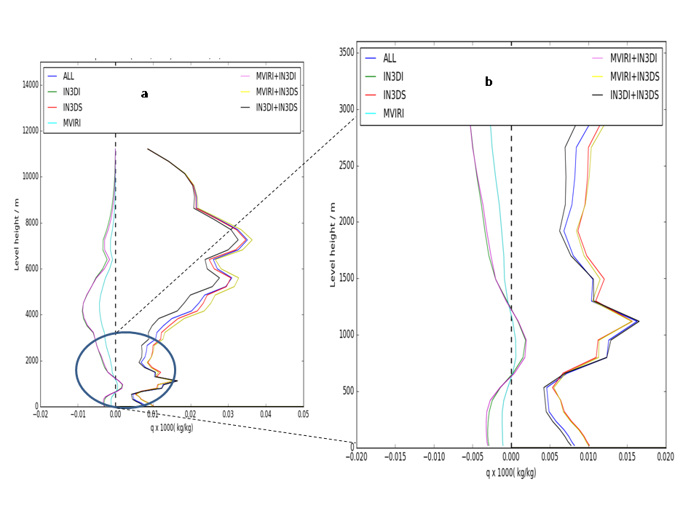
Analysis increment in specific humidity: Single Observation experiment

Slide 6
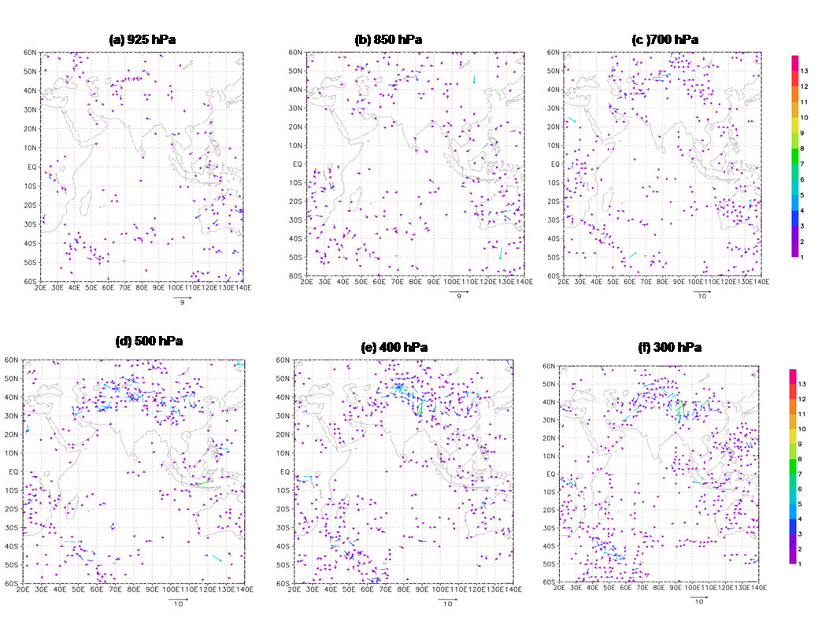
Impact on the INSAT-3D imager radiances in the wind field
Day-1 forecast difference in wind vectors between the OSE with INSAT-3D WV imaging channel radiances and the baseline experiment.

Slide 7
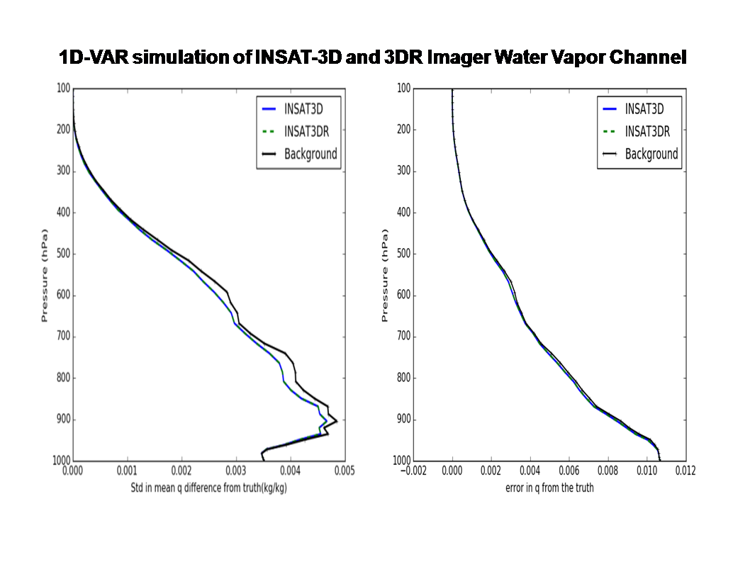
1D-VAR experiment: INSAT3D and INSAT3DR

Slide 8
Conclusions:
INSAT Imager WV CSBTs are assimilating in the NCMRWF global model after bias correction.
The impact of INSAT-3D Imager WV CSBTs was analyzed through a series of single observation experiments and global assimilation experiments.
The single observation experiments show that INSAT Imager WV channel has same influence on the analysis increment of both potential temperature and specific humidity as that other similar instruments.
The influence of INSAT-3D CSBTs was observed mainly in the humidity field and the upper tropospheric winds.
1D-VAR experiments show that both INSAT-3D and 3DR imager have similar characteristics and we expect the same in the future INSAT-3DS.

