Slide 1
Online nonlinear bias correction in ensemble Kalman filter to assimilate GOES-R all-sky radiances for the analysis and prediction of rapidly developing supercells
Xuguang Wang, Krishna Chandramouli, Aaron Johnson
Multiscale data Assimilation and Predictability (MAP) Lab
University of Oklahoma, Norman, OK
Jeff Whitaker
NOAA ESRL PSL, Boulder, CO
Jason Otkin
University of Wisconsin, Maddison, WI

Slide 2
Background and Objective
Background
Complementary to RADAR reflectivity, ABI infrared radiance observations from GOES-R can provide high resolution non-precipitating cloud hydrometeor information.
Studies have shown that for convective scale DA systems, the frequent assimilation of water vapor sensitive all-sky BT along with RADAR observations results in better representation of storms in the analysis and increases forecast lead time than RADAR only experiments. (e.g., Zhang et al. 2019, Johnson* et al. 2021)
Past studies have shown the superiority of online bias correction with anchoring observation in the context of clear-sky radiance assimilation for global NWP. (e.g., Auligne et al. 2007). However, so far only the offline method is implemented to remove complex bias present in all-sky radiance observations for convective scale data assimilation. (Otkin et al. 2018, Johnson* et al. 2021)
Objective
With RADAR reflectivity serving as anchoring observation, how does online non-linear bias correction for all-sky ABI radiances compare with the offline approach for the analysis and forecast of the rapidly developing supercell?
* MAP students or junior scientist

Slide 3
Outline
Case study overview
Experiment design
Bias correction approaches
Non-linear offline bias correction
Non-linear online bias correction
Offline vs. Online bias correction impact on analysis and forecast
Physical diagnostics
Summary and plans

Slide 4
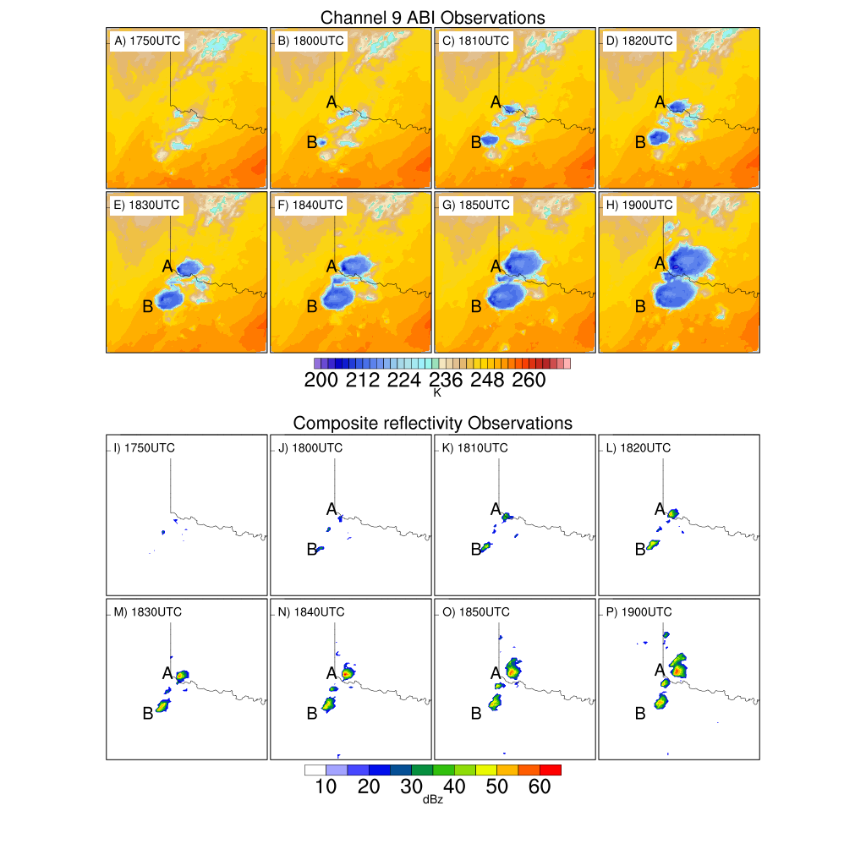
Case study overview
A rapidly developing supercell event of May 18, 2017, was selected.
Conducive dry line along with the high-level trough led to the formation of multiple supercells
ABI channel 9 observations sense the formation of towering cumulus clouds before the strong reflectivity signatures (≧35 dBz) are seen in RADAR observations
The two storms that initiated around 1800 UTC (labelled as A and B in Figure) developed into long-lived supercells.

Slide 5
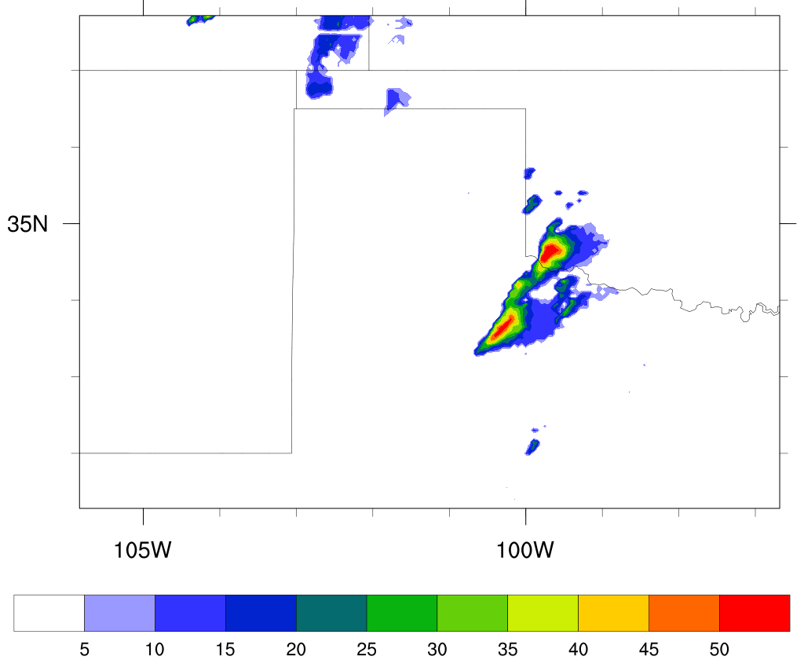
Experiment design
GSI based EnKF convective scale data assimilation system (Johnson* et al. 2015, Wang* and Wang 2017)
40 member ensemble assimilating RADAR reflectivity and Channel 9 (Water vapor sensitive) ABI radiance every 10 minutes from 1750 to 1900UTC.
Adaptive observation error and additive inflation for ABI radiances (Johnson* et al. 2021)
Posterior covariance inflation : Relaxation To Prior Spread (RTPS; Whitaker and Hamill 2012)
Deterministic forecasts for 1 hr initialized from the ensemble mean analyses every 10 minutes from 1820UTC to 1900UTC
Domain
Composite reflectivity swath observation (dBz) 1750 to 1850UTC

Slide 6
Bias correction approaches
Non-linear offline bias correction:
Statistics of first-guess departures (O-B) are used to estimate the bias.
Can not distinguish bias in the obs and bias in the model
The non-linear offline approach by Otkin et al. (2018) represents fitting a polynomial function of bias predictors to the model first-guess departure.
Observation departure: dY = y –h(x)
$dY=[b_{0}+ b_{1}\left(z_{i}−c\right)+b_{2}{\left(z_{i}−c\right)}^{2}+ b_{3}{\left(z_{i}−c\right)}^{3}] , i=1 to m$
z -> bias predictor, b₀,b₁,b₂ and b₃ -> bias coefficients
In matrix form,
$dY=Ab$
The solution to the above system is given by,
$b={[∝I+A^{T}A]}^{−1}A^{T}dY$

Slide 7
Bias correction approaches
Non-linear online bias correction:
The bias is estimated at each analysis step along with the estimated state.
The coupled state and bias update step (Fertig et al. 2009) in EnKF :
Bias $b(p(x_{b}),β)=p_{1}(x_{b})β_{1}+ p_{2}(x_{b})β_{2}+ p_{3}(x_{b})β_{3}+ …$
$δx=K( y−\overline{Hx_{b}}+b\left(p(x_{b}),δβ\right) )$ where $\overline{Hx_{b}}=Hx_{b}$ - $b\left(p(x_{b}),β\right)$
$δβ={\left({P_{β}^{b}}^{−1}+pR^{−1}p^{T}\right)}^{−1}pR^{−1}((y−\overline{Hx_{b}})−Hδx)$
Starting with $δx$=0 , $δβ$=0 : The equations are solved iteratively.
Past studies have revealed the co-existence of an unbiased anchor observation along with bias corrected observation can help distinguish the model and observation component of the biases, which in turn gives better analysis and forecast (Eyre 2016).
The default bias correction in EnKF was modified to accommodate the non-linear cubic polynomial function for ABI radiances similar to the offline approach

Slide 8
Bias correction approaches
Practical consideration
For the rapidly cycled ABI radiance DA experiments, RADAR reflectivity is served as anchor observation.
RADAR reflectivity and ABI radiances are sensitive to different variables and contribute to the analysis increment in different regions of the cloud. However, RADAR reflectivity and ABI cloud sensitive radiances are physically connected.
RADAR can act as anchor:
The increments created by RADAR on precipitating hydrometeors and updrafts at low- and mid-levels are physically linked to the formation of high-level clouds which are seen by ABI radiances .
Similarly, the increments created by RADAR on spurious precipitation also affects the suppression of high-level spurious clouds which are seen by ABI radiances.
RADAR cannot act as anchor :
In the regions where both the model and observations have non-precipitating clouds, RADAR reflectivity can not serve as an anchor because the innovation for RADAR reflectivity observation is zero. Over such regions, no bias correction is currently applied.
In the cloud free regions, the humidity increments created by ABI radiances are not constrained by the RADAR reflectivity observations as RADAR is sensitive only to precipitating hydrometeors.
The bias coefficients for both non-linear offline and online bias correction are calculated and applied over ABI radiances in the vicinity of RADAR anchored region.

Slide 9
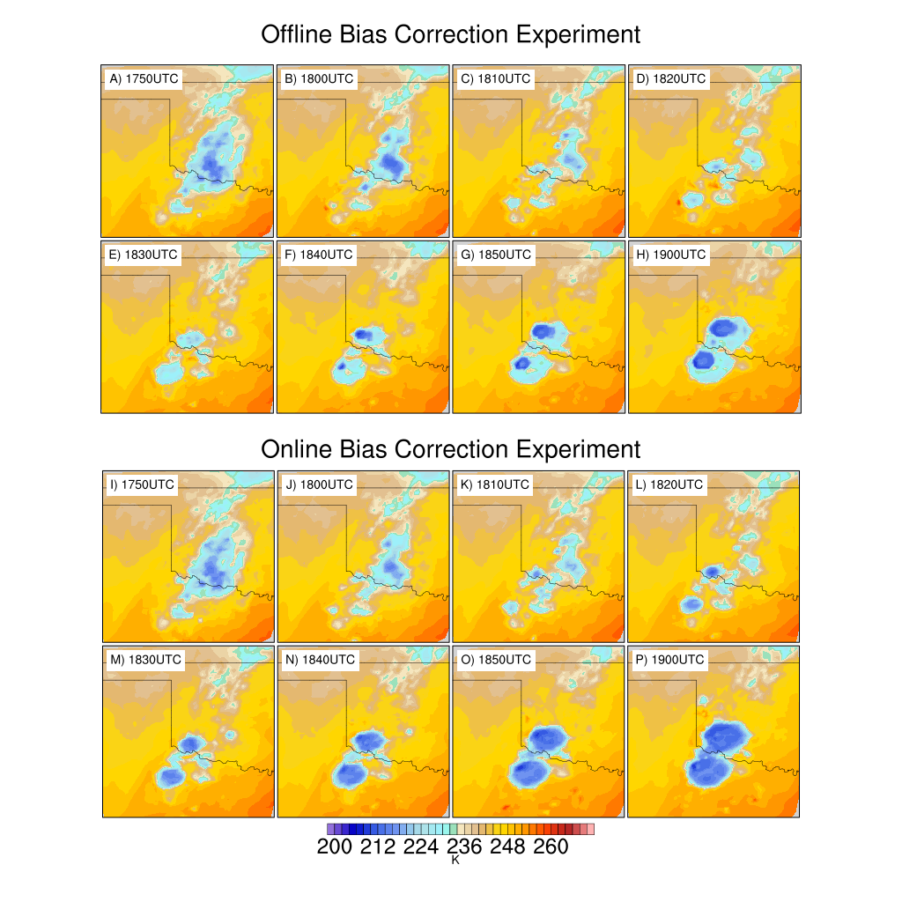
Offline vs Online bias correction
Analysis
Channel 9 BT analysis
offline
obs
online
In comparison to offline approach, the spurious clouds are suppressed relatively more effectively in an online bias correction.
The analysis of the online bias correction approach more closely matches the observed rapid development of the supercell storms.

Slide 10
Offline vs Online bias correction
Analysis & first guess fit to obs
Radar reflectivity over anchored region
RMSI
Starting 1810UTC, the experiment using the online bias correction approach results in smaller bias and RMSI in the first guess verified against the anchored RADAR observations than that using the offline approach
Major improvement from online approach in the suppression of spurious clouds occur at 2nd-4th DA cycle
Innov. Bias
ABI over spurious cloud region
Innov. Bias
RMSI
Suppression of spurious cloud
Establishment of storms
Suppression of spurious cloud
Establishment of storms

Slide 11
Offline vs Online bias correction
Analysis & first guess fit to obs
As the storm intensifies, the first guess of the online approach fits the observed cloud more closely than offline approach.
Although radar anchors precip. region, the first guess of the online bias correction fits the non-precipitating cloud more closely than the offline approach:
Improvements in bias/RMSI are seen in suppression of spurious non-precipitation clouds.
Online approach is able to spin up new non-precipitating clouds faster in the analysis from 1840UTC, which is reflected in both bias and RMSI.
ABI over observed cloud region
RMSI
Innov. Bias
ABI over non-precipitating cloud region
Innov. Bias
RMSI
Suppression of spurious cloud
Establishment of storms
Suppression of spurious cloud
Establishment of storms

Slide 12
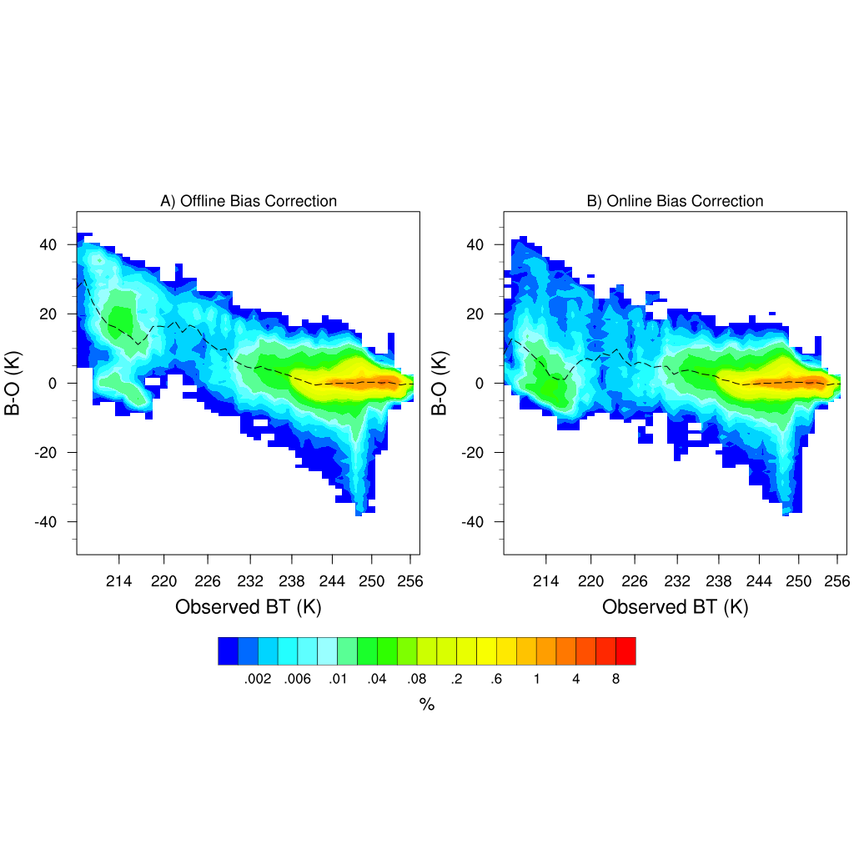
Offline vs Online bias correction
first guess
Probability distribution of channel 9 ABI first-guess departures (B-O)
Offline
Online
The online approach exhibits less systematic deviation over the cloudy region (observed BT <=239K) than offline approach.
This result suggests the effectiveness of using the radar reflectivity as anchoring observation to analyze the observed cloudy regions .

Slide 13
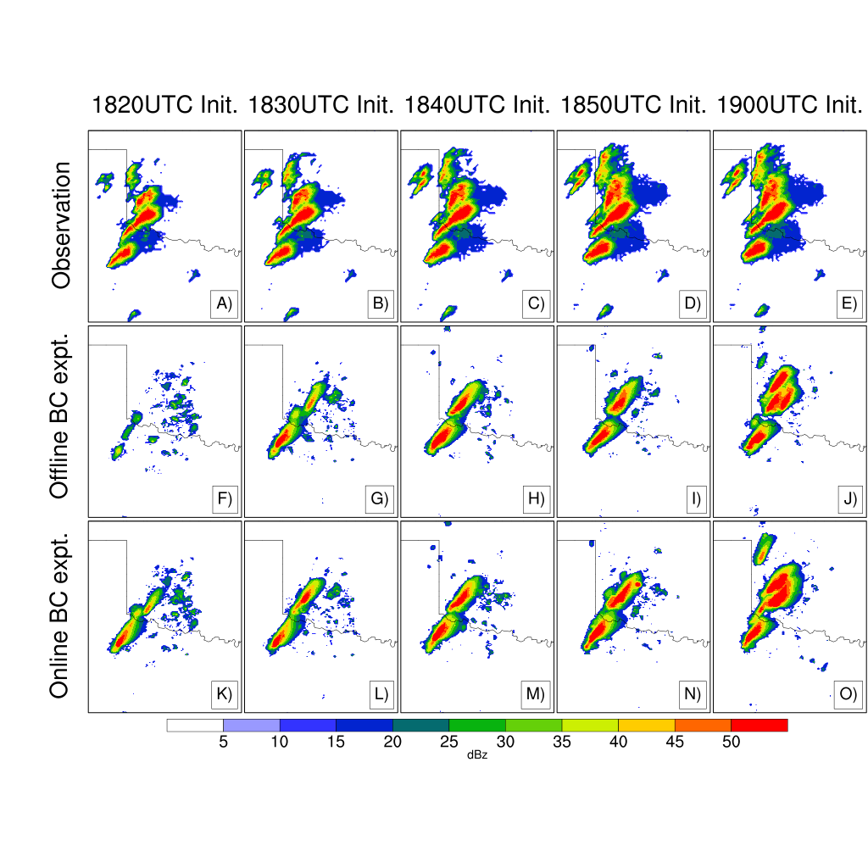
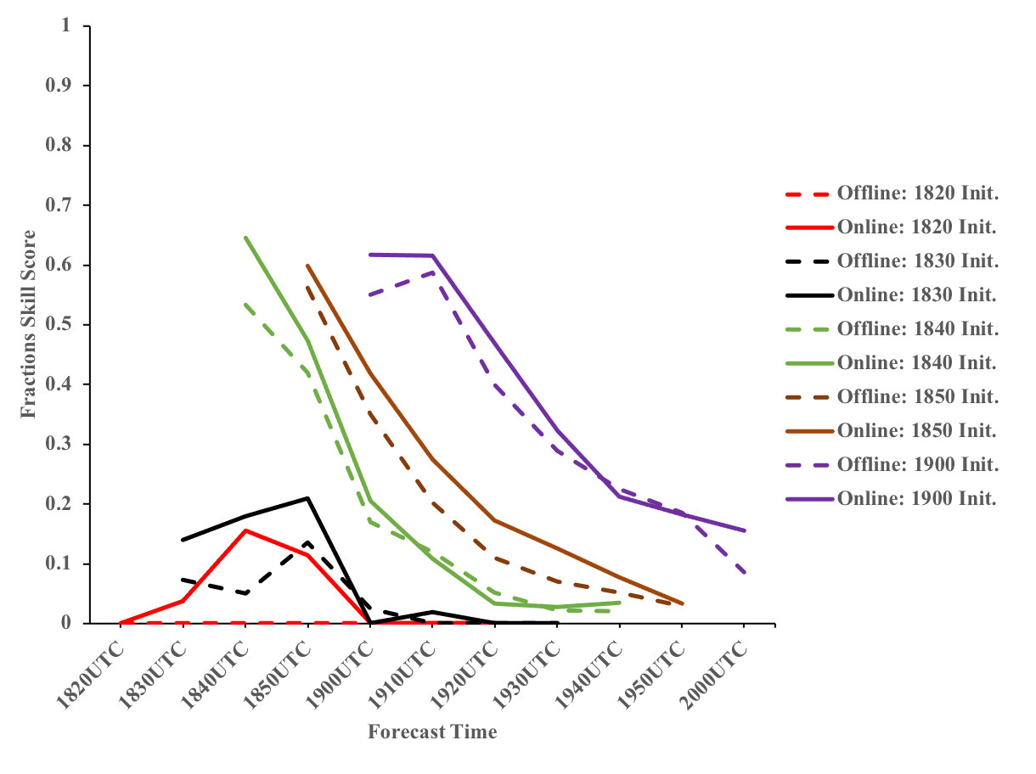
Offline vs Online bias correction
Forecast
Comparison of RADAR reflectivity swath forecasts
offline
online

Slide 14
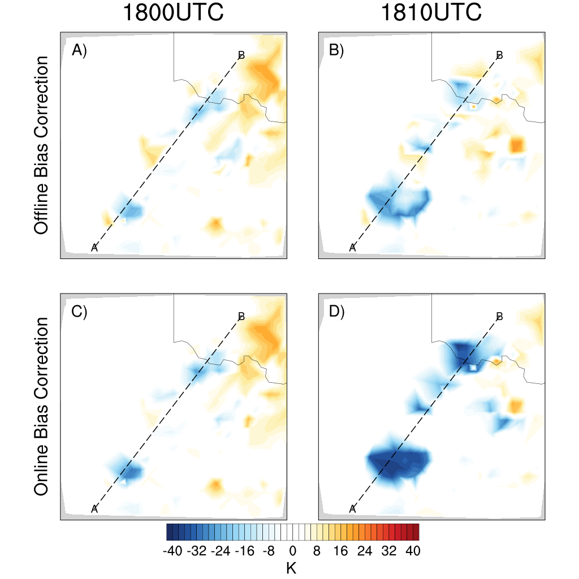
Physical diagnostics
Bias corrected Channel 9 radiance innovation
The estimated bias in the offline approach includes a larger contribution from the model bias, which in this case is the underestimation of storm by the model
The offline bias correction approach removes a large part of the innovation as bias as shown by a smaller bias corrected innovation.
The online approach retains most of the negative innovation over the observed storm region
The different impacts of online and offline bias correction are further understood by the resulting analysis increments of humidity, hydrometeor mixing ratios and updraft velocity.
Offline
Online

Slide 15
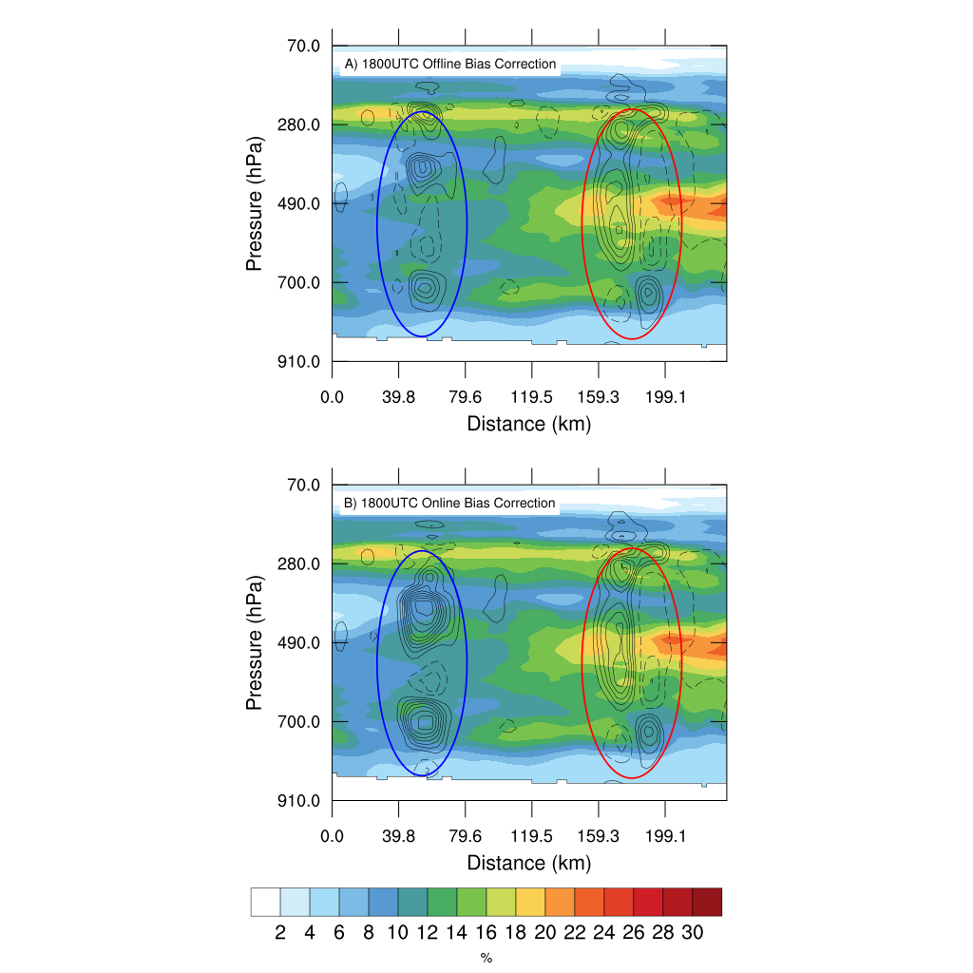
Physical diagnostics
Background spread in RH (%) with ens. mean increments
At 1800UTC, the model background has no hydrometeors at the region of observed storms.
A cross-section of background ensemble spread of RH shows similar background ensemble spreads in offline and online bias correction experiments
Given the larger negative bias corrected innovation in the online approach, the online bias correction experiment produces larger analysis increments to RH at the observed northern and southern storm locations (which is denoted by red and blue circles)
The resultant differences of the RH analyses influence the hydrometeor field in the subsequent background forecast at 1810UTC
Offline
Online

Slide 16
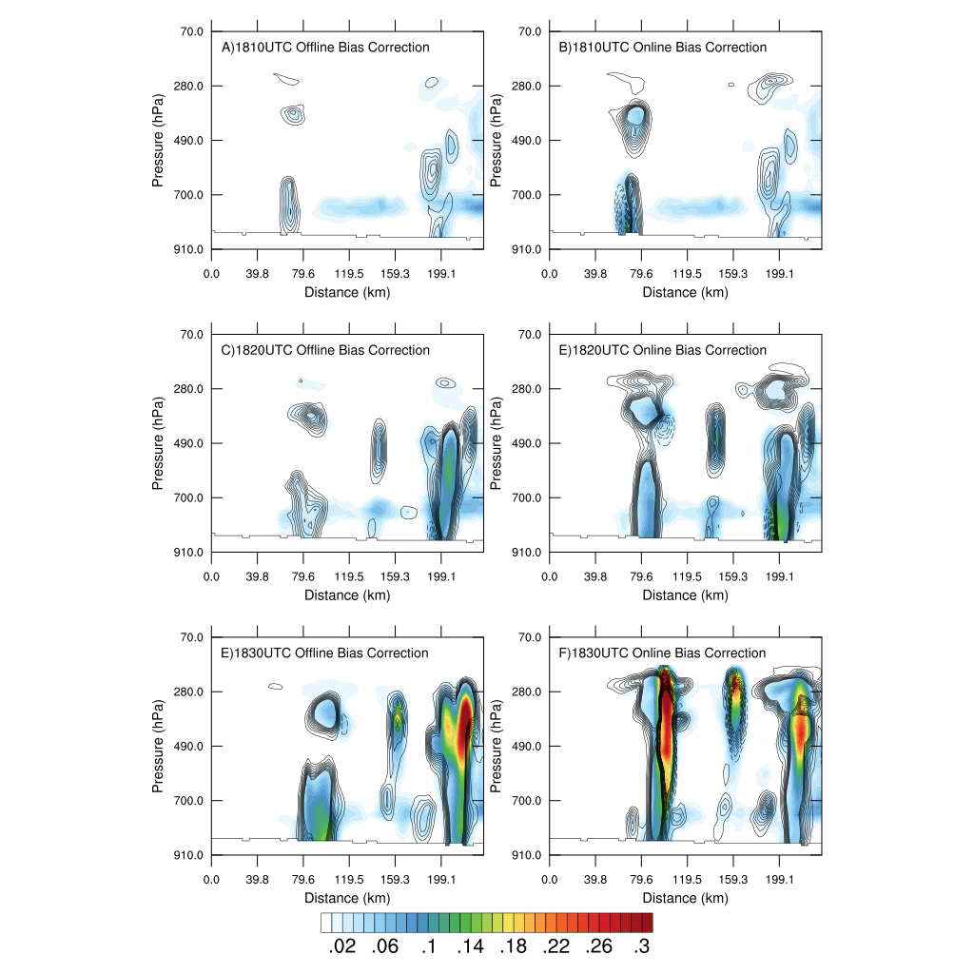
Physical diagnostics
Background spread in hydrometeors (%) with ens. mean increments
offline
online
The background hydrometeor ensemble spread at 1810UTC for the online approach shows larger spread at observed storm locations.
Such a larger background hydrometeor spread together with the greater bias corrected innovation results in a larger hydrometeor increment at both lower and higher model levels by the online approach
The online approach is able to more appropriately increment the moisture and hydrometeor fields during the data assimilation cycling.
As a result, the analysis of the online approach is able to capture the developing storms more rapidly, leading to the reduction of conditional bias over observed cold BT regions

Slide 17
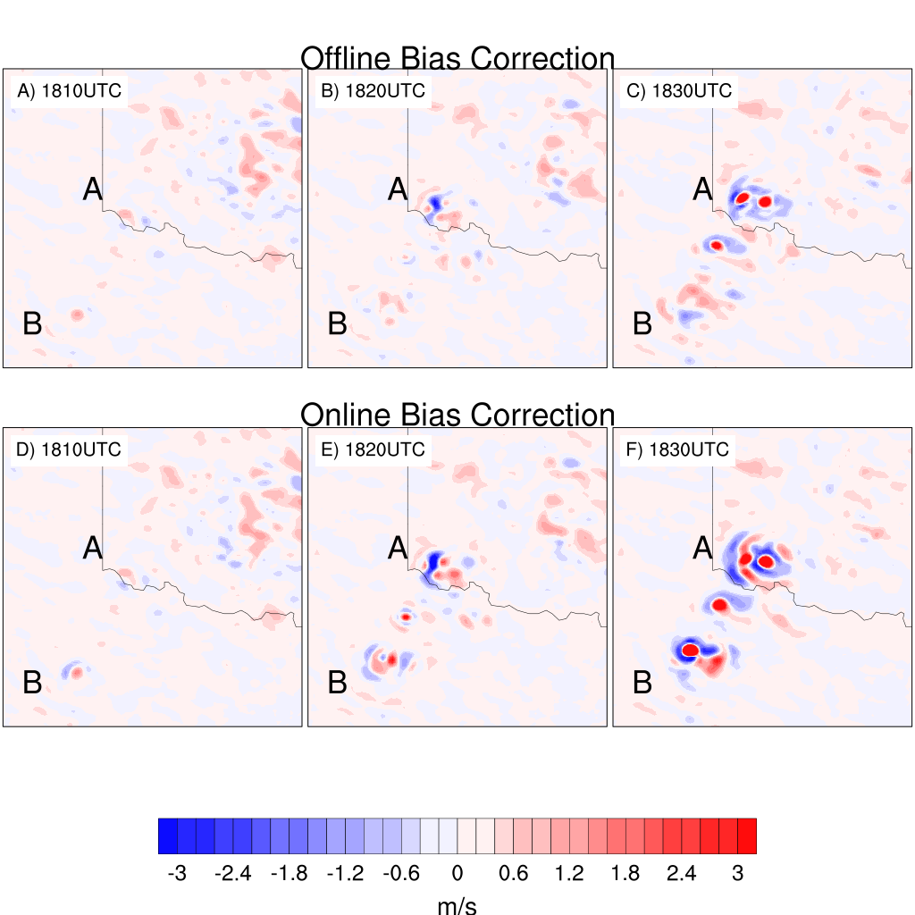
Physical diagnostics
Ensemble mean background updraft velocity at 500 hPa
In addition to the thermodynamic field, the online and offline bias correction experiments analyze dynamical field differently.
As the storm intensifies, the online bias correction experiment shows stronger ensemble mean background updraft (represented by red color in the plot) at northern and southern storm location compared to the offline bias correction experiment .
This stronger updraft along with the more proper hydrometeor and moisture field analysis by the online approach contribute to the superior forecast of the two supercells

Slide 18
Summary and plans
Online non-linear bias correction for all-sky ABI radiance DA is developed in rapidly cycled EnKF system, and compared with an equivalent offline approach
With RADAR reflectivity serving as anchor observation, the online bias correction results in improved first guess and analysis for various cloud regions
The online bias correction retains useful information in the innovation, which in turn produces different subsequent analysis, subsequent background and background ensemble spread for both the thermodynamic and dynamic fields
The effect is accumulated during the DA cycling that is responsible for the superior forecast of the supercells
Future plans:
The online non-linear bias correction for all-sky radiances is also being implemented in EnVar
Application of bias correction to multiple water vapor sensitive ABI channels
Studies are underway to compare the vertical localization in EnKF and EnVar for convective scale ABI all-sky radiance DA

Slide 19
References
Chandramouli, K.*, X. Wang, A. Johnson*, J. Whitaker and J. Otkin., 2021: Online nonlinear bias correction in ensemble Kalman filter to assimilate GOES-R all-sky radiances for the analysis and prediction of rapidly developing supercells, JAMES, to be submitted.
Johnson, A.*, X. Wang, and T. Jones, 2021: Impacts of assimilating GOES-16 ABI channels 9 and 10 clear air and cloudy radiance observations with additive inflation and adaptive observation error in GSI-EnKF for a case of rapidly evolving severe supercells, Mon. Wea. Rev., accepted with revision.
* MAP students or junior scientist

