Slide 1
Radiance Assimilation at the Met Office using JEDI: An Update.
Chawn Harlow, Satellite Radiance Assimilation Manager, Met Office
JCSDA Technical Review Meeting and Science Workshop, June 7-11

Slide 2
Contributors
Stu Newman
Mike Cooke
Brett Candy
Fabien Carminati
Yaswant Pradhan
David Rundle
Ruth Taylor
Wojciech Smigaj
Jo Waller

Slide 3
Overview
Motivation
Overview of Radiance Processing timeline
Report on progress
Specific contributions focusing on ATMS

Slide 4
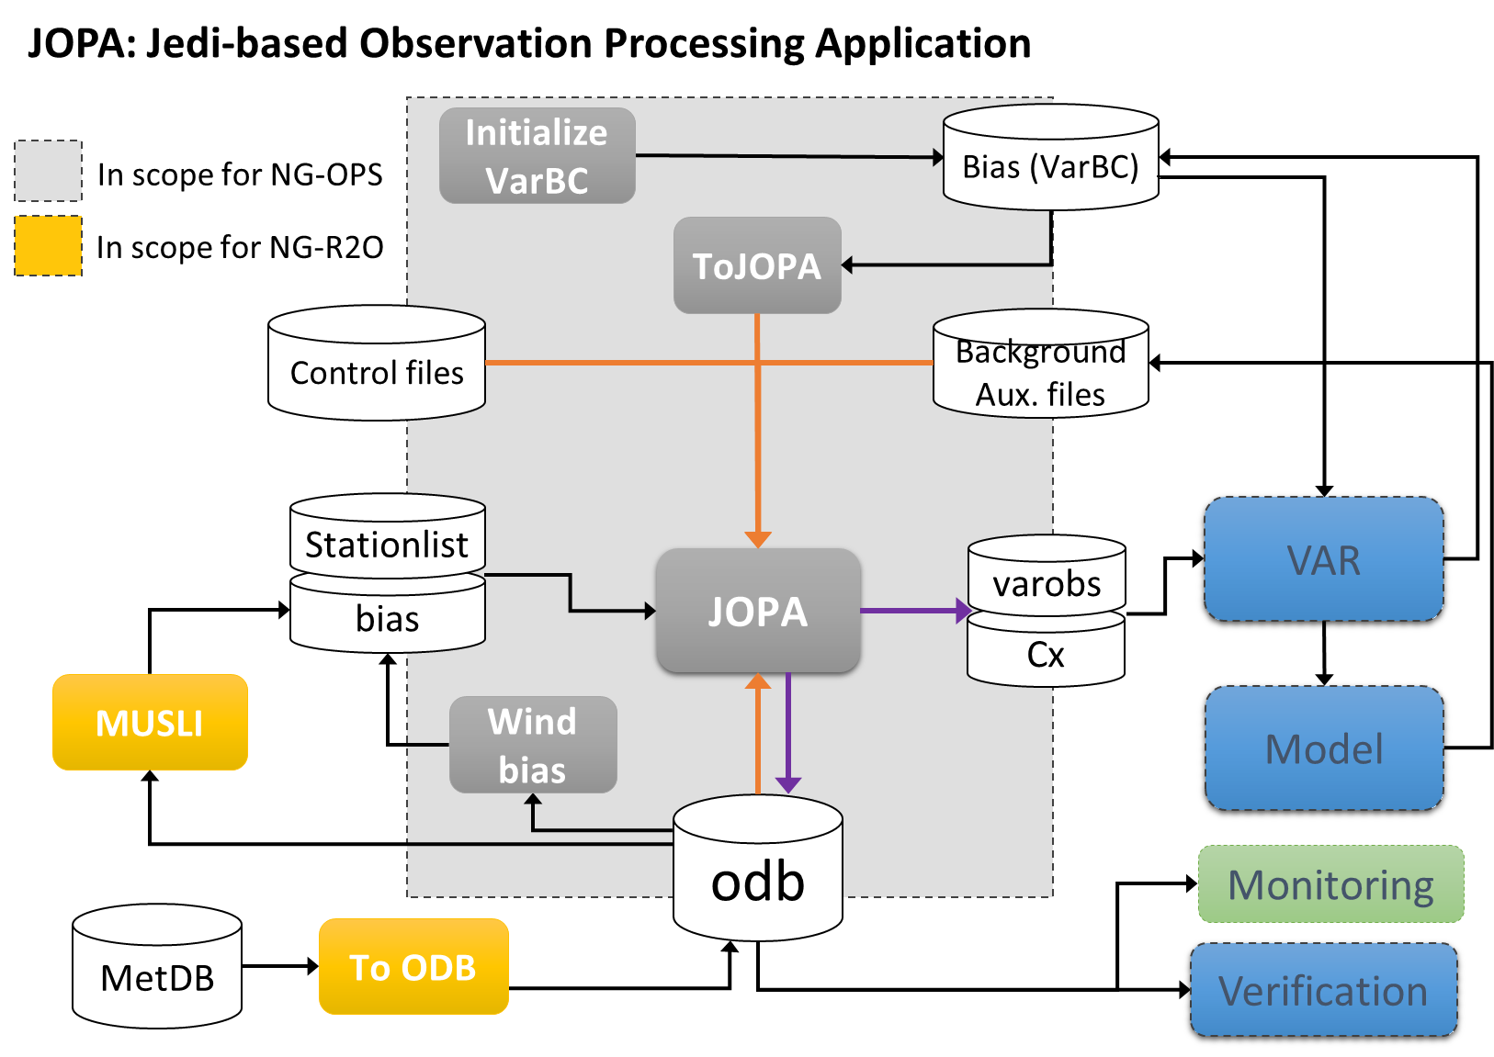
− Observation Processing System: Scopes −
NG-OPS
Delivering the Next Generation Observation Processing System within JEDI
Replicate our current Observation Processing science for atmospheric data assimilation in JEDI (JOPA)
Initially, we will use JOPA to process data before inputting it into our current VAR system.
1-2 years later we’ll implement a full DA system within JEDI.

Slide 5
Radiance Processing Timeline
Oct 2020 –RTTOV interface ready for clear sky processing (prep for ATMS + AMSR2)
Dec 2020 – Scoping of radiance capabilities needed for channel selection, Rmatrix, bias correction, quality control, thinning, etc.
Jun 2021 – Evaluation of JOPA processing of ATMS in comparison to OPS
Jul 2021 – RTTOV interface ready for microwave scattering (prep for ATOVS)
Aug 2021 – Evaluation of JOPA Processing of AMSR2 in comparison to OPS

Slide 6
Radiance Processing Timeline
Remaining timeline contains evaluation of JOPA processing in comparison to OPS:
Dec 2021 – remaining MW imagers
Mar 2022 – ATOVS
Jun 2022 – IASI
Aug 2022 – CrIS and AIRS
Aug 2022 – remaining MW
Oct 2022 – Geostationary CSRs
Each instrument tested to match results from operational system incrementally then together in a large package trial.
May 2023 – Hope to begin trial of full NWP suite with goal to go operational in late 2023

Slide 7
Met Office progress towards ATMS Processing (Jan 2021)
Green elements are in hand.
Orange are being developed at the moment.
*ODB ingest in IODA is critical for Met Office processing
RTTOV interface
Yaml file
Online Bias Correction
Data feed in ODB*
UFO
QC’d Data to assimilation
Obs Filters/Functions used in QC
Bennartz Test
Transmittance Test
Cloud Cost Test
RTTOV 1DVar
Thinning routines
Observation Errors

Slide 8
Met Office progress towards ATMS Processing (Jun 2021)
Green elements are in hand.
Yellow items are changing as requirements change with other developments
Orange are being developed at the moment.
*ODB ingest in IODA is critical for Met Office processing
RTTOV interface
Yaml file
Online Bias Correction
Yellow items are changing as requirements change with other developments
Data feed in ODB*
UFO
QC’d Data to assimilation
Obs Filters/Functions used in QC
Bennartz Test
Transmittance Test
Cloud Cost Test
RTTOV 1DVar
Thinning routines
Observation Errors
QC Flags

Slide 9
Specific Developments
Development of 1D-Var for radiances (Mike Cooke)
RTTOV interface developments (Rundle)
Thinning work (Candy, Newman, Smigaj)
QC filters (Newman, Carminati, Rundle)
Bias correction (Harlow, Waller, Smigaj)

Slide 10
Development of 1D-Var for radiances (Mike Cooke)
Met Office performs 1D variational retrieval on each radiance measurement prior to 4D-Var
Part of QC: if 1D-Var fails to converge, the observation is unlikely to be viable in 4D-Var
Retrieval of poorly-constrained quantities such as skin temperature and emissivity which are passed to 4D-Var for use in the assimilation.
Currently only compatible with RTTOV. Future work will focus on a more generic approach.
Replicates results from OPS to 7 or 8 sig figures.
Future work will focus on:
use of microwave land emissivity atlases for first guess
Support for hyperspectral sounders:
Retrieval of PCs of emissivity
Retrieval of cloud top pressure and effective emissivity for assimilating data over cloud.

Slide 11
QC filters/obsfunctions developed
Cloud Cost (ufo 932)
– 1D cost calculated compared to threshold
Transmittance (ufo 562)
– prevents too much sensitivity to land surface
Scattering Index (ufo 343)
– based on 150-89 GHz ΔTB
Background Departure Anomaly Test (ufo 845)
– cloud/precip detection for MW imagers
SetSurfaceType (ufo 1129)
– use combination of reported (BUFR or AAPP) surface information and model data to classify surface for an observation operator

Slide 12
Bias correction
Predictor Test – test the predictor in isolation (Waller)
Three new predictors developed:
Legendre predictor treats scan bias residuals
Orbital angle predictor for large MW imagers like SSMIS
Thickness predictor – most important predictor
Met Office uses static bias correction of the scan dependence in addition to variational bias correction.

Slide 13
ATMS bias correction done
Bias correction yaml section now constructed to reproduce OPS bias correction.
Static scan bias
Constant
Thickness (x2)
Legendre (x4)
JEDI biases matches OPS values to 7-8 significant figures
obs bias:
input file: satbias_atms_n20_20200331T1800.nc4
static bc:
predictors:
- name: interpolate_data_from_file
corrected variables:
- name: brightness_temperature
channels: *channels
file: static_bias_atms_n20.nc4
interpolation:
- name: scan_position@MetaData
method: exact
variational bc:
predictors:
- name: constant
- name: thickness
options:
layer top: 30000
layer base: 85000 …

Slide 14
Conclusions
Goal: Replicate our current Observation Processing System science for atmospheric data assimilation
First system will do observation processing in JOPA, but 4D-Var will continue to use old VAR system.
Project started Q3 2020 and finishes Q4 2023 when the new system goes operational
Progress towards ATMS processing in JOPA:
-- All necessary filters and obsfunctions have been developed and tested to replicate operations
-- 1DVar filter has been implemented and reproduces OPS results
-- static and variational bias correction implemented and replicates OPS results
-- some capabilities are still in development (eg. QC flags), so intermediate fixes needed to meet deadline.
Overall very positive progress. Once ATMS is finished many other instruments will fall easily into place.
Future challenges
-- IASI/CrIS/AIRS processing with treatment of inter-channel error correlation and using radiances over cloud
-- ATOVS processing including all-sky treatment and land-surface emissivity atlases

