Slide 1
Development and Validation of JEDI Unified Forward Operator (UFO)
Hui Shao, JCSDA OBS Core Team: Benjamine Johnson, Hui Shao, Greg Thompson, Wei Han, Fabio Diniz, Hailing Zhang, Ryan Honeyager, Francois Vandenberghe, Rachel Schweiker 18th JCSDA Technical Review Meeting and Science Workshop June 7-11, 2021 (Virtual)

Slide 2
Acknowledgement
In-Kind Contributors (2020): E. H. Liu, R. Knuteson, H. Revercomb, J. Jin, M. Cooke, C. Harlow, S. Newman, D. Rundle, Y. Wu, H. Liu, L. Kouvaris, M. Pagowski, B. Karpowicz, B. Ruston, N. Bowler, O. Lewis, K. Bathmann, I. Genkova , D. Merkova, L. Hawkness-Smith, C. Thomas, G. Kelly, J. Cotton, D. Simonin, P. Pauley, M. Hu, C. Alexander, S. Benjamin, L. Wicker, D. Kleist, N. Baker, J. Guerrette, Z. (Jake) Liu, C. Snyder, C. Schwarz, B.J. Jung, J. Ban, E. Platt, M. McAtee
With support from JCSDA core teams, partners, and collaborators

Slide 3
Unified Forward Operator (UFO)
Share observation operators between JCSDA partners and reduce duplication of work
Taking the model agnostic approach one level down into the observation operators
Faster use of new observing platforms
Regular satellite missions are expensive
Cube-sat have short expected lifetime
Include users and instruments science teams
Unified Forward Operator (UFO)
Build a community app-store for observation operators

Slide 4
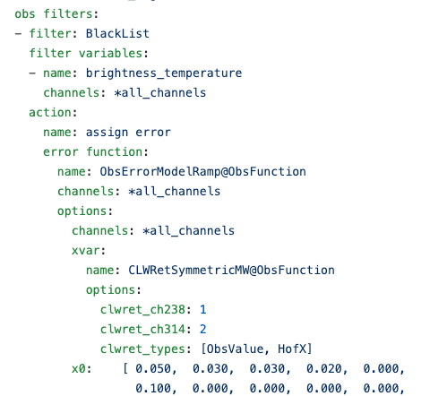
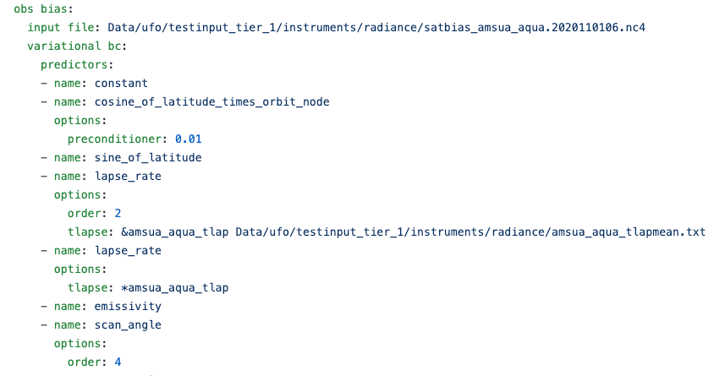
Current Components of UFO
Forward operators
Operators: Interpolation (vertical, surface, layer), GNSSRO, SCATwind, precipitable water, ground GNSS, surface pressure, AOD, …
Interfaces with other packages: CRTM, RTTOV, ROPP
Filters
QC and thinning
Actions
Bias correction (BC) (predictors)
Variable transforms
Configurations (Yaml)

Slide 5
Separate Concerns
Same separation of concerns principles that lead to the design of OOPS
Obs. Locations
Variables
State
Obs. Operators
Observations
Field Values
at Locations
JEDI/UFO introduces standard interfaces between models and observations
Observation operators are independent of the model and can easily be shared, exchanged, compared

Slide 6
UFO Validation Process
UFO is developed and validated using pre-generated geovals (background at obs locations) and observation files
Skip upstream JEDI components
Focus on testing the UFO components
Clean comparison with reference systems
Using JEDI Application Testbed (e.g., JEDI_GDAS):
JEDI models/IODA obs
Ewok workflow
Diagnostic tools using Jupyter Notebook
R2D2 observations and references on AWS S3
End-to-end system validation and comparison (HofX currently, whole system later)
Near real time monitoring
Additional validations performed by partners
IODA observations
Model geovals, other upstream processes
geovals and obs generated by reference systems
UFO:
Forward, TL/AD
Quality control (QC)
Bias correction (BC)
Configurations
Diagnostics and validation

Slide 7
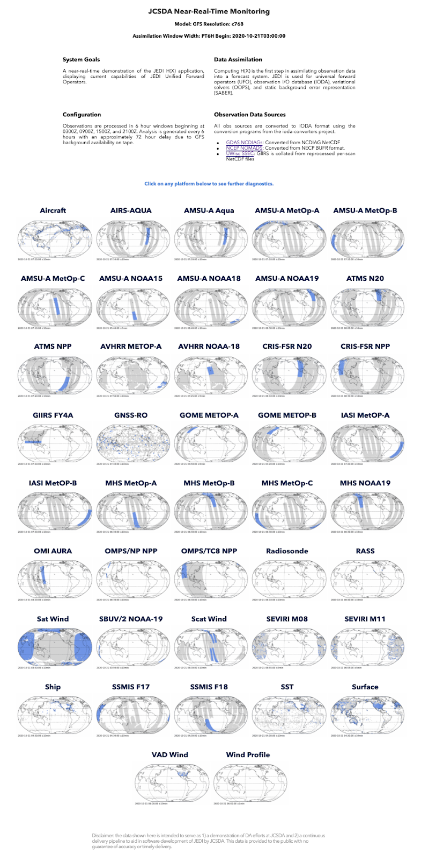
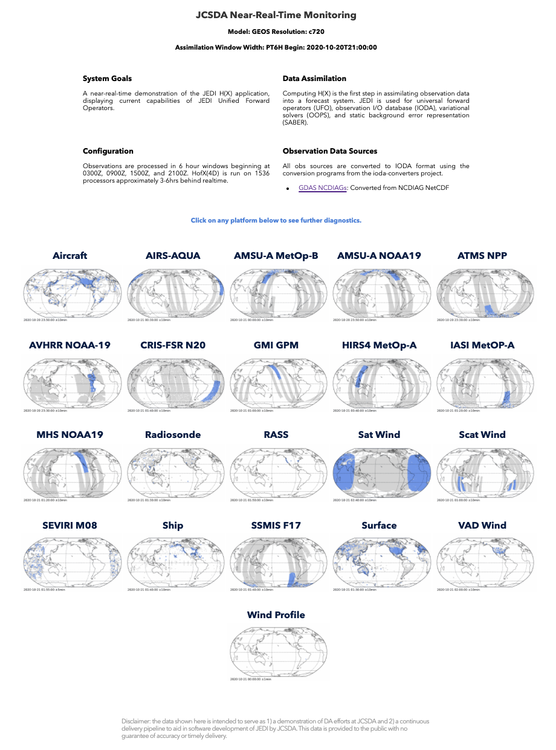
NRT Observation Monitoring Application
Framework for UFO and diagnostic developments
Continuously test all components in pseudo-operational environment

Slide 8
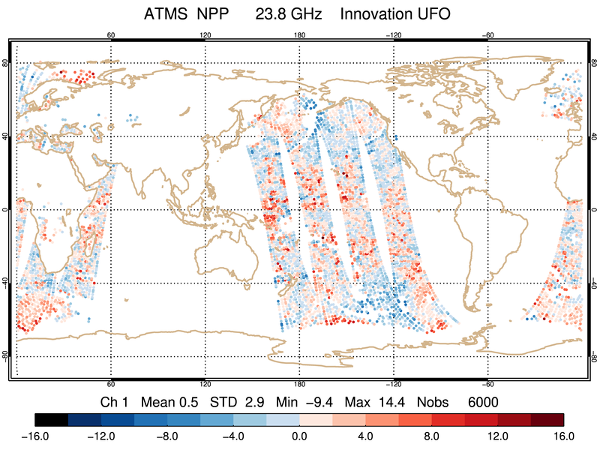
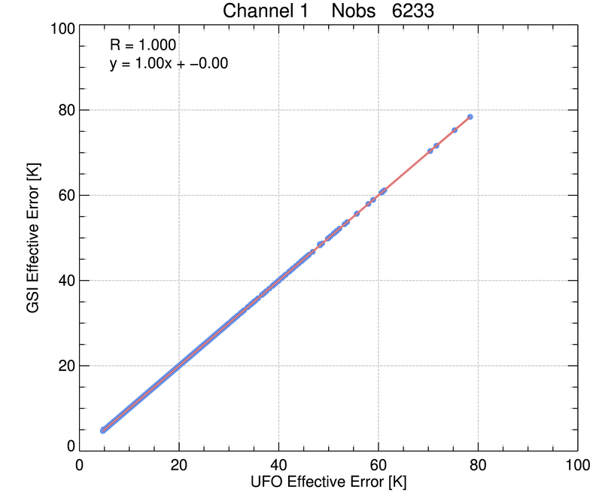
JEDI-FV3 Release 1.1
HDF5
ObsStore
BUFR
ODB
yaml
More…
IODA-Engines: Groups, Variables, Dimensions, Attributes, Type System
IODA V2.0.0
Leverages HDF5 data model for improved organization, management, extensibility, metadata
Enhanced support for multi-dimensional data sets
C++/python interoperability
ObsSpace
Bias
Converters
Diagnostics
Containers
User-facing classes
IODA v2 Release
After Release
Planned / Potential
JEDI UFO for ATMS
UFO V1.1.0
H(x), Bias correction, and QC for NCEP operational instruments following NCEP GDAS implementations
Good agreement with GDAS in most cases; validation work continues
UFO

Slide 9
UFO for JEDI GDAS Sensors/Instruments
Close partnership with NOAA

Slide 10
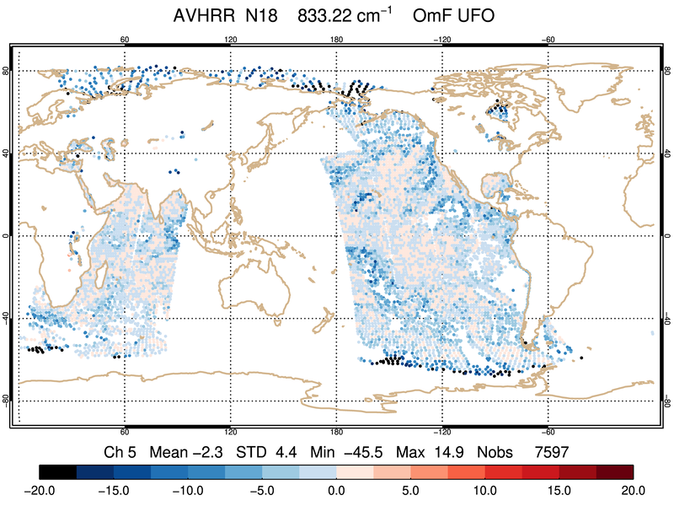
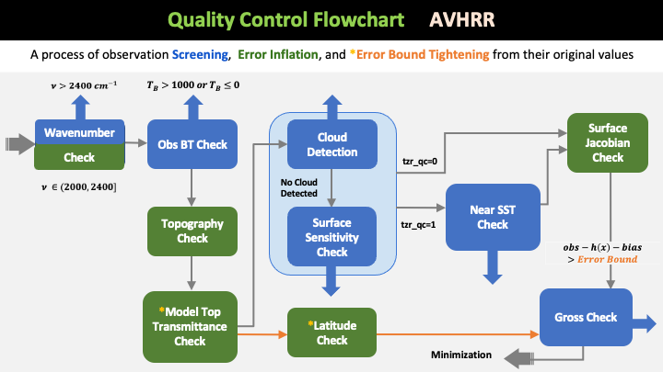
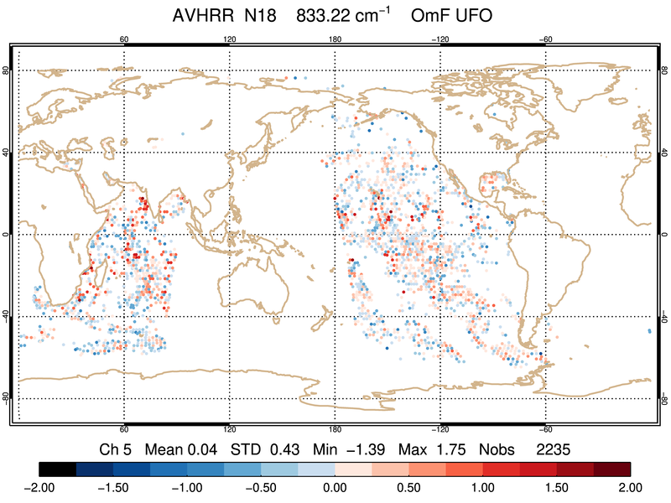
UFO development for AVHRR
Unfiltered
UFO
Filtered
Data filtering using combination of generic filters and obs functions
Parameters defined in GSI resource file (satinfo) for radiances are implemented in YAML
Each QC action implemented has an associated test in UFO
100% replication of GSI result in terms of error inflation, error bound adjustment, and number of observation passed QC filters
GSI
Filtered
Reference
(courtesy of Emily Liu)

Slide 11
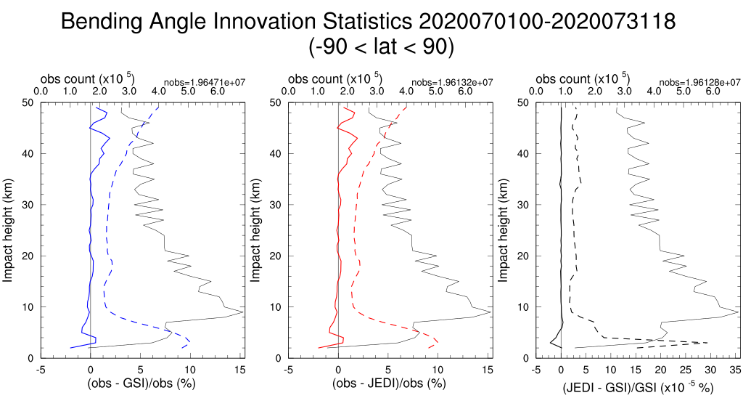
UFO Validation against NCEP GDAS (GSI)
All instruments for JEDI_GDAS have been validated against GSI: H(x) only, with BC, with BC & QC
Using the same input (geovals and obs), UFO can fully replicate GSI forward operators (NCEP GDAS) results for most radiance and GNSSRO instruments.
Other instruments have reasonable matching results with known reasons.
Validations continues using JEDI_GDAS testbed
Ongoing efforts for diagnostic tools

Slide 12
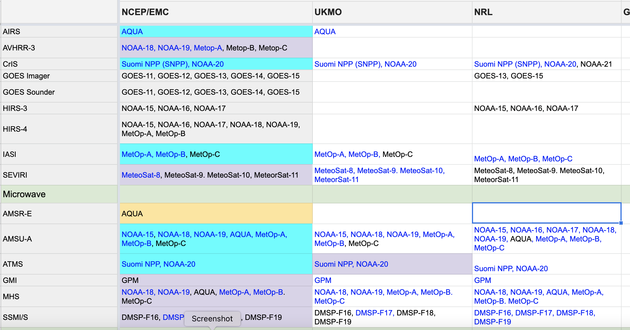
Joint efforts
Active development from other partners, including UKMO, GMAO, NRL …
New operators and filters are being developed for different observation types
JEDI_GDAS is the first testbed for UFO validation. UFO validations will be performed through other applications
Transition table contributed from JCSDA partners

Slide 13
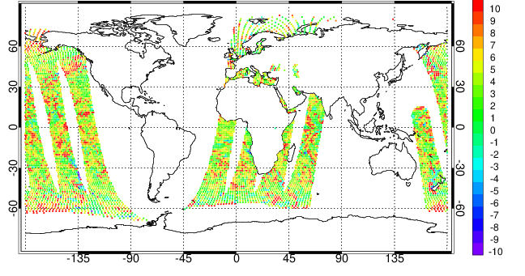
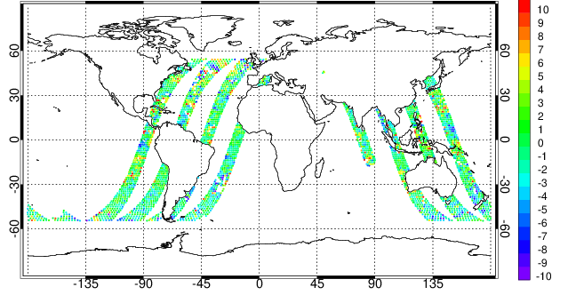
UFO for All Sky Radiance
Updated UFO for AMSR2 and GMI:
Hofx operator
Cloud retrieval function
All-sky observational error assignment function
Quality control procedures
Updated model_2_geoval codes to convert rain and snow clouds and added functions to derive these two clouds’ microphysical properties. These two clouds are needed state and control variables in GEOS all-sky assimilation.
AMSR2 O-F @ 23 GHz
GMI O-F @ 23 GHz
Please refer to the presentations from other agencies for additional information about JEDI/UFO development
JEDI/UFO outputs: (top) AMSR2 and (bottom) GMI O-F (K) values, after QC but without bias correction, at the channel of 23 GHz at 00 hr, Nov 15, 2020.
(Jianjun Jin, GMAO)

Slide 14
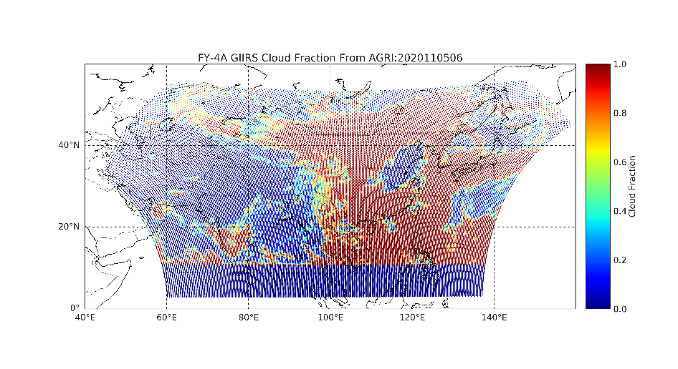
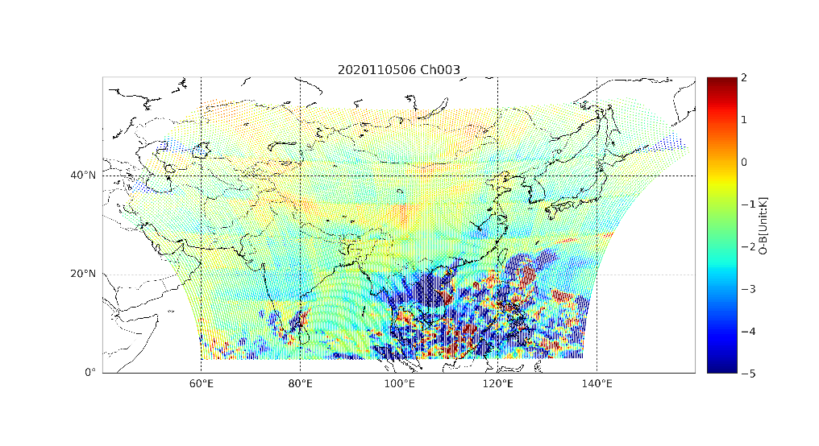
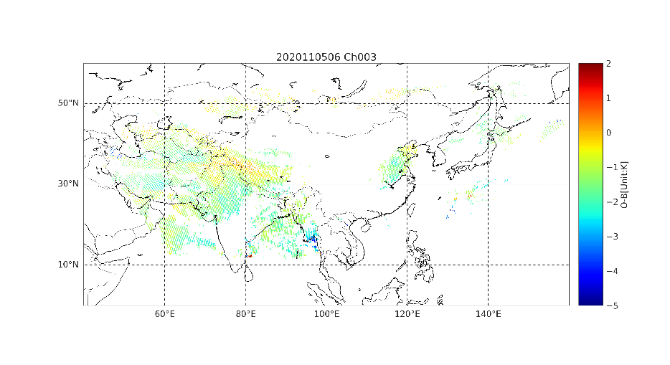
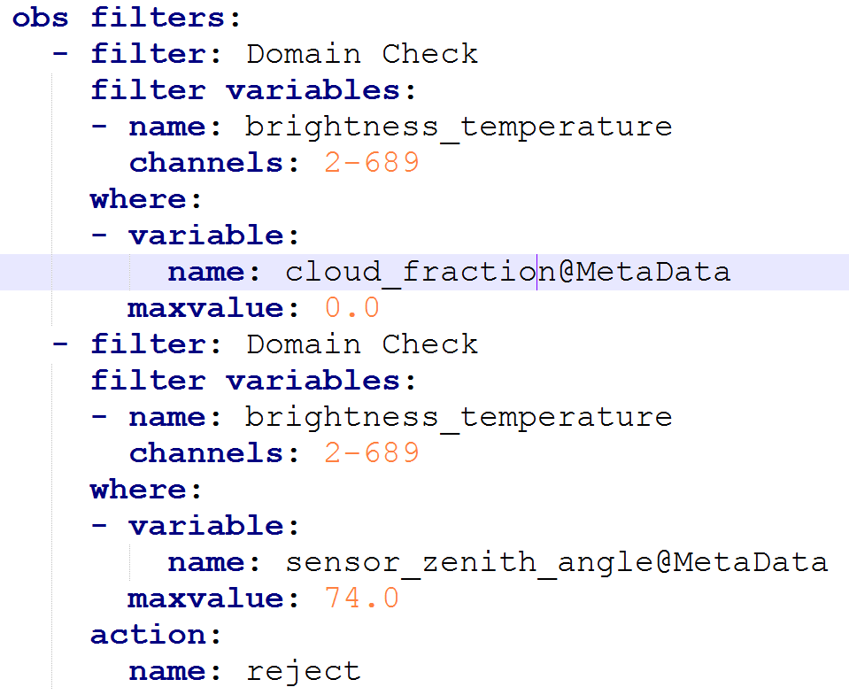
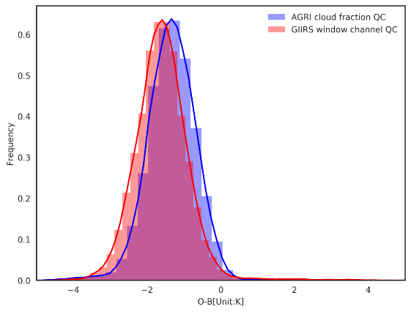
Exploring Geostationary Hyperspectral Sounders
GIIRS LW Ch3 Wn=712.5cm-1
06Z 5th November 2020
Cloud Fraction
Obs-HoFx (ch3)
GIIRS YAML Using a general filter in JEDI
Obs vs HoFx (ch3) with cloud detection QC
(Wei Han)

Slide 15
Shared UFO Capabilities
Generic implementations allows flexibility to switch between operators/QC procedures through configuration files and, therefore, optimize the performance of UFO
Original scheme from reference
Available UKMO scheme from UFO
O-B (hPa)
Surface pressure simulation vs Obs

Slide 16
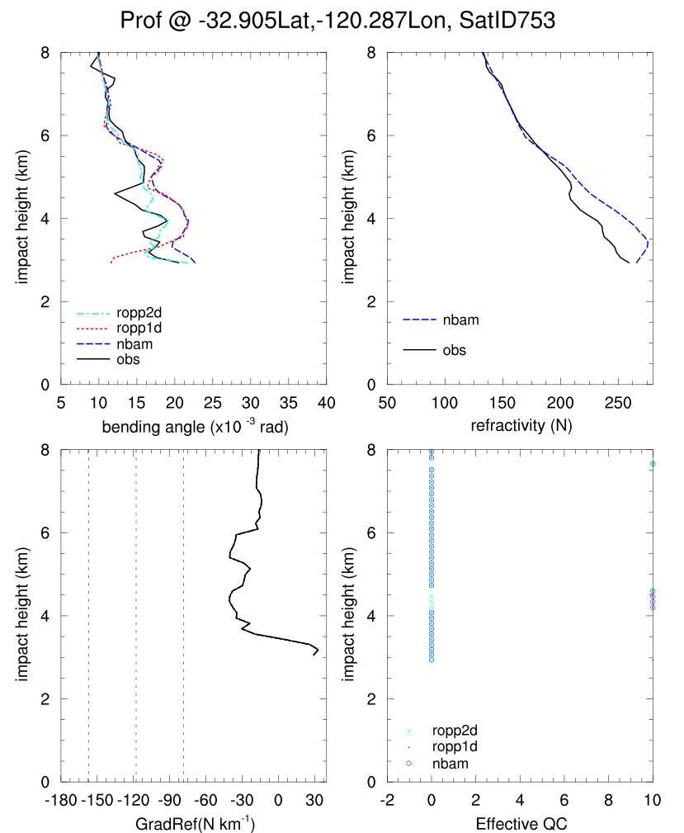
Cross Validation and Comparison
For some observation types, UFO has multiple operators and QC options following operational implementations at various centers
Comparison for operational capabilities is possible under the same framework
Bending angle
Refractivity
OBS
QC flags
COSMIC-2 data are simulated using three operators from UFO:
NBAM (NCEP GSI),
ROPP 2D (ECMWF)
ROPP1D (NRL)
using the same FV3 background (UKMet operator is underway).
Dashed lines: NBAM Super-refraction(SR) check values
Super refraction QC
(Hailing Zhang)

Slide 17
Final Comments
Significant progress has been made for UFO development
H(x) computed in near real time monitoring
H(x), QC, and BC developed to replicate operational capabilities
Ongoing validations for UFO through JEDI application testbed
Next steps:
Development of missing functionalities and additional QC/BC (e.g., bias correction for aircraft, …)
IODA naming conventions and converters
Geoval conventions
UFO for new instruments/sensors (e.g., ground GNSS, all-sky radiance, aerosol…)
Coordinated development with upstream and downstream processing (converters, 4D forward operator, reference baseline, diagnostics, …) and generic UFO framework (obsFunction redefinition, variable transform, …)
UFO for JEDI applications: GDAS, GEOS, regional, SkyLab, …

