Slide 1

Preparation for assimilation of aerosol optical depth data from NPP VIIRS in a global aerosol model
Edward J. Hyer¹
Peng Lynch²
Jeffrey S. Reid¹
Douglas L. Westphal¹
NRL, Monterey, CA
Computer Science Corporation
And the JPSS Aerosol Cal/Val Team

Slide 2
In This Talk
VIIRS Aerosol Product Descriptions
Results from the JPSS Aerosol Cal/Val Team
Data Requirements for Aerosol Assimilation
Preparation of NPP VIIRS products for assimilation
Observations of processed VIIRS data
Conclusions / Prospects

Slide 3
VIIRS Aerosol Products (1)
Aerosol Optical Thickness (AOT)
  for 11 wavelengths (10 M bands + 550 nm)
APSP (Aerosol Particle Size Parameter)
  Ångström Exponent derived from AOTs at M2 (445 nm) and M5 (672 nm) over land, and M7 (865 nm) and M10 (1610 nm) over ocean
  qualitative measure of particle size
  over-land product is not recommended!
Suspended Matter (SM)
  classification of aerosol type (dust, smoke, sea salt, volcanic ash) and smoke concentration
  currently, derived from VIIRS Cloud Mask (volcanic ash) and aerosol model identified by the aerosol algorithm
Only day time data
Only over dark land and non-sunglint ocean

Slide 4
VIIRS Aerosol Products (2)
At NOAA Comprehensive Large Array-data Stewardship System (CLASS):
Intermediate Product (IP)
  0.75-km pixel
    AOT, APSP, AMI (Aerosol Model Information)
      land: single aerosol model
      ocean: indexes of fine and coarse modes and fine mode fraction
    quality flags
Environmental Data Record (EDR)
  6 km aggregated from 8x8 IPs filtered by quality flags
    granule with 96 x 400 EDR cells
    AOT, APSP, quality flags
  0.75 km
    SM
At NOAA/NESDIS/STAR:
  Gridded 550-nm AOT EDR
    regular equal angle grid: 0.25°x0.25° (~28x28 km)
    only high quality AOT EDR is used

Slide 5
VIIRS EDR vs MODIS L2 Aerosol Products
 | Aqua-MODIS | Suomi NPP-VIIRS
Swath Width | 2330 km | 3000 km
Sensor bands used for aerosol retrieval. | 0.411, 0.466, 0.554, 0.646, 0.856, 1.242, 1.629, 2.114 µm | 0.412, 0.445, 0.488, (0.550), 0.555, 0.672, 0.746, 0.865, 1.24, 1.61, 2.25 µm
Pixel size, nadir | 0.5 km | 0. 75 km
Pixel size, edge of scan | 2 km | 1.2 km
Product resolution, nadir | 10x10 km (20x20 500m pixels) | 6x6 km (8x8 750m pixels) (AOT and Angstrom exponent)
Product resolution, scan edge | 40x20 km | 12.8x12.8 km
Compared with MODIS, VIIRS has:
Improved coverage: gap-free daily observation around the globe
  enabled by the wider swath
Improved spatial characteristics Swath-edge pixels are 2x nadir, vs 4x for MODIS
  (but see Polivka poster#352)
Algorithm Differences:
Retrieval of AOD is done at the pixel level: aggregation of AOD values is done to produce the EDR product.
Over-land algorithm (like MOD09 atmospheric correction) retrieves a single aerosol model, a mix of fine and coarse; over-ocean algorithm (like MOD04) retrieves fine and coarse mode properties separately.

Slide 6
VIIRS Aerosol Resources
Two peer-reviewed publications
  Jackson et al. JGR 2013
  Hongqing Liu et al. JGR in review
NOAA VIIRS Air Quality Workshop: http://alg.umbc.edu/aqpg/viirs_workshop/
  Many useful talks, special notice to talk by Rohit Mathur (EPA) on satellite products and AQ models
VIIRS aerosol user’s guide and fully revised ATBD (technical description): http://www.star.nesdis.noaa.gov/smcd/emb/viirs_aerosol/documents.php

Slide 7
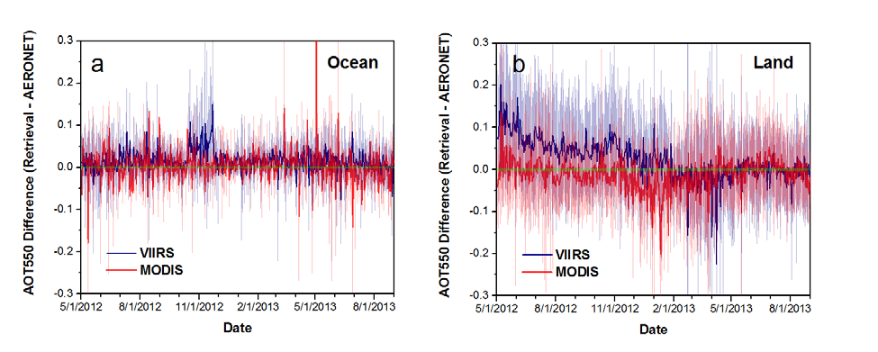
VIIRS Aerosol Cal/Val
AERONET sun photometers are the gold standard
  Accuracy and precision exceed what is expected even from the best satellite products
  Data should not be used uncritically in regions with thin cirrus (Chew et al. Atm. Env 2011; Huang et al. JGR 2011)
Right: time series of AERONET vs VIIRS AOD (blue) and MODIS-Aqua C5 AOD (red) over ocean (top) and land (bottom).
  Evolution of VIIRS algorithm (blue) can be seen
  MODIS Collection 5 (red) and VIIRS have similar accuracy after 1/24/2013
Hongqing Liu et al., JGR in review

Slide 8
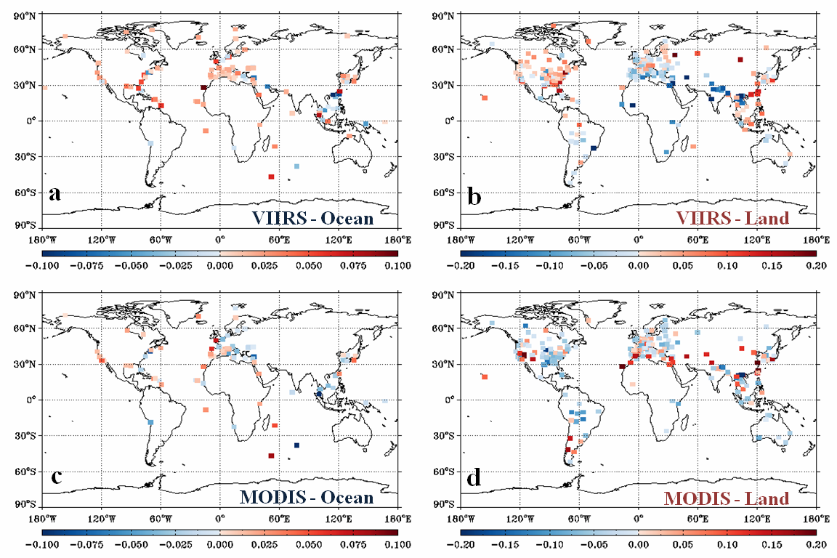
VIIRS Aerosol Cal/Val
Right: geographically, VIIRS and MODIS ocean retrievals have similar errors vs AERONET
Pattern of biases over land is very different for VIIRS vs MODIS Collection 5
Note: MODIS Collection 6 (now in production) will have reduced biases over land
Hongqing Liu et al., JGR in review

Slide 9
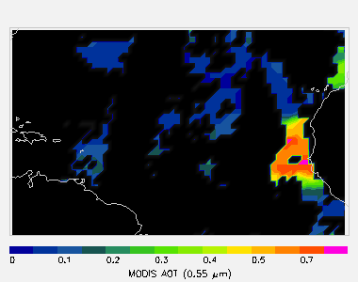
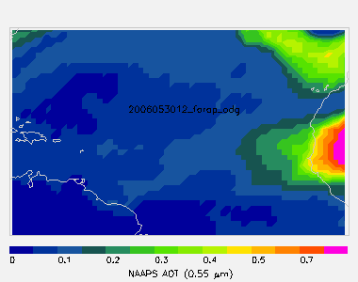
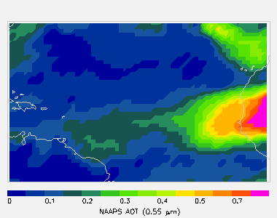
Navy Global Aerosol Forecasting
MODIS RGB
MODIS AOD
Navy Aerosol Analysis and Prediction System (NAAPS) operational since 2005
Navy Variational Data Assimilation System for AOD (NAVDAS-AOD) Operational at FNMOC from September 2009 (MODIS over ocean)
Global MODIS is assimilated operationally as of February 2012
J.L. Zhang et al., “A System for Operational Aerosol Optical Depth Data Assimilation over Global Oceans”, JGR 2008.
NAAPS “Prior”
NAAPS + NAVDAS

Slide 10
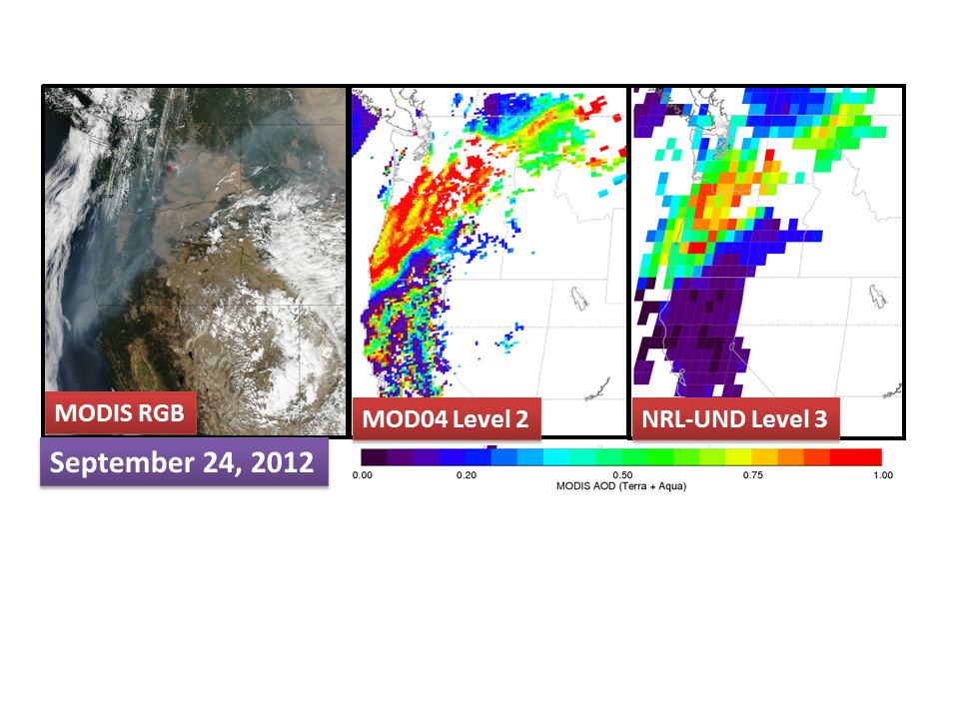
Preparation of Satellite Data for Assimilation
Level 2 MOD04 (NASA) or VAOOO EDR (JPSS) data is generated by upstream data centers – spatial resolutions of a few km
14 April 2011
Hyer ISRSE34 Sydney
10 of 25
Notes:
10

Slide 11
Preparation of Satellite Data for Assimilation
AOD data process developed by NRL and UND, includes
Aggressive cloud filtering
Ocean wind speed correction
Land albedo correction
land surface and snow filters
Microphysical AOD bias correction
0.5 degree product distributed to public via NASA LANCE (MxDAODHD)
This is the process developed for MODIS Collection 4&5
How much pre-processing will be required for Suomi NPP VIIRS?
14 April 2011
Hyer ISRSE34 Sydney
11 of 25
Notes:
11

Slide 12
NPP VIIRS pre-processor
1-degree, 6-hour
  Operational NAAPS now 1/3°, 1° used for testing
“fullQA” uses information packaged with EDR granules
  QA = ‘Good’ (highest EDR QA value)
  Cloud mask, cloud proximity, snow flags, glint flags
  No textural filtering (this is a cal/val experiment, not an operational candidate)
Results shown using 12 months of data
  2013.01.24.00 to 2014.01.12.00

Slide 13
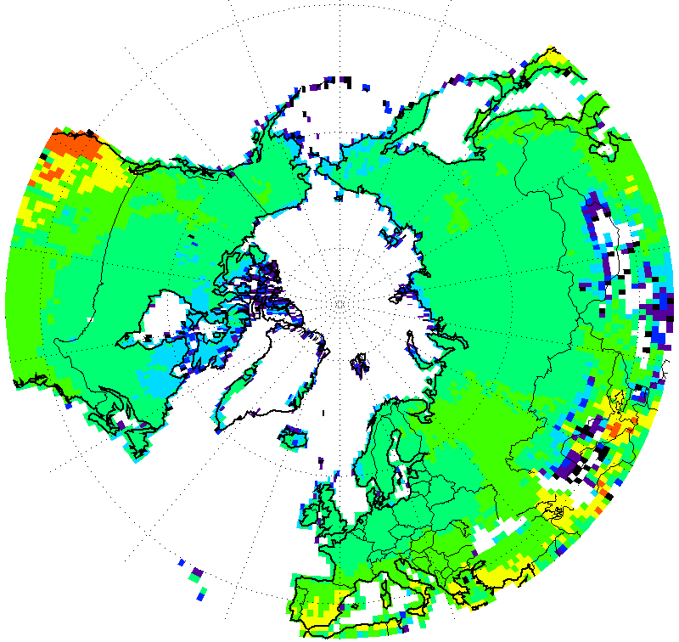
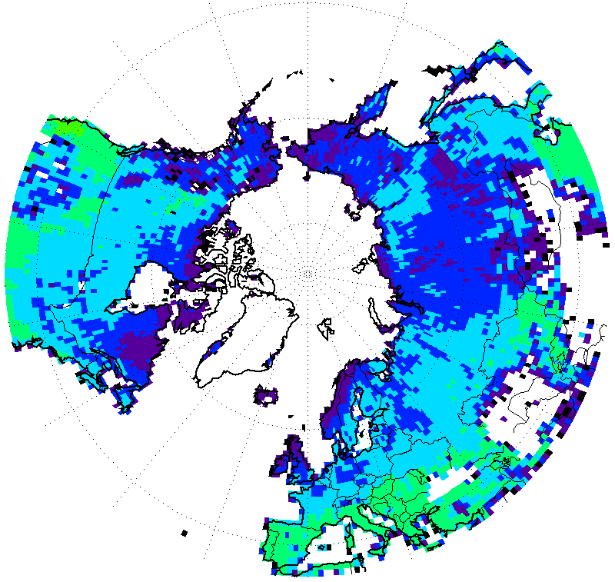
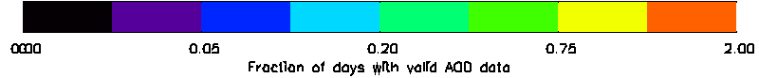
VIIRS ‘fullQA’ coverage vs
NRL-UND Level 3 MODIS-- Land
NPP VIIRS
MODIS AQUA
NPP VIIRS
MODIS AQUA
  NRL/UND Level 3 MODIS is stringently filtered
  VIIRS potentially delivers much more data vs 1 MODIS
    Almost as much as 2 MODIS

Slide 14
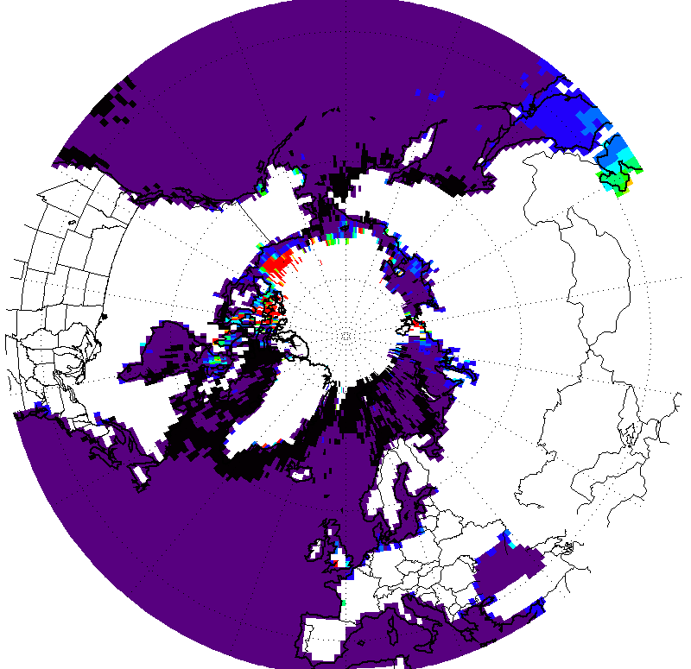
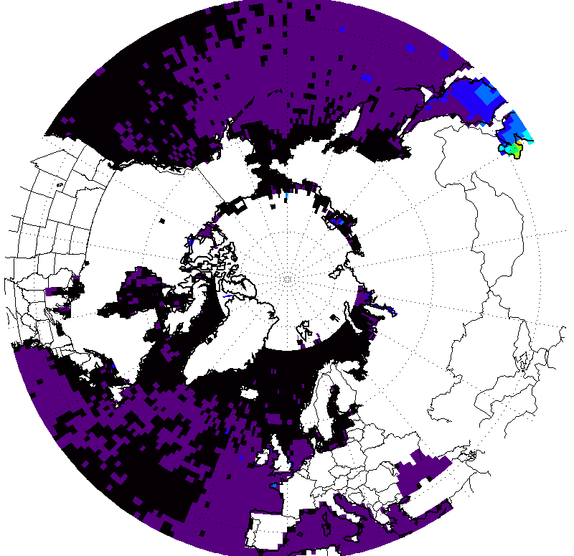
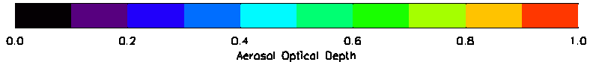
VIIRS ‘fullQA’ AOD vs
NRL-UND Level 3 MODIS-- Ocean
NPP VIIRS
MODIS AQUA
  Anomalous high AOD in polar regions
    Sea ice problem, cal/val team is researching a fix
  VIIRS background AOD is noticeably higher (+0.05)
  Asian outflow feature is similar

Slide 15
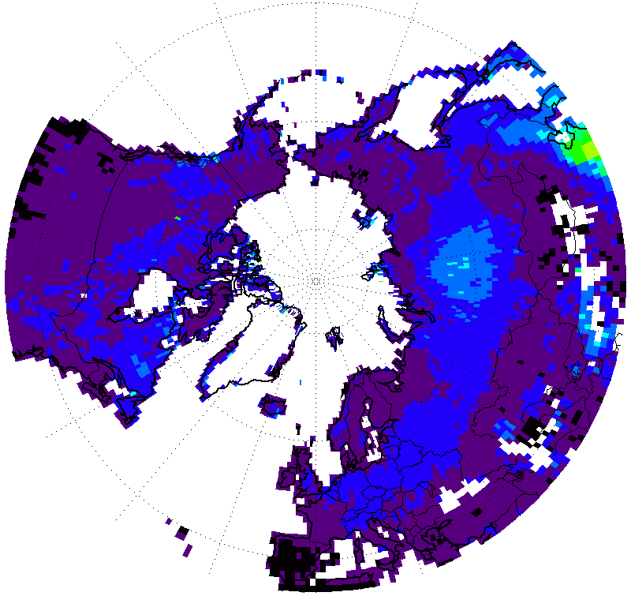
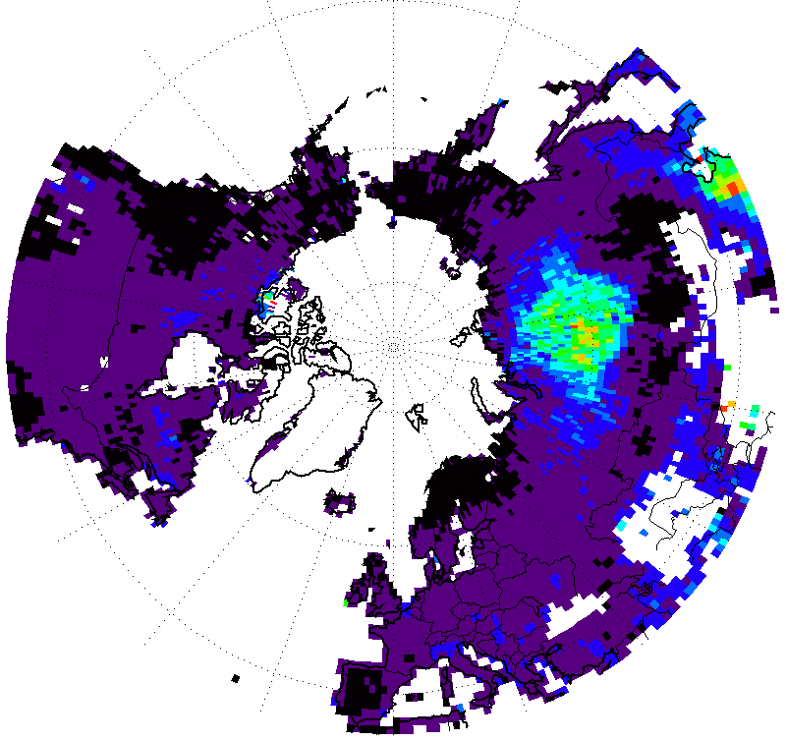
VIIRS ‘fullQA’ AOD vs
NRL-UND Level 3 MODIS-- Land
NPP VIIRS
MODIS AQUA
  VIIRS AOD is generally higher in low-AOD areas, lower near sources
  VIIRS ‘fullqa’ has AOD data in areas filtered from NRL/UND Level 3
    E.g. Himalayas

Slide 16
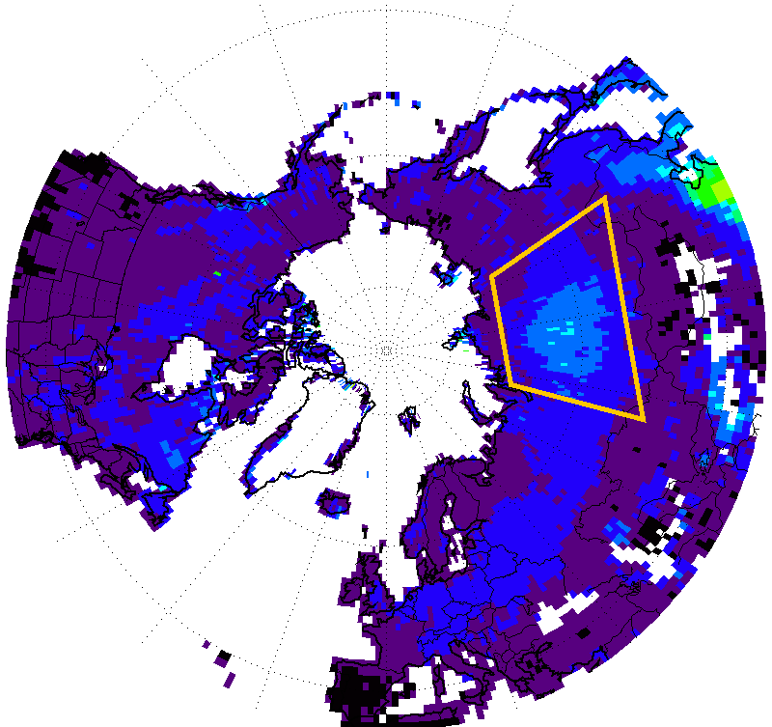
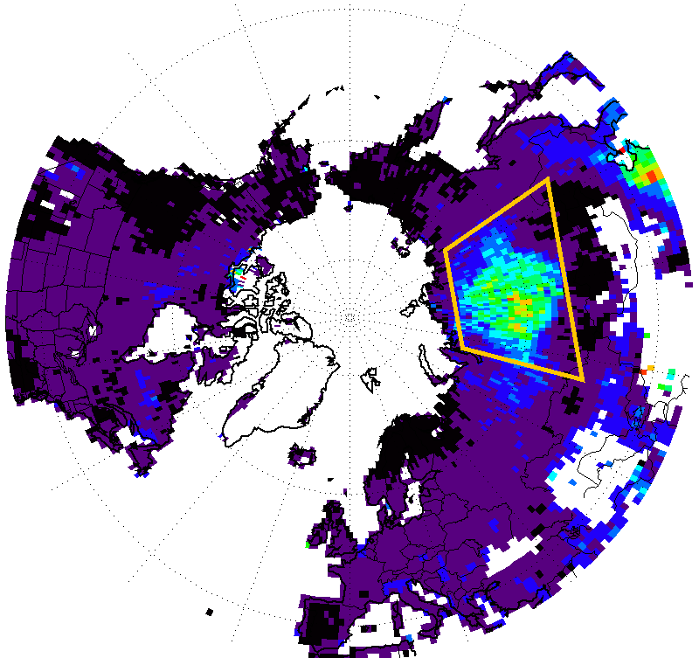
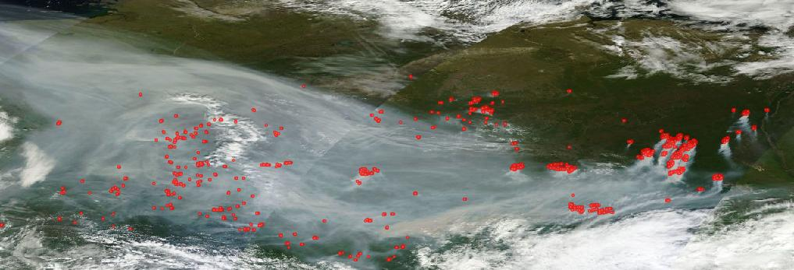
VIIRS vs MODIS– Near Sources
NPP VIIRS
MODIS AQUA
  NASA LANCE Worldview
  MODIS Aqua 3 August 2013
  Massive midsummer Siberian fires
  Episodic, intense plumes
  Signal in VIIRS is much lower than MODIS

Slide 17
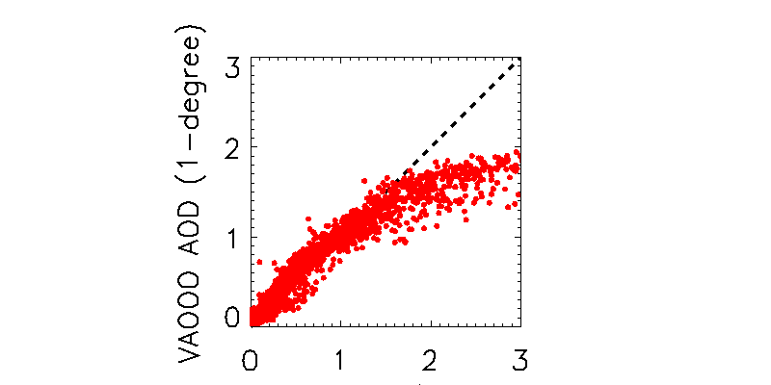
VIIRS vs MODIS– High AOD
Exclusion in EDR leads to truncation in aggregate
IDPS VIIRS Aerosol algorithm does not retrieval optical depths above 2
This results in a truncation effect on averaged data
NPP VIIRS 1°AOD
MODIS-Aqua
NRL/UND1°AOD
NPP VIIRS
MODIS AQUA
  Data in region shown from 2013.07.23 to 2013.08.23
  Suomi NPP VIIRS ‘fullqa’ vs MODIS-Aqua C5 NRL/UND L3

Slide 18
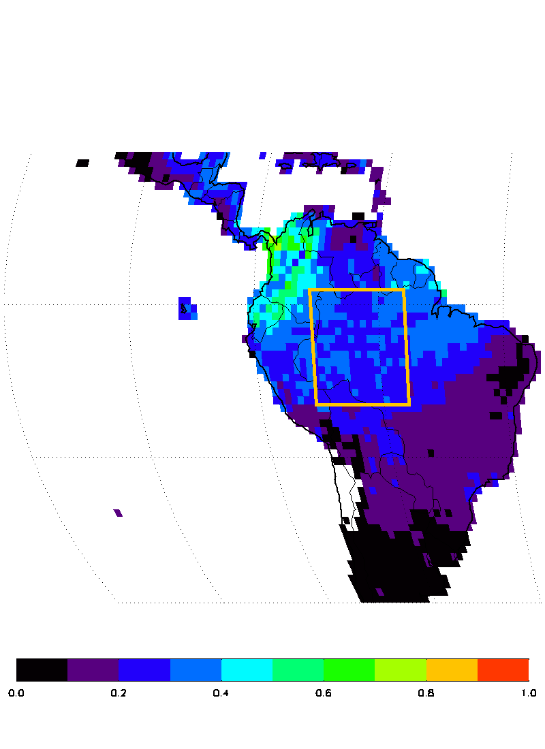
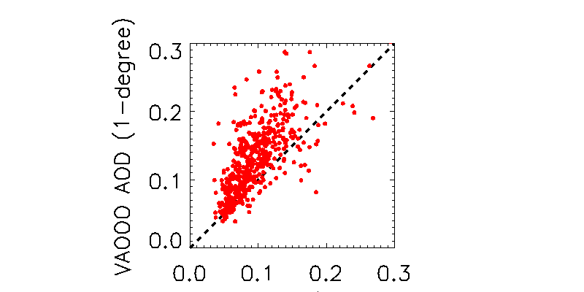
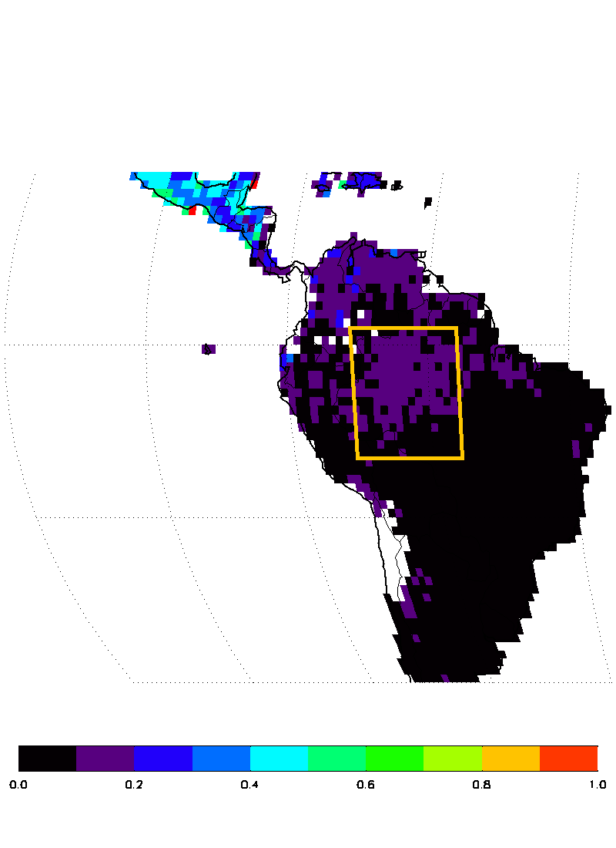
VIIRS vs MODIS AOD– Low AOD
Truncation effect over land
  Data in region shown from 2013.05.01 to 2013.08.01
  MODIS-Aqua retrieves negative AODs (down to -0.05) over land
  NRL/UND post-processing averages with negatives, then truncates to minimum value
MODIS-Aqua
NRL/UND1°AOD
NPP VIIRS 1°AOD
  VIIRS IDPS Processing discards negative AOD values
  Truncation effect after averaging

Slide 19



Results and Next Steps
NPP VIIRS AOD requires additional filtering of EDR to improve analysis and forecast
Cal/Val Team has further improvements to over-land AOD data underway
Additional analysis of over-ocean VIIRS AOD data is needed
  See Jianglong Zhang’s poster #708 on clouds in MODIS, MISR
Thank you to sponsors: JPSS, NASA AQAST, NRL

