Slide 1
Preparing a Satellite for Assimilation Benjamin Ruston Steve Swadley, Nancy Baker, Rolf Langland NRL, Monterey, CA

Slide 2
Outline
Gather information about instrument:
What are previous sensors or instruments, how have they been used?
Decode and preparation:
What is the format of the incoming data?
Are there redundant data streams?
What gross quality control and data thinning is to be applied?
Simulation
What radiative transfer model is to be used?
What surfaces should be considered?
Evaluation
What are the statistics of the observed minus background?
What is the impact on other instruments?
What is the impact on the forecasts?

Slide 3
Gather Information
CrIS
The CrIS instrument launched Oct2011, one of the more recent satellite sounder additions to NWP systems
Gather information about instrument
Decode and preparation
Simulation
Evaluation

Slide 4
IRIS-D (Nimbus 4)
~400 channels (400 – 1500 cm⁻¹)
Nimbus 4 satellite (1970-1980)
IRIS-D operated 1970-1972
Non scanning, i.e. pencil-beam
Interferogram every 13-seconds
95km resolution at NADIR

Slide 5
AIRS (NASA-Aqua)
2378 channels
Aqua satellite (4 May 2002)
Data received is 324 subset of full channel set
Data is collocated and remapped to AMSU-A footprint
1650km wide swath
30 FOR, 9 FOV
+/- 48.95 scan angle
13.5km at NADIR
21.4 x 41km at edge of swath

Slide 6
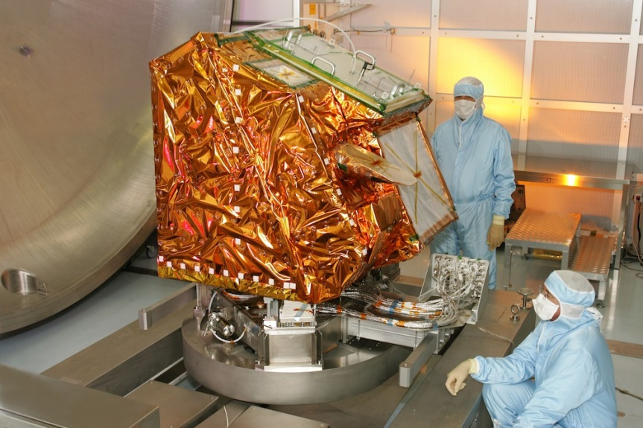
IASI (MetOp series)
8461 channels
Receive a 616 channel subset
Satellites
MetOp-A (19 Oct 2006)
MetOp-B (17 Sep 2012)
2130 km wide swath
30 FOR, 4 FOV
+/- 48.33 scan angle
12km at NADIR
20 x 39km at edge of swath

Slide 7
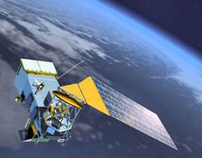
CrIS (SNPP, JPSS series)
1305 channels
Data received is 1317 unapodized channels (1305 apodized)
Data sampled to 399 NESDIS subset for CRTM
Suomi-NPP satellite (28 Oct 2011)
2200 km wide swath
30 FOR, 9 FOV
+/- 48.33 scan angle
14km at NADIR
~24 x 46km at edge of swath
Update to full resolution
2211 apodized channels
Only affected mid- and short-wave
long-wave band (LWIR):
spectral range: 9.14 - 15.38µm
mid-wave band (MWIR):
spectral range: 5.71 - 8.26µm
short-wave band (SWIR):
spectral range: 3.92 - 4.64 µm

Slide 8
Hyperspectral Sounder NWP Use
IRIS-D
Assimilated by ECMWF reanalysis
AIRS
1st hyperspectral sounder widely assimilated: ECMWF, NCEP, UKMO, EC, FNMOC, …
Good noise performance in shortwave
IASI
Two instruments now in orbit assimilated by: ECMWF, NCEP, UKMO, EC, FNMOC, …
Lower noise in longwave channels than spectrometer; shortwave not assimilated
Correlated error now becoming operational: UKMO (water vapor only)
CrIS
Now operationally assimlated at: NCEP, UKMO, and EC
Even lower noise than IASI for longwave channels

Slide 9
Decode and Preparation
CrIS
The target system will be reflected in the decisions made while preparing data for assimilation
Gather information about instrument
Decode and preparation
Simulation
Evaluation

Slide 10
Navy’s Data Assimilation Tools
NRL Coupled Ocean Data Assimilation System Multivariate Analysis of ocean u,v,T,s,ice,SSH,SWH. Global, Regional, Local Ocean Data Assimilation.
NCODA
NRL Atmospheric Variational Data Assimilation System 3D Variational Analysis, Observation Space. Global, Regional, or Local Application.
NAVDAS
NAVDAS Accelerated Representer 4D Variational Analysis, Weak Constraint, Model Space. Global or Regional Application. High Altitude DA.
NAVDAS-AR
ADJOINTS
NAVDAS(–AR) Adjoints of 3D & 4D Data Assimilation Systems NOGAPS TLM; Moist Adjoint COAMPS®TLM; Moist Adjoint, including explicit moist physics
NAVDAS-Adjoint OBservation Monitoring System Real-time monitoring of all data assimilated. Identification of observation quality problems. Real-time data selection and data targeting.
NAVOBS
Ensemble
DA
Ensemble Kalman Filter Algorithm Testing for COAMPS® using real observations. EnKF/4DVAR Hybrid for the NAVDAS-AR framework.

Slide 11
Ingest
Where is the data coming from, what is the format?
Option #1:
HDF5 (557th weather wing [formerly AFWA], NOAA)
Unapodized radiance spectra converted from interferogram
Data and geolocation are in separate files, files are in 30-second granules
Full spatial and spectral resolution
~13Mb per data file, total of ~40Gb/day
Option #2:
BUFR (NOAA-NESDIS-OSPO NUCAPS-C0399)
Apodized radiance spectra (Hamming)
Data and geolocation in single file, files in 30-second granules
Thinned spatially (all FOV per FOR) and spectrally (399 of 1305 channels)
~1Mb per data file, ~2.8Gb/day

Slide 12
Ingest
Option #1 was selected, due to the ability to test channels outside the 399 subset, and test other apodization strategies.
Considerations: storage, all processing should begin with MPI
Option #2 has been used to verify the apodization, and conversion to brightness temperature (Planck function).
During apodization the channel radiance is multiplied by a function which in effect smooths the spectrum (Barnet et al., 2000). Unapodized spectra have distortions which cause complications for radiative transfer using channel averaged transmittance functions.
One consequence of apodization is that the noise becomes correlated among neighboring channels.

Slide 13
Pre-processing
Data integrity:
is data record and matching geolocation complete
Data quality flags
calibration, moon intrusion, … consult developer other users
Independent data quality flags (often from collocated data source)
sun glint, sea-ice, terrain
Physical reality check
Brightness temperature
Geolocation
Time
Angles (satellite and solar zenith and azimuth)
Data thinning
Geospatially (horizontal correlation generally assumed to be zero)
Temporally (is the system 3D-Var or 4D-Var, what is window)
Spectrally (smaller volume to process; radiative transfer significantly faster)

Slide 14
Pre-processing Example: ATMS
ATMS Spatial Smoothing Effects on OB-BK StDv
DTG: 2012070412
Channel | Full Res | 3x3 Boxcar | Gaussian σ=25km | Gaussian σ=36km | Gaussian σ=50km
7 | 0.43 | 0.37 | 0.36 | 0.36 | 0.37
8 | 0.36 | 0.29 | 0.30 | 0.30 | 0.31
9 | 0.45 | 0.38 | 0.38 | 0.38 | 0.39
10 | 0.46 | 0.32 | 0.33 | 0.32 | 0.34
11 | 0.56 | 0.33 | 0.33 | 0.32 | 0.33
12 | 0.64 | 0.43 | 0.43 | 0.42 | 0.43
13 | 0.90 | 0.56 | 0.54 | 0.52 | 0.52
14 | 1.24 | 0.72 | 0.69 | 0.66 | 0.65
15 | 2.04 | 1.18 | 1.12 | 1.06 | 1.04
Gaussian Average
Boxcar Average
s: Scan Position, b: Beam position
N = 200* pre-computed closest points
*note: a 100-point filter is used operationally

Slide 15
Simulation
CrIS
The CrIS instrument launched Oct2011, one of the more recent satellite sounder additions to NWP systems
Gather information about instrument
Decode and preparation
Simulation
Evaluation

Slide 16
Radiative Transfer
CrIS
What radiative transfer model to use:
Line-by-line: LBLRTM, kCARTA, ARTS, …
Fast (band) models: RTTOV, CRTM
What conditions will be simulated:
Clear-sky
Cloudy conditions
Aerosol: dust, smoke, seasalt
Chemistry: O₃, SO₂, CH₄, …
Is a Tangent Linear or Adjoint model needed:
Variational methods: generally Yes
Ensemble methods: not necessarily

Slide 17
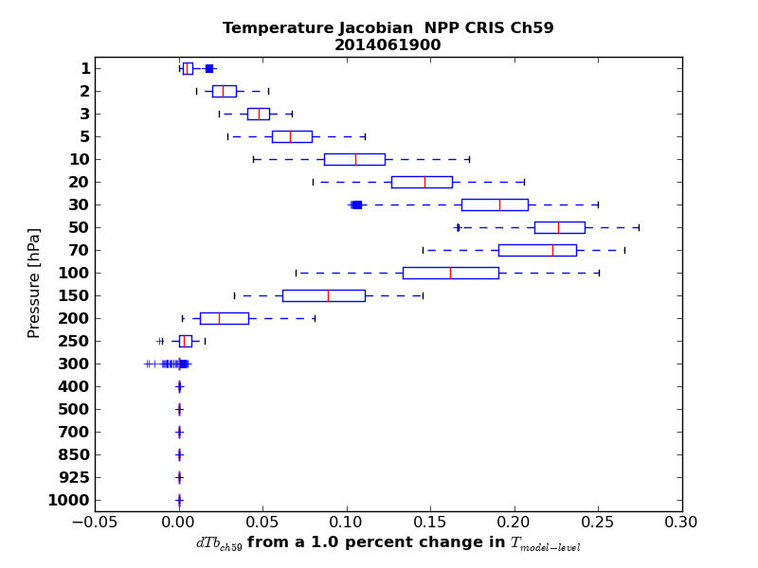
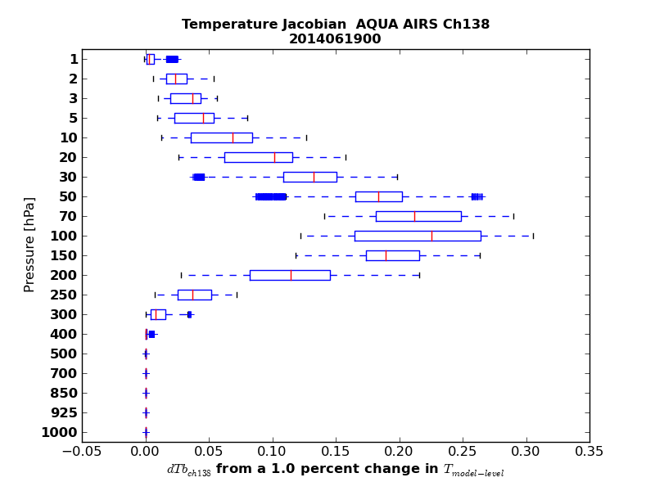
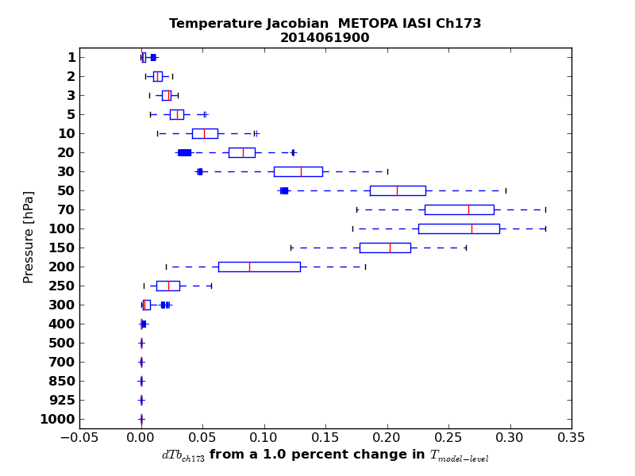
Hyperspectral IR Jacobians
Evaluate CrIS against currently assimilated AIRS and IASI
Jacobians from CrIS were evaluated on channel-by-channel basis

Slide 18
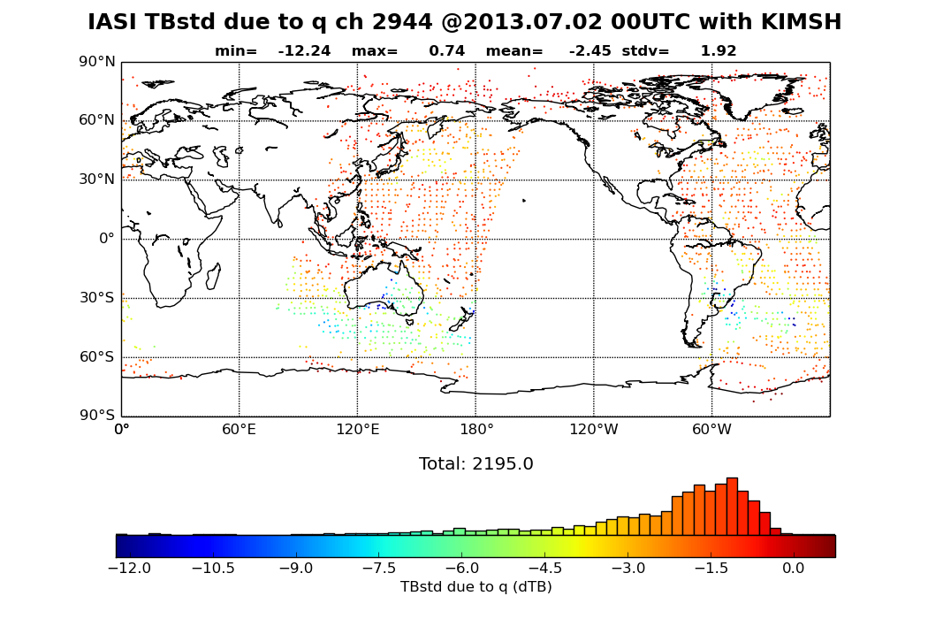
Hyperspectral IR Jacobians
Use a background perturbation to find a ∆T_{B} for each pixel
this is normal -

Slide 19
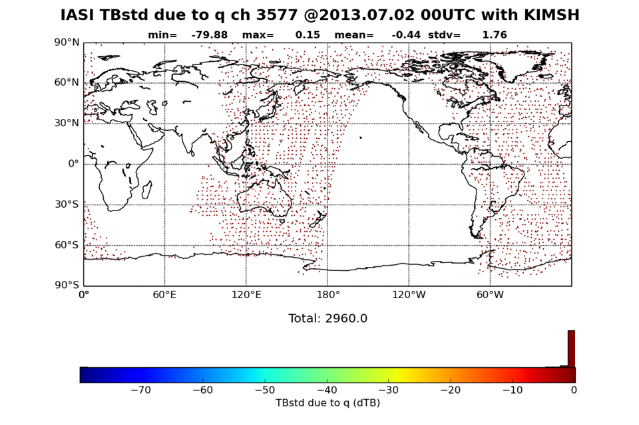
Hyperspectral IR Jacobians
Here the range of the ∆T_{B} due to a background perturbation
has obvious outliers

Slide 20
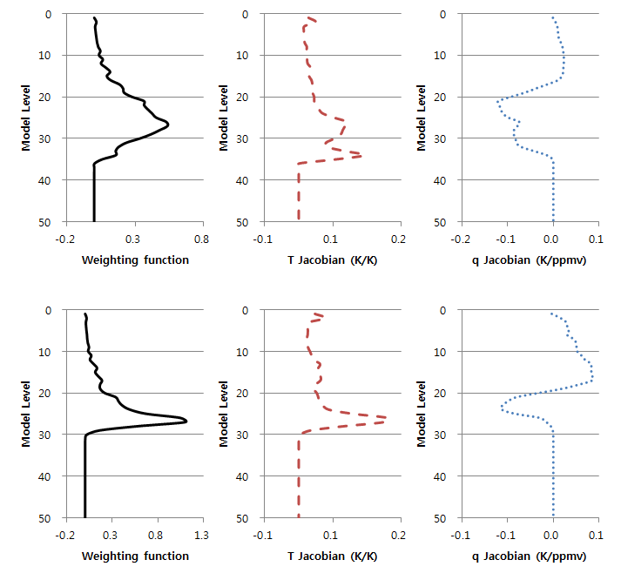
Hyperspectral IR Jacobians
Abnormal Point
Double Peaked
structure in both T and q Jacobian
* near tropopause
Normal Point

Slide 21
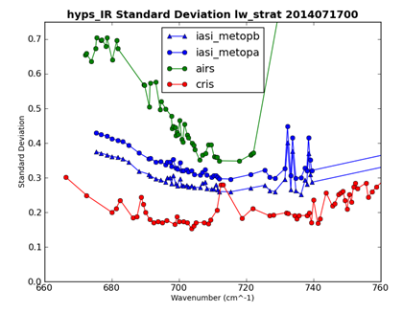
Cloud Detection
Residual analysis: McNally and Watts (2003)
CO₂ slicing: Pavelin et al. (2008); Eyre and Menzel (1989); Susskind (1987); Chahine (1975)
CrIS consistently shows a lower innovation standard deviation than that seen for AIRS or IASI.
This is due in part to the coarser spectral resolution of CrIS

Slide 22
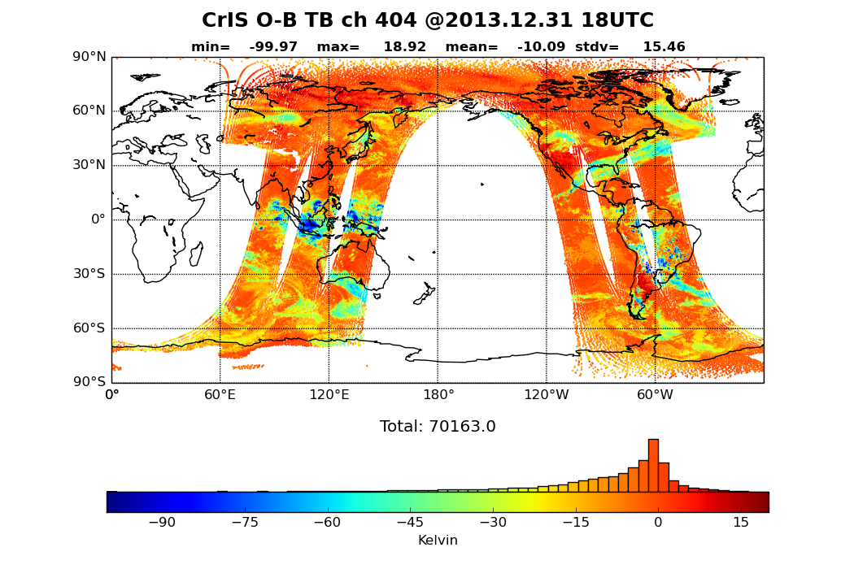
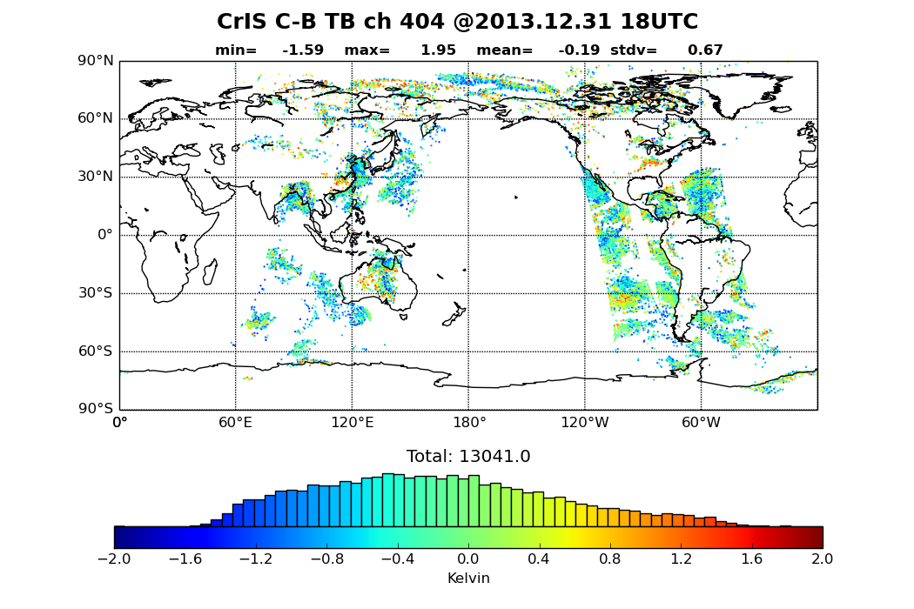
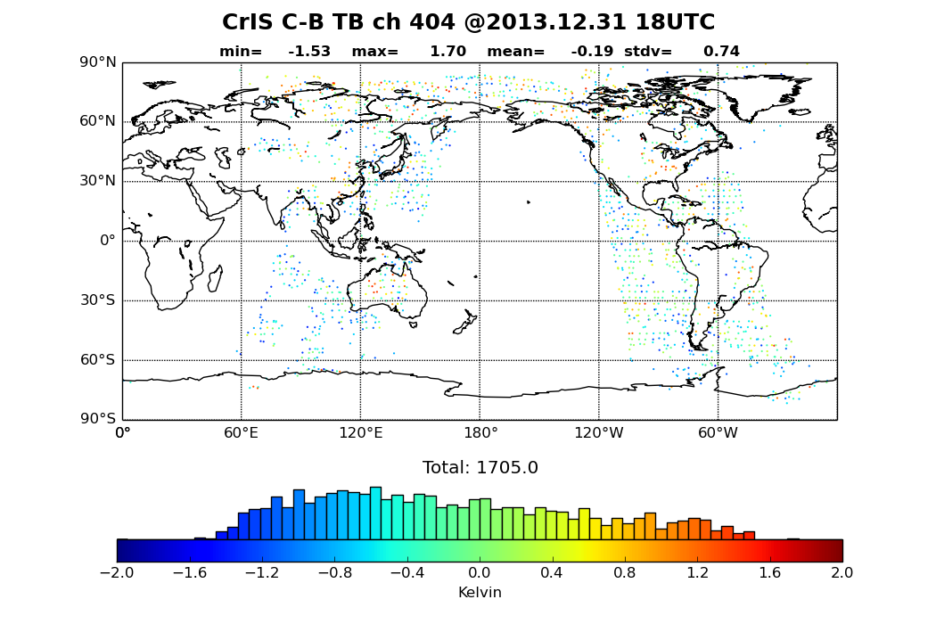
Cloud Detection
6hr raw O-B
6hr clear-sky O_{corr}-B
6hr O_{corr}-B
Clear-sky + thinning

Slide 23
y-H(x_{B}) Analysis
8-day summary for STDV of Innovation for 5x5-degree box
CrIS has very good noise performance in this band

Slide 24
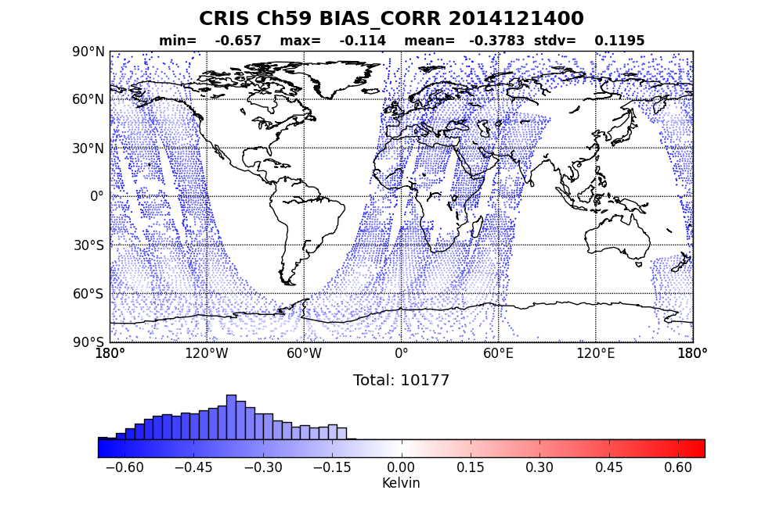
Bias Correction
What predictors should we use?
What channels are being assimilated: CO₂, H₂O, O₃
What method of bias correction: Harris-Kelly, Variational
Typically:
Offset: y-intercept
Atmospheric thickness: 850-300; 200-50; 50-5; 10-1hPa
Scan angle: ɸ, ɸ², ɸ³, ɸ⁴ forces a function onto scan angle predictor
Others: CLW (largely deprecated), orbital angle (seasonal)
What are we correcting?
¡Model bias! must be cautious

Slide 25
Evaluation
CrIS
The CrIS instrument launched Oct2011, one of the more recent satellite sounder additions to NWP systems
Gather information about instrument
Decode and preparation
Simulation
Evaluation

Slide 26
Evaluation
We have an expectation what the instrument should be identifying, e.g. T & q structure
We’ve checked the data for integrity, done gross quality control as well as spatial and spectral thinning
We’ve simulated the data, examined the residuals, done any cloud, dust or other contaminant screening, examined the Jacobians, and performed bias correction
This data is now “assimilation quality”
Evaluate the impact on data assimilation system:
Increments
Fit to other sensors
Evaluate the impact on the forecasts
What metrics? -- 500hPa anomaly correlation; wind vector RMS; fit to radiosonde
Fit to independent analysis and future observations
Other assimilation system diagnostics
Adjoint based (Langland and Baker [2004])
analysis increment based examinations (Desroziers [2005])

Slide 27
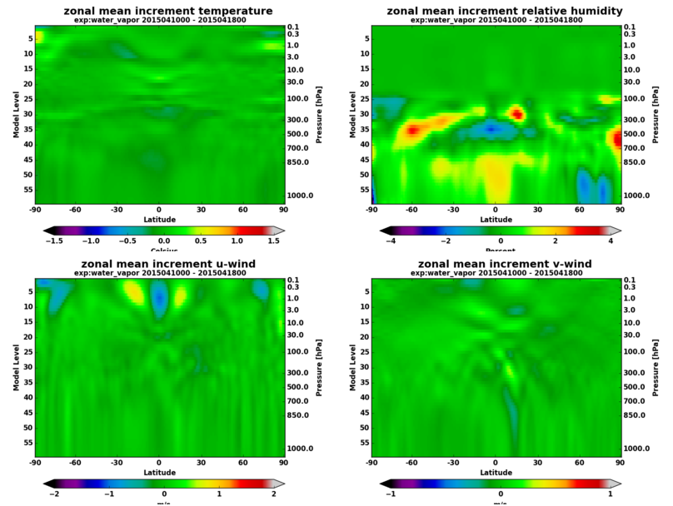
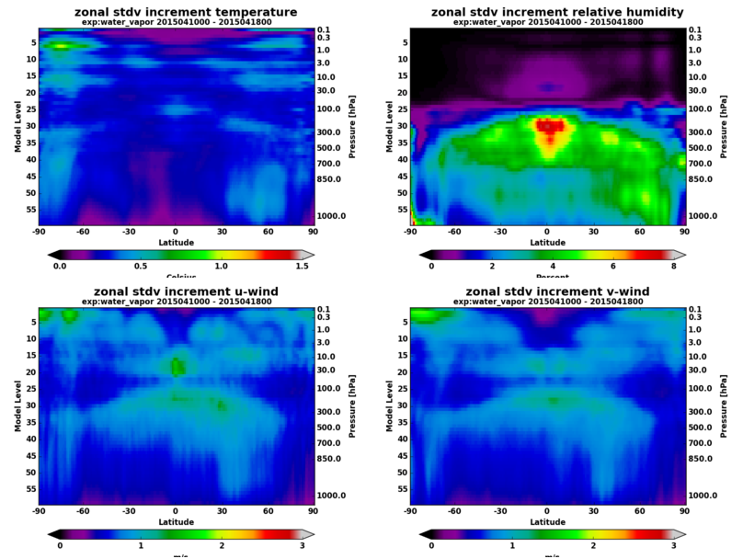
Increments
What do the increments look like in a mean sense?
Are there anomalies or large persistent corrections (model bias)?
How is the increment behaving at the boundaries (model top, poles, surface)?
Zonal Mean
Zonal STDV

Slide 28
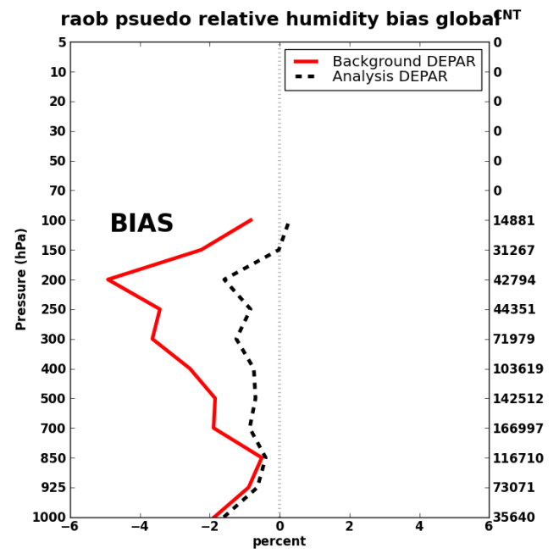
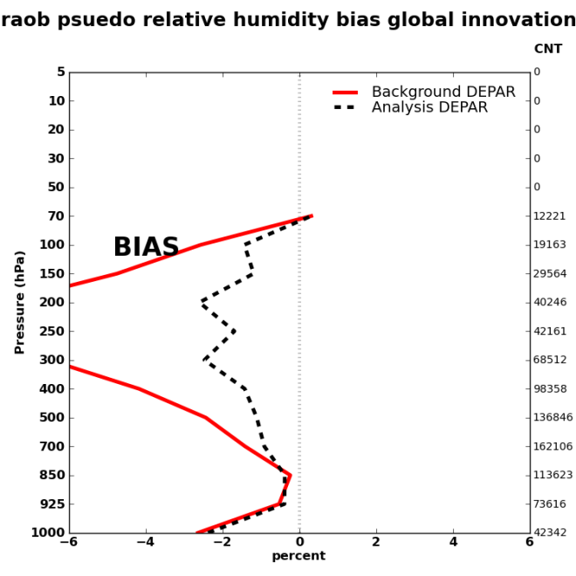
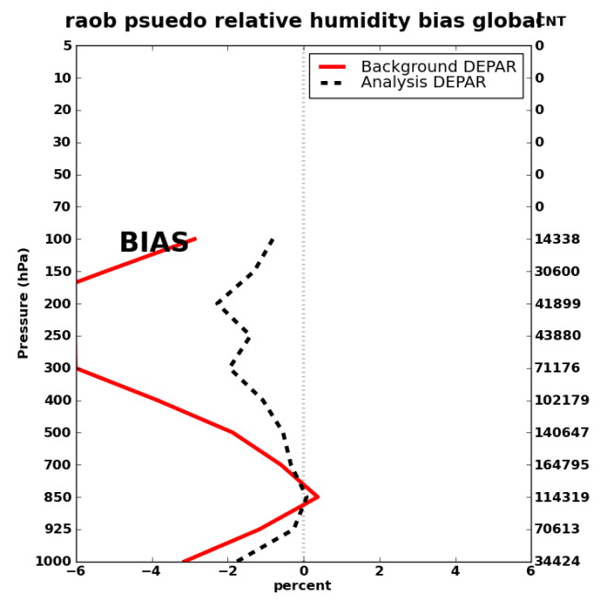
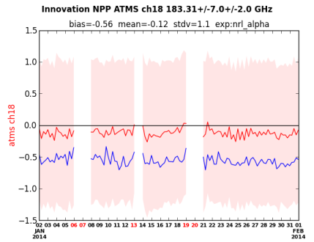
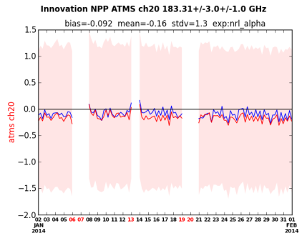
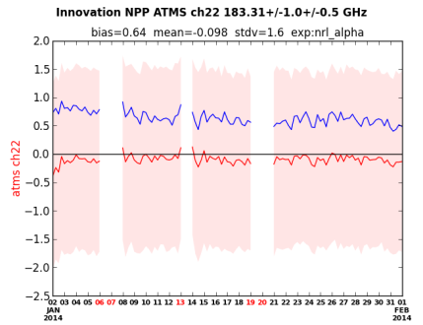
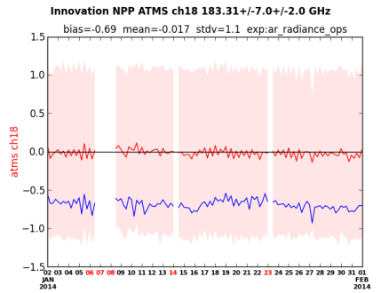
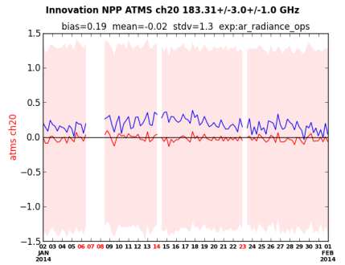
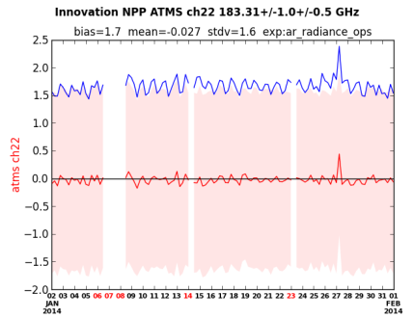
Vicarious (fit to other observations)
Addition of IASI water vapor radiance channel assimilation
reduced radiosonde humidity bias at upper levels
(red and black dashed lines)
NRL-Alpha
01Jan-01Feb,2014
With IR-WV
01Jan-01Feb,2014
FNMOC-OPS
01Jan-01Feb,2014
reduced MW radiance bias in water vapor channels
(Blue Lines in top three images are closer to zero, less bias correction needed)
With IR-WV
Jan
Feb
Adding IR water vapor radiances improves fit to both Radiosonde and MW radiances
FNMOC OPS

Slide 29
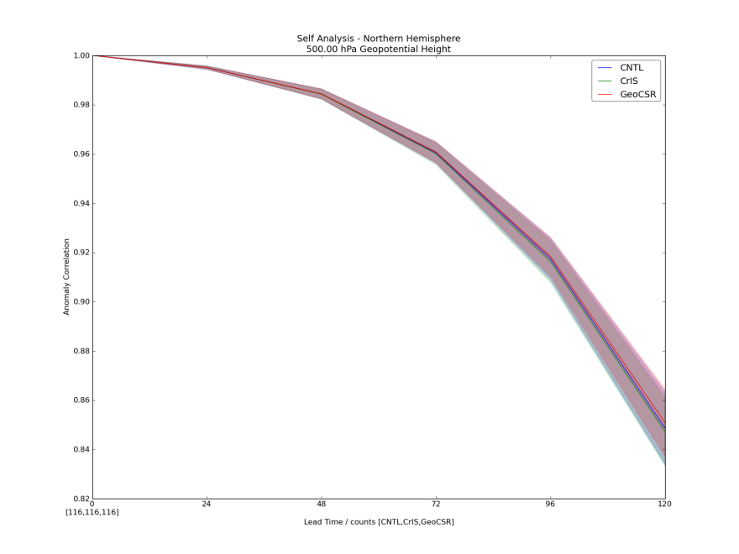
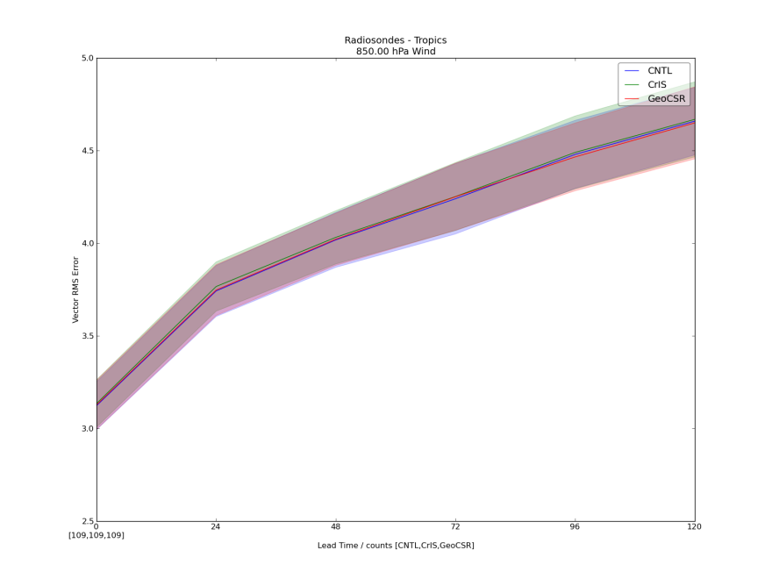
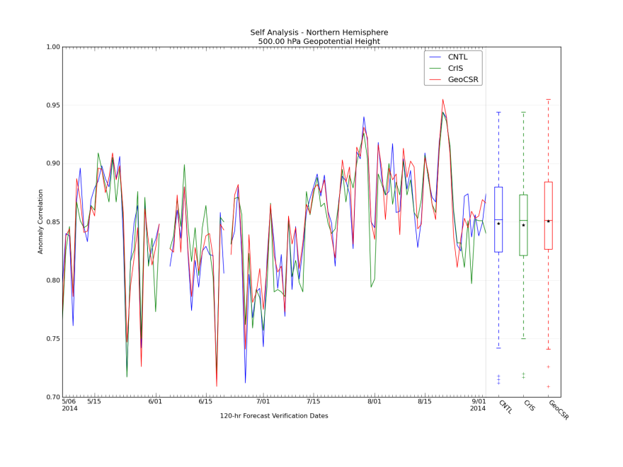
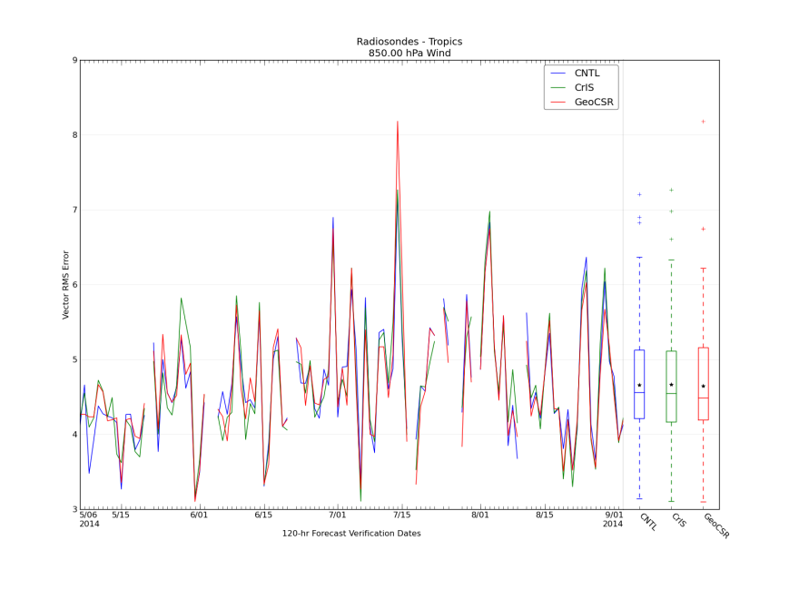
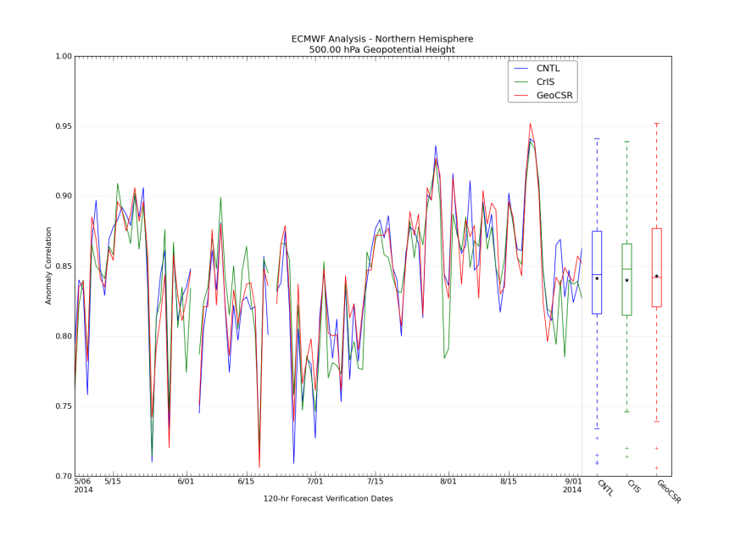
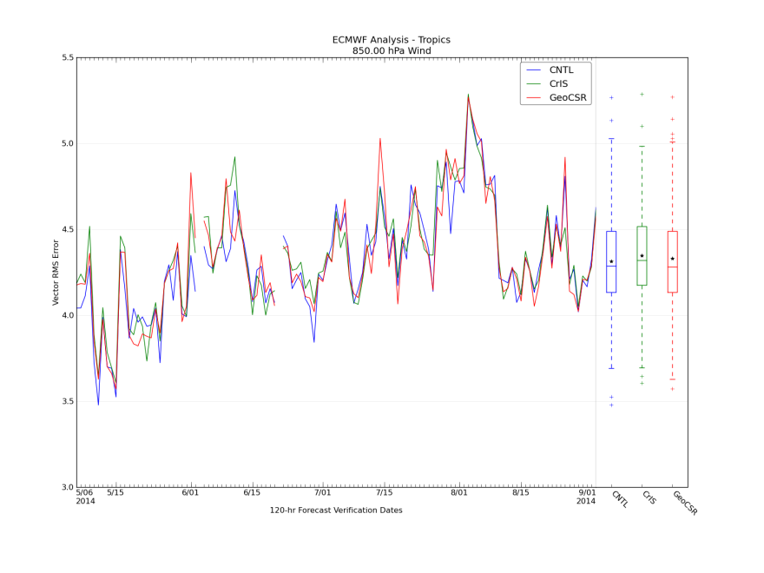
Forecast Metrics
By lead time – often small differences
Differences at 120h – “bust” occurrences
Differences at 120h – independent verifying analysis

Slide 30
Forecast Metrics
“Score Card”
Type | Level | Area | Parameter | Error-Type | Fcst Tau | Weight
Field | Surface | Tropics | Tropical cyclone | Track error | 96 hrs | 4
Field | 500 hPa | N Hem | Height | AC | 96 hrs | 4
Field | 1000 hPa | N Hem | Height | AC | 96 hrs | 1
Field | 500 hPa | S Hem | Height | AC | 96 hrs | 1
Field | 1000 hPa | S Hem | Height | AC | 96 hrs | 1
Field | 850 hPa | Tropics | Wind | Vector RMS | 72 hrs | 2
Field | 200 hPa | Tropics | Wind | Vector RMS | 72 hrs | 1
Field | 850 hPa | N Hem | Wind | Vector RMS | 72 hrs | 1
Field | 200 hPa | N Hem | Wind | Vector RMS | 72 hrs | 1
Buoy | Surface | Global | Wind | Speed Error | 72 hrs | 2
Raob | 850 hPa | Global | Wind | RMS | 72 hrs | 1
Raob | 250 hPa | Global | Wind | RMS | 72 hrs | 1
Raob | 850 hPa | Global | Temperature | RMS | 72 hrs | 1
Raob | 250 hPa | Global | Temperature | RMS | 72 hrs | 1
Raob | 500 hPa | Global | Height | RMS | 72 hrs | 1
Raob | 100 hPa | Global | Height | RMS | 72 hrs | 1

Slide 31
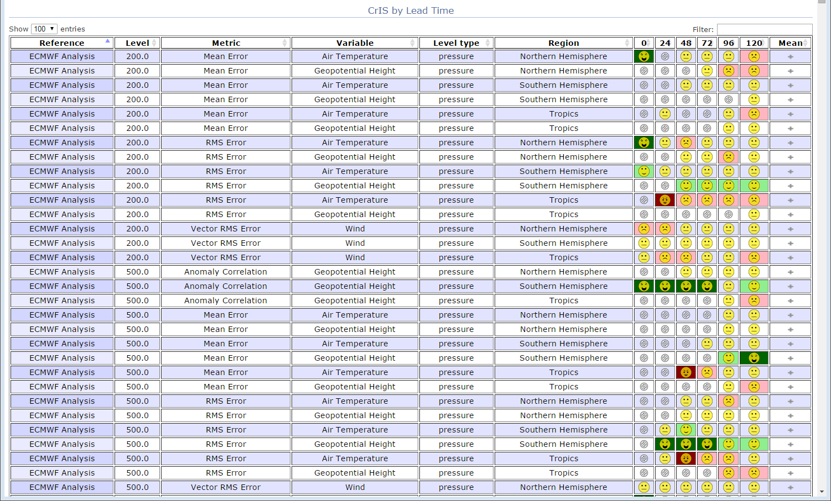
Forecast Metrics
Expand set of parameters, and get more complete “snapshot” of performance

Slide 32
Evaluation: Adjoint-Based Diagnostics
Observations move the forecast from the background trajectory to the trajectory starting from the new analysis
In this context, “OBSERVATION IMPACT” is the effect of observations on the difference in forecast error norms (e_{f}-e_{g})
x_{g}
x_{f}
e_{g}
e_{f}
x_{t}
x_{b}
x_{a}
t= -6 hrs
t=0
t= 24 hrs
6 hr assimilation window
Langland and Baker (Tellus, 2004), Gelaro et al (2007), Morneau et al. (2006)

Slide 33
Evaluation: Adjoint-Based Diagnostics
The impact of observation subsets (e.g., separate channels, or separate satellites) can be easily quantified
Computation always involves entire set of observations; changing properties of one observation changes the scalar measure for all other observations

Slide 34
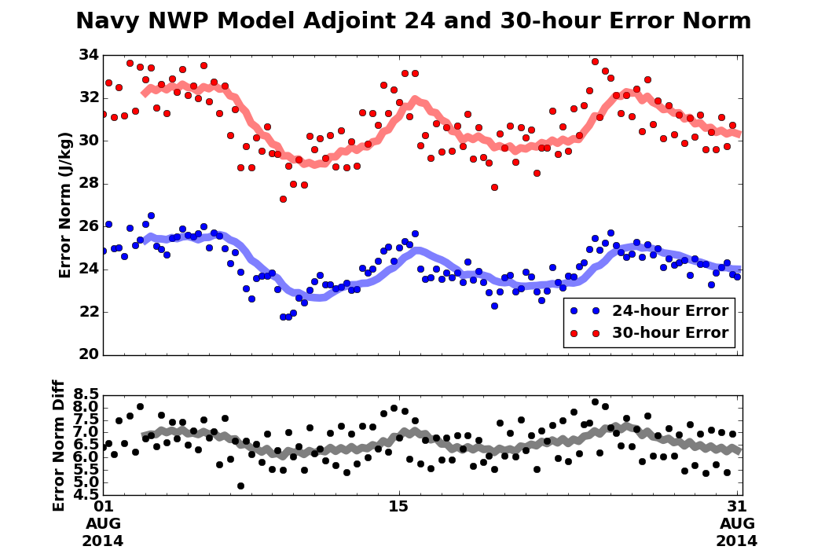
Evaluation: Adjoint-Based Diagnostics
How does the model error evolve?
Examine for anomalies, dropouts, trends, …
30-hr error (e_{g})
24-hr error (e_{f})
(e_{g} – e_{f})

Slide 35
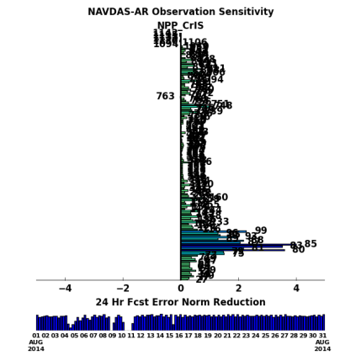
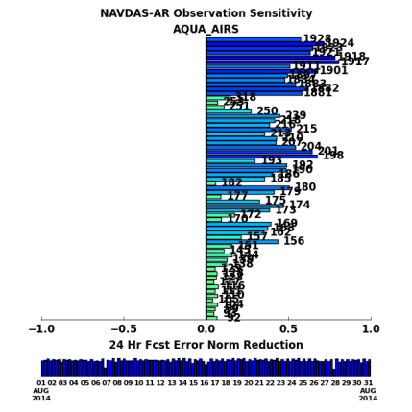
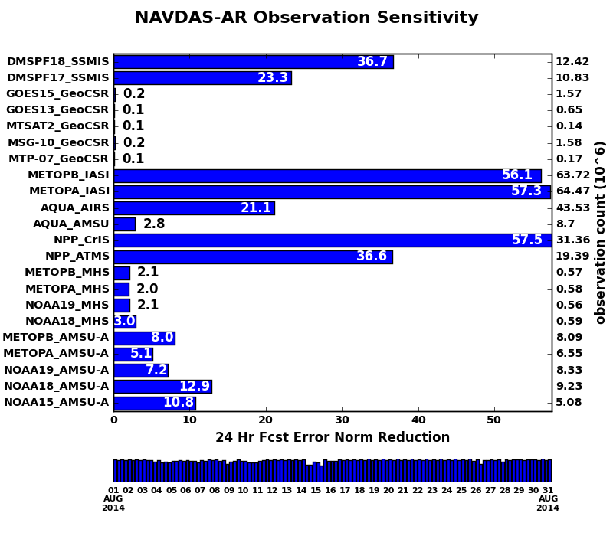
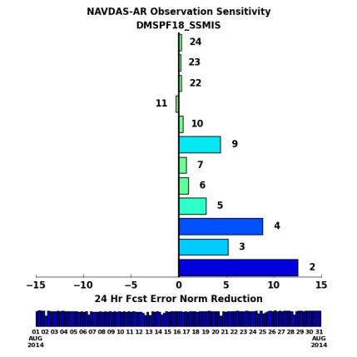
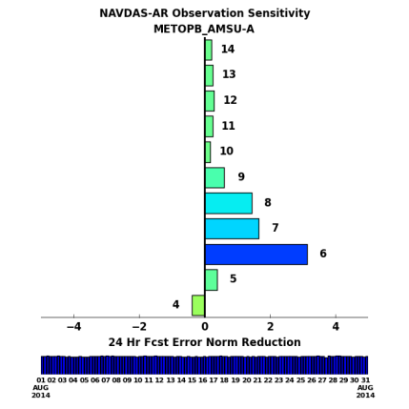
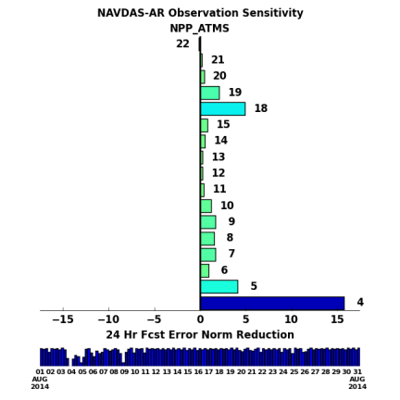
Evaluation: Adjoint-Based Diagnostics
By Channel
For selected instruments
30-day Fcst Error Reduction (IR/MW Sounders)

Slide 36
Evaluation: Departure and Residual Based
Desroziers et al. (2005) developed widely used diagnostics from which it is possible to diagnose a posteriori observation (R), background (B), and analysis (A) error statistics.
d_{b}º = y - H(x_{b})
d_{a}º = y - H(x_{a})
d_{b}ª = H(x_{a}) - H(x_{b})
Also can be used to estimate the off-diagonal terms in the observation error covariance matrix!

Slide 37
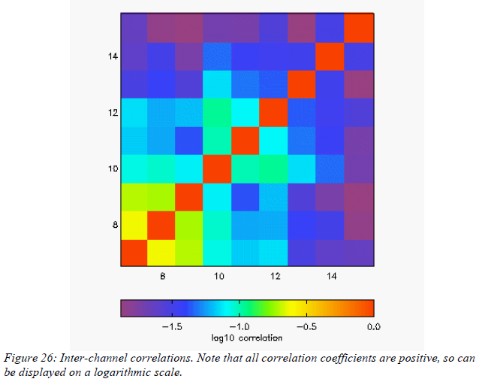
Evaluation: Departure and Residual Based
Doherty et al. (2012) used this technique to show the impact of a correlated noise from the ATMS instrument.
Normally the microwave temperature sounding channels would be expected to show little correlation.
Humidity channels however, in both the microwave and infrared would be expected to exhibit correlation structures [Weston et al. (2014)].

Slide 38
Summary
Space-borne assets likely have heritage sensors, or field experiments which can be used for knowledge on expected behavior of an instrument.
Leverage the community for previous research and reach-out to others.
Be cognizant of the source of the data stream, and what level of processing has been done, and what quality information is already inherent in the data.
Often spatial averaging, and spatial/spectral thinning has been or will need to be applied.
Be prepared to store long time-series of the data stream.
Care should be taken when simulating the data to select an observation operator which is accurate but meets timing requirements. If possible multiple options can be very beneficial.
Spend time carefully examining for outlier cases, and review both the inputs (from NWP) and the outputs from the observation operator. The adjoint and TLM codes can be very sensitive and can show when model assumptions may be undergoing potential violations.
Develop ways to be knowledgeable about the scene characteristics: cloud, dust, surface, … Even if assimilation is not going to take place yet useful statistics can be gathered.
Be vigilant in monitoring the O-B, O-A and A-B statistics. Adjoints of the model and assimilation system, and techniques such as those of Desroziers can be used to re-evaluate the observation error and its correlation, as well as the background error in observation space.
Many global metrics can hide impacts, be cautious of solely using self-analysis based metrics. Comparing forecasts to other observations and independent analysis can often show a much clearly picture of observation impact on NWP.

Slide 39
Thank You

Slide 40
References
Barnet, C. D., J. M. Blaisdell and J. Susskind, 2000. Practical methods for rapid and accurate computation of interferometric spectra for remote sensing applications. IEEE Trans Geosci. Rem. Sens., 38, pp. 169-183.
Chahine, M. T., 1975. An analytic transformation for remote sensing of clear-column atmospheric temperature profiles. J. Atmos. Sci., 32, pp.63-67.
Desroziers, G., L. Berre, B. Chapnik, and P. Poli, 2005. Diagnosis of observation, background and analysis-error statistics in observation space. Q. J. R. Meteorol. Soc., 131, pp. 3385-3396.
Doherty, A., N. Atkinson, W. Bell, B. Candy, S. Keogh, and C. Cooper, 2012. An initial assessment of data from the advanced technology microwave sounder. UK MetOffice Forecast R&T, Report no. 569, Oct. 2012.
Eyre J. R. and W. P. Menzel, 1989. Retrieval of cloud parameters from satellite sounder data: a simulation study. J. Applied Meteorology, 28, pp267-275.
Gelaro, R., Y. Zhu, R. Errico, 2007. Examination of various order adjoint-based approximations of observation impact. Meteorologische Zeitschrift, 16, pp. 685-692.
Langland, R. H. and N. L. Baker, 2004. Estimation of observation impact using the NRL atmospheric variational data assimilation adjoint system. Tellus, 56A, pp.189-201.
Morneau, J., S. Pellerin, S. Laroche, M. Tanquay, 2006. Estimation of the adjoint sensitivity gradients in observation space using the dual (PSAS) formulation of the Environment Canada operational 4D-Var. Proceedings, 2nd THORPEX Intl Sciencde Symp, Landshut, Germany, 4-8Dec2006. pp. 162-163.
Pavelin, E. G., S. J. English and J. R. Eyre, 2008. The assimilation of cloud-affected infrared satellite radinaces for numerical weather prediction. Q. J. R. Meteorol. Soc., 134, pp. 737-749.
Susskind, J., D. Reuter and M. T. Chahine, 1987. Cloud fields retrieved from analysis of HIRS2/MSU sounding data. J. Geophys. Res., 92, pp.4035-4050.
Weston, P. P., W. Bell and J. R. Eyre, 2014. Accounting for correlated error in the assimilation of high-resolution sounder data. Q. J. R. Meteorol. Soc., 140, pp. 2420-2429.

Slide 41
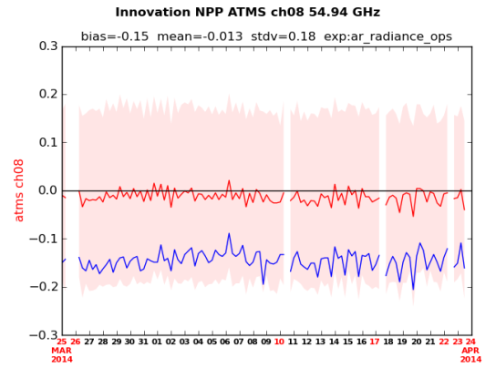
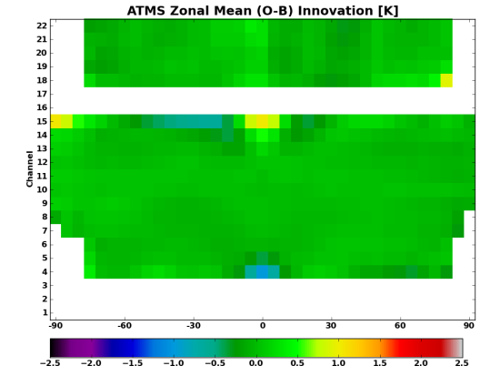
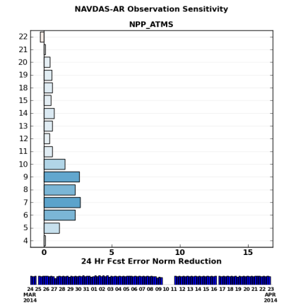
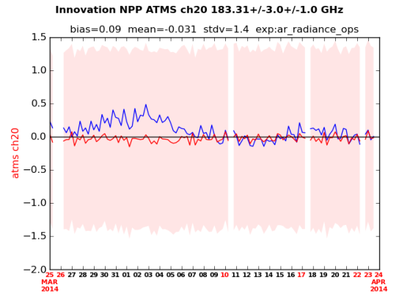
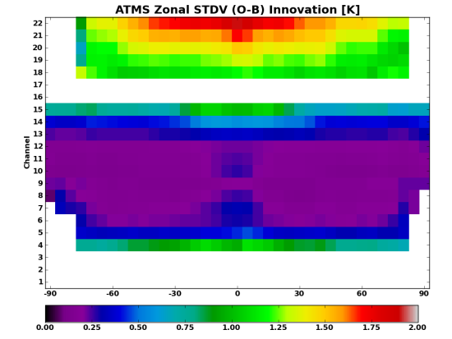
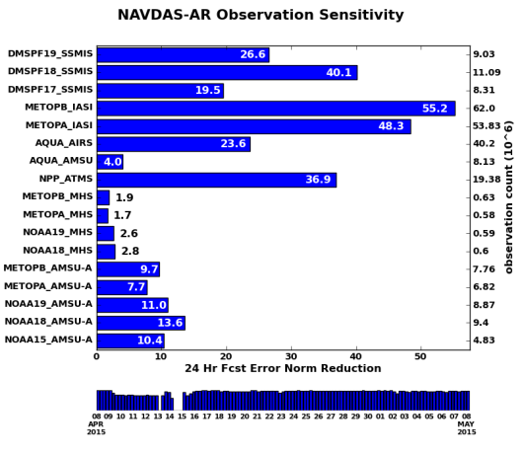
Operational Use of ATMS
Monitoring of operational data streams at FNMOC
http://www.nrlmry.navy.mil/metoc/ar_monitor/
Radgrams
Global mean and stdv of innovation
Zonal Innovation
Latitudinal dependence of mean and stdv
Observation Impact
Reduction of NWP error due to observation

