Slide 1
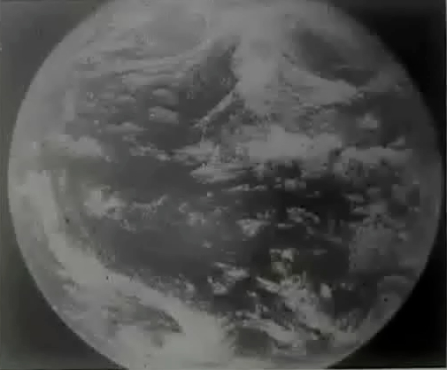
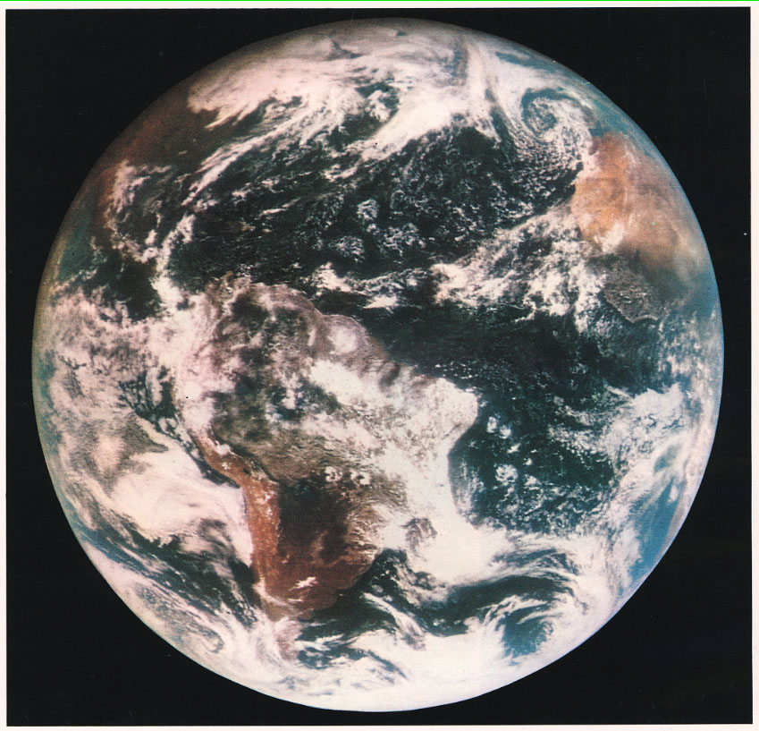
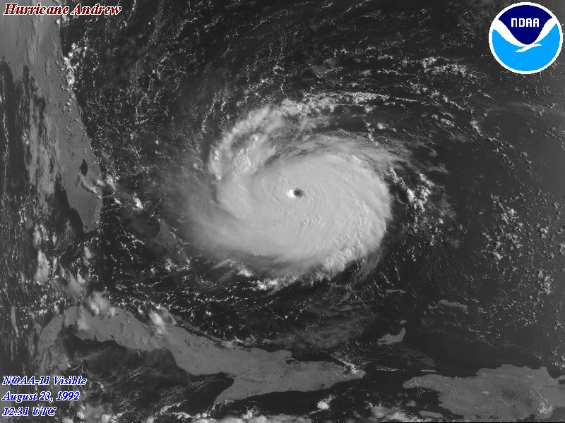
Clockwise:
ATS-1, 1967, Court. of NASA
ATS-3, 18 Nov 1967, Court. of NASA
23 Aug 1992, Hurricane Andrew, Courtesy of NOAA
Notes:
Ever since the launch of Tiros in 1960, weather satellites have played major role in the global monitoring and understanding of the atmosphere.

Slide 2
Satellite-derived winds &
Numerical Weather Prediction models
iliana Genkova
IMSG for NOAA/NCEP/EMC
Sharon Nebuda, Kirsty Salonen,
Giovanna De Chiara, Li Bi,
Chris Velden, Anne Grette Straume
29 July 2015
JCSDA Summer Colloquium

Slide 3
Outline
satellite-derived atmospheric motion vectors (AMV):
retrieval methods, properties, quality
scatterometer ocean surface winds:
measurements, properties, quality
assimilating winds in global NWP models:
AMVs, scatterometer winds
- evaluating the impact of satellite winds in NWP
novel satellite-derived wind data sets:
MISR, hyperspectral, Doppler wind lidar, rapid scan

Slide 4
Outline
satellite atmospheric motion vectors (AMV):
retrieval methods, properties, quality
scatterometer ocean surface winds:
measurements, properties, quality
assimilating winds in NWP models:
AMVs, scatterometer winds
- evaluating the impact of satellite winds in NWP
novel wind data sets:
MISR, hyperspectral, Doppler wind lidar

Slide 5
Satellite Atmospheric Motion Vectors (AMV): Retrieval
Wind vectors are retrieved from tracking cloud or water vapor features in consecutive satellite images.
Main steps:
find a suitable tracer in the first image
locate the tracer in the later images based on high correlations
3) calculate an average wind vector from the tracer displacements
4) assign a height to the final wind vector –
Water Vapor Intercept Method, Infrared Window Channel Method,
CO2 Slicing Method, Water Vapor Histogram Method, Cloud Base Method
5) perform objective quality control
Target
Target box
Search box
t1
t2
t3
+
=

Slide 6
Winds off the coast of Australia

Slide 7
Winds off the coast of Australia

Slide 8
Winds off the coast of Australia

Slide 9
Winds off the coast of Australia

Slide 10
Example: AMVs off the coast of Australia
(Low-level yellow, Upper-level red/magenta)

Slide 11
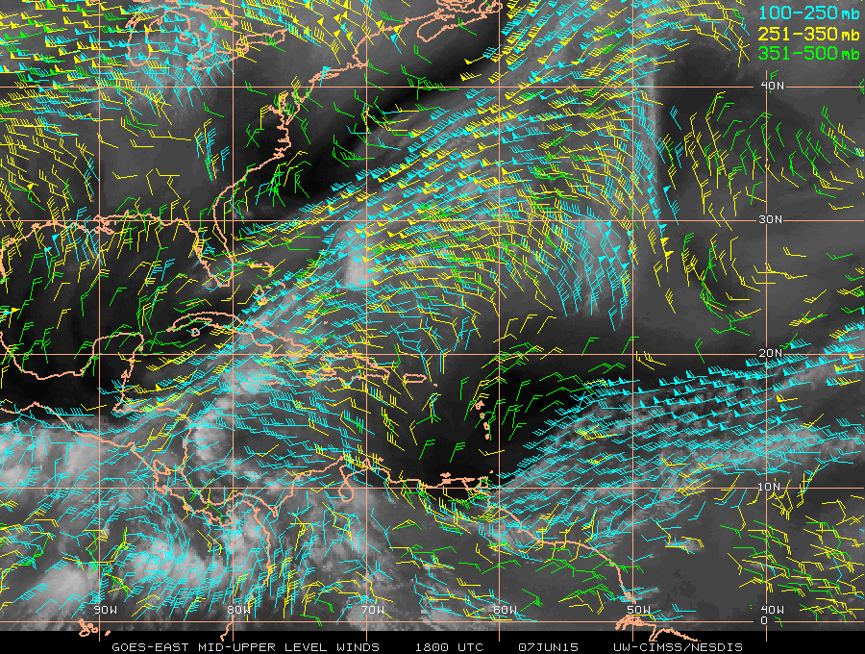
Atmospheric Motion Vectors (AMV): Properties
Attributes: Estimates of Wind Speed, Direction, Height
Coverage: Geostationary (full disk, hourly intervals), Polar (n/s of 70N/S lat., ~100min intervals)
Spectral types: VIS (~0.65μm), SWIR (~3.9μm), IR(~11-12μm),
cloudy/clear WV (~6.7μm)
Vertical attributes: Dependence on clouds, generally best coverage in lower levels (950 hPa - 700 hPa) over marine areas (cumulus clouds), and upper levels (400hPa – 150hPa) with cirrus clouds. Mid-levels (700hPa - 400hPa) are normally sparse in coverage.
Operational Producer/Satellite: NESDIS: GOES, NPP/JPSS
EUMETSAT: Meteosat, Metop
JMA: MTSAT, HIMAWARI
CMA: FY-2
India: Kalpana, INSAT-3D
Korea: KOMPSAT

Slide 12
Atmospheric Motion Vectors (AMV): Quality Control
Continuous verification: against radiosondes (RAOBS), model analyses, lidar measured heights; monitoring
Error sources: image quality and navigation, target selection and tracking, cloud/water vapor feature evolution, height assignment, AMVs only represent horizontal motion, the assumption that a selected target’s motion represents a true atmospheric wind
Quality Indicator (QI, -): a non-dimensional measure of the spatial consistency of an AMV; range [0, 100], considers the acceleration, vector consistency, U and V component consistency, ‘buddy check‘ of the wind vector with neighboring vectors (Holmlund, 1998)
Expected Error (EE, m/s): determined by the QI components plus local wind profile shear and regression statistics against radiosondes (Le Marshall, 2004)
NOTE: Producers do not derive/provide an AMV Observation Error (OE) …yet!

Slide 13
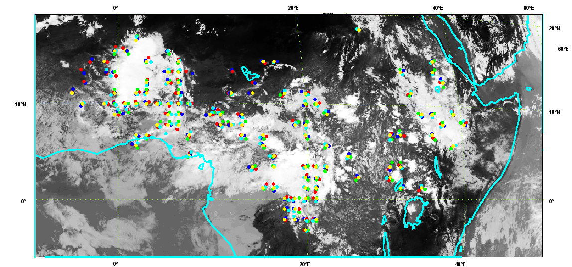
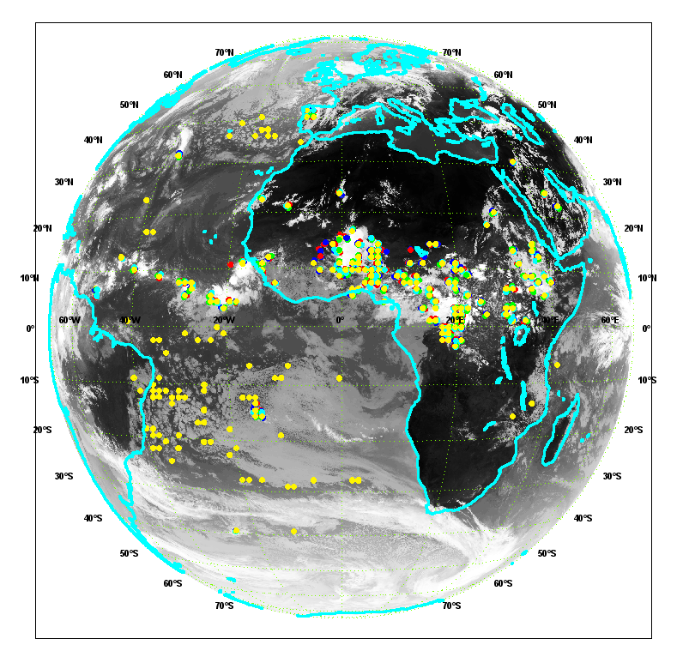
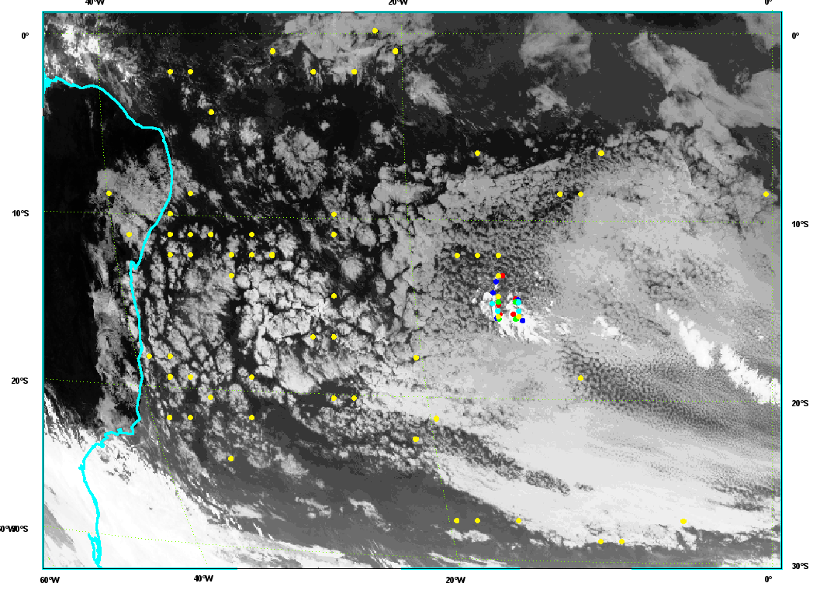
Height assignment issues: example
Speed < 20m/s; P<500hPa
Convective systems over the Equator belt; vertically developing Cumulus; growing or dissipating clouds
Vertically misplaced winds from tracking open/closed cell marine cumulus

Slide 14
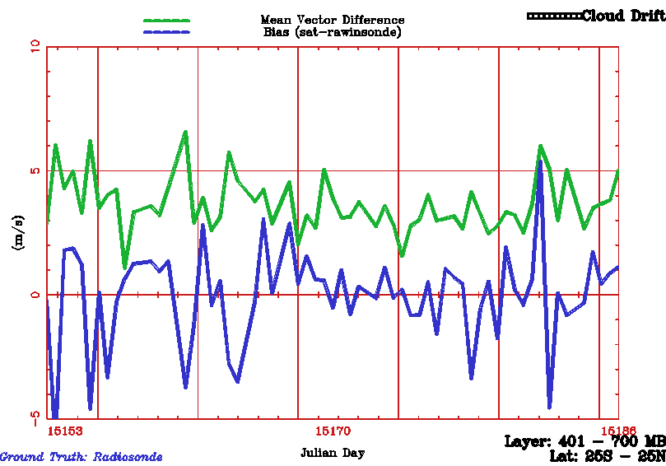
AMV monitoring: example
GOES-East cloud-drift (IR) winds using rawinsondes verification,
ongoing 30 day time series, Tropics, Mid-level winds

Slide 15
Outline
satellite atmospheric motion vectors (AMV):
retrieval methods, properties, quality
scatterometer ocean surface winds:
measurements, properties, quality
assimilating winds in NWP models:
AMVs, scatterometer winds
- evaluating the impact of satellite winds in NWP
novel wind data sets:
MISR, hyperspectral, Doppler wind lidar

Slide 16
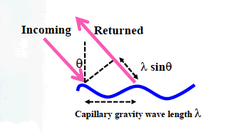
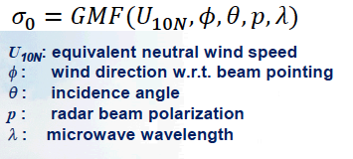
Scatterometer ocean surface winds: Measurement
Scatterometer - active microwave instrument (radar), day & night acquisition,
not affected strongly by clouds. The return signal - backscatter (σ0), is sensitive to the ocean-surface roughness due to capillary gravity waves generated by local wind conditions (surface stress), thus measures surface wind. Observations from different viewing angles measure wind direction.
Geophysical Model Function (GMF) – the relation between backscatter and wind speed and direction, is derived empirically (collocated surface stress observations, buoy data, 10m model winds)
Notes:
Scatterometers winds affect the full range of ocean movement - from individual surface waves to current systems, modulate air-sea exchange of heat, momentum, gases, particulates

Slide 17
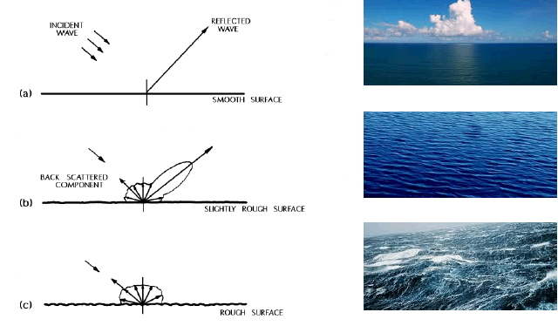

Slide 18
Scatterometer ocean surface winds: Properties & Quality
Backscatter signal depends on:
Frequency of the emitted wave
C-band(5.3GHz/~5.6cm), Ku-band(14.6GHz/~2.1cm)
Incidence angle
Winds speed
C-band scatterometers:
SCAT (ERS-1/2,) ASCAT (Metop-A/B)
Good: Hardly affected by rain, High quality wind direction
Bad: Two nearly opposite wind solutions, narrow swath
Ku-band scatterometers:
NSCAT, QuikSCAT, SeaWinds, Oceansat-2 (OSCAT),Haiyang-2A
Good: Up to 4 wind solutions, rank-1 the correct one; broad swath
Bad: Affected by rain, problems with wind direction
Validation: against buoy data, ship data, NWP Model 10 m winds

Slide 19
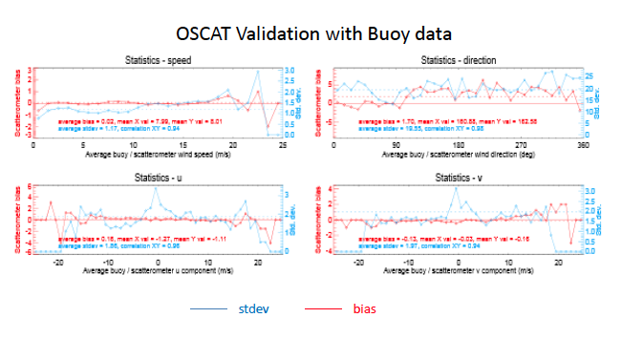

Slide 20
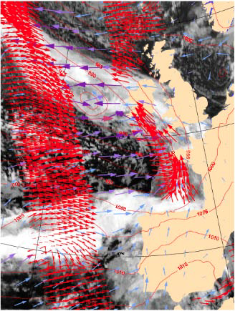
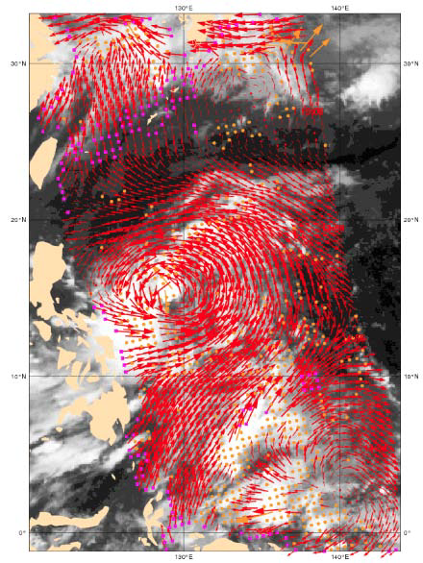
ASCAT Winds OSCAT Winds

Slide 21
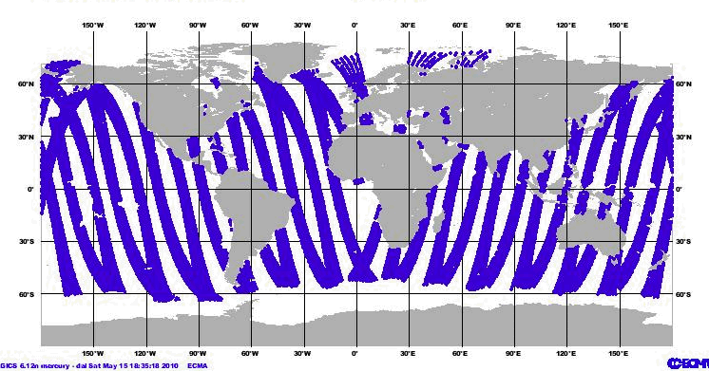
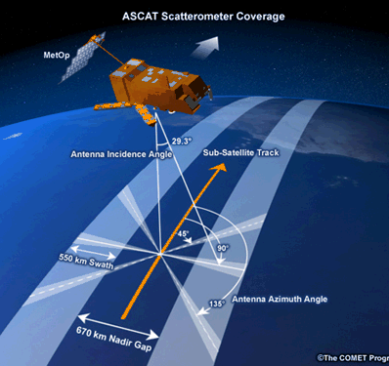
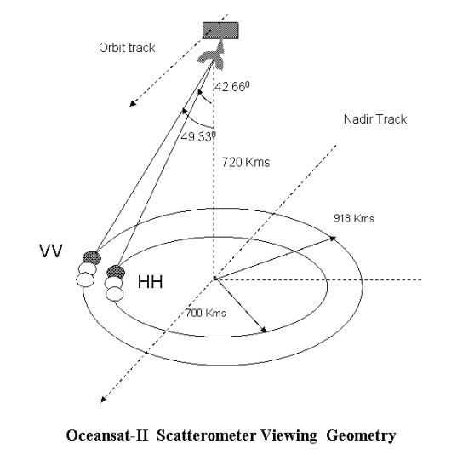
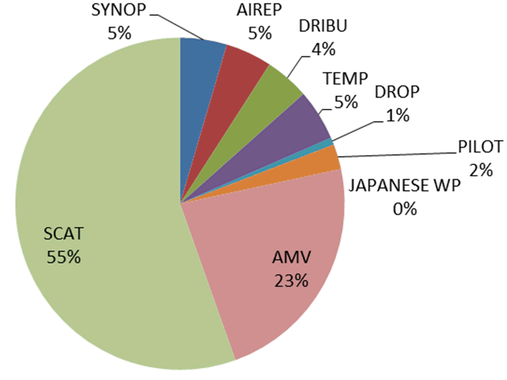
Daily coverage of ASCAT-A surface winds
Wind observations below 850 hPa
FSO values relative quantities (in %)
Horanyi et al., 2013

Slide 22
Outline
satellite atmospheric motion vectors (AMV):
retrieval methods, properties, quality
scatterometer ocean surface winds:
measurements, properties, quality
assimilating winds in global NWP models:
AMVs, scatterometer winds
- evaluating the impact of satellite winds in NWP
novel wind data sets:
MISR, hyperspectral, Doppler wind lidar

Slide 23
Assimilating winds in NWP
J : Penalty (cost) function
(fit to background + fit to observations + constraints)
X-Xb : analysis increment, where Xb is background
B : background error, contains spatial correlations between errors of
neighboring state variables, i.e. background error covariance
Y : observation, y-H[x] is departure / increment / O-B / O-F
H : observation (forward) operator, i.e. transformation operator from
the analysis variable to the form of the observations (interpolation
to the observation location and time)
R : observation error, instrument + representativeness
(since the spatial context of the observation is generally different
from the state variables), i.e. observation error covariance
Jc : constraints (physical quantities, balance/noise, etc.)

Slide 24
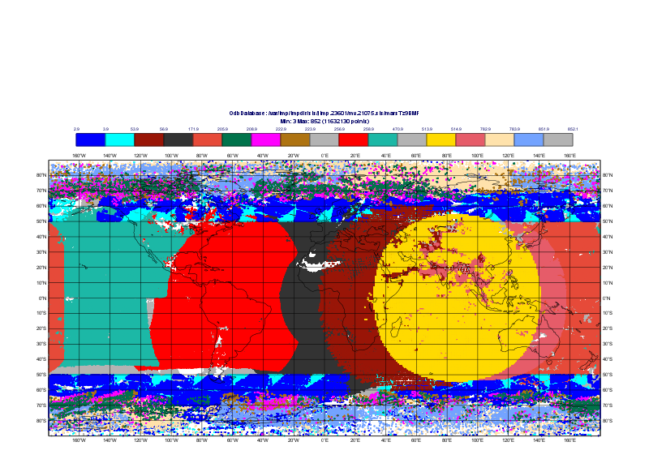
Currently available winds to NWP centers (2015)
GOES-15 GOES-13 MET-10 MET-7 MTSAT-2
NOAA-15 NOAA-18 NOAA-19 FY-2D FY-2E
AQUA TERRA METOP-A METOP-B
INSAT-3D dual METOP-A/B, -B/A VIIRS

Slide 25
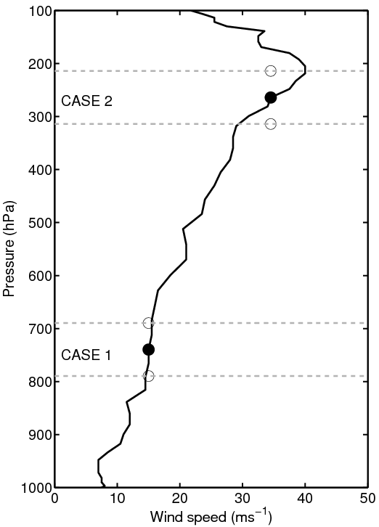
How do we use satellite winds in NWP?
AMVs
Each wind vector is a single-level point
measurement of speed and direction
at an assigned representative height.
The height is derived from cloud top’s
height (high and mid-level clouds) and
cloud base (low clouds).
Height error is considered the
dominant source of error for AMVs
(Velden and Bedka, 2005).
Speed and directions are converted
to U and V components.
Scatterometer near-surface marine winds
Assigned at 10-m above surface level

Slide 26
AMVs in NWP – Quality Control (QC)
Quality Indicator (QI): QI > QI_threshold (~80, depends on AMV type and
producer)
Solar Zenith Angle: SZA< SZA threshold (~65 degrees)
Quality Mark (QM): QM < 8
(assigned by NCO)
Blacklisting: Spatially (lat,lon, land/ocean) and in the vertical
(hPa), and by AMV type
Thinning: ~200x200km, ~100hPa; to avoid significant spatial
error correlation
Observation Error (OE, m/s): errors assumed to be uncorrelated,
currently one error profile per instrument,
empirically derived, new OE implementation
is underway

Slide 27
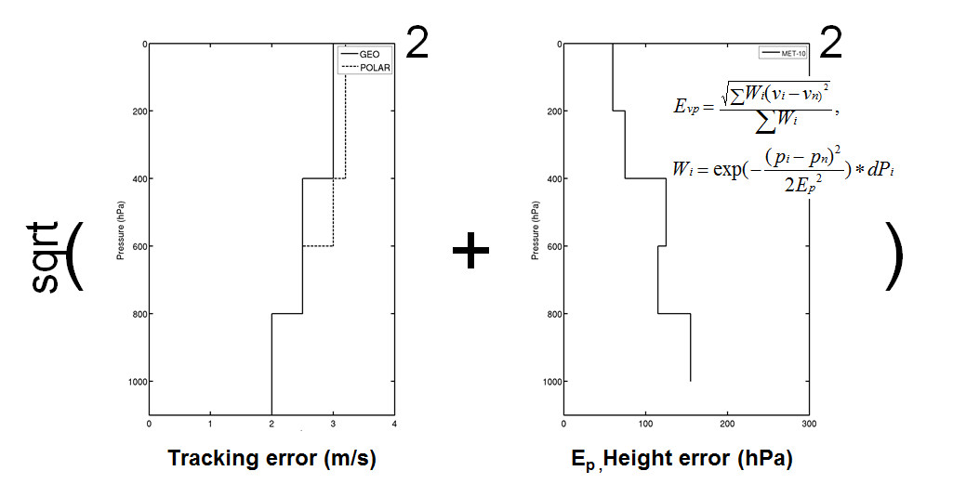
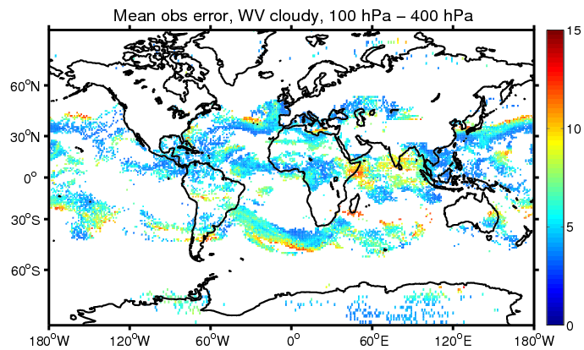
Situation dependent observation errors
=
[Tracking error]² + [Error in u/v due to error in height]² = [Total u/v error]²
Forsythe M, Saunders R, 2008: AMV errors: A new approach in NWP. Proceedings of the 9th international winds workshop.
Salonen et al., 2015: Characterising AMV height assignment error by comparing best-fit pressure statistics from the Met Office and ECMWF data assimilation systems. JAMC, 54, 225-242.

Slide 28
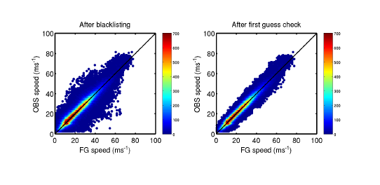
AMVs in NWP – Quality Control (QC)
First Guess departure: for each of 3 internal loops
|U_{AMV} - U_{GFS}| < 6 m/s
|V_{AMV} - V_{GFS}| < 6 m/s
Log Normal Vector Difference (LNVD) check (New!!!):
Sqrt [ (U_{AMV}-U_{GFS})² + (V_{AMV}-V_{GFS})² ] / LN (AMV Speed) < 3
All Quality Control components together determine an AMV’s weight in the minimization!!!

Slide 29
Winds DA - relevant code in GFS/GSI
read_satwnd.f90, read_surfwnd.f90 – input via BUFR file, logic for satellite IDs, quality control and diagnostics via cdata_all, blacklisting
setupw.f90 – screening for tropopause proximity, departure check, add diagnostic info to rdiagbuf for output to diag_conv_ges & diag_conv_anl
global_convinfo.txt – control usage of AMVs, thinning, possibility to add sub-type for winds
prepobs_errtable.global – profile of AMV observation error for each satellite ID type
Relevant output files: gsistat.gdas.YMDH, cnvstat.gdas.YMDH, etc.

Slide 30
Currently available winds to NWP centers (2015)
GOES-15 GOES-13 MET-10 MET-7 MTSAT-2
NOAA-15 NOAA-18 NOAA-19 FY-2D FY-2E
AQUA TERRA METOP-A METOP-B
INSAT-3D dual METOP-A/B, -B/A VIIRS

Slide 31
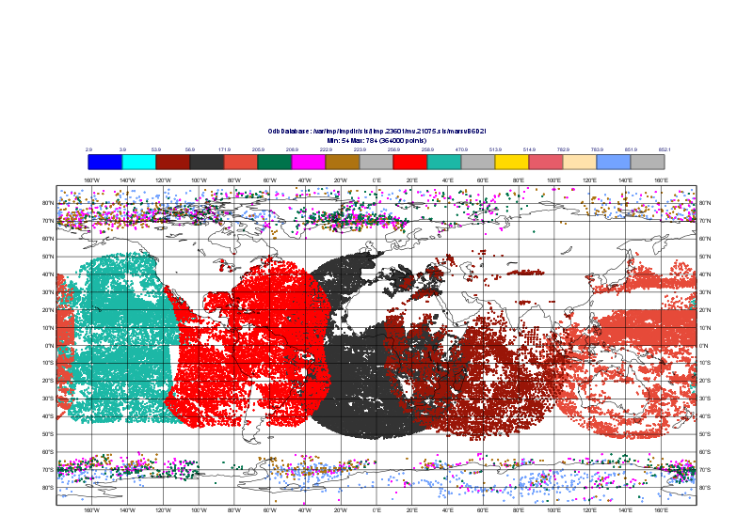
Active winds in DA
GOES-15 GOES-13 MET-10 MET-7 MTSAT-2
NOAA-15 NOAA-18 NOAA-19
AQUA

Slide 32
Scatterometer winds: NWP – Quality Control (QC) (ECMWF)
Wind speed bias correction
Quality Control – sea ice check, rain flag
Spatial thinning – C-band (100x100km) / no thinning for Ku-band
Assimilation weight - 0.25
High winds speed cut-off - 20m/s
U and V component check - 6m/s, vector check – 1 m/s
Assimilated as 10m equivalent neutral winds
OE=1.5m/s / 2m/s

Slide 33
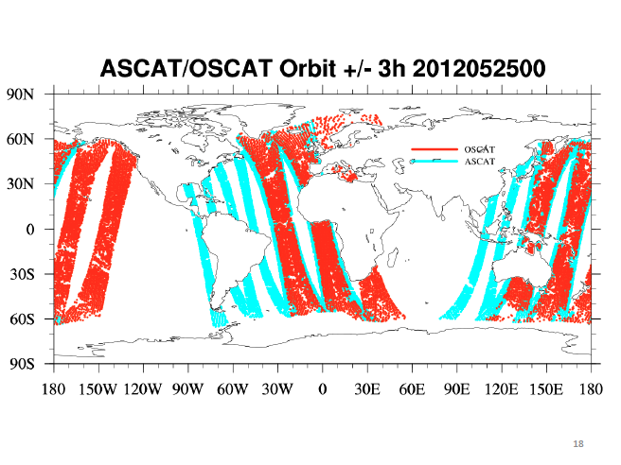

Slide 34
Outline
satellite atmospheric motion vectors (AMV):
retrieval methods, properties, quality
scatterometer ocean surface winds:
measurements, properties, quality
assimilating winds in NWP models:
AMVs, scatterometer winds
- evaluating the impact of satellite winds in global NWP
novel wind data sets:
MISR, hyperspectral, Doppler wind lidar

Slide 35
How to evaluate AMVs impact in global NWP?
Check behavior (normal O-B & O-A)
Examine analysis fit to obs
Check innovations (siganl – sigf06)
Global verification statistics software (VSDB):
forecast skill and analysis state

Slide 36
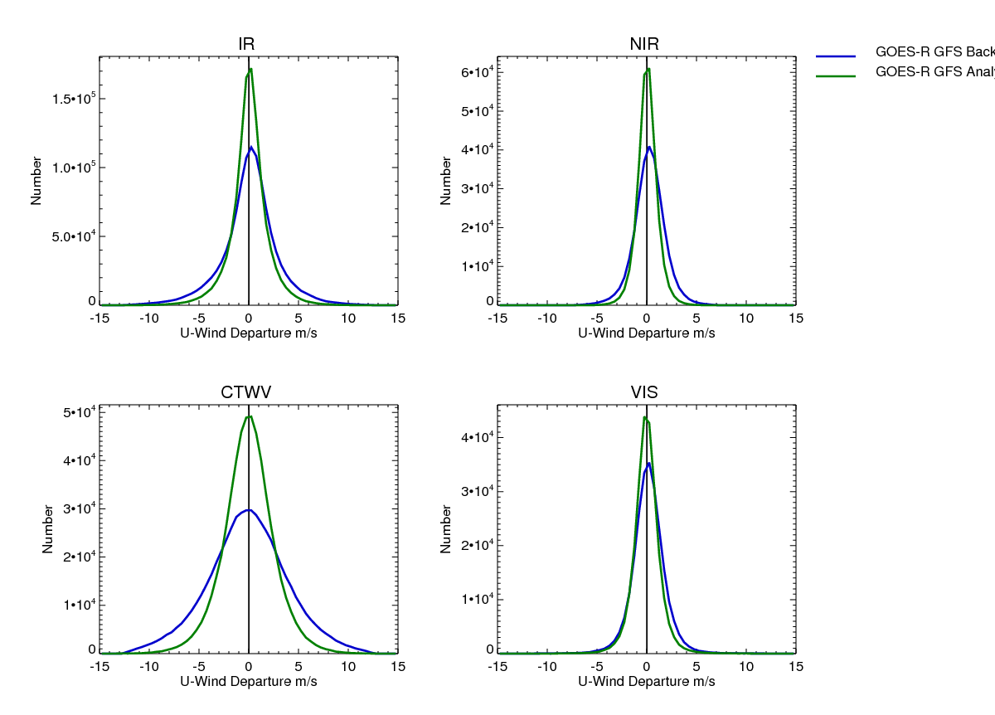
O-B / O-A : U wind Component
Confirm that normal distribution has been maintained after QC

Slide 37
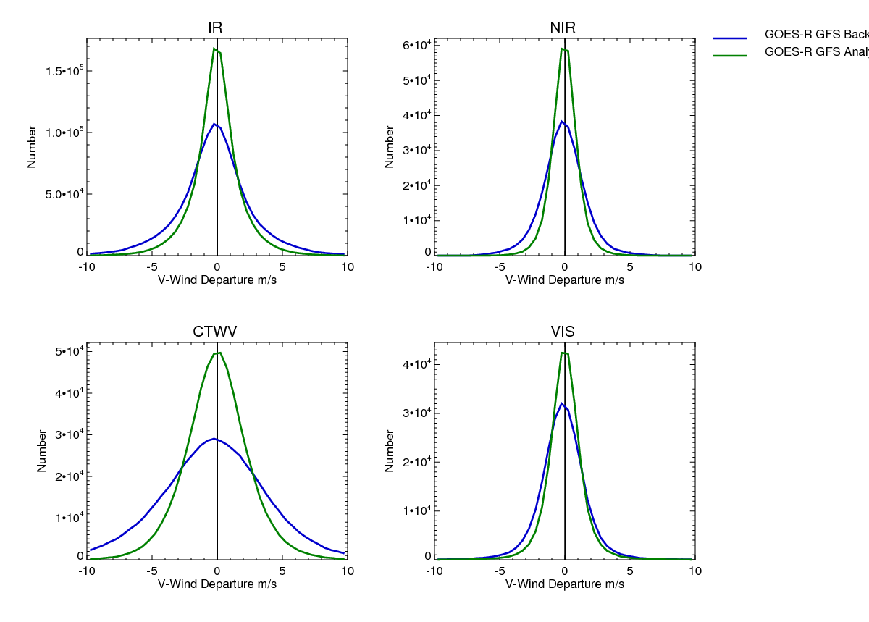
O-B / O-A : V wind Component
Confirm that normal distribution has been maintained for
Speed and Direction departure distribution

Slide 39
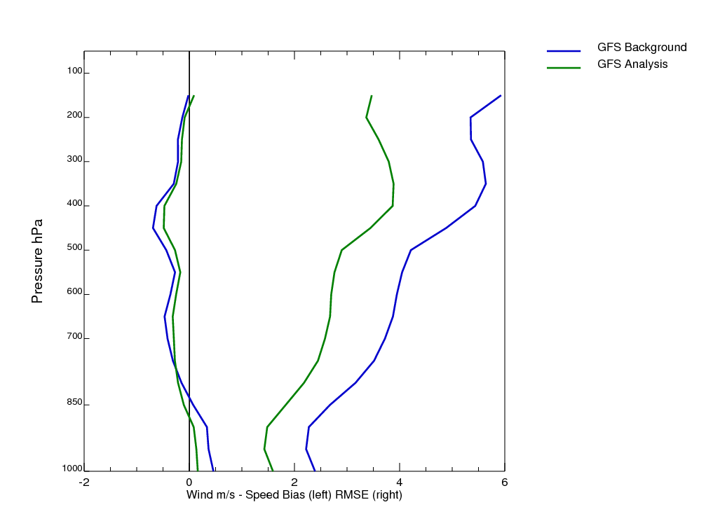
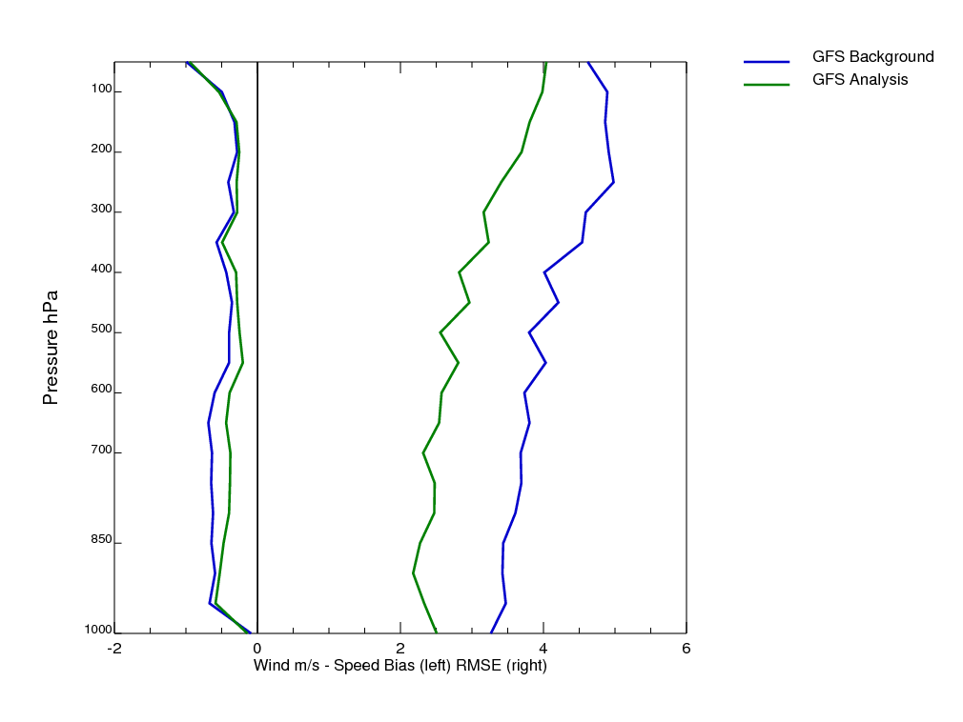
Fit to Observations
June 2012 for the SEVIRI region
IR AMVs
Radiosondes
Mean GFS speed – AMV speed (left) and vector difference RMSE (right)
Mean GFS speed – radiosonde speed (left) and vector difference RMSE (right)
Check (AN – AMV) speed bias and vector difference RMSE are within required bounds. Repeat check on other data fit to obs performance.

Slide 40
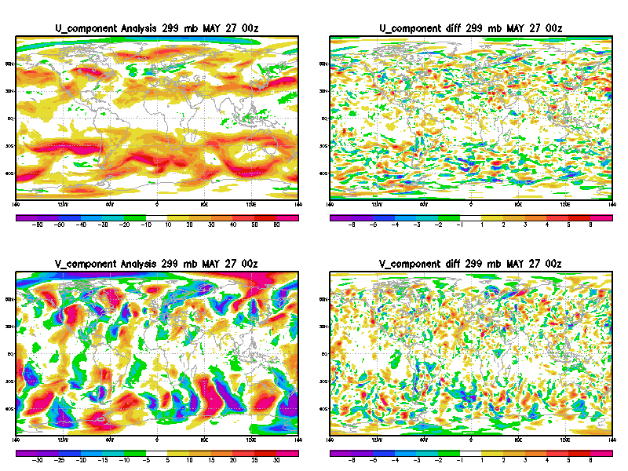
Innovations
siganl – sigf06 innovations on various sigma levels. For GOES AMVs, check that contribution from 4 different AMVs types are consistent with each other in space
Analysis
U wind m/s
U Analysis –
6 hour forecast
m/s
Analysis
V wind m/s
V Analysis –
6 hour forecast
m/s
Notes:
Local improvement

Slide 41
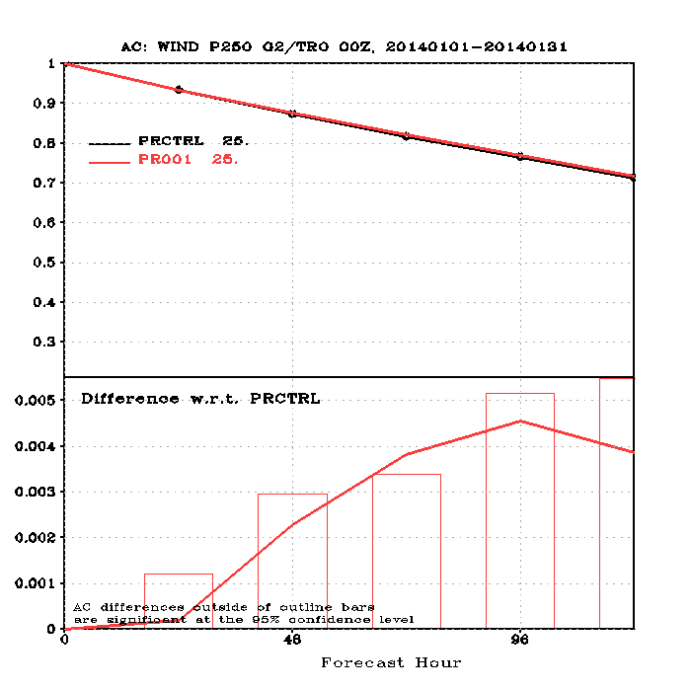
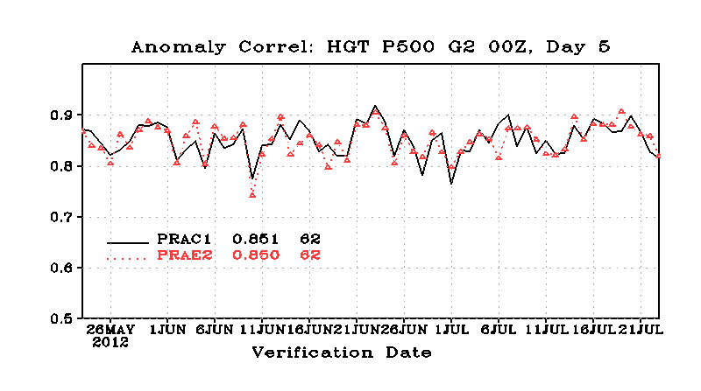
Verification Statistics Database (VSDB)
Do no harm to forecast skill !
(hopefully improve it)
Look for reduction in drop outs

Slide 42
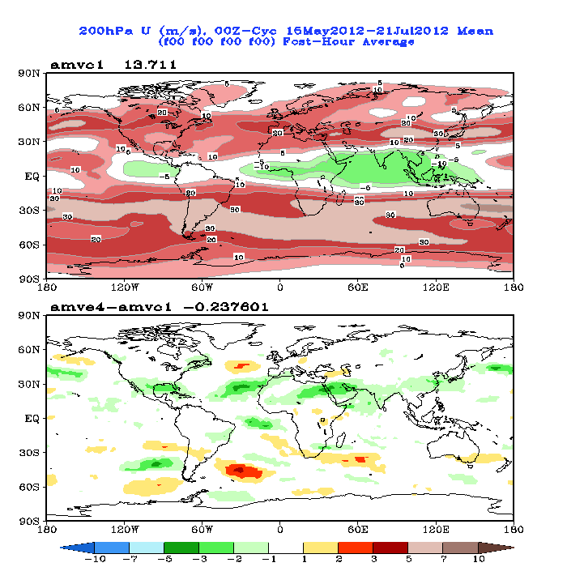
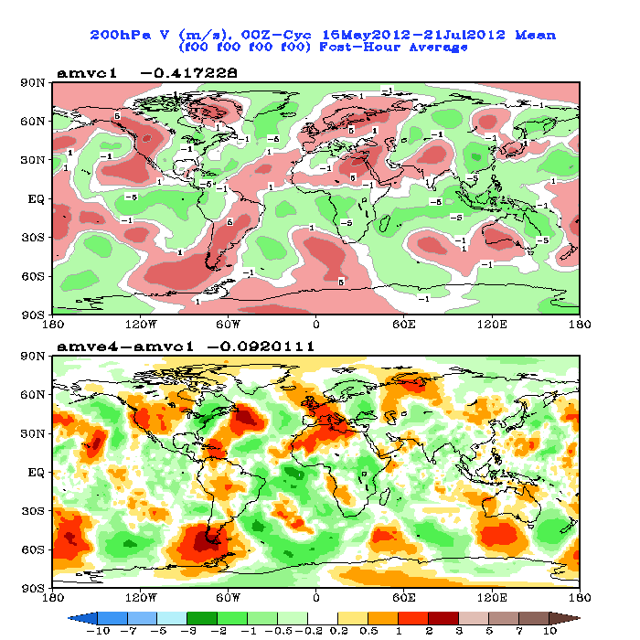
Analysis State
Comparing two analysis states - without and with GOES AMVs
200 hPa U Wind of control (no GOES AMVs) and the difference with the experiment AMVE4.
200 hPa V Wind of control (no GOES AMVs) and the difference with the experiment AMVE4.

Slide 43
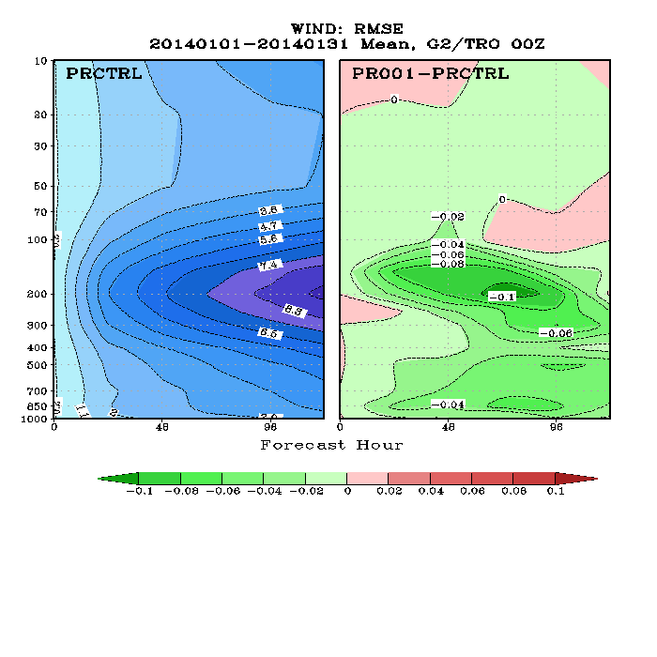

Slide 44
Some examples of AMV use and results...

Slide 45
AMV Data Denial experiment
Setup
Model resolution T511 (~40km)
Incremental analysis at T95(~200km)/T159 (~115km)/T255(~80km);
60 Pressure levels up to 0.1hPa
DA - 12 hour 4D VAR / 2007121200- 2008011212
FC - 10 day forecast produced once per day at 12Z (32 forecasts)‏
Verification - against observations and operational analysis
Assimilated AMVs: VIS, IR and WV (cloudy) from Meteosat, MTSAT-1R and GOES; IR and WV from MODIS polar Terra and Aqua;
All subject to quality control and thinning as described on the NWP SAF web-page
Other sat observations: CSR from Meteosat 7 & 9, GOES 10 & 11; IASI, AIRS; 5 AMSU-As, 4 AMSU-B/MHSs, 2 HIRSs; SSMI, AMSR-E, TMI; rainy radiances from SSMI; scatterometer winds - ERS, ASCAT, QUICKSCAT

Slide 46
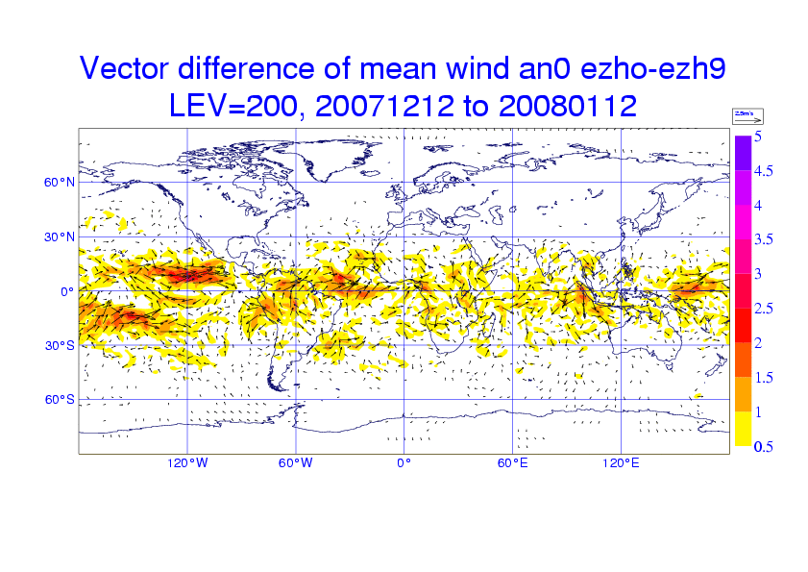
AMV Data Denial experiment
Vector difference of mean wind analysis at 200hPa (ezh9 - with winds, ezho - without winds). Shading indicates the magnitude of the speed difference vector [m/s]

Slide 47
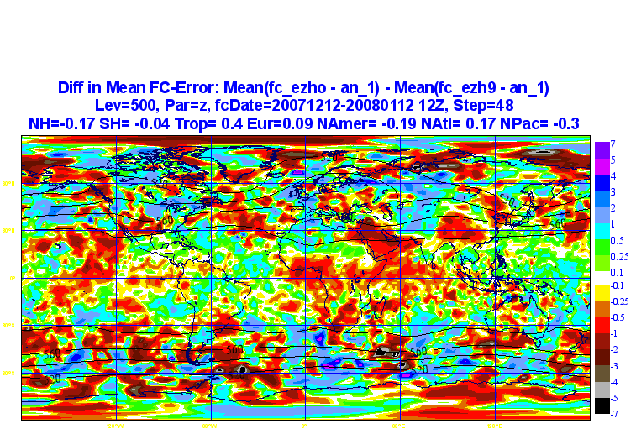
AMV Data Denial experiment
Difference in Mean T+48h FC error for 500hPa Geopotential Height with and without winds (ezho - without AMV, ezh9 - with AMV).
Green/blue/purple colouring shows benefit from assimilating winds. Operations AN is used as verifying analysis.

Slide 48
Investigating the impact of AMV assimilation on the African Easterly Jet in the ECMWF Analysis for African Monsoon Multidisciplinary Analysis (AMMA) (Anna Agusti-Panareda, Carla Cardinali)
Control = “operations” + AMMA radiosondes
Experiment = Control + AMV alterations
AMV alterations for the AMMA region [40W-60E;10S-40N]
- Allows AMVs with QI≥30 to be assimilated at all pressure levels (operationally only AMVs with QI≥85 are generally used)
- Observation Error is reduced by half
- Relaxed Variational Quality control allowing most winds to be assimilated
All changes above affect the Observational Influence for the U component of the wind for the layer below 750hPa !!!

Slide 49
AMV OBSERVATIONAL OPERATOR REVISION for AMMA
Observation Influence for the U component of the wind below 750hPa
Average Assimilation Cycle | AMMA | AMMA+AMV
Number of AMV | 2618 | 6370
DFS (deg. of freedom for signal) | 585 | 1417

Slide 50
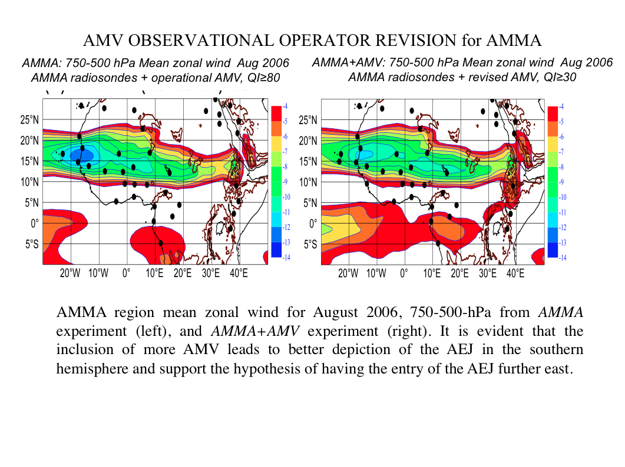
AMMA regional mean zonal wind for August 2006, 750-500 hPa, from AMMA experiment (left), and AMMA+AMV experiment (right).
The inclusion of more AMVs leads to better depiction of the AEJ in the Southern Hemisphere and support the hypothesis of having the entry of the AEJ further to the East

Slide 51
The difference field suggests:
• Reduction of the south-westerly low level monsoon flow (West Africa Monsoon) and consistency with the scatterometer data information
• Reduction of the heat low circulation consistent with too strong circulation in the short-range forecast
Reduction of the Somali jet (Indian Monsoon well known to have too strong inflow)
Encouraging results in depicting region/events known to be not very well understood and/or represented in models

Slide 52
NOAA Hurricane Forecast Improvement Program: Assimilation of High-Resolution GOES AMVs in HWRF (PIs: Velden and Lewis (UWisc-CIMSS), Tallapragada (NCEP-EMC)
The HWRF team at EMC is collaborating with the Atmospheric Motion Vectors (AMVs) development and applications team at CIMSS, University of Wisconsin in evaluating potential impacts of assimilating GOES-derived AMVs to improve HWRF forecasts. (September, 2014)
This interest stems in part from recent experimental results showing positive impact of assimilating high spatial/temporal resolution GOES AMVs for tropical cyclone simulations using: i) WRF/DART (Wu et al. 2014), and ii) HEDAS/HWRF (Aksoy et al. 2014).
The HFIP Vortex-scale Data Assimilation strategic team and Satellite Data Assimilation tiger team support this effort as a near-term priority towards the development and improvement of the HWRF performance.

Slide 53
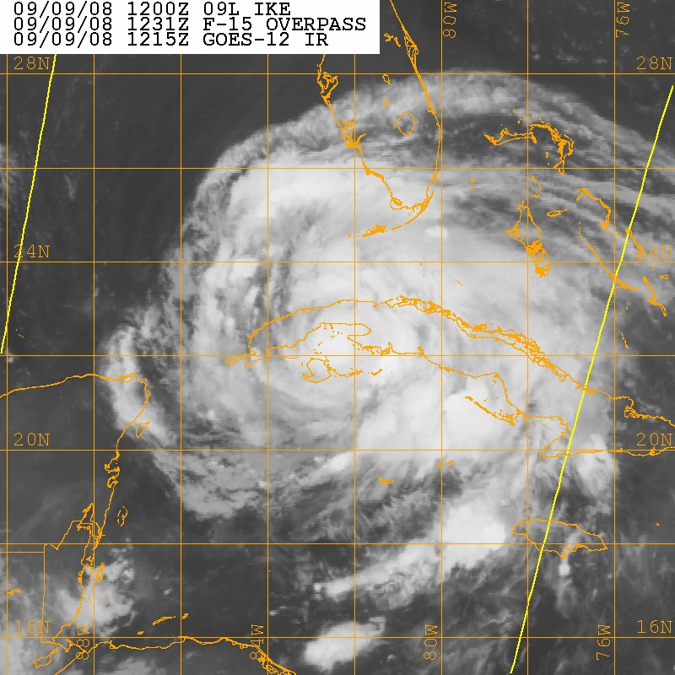
Influence of Assimilating High-resolution Satellite-Derived Winds on Mesoscale Analyses and Forecasts of Tropical Cyclones Example: Hurricane Ike (2008)
P ≤ 350 hPa 350 < P ≤ 800 hPa P > 800 hPa
Intensity analysis
Above: As a proxy for GOES-R 5-minute imagery, GOES-East rapid-scan imagery (7-min) is used to derive winds. The coverage vs. normally-available winds is substantially increased over Hurricane Ike.
Left: Assimilation of the rapid-scan winds into the mesoscale DART/WRF system produces superior analyses of Hurricane Ike’s intensity (OBS) over a Control (CTL) without the winds. Velden, CIMSS
Notes:
DART: Data Assimilation Research Testbed

Slide 54
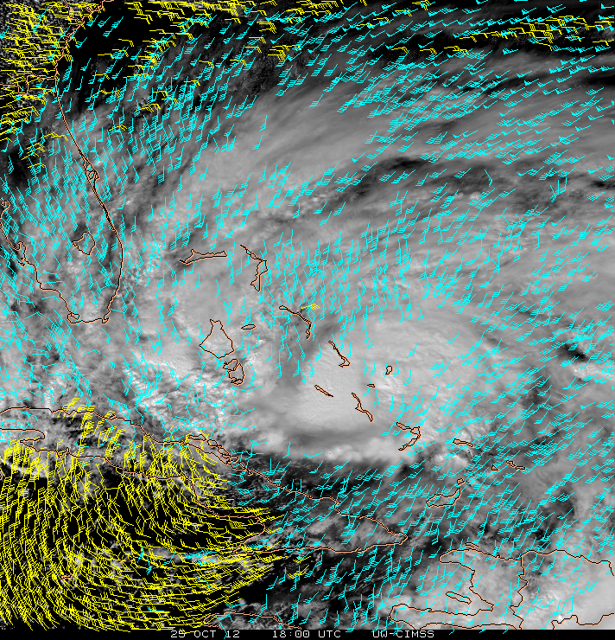
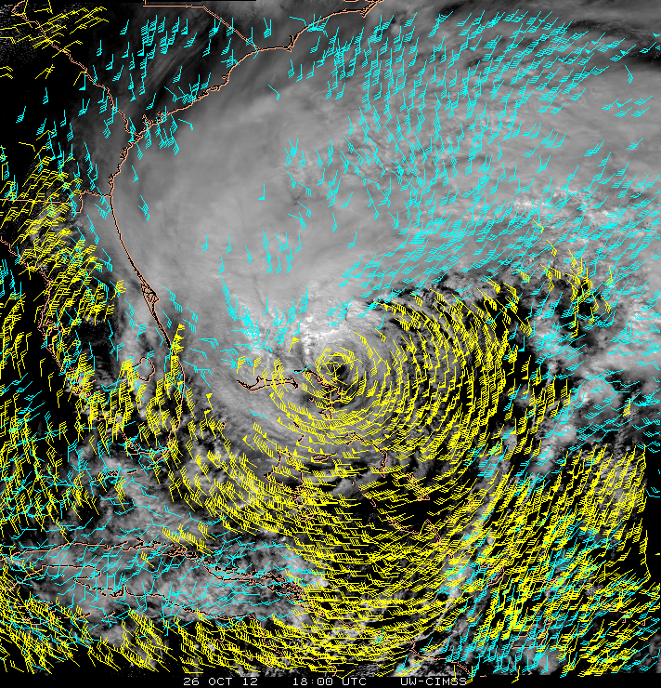
Initial Test Case
AMVs from GOES 5-min. rapid-scans during Hurricane Sandy
1800 UTC 25 Oct, 2012 1800 UTC 26 Oct, 2012
100-500 hPa
500-950 hPa
Examples of VIS/IR cloud-tracked winds from 5-min image intervals derived by UW-CIMSS using AMV processing algorithms similar to the current NESDIS operational algorithm.

Slide 55
NOAA Hurricane Forecast Improvement Program: Assimilation of High-Resolution GOES AMVs in HWRF
Progress to Date
Completed -- Processing of AMV datasets (hourly) from GOES
rapid scans for Sandy from 24 Oct. 2012 through landfall
Completed -- HWRF CTL run over same period
In Progress – HWRF assimilation experiments with AMVs
-- Assess forecast impacts of the AMVs on Hurricane Sandy
HWRF track/intensity
Future Plans
Identify other cases for further experiments
Real-time HWRF trial over full TC season

Slide 56
AMVs DA for improved WRF-Chem simulations of CO2 emissions from isolated sources (power plant plume) (S.Utembe, P.Rayner, I.Genkova) …work in progress…

Slide 57
Outline
satellite atmospheric motion vectors (AMV):
retrieval methods, properties, quality
scatterometer ocean surface winds:
measurements, properties, quality
assimilating winds in NWP models:
AMVs, scatterometer winds
- evaluating the impact of satellite winds in NWP
novel wind data sets:
MISR, hyperspectral, Doppler wind lidar, rapid scans

Slide 58
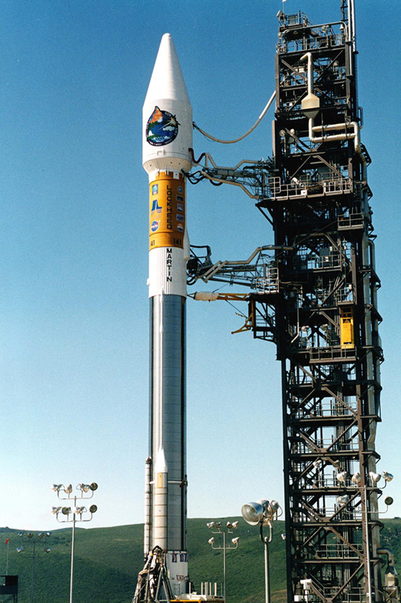
TERRA EOS
(Earth Orbiting Satellite)
18 December 1999
ASTER
CERES
MISR
MODIS
MOPITT

Slide 59
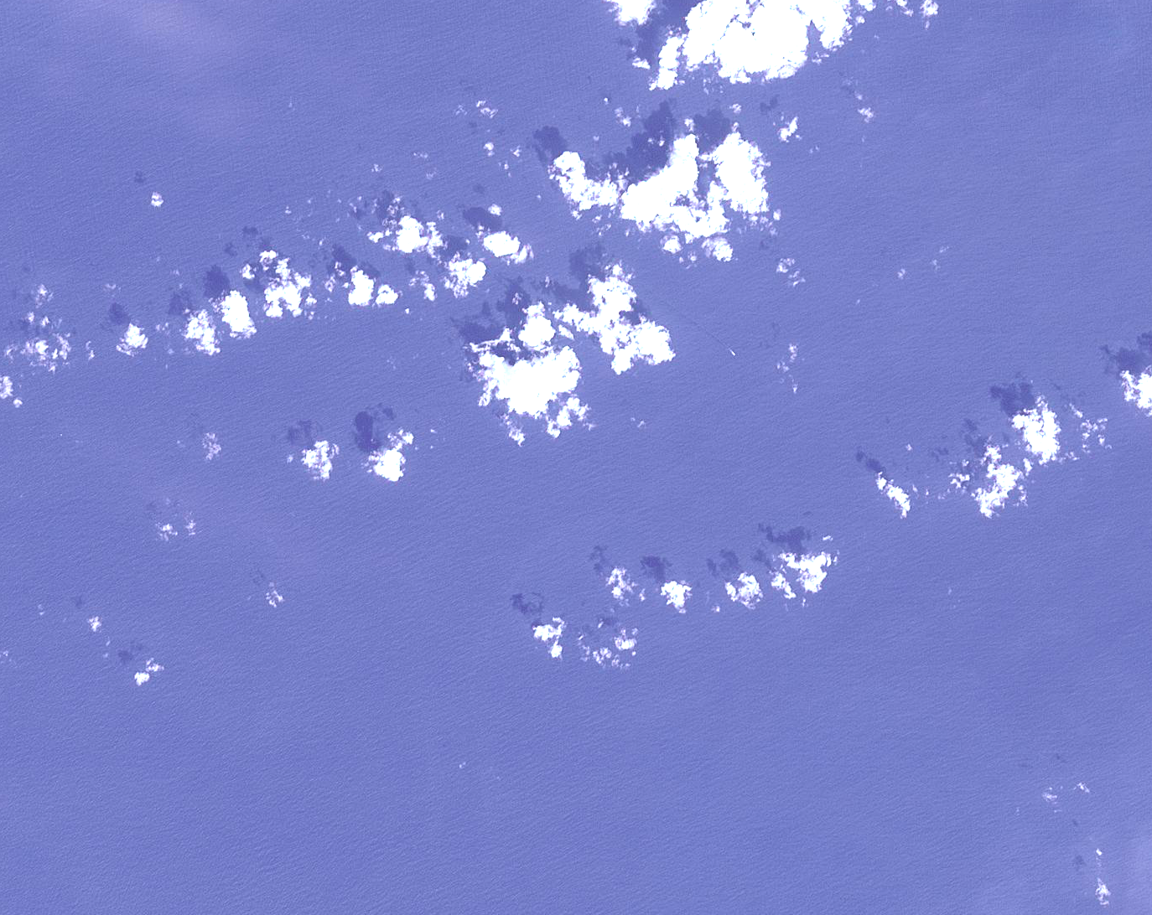
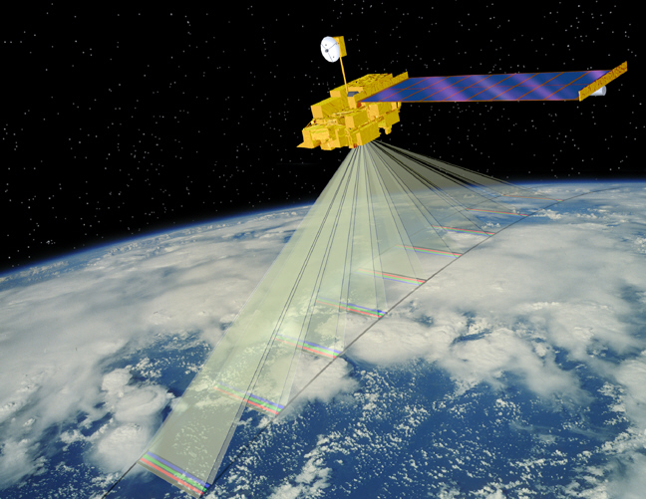
MISR - Multi-angle Imaging SpectroRadiometer
• 360 km swath, pushbroom
• 443, 550, 670, 865 nm channels
• 275 m – 1100 km sampling
• 7 minutes to view the same scene
from all 9 cameras
• 0°, 26.1°, 45.6°, 60.0°, 70.5°
• 16 days global coverage
• Stereo derived CTH at 1100 m spatial resolution
motion: 0 ° - 26.1 ° - 70.5 °
height: 0 ° - 26.1 °
Image courtesy of Shigeru Suzuki and Eric M. De Jong
Notes:
Add a photo of a hurricane in 3 D
Terra Platform: 705-km descending polar orbit, 10:30 AM LT Equator Crossing Time
4 bands: 446 (blue), 558(green), 672(red), and 866(near-infrared) nm.
Stereo height
• Derived through area/feature image matching between the different MISR cameras, detecting cloud motion, and assigning
cloud altitude. If the stereo-derived height is above the surface by some error value (currently 562 m), then the feature is called cloudy.
• Uses two camera triplets for motion: An-Bf-Df and An-Ba-Da • Uses two camera pairs for stereo heights: An-Af and An-Aa

Slide 60
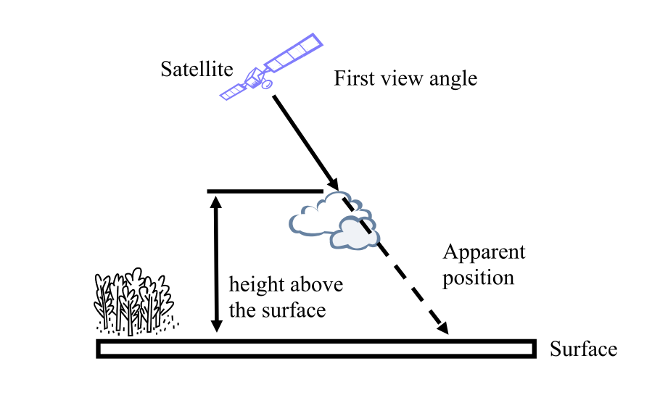
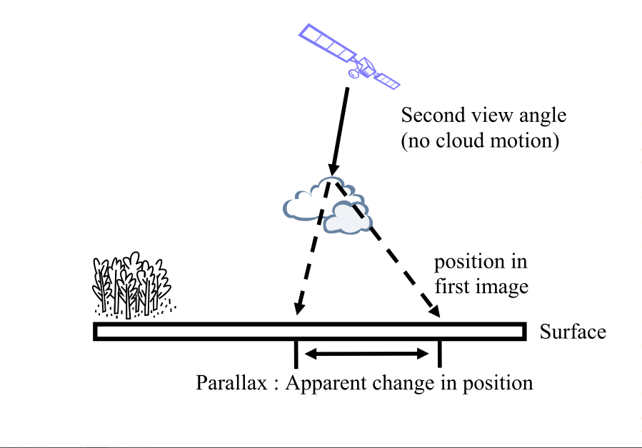
MISR (1100m) / ASTER (90m) Stereo cloud top heights method
(Marchand, 2007)
Notes:
The MISR stereo-height retrieval is conceptually simple -an object located above the surface (such as a cloud) will appear in two different positions when viewed from two different angles. From the apparent change in position (or parallax) one can calculate the height of the object relative to the surface. Using multiple views, one can estimate both the height and velocity of the object (assuming the object moves sufficiently far in the time between when images are acquired).

Slide 65
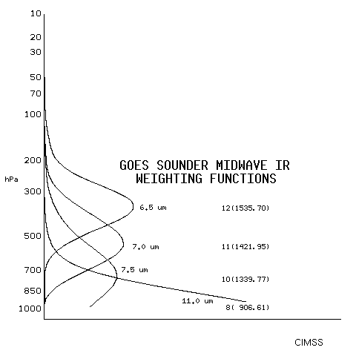
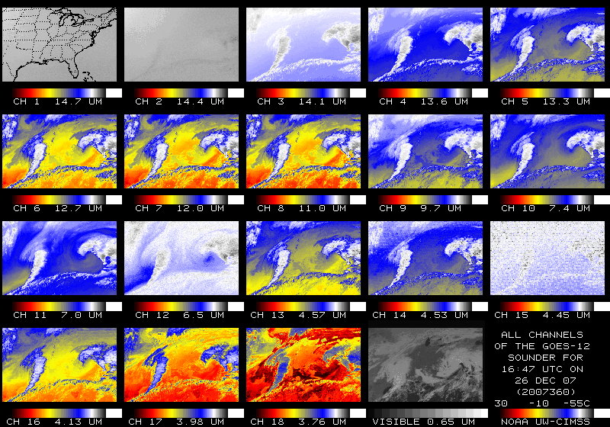
AMVs from GOES Sounder Moisture Fields
SFOV Temperature and Moisture (RH, Td) Profiles
1h temporal and 10km SFOV nominal spatial resolution
40 pressure levels between 1000 and 0.1 hPa → 30 between
1000 and 10 hPa
Constant pressure images
CIMSS satellite-derived wind algorithm (Velden at al., 2005)
Ma, X.L., Schmit, T. J., Smith, W. L.,1998: A Nonlinear Physical
Retrieval Algorithm - Its Application to the GOES-8/9 Sounder,
JAM, Vol.38, No5, pp.501–513
Notes:
GOES-East and GOES-West sounders provide real-time retrievals of temperature and moisture on an hourly basis.
The single field-of-view product is generated every hour and has spatial resolution of 10 km.
Vertical temperature profiles from sounder radiance measurements are produced at 40 pressure levels from 1000 to 0.1 mb using a physical retrieval algorithm that solves for
surface skin temperature, atmospheric temperature, and atmospheric moisture simultaneously.
Question: / What's the resolution of the GOES sounder? /*Answer:* The detectors themselves have a resolution of approximately 8.7 km (an Instantaneous Geometric Field Of View (IGFOV) of 242 micro-radians) on a side at the sub-satellite point (ie, 0 Latitude and 75 W Longitude for the eastern satellite). However, the IGFOV spacing (sampling) at the sub-satellite point is only every 10 km (280 micro-radians). This is why the sounder is said to have a "nominal resolution" of 10 km. Now, just as with the imager, the FOV resolution (area that is sensed) becomes more coarse as the sample is taken at higher local zenith angles (the local zenith angle is the same as the absolute value of the latitude for locations at the same longitude as the satellite). So, if the eastern sounder is taking samples over Wisconsin, the resolution is basically 11 km (East/West) by 16 km (North-South).

Slide 66
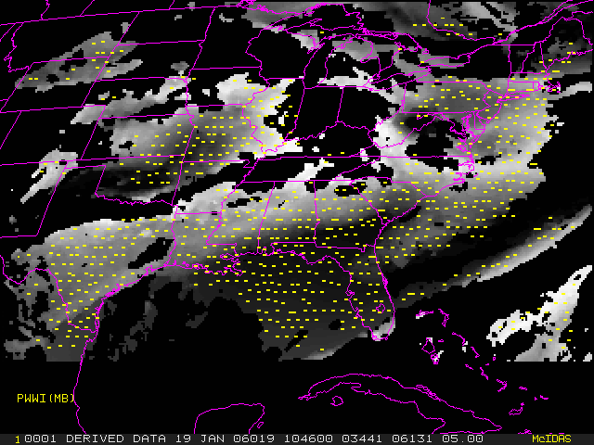
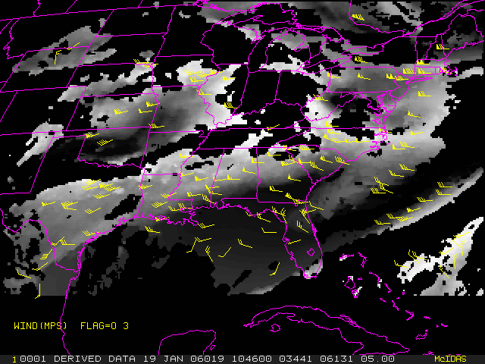
GOES Sounder constant pressure Td images
Targets, 500mb Wind Vectors, 500mb
Constant pressure level dew point temperature (Td) images
eliminate the need for AMV height assignment
Notes:
On the left – targets (clouds are black!)
On the right – wind vectors at 500mb
Before showing results, point out this is preliminary results! First attempt at deriving moisture tracked winds form the sounder.
Wind code has not been significantly changed to accommodate the specific of the data set.

Slide 67
Example: 5 December 2003
12:00 UTC
km
Notes:
Winds at only 20 pressure levels have been shown, due to limitation in the wind code, but the code will be worked on.
These are only Flag 0-3, all QI winds

Slide 68
Example: 5 December 2003
12:00 UTC
km

Slide 69
Thank you!
http://cimss.ssec.wisc.edu/iwwg/iwwg.html

