Slide 1
Basics of Satellite Observations
Will McCarty
Global Modeling and Assimilation Office NASA Goddard Space Flight Center
2015 JCSDA Summer Colloquium
28 July 2015

Slide 2
Acknowledgments
First, parts of these two talks (Basics of Satellite Observations and Infrared Remote Sensing) are drawn from the previous talks of Chris Barnet. He was kind enough to give me his talks and full permission to take from them
Second, a large portion of the figures in this talk were found via google. I didn’t do a good job of giving credit where due, but I don’t deserve credit on many of them

Slide 3
My Background
B. S. Meteorology
Valparaiso University (2003)
M.S., Ph. D. Atmospheric Science
Univ. of Alabama in Huntsville (2005, 2008)
Global Modeling and Assimilation Office
NASA Goddard Space Flight Center
Since January 2009
Of Note:
Summer 2006 (I think) – Spent summer at WWB working w/ John LeMarshall (then-director of JCSDA)
Summer 2007 – Student at the first JCSDA Summer Colloquium

Slide 4
Satellite Basics
What I won’t cover, but can at least address offline if you’re interested:
Anything that looks upwards
Links between ground-based and satellite remote sensing
Links between earth science and space science
This talk will present a number of characteristics of satellite observations, hopefully introducing key terminology

Slide 5
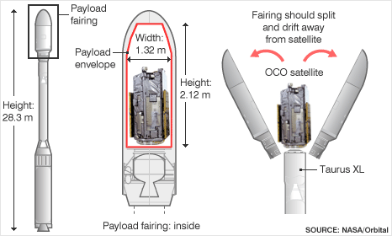
Launch Vehicle/Satellite

Slide 6
Launch Vehicle/Satellite

Slide 7
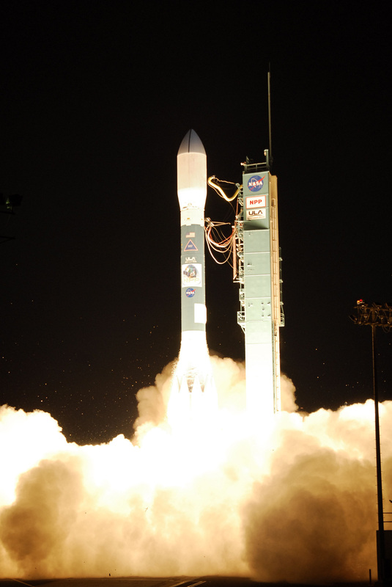
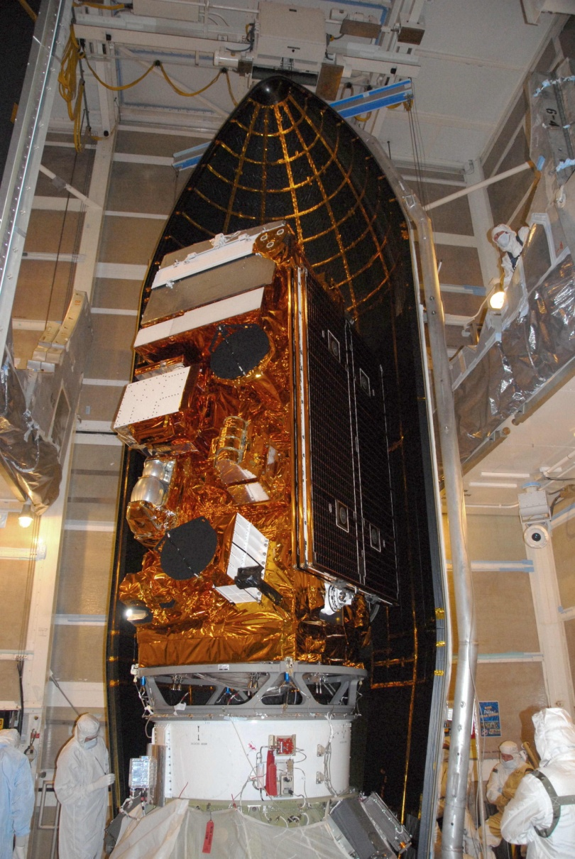
Satellite/Instruments
VIIRS
S-band C+T Antenna
CrIS
X-band DB Antenna
ATMS
CERES
OMPS Nadir, limb
X-band 300 Mb/s Antenna
OMPS (electronics)
Delta-II-7920
Vandenburg AFB
Cubesats
7

Slide 8
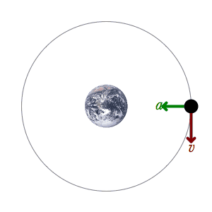
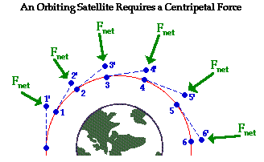
Orbit Characteristics
Satellites orbit as the result of the gravitational force that is equivalent to the net centripetal force
$$F_{centripital}=F_{gravity}$$
Let’s assume a circular orbit…

Slide 9
Orbit Characteristics
$$F_{centripital}=F_{gravity}$$
$F_{centripital}=\frac{m_{satellite}{v_{satellite}}^{2}}{r_{earth}+r_{satellite}}$ $F_{gravity}=G\frac{m_{satellite}m_{earth}}{{\left(r_{earth}+r_{satellite}\right)}^{2}}$
Variable | Value | Description
$$r_{satellite}$$ | constant | Satellite height above surface
$$r_{earth}$$ | 6,378,137.0 m | Earth Radius at equator The earth is not a perfect sphere but an oblate spheroid ($r_{earth}^{equator}>r_{earth}^{pole}$)
$$m_{earth}$$ | 5.972 x 10²⁴ kg | Mass of the Earth
$$v_{satellite}$$ | unknown | Satellite Velocity
G | $$6.67384×{10}^{−11} \frac{m^{3}}{kg s^{2}}$$ | Gravitational constant

Slide 10
Orbit Characteristics
$$F_{centripital}=F_{gravity}$$
$$\frac{m_{satellite}{v_{satellite}}^{2}}{r_{earth}+r_{satellite}}= G\frac{m_{satellite}m_{earth}}{{\left(r_{earth}+r_{satellite}\right)}^{2}}$$
$$v_{satellite}= \sqrt{\frac{Gm_{earth}}{r_{earth}+r_{satellite}}}$$
All that matters for your orbit is that put it at the right height at the right velocity!

Slide 11
Orbital Characteristics
Now you can play games to determine different orbits, and these can be used to determine idealized sampling strategies
We will now walk through a few typical (and atypical) types of orbits in the earth sciences
Sun-synchronous
Geosynchronous (or geostationary)
Molniya
Low inclination, low-earth orbits

Slide 12
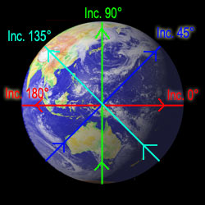
Orbital Characteristics
Quick definitions:
Orbit Inclination
The angle of the orbit relative to the equator
Orbit Period
The time it takes to complete a full orbit
Orbit Node
The ascending node is when the satellite travels from south to north, and the descending node is from north to south

Slide 13
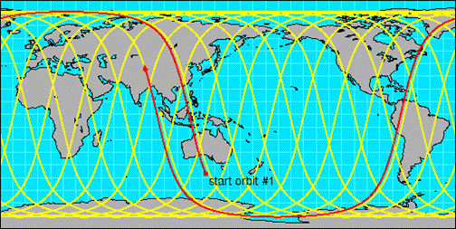
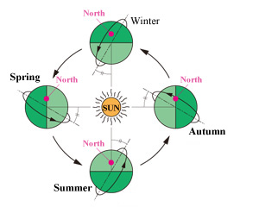
Sun-Synchronous Orbits
Low-earth orbit (~800 km)
High Inclination (polar orbit)
Orbit period is set based a fractional rotation of the earth underneath it
The satellite overpasses the equator at the same local time on its ascending node (e.g. noon at that point)
e.g. 10 orbits per day? Then the period must be 144 minutes
10 orbits * 144 min = 24 hr * 60 min
Orbital plane is consistent in position to the sun
Allows for consistent global sampling daily

Slide 14
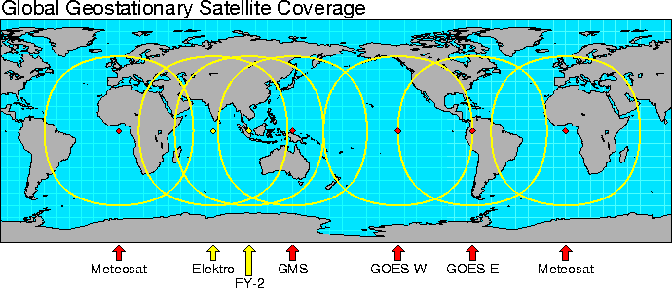
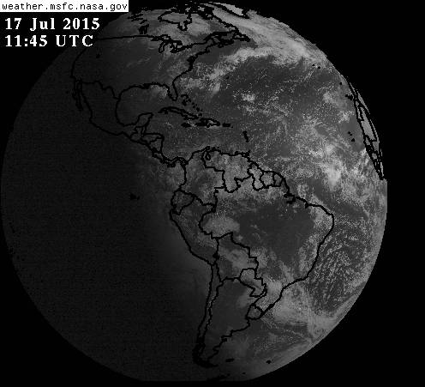
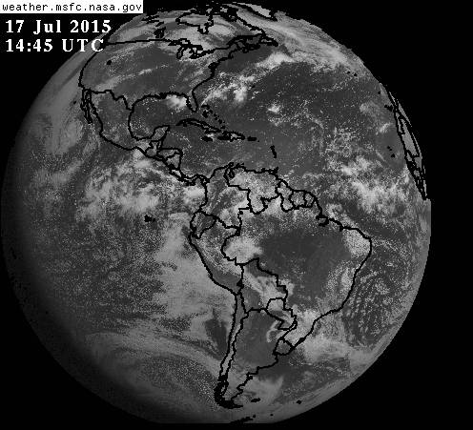
Geosynchronous (Geostationary) Orbit
High Earth Orbit (~35000 km)
0° Inclination (orbits over equator)
Angular velocity of satellite is equal to the angular velocity of Earth
The relative velocity of the satellite to the earth’s surface is zero
Therefore, the orbital period is 1 day, just like the earth
Allows for good local temporal resolution below satellite
multiple satellites are required for global coverage
Also, weak for viewing poles because of high viewing angles

Slide 15
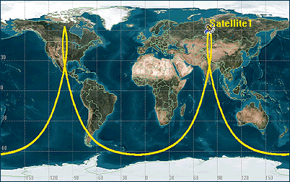
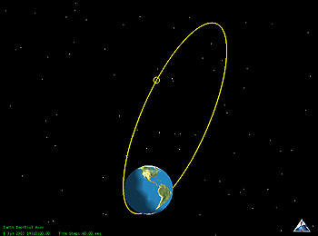
Molnyia Orbit
Highly elliptical
Provides long dwell over the north (or south if flipped) polar regions
Named after a series of Soviet military communication satellites in the 1960s
Has been proposed that a small constellation (~3 satellites) could provide geostationary temporal resolution for the poles

Slide 16
Molnyia Orbit

Slide 17
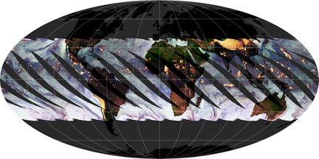
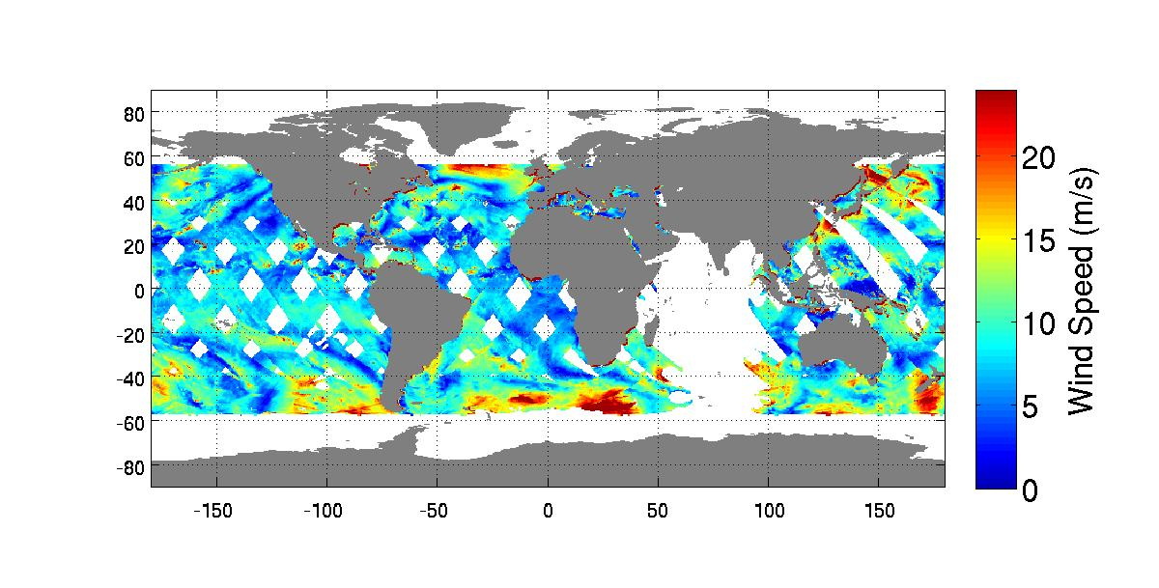
Low-Inclination Orbits
Generally circular orbits at with inclination set to study a specific question
Tropical Rainfall Measurement Mission (incl = 35°)
Global Precipitation Mission (incl = 65°)
RapidScat Instrument
Payload on International Space Station (incl. = 51.6°)
Not sun-synchronous, so diurnal information can be obtained
The relative position to the sun can differ, resulting in complicated satellite maneuvers in space as a result more complicated power management
TRMM
ISS-RapidScat

Slide 18
Other Orbits
These are a sampling of the key meteorological orbits, but there are others of note
GPS orbits (circular in medium earth orbit @ ~ 2000 km)
Space sciences use all sorts of different orbits

Slide 19
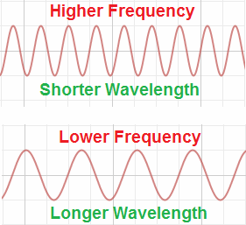
Atmospheric Radiation
At their core, satellite instruments measure atmospheric radiation
Types of radiation are defined in spectral space by:
Frequency (f) – the number of waves of radiation per second (Hz)
Wavelength (λ) – the length of a single wave of radiation (m)
Wavenumber (ν) – one over the wavelength (1/m)
ν = 1/ λ ; λf = c

Slide 20
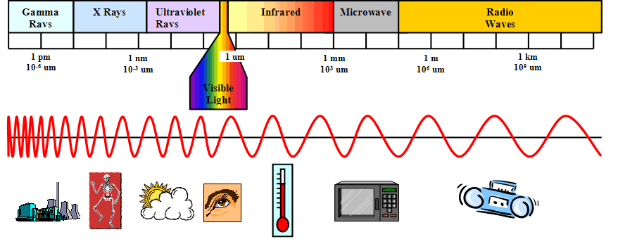
Atmospheric Radiation
Basic Categories in our field:
Ultraviolet (λ < 400 nm)
Visible (400 nm < λ < 700 nm)
Infrared (0.7 μm < λ < 1 mm)
Microwave (λ > 1 mm)
For this talk, I’m going to keep it that simple.

Slide 21
Very Simple Radiative Transfer
Something emits a photon (or light/radiation particle) at a given wavelength as a function of its temperature
When a photon interacts with a medium (gas, a surface, anything), it is either:
Transmitted – passes through with no interaction
Reflected – bounces off the medium
Absorbed – the energy of the photon is incorporated into the internal energy of the medium
 | Temperature | Peak Wavelength | Type of Radiation
Sun | 6000 K | 500 nm | Visible Light
Earth | 290 K | 10 μm | Thermal Infrared

Slide 22
Very Simple Radiative Transfer
The efficiency of these three processes are known as transmissivity (t), reflectivity (ρ), and absorptivity (α), and their sum is equal to 1.0
t = 1.0
α = 1.0
t = ρ = α = 0.333
T = 1.0
ρ = 1.0
=

Slide 23
Very Simple Radiative Transfer
When considering the atmosphere, where there are many different molecules and particles interacting, radiation (many photons) can be scattered
When radiation is scattered back to the source (satellite), that is called backscatter

Slide 24
Instrument Characteristics
Active vs. Passive
Active Instrument: Measures the return reflected by an observed feature from an actively emitted (man-made) source
e.g. Radar, Lidar
Passive Instruments: Measures the radiation emitted or reflected from the observed feature from a natural source (generally Sun and Earth)
e.g. Radiometer

Slide 25
Active Instruments
In atmospheric sciences, active instruments generally break down into three sources
Radar
Lidar
GPS-Centric

Slide 26
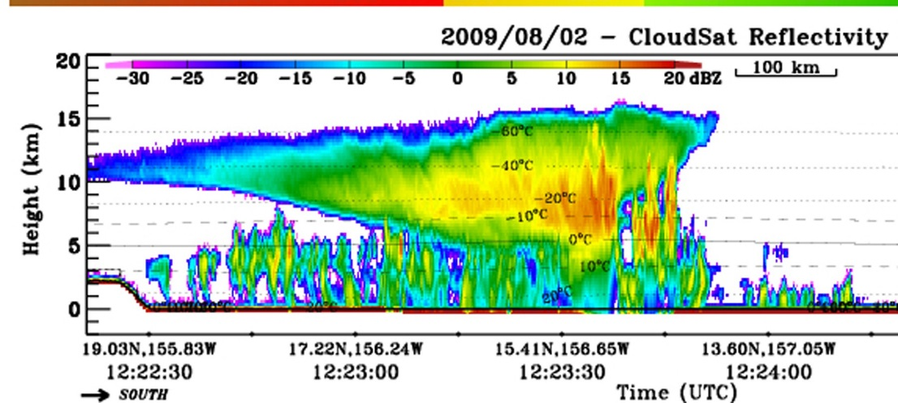
Active Instruments
Radar: a microwave pulse is emitted from the satellite and the backscatter is measured
Some spaceborne radars are cloud- and precipitation profiling
Scatterometry uses a radar to measure surface roughness, which is related to wind speed.
Many measurements from different angles can be used to determine a surface wind vector
Examples:
CloudSat Cloud Profiling Radar
TRMM Precipitation Radar
GPM Dual-Frequency Precip Radar
RapidScat Scatterometer

Slide 27
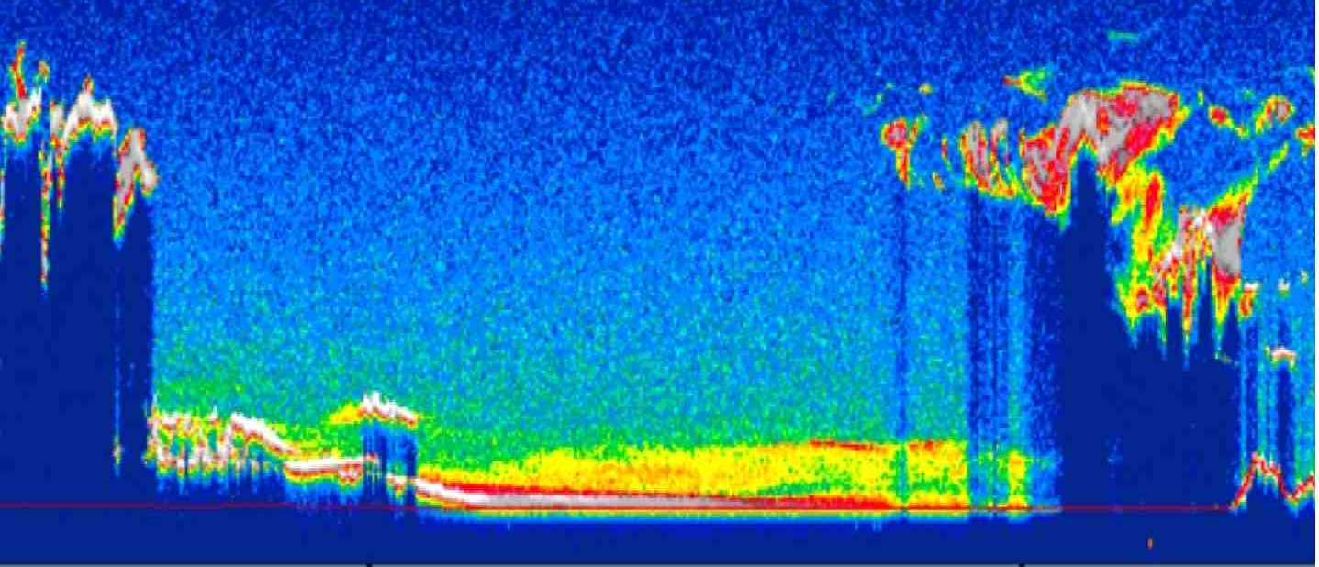
Active Instruments
Lidar: An ultraviolet/visible/near-infrared pulse of light is emitted and the backscatter is measured
Smaller wavelengths means sensitivity to smaller particles
Often used for thin cloud and aerosol studies
Examples:
CALIPSO Cloud-Aerosol Lidar with Orthogonal Polarization (CALIOP)
ISS Cloud Aerosol Transport System (CATS)
ICESat Geoscience Laser Altimeter System (GLAS)
Note the lidar data is subject to attenuation by clouds, while radar can penetrate through
Lidar is more sensitive to small aerosols. Here dispersants from the BP Deepwater Horizon Oil Spill are seen

Slide 28
Active Instruments
GPS: the characteristics of a GPS signal emitted from another satellite is measured and used to determine geophysical information
GPS Radio Occultation
Vertical profiles of refractivity, which is related to temperature and moisture
GPS Surface Wind Speed
Surface roughness is determined by measuring GPS signals reflected off the ocean surface
Lidia will talk more on this tomorrow

Slide 29
Passive Instruments
Passive instruments generally measure either:
Solar radiation reflected by the earth
Terrestrial radiation emitted by the Earth System
Surface and atmosphere
Passive instruments are generally classified into two types:
Imager
Instruments that focus on horizontal resolution
Sounder
Instruments that focus on vertical resolution
Fundamental to all satellite instruments is the concept of resolution

Slide 30
Fundemental Measurements
Radiance
In wavenumber space:
$$\frac{mW}{m^{2}×sr×{cm}^{−1}}$$
or, energy per second (mW) per unit area per unit of solid angle viewing (steradian) per wavenumber (cm⁻¹)
Irradiance
Earth Radiation Budget Experiment (ERBE), Clouds and the Earth's Radiant Energy System (CERES)
Generally, $\frac{W}{m^{2}}$
Or Energy per second (J/s, or W) per unit area
Irradiance is simply radiance integrated over viewing area and wavenumber

Slide 31
Satellite Resolution
At a basic level, satellites are measuring the number of photons hitting a detector over a given time
The detector will have some quantifiable accuracy of how many photons it can detect over an integration period
Detector accuracy translates to a trade-off study of different types of resolution:
Spatial
Spectral
Temporal
Radiometric

Slide 32
Satellite Resolution
Spatial Resolution
Observations are made over a viewing cone (IFOV)
Width of this cone affects the amount of photons that reach the detector
Spectral Resolution
Satellites measure over a spectral response function
For some instruments this may be small (fractions of a cm⁻¹) and others large (many microns)
Spectral resolution is analogous to vertical resolution
Figuratively in land surface remote sensing
Literally in the case of temperature and moisture remote sensing

Slide 33
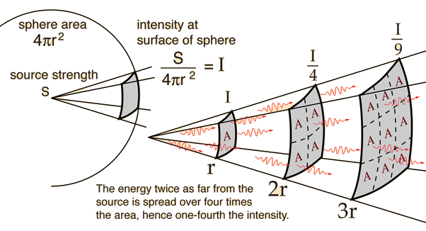
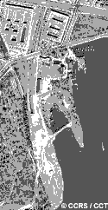
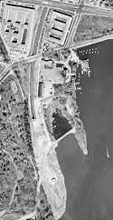
Satellite Resolution
Temporal Resolution
Amount of time between observations of the same earth spot
Affects observation accuracy because better temporal resolution requires higher orbits
Sun-Synchronous ~800 km (2x / day), Geostationary ~35000 km (4x / hour)
Inverse square law
Radiometric Resolution
The amount of pieces of data that can be discerned
Bits of information!
2-bit
8-bit

Slide 34
Satellite Design
The ultimate goal of all of these trade offs are to come up with a platform that is technically feasible but scientifically useful
The bridge between satellite engineers and scientists is often a balance of what can be measured and how it is measured
In terms of harsh stereotypes:
Engineers don’t care about the use of the data, only on how the system can be designed to get the optimal measurement within the limits of technology
Scientists don’t care why the measurements are limited, they just want all the data possible and typically more data and better data than is feasible

Slide 35
Satellite Design
The ultimate goal of all of these trade offs are to come up with a platform that is technically feasible but scientifically useful
The bridge between satellite engineers and scientists is often a balance of what can be measured and how it is measured
In terms of harsh stereotypes:
Engineers don’t care about the use of the data, only on how the system can be designed to get the optimal measurement within the limits of technology
Scientists don’t care why the measurements are limited, they just want all the data possible and typically more data and better data than is feasible
Program managers get the fun of balancing all this within a cost cap

Slide 36
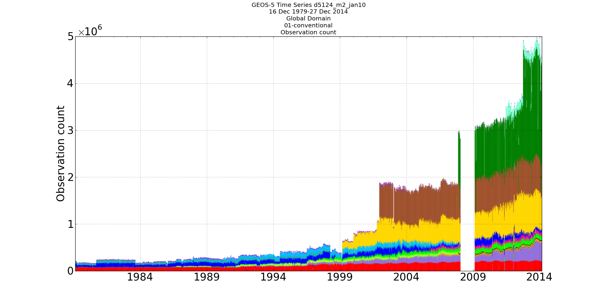
Observations as a Function of Time
Observations assimilated per 6-hr cycle
The vast majority of observations over the modern era (1979-onward) are of satellite origin
This excludes SSMIS. Using SSMIS, the total eclipses 5 million

Slide 37
Satellites in the Global Observation System
Animation

Slide 38
The Variational Approach for Satellite Data
y – H(x) = y – (H(x_{b}) + Hδx)
H(x) transforms the background/guess state to observation space
If in the same space, as simple as an interpolation
If in different space, H can be radiative transfer (radiances), a projection of the wind…
anything to relate analysis space to observation space (well, that can be linearized to H)

Slide 39
Satellite Data Assimilation
A fundamental part of satellite data assimilation is an understanding of both the assimilation process and the observations
And all the assumptions underlying
The use of retrieved quantities adds another set of assumptions
Some retrievals will be more compatible with data assimilation than others
The modern observing system is debatably saturated
It is difficult to gain quantifiable impact by adding new instruments via existing methodologies

