Slide 1
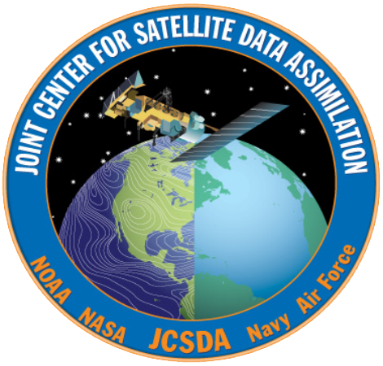
The Global Observing System
Presented By: Jim Yoe
Based on a presentation by Lars Peter Riishojgaard

Slide 2
Overview
Why is a Global Observing System needed?
Characteristics of the GOS
Ideal
Actual
Ownership and Management
Main GOS components
Surface-based
In-situ
Satellites
How do we know how well it works?
The future of the Global Observing System

Slide 3
Need for the GOS
Numerical weather prediction is an Initial Value Problem
The kinematics, dynamics, and thermodynamics of the atmosphere can be described by known partial differential equations, discretized versions of which are solved using high performance computing systems
Initial conditions necessarily for solving these equations are established using observations
Three-legged stool analogy often used
Notes:
Opportunity to discuss three-legged stool of science/tech (model and DAS), HPC, and observations, and the need for balance.

Slide 4
NWP requirements for upper-air data coverage
Notes:
NWP beyond the two to three-day range is a global problem, requiring a continuous supply of observational data from the entire global domain

Slide 5
Ideal Global Observations for NWP
Regularly spaced measurements over entire model domain; Close to model resolution; taken at regular intervals in time, of the following quantities
Temperature (3D)
Humidity (3D)
Horizontal winds (3D)
Secondary constituents - e.g. ozone (3D), aerosols
Surface pressure (2D)
Lower boundary conditions; sea ice characteristics, sea/land surface temperature, soil moisture & type, vegetation (2D)
We need this at low latency, i.e. data should be no older than 1-2 hours by the time they are available to modelers (and growing more stringent)

Slide 6
Actual Global Observations
A heterogeneous mix of measurements at widely varying spatial and temporal resolutions
Quantities that are mostly indirectly related to the predicted and analyzed variables
Data latencies varying from minutes to 8-10 hours or more
Part of the challenge in data assimilation
Why? Partly physics, and partly……

Slide 7
Ownership and Management
Ownership
Multiple national entities
Predominately public, but some private
Operational and research components
Management (Simplified/Idealized)
World Meteorological Organization (UN)
World Weather Watch
Global Observing System
Notes:
The reality of the ownership places huge constraints on the international management. WMO is in a good position to recommend and encourage, but NOT to dictate. Generally cooperation is good, w/in the bounds of varying resources by individual nations – since ALL need more observations than they can afford or are otherwise able to collect, open exchange is the norm.

Slide 8
The Global Observing System
A global network of observatories taking routine weather-related observations that are processed and disseminated to all WMO member states in (near-) real time
“Observatories” are operated by WMO members (NMHS’s), and international organizations (e.g. ESA, EUMETSAT)
WMO coordinates, regulates, and issues guidelines and standards

Slide 9
The Global Observing System (II)
The GOS represents the collective efforts of the ~190 WMO member states, associated territories and partner international organizations toward getting real-time meteorological observations
Total cost of running all components of the GOS estimated to be on the order of $10B/year
~ 50 years of international collaboration

Slide 10
Surface-based components of the GOS
SYNOPs (Z,u,v,t,q, cloud base, visibility, etc., reported every 6 h)
Ships, buoys (similar to SYNOPS, at sea)
Wind profilers - regional, over the US, Europe
Radars – precipitation (phase, rate), wind; essential for nowcasting, AND for regional NWP
Lidars - limited range, useful for clear air wind measurements
SODARs
Ground-based GPS sensors for column IWV (US, Japan, Europe)

Slide 11
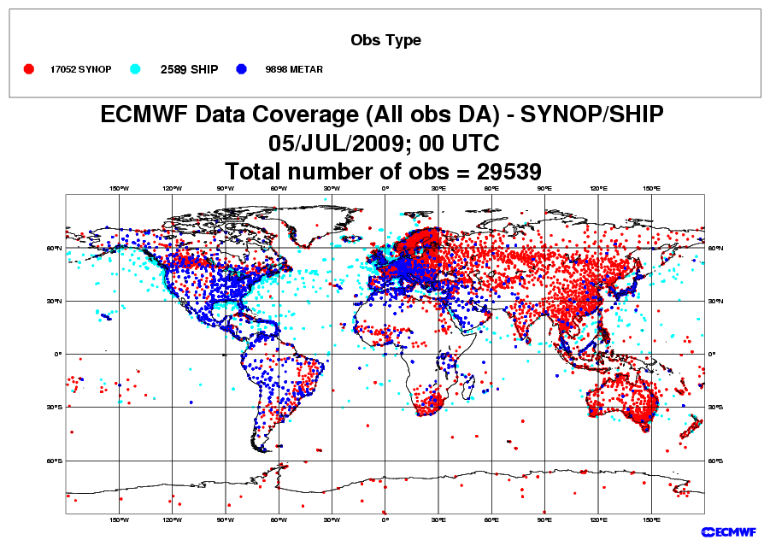
SYNOPS, SHIPS
Impact, issues
Models cannot function well without these data
Highly heterogeneous distribution
Sparse in the Southern Hemisphere
Observations over land difficult to use in terrain (mismatch between actual vs. model topography)

Slide 12
In situ measurements
Balloon-borne radiosondes
TEMP - u, v, T, q at synoptic times (00 and 12 Z) at ~600 locations mostly over the densely populated regions in the NH
PILOT - u, v at synoptic times (6 and 18Z) at limited number of locations
Dropsondes (targeted)
Aircraft measurements
Research balloons

Slide 13
Radiosondes (TEMP)
“Point” measurements of (Z),T, u, v, q
Essential for NWP skill, both directly and indirectly (satellite radiance bias correction)
Time sampling is problematic
Different parts of the globe systematically sampled at different local times
Horizontal sampling is inadequate (minimal SH, oceanic coverage)
Little or no stratospheric penetration
Quality control very difficult
Different operating (and reporting) practices
Different models and manufacturers of on-board sensors
Operating costs (~$B/year; some nations reducing to save)

Slide 14
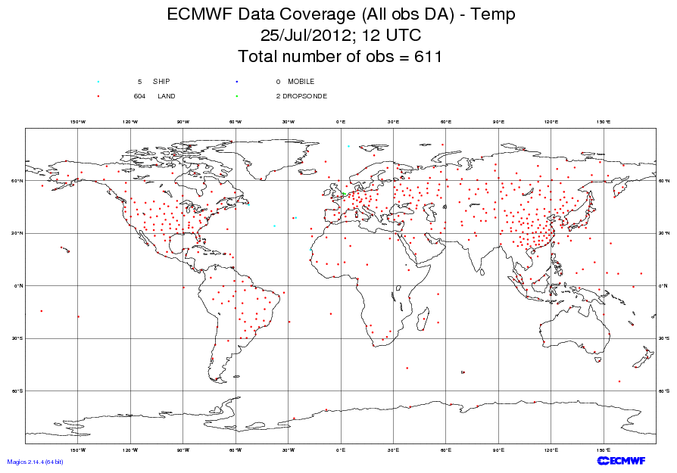

Slide 15
Aircraft observations
PIREP - human report, provided by both general and commercial aviation; no longer widely used for NWP
AIREP - human report, regular lat/lon intervals, disseminated on WMO GTS
AMDAR - automated observations of u,v,T transmitted to ground via terrestrial or satellite radio, disseminated on GTS
Both ascent/descent profiles and flight level information widely used for NWP
Pilot programs with on-board humidity sensors both in Europe and the US (primarily for profiling)

Slide 16
AMDAR
Large and growing NWP impact
Anisotropic sampling both horizontally and vertically
Flight level winds represent a biased sampling (routing driven by fuel savings)
Vertical profiles are sparse (ascent/descent near major airports)
Difficult QC problem
E.g. record does not include aircraft tail number

Slide 17
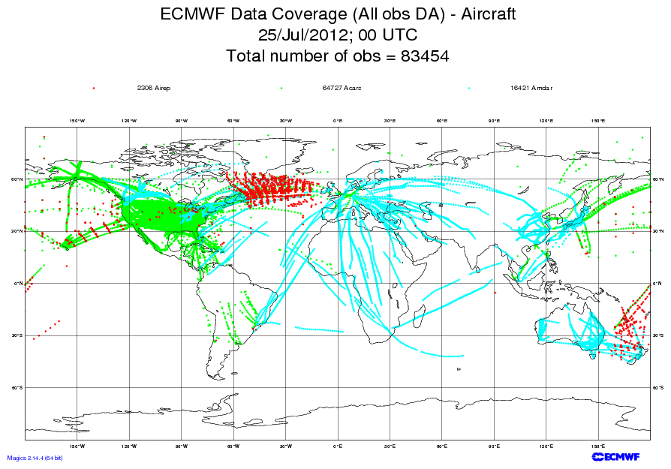

Slide 18
Space-based components of the GOS
Geostationary orbit
Polar orbit
Sun-synchronous

Slide 19
Geostationary satellites
An international constellation of ~6 operational satellites at 35,800 km altitude at fixed longitudes in the Earth’s equatorial plane
High temporal resolution imaging
Extremely valuable for monitoring & nowcasting
High and “upper middle” latitudes not well covered
Data assimilation previously considered a secondary
Changing with advances in time-dependent DA
Changing with coming of more “sounder-like” sensors

Slide 20
AMV (SATWIND)
Winds derived from tracking of features in cloud (or WV) field in imagery from geostationary and polar platforms
Large and growing impact on NWP skill
Single level coverage
No operational high-latitude coverage
Experimental dataset available from MODIS
Difficult quality control problem
Errors in assigned height can lead to negative impact
Errors in tracking can lead to gross errors

Slide 21
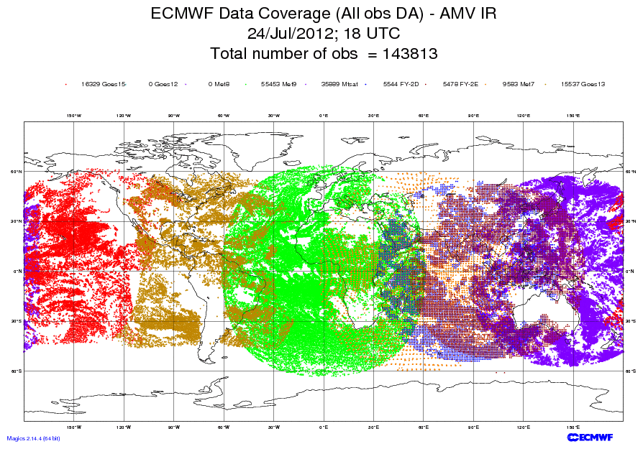

Slide 22
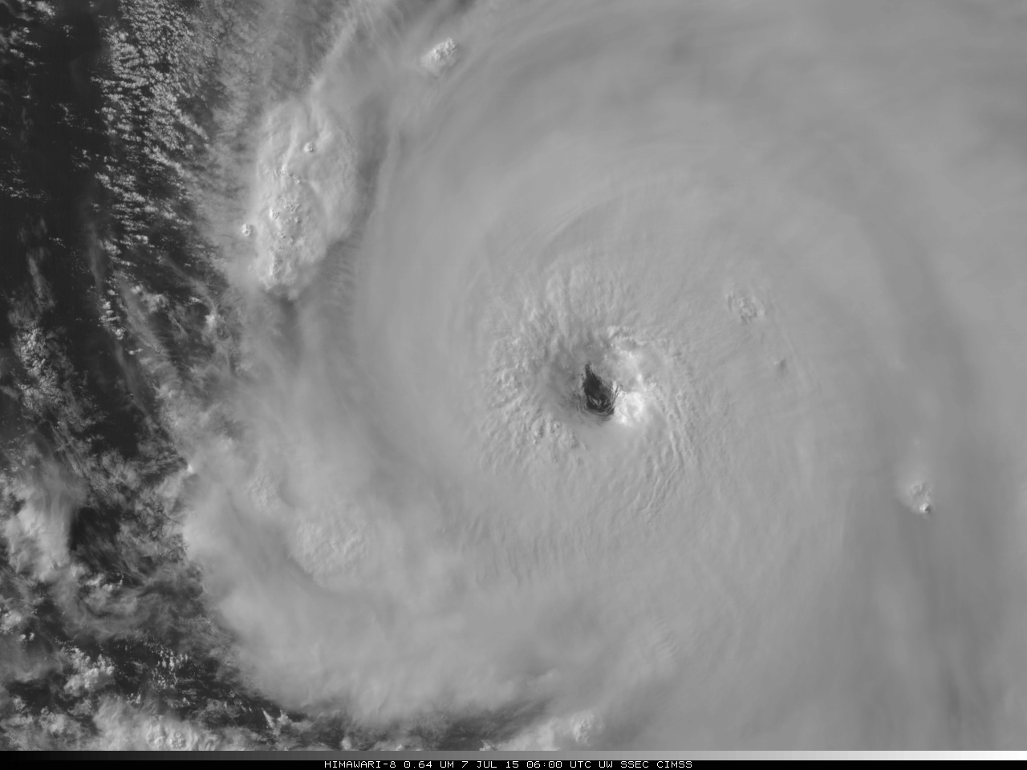
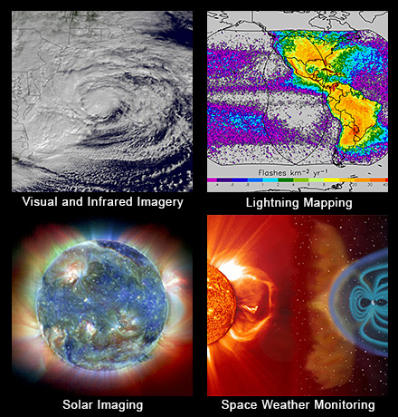
GOES-R: Coming 2016
H8 Image of Typhoon – 7/7/15

Slide 23
Polar orbiters
Large fleet of research and operational satellites in a variety of “polar” orbits (many sun-synchronous) provides NWP impact (see later slides) w/resilience
Operational satellites include:
NOAA/NESDIS: POES, S-NPP, JPSS (coming)
EUMETSAT: METOP A and B
China
Research satellites include
NASA: Aqua/AIRS, Terra, GPM, SMAP
JAXA
ESA
CSA

Slide 24
Polar orbiters (II)
Observations are asynoptic by nature
Typical orbit height between 350 and 850 km; velocity relative to ground ~7 km/s
Global coverage is “patched” together over a period of 12 or 24 hours or longer
Data assimilation is the primary application for several polar orbiting sensors
Microwave sounders and hyperspectral IR sounders are among the most important data sources for NWP

Slide 25
Microwave Sounders
Essential for NWP (AMSU-A typically ranked at or near the top in terms of impact on skill)
Best global coverage of any observing system
Requires observation operators (radiative transfer modeling)
Use of surface sensing channels problematic; emissivity of snow, ice, land, and to some extent sea
Clouds, precipitation affect
Inter-instrument biases

Slide 26
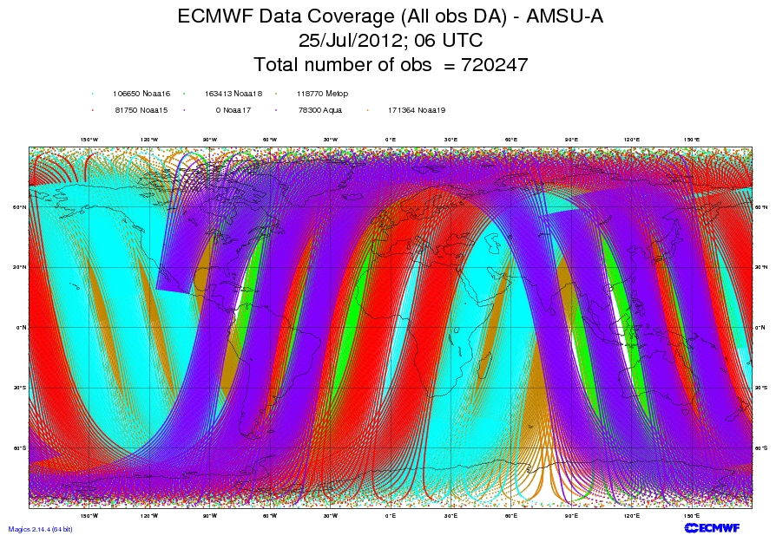

Slide 27
Hyperspectral IR sounders (AIRS, IASI, CrIS)
Typically ranked at or near the top in terms of impact on skill per instrument
Prolific data source (billions of measurements per day)
Only a small fraction these used for NWP due to difficulties with
Clouds
Model prediction (WV)
Surface emissivity
Correlated information
Data volume

Slide 28
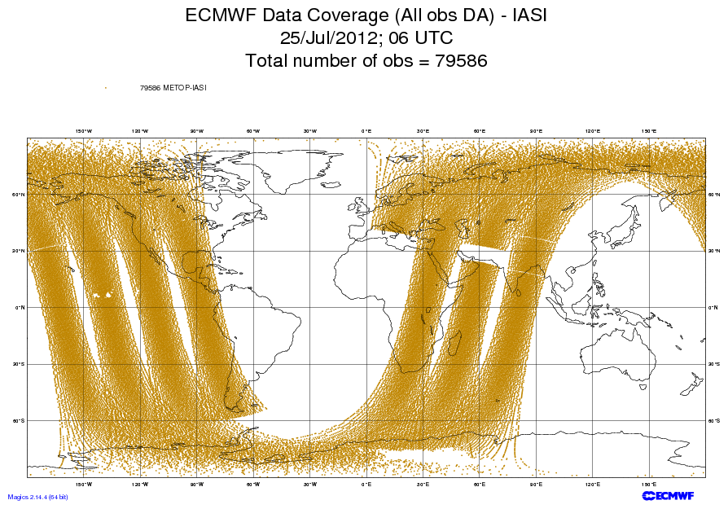

Slide 29
Slide from Cucurull

Slide 30
GPSRO
Medium/high impact on NWP skill
Large impact especially in the upper troposphere
Free from calibration drift; can be used to calibrate data from other observing systems
Assimilation methodology still evolving: From T/q to refractivity to bending angle to phase delay ….
Unusual (complementary) measurement geometry due to limb approach
Good global coverage can be obtained by constellation approach (COSMIC and COSMIC-2)

Slide 31
Other satellite sensors used for assimilation or validation of NWP
Scatterometers and Synthetic Aperture Radars
Radar altimeters (Ocean Surface Topograpghy)
Microwave imagers
VIS/IR imagers
Precipitation radars
Cloud radars
Aerosol lidars
UV imagers/spectrometers for atmospheric composition
New sensors
GOES-R Lighting Mapper (GLM)
Soil Moisture Active/Passive
Doppler Wind Lidar

Slide 32
Impact assessment (I)
Observing system simulation experiments (data denials)
No additional development required
Computational expensive to run
Typically require runs in TWO seasons
Only bulk measure of impact
But more statistically significant that case studies
Focusing on the medium range
Many different measures of skill can be studied for a given set of experiments

Slide 33
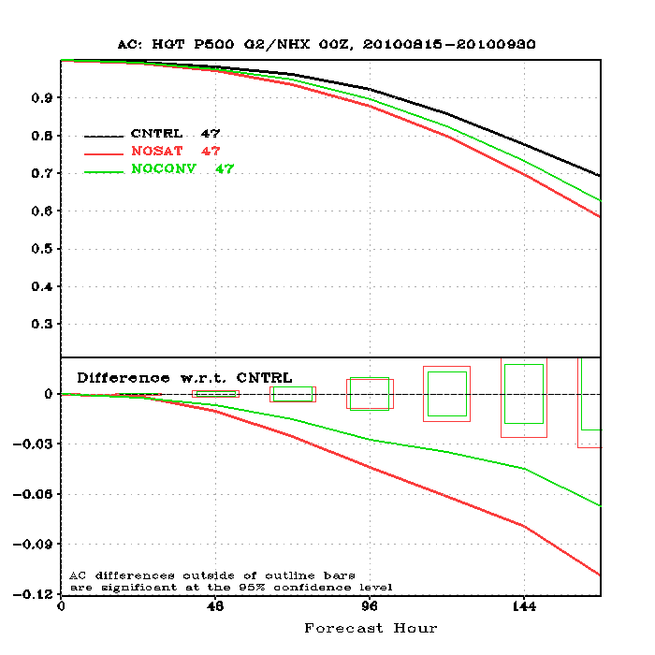
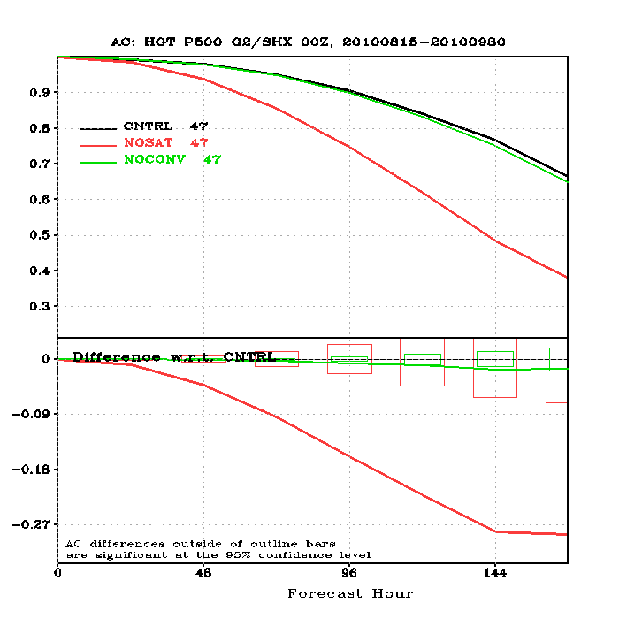
500 hPa Anomaly Correlations 15 Aug – 30 Sep 2010
No Satellite / No Conventional Data
Northern Hemisphere
Southern Hemisphere
(J. Jung, 5th WMO Impact Workshop, Sedona 2012)

Slide 34
Impact assessment (II)
Forecast Sensitivity to Observations (FSO)
Development-intensive (e.g. adjoint of forecast model)
Relatively inexpensive to run
Detailed “per ob” apportionment of impact
Focus on impact of the observation on skill during first 24 h (assumption of linearity)
Method only shows impact on one pre-defined cost function per calculation

Slide 35
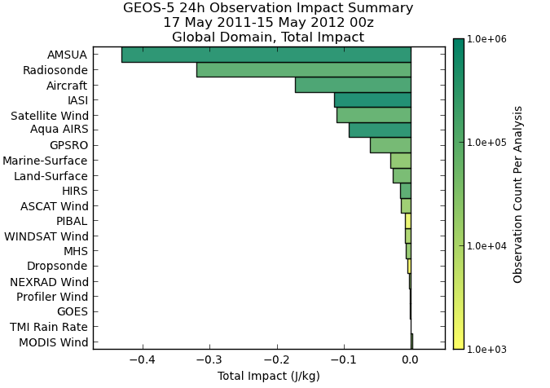
FSO Example From NASA

Slide 36
The future of the GOS
Recognizing that the mandates of most National Meteorological and Hydrological Services are expanding, WMO has decided to implement WIGOS, the WMO Integrated Global Observing System
“GOS++”, or GOS with
Observations (beyond those needed for weather applications) of climate, atmospheric composition, oceans, land surface, hydrology parameters
RRR fully integrated for all components
Quality Management Framework
Disseminated via WIS (WMO Information System)

Slide 37
GOS in Summary (1)
Critical collection of infrastructure for meteorology and NWP
Complex with many stakeholders
Users
Providers
“Somewhat opaque management structure and decision-making processes”

Slide 38
GOS in Summary (2)
In spite of its successes, the heterogeneity of the GOS poses an enormous challenge to the data assimilation/NWP community
Quality control
Bias
Observation operators (relationship between observed and modeled variables)
Data latency
Data assimilation community can help define the GOS of the future

