Slide 1
Community Radiative Transfer Model
(CRTM)
Overview and Tutorial

Slide 2
Overview
Some background
  How does radiation interact with matter
  Development of radiative transfer
Additional CRTM components (not all, just some)
  Non-LTE, Zeeman, emissivity models, etc
CRTM Interface
  Forward, Tangent-linear, Adjoint, and K-matrix models.
Calling the CRTM
  Step-by-step for the K-matrix model.
Default available object methods
  Not really OO yet, but we’re heading that way.

Slide 3
Introduction
CRTM is a library containing functions to compute satellite sensor radiances, and Jacobians.
  Fortran95/2003.
  Heavy use of language features made to ease code maintenance and reuse of common components.
Geared towards data assimilation (i.e. GSI at NCEP) but used in other contexts.
There are forward, tangent-linear, adjoint, and K-matrix functions.
  Forward model is “built in” to the other functions so they are all stand-alone.

Slide 4
Background

Slide 5
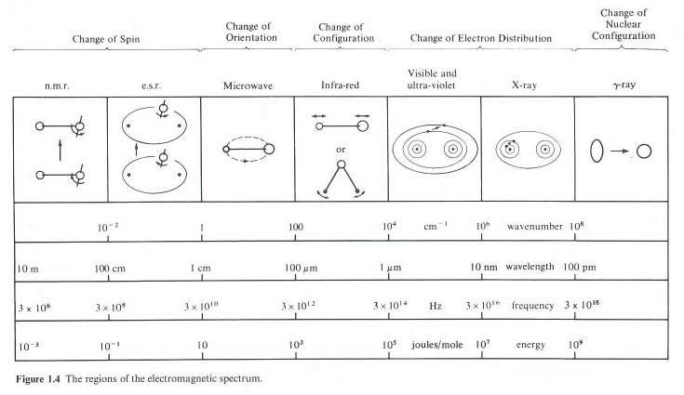
Electromagnetic spectrum
From: Banwell, C.N., 1983, “Fundamentals of Molecular Spectroscopy”, McGraw-Hill, London.

Slide 6
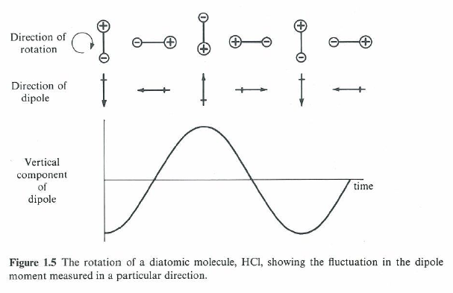
Microwave – rotation of molecules
Same process for oxygen, but due to its permanent magnetic dipole.
From: Banwell, C.N., 1983, “Fundamentals of Molecular Spectroscopy”, McGraw-Hill, London.

Slide 7
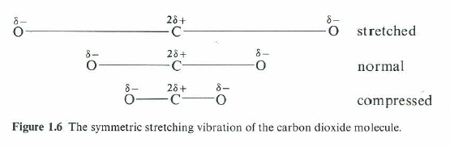
Infrared – vibration of molecules. Symmetric stretching
No change in dipole moment.
Vibration is “infrared inactive”
From: Banwell, C.N., 1983, “Fundamentals of Molecular Spectroscopy”, McGraw-Hill, London.

Slide 8
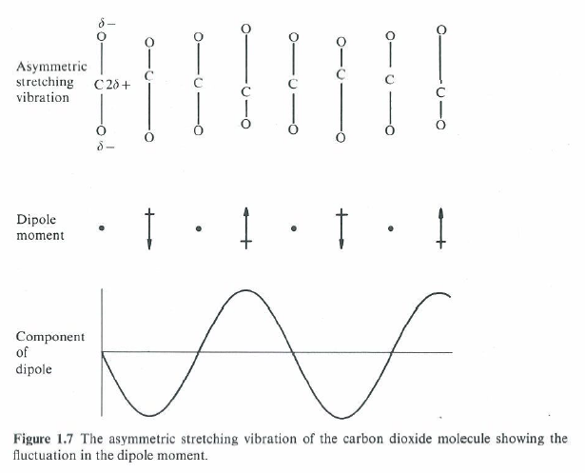
Infrared – vibration of molecules. Asymmetric stretching
From: Banwell, C.N., 1983, “Fundamentals of Molecular Spectroscopy”, McGraw-Hill, London.

Slide 9
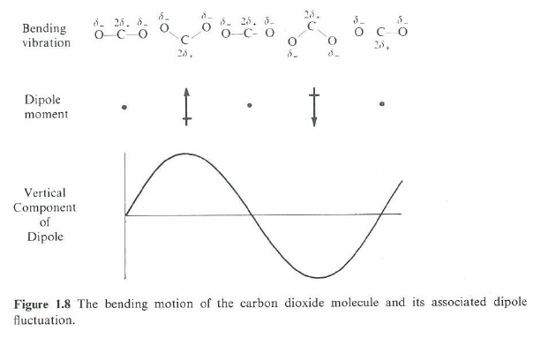
Infrared – vibration of molecules. Bending motion
From: Banwell, C.N., 1983, “Fundamentals of Molecular Spectroscopy”, McGraw-Hill, London.

Slide 10
Mechanism behind the interaction of radiation and matter
The change in a molecule’s dipole moment (electric or magnetic) as it rotates or vibrates is what allows it to interact with radiation.
The energies at which molecules interact with radiation are determined by properties such as their shape (e.g. rotational inertia) and bond strength (e.g. elasticity of stretching and bending motions).
Additionally, the rotational and vibrational energies of molecules are quantised. Thus, molecules interact with radiation at well defined frequencies.
So what?

Slide 11
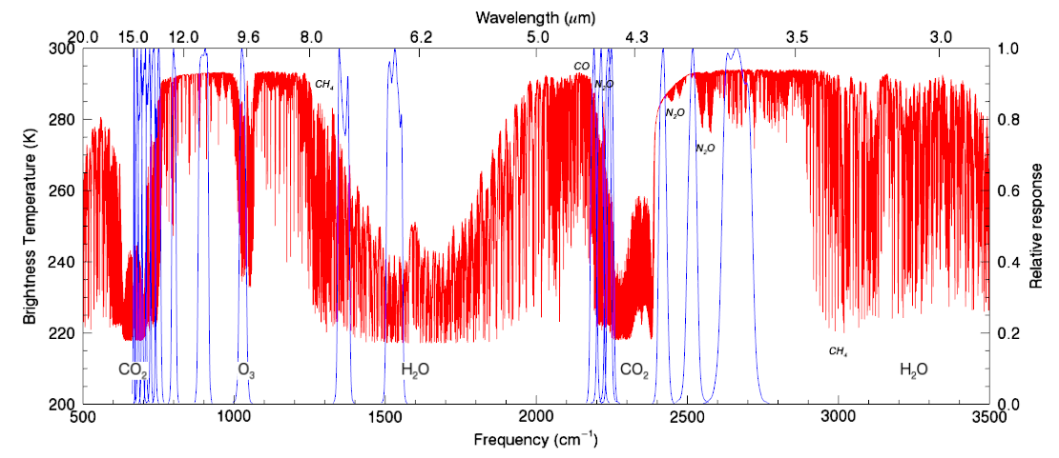
Infrared spectrum
HIRS spectral response functions

Slide 12
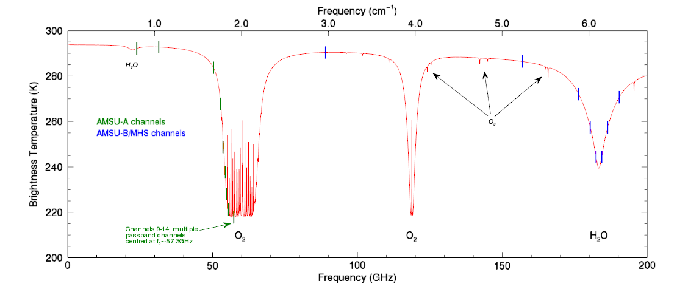
Microwave spectrum

Slide 13
Information in the measured spectra
The measured spectra give us information about the state of the atmosphere and surface.
  How much of molecule X?
  Temperature at pressure Y?
  Surface temperature?
Extracting this information from radiance measurements is a classical inversion problem.
But first we have to be able to simulate the transfer of radiation through the atmosphere.

Slide 14
Some definitions
Absorption, extinction: radiance decreases.
Emission: radiance increases.
Kirchoff’s Law: Under the conditions of local thermodynamic equilibrium (LTE), the absorptivity, a, of a medium is equal to its emissivity, ε.
Lambert’s (or Bouguet’s) law: The absorption process is linear, independent of the radiant intensity and amount of matter, provided the physical state is held constant.

Slide 15
Interaction of radiation and matter
From Lambert’s law, the change of radiance, I, along a path ds due to extinction is proportional to the amount of matter in the path:
Similarly for emission
  β_{a} = volume absorption coefficient
  J = source function.
Total change in radiance due to interaction of radiation and matter is then,
This is Schwarzchild’s equation
k_{a} = mass absorption coefficient
ρ = density
Is the Planck function, B(T), under LTE in a non-scattering medium
With apologies to Max Planck, k_{a} encompasses all the interesting physics
Petty, G.W., 2004, “A First Course in Atmospheric Radiation”, Sundog Publishing, Madison WI.
Goody, R.M. and Y.L. Yung, 1989, “Atmospheric Radiation: Theoretical Basis”, 2nd Ed, Oxford University Press, New York.

Slide 16
Non-scattering solution
This is where we define the optical thickness between two points along the path:
Using this in Schwarzchild’s equation and integrating the optical thickness thickness from 0 (s_{toa}) to it’s value at the surface (s_{sfc}) :
Manipulation of this expression leads to the more familiar (well, to me) non-scattering radiative transfer equation (RTE),
  where
Weighting function
Petty, G.W., 2004, “A First Course in Atmospheric Radiation”, Sundog Publishing, Madison WI.

Slide 17
Transmittance calculation
The gaseous absorption algorithm is the core of the CRTM (or any model).
Regular regression model is used where frequency dependent regression coefficients, c_{i,v}, are used with atmospheric state predictors, X_{i}, to compute the channel absorption coefficients,
Two algorithms for gaseous absorption
  ODAS (Optical Depth in Absorber Space).
    A “compact” version of the OPTRAN model.
    H₂O, O₃ absorption only.
  ODPS (Optical Depth in Pressure Space).
    Optical depths computed on a fixed pressure grid.
    Better fitting statistics.
    More trace gases: CO₂, CH₄, N₂O.
    Enables incorporation of Zeeman model (requires fixed pressure grid).

Slide 18
RTE with scattering
With scattering the change in intensity, dI, becomes:
  where
  and
The dI_{scat} term takes into account radiation from any direction being scattered into the sensor field-of-view (FOV),
The CRTM uses a look-up table to obtain scattering optical properties (e.g. extinction coefficient, single scatter albedo, etc) and reconstruct phase functions for the necessary number of streams (angles over which the zenith integration is done)
Scattering phase function
Petty, G.W., 2004, “A First Course in Atmospheric Radiation”, Sundog Publishing, Madison WI.

Slide 19
OTHER CRTM components

Slide 20
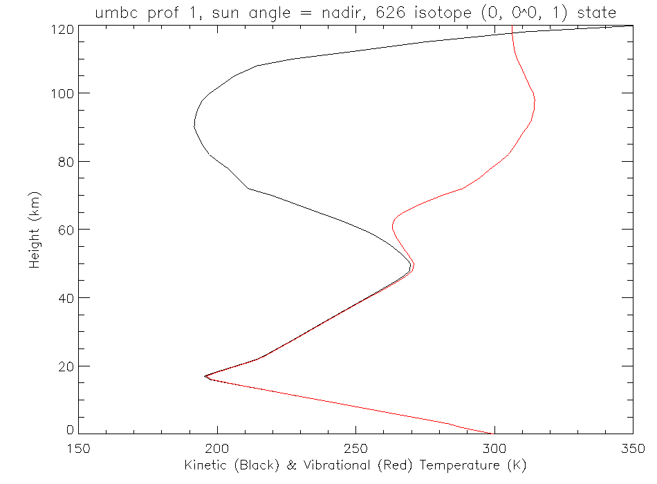
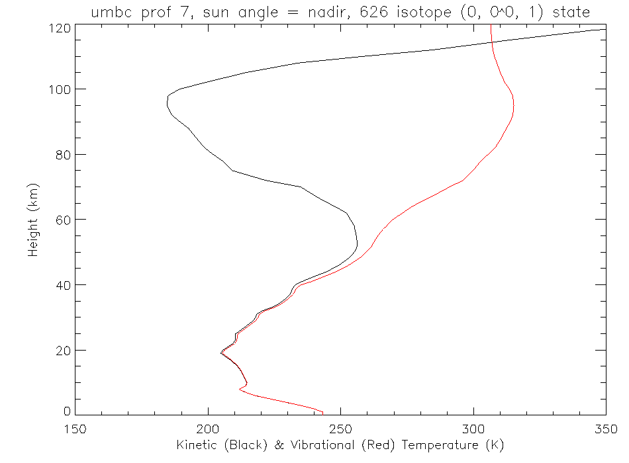
Non-LTE model (1)
At high altitudes, vibrational transitions depart from LTE.
Planck function cannot be used as a source function.
Populations of NLTE and LTE high states
Kinetic temperature
Vibrational temperature
NLTE and LTE absorption coefficients
Vibrational temperature

Slide 21
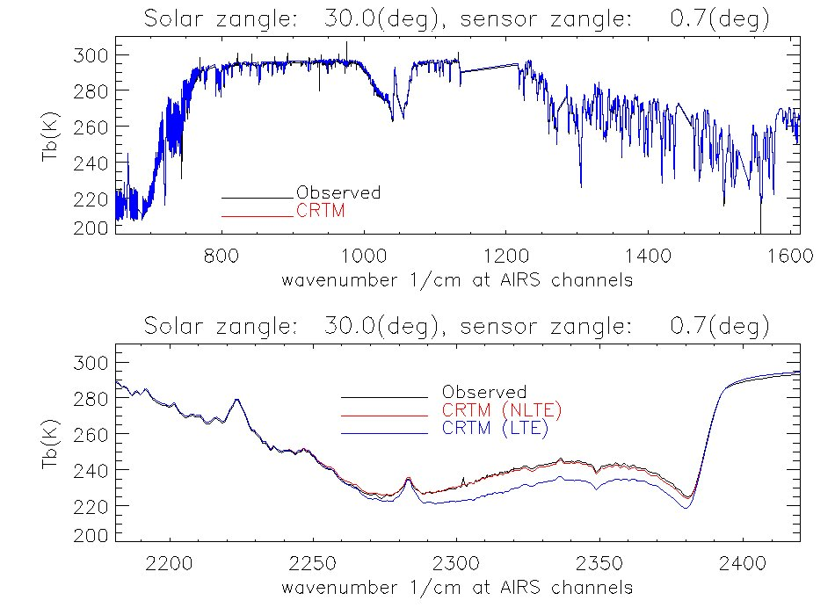
Non-LTE model (2)
Simple regression model predicts the correction to LTE radiances,
Predictors | Description
X₁ | Solar zenith angle
X₂ | Mean temperature from 0.005-0.2hPa
X₃ | Mean temperature from 0.2-52hPa
X₄ | Sensor zenith angle
Remaining differences between observations and NLTE simulations in the shortwave traced to certain CO₂ isotopologues not being present in the spectroscopic database.

Slide 22
Non-LTE model (3)
Comparison of observations and CRTM calculations for IASI shortwave channels, both day and night.
Non-LTE
BRDF

Slide 23
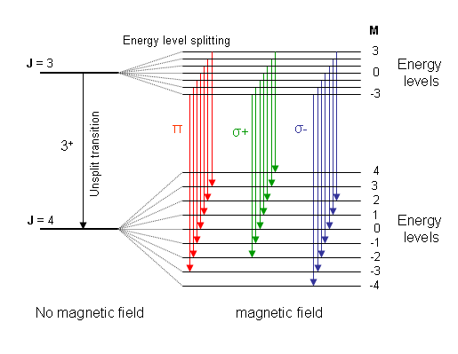
Zeeman model (1)
Energy level splitting:
In the presence of an external magnetic field, each energy level associated with the total angular momentum quantum number J is split into 2J+1 levels corresponding to the azimuthal quantum number M = -J, …, 0, …,J
Transition lines (Zeeman components) :
The selection rules permit transitions with ∆J = ±1 and ∆M = 0, ±1. For a change in J (e.g. J=3 to J=4, represented by 3⁺), transitions with
∆M = 0 are called π components,
∆M = 1 are called σ+ components and
∆M = -1 are called σ- components.
Polarization:
The three groups of Zeeman components also exhibit polarization effects with different characteristics. Radiation from these components received by a circularly polarized radiometer such as the SSMIS upper-air channels is a function of the magnetic field strength |B|, the angle θ_{B} between B and the wave propagation direction k as well as the state of atmosphere, not dependent on the azimuthal angle of k relative to B.

Slide 24
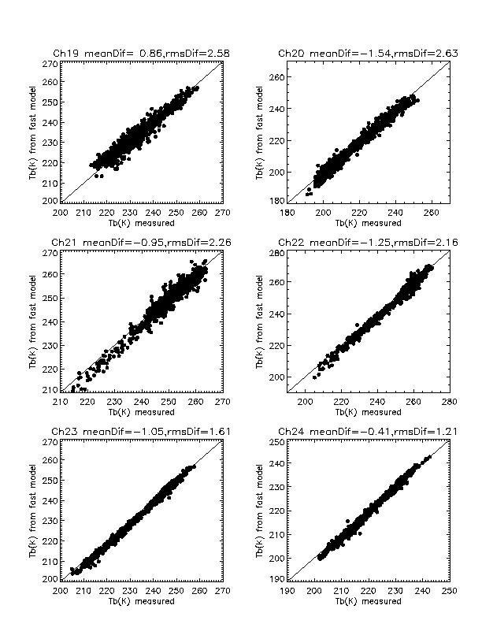
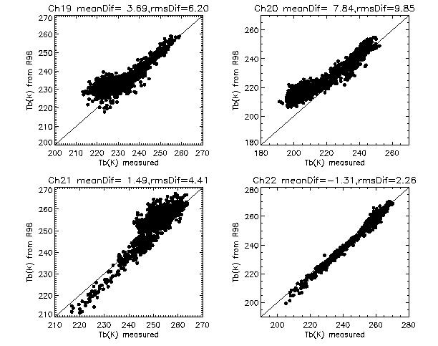
Zeeman model (2)
Comparison between SSMIS observations and CRTM calculations
Including Zeeman effect
Without including Zeeman effect
Channels 23 and 24 are not affected by Zeeman-splitting.
Colocated temperature profiles for model inputs are retrievals from the SABER experiment. 1097 samples.

Slide 25
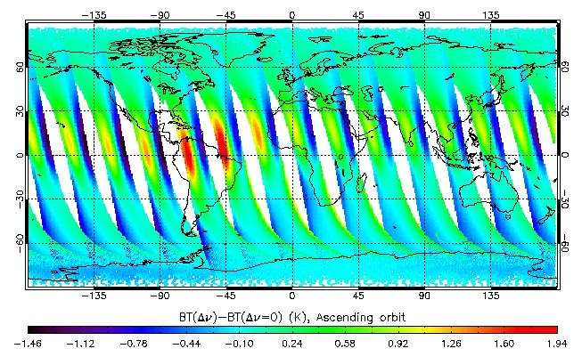
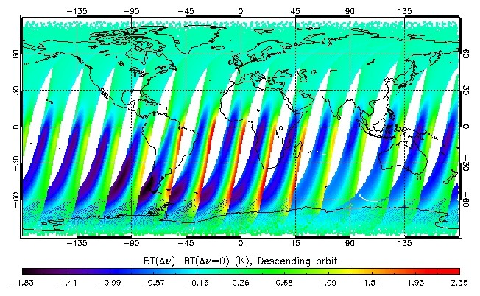
Zeeman model (3)
Frequency shift of radiation spectrum due to Earth’s rotation also has to be taken into account.
Doppler shift in frequencies can be as much as 80kHz in some regions and scan pixels.
Impact of Doppler shift has a strong dependence on the angle between the Earth’s magnetic field and the wave propagation direction, θ_{B}. Can reach 2K when θ_{B} = 0° or 180°, but becomes very small when θ_{B}=90°.
Simulated brightness temperature differences for SSMIS channel 20 with and without the inclusion of the Doppler shift effect for observations on January 1, 2006. Temperature profiles obtained from the CIRA-88 model.

Slide 26
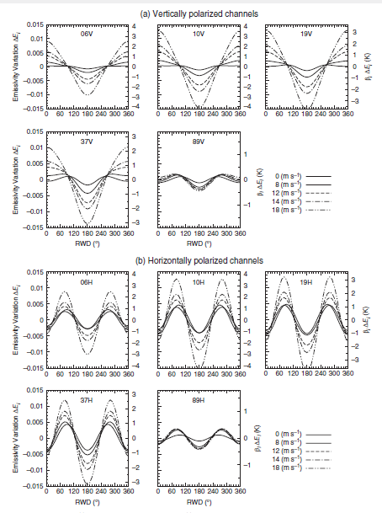
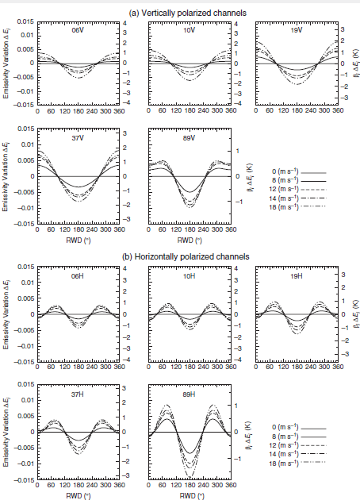
Microwave sea surface emissivity model
FASTEM-6 azimuthal emissivity dependence using Kazumori and English¹ RWD model.
FASTEM-5 CRTM response
FASTEM-6 response
¹Kazumori, M. and S.J. English (2014), Q. J. R. Meteorol. Soc., doi:10.1002/qj.2445

Slide 27
And regarding emissivity modeling…
CRTM currently contains models to handle IR/MW land/sea/snow/ice surface optics.
We are moving towards use of a separate library, the Community Surface Emissivity Model (CSEM) within the CRTM to allow for quicker updates to surface models.
Ming Chen (NESDIS/STAR – JCSDA) is the project lead for this implementation
CSEM is a OOP-based surface emissivity model system:
  It may be used as an independent model system or as a subsystem of upper-level systems, e.g. CRTM.
  CSEM is designed to offer such a platform where optional research algorithms (models) may be easily developed, added, tested and used besides those that have been chosen for operational (default) use.
  CSEM will have its own infrastructure module design and software abstract layers to facilitate the off-line model optimizations and the R2O processes for the implementation in CRTM.
  The OOP-based I/O data structures and software architecture should provide flexible interfacing with different host systems to allow easier model expansion and code maintenance.
  It will cover the full functions of the current surface subsystem of CRTM, providing forward, tangent-linear, and adjoint computations in the microwave, infrared, and visible spectral regions for the supported sensors, and over the different surface types.

Slide 28
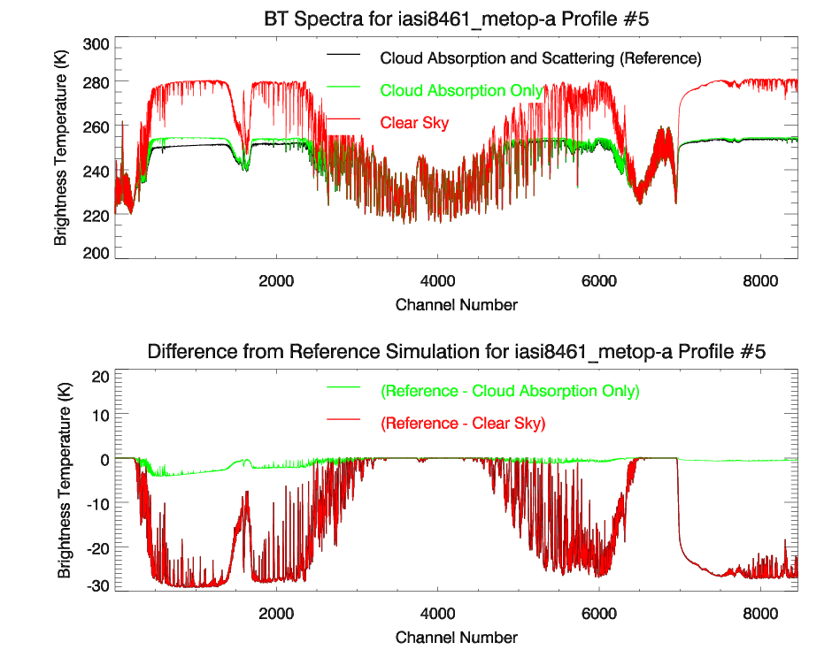
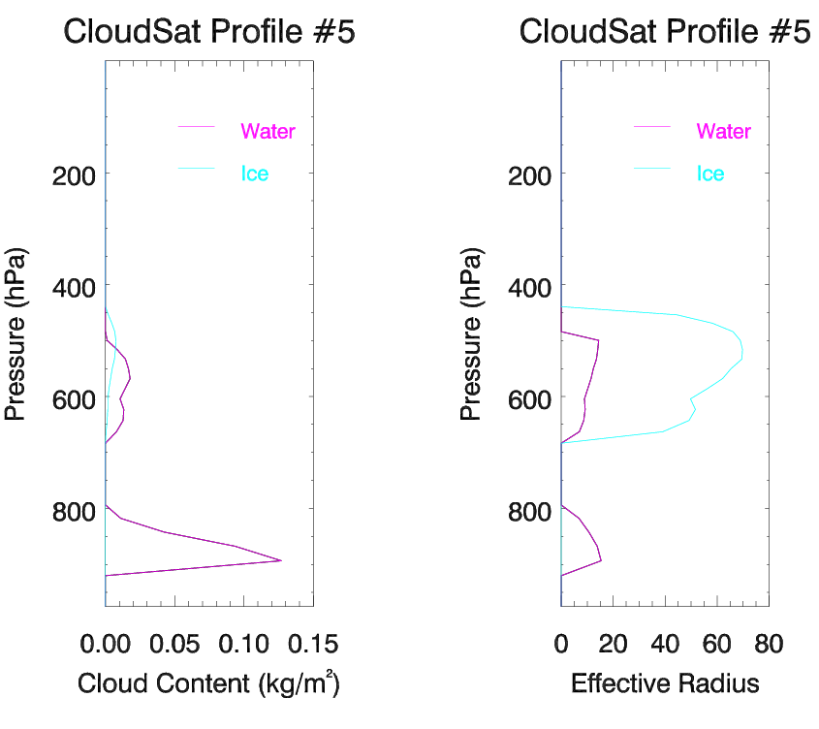
Scattering switch
Implementation of a user-selectable switch to skip the scattering computations and only compute the cloud and aerosol absorption.
Useful for initial cloud detection in assimilation system.

Slide 29
Other
Implementation of additional RT solvers.
  Successive Order of Interaction (SOI) algorithm implemented. Under review.
  Additional algorithms being considered
    Dedicated 2/4-stream algorithms.
    VDISORT for research use (fast, but too slow for operational use).
Cloud fraction implementation (ongoing)
Overcast radiance computation
AOD computation functions
Update of aerosol inputs (being formulated)
Channel selection capability
  Selection capability allows users to turn off the processing of unwanted channels.
User specified number of streams
  Users can input their own value which overrides default.

Slide 30
CRTM Interface

Slide 31
CRTM Interface
Overview of procedure flow.
Main function interface definitions
  Dimensioning
  Argument structure definitions
    Atmosphere, Surface, Geometry, ChannelInfo, Options, RTSolution
Initialisation interface definition
  Argument definitions

Slide 32
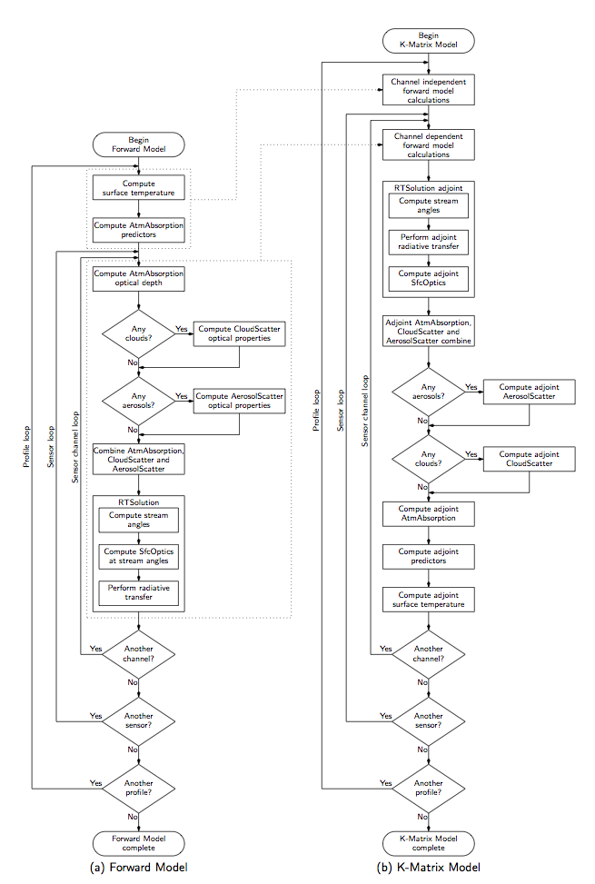
Overview
CRTM uses regression transmittance models
Cloud and aerosol optical properties are read from a LUT
Surface emissivity models are split into four “gross” surface types (land, water, snow, and ice) and three spectral regions (microwave, infrared, and visible). There is a great variety of model implementations, e.g. surface categories, emissivity atlases, empirical models, physical models.
Radiative transfer is a simple emission model for clear sky; ADA, or SOI, for scattering.
Inputs and outputs to the CRTM are packaged in their own structures.
Tangent-linear, adjoint, and K-matrix functions are all constructed “line-by-line” from the forward model. Each are stand-alone, i.e. the forward model calls are incorporated in each.

Slide 33
Argument definitions
Error_Status = CRTM_Forward( &
Atmosphere , &
Surface , &
Geometry , &
ChannelInfo , &
RTSolution , &
Options = Options )
Using the forward model as an example here.
Structure definitions and dimensioning are appropriately similar for the tangent-linear, adjoint, and K-matrix functions.
Argument type definitions
TYPE(CRTM_Atmosphere_type), INTENT(IN) :: Atmosphere(:) ! M
TYPE(CRTM_Surface_type), INTENT(IN) :: Surface(:) ! M
TYPE(CRTM_Geometry_type), INTENT(IN) :: Geometry(:) ! M
TYPE(CRTM_ChannelInfo_type), INTENT(IN) :: ChannelInfo(:) ! N
TYPE(CRTM_RTSolution_type), INTENT(IN OUT) :: RTSolution(:,:) ! L x M
TYPE(CRTM_Options_type), OPTIONAL, INTENT(IN) :: Options(:) ! M
Dimension Key
L = number of channels
M = number of profiles
N = number of sensors

Slide 34
Atmosphere structure
Error_Status = CRTM_Forward( &
Atmosphere , &
Surface , &
Geometry , &
ChannelInfo , &
RTSolution , &
Options = Options )
TYPE :: CRTM_Atmosphere_type
! Dimension values
INTEGER :: n_Layers = 0 ! K dimension
INTEGER :: n_Absorbers = 0 ! J dimension
INTEGER :: n_Clouds = 0 ! Nc dimension
INTEGER :: n_Aerosols = 0 ! Na dimension
! Climatology model associated with the profile
INTEGER :: Climatology = US_STANDARD_ATMOSPHERE
! Absorber ID and units
INTEGER, ALLOCATABLE :: Absorber_ID(:) ! J
INTEGER, ALLOCATABLE :: Absorber_Units(:) ! J
! Profile LEVEL and LAYER quantities
REAL(fp), ALLOCATABLE :: Level_Pressure(:) ! 0:K
REAL(fp), ALLOCATABLE :: Pressure(:) ! K
REAL(fp), ALLOCATABLE :: Temperature(:) ! K
REAL(fp), ALLOCATABLE :: Absorber(:,:) ! K x J
! Clouds associated with each profile
TYPE(CRTM_Cloud_type), ALLOCATABLE :: Cloud(:) ! Nc
! Aerosols associated with each profile
TYPE(CRTM_Aerosol_type), ALLOCATABLE :: Aerosol(:) ! Na
END TYPE CRTM_Atmosphere_type

Slide 35
Cloud substructure
Error_Status = CRTM_Forward( &
Atmosphere , &
Surface , &
Geometry , &
ChannelInfo , &
RTSolution , &
Options = Options )
TYPE :: CRTM_Atmosphere_type
! Dimension values
INTEGER :: n_Layers = 0 ! K dimension
INTEGER :: n_Absorbers = 0 ! J dimension
INTEGER :: n_Clouds = 0 ! Nc dimension
INTEGER :: n_Aerosols = 0 ! Na dimension
! Climatology model associated with the profile
INTEGER :: Climatology = US_STANDARD_ATMOSPHERE
! Absorber ID and units
INTEGER, ALLOCATABLE :: Absorber_ID(:) ! J
INTEGER, ALLOCATABLE :: Absorber_Units(:) ! J
! Profile LEVEL and LAYER quantities
REAL(fp), ALLOCATABLE :: Level_Pressure(:) ! 0:K
REAL(fp), ALLOCATABLE :: Pressure(:) ! K
REAL(fp), ALLOCATABLE :: Temperature(:) ! K
REAL(fp), ALLOCATABLE :: Absorber(:,:) ! K x J
! Clouds associated with each profile
TYPE(CRTM_Cloud_type), ALLOCATABLE :: Cloud(:) ! Nc
! Aerosols associated with each profile
TYPE(CRTM_Aerosol_type), ALLOCATABLE :: Aerosol(:) ! Na
END TYPE CRTM_Atmosphere_type
TYPE :: CRTM_Cloud_type
! Dimension values
INTEGER :: n_Layers = 0 ! K dimension.
! Cloud type
INTEGER :: Type = INVALID_CLOUD
! Cloud state variables
REAL(fp), ALLOCATABLE :: Effective_Radius(:) ! K. um
REAL(fp), ALLOCATABLE :: Water_Content(:) ! K. kg/m^2
END TYPE CRTM_Cloud_type

Slide 36
Aerosol substructure
Error_Status = CRTM_Forward( &
Atmosphere , &
Surface , &
Geometry , &
ChannelInfo , &
RTSolution , &
Options = Options )
TYPE :: CRTM_Atmosphere_type
! Dimension values
INTEGER :: n_Layers = 0 ! K dimension
INTEGER :: n_Absorbers = 0 ! J dimension
INTEGER :: n_Clouds = 0 ! Nc dimension
INTEGER :: n_Aerosols = 0 ! Na dimension
! Climatology model associated with the profile
INTEGER :: Climatology = US_STANDARD_ATMOSPHERE
! Absorber ID and units
INTEGER, ALLOCATABLE :: Absorber_ID(:) ! J
INTEGER, ALLOCATABLE :: Absorber_Units(:) ! J
! Profile LEVEL and LAYER quantities
REAL(fp), ALLOCATABLE :: Level_Pressure(:) ! 0:K
REAL(fp), ALLOCATABLE :: Pressure(:) ! K
REAL(fp), ALLOCATABLE :: Temperature(:) ! K
REAL(fp), ALLOCATABLE :: Absorber(:,:) ! K x J
! Clouds associated with each profile
TYPE(CRTM_Cloud_type), ALLOCATABLE :: Cloud(:) ! Nc
! Aerosols associated with each profile
TYPE(CRTM_Aerosol_type), ALLOCATABLE :: Aerosol(:) ! Na
END TYPE CRTM_Atmosphere_type
TYPE :: CRTM_Aerosol_type
! Dimension values
INTEGER :: n_Layers = 0 ! K dimension.
! Aerosol type
INTEGER :: Type = INVALID_AEROSOL
! Aerosol state variables
REAL(fp), ALLOCATABLE :: Effective_Radius(:) ! K. um
REAL(fp), ALLOCATABLE :: Concentration(:) ! K. kg/m^2
END TYPE CRTM_Aerosol_type

Slide 37
Surface structure
Error_Status = CRTM_Forward( &
Atmosphere , &
Surface , &
Geometry , &
ChannelInfo , &
RTSolution , &
Options = Options )
TYPE :: CRTM_Surface_type
! Gross type of surface determined by coverage
REAL(fp) :: Land_Coverage = ZERO
REAL(fp) :: Water_Coverage = ZERO
REAL(fp) :: Snow_Coverage = ZERO
REAL(fp) :: Ice_Coverage = ZERO
! Land surface type data
INTEGER :: Land_Type = DEFAULT_LAND_TYPE
...other land surface inputs...
! Water type data
INTEGER :: Water_Type = DEFAULT_WATER_TYPE
...other water surface inputs…
! Snow surface type data
INTEGER :: Snow_Type = DEFAULT_SNOW_TYPE
...other snow surface inputs…
! Ice surface type data
INTEGER :: Ice_Type = DEFAULT_ICE_TYPE
...other ice surface inputs…
END TYPE CRTM_Surface_type
In v3.0, to accommodate multiple surface subtypes in a single FOV (in particular the land subtypes), the gross surface types will be split into their own structure arrays, e.g.
TYPE(LandSurface_type), ALLOCATABLE :: Land(:)

Slide 38
Geometry structure
Error_Status = CRTM_Forward( &
Atmosphere , &
Surface , &
Geometry , &
ChannelInfo , &
RTSolution , &
Options = Options )
TYPE :: CRTM_Geometry_type
! Field of view index (1-nFOV)
INTEGER :: iFOV = 0
! Earth location
REAL(fp) :: Longitude = ZERO
REAL(fp) :: Latitude = ZERO
REAL(fp) :: Surface_Altitude = ZERO
! Sensor angle information
REAL(fp) :: Sensor_Scan_Angle = ZERO
REAL(fp) :: Sensor_Zenith_Angle = ZERO
REAL(fp) :: Sensor_Azimuth_Angle = 999.9_fp
! Source angle information
REAL(fp) :: Source_Zenith_Angle = 100.0_fp
REAL(fp) :: Source_Azimuth_Angle = ZERO
! Flux angle information
REAL(fp) :: Flux_Zenith_Angle = DIFFUSIVITY_ANGLE
END TYPE CRTM_Geometry_type
Not all the data in the structure is always required. E.g.:
iFOV is only used in antenna correction for the AMSU/MHS instruments,
Lat/Lon is planned for use with atlas-type emissivity databases,
Azimuth angles are only used in surface emissivity model for microwave polarimetric sensors, and in solar calculations for visible sensors. Recent VIIRS comparisons indicate it’s also required for multi-detector SWIR and NIR channels.

Slide 39
ChannelInfo structure
Error_Status = CRTM_Forward( &
Atmosphere , &
Surface , &
Geometry , &
ChannelInfo , &
RTSolution , &
Options = Options )
TYPE :: CRTM_ChannelInfo_type
! Dimensions
INTEGER :: n_Channels = 0 ! L dimension
! Scalar data
CHARACTER(STRLEN) :: Sensor_ID
INTEGER :: Sensor_Type
INTEGER :: WMO_Satellite_ID
INTEGER :: WMO_Sensor_ID
INTEGER :: Sensor_Index
! Array data
LOGICAL, ALLOCATABLE :: Process_Channel(:) ! L
INTEGER, ALLOCATABLE :: Sensor_Channel(:) ! L
INTEGER, ALLOCATABLE :: Channel_Index(:) ! L
END TYPE CRTM_ChannelInfo_type
Users do not have to worry about filling this data structure – it is done during the CRTM initialisation step.
CRTM v2.1 (re)introduces a channel selection capability. By default, all channels for a given sensor are processed. A call to the new channel subset function allows the user to control what channels are processed.

Slide 40
RTSolution structure
Error_Status = CRTM_Forward( &
Atmosphere , &
Surface , &
Geometry , &
ChannelInfo , &
RTSolution , &
Options = Options )
TYPE :: CRTM_RTSolution_type
! Dimensions
INTEGER :: n_Layers = 0 ! K
! Sensor information
CHARACTER(STRLEN) :: Sensor_ID
INTEGER :: WMO_Satellite_ID
INTEGER :: WMO_Sensor_ID
INTEGER :: Sensor_Channel
! Forward intermediate results
! Not defined when they for TL, AD, and K.
REAL(fp) :: Surface_Emissivity = ZERO
REAL(fp) :: Up_Radiance = ZERO
REAL(fp) :: Down_Radiance = ZERO
REAL(fp) :: Down_Solar_Radiance = ZERO
REAL(fp) :: Surface_Planck_Radiance = ZERO
REAL(fp), ALLOCATABLE :: Upwelling_Radiance(:)
! The layer optical depths
REAL(fp), ALLOCATABLE :: Layer_Optical_Depth(:)
! RT results for a single channel
REAL(fp) :: Radiance = ZERO
REAL(fp) :: Brightness_Temperature = ZERO
END TYPE CRTM_RTSolution_type
The internal arrays do not have to be allocated – the code checks if they are allocated before attempting to assign them.
The channel dimension is handled by dimensioning the RTSolution argument to the required number of channels. We have considered putting the channel dimension inside the structure definition to make it congruent with the ChannelInfo input.

Slide 41
Options structure (optional)
Error_Status = CRTM_Forward( &
Atmosphere , &
Surface , &
Geometry , &
ChannelInfo , &
RTSolution , &
Options = Options )
TYPE :: CRTM_Options_type
LOGICAL :: Check_Input = .TRUE.
LOGICAL :: Use_Old_MWSSEM = .FALSE.
LOGICAL :: Use_Antenna_Correction = .FALSE.
LOGICAL :: Apply_NLTE_Correction = .TRUE.
LOGICAL :: Include_Scattering = .TRUE.
! Aircraft flight level pressure
! Value > 0 turns "on" the aircraft option
REAL(fp) :: Aircraft_Pressure = -ONE
! User defined emissivity/reflectivity
INTEGER :: n_Channels = 0
LOGICAL :: Use_Emissivity = .FALSE.
REAL(fp), ALLOCATABLE :: Emissivity(:)
LOGICAL :: Use_Direct_Reflectivity = .FALSE.
REAL(fp), ALLOCATABLE :: Direct_Reflectivity(:)
! User defined number of RT streams
LOGICAL :: Use_n_Streams = .FALSE.
INTEGER :: n_Streams = 0
! SSU instrument input
TYPE(SSU_Input_type) :: SSU
! Zeeman-splitting input
TYPE(Zeeman_Input_type) :: Zeeman
END TYPE CRTM_Options_type
This is where all the optional features are specified. (Note: not all options slated for v2.1 are shown here as they still reside in their respective branches in the repository.)
The emissivity/reflectivity input option was an early request (in v1.x). It will eventually be moved into its own structure, like the SSU and Zeeman components, but not until v3.0 (we restrict existing interface changes to the main version number updates).
Prior to v3.0, we’ve begun discussing implementation of a user-specified input reflectivity matrix.

Slide 42
Other main functions
Error_Status = CRTM_Tangent_Linear( &
Atmosphere , & ! M
Surface , & ! M
Atmosphere_TL , & ! M
Surface_TL , & ! M
Geometry , & ! M
ChannelInfo , & ! N
RTSolution , & ! L x M
RTSolution_TL , & ! L x M
Options = Options ) ! M
Similar interfaces for tangent-linear, adjoint, and K-matrix functions.
Adjoint and K-matrix functions are similar
  Adjoint is a strict transpose of the tangent-linear code, so atmosphere and surface adjoint results are a sum over channels.
  K-matrix function simply moves all the channel independent code inside the channel loop to provide Jacobians for each channel.
Error_Status = CRTM_Adjoint( &
Atmosphere , & ! M
Surface , & ! M
RTSolution_AD , & ! L x M
Geometry , & ! M
ChannelInfo , & ! N
Atmosphere_AD , & ! M
Surface_AD , & ! M
RTSolution , & ! L x M
Options = Options ) ! M
Error_Status = CRTM_K_Matrix( &
Atmosphere , & ! M
Surface , & ! M
RTSolution_K , & ! L x M
Geometry , & ! M
ChannelInfo , & ! N
Atmosphere_K , & ! L x M
Surface_K , & ! L x M
RTSolution , & ! L x M
Options = Options )
Note dimension change

Slide 43
Initialisation function
Error_Status = CRTM_Init( &
Sensor_ID , & ! N
ChannelInfo , & ! N
File_Path = File_Path , & ! Scalar
Load_CloudCoeff = Load_CloudCoeff , & ! Scalar
Load_AerosolCoeff = Load_AerosolCoeff, & ! Scalar
…optional specification of explicit coefficient filenames… )
CHARACTER(*), INTENT(IN) :: Sensor_ID(:)
Character string identifying the sensor and platform for which radiances are to be computed.
Filenames are constructed from this value.
Standard specification of “sensor_platform”
  abi_gr
  amusa_metop-a
  iasi_metop-b
  cris_npp
  Etc..
Dimension, N, is the number of sensors. Most often this is just one.

Slide 44
Initialisation function
Error_Status = CRTM_Init( &
Sensor_ID , & ! N
ChannelInfo , & ! N
File_Path = File_Path , & ! Scalar
Load_CloudCoeff = Load_CloudCoeff , & ! Scalar
Load_AerosolCoeff = Load_AerosolCoeff, & ! Scalar
…optional specification of explicit coefficient filenames… )
TYPE(CRTM_ChannelInfo_type), INTENT(OUT) :: ChannelInfo(:)
Structure array (described previously) whose contents are populated based on the contents of the sensor coefficient files..
Dimension, N, is the number of sensors. Must be the same as Sensor_Id.

Slide 45
Initialisation function
Error_Status = CRTM_Init( &
Sensor_ID , & ! N
ChannelInfo , & ! N
File_Path = File_Path , & ! Scalar
Load_CloudCoeff = Load_CloudCoeff , & ! Scalar
Load_AerosolCoeff = Load_AerosolCoeff, & ! Scalar
…optional specification of explicit coefficient filenames… )
CHARACTER(*), OPTIONAL, INTENT(IN) :: File_Path
Character string specifying a file path for the various input coefficient files.
If not specified, the current directory is the default.
No fine-grain control of locations; all files in one place.

Slide 46
Initialisation function
Error_Status = CRTM_Init( &
Sensor_ID , & ! N
ChannelInfo , & ! N
File_Path = File_Path , & ! Scalar
Load_CloudCoeff = Load_CloudCoeff , & ! Scalar
Load_AerosolCoeff = Load_AerosolCoeff, & ! Scalar
…optional specification of explicit coefficient filenames… )
LOGICAL, OPTIONAL, INTENT(IN) :: Load_CloudCoeff
LOGICAL, OPTIONAL, INTENT(IN) :: Load_AerosolCoeff
Logical switches to disable loading of cloud and aerosol optical properties look-up tables.
Saves memory for clear-sky-only computations.
Default is to load the data. Set to .FALSE. to disable.

Slide 47
CALLING THE CRTM

Slide 48
Example of calling the CRTM
Will use K-matrix function.
Dimensions to be defined:
  n_Profiles
  n_Layers
  n_Absorbers
  n_Clouds
  n_Aerosols
We’ll set the number of sensor, n_Sensors, to just one.

Slide 49
Step 0: Define the dimensions
! This example processes TWO profiles of 100 layers and
! 2 absorbers and
! 2 clouds and
! 1 aerosol....
INTEGER, PARAMETER :: N_PROFILES = 2
INTEGER, PARAMETER :: N_LAYERS = 100
INTEGER, PARAMETER :: N_ABSORBERS = 2
INTEGER, PARAMETER :: N_CLOUDS = 2
INTEGER, PARAMETER :: N_AEROSOLS = 1
! ...but only ONE Sensor at a time
INTEGER, PARAMETER :: N_SENSORS = 1

Slide 50
Step 1: Define the variables
Let’s make everything allocatable.
Plan for future expansion/changes.
CHARACTER(256) , ALLOCATABLE :: sensor_id(:)
TYPE(CRTM_ChannelInfo_type), ALLOCATABLE :: chinfo(:)
TYPE(CRTM_Geometry_type) , ALLOCATABLE :: geo(:)
! Define the FORWARD variables
TYPE(CRTM_Atmosphere_type) , ALLOCATABLE :: atm(:)
TYPE(CRTM_Surface_type) , ALLOCATABLE :: sfc(:)
TYPE(CRTM_RTSolution_type) , ALLOCATABLE :: rts(:,:)
! Define the K-MATRIX variables
TYPE(CRTM_Atmosphere_type) , ALLOCATABLE :: atm_K(:,:)
TYPE(CRTM_Surface_type) , ALLOCATABLE :: sfc_K(:,:)
TYPE(CRTM_RTSolution_type) , ALLOCATABLE :: rts_K(:,:)
Note that the FORWARD and K-MATRIX variables are the same type.
Done to minimise code maintenance, but means K-matrix variables cannot have extra internal dimensions, e.g. channels.

Slide 51
Step 2: Initialise the CRTM
Let’s initialise the CRTM for the GOES-R ABI.
We’ll use the Nalli IR sea surface emissivity model.
n_Sensors = 1
ALLOCATE( sensor_id(n_sensors), chinfo(n_sensors) )
sensor_id = ‘abi_gr’
emiscoeff_file = 'Nalli.EmisCoeff.bin’
Error_Status = CRTM_Init( sensor_id, &
chinfo, &
EmisCoeff_File = emiscoeff_file )
IF ( Error_Status /= SUCCESS ) THEN
…handle error…
END IF
Allocate the sensor dependent arrays.
Use abi_gr as example.
IR water EmisCoeff default filename is ‘EmisCoeff.bin’, but we distribute the various files named by model for historical consistency only.
Error status integer results are either SUCCESS, FAILURE, or WARNING.

Slide 52
Step 2b: Select channels
Default is to process ALL channels for a sensor.
New ChannelInfo procedures allow user selection.
! Select the channel subset to be processed
Error_Status = CRTM_ChannelInfo_Subset( &
chinfo(1), &
Channel_Subset = (/ 16, 11, 13 /) )
IF ( Error_Status /= SUCCESS ) THEN
…handle error…
END IF
! Determine the total number of channels to be processed
n_Channels = CRTM_ChannelInfo_n_Channels(chinfo(1))
! The list of channels to be processed
WRITE( *,'(1x,10i5)' ) CRTM_ChannelInfo_Channels(chinfo(1))
Channel list is sorted into ascending order regardless of order specified in subset.

Slide 53
Step 3a: Allocate ARRAYS
Don’t confuse structure arrays with the structure components.
Both need to be allocated.
! Allocate the ARRAYS
ALLOCATE( atm(N_PROFILES), sfc(N_PROFILES), geo(N_PROFILES), &
rts(n_channels, N_PROFILES), &
atm_K(n_channels, N_PROFILES), &
sfc_K(n_channels, N_PROFILES), &
rts_K(n_channels, N_PROFILES), &
STAT = Allocate_Status )
IF ( Allocate_Status /= 0 ) THEN
…handle error…
END IF

Slide 54
Step 3b: Allocate STRUCTURES
Recall that structure creation procedures are ELEMENTAL.
Only allocation of the atmosphere structure is mandatory.
! The input FORWARD structure
CALL CRTM_Atmosphere_Create( &
atm, N_LAYERS, N_ABSORBERS, N_CLOUDS, N_AEROSOLS )
IF ( ANY(.NOT. CRTM_Atmosphere_Associated(atm)) ) THEN
…handle error…
END IF
! The output K-MATRIX structure
CALL CRTM_Atmosphere_Create( &
atm_K, N_LAYERS, N_ABSORBERS, N_CLOUDS, N_AEROSOLS )
IF ( ANY(.NOT. CRTM_Atmosphere_Associated(atm_K)) ) THEN
…handle error…
END IF
Elemental procedures make allocation of structure arrays simple(r).
Note the use of the ANY() intrinsic..

Slide 55
Step 4: Assign input data
Once the structures are allocated, fill them with the necessary data.
ChannelInfo is handled via initialisation and procedures.
Atmosphere and Surface are assigned values as appropriate.
sfc(1)%Land_Coverage = 1.0_fp
sfc(1)%Land_Type = SCRUB
sfc(1)%Land_Temperature = 318.0_fp
sfc(1)%LAI = 1.70_fp
sfc(1)%Soil_Type = MEDIUM
sfc(1)%Vegetation_Type = GROUNDCOVER
atm(1)%Climatology = TROPICAL
atm(1)%Absorber_Id = &
(/ H2O_ID, O3_ID /)
atm(1)%Absorber_Units = &
(/ MASS_MIXING_RATIO_UNITS, &
VOLUME_MIXING_RATIO_UNITS /)
atm(1)%Level_Pressure = &
atm(1)%Pressure = &
atm(1)%Temperature = &
atm(1)%Absorber(:,1) = …H2O data…
atm(1)%Absorber(:,2) = …O3 data…
Surface data can be specified for multiple surface types: land, water, snow, and ice
Climatology required for “profile extension”.
Absorber id is needed to identify the absorber.
Absorber units are currently fixed: g/kg for H₂O, ppmv for everything else.
The order of absorber data must match the absorber identifier.

Slide 56
Step 4: Assign input data
Atmosphere component Cloud and Aerosol are also assigned data as appropriate.
! Some cloud data
k1 = 75 ! Pressure[k1] = 650.104hPa
k2 = 79 ! Pressure[k2] = 741.693hPa
atm(1)%Cloud(1)%Type = WATER_CLOUD
atm(1)%Cloud(1)%Effective_Radius(k1:k2) = 20.0_fp ! Microns
atm(1)%Cloud(1)%Water_Content(k1:k2) = 5.0_fp ! kg/m^2
! Some pretend aerosol data
k1 = 83 ! Pressure[k1] = 840.016hPa
k2 = 85 ! Pressure[k2] = 891.679hPa
atm(1)%Aerosol(1)%Type = DUST_AEROSOL
atm(1)%Aerosol(1)%Effective_Radius(k1:k2) = 2.0_fp ! microns
atm(1)%Aerosol(1)%Concentration(k1:k2) = 5.0_fp ! kg/m^2
Other cloud types are ICE, RAIN, SNOW, GRAUPEL, and HAIL.
GO-CART aerosol species only. Work on CMAQ has been postponed indefinitely.

Slide 57
Step 4: Assign input data
Geometry. Structure also assigned values as appropriate.
TYPE :: CRTM_Geometry_type
! Field of view index (1-nFOV)
INTEGER :: iFOV = 0
! Earth location
REAL(fp) :: Longitude = ZERO
REAL(fp) :: Latitude = ZERO
REAL(fp) :: Surface_Altitude = ZERO
! Sensor angle information
REAL(fp) :: Sensor_Scan_Angle = ZERO
REAL(fp) :: Sensor_Zenith_Angle = ZERO
REAL(fp) :: Sensor_Azimuth_Angle = 999.9_fp
! Source angle information
REAL(fp) :: Source_Zenith_Angle = 100.0_fp
REAL(fp) :: Source_Azimuth_Angle = ZERO
! Flux angle information
REAL(fp) :: Flux_Zenith_Angle = DIFFUSIVITY_ANGLE
END TYPE CRTM_Geometry_type
Only used for AMSU-A/B and MHS antenna temperature correction.
Only used for emissivity database location matching.
These are (currently) the only “mandatory” elements – unless you always want to compute nadir radiances.

Slide 58
Step 5: Initialise the K-matrix arguments
Initialise the inputs for the sensor-dependent result.
Zero out the outputs (just to be sure).
! Zero the K-matrix OUTPUT structures
CALL CRTM_Atmosphere_Zero( atm_K )
CALL CRTM_Surface_Zero( sfc_K )
! Initialize the K-matrix INPUT
DO l = 1, n_Channels
IF ( ChannelInfo(1)%Sensor_Type == INFRARED_SENSOR .OR. &
ChannelInfo(1)%Sensor_Type == MICROWAVE_SENSOR ) THEN
RTSolution_K(l,:)%Brightness_Temperature = ONE
ELSE
RTSolution_K(l,:)%Radiance = ONE
END IF
END DO
IR/MW Jacobians are dTb/dx.
Visible Jacobians are dR/dx.

Slide 59
Step 6: Call the K-matrix function
Error_Status = CRTM_K_Matrix( &
atm , &
sfc , &
rts_K , &
geo , &
chinfo, &
atm_K , &
sfc_K , &
rts )
IF ( Error_Status /= SUCCESS ) THEN
…handle error…
END IF
If it’s a forward model output, it’s a K-matrix input.
If it’s a forward model input, it’s a K-matrix output.

Slide 60
Step 7: Destroy the CRTM
This step deallocates memory allocated during initialisation.
Note: deallocation of structure ARRAYS is sufficient to deallocate structure components.
Error_Status = CRTM_Destroy( chinfo )
IF ( Error_Status /= SUCCESS ) THEN
…handle error…
END IF
DEALLOCATE( sensor_id, chinfo, &
atm, sfc, geo, &
rts_K, &
atm_K, sfc_K, &
rts )
No need to call the various structure Destroy() procedures explicitly.

Slide 61
CRTM OBJECT METHODS

Slide 62
Object methods
Huh?
Currently, no functional OO concepts are implemented in the CRTM.
So, for our purposes here:
  Object ≅ Derived type (aka structure)
  Method ≅ Function or subroutine (aka procedure, or type-bound procedure) operating on an instance (aka variable) of that type.
We’ve defined a list of list of default procedures that must be available for all CRTM objects.

Slide 63
Naming conventions
Modules
  All structures and their procedures are defined in their respective definition modules,
  CRTM_structure_Define
  Currently, I/O procedures are defined in a separate module,
  CRTM_structure_IO
but will eventually be moved to the definition module.
Procedures are named following the convention
  CRTM_structure_action

Slide 64
Implemented default procedures
Action | Type | Description
Associated | Elemental function | Tests if the structure components have been allocated.
Destroy | Elemental subroutine | Deallocates any allocated structure components.
Create | Elemental subroutine | Allocates any allocatable structure components.
Inspect | Subroutine | Displays structure contents.
OPERATOR(==) | Elemental function | Tests the equality of two structure.

Slide 65
Example default procedures
MODULE CRTM_Atmosphere_Define
…etc…
PUBLIC :: OPERATOR(==)
…etc…
PUBLIC :: CRTM_Atmosphere_Associated
PUBLIC :: CRTM_Atmosphere_Destroy
PUBLIC :: CRTM_Atmosphere_Create
PUBLIC :: CRTM_Atmosphere_Inspect
…etc…
END MODULE CRTM_Atmosphere_Define

Slide 66
Example default procedures
MODULE CRTM_Atmosphere_Define
…etc…
PUBLIC :: OPERATOR(==)
…etc…
PUBLIC :: CRTM_Atmosphere_Associated
PUBLIC :: CRTM_Atmosphere_Destroy
PUBLIC :: CRTM_Atmosphere_Create
PUBLIC :: CRTM_Atmosphere_Inspect
…etc…
END MODULE CRTM_Atmosphere_Define
TYPE(CRTM_Atmosphere_type) :: atm1(10), atm2(10) ! Many profiles
…etc…
IF ( .NOT. ALL(atm1 == atm2) ) THEN
…handle non-equality…
END IF

Slide 67
Example default procedures
MODULE CRTM_Atmosphere_Define
…etc…
PUBLIC :: OPERATOR(==)
…etc…
PUBLIC :: CRTM_Atmosphere_Associated
PUBLIC :: CRTM_Atmosphere_Destroy
PUBLIC :: CRTM_Atmosphere_Create
PUBLIC :: CRTM_Atmosphere_Inspect
…etc…
END MODULE CRTM_Atmosphere_Define
TYPE(CRTM_Atmosphere_type) :: atm(100) ! Many profiles
…etc…
IF ( .NOT. ALL(CRTM_Atmosphere_Associated(atm)) ) THEN
…handle non-association…
END IF

Slide 68
Example default procedures
MODULE CRTM_Atmosphere_Define
…etc…
PUBLIC :: OPERATOR(==)
…etc…
PUBLIC :: CRTM_Atmosphere_Associated
PUBLIC :: CRTM_Atmosphere_Destroy
PUBLIC :: CRTM_Atmosphere_Create
PUBLIC :: CRTM_Atmosphere_Inspect
…etc…
END MODULE CRTM_Atmosphere_Define
TYPE(CRTM_Atmosphere_type) :: atm(100) ! Many profiles
INTEGER :: scalar_n_layers, rank1_n_layers(100)
…etc…
! All profiles have same layering
scalar_n_layers = 64
CALL CRTM_Atmosphere_Create( atm, scalar_n_layers, …etc… )
…etc…
! All profiles can have different layering
Rank1_n_layers = [28,64,91,…,75]
CALL CRTM_Atmosphere_Create( atm, rank1_n_layers, …etc… )

Slide 69
Example default procedures
MODULE CRTM_Atmosphere_Define
…etc…
PUBLIC :: OPERATOR(==)
…etc…
PUBLIC :: CRTM_Atmosphere_Associated
PUBLIC :: CRTM_Atmosphere_Destroy
PUBLIC :: CRTM_Atmosphere_Create
PUBLIC :: CRTM_Atmosphere_Inspect
…etc…
END MODULE CRTM_Atmosphere_Define
TYPE(CRTM_Atmosphere_type) :: atm(100) ! Many profiles
…allocation…etc…
! Destroy structure components
CALL CRTM_Atmosphere_Destroy( atm )

Slide 70
Example default procedures
MODULE CRTM_Atmosphere_Define
…etc…
PUBLIC :: OPERATOR(==)
…etc…
PUBLIC :: CRTM_Atmosphere_Associated
PUBLIC :: CRTM_Atmosphere_Destroy
PUBLIC :: CRTM_Atmosphere_Create
PUBLIC :: CRTM_Atmosphere_Inspect
…etc…
END MODULE CRTM_Atmosphere_Define
TYPE(CRTM_Atmosphere_type) :: atm(100) ! Many profiles
…etc…
DO i = 1, 100
CALL CRTM_Atmosphere_Inspect( atm(i) )
END DO

Slide 71
I/O procedures
Action | Type | Description
InquireFile | Function | Inquires file for dimensions to use in allocations if necessary. As yet, doesn’t actually act upon the structure.
WriteFile | Function | Write a structure instance to file.
ReadFile | Function | Loads a structure instance with data read from file.

