Slide 1
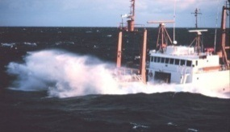
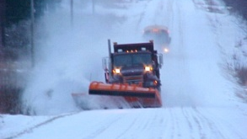
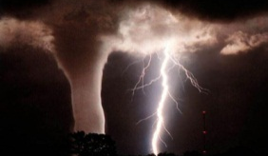
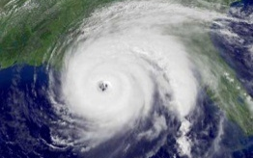
Computational Issues
Presented by John Derber
National Centers for Environmental Prediction
JCSDA Summer Colloquium
July 27, 2015
“Where America’s Climate, Weather, Ocean and Space Weather Services Begin”

Slide 2
Many aspects of the design and implementation of a DA system are controlled by Computational Issues, not Science
The devil is in the details.

Slide 3
Constraints on DA system
Must be completed on time using available resources
Reliable – runs properly in (almost) all situations
Reproducible
Best possible solution

Slide 4
Constraints on DA system
Must be completed on time using available resources
< ~20min in allocated nodes for global system
Reliable – runs properly in (almost) all situations
Reproducible
Best possible solution

Slide 5
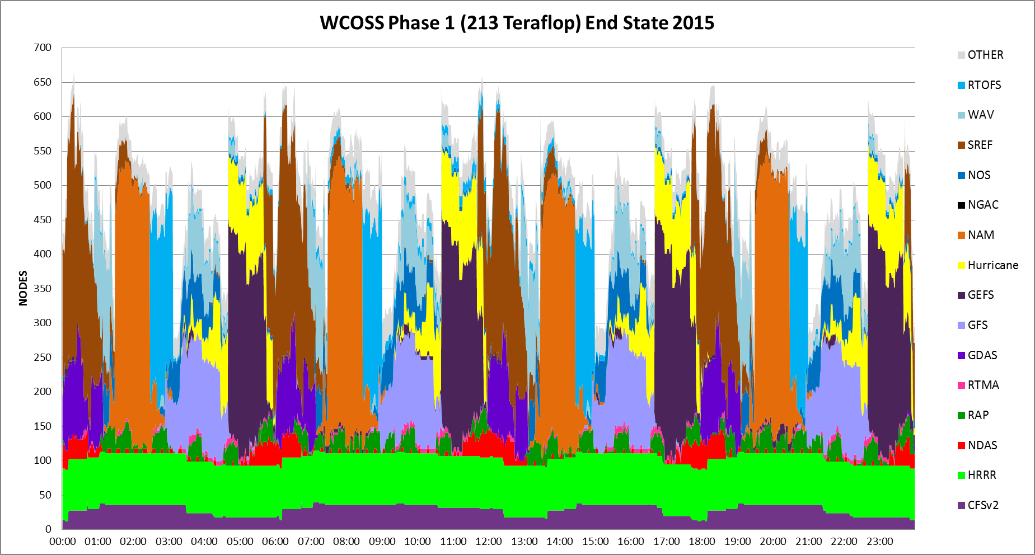
Phase 1 End of 2015 Dark purple is Global Data Assimilation system (including 9 hour forecasts and ensembles)

Slide 6
Constraints on DA system
Must be completed on time using available resources
< ~20min in allocated nodes for global system
Reliable – runs properly in (almost) all situations
No failures due to overflow/underflow, missing or bad data with or w/o file available, etc.
Reproducible
Best possible solution

Slide 7
Constraints on DA system
Must be completed on time using available resources
< ~20min in allocated nodes for global system
Reliable – runs properly in (almost) all situations
No failures due to overflow/underflow, missing data with or w/o file available, etc.
Reproducible
Order of math (addition, etc. ) can change results. Since parallel over many processors, have to be careful to not change results when different number of processors used.
(x + y) + z ≠ x + (y + z)
Best possible solution

Slide 8
Constraints on DA system
Must be completed on time using available resources
< ~20min in allocated nodes for global system
Reliable – runs properly in (almost) all situations
No failures due to overflow/underflow, missing data with or w/o file available, etc.
Reproducible
Order of math (addition, etc. ) can change results. Since parallel over many processors, have to be careful to not change results when different number of processors used.
Best possible solution
Cannot afford doing everything the way you would like. Goal extract as much information as possible from data while satisfying constraints

Slide 9
Simplest 3-D analysis problem
J = ½(x-x_{b})B⁻¹(x-x_{b}) + ½(Hx-y)^{T}O⁻¹(Hx-y)
x – analysis variables
x_{b} – background field (usually a short forecast)
B - Background error covariance matrix
H - Transform from analysis to observation (linear in this example)
y - Observation vector
O - Observation error covariance matrix

Slide 10
Solution 3-D analysis problem
x = x_{b} + (B⁻¹ +H^{T}O⁻¹H)⁻¹H^{T}O⁻¹(y-Hx_{b})
Size of matrix to be inverted determined by size of x (N)
N = (Number of 3-D variables*Number of levels + Number of 2-D variables)*Number of degrees of freedom in each 2-D field
For GFS (global forecast system) at NCEP
= (5*64+2)*(1535*1536)
= 759,198,720!
Matrix to be inverted is 759,198,720 x 759,198,720

Slide 11
Computational implications of large N
Problem must be solved iteratively – exact solution not possible (especially if H is nonlinear)
Problem must be spread across many nodes (too much memory required) – Creates problems for 3-D observation operators.
B matrix is defined as series of operations not explicitly
Often analysis increment (x-x_{b}) created at lower resolution in horizontal.
Note that problem size (N) increases for hybrid, 4-D, in-line bias correction, etc.

Slide 12
Annual Mean 500-hPa HGT Day-5 Anomaly Correlation
CDAS is a legacy GFS (T64) used for NCEP/NCAR Reanalysis circa 1995.
CFSR is the coupled GFS (T126) used for reanalysis circa 2006.

Slide 13
Number of Observations
Dual problem can be solved in observation space. However, problem still remains large since large numbers of observations used in modern systems.
Use of many observations can also be computationally expensive because of expensive forward models (and memory requirements).
Try to use observations which contribute most new information to the analysis system (information content).
If correlated errors, O must be inverted. Try to keep block diagonal.

Slide 14
Data Timeliness and Availability
To perform analysis, observations are used within time window. (e.g., ± 3hr, or from 00UTC to 12UTC)
May have to start forecast before end of time window to meet forecast delivery time.
Observations do not instantaneously appear at operational centers.
Communications delays
Ground station locations
Etc.
The smaller the difference between the observation time and the end of the analysis window, the less data will be available
Less for regional or mesoscale forecasts
Catch up cycles

Slide 15
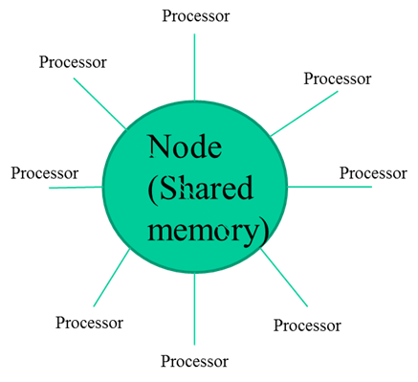
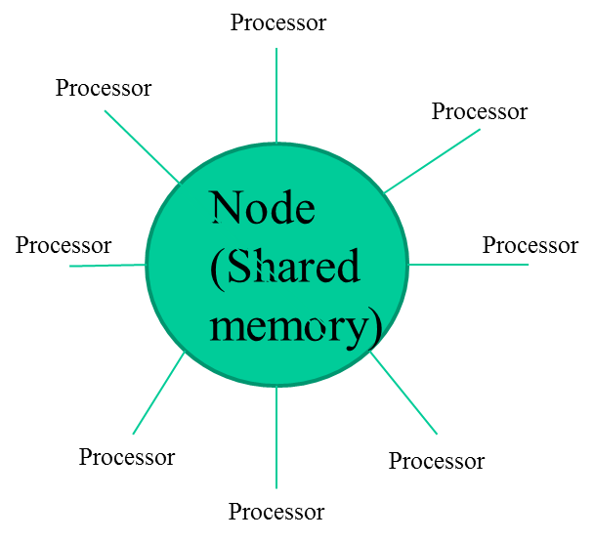
Current Computer Architecture
Disk

Slide 16
Optimization
Need to know assimilation system (where is maximum memory, maximum use of wall time, etc.)
Memory
MPI
Threading
Vectorization
I/O
Parallel
Can be System Dependent

Slide 17
Memory
Limit is on memory/node
If the memory is used up with parallel processes, CPUs can be used by threading (if not too much duplicated memory) – if threading is possible.
Hidden memory (i/o buffers, temporary arrays generated by compiler, etc.)
Memory leaks (allocated arrays without deallocation, etc.)

Slide 18
Optimization
Need to know assimilation system (where is maximum memory, maximum use of wall time, etc.)
Memory
MPI
Threading
Vectorization
I/O
Parallel
Can be System Dependent

Slide 19
Final comments
Computational Issues are extremely important in the design and development of a data assimilation system.
Systems are constrained by many components including delivery time, observational availability, and available resources.
Additional capabilities/observational information can be included by enhancing resources or optimizing system.
Many trade-offs (e.g., number of ensemble members vs. resolution, accuracy of forward model vs. number of observations used, etc.)
Details important – experience and intuition.

