Slide 1
Satellite data assimilation applications: Mesoscale (and cloud-resolving)
JCSDA Summer Colloquium
CIRA/Colorado State University, Fort Collins, CO
July 27 – August 7, 2015
Milija Zupanski
Cooperative Institute for Research in the Atmosphere
Colorado State University
Fort Collins, Colorado

Slide 2
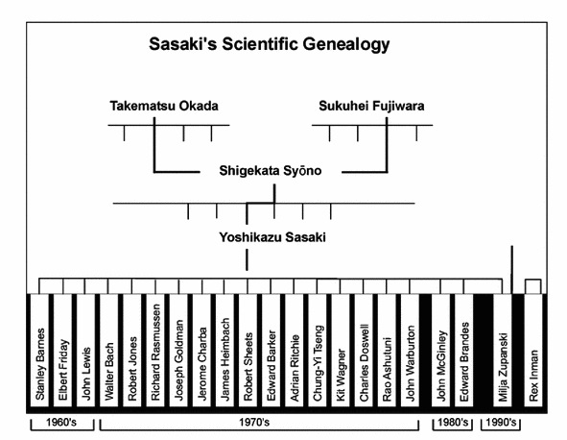
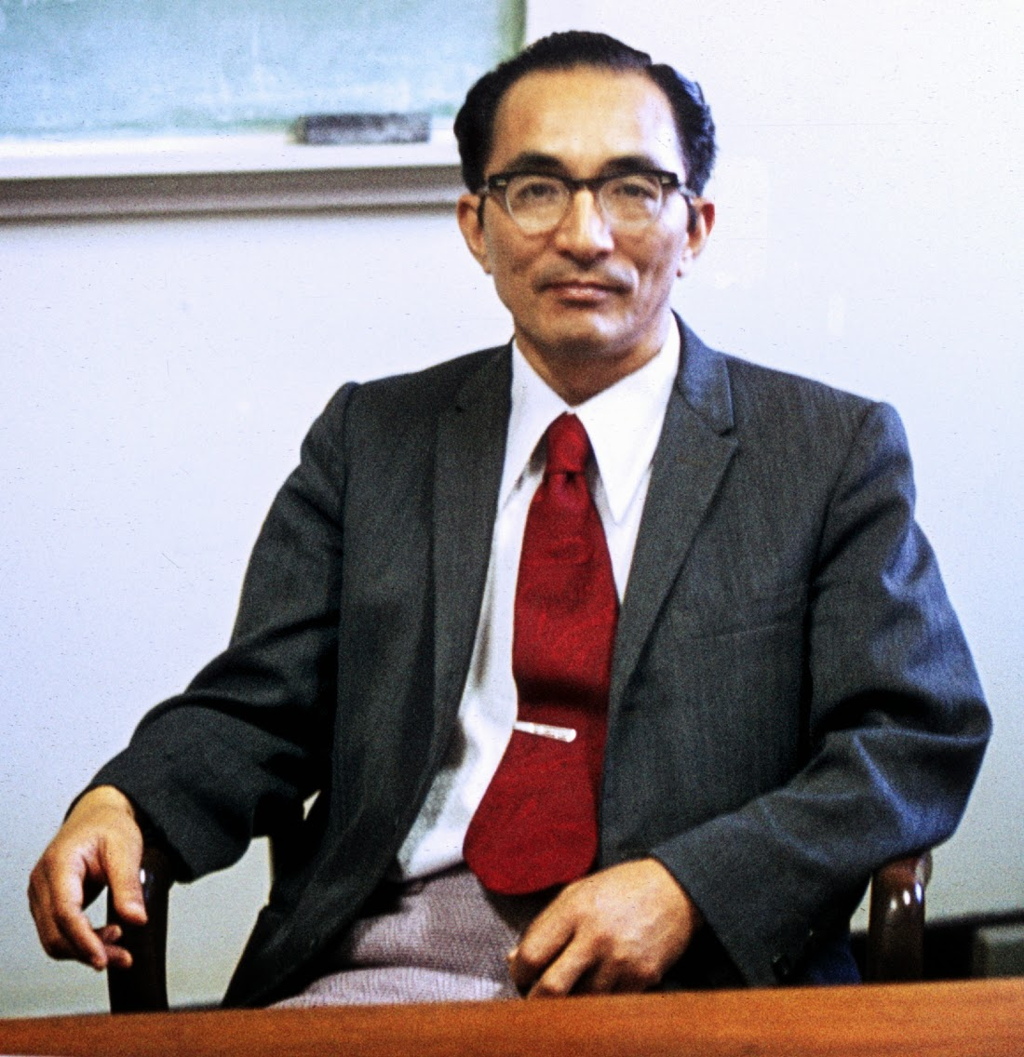
History – assimilation
Yoshi Sasaki (1927-2015)
Calculus of variations
Variational weak and strong constraints
from Lewis (2009)
Variational principles are important for data assimilation

Slide 3


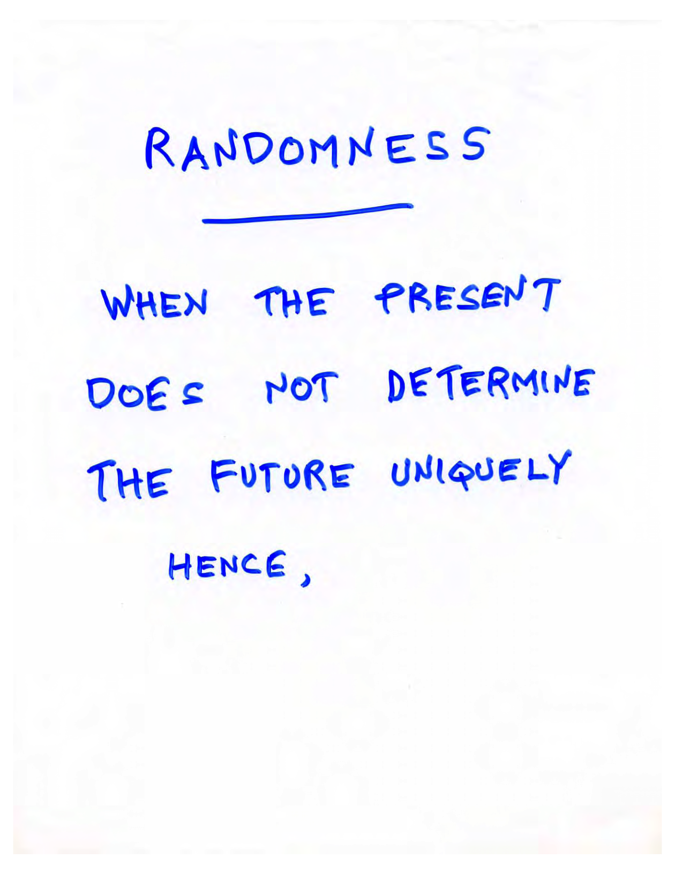
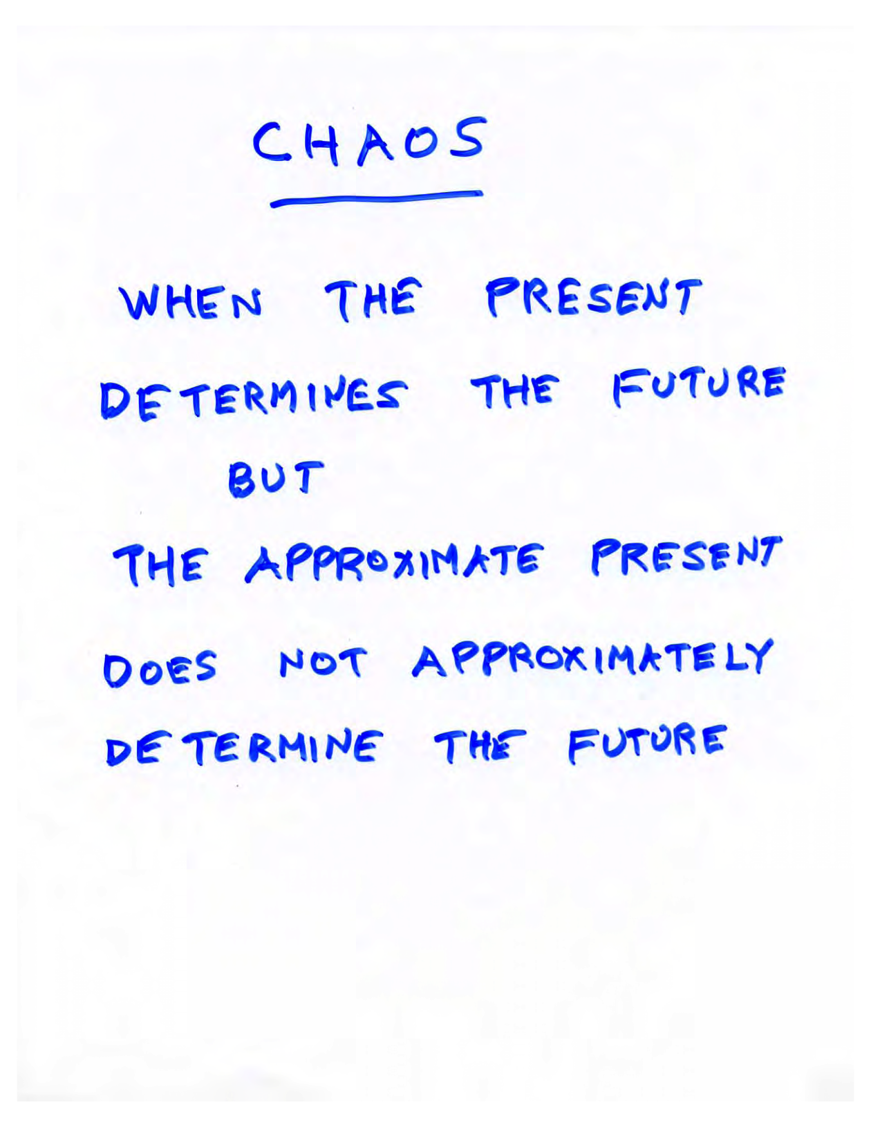
History - prediction
Ed Lorenz (1917-2008)
Chaotic dynamics (inserts from the 2006 presentation at FSU, Tallahassee)
Data assimilation is closely connected to chaotic/nonlinear dynamics

Slide 4
Overview
Motivation
Satellite data assimilation and clouds
Challenges
Applications with WRF model

Slide 5
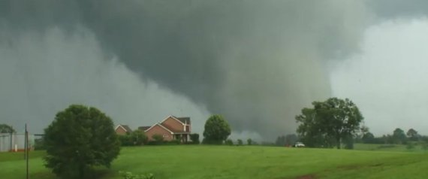
Motivation: High-impact weather
GOES-R
Thunderstorms
Tornadoes
Rainfall
Hail
Flash floods
  Mississippi tornado (04/2011)
Cloud-resolving (CR) modeling typically implies:
- high dimensionality
- cloud microphysics (bulk, 1-2-moment microphysics)
- parallel processing (MPI, Open MP)
Cloud hydrometeor prediction is in the focus of CR applications

Slide 6
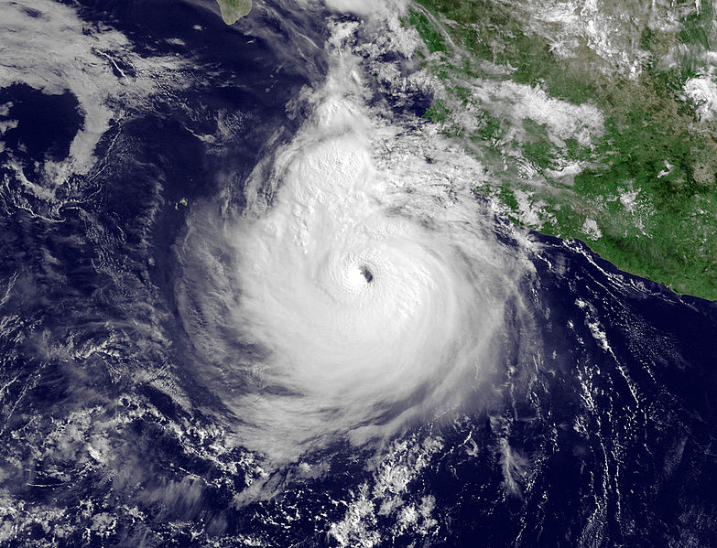
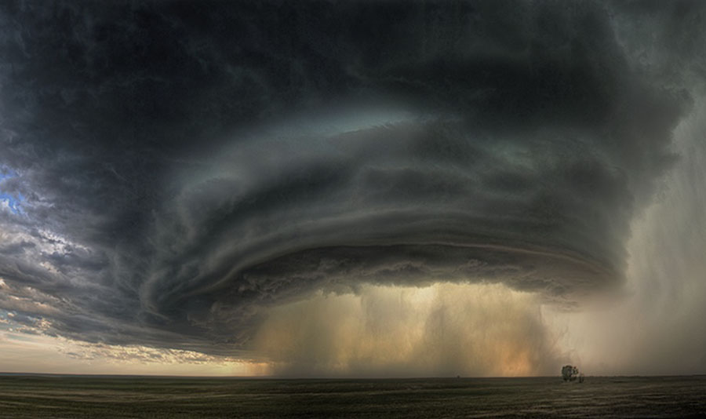
Motivation: Clouds
Clouds: information to be utilized
  Typically associated with high impact weather
  Can produce extreme rainfall and floods
  Cloud microphysics
  Radiation
GOES-R
  Hurricane Dora (2012) - GOES
Improving analysis and prediction of clouds is challenging, but fundamentally important
  Supercell thunderstorm cloud (2010) - NASA

Slide 7
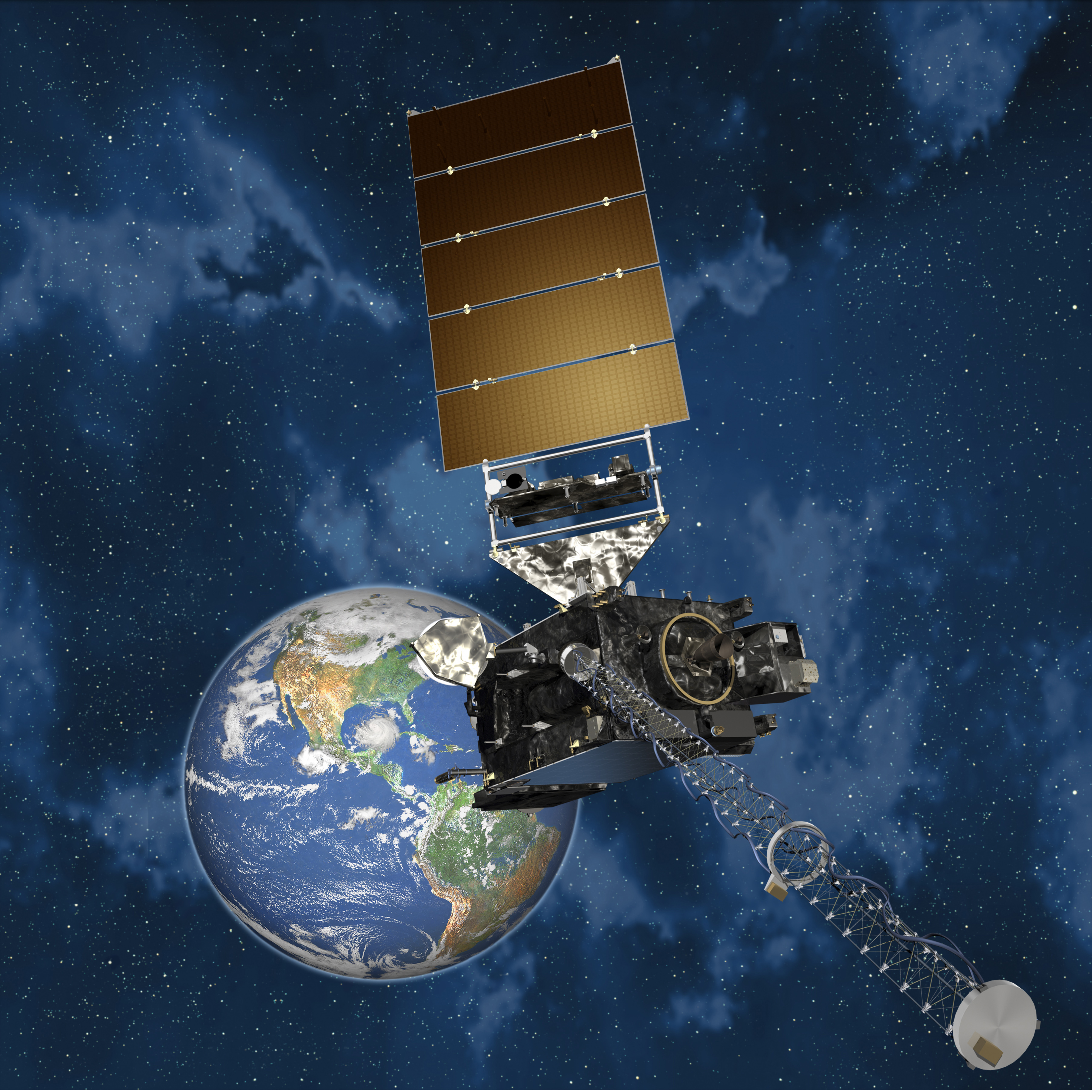
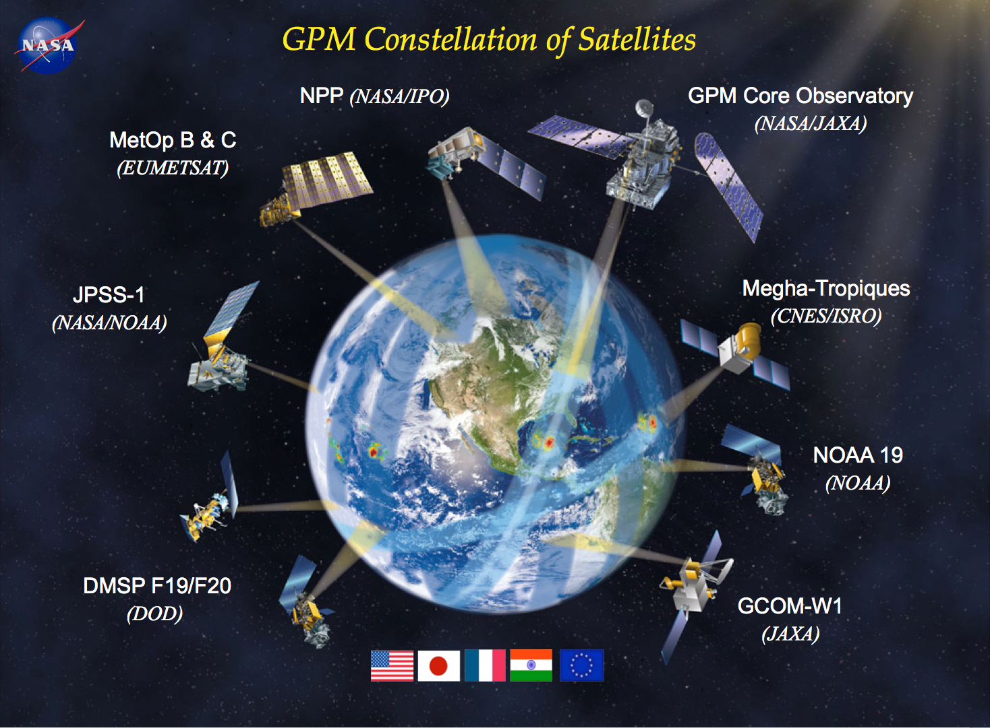
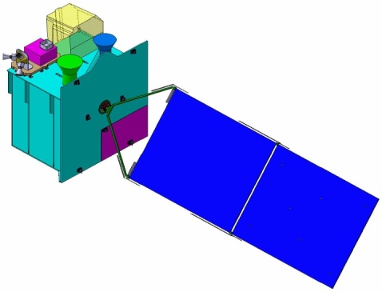
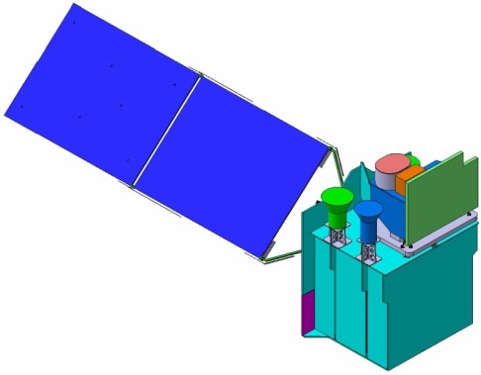
Motivation-3: New satellites
GOES-R
NOAA Geostationary Operational Environmental Satellite(GOES-R)
Advanced Baseline Imager (ABI)
Geostationary Lightning Mapper (GLM)
NASA Global Precipitation Mission (GPM) satellite
Dual-frequency precipitation radar (DPR)
GPM microwave imager (GMI)
Korean Environmental Satellite (MP-GEOSAT)
Geostationary Environment spectrometer (GEMS)
ABI + GOCI-2 (ocean color)
GPM
GEMS
GOCI-2
Applications
High-impact weather
Precipitation (water vapor, clouds)
Air pollution (aerosol, SO2, NO2, O3)
Solar Panel
ABI
Solar Panel

Slide 8
Satellite observations relevant for clouds
Microwave radiances
Infrared radiances
Spaceborne lightning
Spaceborne radars

Slide 9
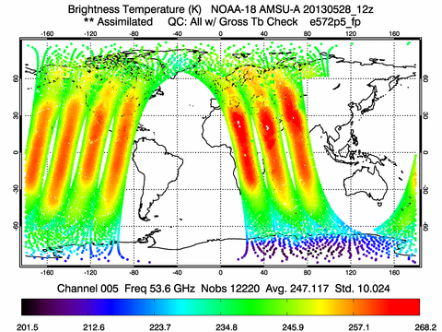
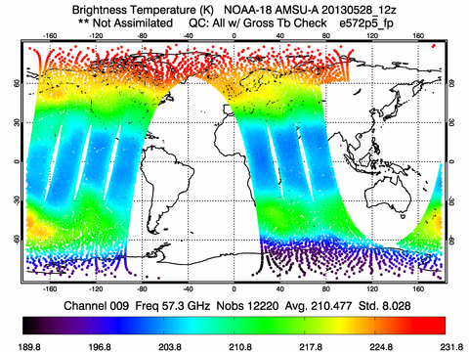
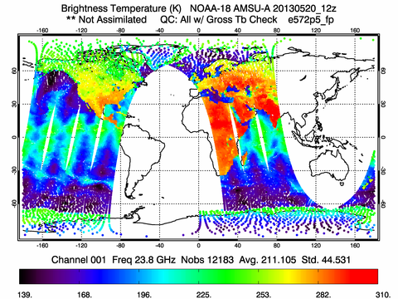
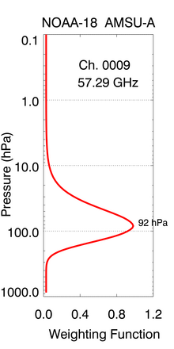
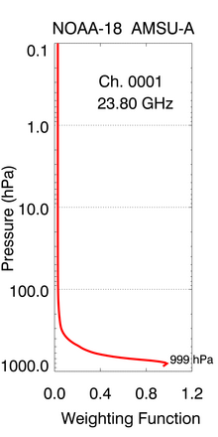
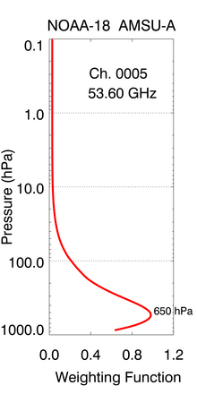
Satellite observations relevant for clouds: Microwave radiances
Penetrate clouds, can “see” inside
Related to microphysics
Channel 3: 53.6 GHz
20 May 2013, 12z
Channel 9: 57.3 GHz
20 May 2013, 12z
Channel 1: 23.8 GHz
20 May 2013, 12z
Weighting function: Surface
Weighting function: 650 hPa
Weighting function: 92 hPa

Slide 10
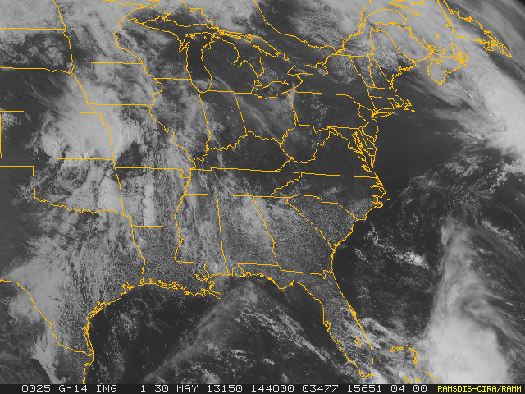
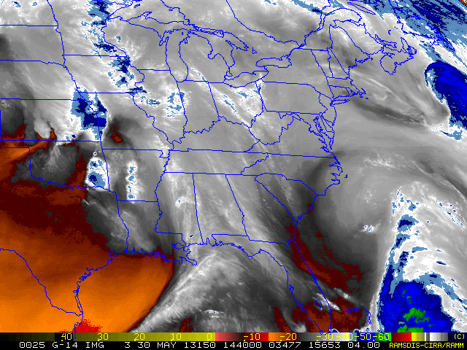
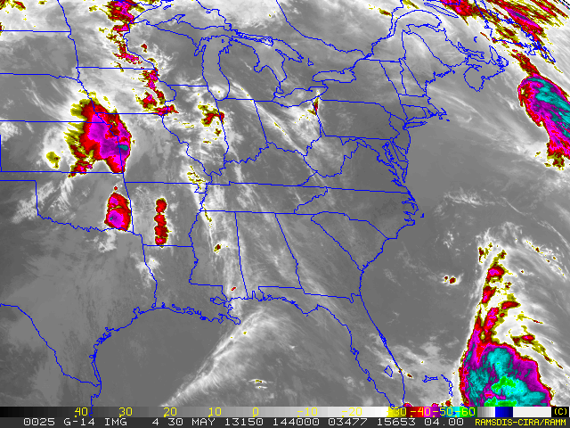
Satellite observations relevant for clouds: Infrared radiances
Imager cannot penetrate clouds, can “see” cloud top
Potential benefit for improving the location of a storm
Visible (4 km)
30 May 2013, 13:15z
Water vapor (4 km)
30 May 2013, 13:15z
Thermal infrared (4 km)
30 May 2013, 13:15z

Slide 11
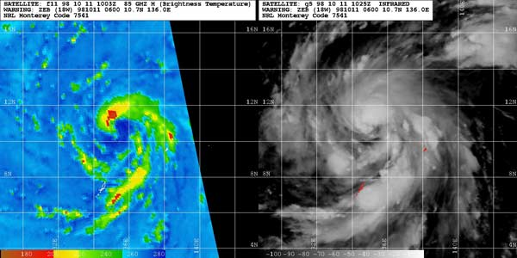
Combined MW and IR observations of clouds
Microwave
Infrared
Two images of typhoon Zeb (1998) intensifying in the western Pacific. In the microwave image on the left, dark blue marks a developing eye at the center of circulation. This dark blue coloration suggests abundant low-level cloud water in the eye but no deep convection above. The greens and yellows in the spiral bands represent scattering signatures from precipitation-size ice particles above the freezing level. The infrared image on the right shows the cirrus clouds and cumulonimbus that covers most of the storm. It shows a portion of the eye. However, the northern part of the eye is covered by cirrus clouds. Navy Research Lab Monterey, Marine Meteorology Division.

Slide 12
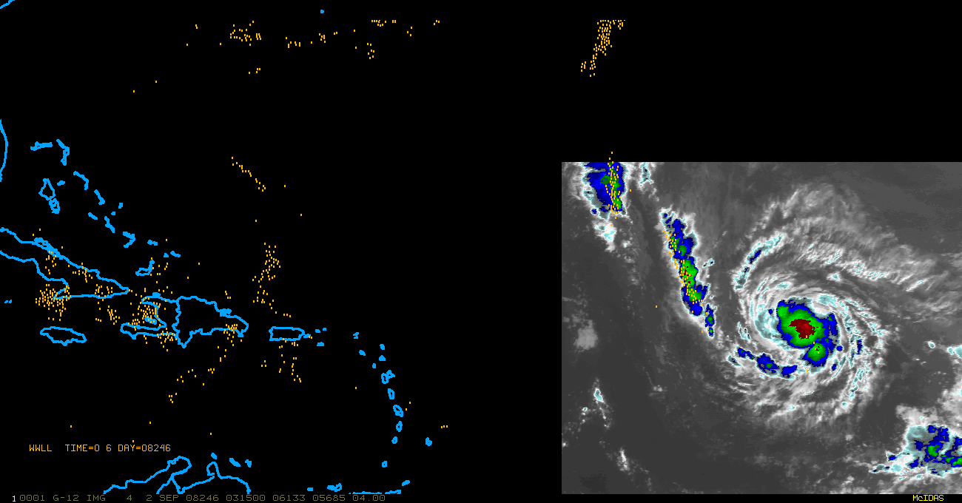
Satellite observations relevant for clouds: Lightning mapper
GOES-R Global Lightning Mapper (GLM) – 2016
Location and strength of the storm and its environment
6-hour lightning observations of Hurricane Ike (2008)

Slide 13
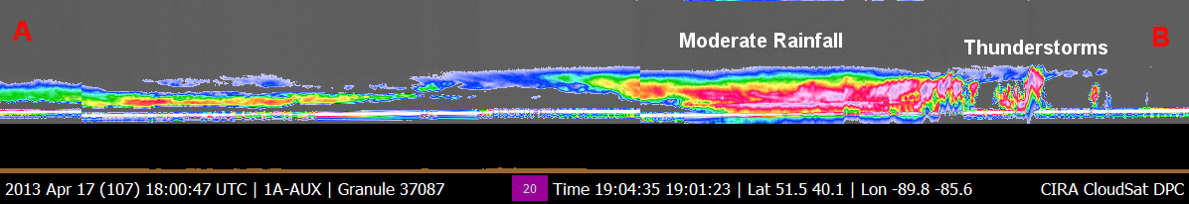
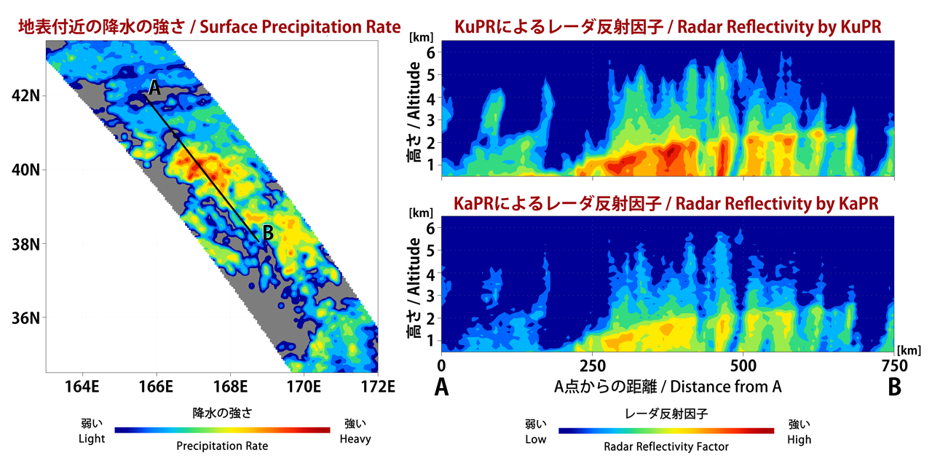
Satellite observations relevant for clouds: Airborne radar
CloudSat radar: Chicago flooding (April 2013)
GPM Dual-frequency Precipitation radar (DPR)
Courtesy of JAXA
High-resolution cross-section of clouds

Slide 14
Satellites and clouds
Satellites observational coverage includes polar regions and open oceans
  - temperature, moisture, winds, clouds
  - chemical constituents
  - ocean surface (waves, tides, algae)
Most high impact weather systems are associated with clouds
- Severe weather
- Tropical cyclones
- Extreme precipitation events
Information about clouds can be very important
- cloud properties (microphysics)
Improving analysis and prediction of clouds is challenging, but fundamentally important
However, current operational systems rarely include assimilation of cloud/precipitation-affected radiances

Slide 15
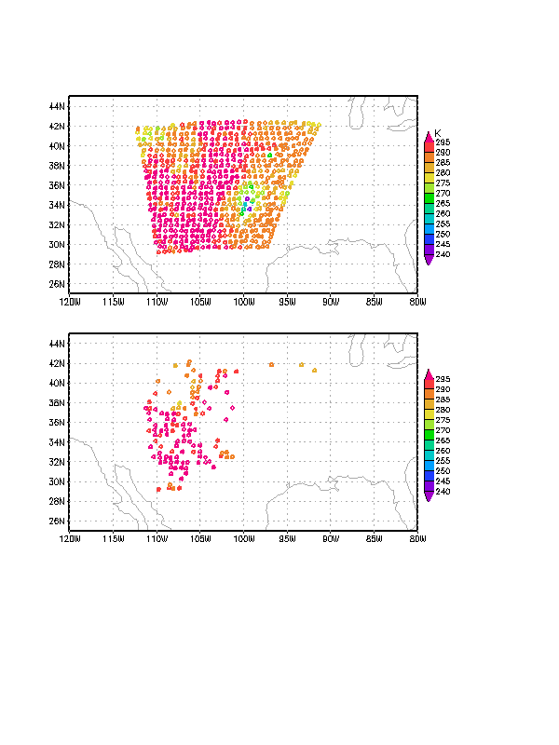
Impact of cloud clearing
GOES-R
Re-development of the TS Erin (2007): Distribution of AMSU-B radiance data in the NCEP operational data stream: (a) all observations, (b) accepted observations after cloud clearing. Data are collected during the period 15-18Z, August 18, 2007. Note that almost all observations in the area of the storm got rejected by cloud clearing. (from Zupanski et al. 2011, J. Hydrometeorology)
Valuable information is lost due to cloud clearing
Need to assimilate all-sky satellite radiances

Slide 16
Mesoscale/CR data assimilation application is a magnifying glass for data assimilation deficiencies
Mesoscale and cloud-resolving data assimilation is:
Nonlinear
Microphysical processes are nonlinear
Scattering makes radiative transfer operator nonlinear
Non-differentiable
Radiative transfer with scattering
Ice/liquid water content assimilation
Non-Gaussian
Cloud, moisture, chemistry, aerosol control variables
High-dimensional
Some standard DA techniques have limitations in high dimensional problems
Computing efficiency can be hampered
Multivariate, time-dependent
Balances between variables are not known, or difficult to represented in the forecast error covariance
Highly correlated and complex dynamics

Slide 17
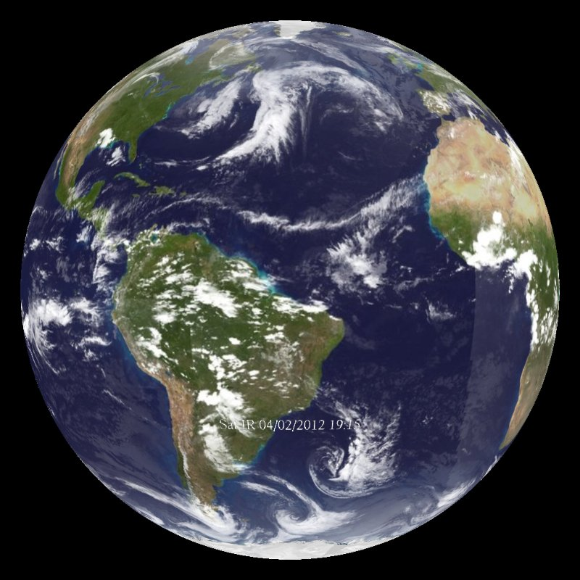
Global and limited-area CR data assimilation
Global domain:
Number of potentially challenging points is relatively small compared to all model points
This implies a small contribution to the cost function

Slide 18
Global and limited-area CR data assimilation
Global domain:
Number of potentially challenging points is relatively small compared to all model points
This implies a small contribution to the cost function
Limited area mesoscale-CR domain
Nonlinear points can dominate in the model domain
Large contribution to the cost function
Computational cost considerations?
Inadequate treatment of challenging points can only marginally impact global DA, but effectively destroy the limited-area mesoscale and cloud resolving DA

Slide 19
How is radiance included in data assimilation?
GOES-R
Additional term in observation cost function
T_{b} – Brightness temperature (equivalent to radiance)
RT – radiative transfer equation operator
Methodologically is simple adding satellite radiances
Problem comes from:
- high number of observations
- slow calculations of RT
- imperfect calculations of RT (radiance bias correction)

Slide 20
Forecast error covariance in cloud-resolving satellite data assimilation
Complex inter-variable correlations
Correlations between dynamical variables
Correlations between microphysical variables
Cross-correlations between dynamical and microphysical variables
Only dynamical auto-correlations are relatively well known
Correlations among microphysical variables are generally unknown
Even less known are the cross-correlations between dynamical and microphysical variables

Slide 21
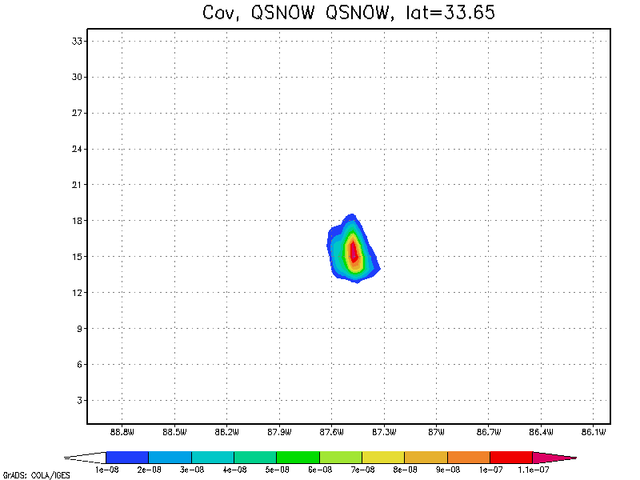
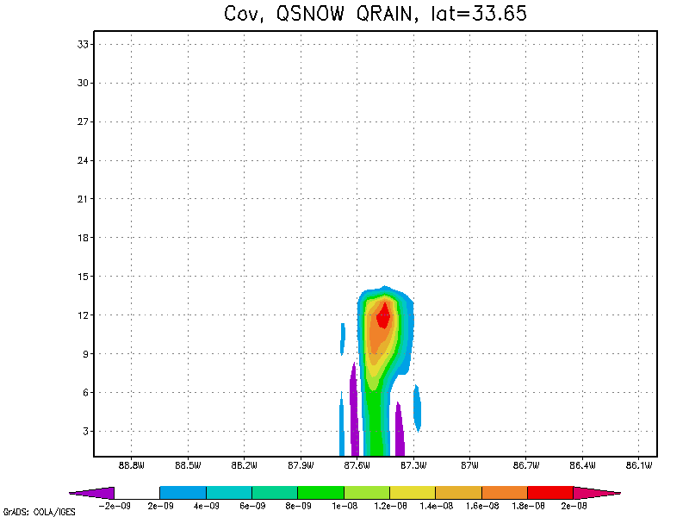
Single observation of cloud snow at 650 hPa: ensemble DA response in vertical
(a) Snow at 34N (P_{snow,snow})
(b) Rain at 34N (P_{rain,snow})
X
Vertical analysis increments for (a) snow, and (b) rain.
Difficult to model rain-snow correlation:
non-centered response and time-dependence

Slide 22
High dimensionality implications on cloud-resolving satellite data assimilation
Computational and scientific challenge
Complex cloud-resolving processes would most benefit from ensemble-based error covariance
Flow-dependent error covariance requires ensemble forecasts
Given the high computational cost of cloud-resolving model, only a small number of ensemble forecasts is feasible
Small number of ensembles implies poorly estimated forecast error covariance

Slide 23
Typical computational approximation (model-space-VAR)
Neglect the impact of observations in matrix inversion
Use iterative minimization
Simplify matrix formulation in order to accomplish matrix inversion

Slide 24
Typical computational approximation (ENS)
Define ensemble-based forecast error covariance in order to invert the matrix
Reduce the number of degrees of freedom in order to accomplish matrix inversion

Slide 25
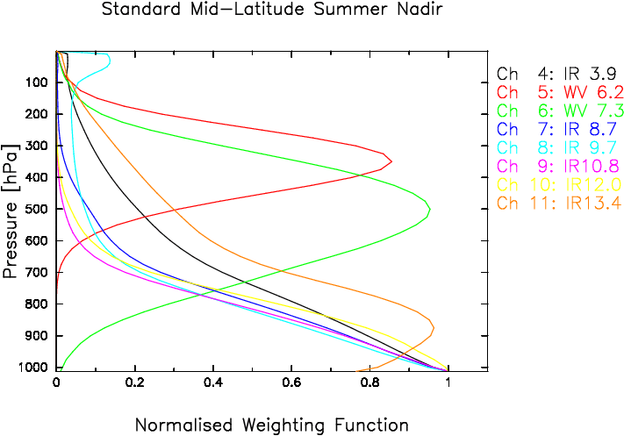
Error covariance localization and satellite radiance assimilation
Error covariance localization is used in ensemble DA to increase the number of degrees of freedom
+
Original error covariance
Localizing function
Final localized error covariance
Meteosat Second Generation
Localization implies local impact of observations. However, satellite radiances are vertically integrated observations!
Need to pay special attention to vertical localization in Ensemble and Hybrid DA

Slide 26
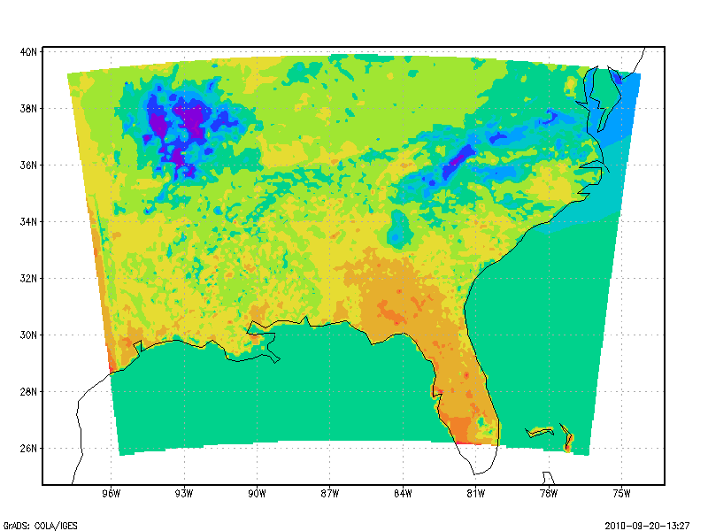
Radiance bias correction
Biases in radiance innovations [y-h(x)] are mainly caused by systematic errors in prediction model inputs to radiative transfer model
- biased surface conditions (e.g., skin temperature)
- excessive snow or ice content
- excessive precipitation near boundaries
Typical approach is to use linear regression
WRF skin temperature
Input to RTM 2009-09-19-18z
p = predictor
= regression parameter

Slide 27
Maximum Likelihood Ensemble Filter (MLEF): Forecast
In KF, the forecast error column is a forecast of the analysis error column
Since spans the analysis uncertainty subspace, one can say that uncertainty is transported in time by a (linear) model M
Generalize KF to include nonlinear forecast model:
Transport uncertainty in time by a nonlinear model m (one span vector at a time)
Each uncertainty column vector is a member of an“ensemble” (i.e. span)

Slide 28
Maximum Likelihood Ensemble Filter (MLEF): Analysis
Control theory viewpoint:
In standard KF, the analysis is obtained by minimizing a
quadratic cost function (i.e. with linear observation operators)
Generalize KF to include nonlinear observation operators:
Minimize nonlinear (i.e. non-quadratic) cost function
Use best applicable minimization method
Build data assimilation around minimization

Slide 29
MLEF overview
“Ensembles” are not considered random
- Information processing (Shannon) rather than a statistical update
- Side product is the observation information content (entropy change)
Full-rank or Reduced-rank
- Computational considerations (low/high-dimensional modeling systems)
Nonlinear minimization:
- Generalized gradient-based methods (Zupanski et al. 2008)
- Non-smooth methods (Steward et al. 2012)
3D, 4D approach:
- 3D or 4D control variable (and error covariance)
Additional details:
- No covariance inflation
- Use both enforced and dynamical covariance localization
- Control variable includes initial conditions and/or empirical parameters
Notes:
Outline slide

Slide 30
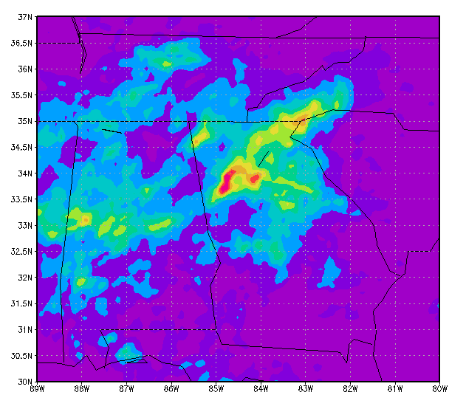
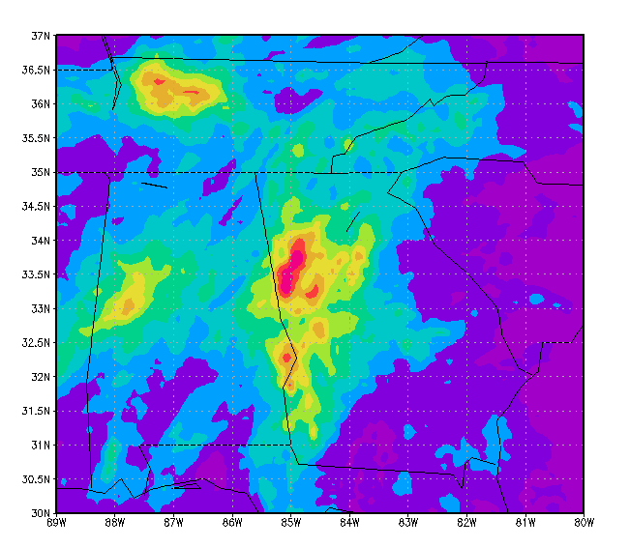
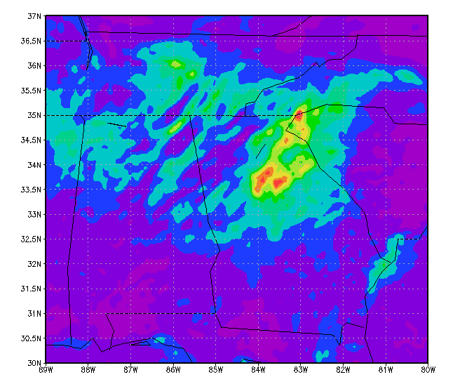
Precipitation: NASA Global Precipitation Mission - GPM: Downscaling satellite precipitation information using ensemble data assimilation
Assimilate precipitation-affected microwave satellite radiances
AMSR-E, TMI, AMSU-A,B, MHS
Provide improved precipitation information for hydrology models
Cloud-scale data assimilation with NASA WRF model (27-9-3-1 km)
Sara Zhang et al. (2012), Mon. Wea. Rev.
Surface precipitation short-term forecasts verification
(accumulated during 15-22 Sep 2009 in the southeast US flood region)
Ground-based Verification
(NOAA Stage IV data)
3DVAR, no AMSR-E,TMI
(WRF-GSI)
EDAS, with AMSR-E, TMI
(WRF-EDAS)

Slide 31
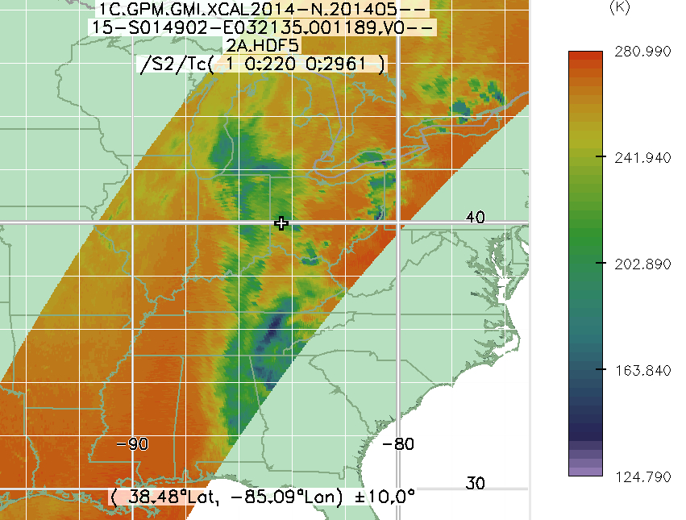
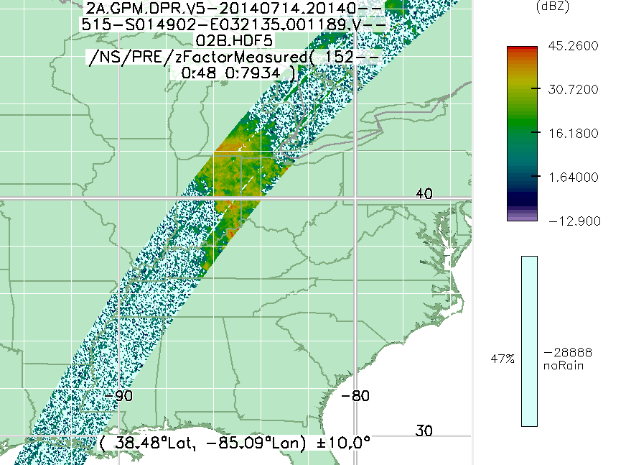
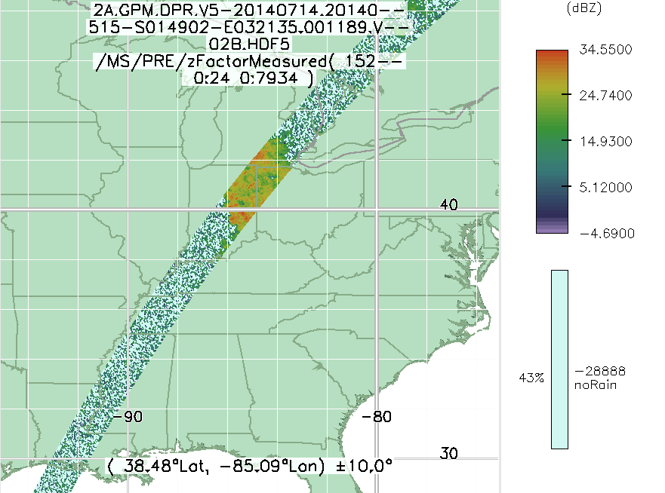
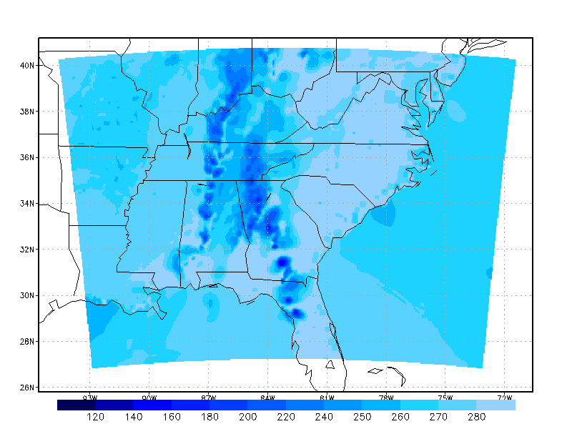
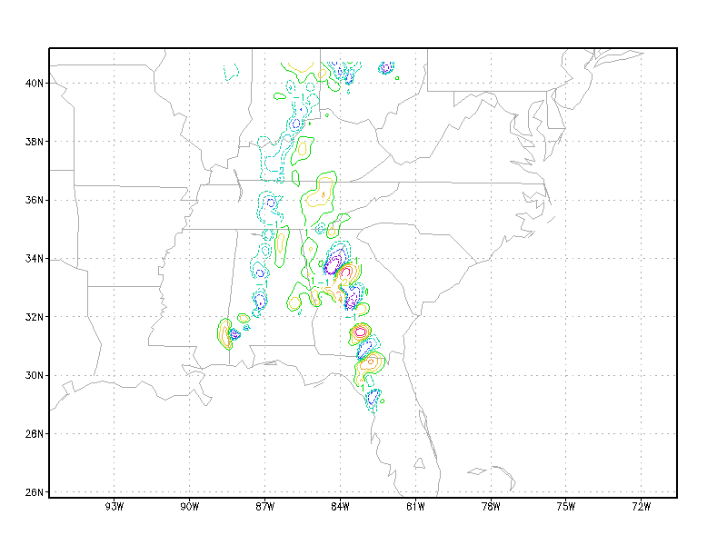
Assimilation of GPM Microwave Imager (GMI) all-sky satellite radiances
NASA Unified WRF (NU-WRF) at 9km/3km
32 ensembles, 3-hour assimilation interval
Control variable includes dynamic and cloud variables
GMI 89GHz
DPR Ku
DPR Ka
Guess GMI radiance
Hydrometeor analysis increments
(Valid 15 May 2014 at 0000 UTC)
Positive impact of GMI radiance assimilation on precipitation and near-surface wind.
The accumulated precipitation forecast (0-6 h) is improved by 23% in RMSE verified using ground validation observations.

Slide 32
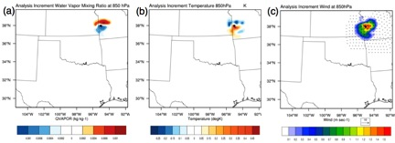
Lightning data assimilation
Lightning observation operator is a regression:
Single observation experiment using h₁ operator
Q at 850 hPa
T at 850 hPa
(u,v) at 850 hPa
Lightning observation impacts the analyses of specific humidity, temperature and horizontal winds
Karina Apodaca (karina.apodaca@colostate.edu)

Slide 33
Impact of lightning DA on cloud hydrometeors using h₂
Graupel Mixing Ratio (g/kg)
Cloud Snow Mixing Ratio (g/kg)
Pressure (hPa)
Pressure (hPa)
Cloud Ice Mixing Ratio (g/kg)
Pressure (hPa)
Karina Apodaca (karina.apodaca@colostate.edu)
QICE (g kg-1)

Slide 34
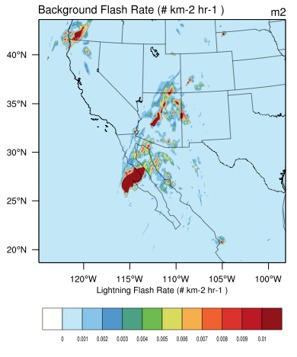
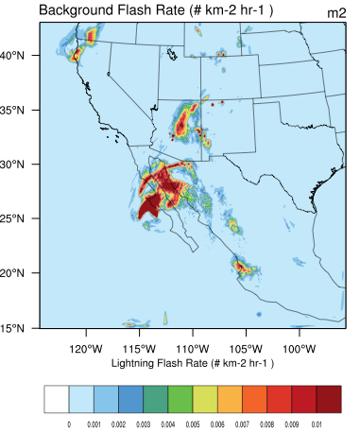
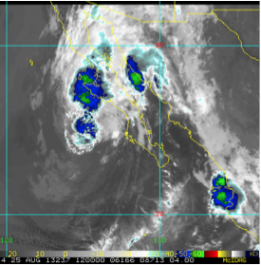
Impact of lightning DA on 3-hour forecast of lightning
Tropical storm Ivo (2013)
CTL: NOAA/NCEP data assimilation algorithm (no lightning)
(2) LIGHT: same as CTL, but with assimilation of lightning (h₂)
CTL
LIGHT
Observed
GOES-15 Infrared
Improved representation of storm structure through more accurate location and intensity of lightning activity
Karina Apodaca (karina.apodaca@colostate.edu)

Slide 35
Summary and Future
Assimilation of cloud/precipitation affected radiances is important for mesoscale and cloud-resolving modeling systems
- Preliminary results for severe weather, precipitation applications
- Benefit from unique geographical coverage over open oceans, polar regions
Challenges of cloud/precipitation affected radiance assimilation
- nonlinear/non-differentiable RT operator
- radiance bias correction
- correlated observation errors
- non-Gaussian observation errors
- land emissivity
Assimilation of lightning from satellites (e.g., GOES-R)
- lightning flash rate can impact the storm and its environment
Assimilation of atmospheric chemistry/aerosol information from radiances
- air pollution/quality, dust storms
Notes:
Outline slide

Slide 36
Thank you!
References:
Apodaca, K., M. Zupanski, M. DeMaria, J. Knaff, and L. Grasso, 2013: Evaluating the potential impact of assimilating satellite lightning data utilizing hybrid (variational-ensemble) methods. Submitted to J. Appl. Met. Clim.
Chambon, P., S. Q. Zhang, A. Y. Hou, M. Zupanski, and S. Cheung, 2013: Assessing the impact of pre-GPM constellation microwave precipitation radiance data in the Goddard WRF ensemble data assimilation system. Quart. J. Roy. Meteorol. Soc., DOI:10.1002/qj.2215.
Steward, J. L., I. M. Navon, M. Zupanski, and N. Karmitsa, 2012: Impact of Non-Smooth Observation Operators on Variational and Sequential Data Assimilation for a Limited-Area Shallow-Water Equation Model. Quart. J. Roy. Meteorol. Soc., 138, 323-339.
Zhang, M., M. Zupanski, M.-J. Kim, and J. Knaff, 2013: Assimilating AMSU-A Radiances in TC Core Area with NOAA Operational HWRF (2011) and a Hybrid Data Assimilation System: Danielle (2010). Mon. Wea. Rev., doi:10.1175/MWR-D- 12-00340.1, in press.
Zhang, S. Q., M. Zupanski, A. Y. Hou, X. Lin, and S. H. Cheung, 2013: Assimilation of precipitation-affected radiances in a cloud-resolving WRF ensemble data assimilation system. Mon. Wea. Rev., 141, 754-772.
Zupanski D., M. Zupanski, L. D. Grasso, R. Brummer, I. Jankov, D. Lindsey and M. Sengupta, and M. DeMaria, 2011: Assimilating synthetic GOES-R radiances in cloudy conditions using an ensemble-based method. Int. J. Remote Sensing, 32, 9637-9659.
Zupanski, D., S. Q. Zhang, M. Zupanski, A. Y. Hou, and S. H. Cheung, 2011: A prototype WRF-based ensemble data assimilation system for downscaling satellite precipitation observations. J. Hydromet., 12, 118-134.
Zupanski, M., 2005: Maximum Likelihood Ensemble Filter: Theoretical Aspects. Mon. Wea. Rev., 133, 1710–1726.
Zupanski, M., I. M. Navon, and D. Zupanski 2008: The maximum likelihood ensemble filter as a non-differentiable minimization algorithm. Q. J. Roy. Meteor. Soc. 134, 1039-1050.
Zupanski M., 2013: All-sky satellite radiance data assimilation: Methodology and Challenges. Data Assimilation for Atmospheric, Oceanic, and Hydrologic Applications, S.-K. Park and L. Xu, Eds, Springer Heidelberg New York Dordrecht London, pp. 465-488.
[http://ensembleda.cira.colostate.edu]
Notes:
Outline slide

