Slide 1
Regional 4D-Var
Hans Huang
NCAR
Acknowledgements: NCAR/MMM/DAS
USWRP, NSF-OPP, NCAR
AFWA, KMA, CWB, CAA, EUMETSAT, AirDat
Dale Barker (UKMO), Nils Gustafsson and Per Dahlgren (SMHI)

Slide 2
Outline
4D-Var formulation and “why regional?”
The WRFDA approach
Issues specific to regional 4D-Var
Summary
Notes:
2

Slide 3
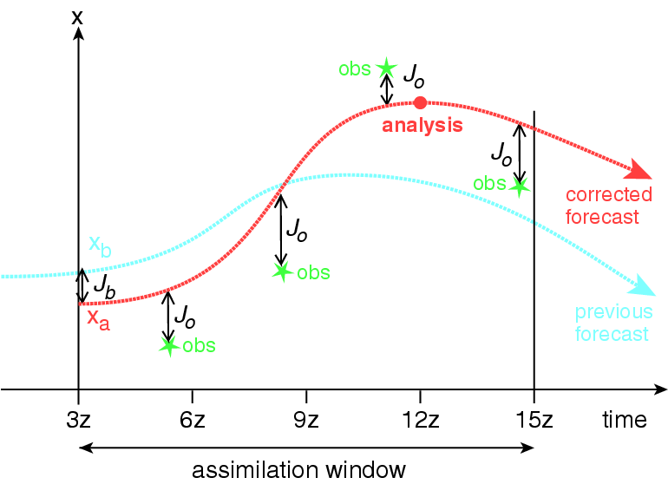
4D-Var

Slide 4
Why 4D-Var?
Use observations over a time interval, which suits most asynoptic data and uses tendency information from observations.
Use a forecast model as a constraint, which enhances the dynamic balance of the analysis.
Implicitly use flow-dependent background errors, which ensures the analysis quality for fast-developing weather systems.
NOT easy to build and maintain!

Slide 5
Why regional?
High resolution model
Regional observation network
Radar data and other high resolution observing systems (including satellites)
Cloud- and precipitation-affected satellite observations
Model B with only regional balance considerations, e.g. tropical B
…

Slide 6
Regional 4D-Var systems
Zupanski M (1993); the Eta model
Zou, et al. (1995); MM5
Sun and Crook (1998); a cloud model
Huang, et al. (2002), Gustafsson et al. (2012); HIRLAM
Zupanski M, et al. (2005); RAMS
Ishikawa, et al. (2005); the JMA mesoscale model
Lorenc, et al (2007); UK Met Office UM
Tanguay, et al. (2012); Canadian LAM
…
Huang, et al. (2009); WRF

Slide 7
HIRLAM tests: 3D-Var vs 4D-Var Nils Gustafsson (SMHI)
SMHI area, 22 km, 40 levels, HIRLAM 7.2, KF/RK, statistical balance background constraint, reference system background error statistics (scaling 0.9), no ”large-scale mix”, 4 months, operational SMHI observations and boundaries
3D-Var with FGAT, 40 km increments, quadratic grid, incremental digital filter initialization
4D-Var, 6h assimilation window, Meteo-France simplified physics (vertical diffusion only), weak digital filter constraint, no explicit initialization.
One experiment with one outer loop iteration (60 km increments) and one experiment with two outer loop iterations (60 km and 40 km increments)

Slide 8
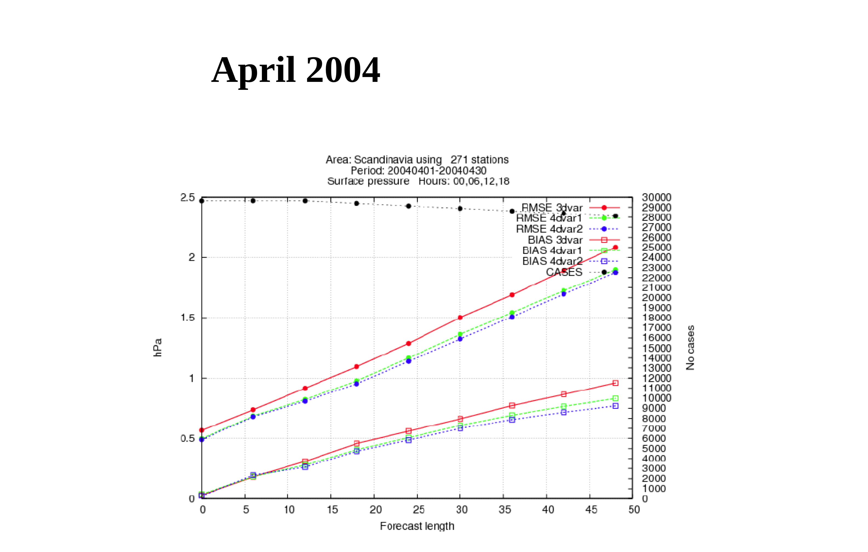
Nils Gustafsson

Slide 9
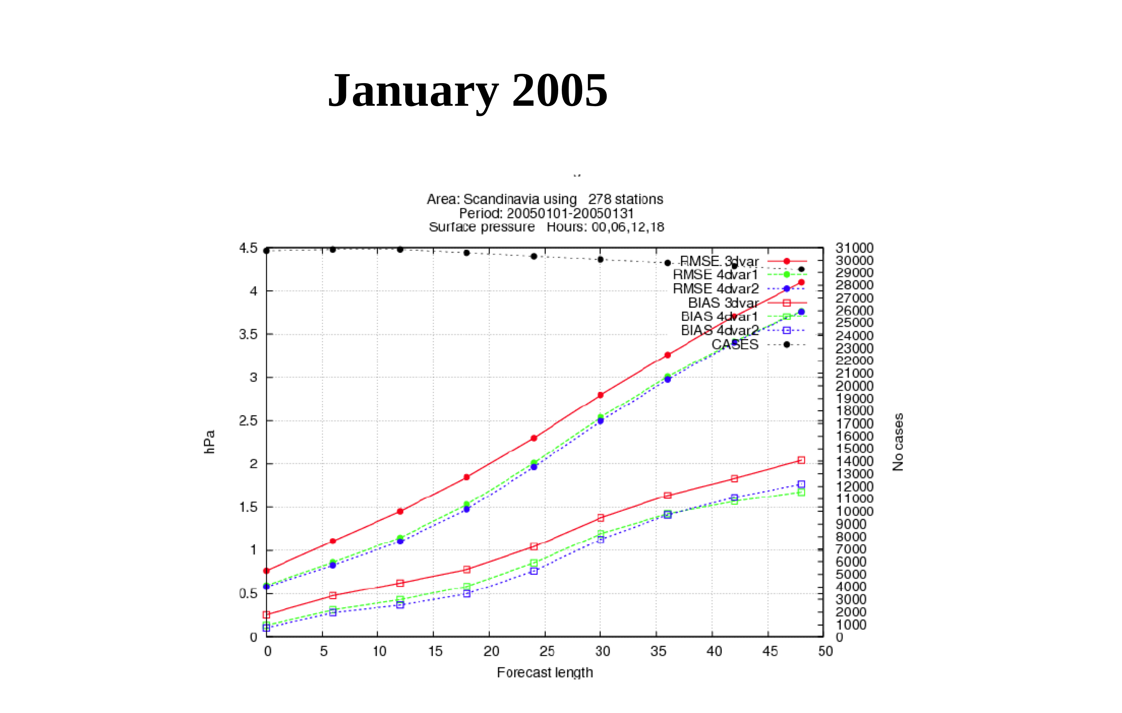
Nils Gustafsson

Slide 10
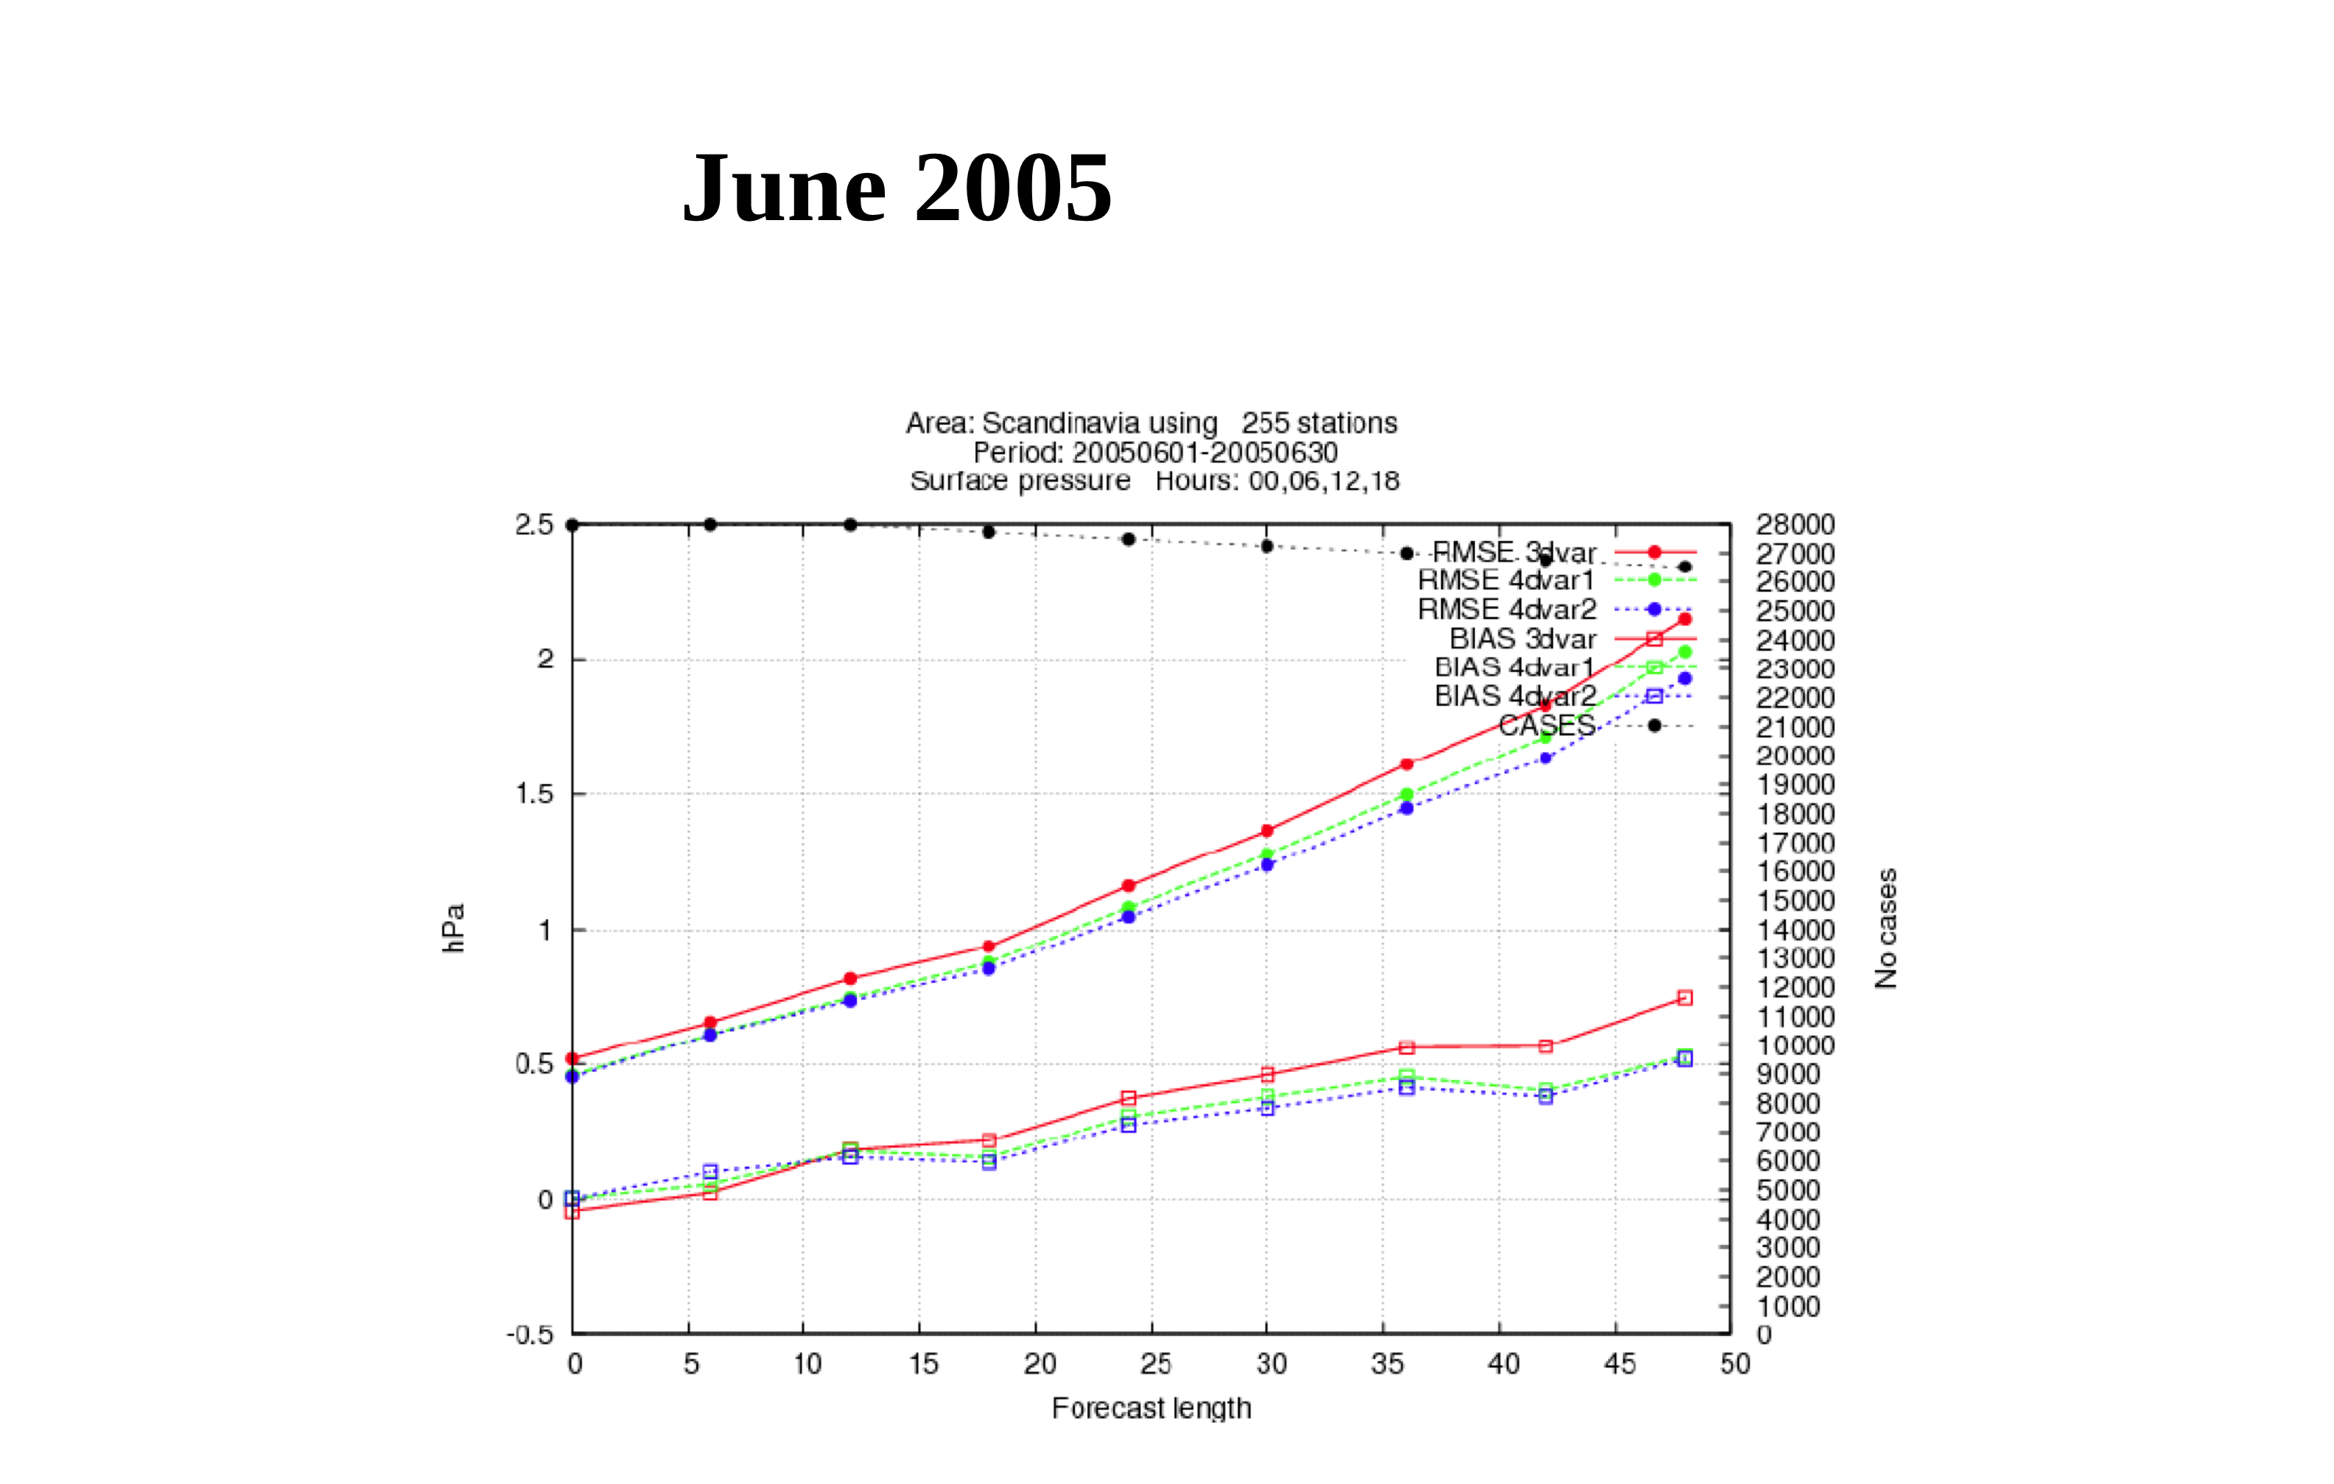
Nils Gustafsson

Slide 11
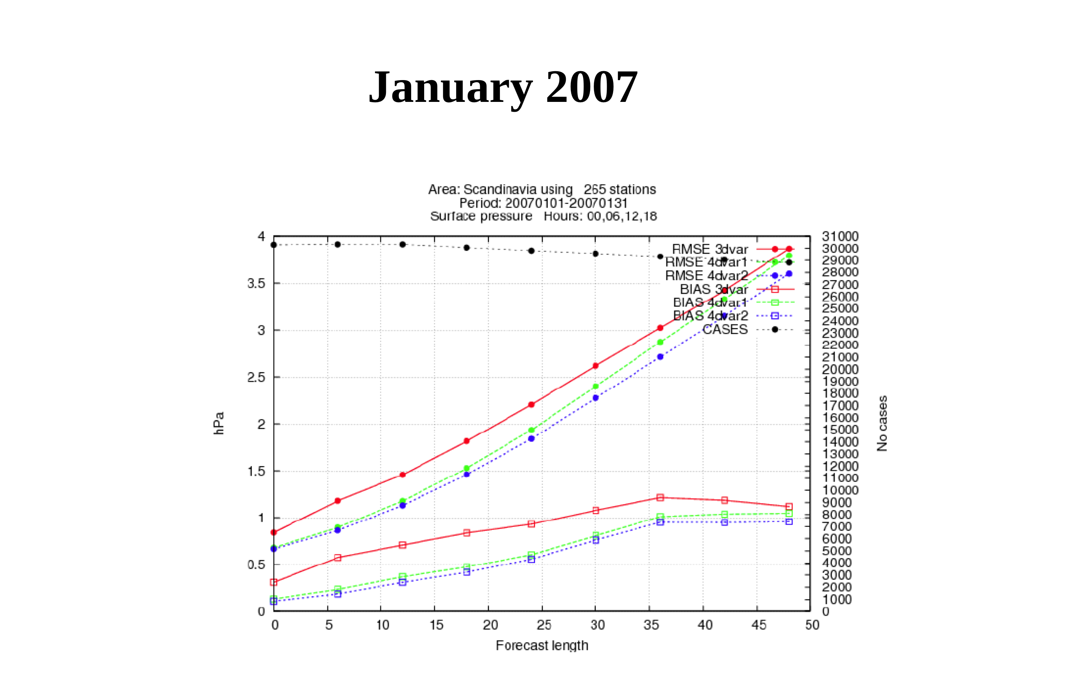
Nils Gustafsson

Slide 12
Outline
4D-Var formulation and “why regional?”
The WRFDA approach
WRFDA is a Data Assimilation system built within the WRF software framework, used for application in both research and operational environments….
Issues specific to regional 4D-Var
Summary
Notes:
12

Slide 13
WRFDA Overview
Goal: Community WRF DA system for
regional/global,
research/operations, and
deterministic/probabilistic applications.
Techniques:
3D-Var
4D-Var (regional)
Ensemble DA
Hybrid Variational/Ensemble DA
Model: WRF (ARW, NMM, Global)
Observations: Conv. + Sat. + Radar (+Bogus)

Slide 14
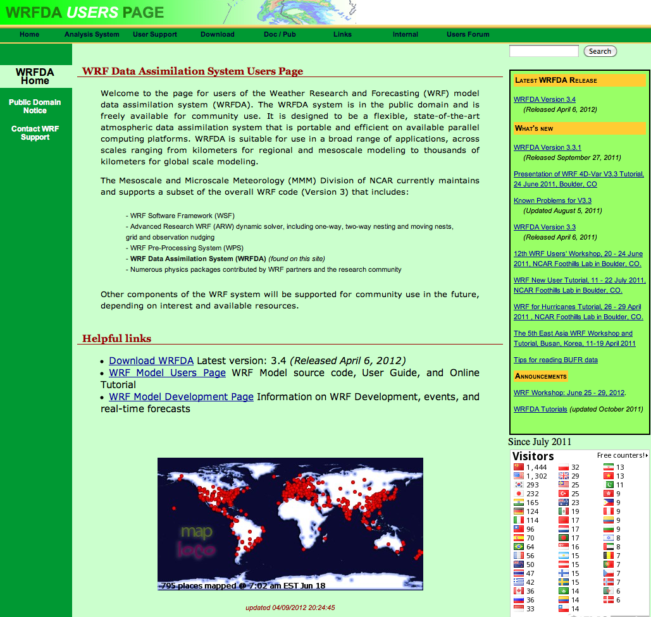
www.mmm.ucar.edu/wrf/users/wrfda

Slide 15
Recent Tutorials at NCAR
WRFDA Overview
Observation Pre-processing
WRFDA System
WRFDA Set-up, Run
WRFDA Background Error Estimations
Radar Data
Satellite Data
WRF 4D-Var
WRF Hybrid Data Assimilation System
WRFDA Tools and Verification
Observation Sensitivity
Practice
obsproc
wrfda (3D-Var)
Single-ob tests
Gen_be
Radar
Radiance
4D-Var
Hybrid
Advanced (optional)

Slide 16
Observing System Simulation Experiment (OSSE) 2010-09-11-00 +6h precipitation (IC and BC come from +12h forecast from 2010-09-10-12 NCEP FNL)

Slide 17
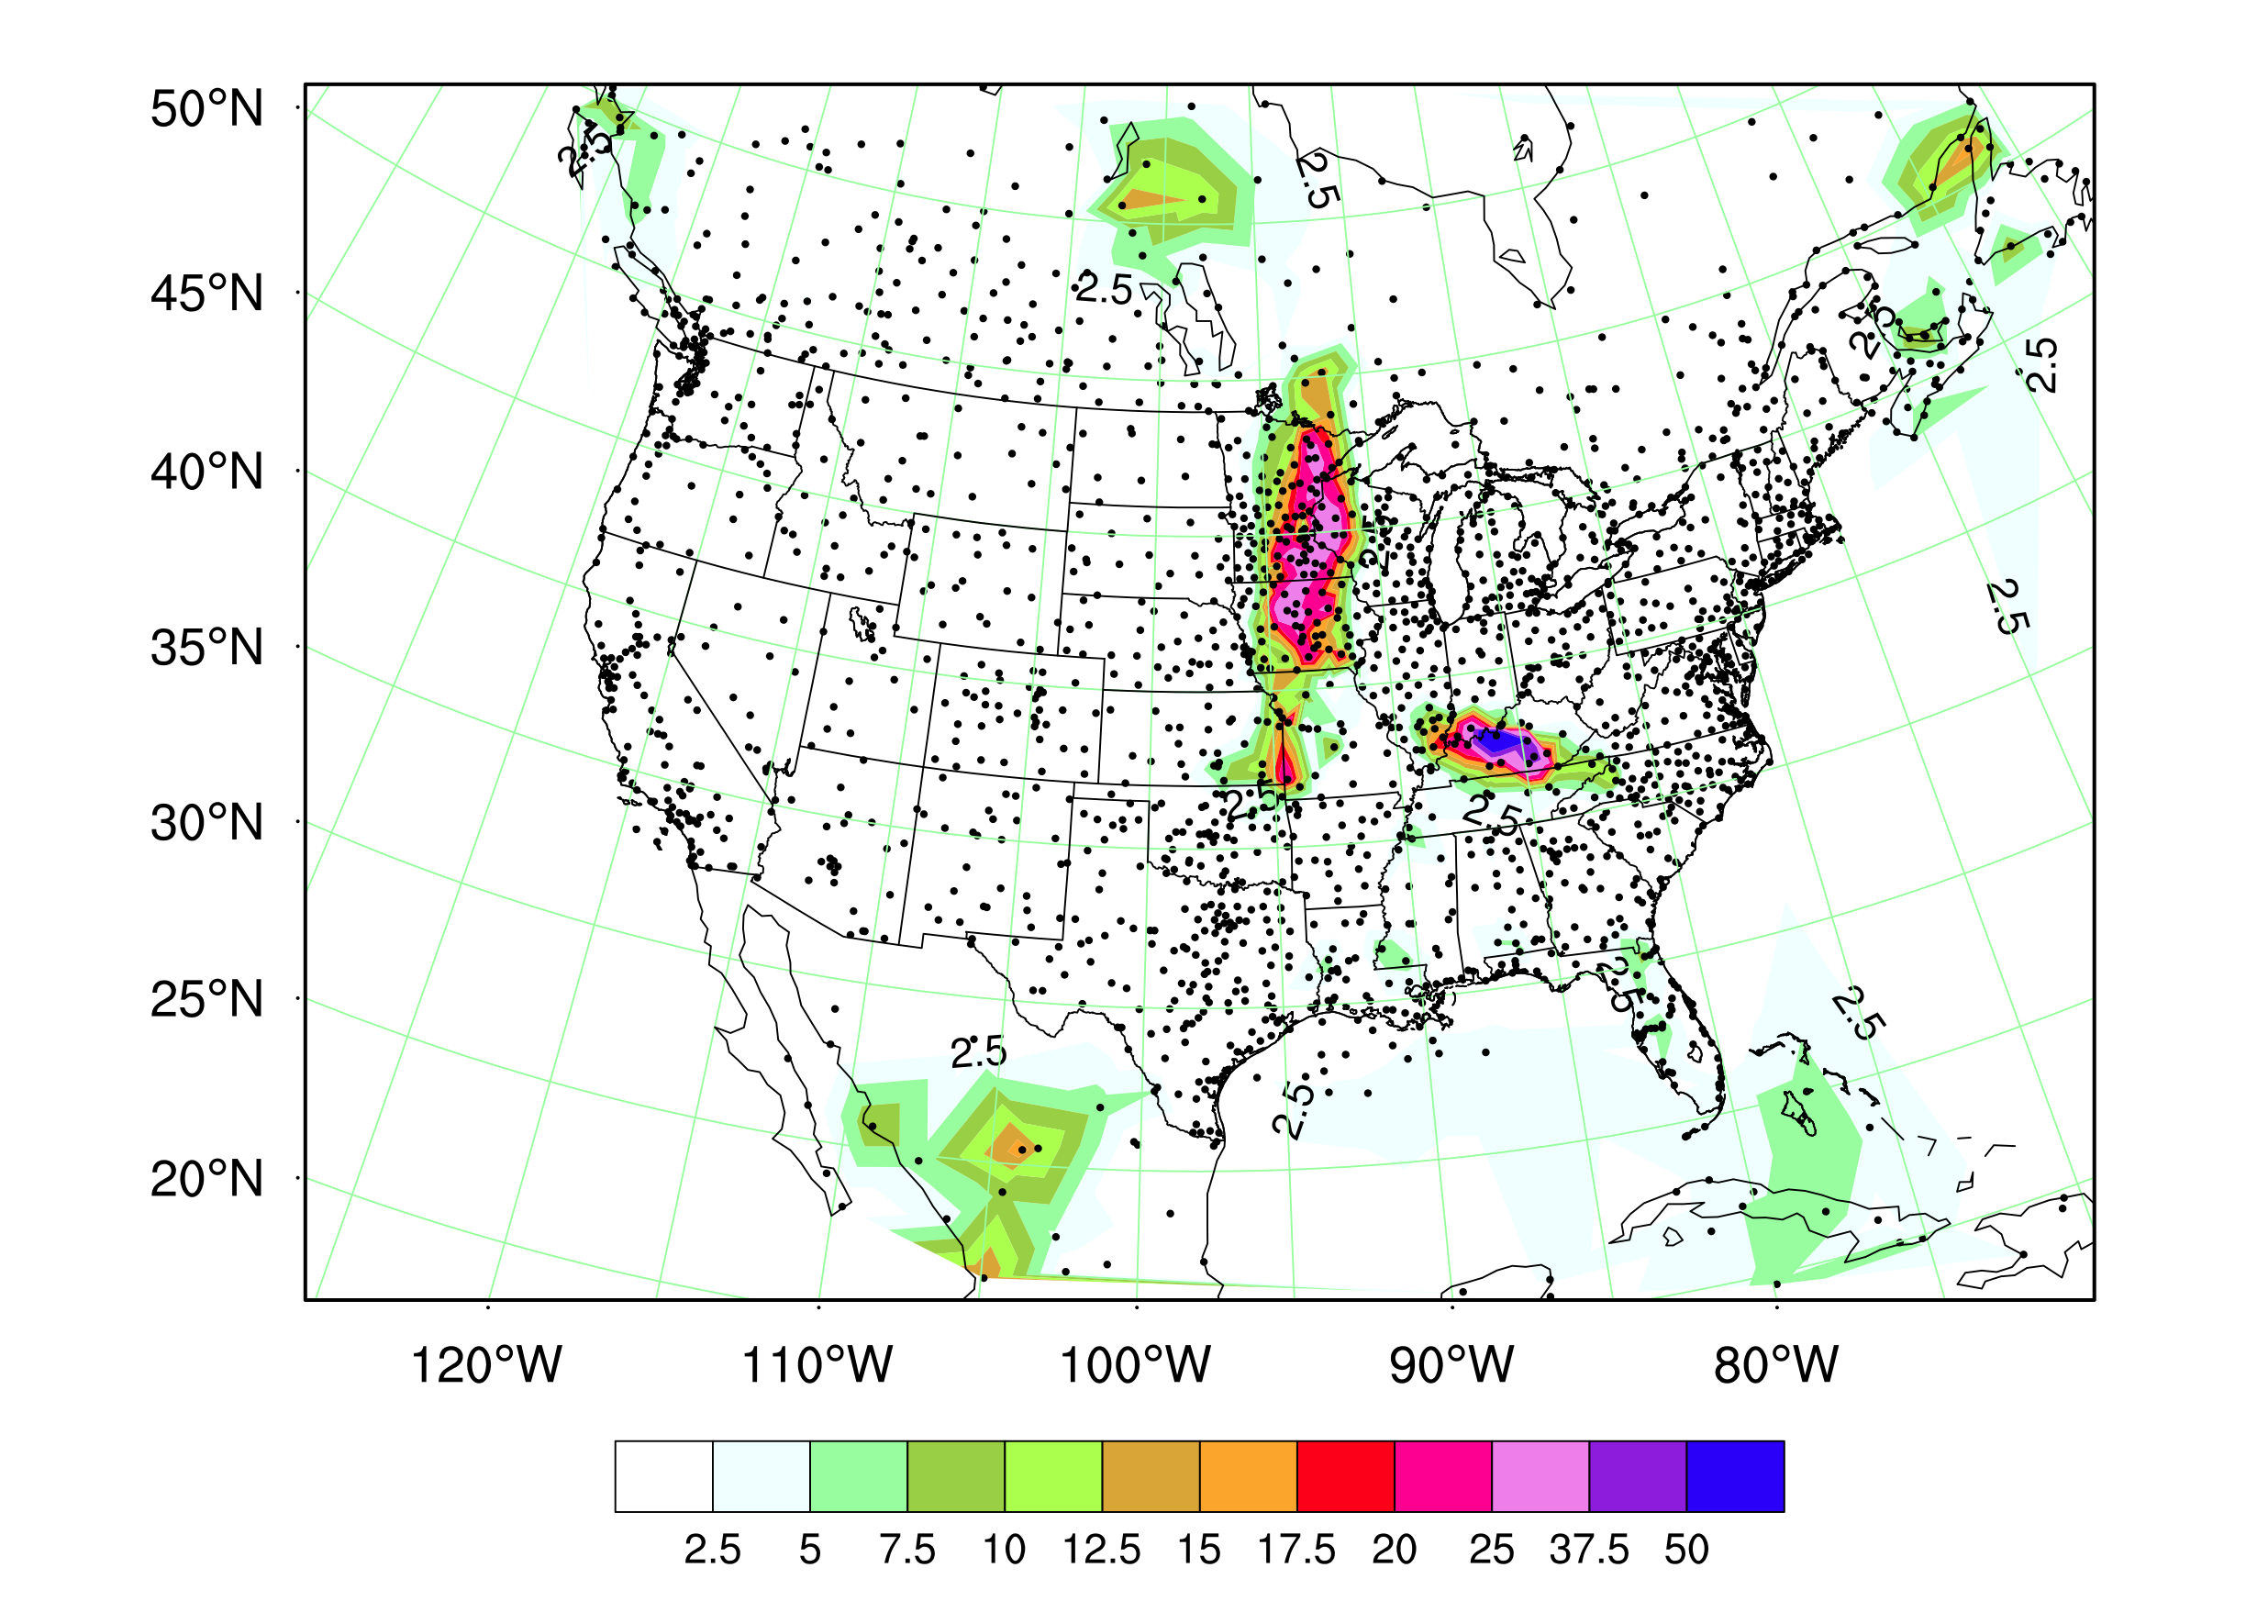
Sample the hourly precipitation obs. based on the NA METAR sta.(2066) + random error (<±1 mm)

Slide 18
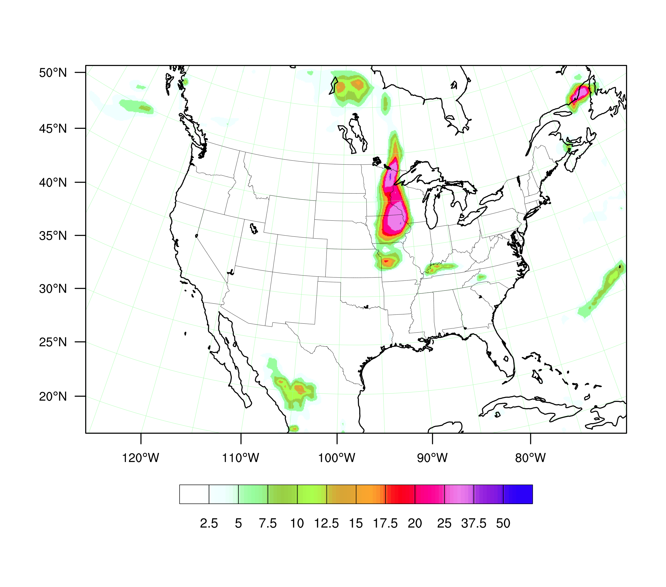
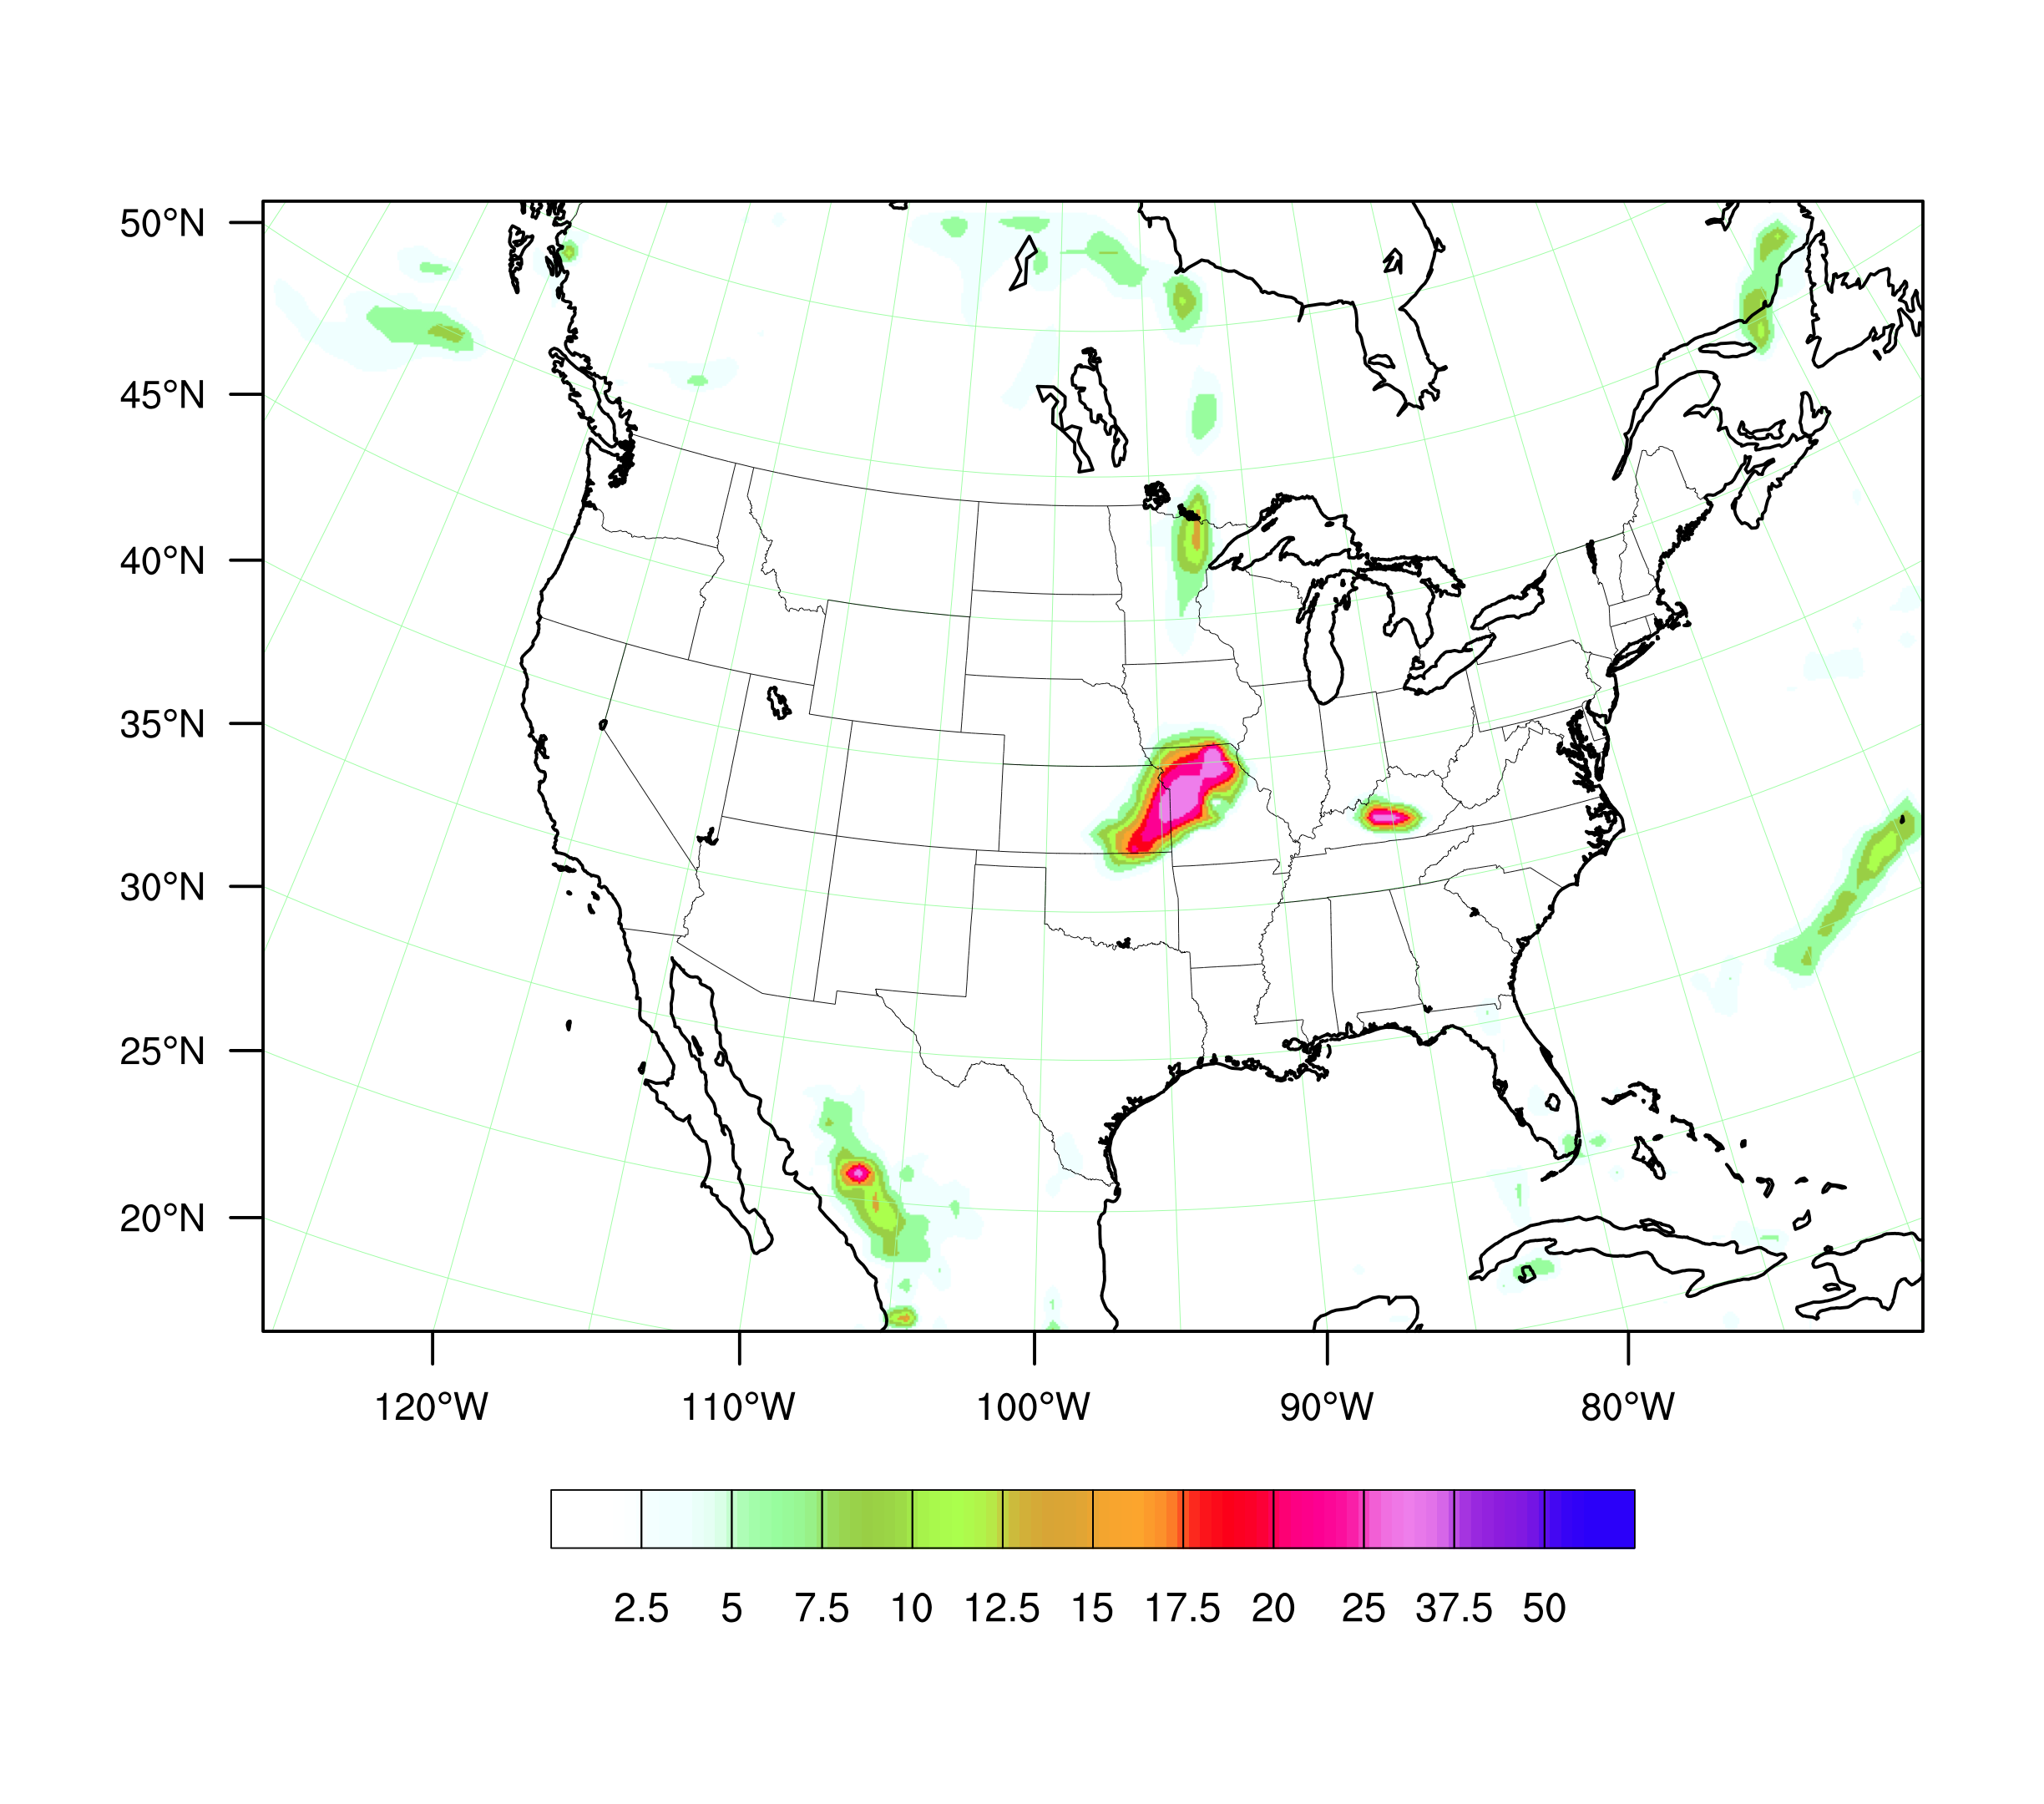
+6h total precipitation simulations
4DVAR
Control
4dvar
control
“OBS”
obs

Slide 19
A short list of 4D-Var issues
Notes:
19

Slide 20
(WRFDA) Observations, y
In-Situ:
Surface (SYNOP, METAR, SHIP, BUOY).
Upper air (TEMP, PIBAL, AIREP, ACARS, TAMDAR).
Remotely sensed retrievals:
Atmospheric Motion Vectors (geo/polar).
SATEM thickness.
Ground-based GPS Total Precipitable Water/Zenith Total Delay.
SSM/I oceanic surface wind speed and TPW.
Scatterometer oceanic surface winds.
Wind Profiler.
Radar radial velocities and reflectivities.
Satellite temperature/humidity/thickness profiles.
GPS refractivity (e.g. COSMIC).
Radiative Transfer (RTTOV or CRTM):
HIRS from NOAA-16, NOAA-17, NOAA-18, METOP-2
AMSU-A from NOAA-15, NOAA-16, NOAA-18, EOS-Aqua, METOP-2
AMSU-B from NOAA-15, NOAA-16, NOAA-17
MHS from NOAA-18, METOP-2
AIRS from EOS-Aqua
SSMIS from DMSP-16
Bogus:
TC bogus.
Global bogus.

Slide 21
^{H - Observation operator}
H maps variables from “model space” to “observation space”
x y
Interpolations from model grids to observation locations
Extrapolations using PBL schemes
Time integration using full NWP models (4D-Var in generalized form)
Transformations of model variables (u, v, T, q, p_{s}, etc.) to “indirect” observations (e.g. satellite radiance, radar radial winds, etc.)
Simple relations like PW, radial wind, refractivity, …
Radar reflectivity
Radiative transfer models
Precipitation using simple or complex models
…
!!! Need H, H and H^{T}, not H⁻¹ !!!

Slide 22
4D-Var
Use observations over a time interval, which suits most asynoptic data and use tendency information from observations.
Use a forecast model as a constraint, which enhances the dynamic balance of the analysis.
Implicitly use flow-dependent background errors, which ensures the analysis quality for fast-developing weather systems.
NOT easy to build and maintain!

Slide 23
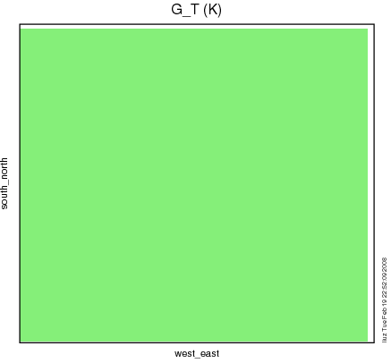
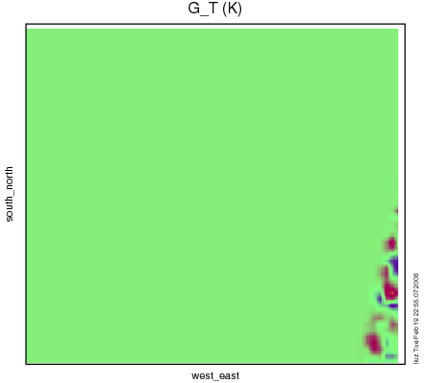
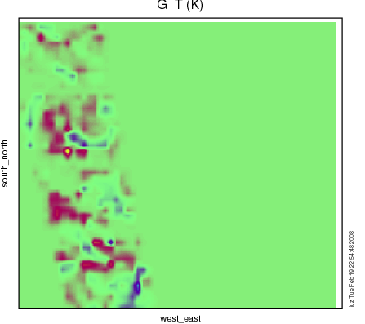
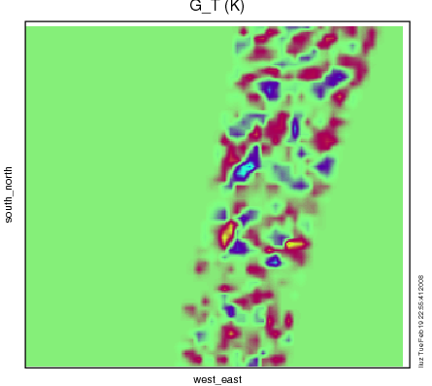
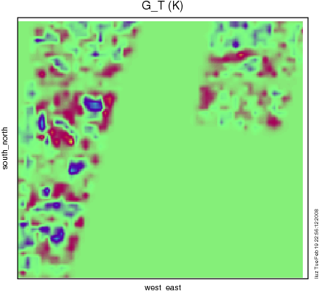
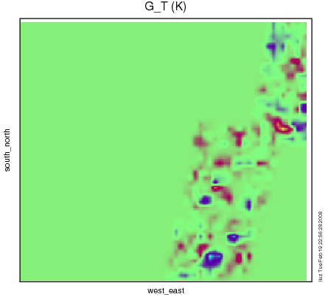
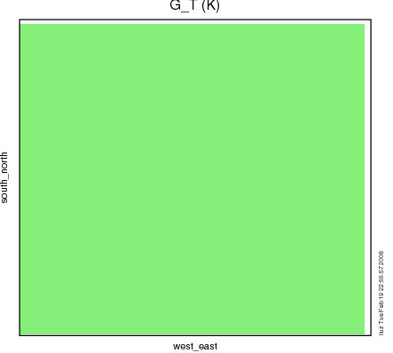
Radiance Observation Forcing at 7 data slots

Slide 24
A short list of 4D-Var issues
Notes:
24

Slide 25
Model-Based Estimation of Climatological Background Errors
Assume background error covariance estimated by model perturbations x’ :
Two ways of defining x’:
The NMC-method (Parrish and Derber 1992):
where e.g. t2=24hr, t1=12hr forecasts…
…or ensemble perturbations (Fisher 2003):
Tuning via innovation vector statistics and/or variational methods.

Slide 26
Single observation experiment - one way to view the structure of B
The solution of 3D-Var should be
Single observation

Slide 27
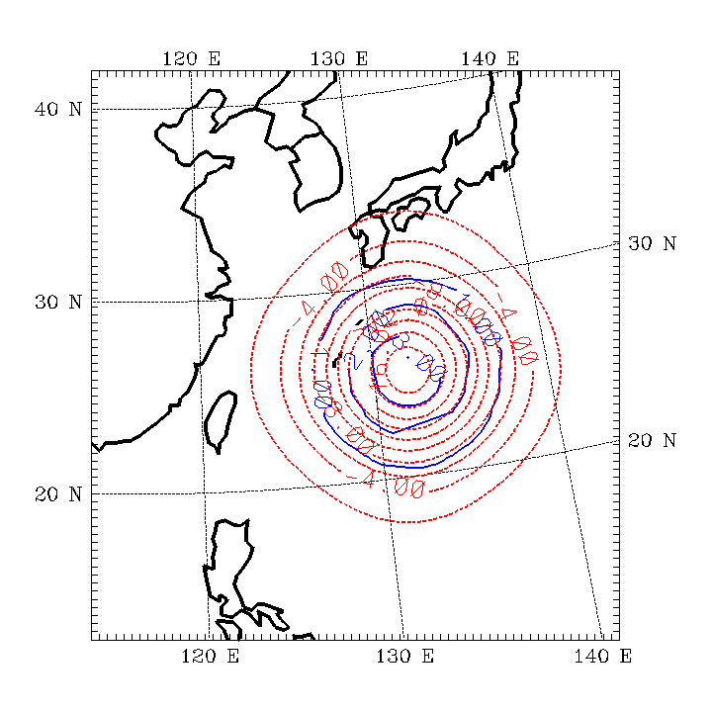
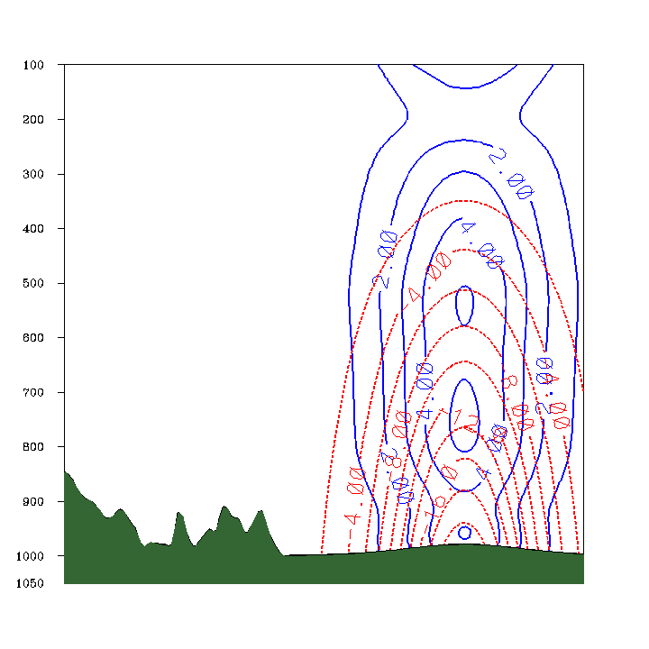
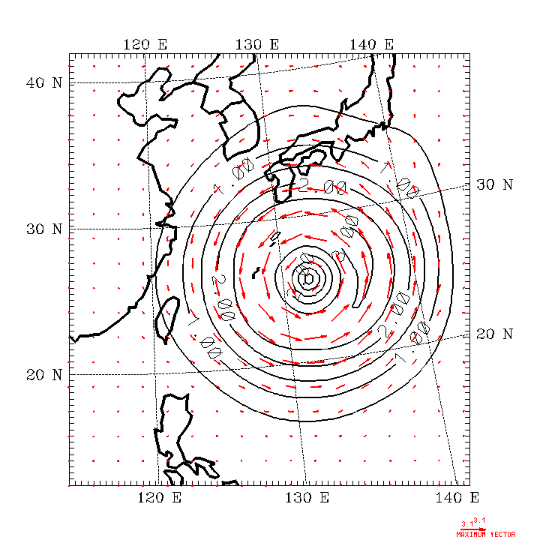
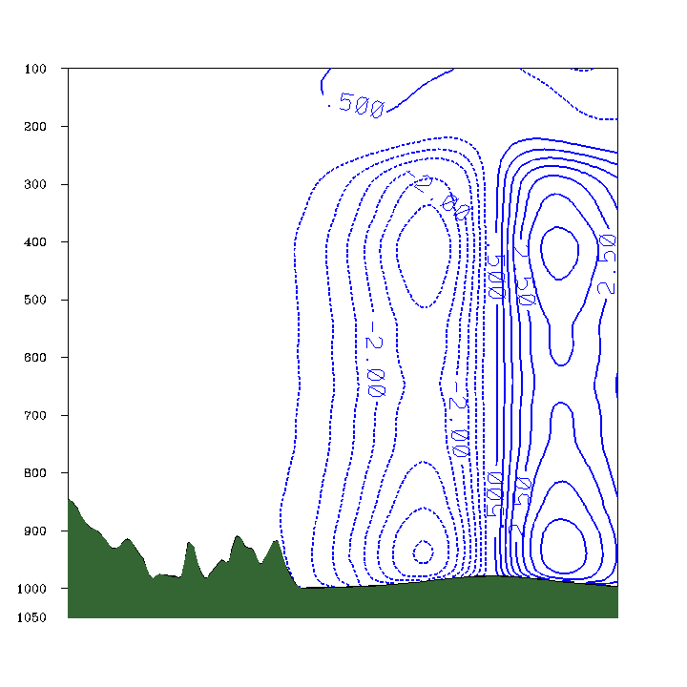
Example of B 3D-Var response to a single p_{s} observation
Pressure,
Temperature
Wind Speed,
Vector,
v-wind component.

Slide 28
Examples of B
T increments : T Observation (1 Deg , 0.001 error around 850 hPa)
B from NMC method
B from ensemble method
Notes:
This slide shows vertical cross section of T increment according to T observations.
We can see several things.
Default CV3 has strong vertical autocorrelation than CV5
ENSo shows smaller influence range than CV5-NMC and CV3
ENSb shows similar affected range to NMC. But vertical propagation by the observation was increased.
Finding.
1. CV3-T : 연직 상관이 크다.
SNMC & ENSo : 연직상관이 작다 .
2. Scale Length → Enso 는 약 50 % 작다.
3. ENSb는 연직상관이 커지고, Scale length는 NMC 수준

Slide 29
Incremental WRFDA J_{b} Preconditioning
Define preconditioned control variable v space transform
where U transform CAREFULLY chosen to satisfy B_{o} = UUT .
Choose (at least assume) control variable components with uncorrelated errors:
where n~number pieces of independent information.

Slide 30
WRFDA Background Error Modeling
U_{p}: Change of variable,
impose balance.
U_{v}: Vertical correlations
EOF Decomposition
U_{h}: RF = Recursive Filter,
e.g. Purser et al 2003

Slide 31
WRFDA Background Error Modeling
U_{p}: Change of variable,
impose balance.
U_{v}: Vertical correlations
EOF Decomposition
U_{h}: RF = Recursive Filter,
e.g. Purser et al 2003

Slide 32
WRFDA Background Error Modeling
U_{p}: Change of variable,
impose balance.
U_{v}: Vertical correlations
EOF Decomposition
U_{h}: RF = Recursive Filter,
e.g. Purser et al 2003

Slide 33
WRFDA Background Error Modeling
Define control variables:
U_{p}: Change of variable,
impose balance.
U_{v}: Vertical correlations
EOF Decomposition
U_{h}: RF = Recursive Filter,
e.g. Purser et al 2003

Slide 34
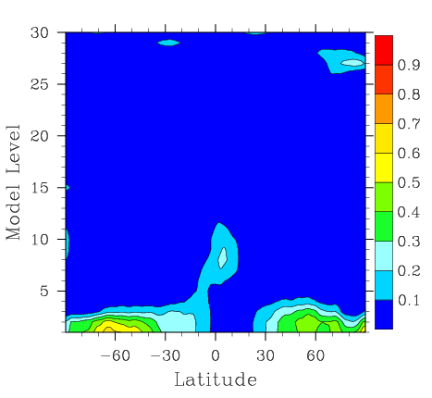
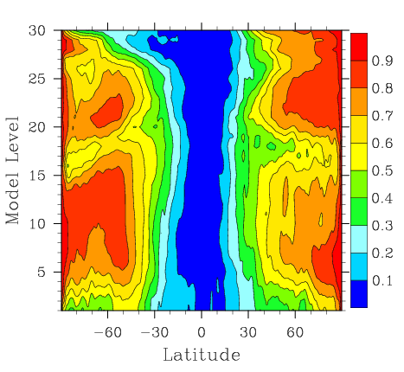
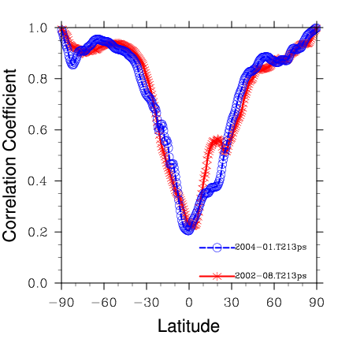
WRFDA Statistical Balance Constraints
Define statistical balance after Wu et al (2002):
How good are these balance constraints? Test on KMA global model data. Plot correlation between “Full” and balanced components of field:

Slide 35
Why 4D-Var?
Use observations over a time interval, which suits most asynoptic data and use tendency information from observations.
Use a forecast model as a constraint, which enhances the dynamic balance of the analysis.
Implicitly use flow-dependent background errors, which ensures the analysis quality for fast-developing weather systems.
NOT easy to build and maintain!

Slide 36
Single observation experiment
The idea behind single ob tests:
The solution of 3D-Var should be
Single observation
3D-Var → 4D-Var: H → HM; H → HM; HT → MTHT
The solution of 4D-Var should be
Single observation, solution at observation time

Slide 37
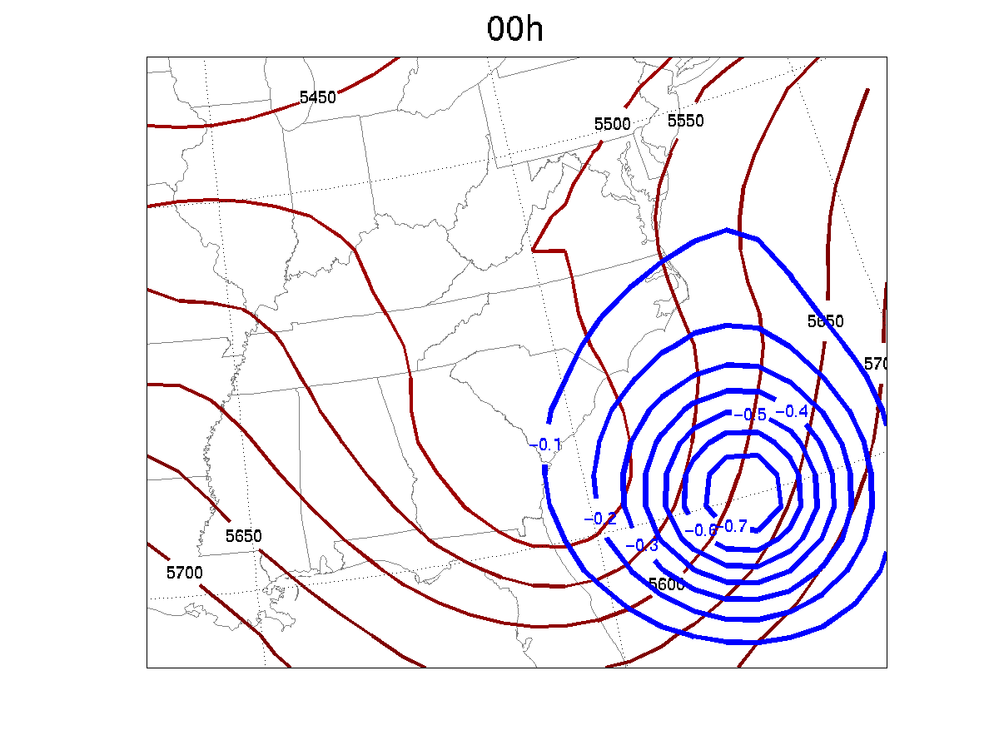
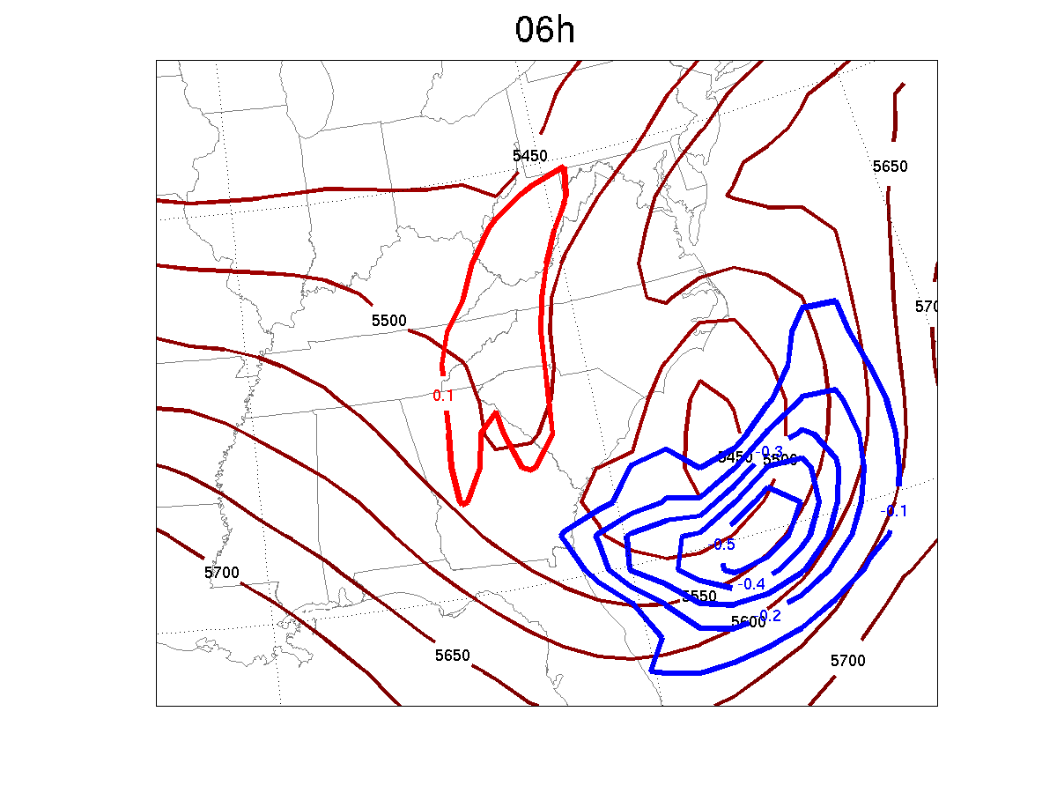
Analysis increments of 500mb θ
from 3D-Var at 00h and from 4D-Var at 06h
due to a 500mb T observation at 06h
+
+
3D-Var
4D-Var

Slide 38
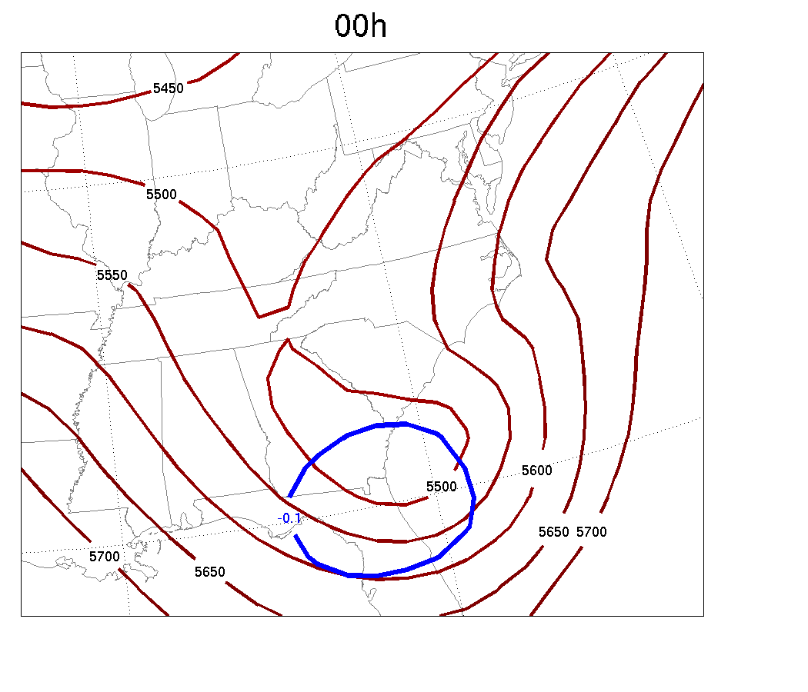
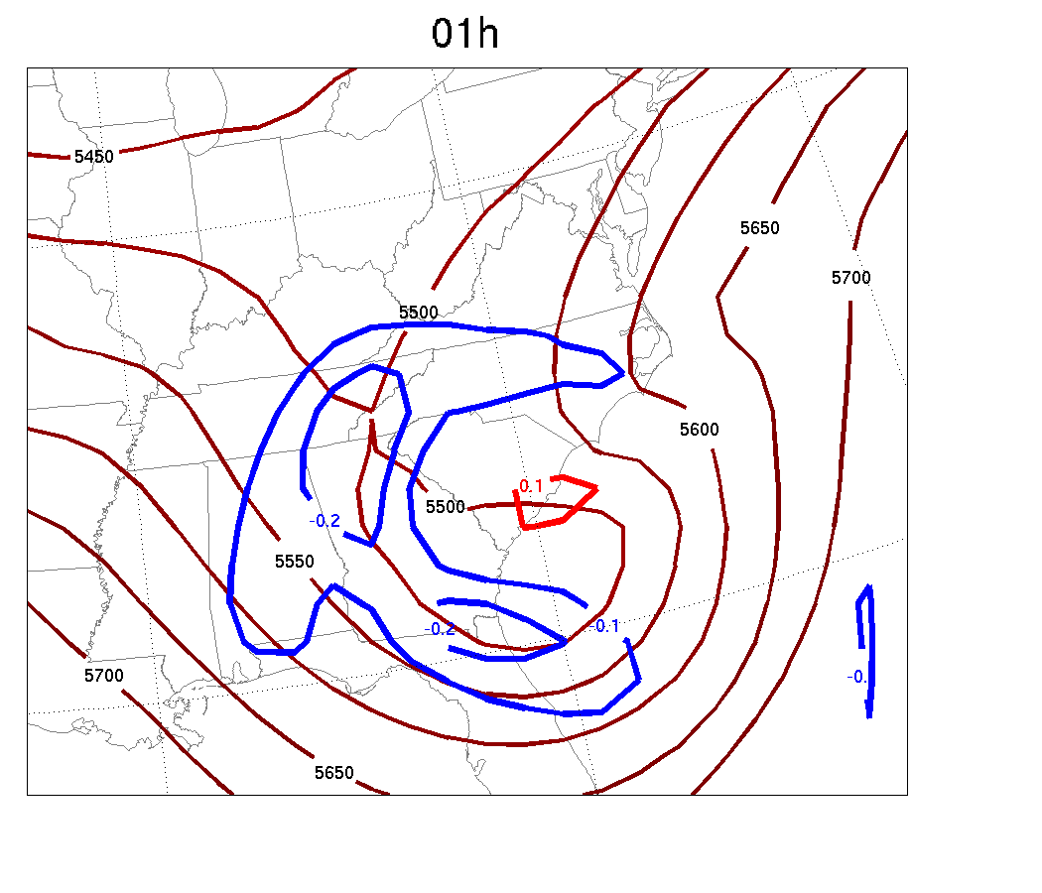
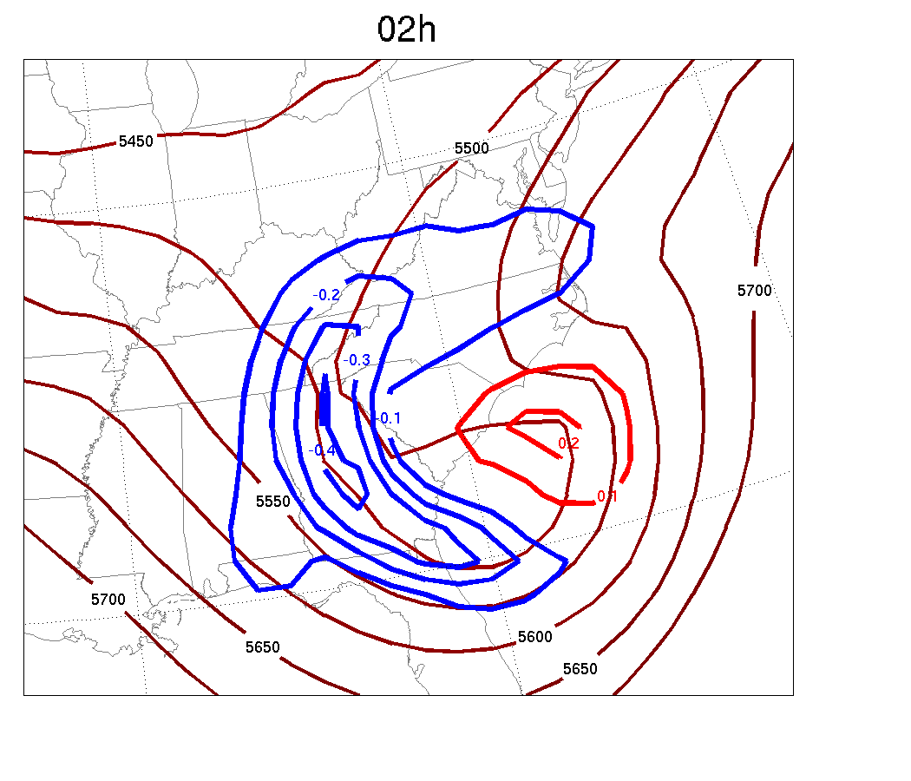
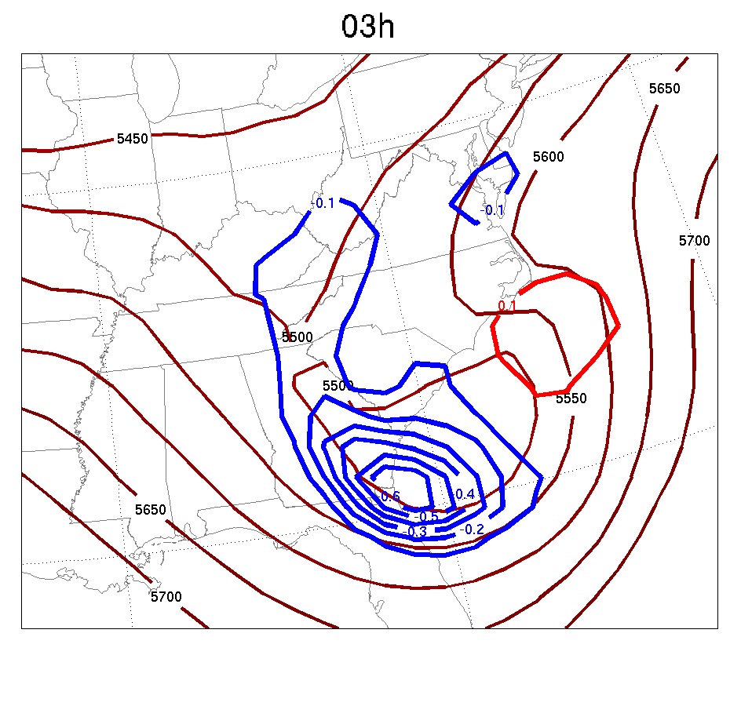
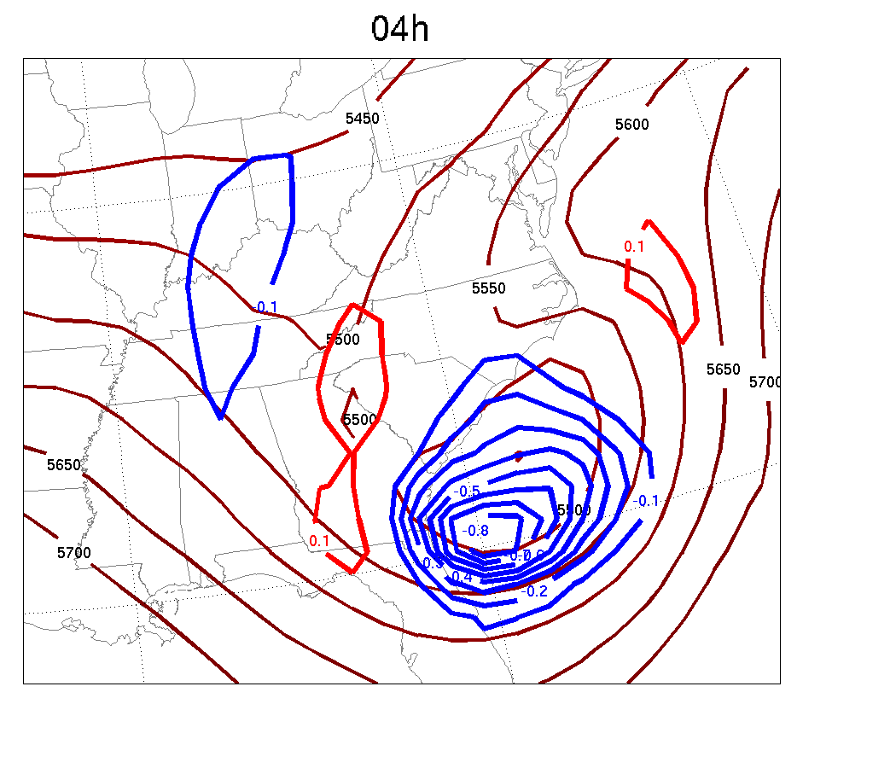
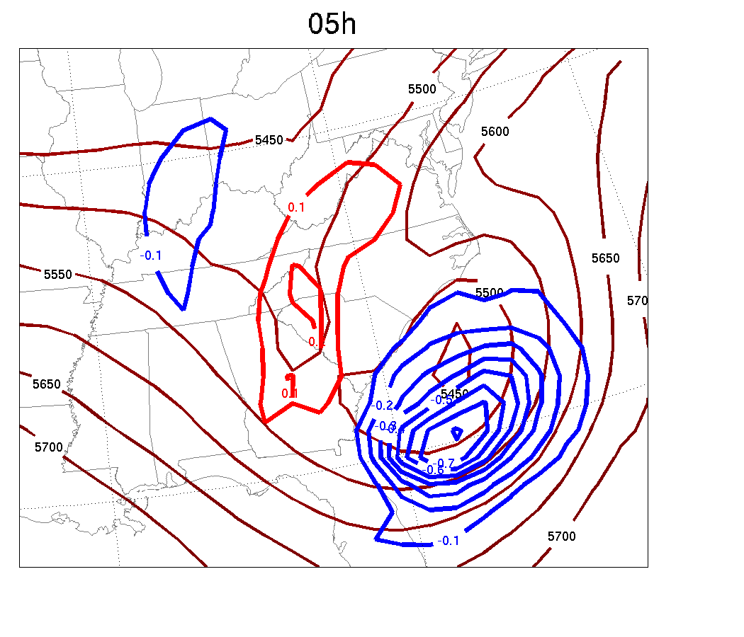
500mb θ increments at 00,01,02,03,04,05,06h to a 500mb T ob at 06h
+
OBS

Slide 39
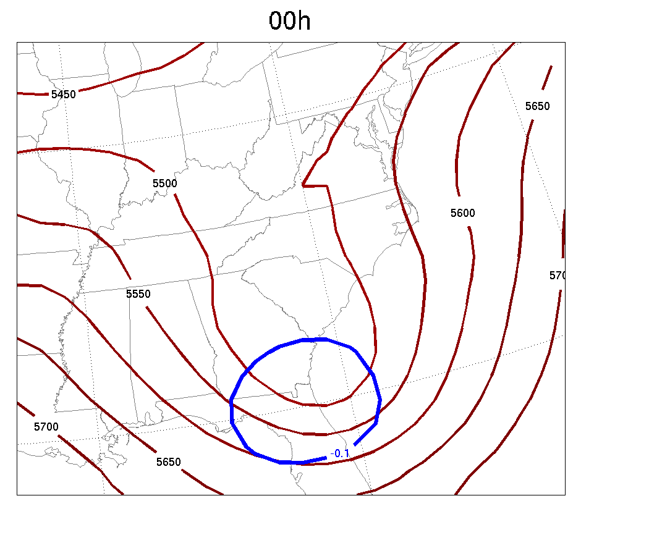
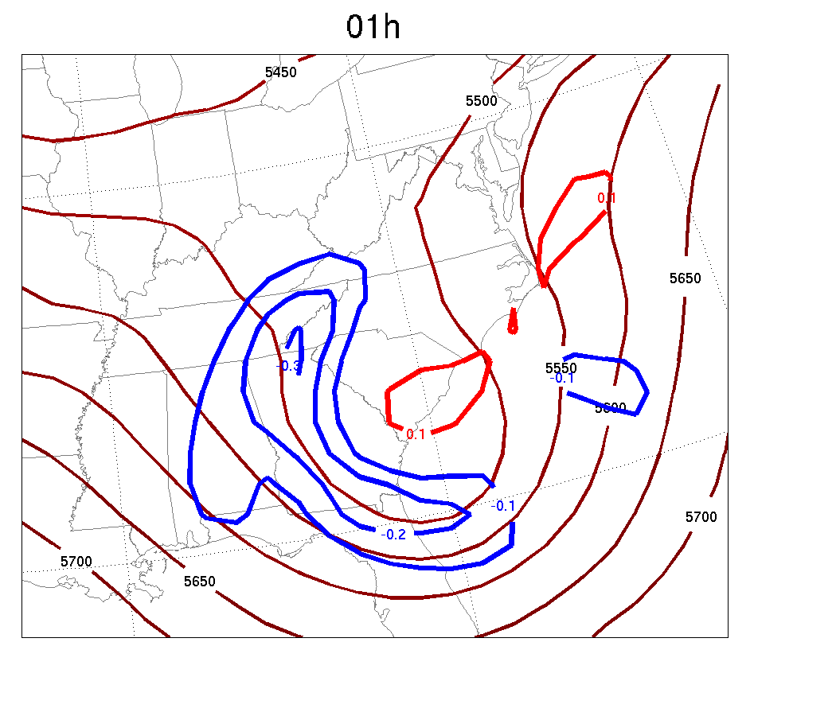
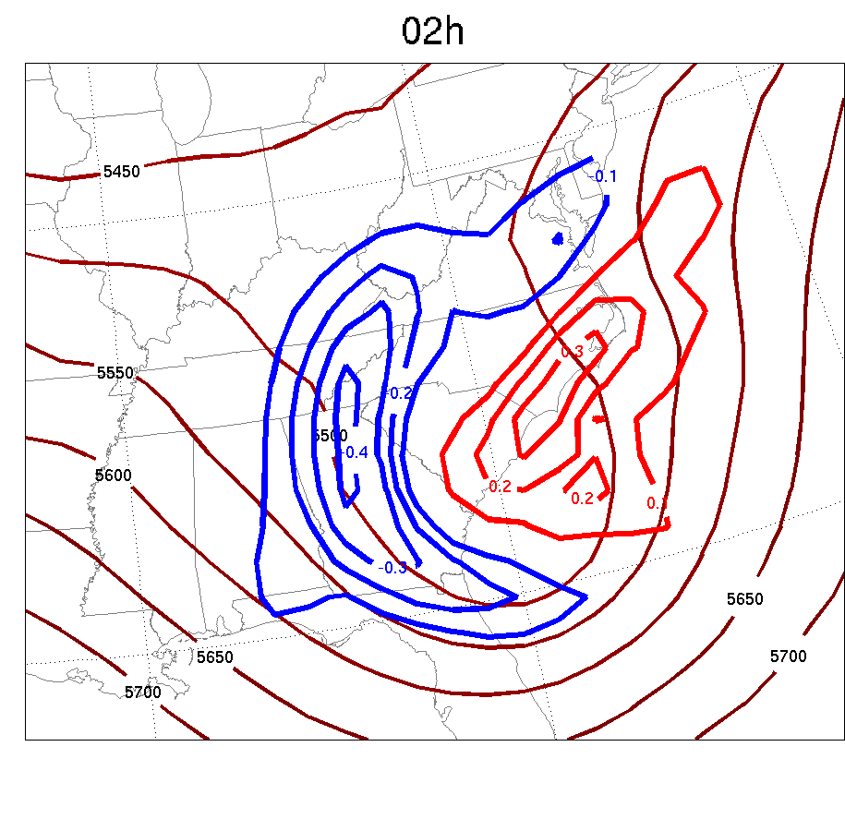
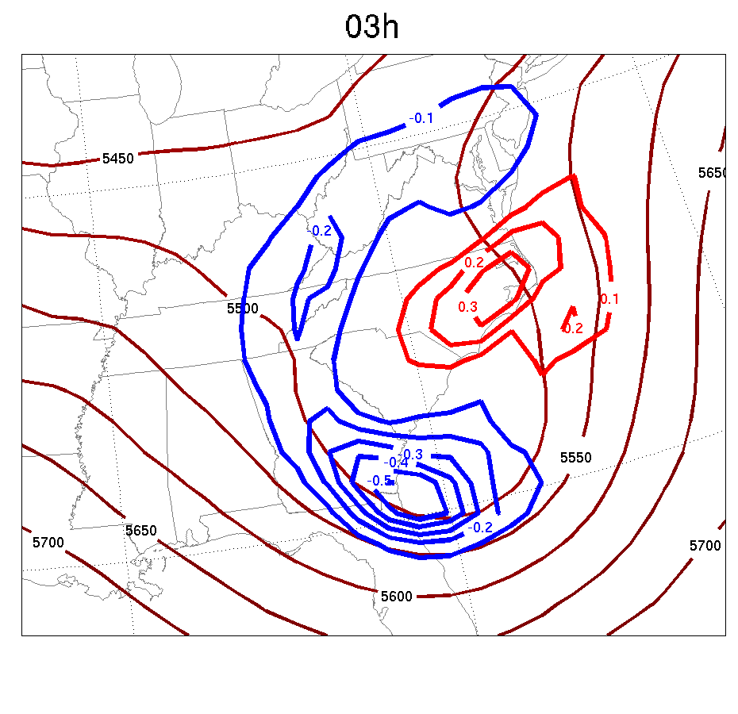
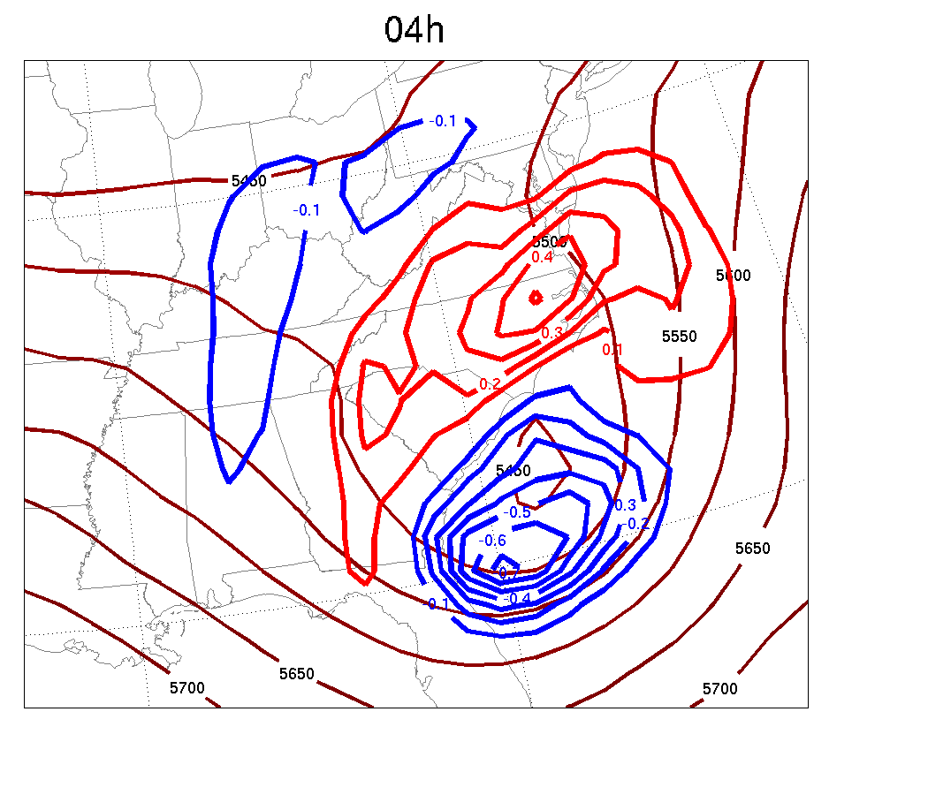
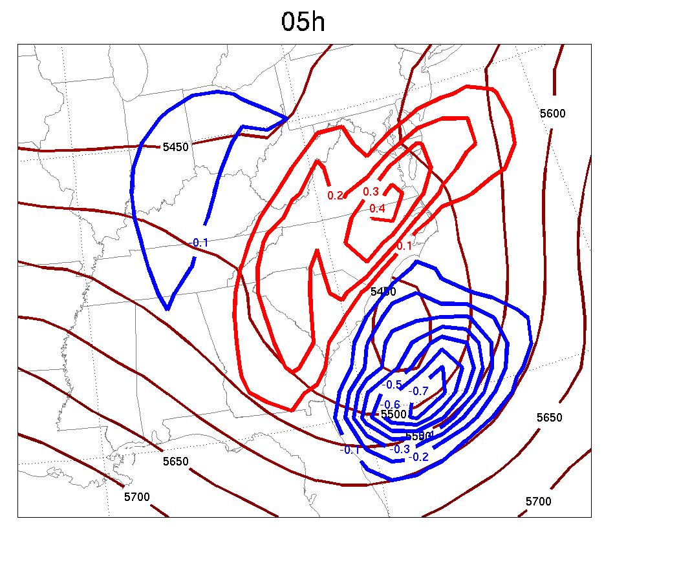
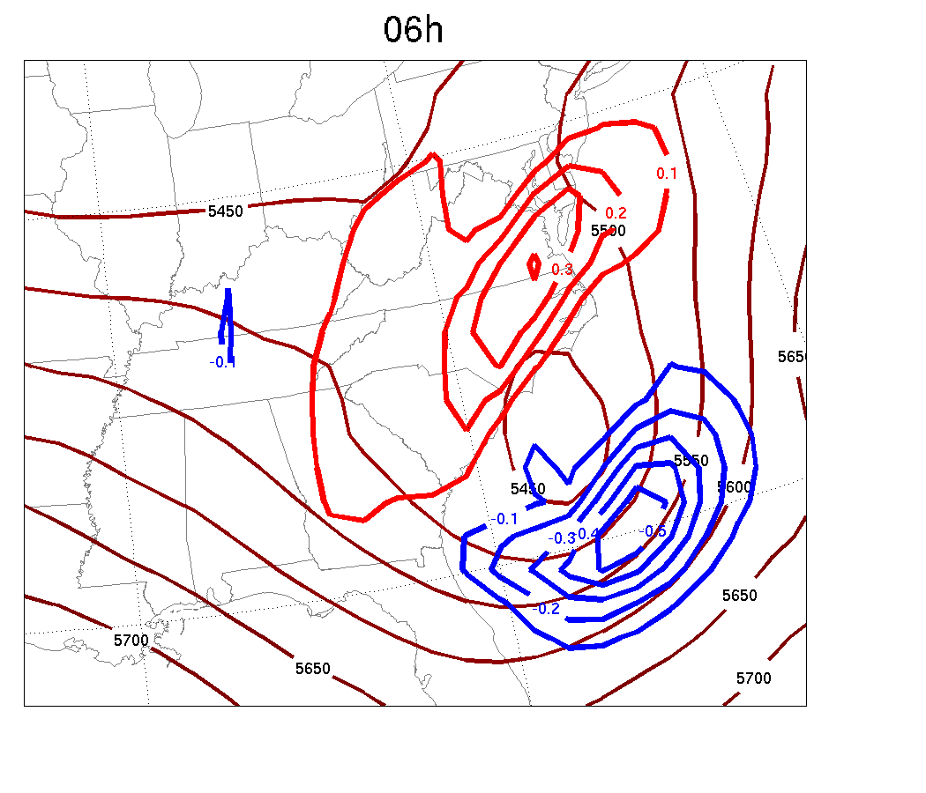
500mb θ difference at 00,01,02,03,04,05,06h from two nonlinear runs (one from background; one from 4D-Var)
+
OBS

Slide 40
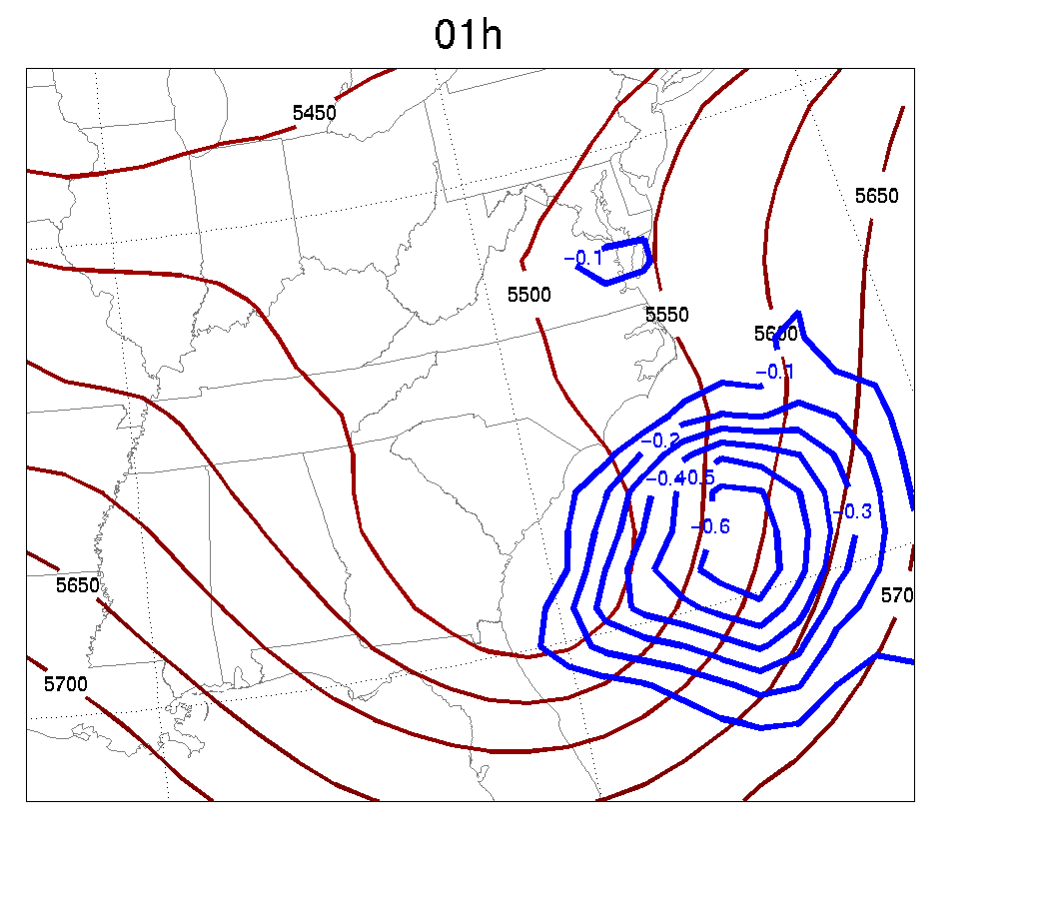
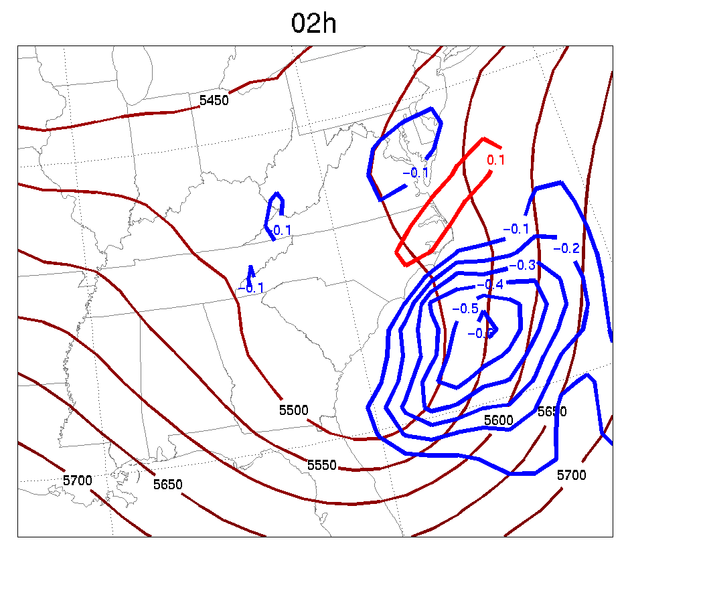
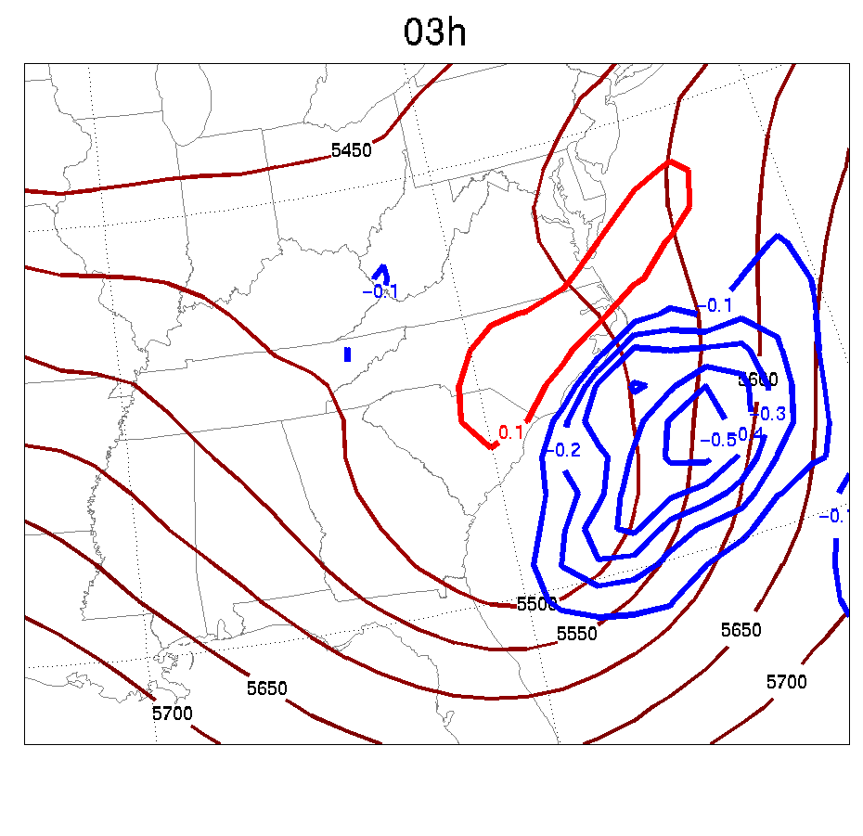
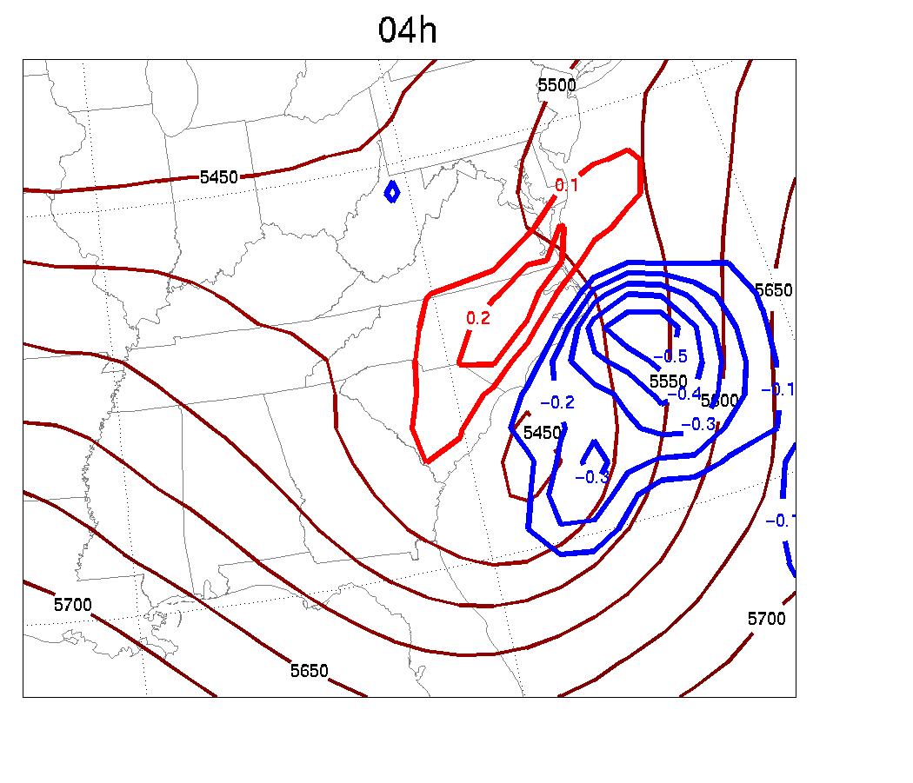
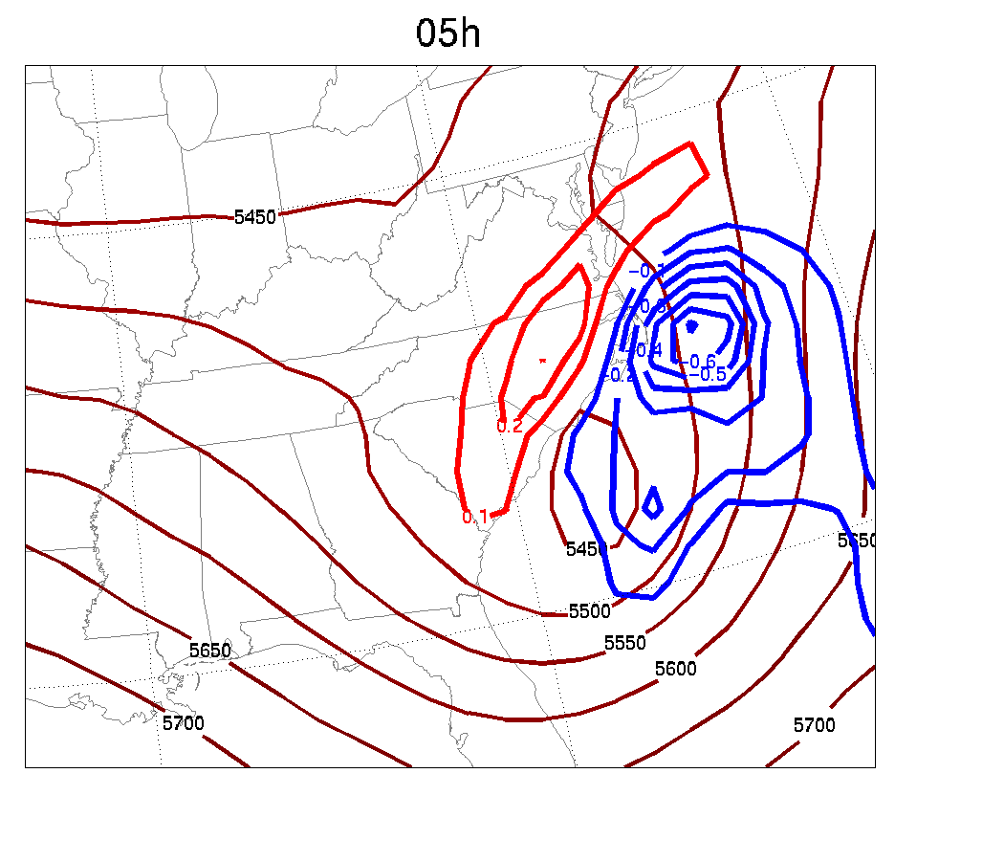
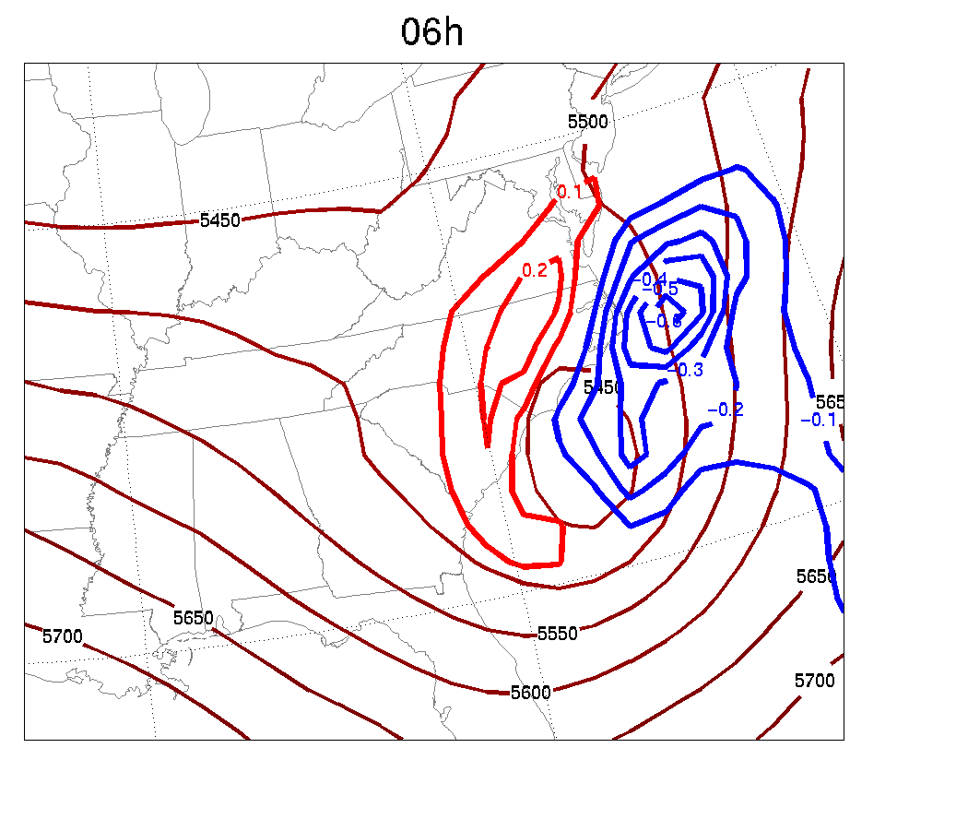
500mb θ difference at 00,01,02,03,04,05,06h from two nonlinear runs (one from background; one from FGAT)
+
OBS

Slide 41
Control of noise: J_{c}

Slide 42
Cost functions when minimize
J=J_{b}+J_{o}
Cost functions when minimize
J=J_{b}+J_{o} +J_{c}
γ_{df} = 0.1

Slide 43
3-hour Surface Pressure Tendency

Slide 44
(Dry) Surface Pressure Tendency
DFI
No DFI

Slide 45
Outline
4D-Var formulation and “why regional?”
The WRFDA approach
Issues specific to regional 4D-Var
Summary
Notes:
45

Slide 46
Issues specific to regional 4D-Var
Control of lateral boundaries.
Control of the large scales or coupling to a large scale model?
Mesoscale balances.

Slide 47
Options for LBC in 4D-Var (Nils Gustafsson)
Trust the large scale model providing the LBC.
Apply relaxation toward zero on the lateral boundaries during the integration of the TL and AD models in regional 4D-Var.
This, however, will have some negative effects:
Larger scale increments as provided via the background error constraint may be filtered during the forward TL model integration.
Observations close the the lateral boundaries will have reduced effect. In particular, information from observations downstream of the lateral boundaries and from the end of the assimilation window will be filtered due to the adjoint model LBC relaxation.
2. Control the lateral boundary conditions.

Slide 48
Control of Lateral Boundary Conditions
in 4DVAR
(JMA, HIRLAM and WRF)
1) Introduce the LBCs at the end of the data assimilation window as assimilation control variables (full model state = double size control vector)
2) Introduce the adjoints of the Davies LBC relaxation scheme and the time interpolation of the LBCs
3) Introduce a “smoothing and balancing” constraint for the LBCs into the cost function to be minimized
J = J_{b} + J_{o} + J_{c} + J_{lbc}
where

Slide 51
Problems with Control of LBC
Double the control vector length
Pre-conditioning; LBC_0h and LBC_6h are correlated
Relative weights for J_{b} and J_{lbc}??

Slide 52
Control of “larger” horizontal scales in regional 4D-Var Per Dahlgren and Nils Gustafsson
There are difficulties to handle larger horizontal scales in regional 4D-Var
Observations inside a small domain may not provide information on larger horizontal scales
The assimilation basis functions (via the background error constraint) may not represent larger scales properly .
Possibilities in handling the larger horizontal scales:
Via the LBC in the forecast model only; Depending on the cycle for refreshment of LBC, one may miss important advection of information over the LBC
Via ad hoc techniques for mixing in information from a large scale data assimilation (applied in HIRLAM).
Via a large scale error constraint - J_{ls}

Slide 53
A large scale error constraint - J_{ls}
Add a large scale constraint J_{ls} to the regional 4D-Var cost function:
J = J_{b} + J_{o} + J_{c} + J_{lbc} + J_{ls}
where
Has been tried in ALADIN 3D-Var with x_{ls} being a global analysis from the same observation time. In this case one needs to, at least in principle, use different observations for the global and regional assimilations
Is being tried in HIRLAM 4D-Var with x_{ls} being a global forecast valid at the start of the assimilation window.
For both applications one needs to check that (x-xb) and (x-x_{ls}) are not too strongly correlated!

Slide 54
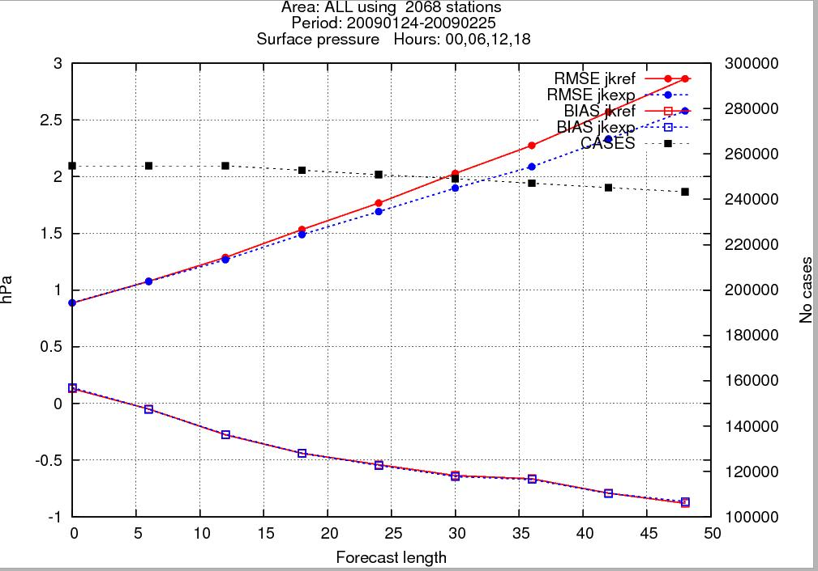
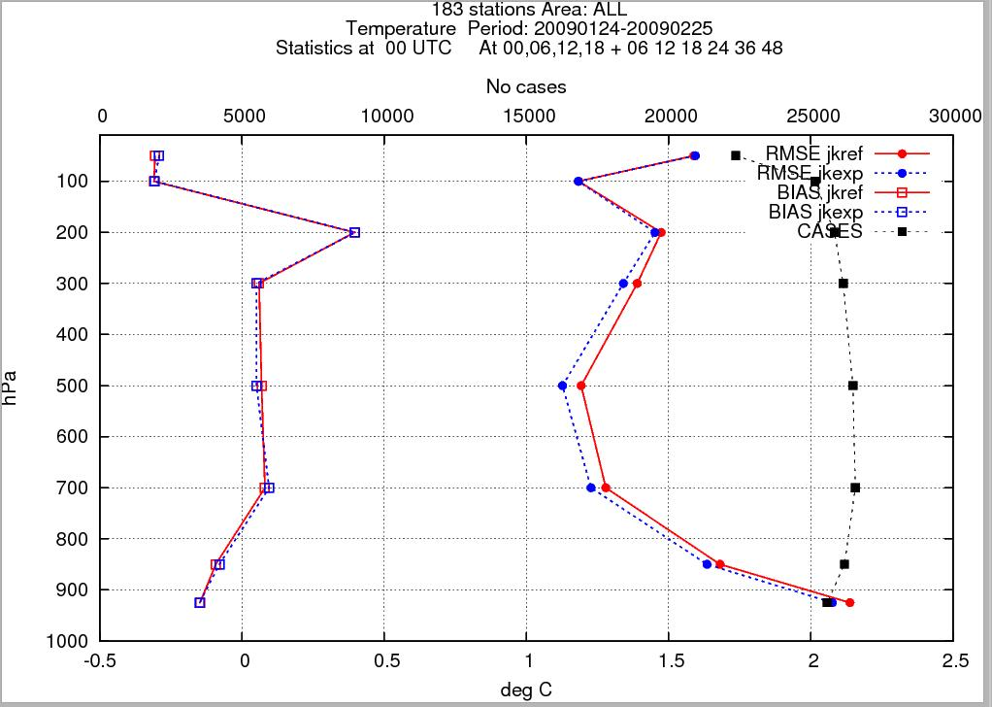
Forecast Impact
Verification Against Observations
Upper air, MSLP: Very good
Surface parameters: Unchanged
MSLP
Temperature

Slide 55
Summary
4D-Var formulation and “why 4D-Var?”
Why regional? (high resolution; regional observation network;…)
The WRFDA approach: J_{b}; J_{o}; J_{c}
Regional 4D-Var issues: J_{lbc}, J_{ls}
Notes:
55

