Slide 1




Background Error Covariance Modeling
Craig H. Bishop
Naval Research Laboratory, Monterey
JCSDA Summer Colloquium
July 2012
Santa Fe, NM

Slide 2
Overview
Strategies for flow dependent error covariance modeling
  Ensemble covariances and the need for localization
  Non-adaptive ensemble covariance localization
  Adaptive ensemble covariance localization
  Scale dependent adaptive localization
Flexibility of localization scheme allowed by DA algorithm.
Hidden error covariances and the need for a linear combination of static-climatological error covariances and flow dependent covariances.
New theory for deriving weights for Hybrid covariance model from (innovation, ensemble-variance) pairs
Conclusions
Notes:
If one could find numerous historical forecasts like today’s forecast, the variance of the associated forecast errors would approximate the true forecast error variance given today’s forecast Square of error of a single forecast error poorly approximates the error variance. Chaos, changing models, data assimilation schemes, obseving networks and short records make historical categorization difficult. Variance depends on presence or absence of weather phenomena in atmosphere, ensembles try to capture this flow dependence, but are imperfect.

Slide 3

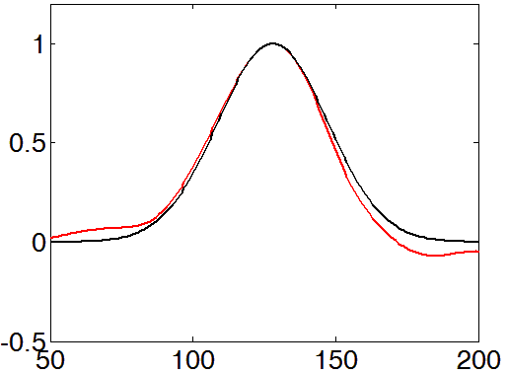
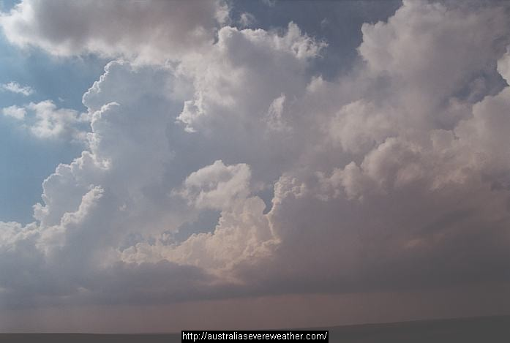
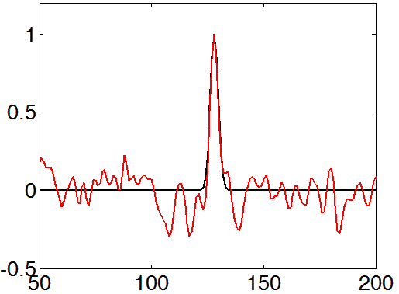
Small Ensembles and
Spurious Correlations
Stable flow error correlations
km
Unstable flow error correlations
km
Ensembles give flow dependent, but noisy correlations

Slide 4
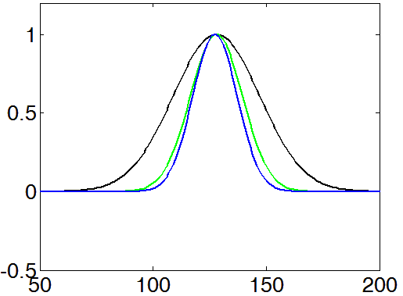
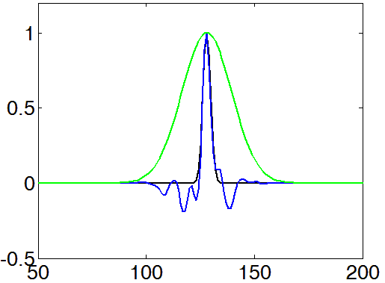
Small Ensembles and
Spurious Correlations
Stable flow error correlations
Fixed localization
Most ensemble DA techniques
reduce noise by multiplying ensemble
correlation function by fixed
localization function (green line).
Resulting correlations (blue line) are too thin when true correlation is broad and too noisy when true correlation is
thin.
km
Unstable flow error correlations
Fixed localization
km
Fixed localization functions limit adaptivity

Slide 5
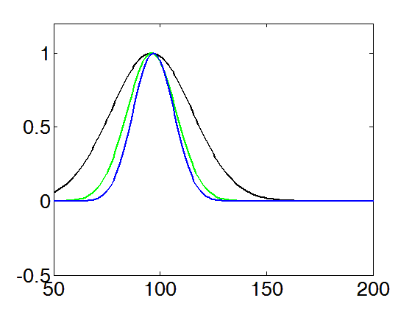
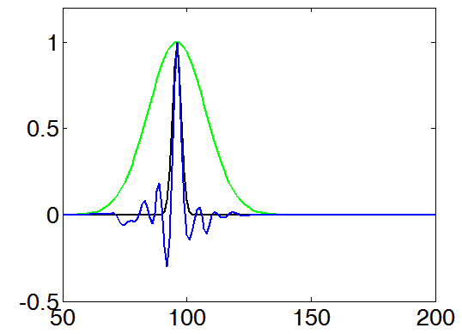
Small Ensembles and Spurious Correlations
Stable flow error correlations
Current ensemble localization functions poorly represent propagating error correlations.
t = 0
km
Unstable flow error correlations
t = 0
km
Fixed localization functions limit ensemble-based 4D DA

Slide 6
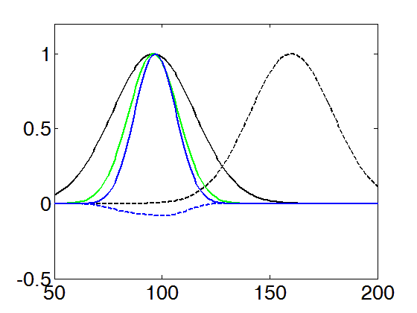
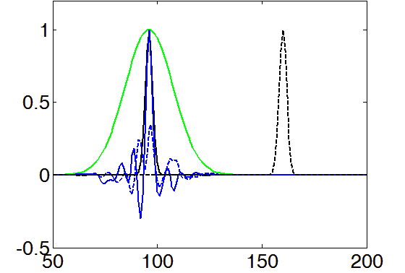
Small Ensembles and Spurious Correlations
Stable flow error correlations
Current ensemble localization functions poorly represent propagating error correlations.
t = 0
t = 1
km
Unstable flow error correlations
t = 0
t = 1
km
Fixed localization functions limit ensemble-based 4D DA

Slide 7
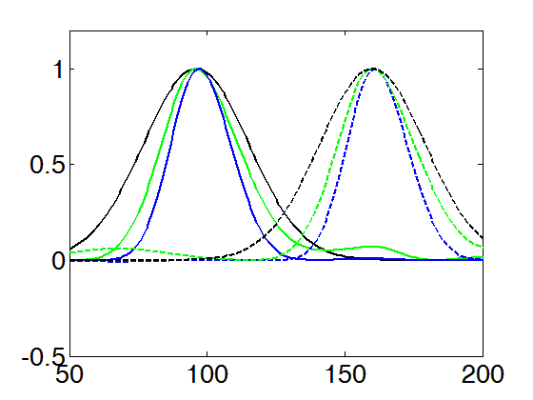
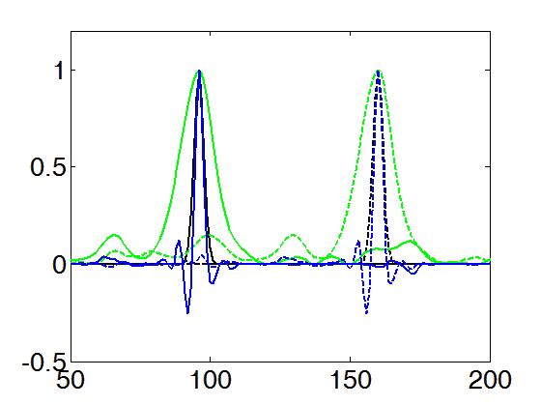
Small Ensembles and Spurious Correlations
Stable flow error correlations
t = 0
t = 1
Green line now gives an example of one of the adaptive localization functions that are the subject of this talk.
km
Unstable flow error correlations
t = 0
t = 1
km
Want localization to adapt to width and propagation of true correlation

Slide 8
Bayesian perspective on localization
Ideally, localization would yield the mean or mode of the posterior based on informed guesses of the prior and likelihood distributions.
Notes:
Hollingsworth and Lonnberg’s (1986, Tellus) and Parish and Derber’s (1992, MWR) fitting of covariance models to sample correlations may be viewed as a guess of the mean of the posterior based on prior assumptions of isotropy and/or smoothness.

Slide 9
Prior correlation distribution might be a function of:
distance from sample correlation of 1
latitude, longitude, height
Rossby radius, Richardson number
estimated geostrophic coupling (for multi-variate case)
estimated group velocity of errors (for variables separated in time)
anisotropy of nearby features (e.g. fronts)
Non-adaptive localization
Adaptive localization
How about trying to extract this info from the ensemble?

Slide 10
Ad-hoc adaptive error covariance localization

Slide 11
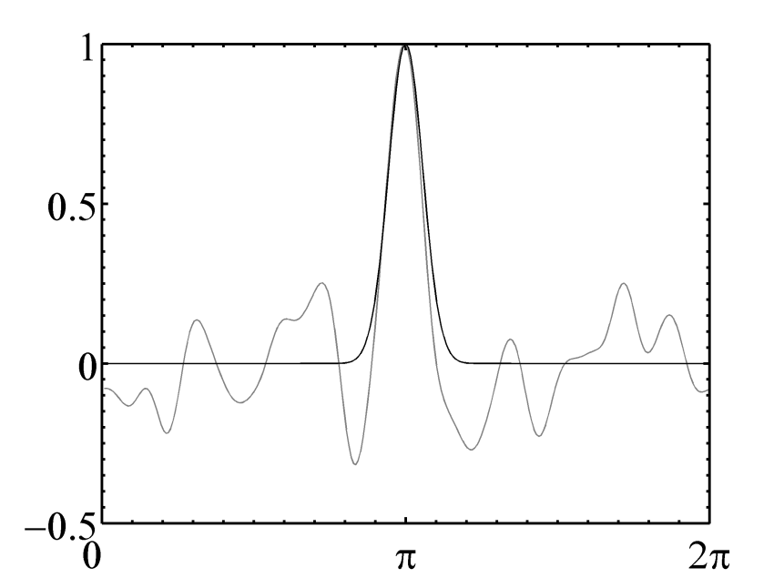
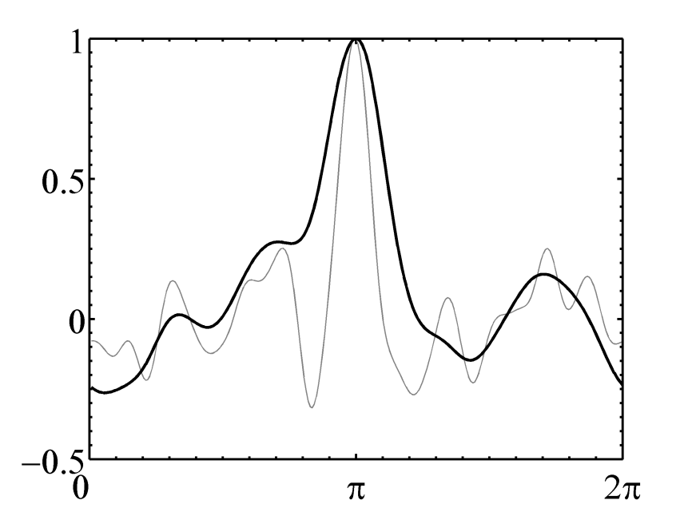
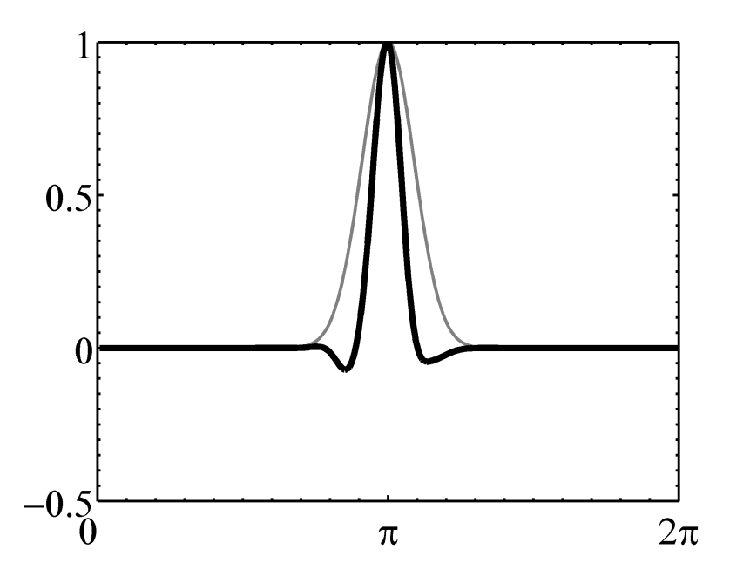
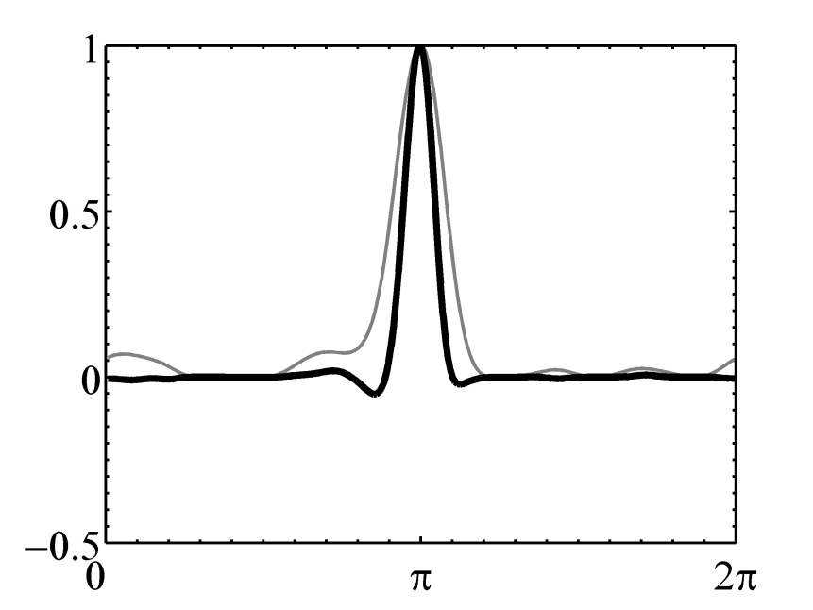
Smoothed ENsemble COrrelations
Raised to a Power (SENCORP)
(Bishop and Hodyss, 2007, QJRMS)
1 128 256
1 128 256
(a)
(b)
Bishop and Hodyss,
2007, QJRMS.
(c)
(d)
In matrix form,

Slide 12
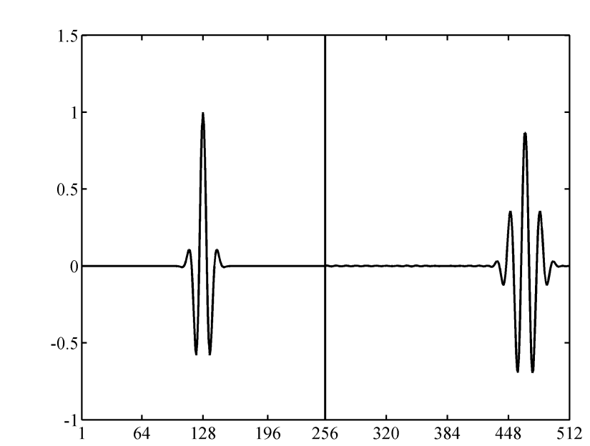
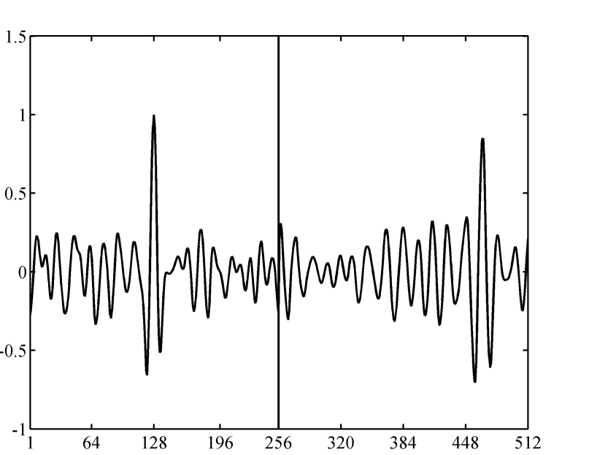
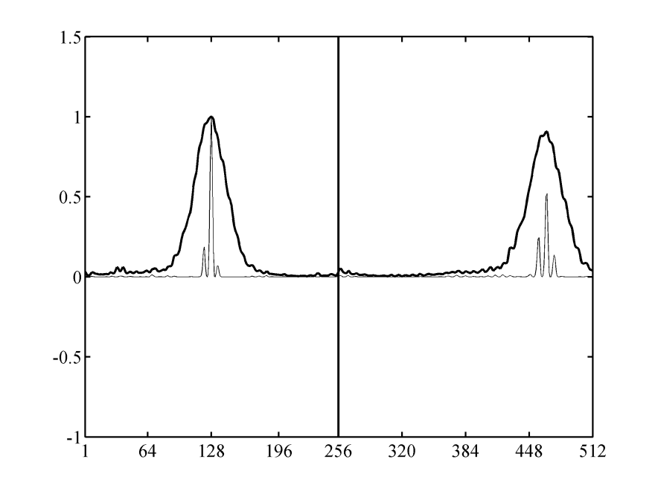
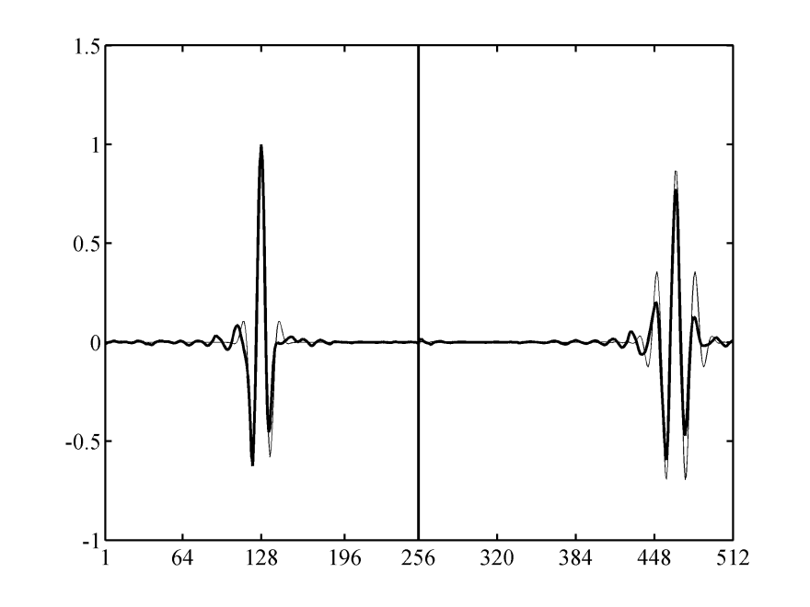
Ensemble COrrelations Raised
to A Power (ECO-RAP)
Bishop and Hodyss, 2009ab, Tellus
(a)
(b)
K = 64 member
ensemble
Ensemble
correlation
matrix
n elementwise
products of
ensemble
correlation
(c)
(d)
Non-adaptive
localization
matrix

Slide 13
Bishop and Hodyss, 2009ab, Tellus
Nice features of ECO-RAP include:
  Reduces to a propagating non-adaptive localization in limit of high power
  Can apply square root theorem and separability assumption to reduce memory requirements

Slide 14

Square root theorem provides memory efficient representation (Bishop and Hodyss, 2009b, Tellus)
Modulated ensemble
Modulated ensemble member
Root is huge ensemble of modulated ensemble members!
K²(K+1)/2 can be linearly independent (K=128 => a possible 1,056,768 linear independent members)

Slide 15
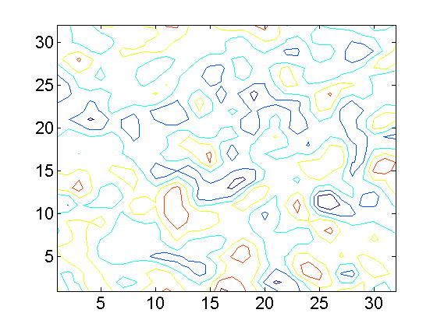
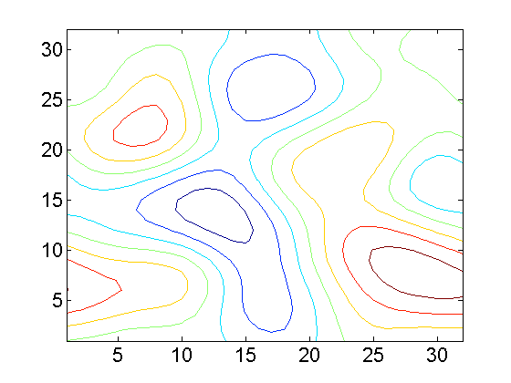
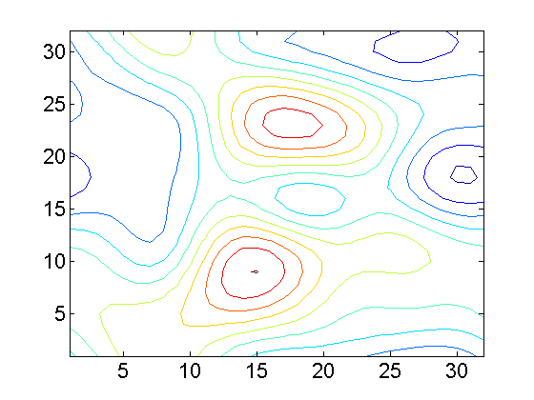
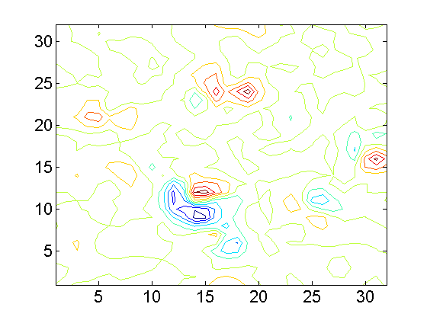
Example of a modulated ensemble member
Raw ensemble member k
Smooth ensemble member j
Smooth ensemble member i
Modulated ensemble member

Slide 16
Data Assimilation using Modulated EnsembleS (DAMES) using Navy global atmospheric model, NOGAPS

Slide 17
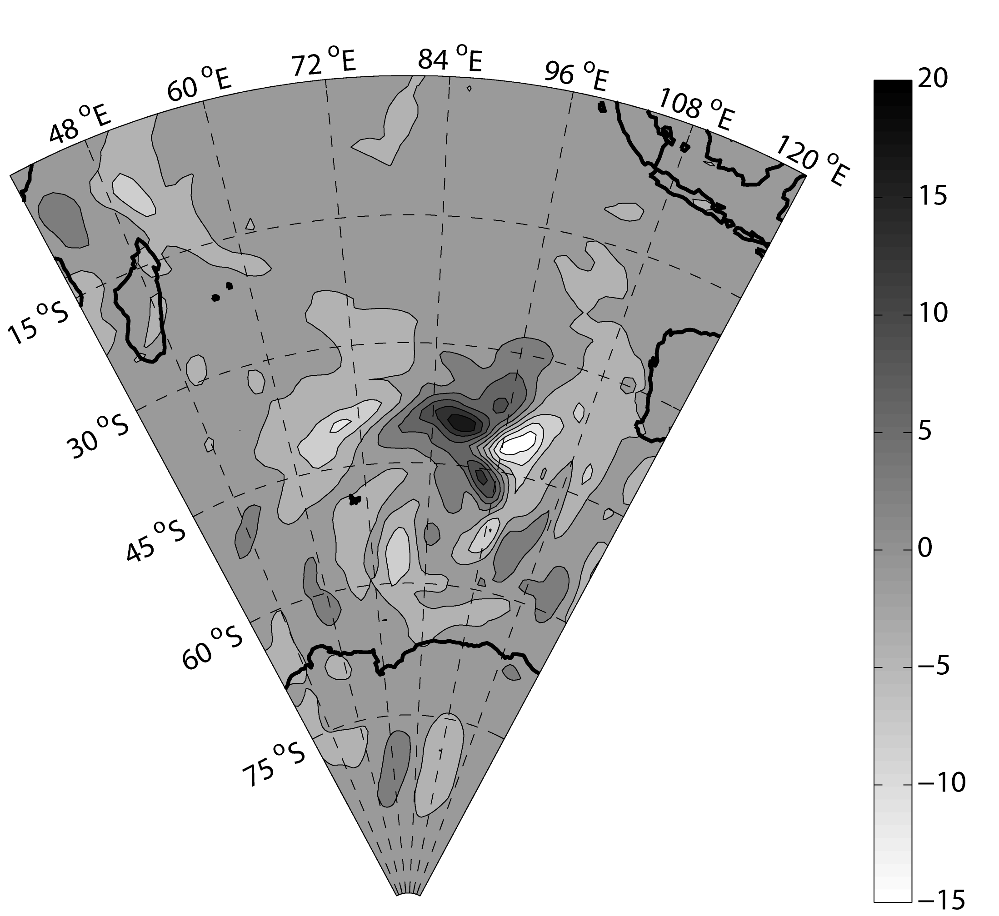
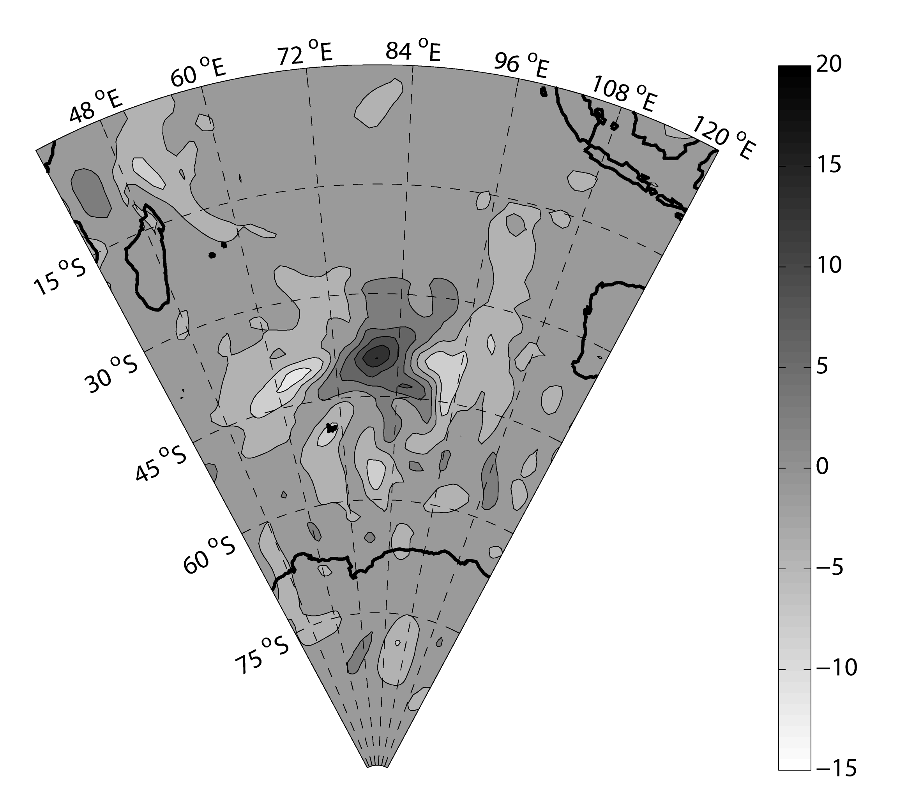
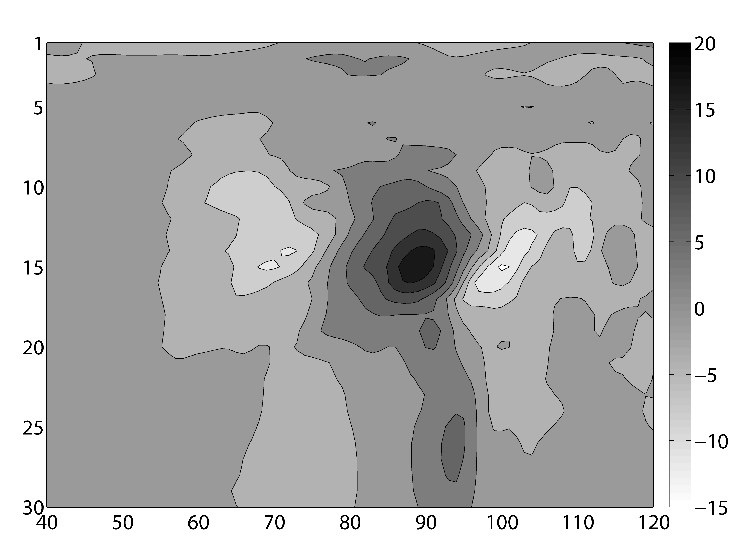
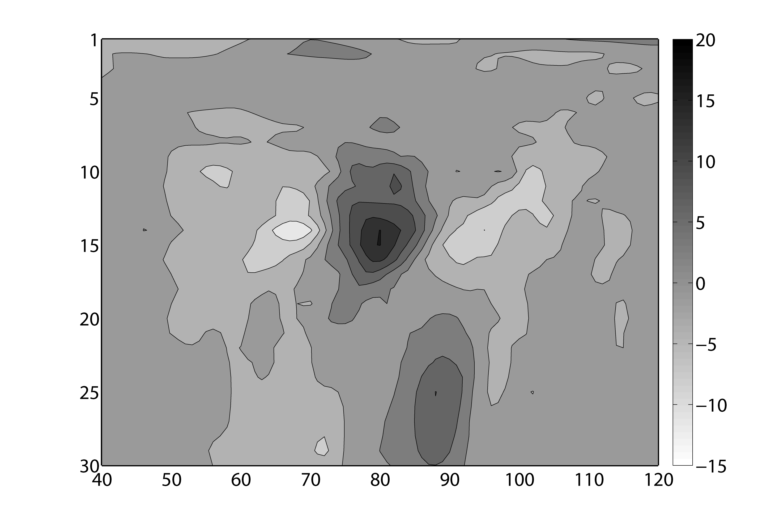
No localization
18 Z
12 Z
(a)
(b)
Sigma Level
Sigma Level
(c)
(d)
Longitude
Longitude
Unlocalized ensemble covariance function of meridional wind at 18 UTC and 12 UTC with 18 UTC meridional wind variable at 90E, 40S sigma-level 15 (about 400 hPa).
Bishop, C.H. and D. Hodyss, 2011: Adaptive ensemble covariance localization in ensemble 4D-VAR state estimation, Mon. Wea . Rev. 139, 1241-1255.

Slide 18

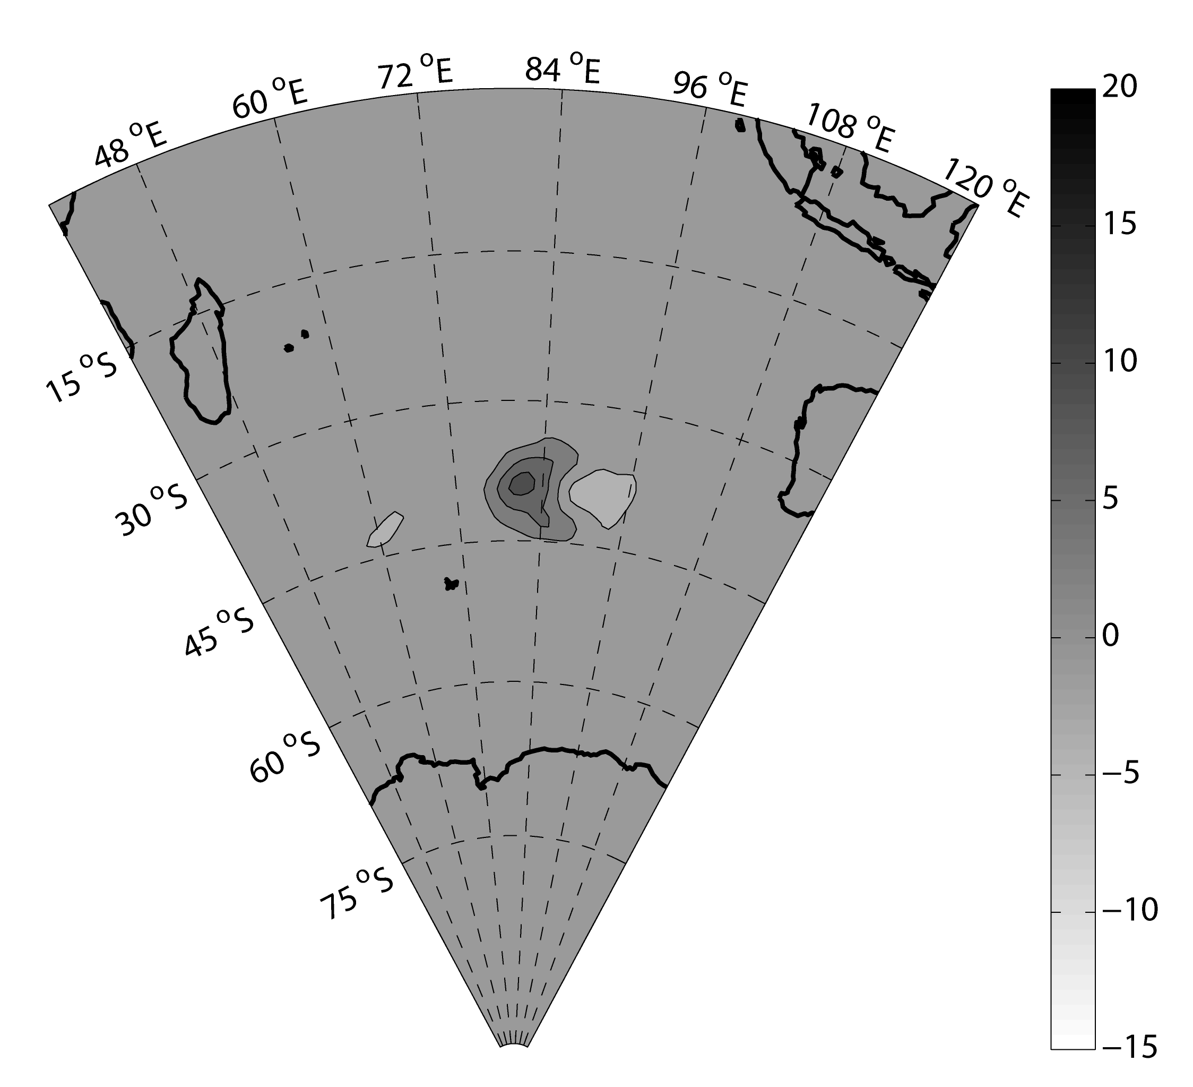
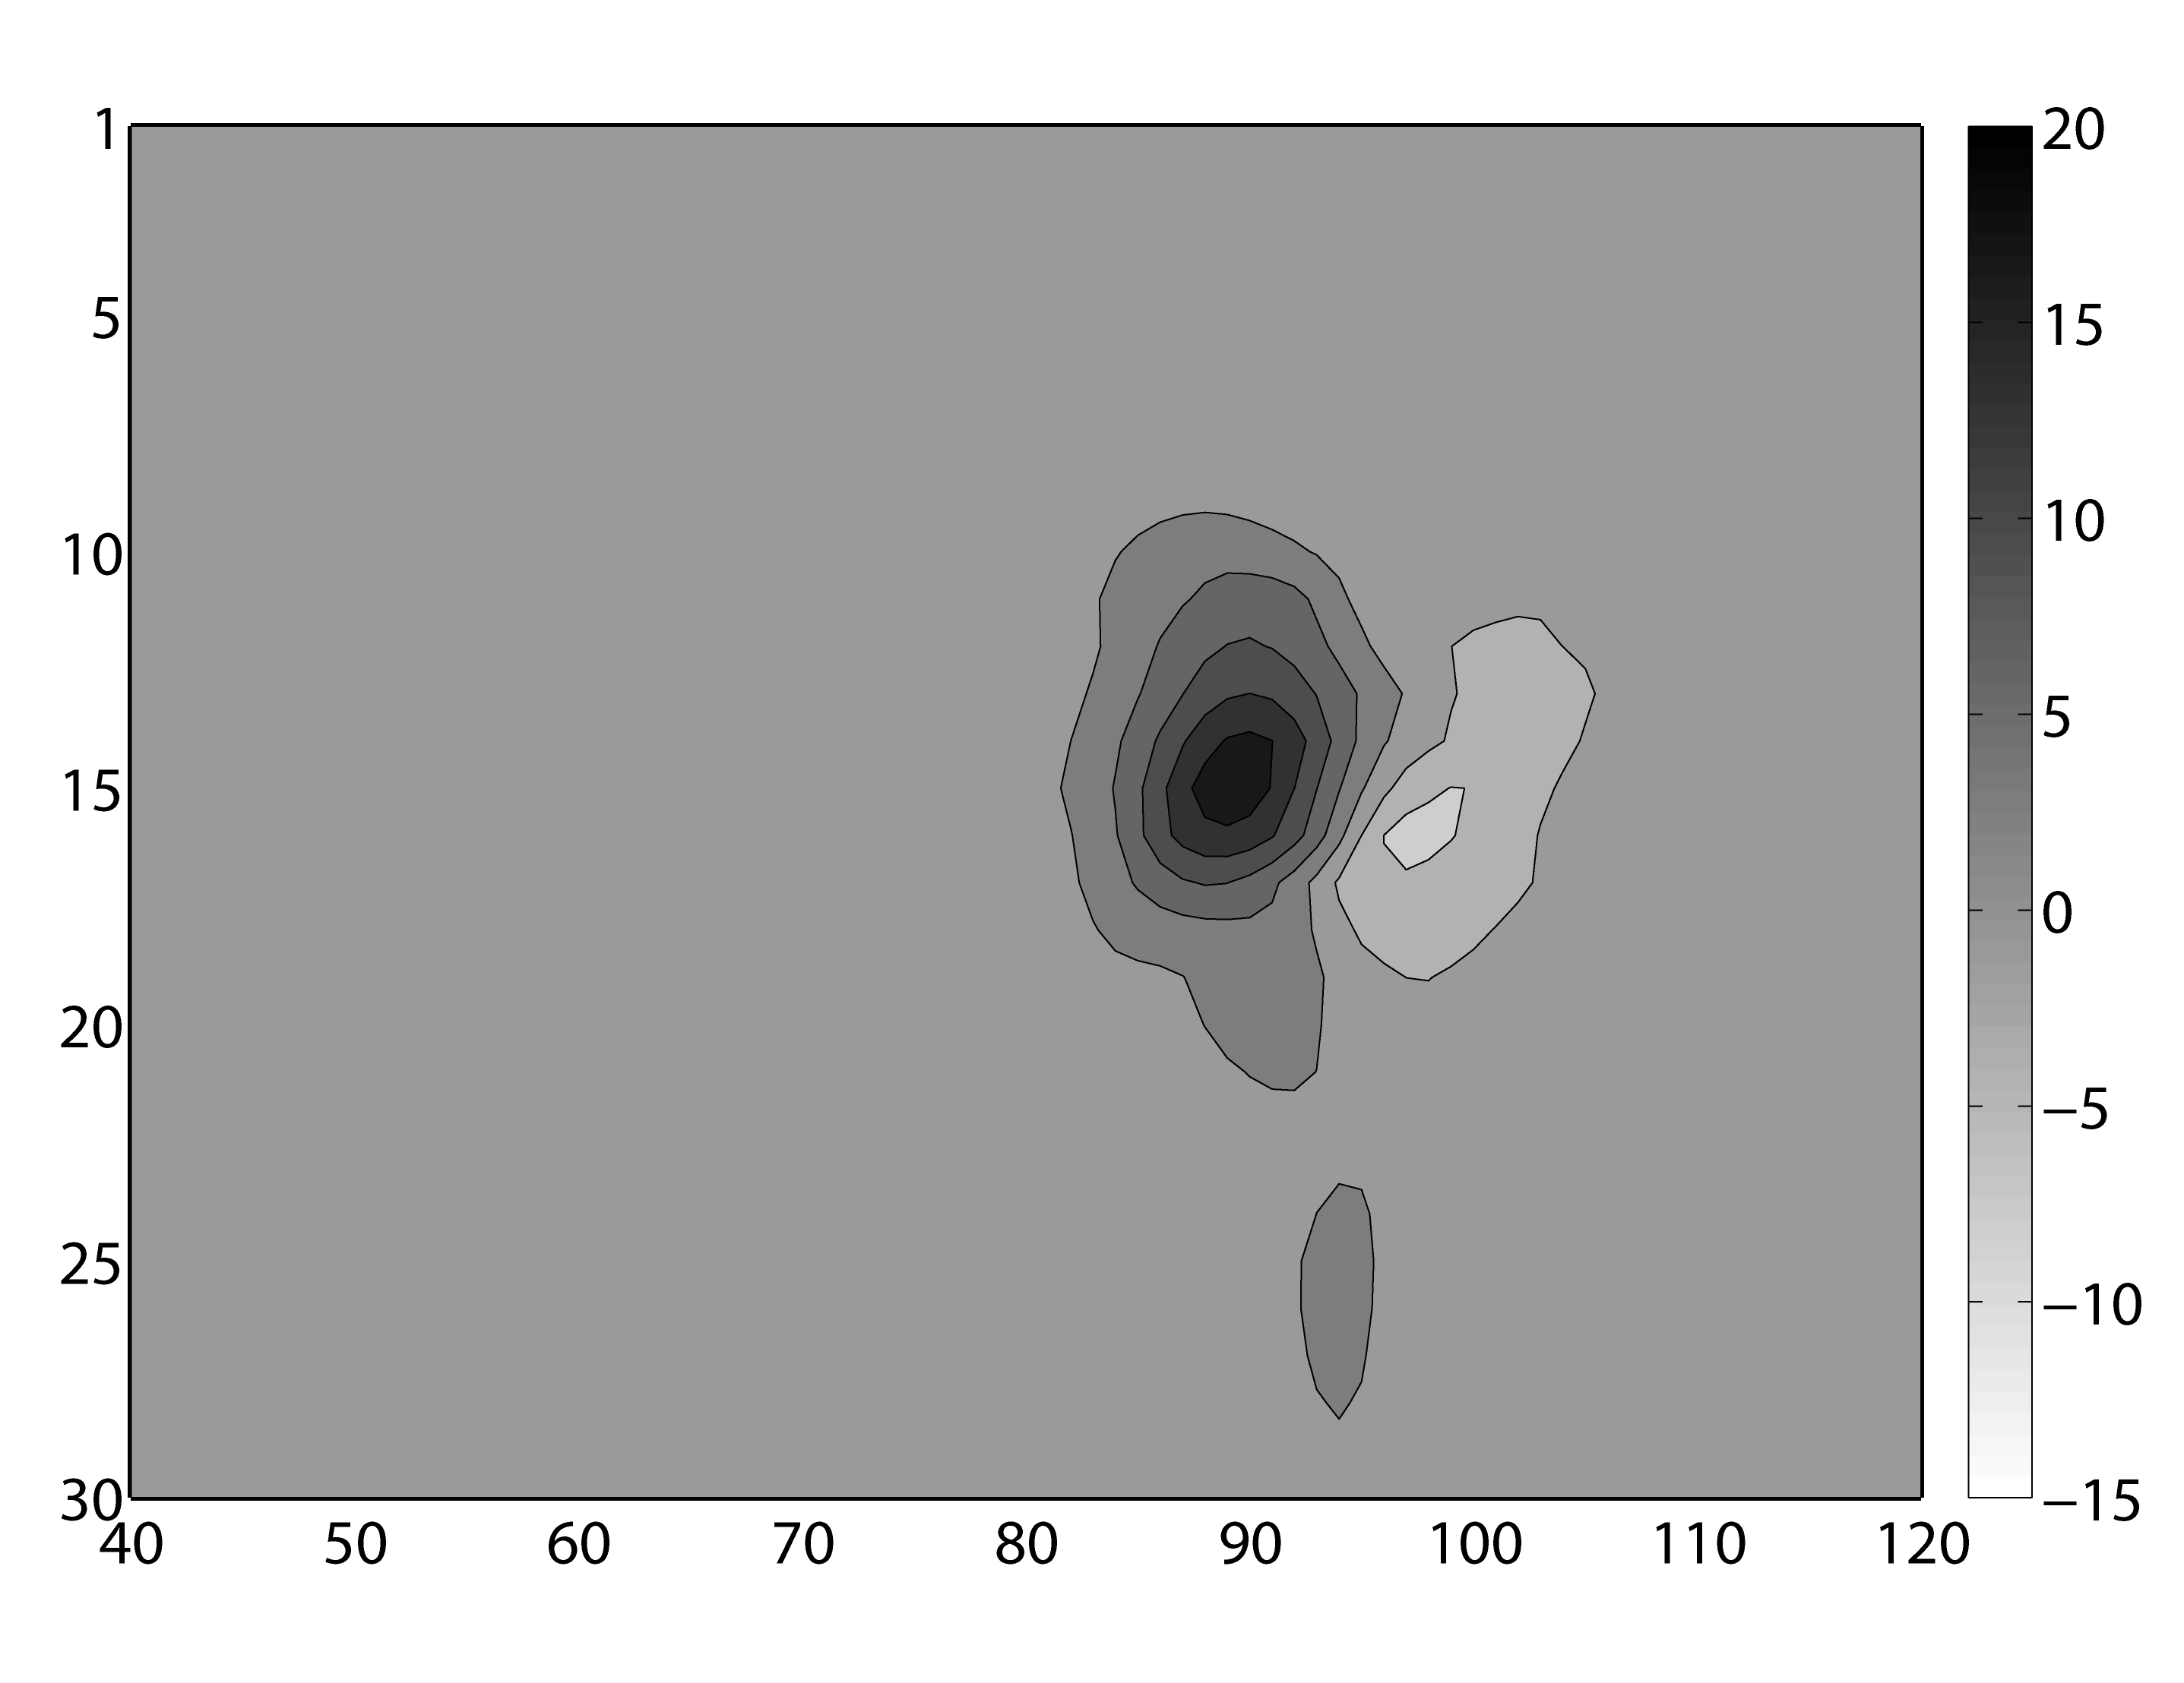
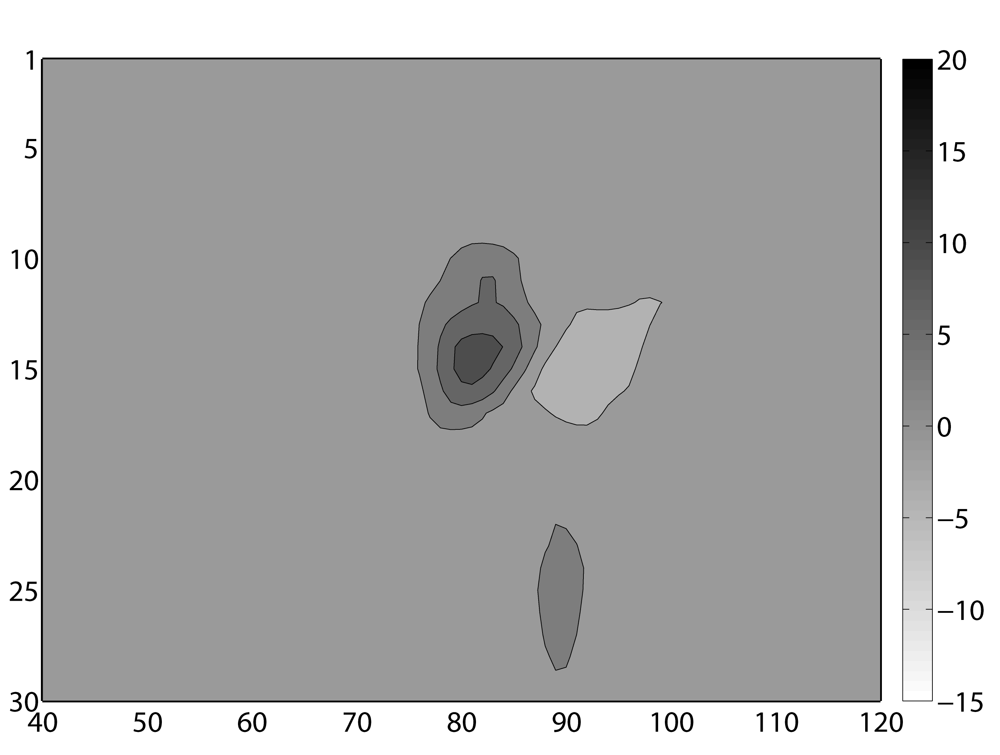
Adaptive localization
18 Z
12 Z
(a)
(b)
Sigma Level
Sigma Level
(c)
(d)
Longitude
Longitude
Ensemble covariance function localized with the partially adaptive ensemble covariance localization function (PAECL).
Bishop, C.H. and D. Hodyss, 2011: Adaptive ensemble covariance localization in ensemble 4D-VAR state estimation, Mon. Wea . Rev. 139, 1241-1255.

Slide 19


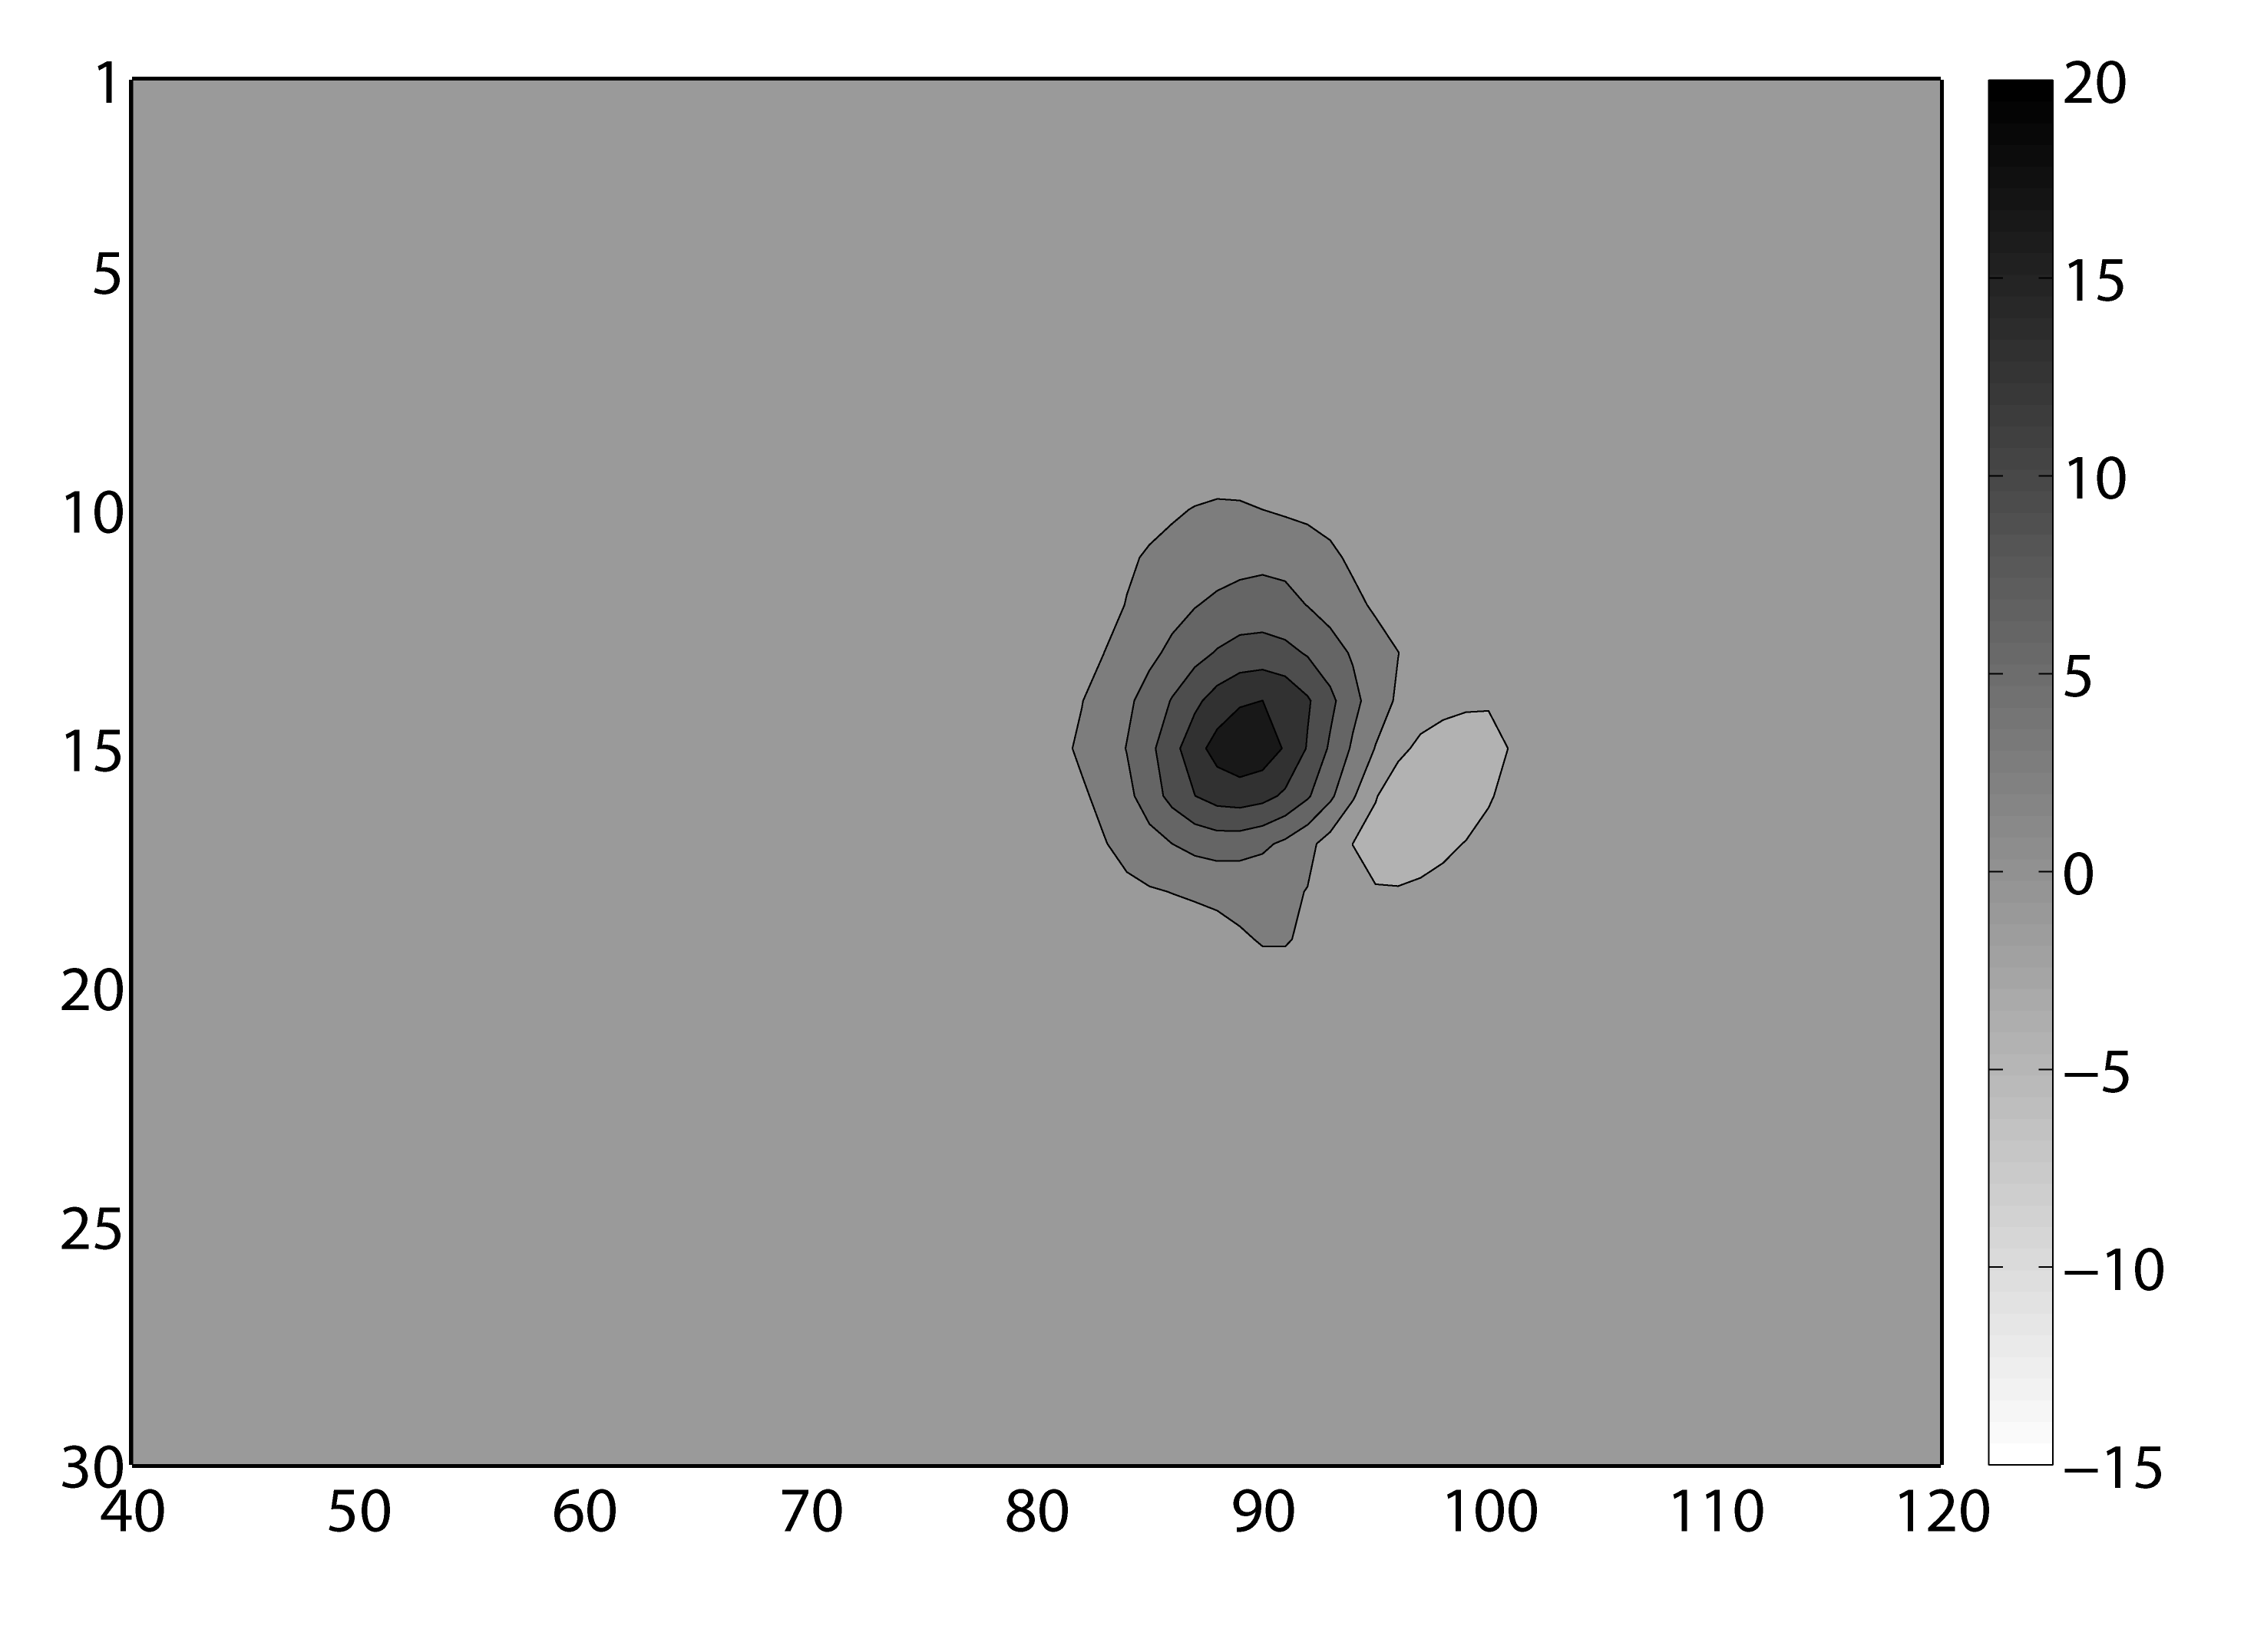
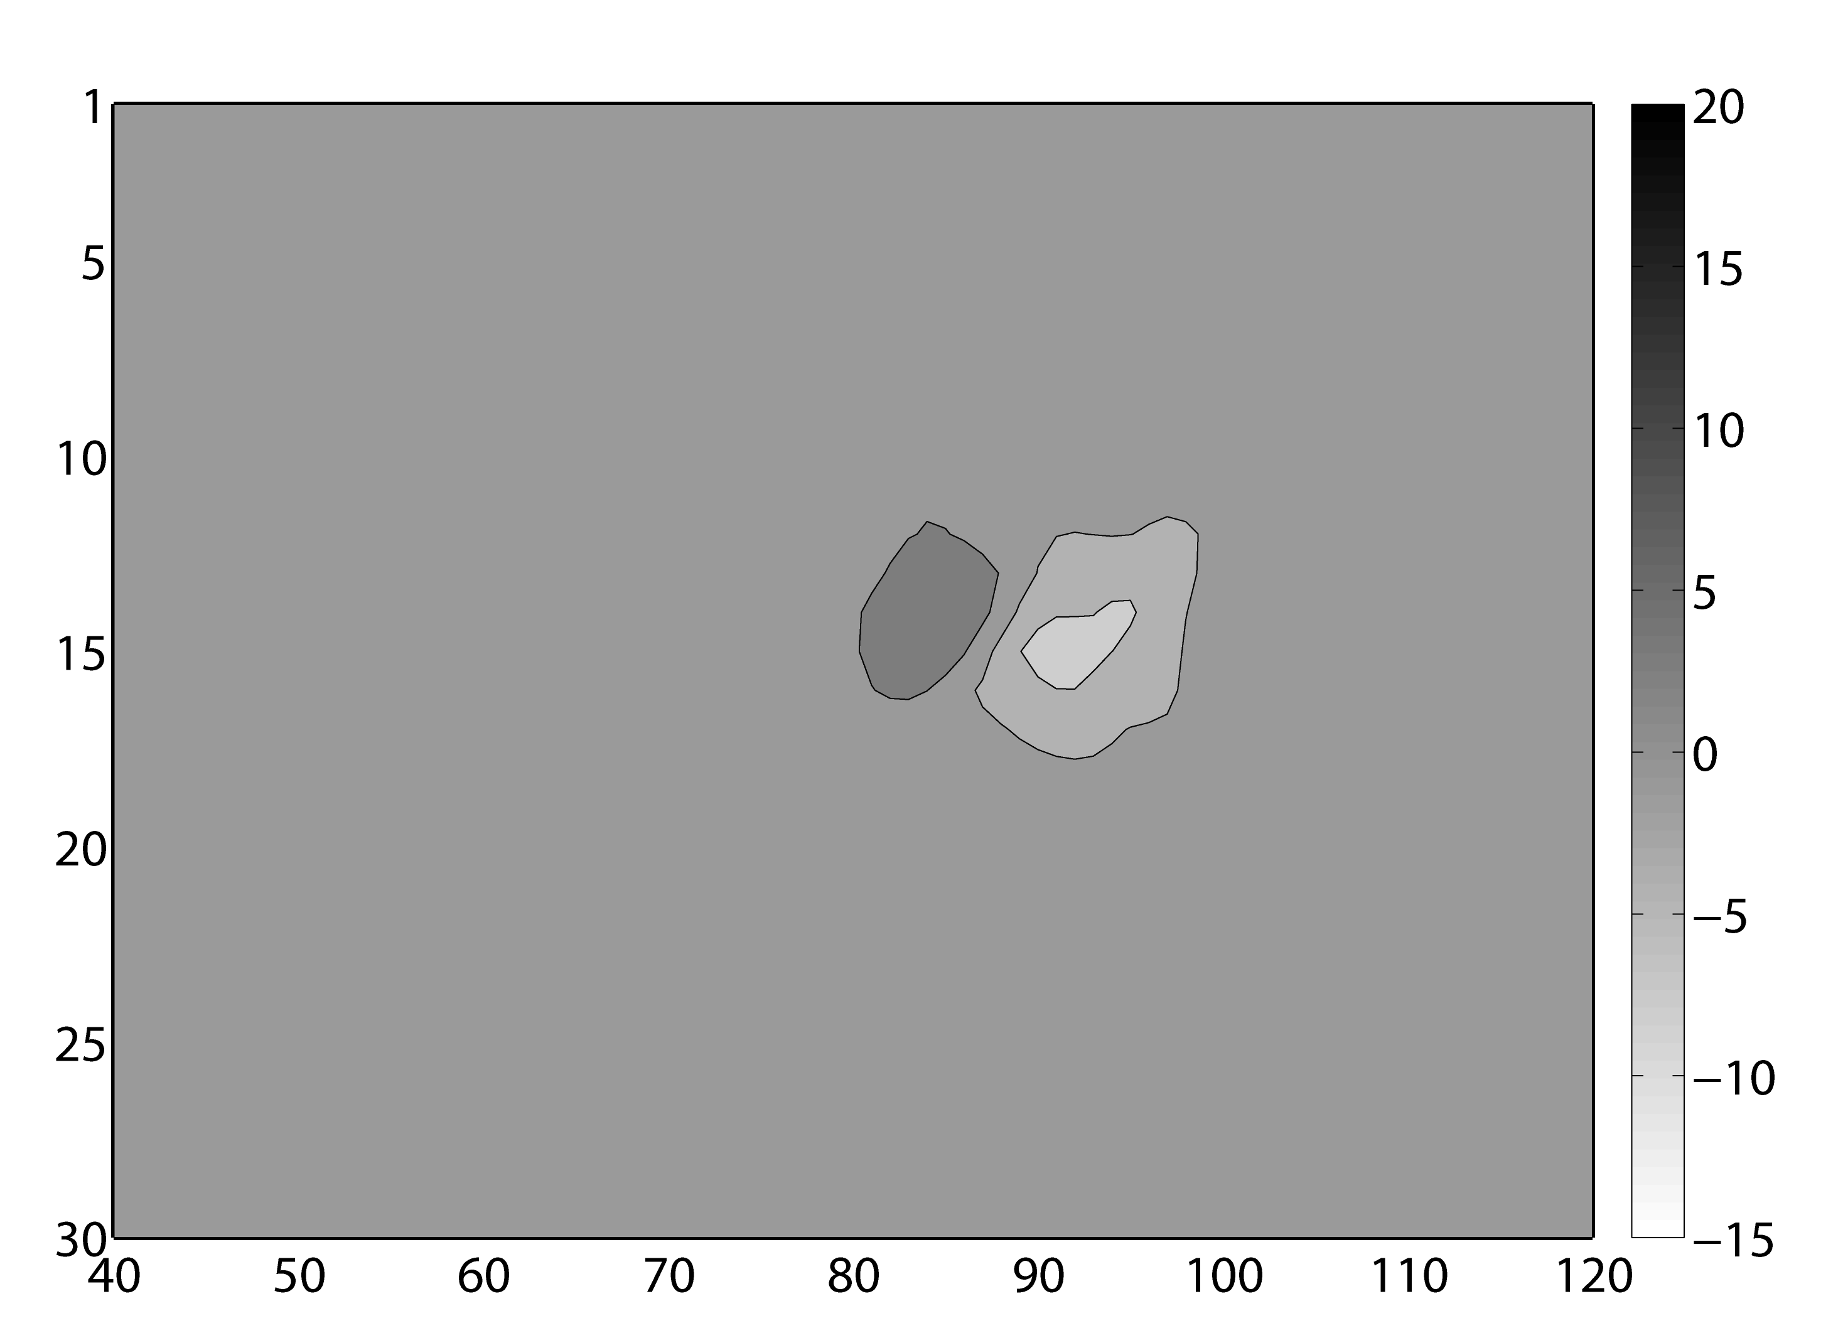
Non-adaptive localization
18 Z
12 Z
(a)
(b)
Sigma Level
Sigma Level
(c)
(d)
Longitude
Longitude
Ensemble covariance function localized with the non-adaptive ensemble covariance localization (NECL).

Slide 20
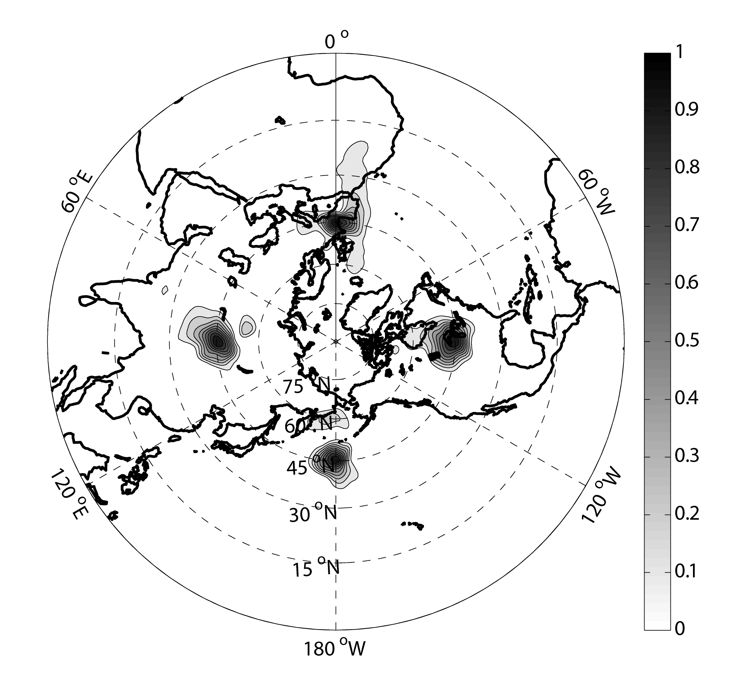
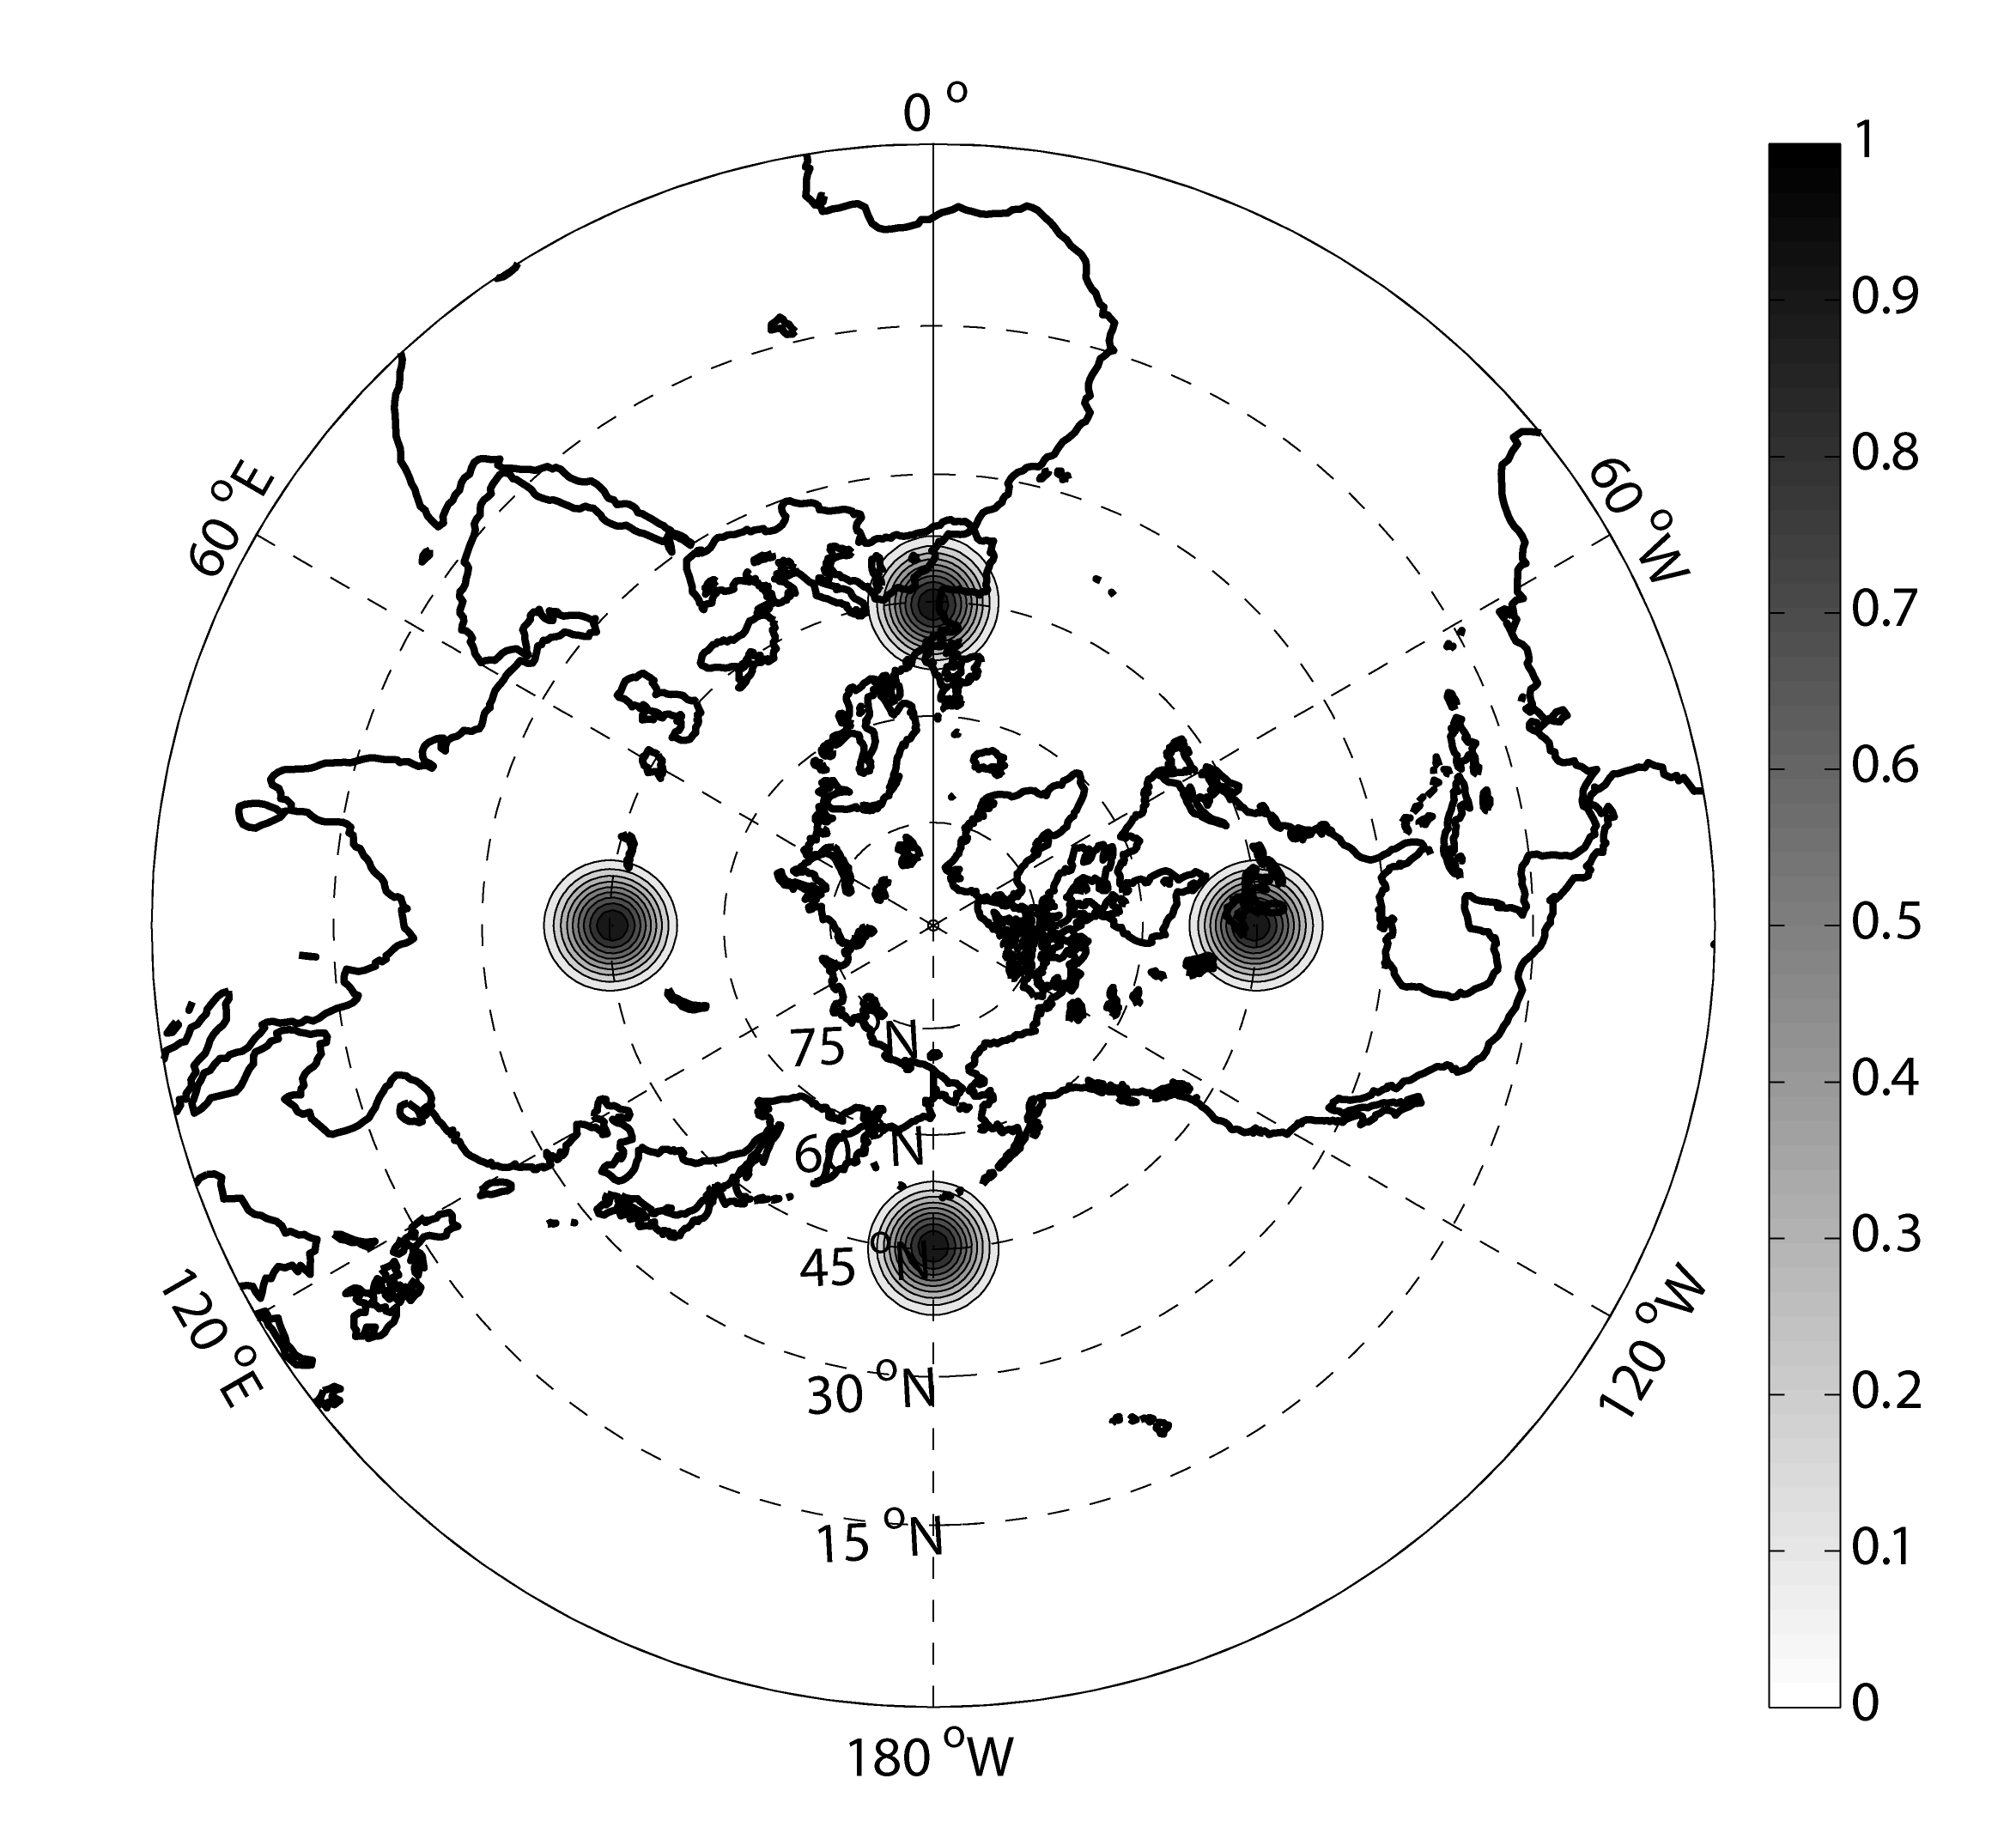
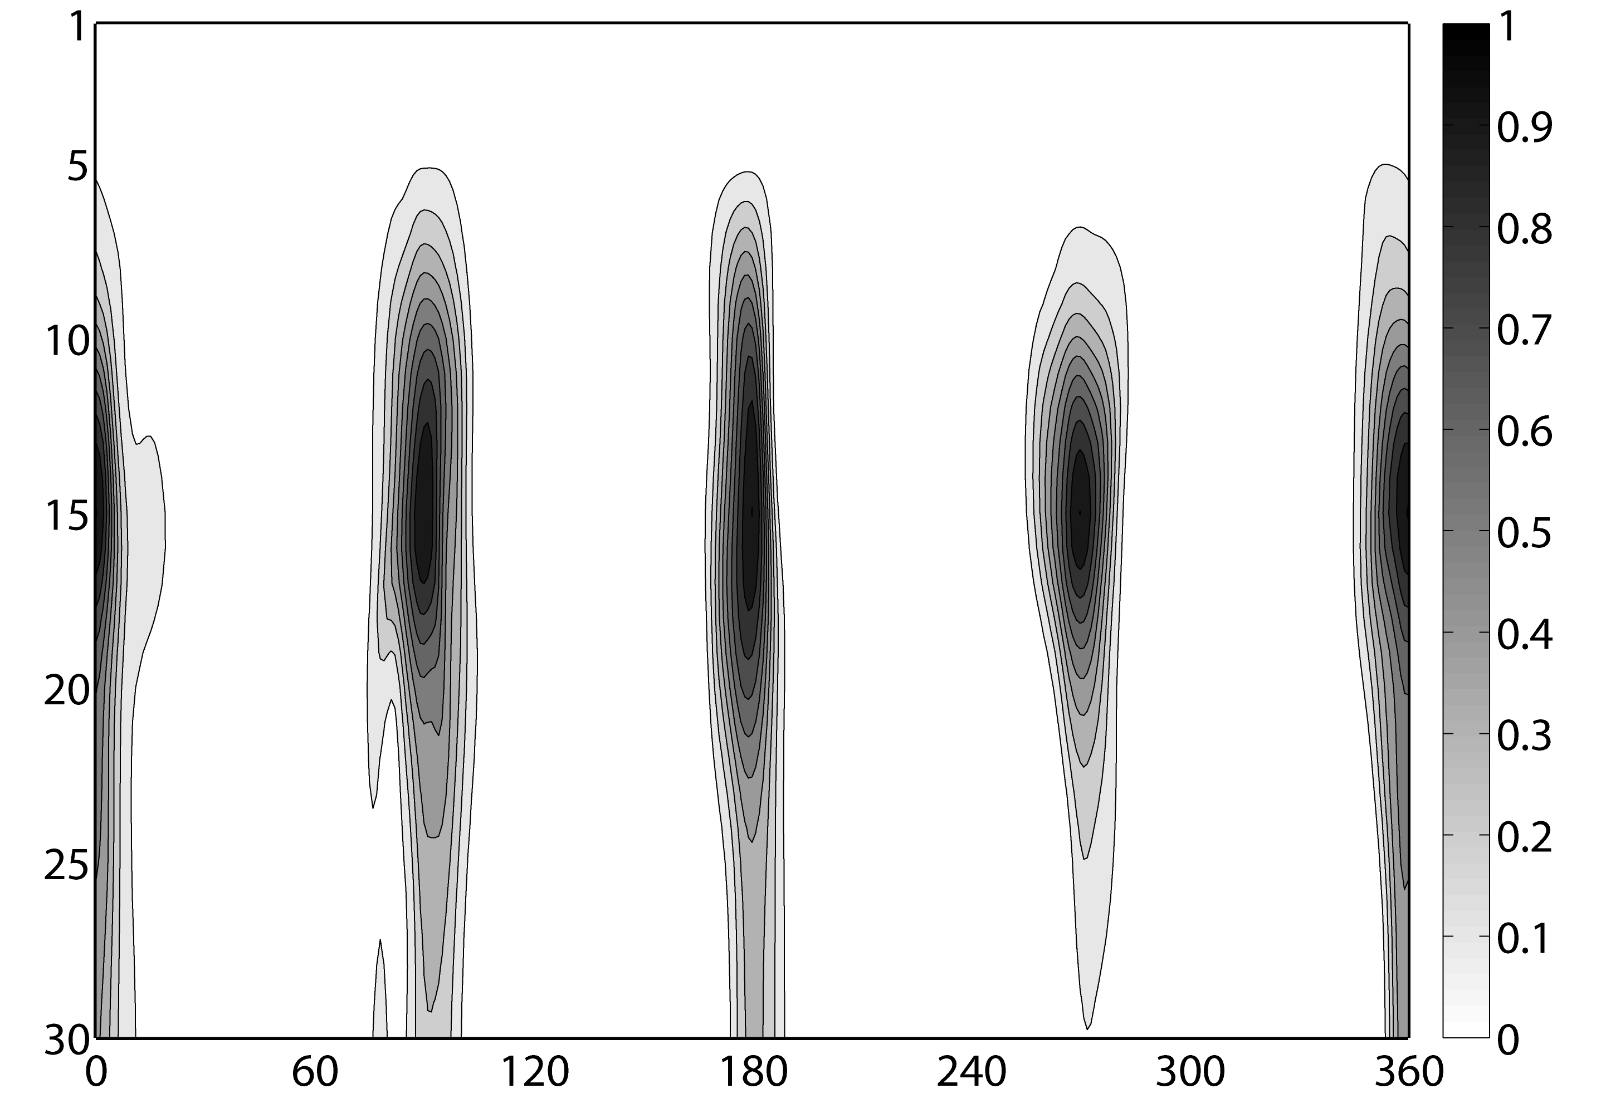
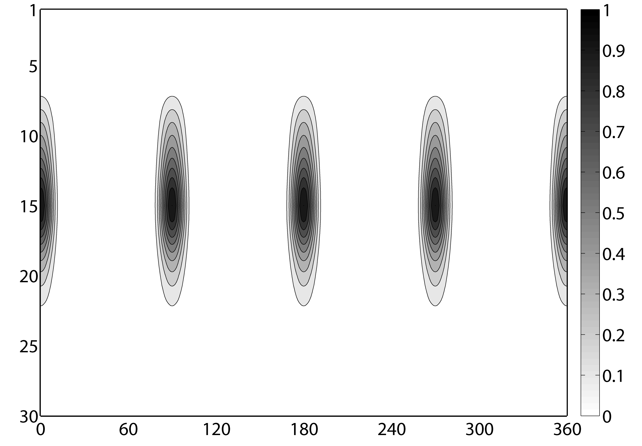
(a)
(b)
This study was only able to compare the performance of the two schemes over a long enough period to establish any significance between the performance of non-adaptive and adaptive localization. In simpler models, adaptive localization has been shown to beat or match the performance of non-adaptive localization – depending on the need for adaptive localization.
Sigma Level
Sigma Level
(c)
(d)
Longitude
Longitude
Comparison of structure of optimally tuned adaptive (a) and non-adaptive (b) localization functions at 12 UTC. Fig’s (c) and (d) give the corresponding vertical structure of the adaptive and non-adaptive localization functions along the N latitude circle.

Slide 21
Multi-scale issues

Slide 22


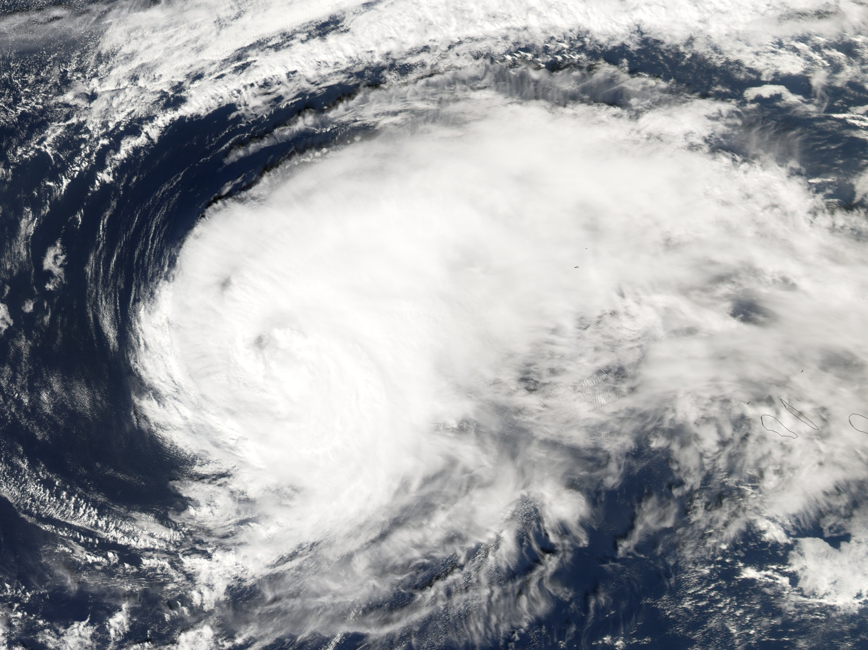
Synoptic scales need to be analyzed
1,000 km
Notes:
A large tropical cyclone, can be 1000 km across, but we can see lots of structure on smaller scales, for instance, if we zoom in on this south west quadrant

Slide 23

so do mesoscales,
100 km
100 km
Notes:
We can see that this feeder band has a width of about 100km, as well as these organized convective complexes. We can, of course, zoom in again.

Slide 24
and convective scales need to be analyzed too!
10 km
Notes:
and find that Individual convective cells can be 10 km across, and so on down to much smaller scales as well.

Slide 25
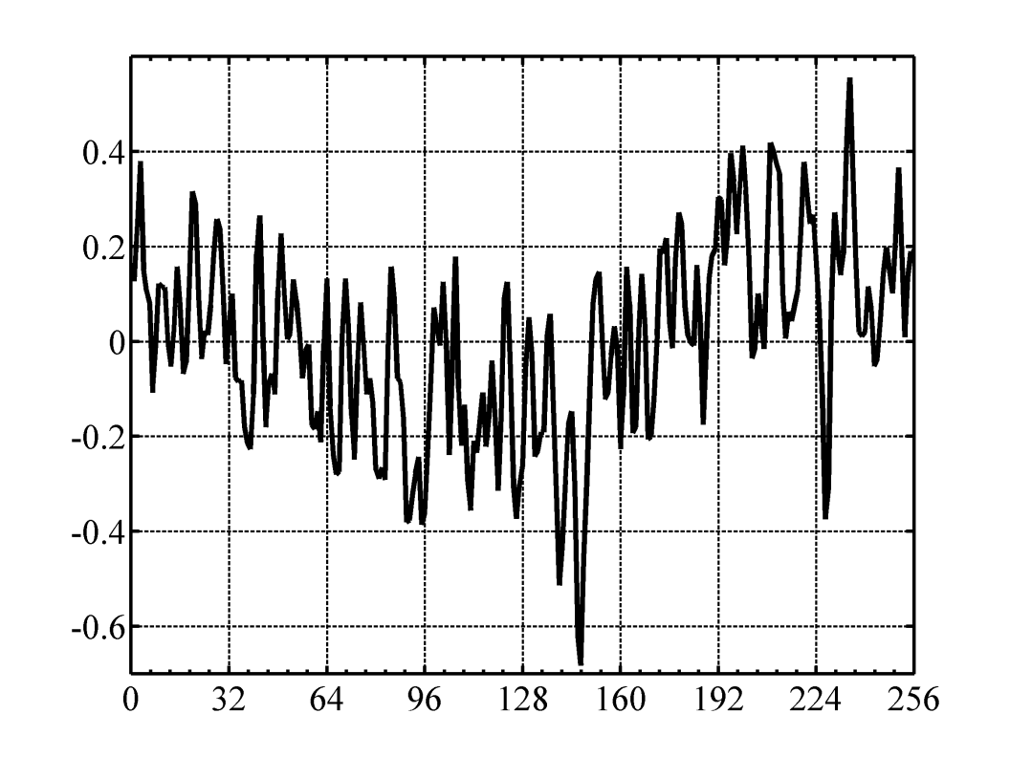
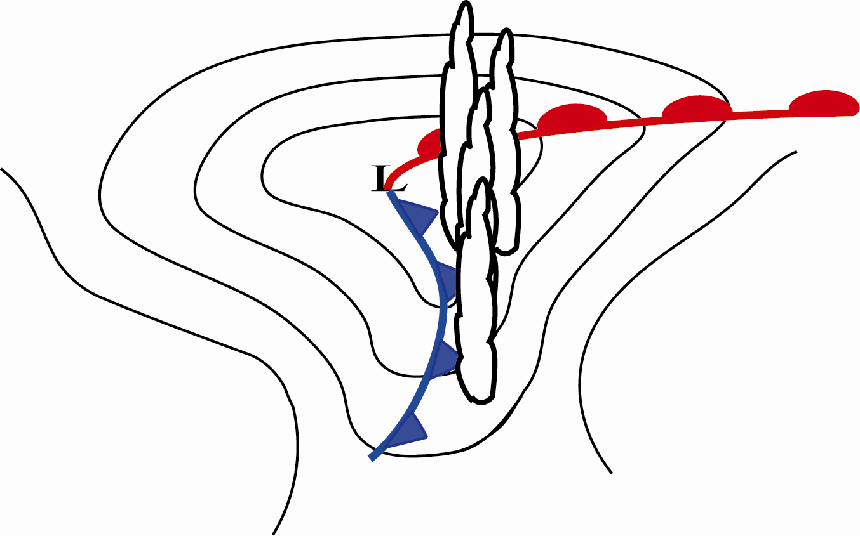
Motivation: Our Multi-Scale World
Convection near a mid-latitude cyclone
Simple Model Ensemble Perturbation

Slide 26
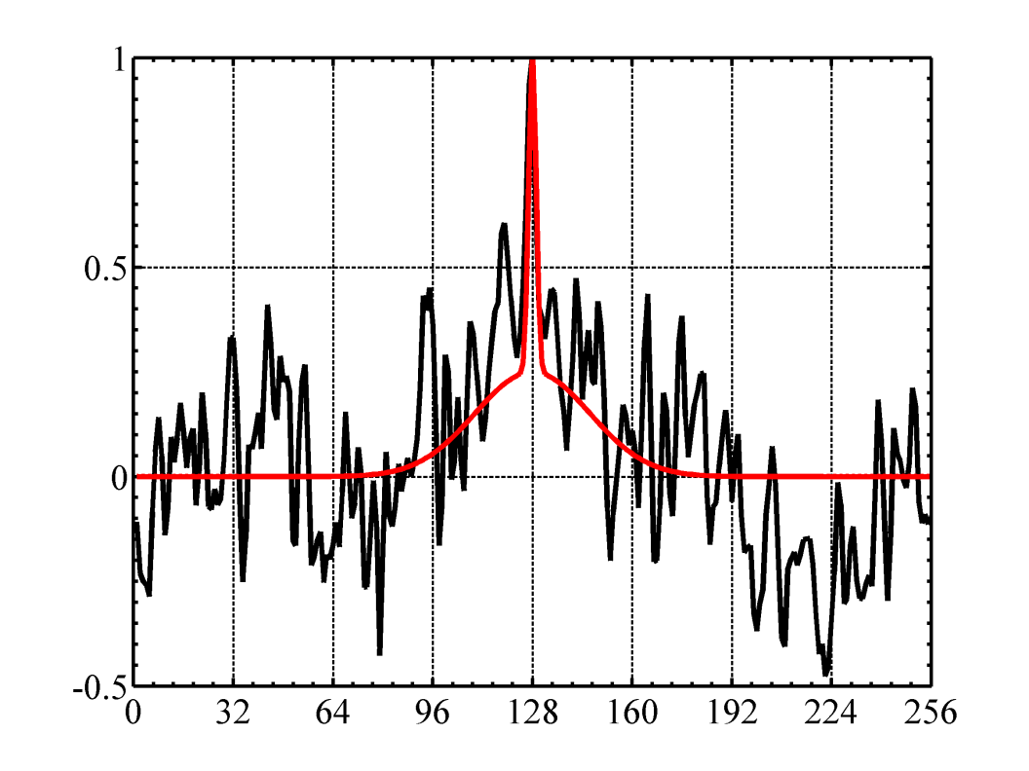
Motivation: Our Multi-Scale World
Convection near a mid-latitude cyclone
Red – True 1-point covariance
Black – 32 member ensemble 1-point covariance

Slide 27
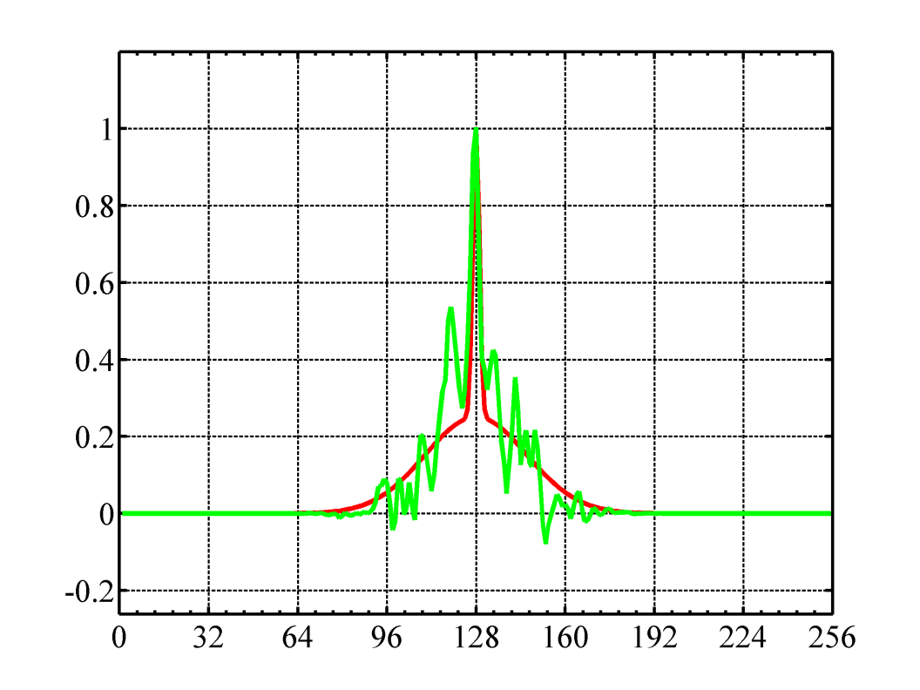
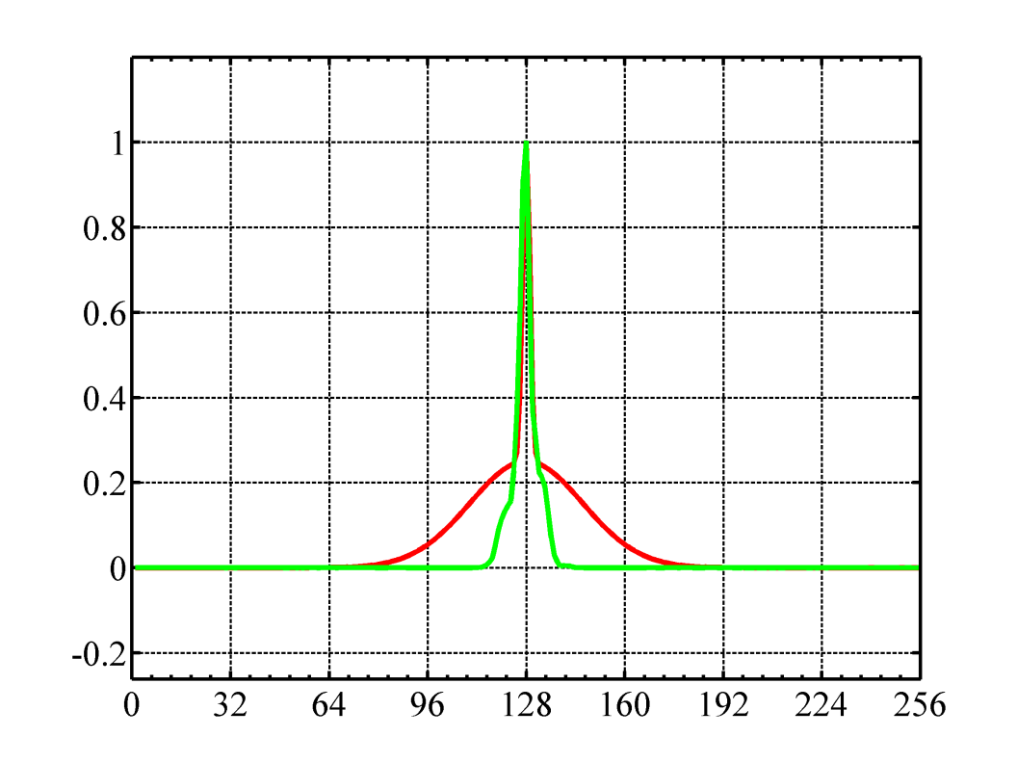
Will traditional localization help?
Localization with Broad Function
Localization with Narrow Function
Green – Localized 1-point covariance

Slide 28

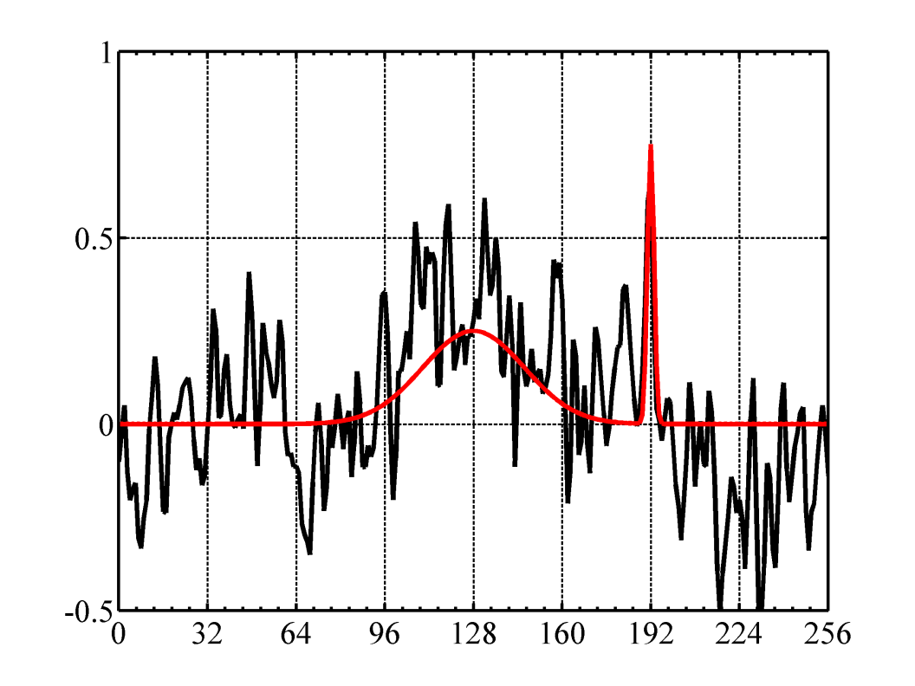
Now imagine the convection is moving …
Initial Time
Final Time
Red – True 1-point covariance
Black – 32 member ensemble 1-point covariance

Slide 29
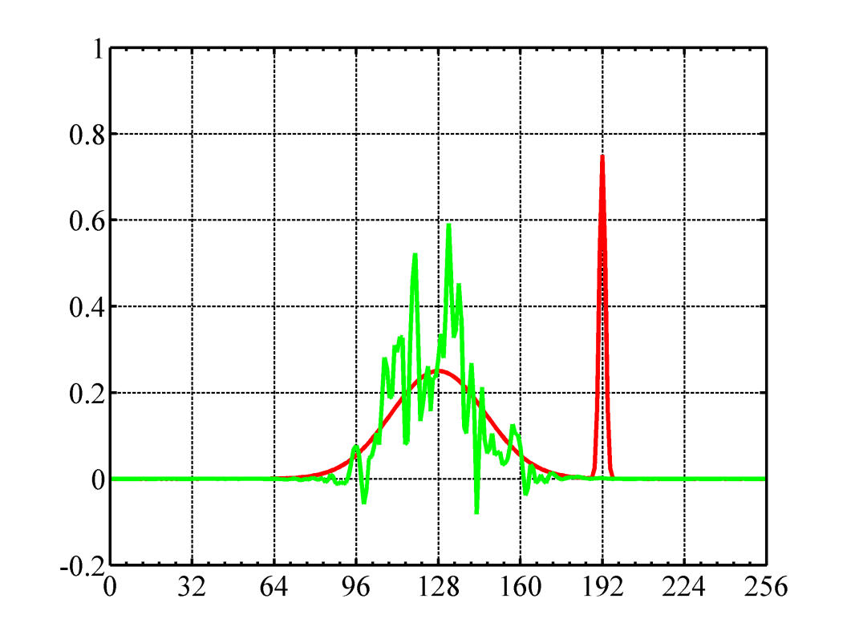
Will traditional localization help?
Localization with Broad Function
Initial Time
Final Time
Green – Localized 1-point covariance

Slide 30
New Method: Multi-scale DAMES
Spatially smooth the ensemble members and call this the large-scale ensemble
  Use a step-function in wavenumber space
Subtract the large-scale ensemble from the raw ensemble and call this the small-scale ensemble
  This implies a partition like
Apply the DAMES method to expand ensemble size
to each ensemble separately
  Create localization ensemble members, i.e. choose variable and smooth
  Use modulation products to construct “modulation” ensemble members
Add modulation ensemble members from the large-scale ensemble and the small-scale ensemble together to form one set of modulation ensemble members
  This implies that the final ensemble looks like

Slide 31
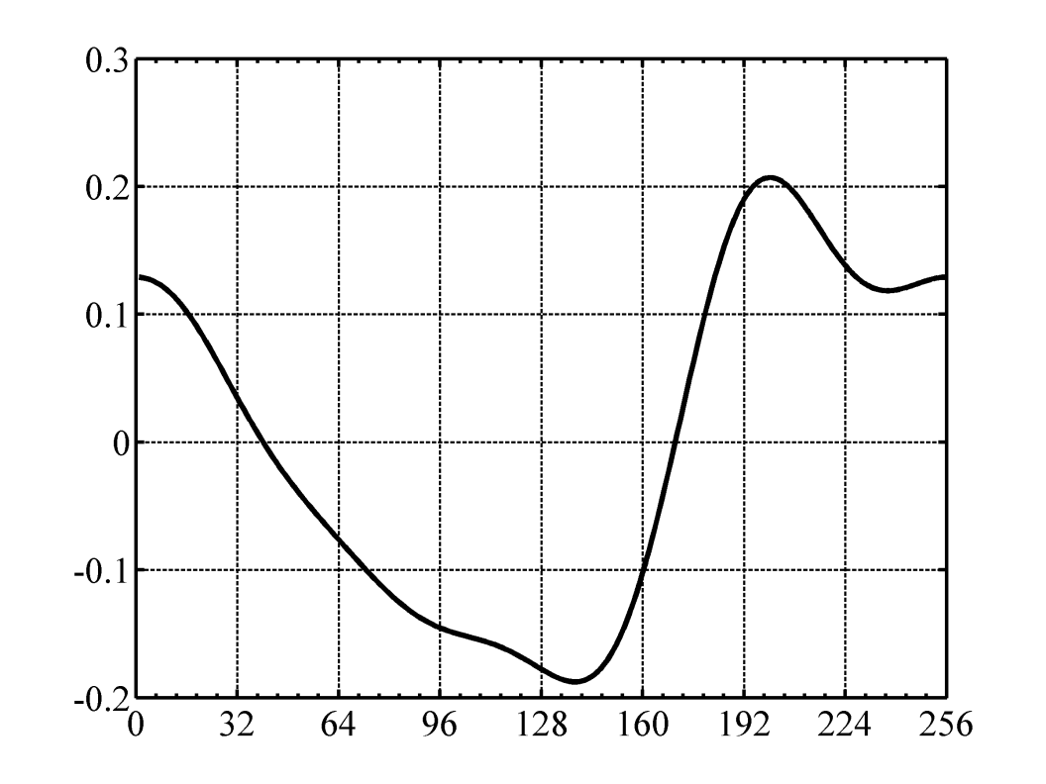
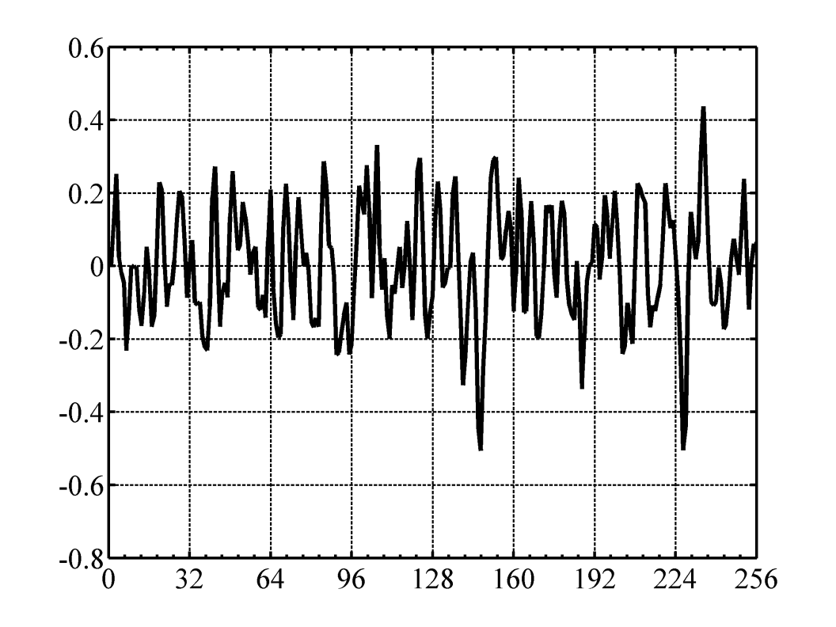
Decompose into large and small-scale portions …
Large-Scale Ensemble Perturbation
Small-Scale Ensemble Perturbation

Slide 32
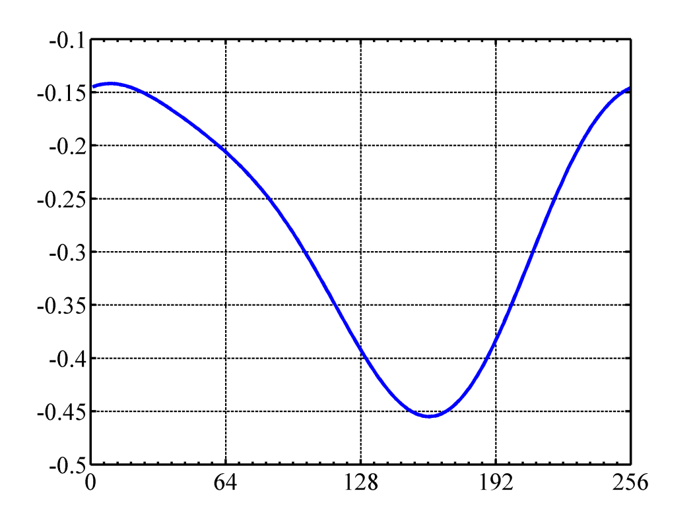
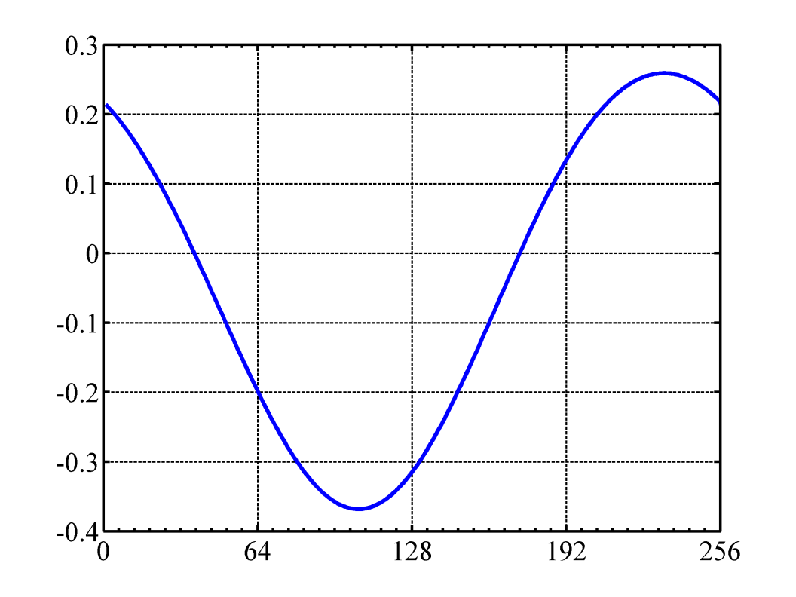
DAMES: Step 1 – Smooth the perturbations
Smoothed Large-Scale Ensemble Perturbations
(Smooth Member 1)
(Smooth Member 2)

Slide 33
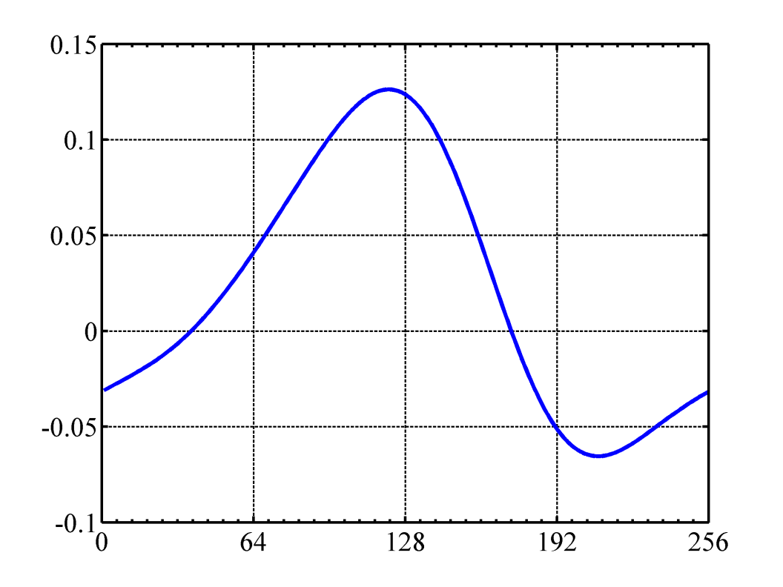
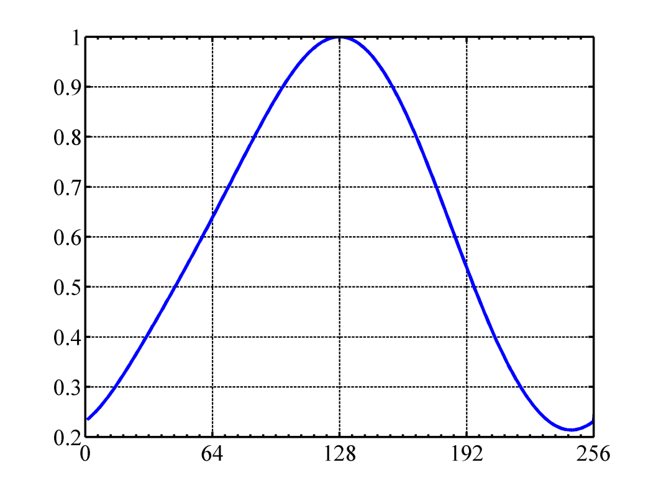
DAMES: Step 2 – Modulate smooth members and normalize the resulting ensemble
Large-Scale Ensemble Perturbations
(Smooth Member 1) x (Smooth Member 2)
Associated Localization Function

Slide 34

DAMES: Step 3 – Modulate raw member
Large-Scale Ensemble Perturbations
(Raw Member 2) x (Smooth Member 1) x (Smooth Member 2)
This is a modulation ensemble member!

Slide 35

Large-Scale and Small-Scale Perturbations
(Raw Member 2) x (Smooth Member 1) x (Smooth Member 2)
Large-Scale Ensemble Perturbation
Small-Scale Ensemble Perturbation

Slide 36

The MS-DAMES Ensemble
Recall that the MS-DAMES modulation ensemble is
the sum of the large-scale and small-scale members:
Subsequent research has shown that treating the small and large scale modulated members as individual members (rather than adding them together) actually works better.

Slide 37


1-point Covariance functions
The Multi-scale DAMES algorithm gave a qualitatively good result!
Initial Time
Final Time
Red – True 1-point covariance
Green – Non-adaptively localized covariance
Blue – Multi-scale DAMES covariance

Slide 38


Have we localized the covariance?
Effective Localization
Blue – MS-DAMES 1-point covariance
Black – Raw 1-point covariance

Slide 39

Let’s Assimilate Some Obs …
The MS-DAMES algorithm gave a superior quantitative result
Two cases: Observe every point at the final time with ob error = 0 or 1
Obtain the initial state using the modulation ensemble to propagate the effect of the obs back in time
16 trials:
Initial time RMS(Analysis Error)
Ob error = 0 Ob error = 1
Optimal 0.27 0.61
MS-D 0.31 0.63
Non-adapt 1.4 0.92
Initial Time Analysis Error (R = 0)
Red – Optimal
Green – Non-adaptive
Blue – MS-DAMES

Slide 40
Summary
Ensemble based error covariance models require some form of covariance localization that serves to (a) increase the effective ensemble size, and (b) attenuate spurious correlations.
When errors (a) move a significant distance relative to their correlation length scale over the DA window and/or (b) exhibit differing scales at differing locations, adaptive localization can significantly improve the covariance model.
When differing error scales move in differing directions multi-scale ensemble covariance localization is likely to be of use.

Slide 41
Current DA ill-suited to multi-scale problem
Multiscale correlation functions. In (a) and (b) red lines give the true covariance of variables in 256 variable model at t=0 and t=12, respectively, with the 128th variable at t=0. Blue lines give the corresponding raw ensemble covariance from a 32 member ensemble. Black lines give the corresponding localized ensemble covariance. Green lines give the non-adaptive localization function used to localize the ensemble covariances.
Current physical space ensemble covariance localization techniques inadequate for multi-scale problem

Slide 42
Adaptive Localization needed because:
Naval Research Laboratory Marine Meteorology Division Monterey, California
True error correlation length scale is a function of time and location
The location of correlated errors propagates through time
Multiple error correlation length scales may exist simultaneously

Slide 43






What is the true error distribution ?
(Slartibartfast – Magrathean designer of planets, D. Adams, Hitchhikers …)
Imagine an unimaginably large number of quasi-identical Earths.

Slide 44
What is an error covariance?

Slide 45
Why do error covariances matter?
The temperature forecast for Albuquerque is much colder than the verifying observation by 5K. Does this mean that the forecast for Santa Fe was also to cold?
What if the forecast error was associated with an approaching cold front?
How would the orientation of the cold front change your answer to question 1?

Slide 46
Problem
We don’t know the true state and hence cannot produce error samples.
We can attempt to
  infer forecast error covariances from innovations (y-Hx^{f}) (e.g. Hollingsworth and Lohnberg, 1986, Tellus)
And/or
  create proxies of error from first principals (e.g. ensemble perturbations)

Slide 47
Static forecast error covariances from innovations

Slide 48
Static forecast error covariances from innovations

Slide 49
Static forecast error covariances from innovations
An attractive property of the HL method is that its estimates are entirely independent of the estimates of P and R that are used in the data assimilation scheme.
Hollingsworth-Lönnberg Method
(Hollingsworth and Lönnberg, 1986)
Ob error variance R_{ii}
Includes uncorrelated error of representation
Extrapolate green curve to zero separation, and compare with innovation variance
Fcst error variance P_{ii}
Desrozier’s method depends on differences between analyses and observations. These differences are entirely dependent on the assumptions made in the DA scheme.
Innovation covariances binned by separation distance
Desroziers’ Method
(Desroziers et al 2005)
From O-F, O-A, and A-F statistics, the observation error covariance matrix R, the representer HBH^{T}, and their sum can be diagnosed

Slide 50

Static forecast error covariances from innovations
Bauer et al., 2006,
QJRMS

Slide 51

Why does the correlation function for the AIREP data look qualitatively different to that from the SSMI radiances?
C/O Mike Fisher

Slide 52
Pros and cons of error covariances from binned innovations
Pros
  Ultimately, observations are our only means to perceive forecast error.
  Innovation based approaches enable both forecast error covariances and observation error variances to be simultaneously estimated.
Cons
  Only gives error estimates where there are observations (what about the deep ocean, upper atmosphere, cloud species, etc)
  Provides extremely limited information about multi-variate balance.
  Limited flow dependent error covariance information.

Slide 53
Covariances of proxies of forecast error
Parish and Derber’s (1992, MWR)“very crude 1st step” using the difference between a 48 hr and 24 hr fcsts valid at the same time as a proxy for 6 hr fcst error has been widely used.
Oke et al. (2008, Ocean Modelling) use deviations of state about 3 month running average as a proxy for forecast error.
Both 1 and 2 can be made to be somewhat consistent with innovations
How could we produce better proxies of forecast error?

Slide 54
Covariances of proxies of forecast error
Forecast error distributions depend on analysis error distributions and model error distributions.
Analysis error distributions depend on the data assimilation scheme used and the location and accuracy of the observations assimilated.
Estimation of these distributions is difficult in practice but there is theory for it.

Slide 55
The effect of observations on errors,
Bayes’ theorem

Slide 56

Prior pdf of truth
Probability density
Ensemble forecasts are used to estimate this distribution. They are a collection of weather forecasts started from differing but equally plausible initial conditions and propagated forward using a collection of equally plausible dynamical or stochastic-dynamical models.
Value of truth

Slide 57

Likelihood density function
In interpreting the likelihood function (red curve) note that y is fixed at y=1.
The red curve describes how the probability density of obtaining an error prone observation of y=1 varies with the true value x^{t}.
Value of truth

Slide 58

Posterior pdf
Probability density
No operational or near operational data assimilation schemes are capable of accurately representing such multi-modal posterior distributions.
Value of truth

Slide 59


Slide 60

Works for Gaussian forecast and observation errors.

Slide 61
Ensemble of perturbed obs 4DVARS does not solve Bayes’ theorem
Green line is pdf of ensemble of converged perturbed obs 4DVARs having the correct prior and correct observation error variance.
Blue line is the pdf of ensemble of 4DVARS after 1st inner loop (not converged)
Black line is the true posterior pdf.

Slide 62
EnKF doesn’t solve Bayes’ theorem either
Cyan line is posterior pdf from EnKF
Black line is the true posterior pdf.

Slide 63
Recapitulation on proxy error distributions
Ensembles of 4DVARs and/or EnKFs provide accurate flow dependent analysis and forecast error distributions provided all error distributions are Gaussian and accurately specified.
In the presence of non-linearities and non-Gaussianity, the 4DVAR/EnKF proxies are inaccurate but probably not as inaccurate as proxies for which 1 does not hold.
One can use an archive of past flow dependent error proxies to define a static or quasi-climatological error covariance. (Examples follow)

Slide 64


Slide 65


Slide 66

Computationally Efficient Quasi-Static Error Covariance Models

Slide 67


Slide 68

Boer, G. J., 1983: Homogeneous and Isotropic Turbulence on the Sphere. J. Atmos. Sci., 40, 154–163.
Pointed out that isotropic correlation functions on the sphere are obtained from EDE^T where E is a matrix listing spherical harmonics and D is a diagonal matrix whose values (variances) only depend on the total wave number.

Slide 69


Slide 70


Slide 71


Slide 72

Wavelet transforms permit a compromise between these two extremes. ECMWF currently has a wavelet transform based background error covariance model.
May have time to touch on this tomorrow.

Slide 73


Slide 74


Slide 75


Slide 76


Slide 77


Slide 78

Divergence
without omega equation
Divergence
with omega equation

Slide 79

Sophisticated balance operators impart a degree of flow dependence to both the error correlations and the error variances!

Slide 80
Recapitulation on today’s lecture
Differences between forecasts and observations can be used to infer aspects of spatio-temporal averages of
  Observation error variance
  Forecast error variance
  Quasi-isotropic error correlations
Monte Carlo approaches (Perturbed obs 3D/4D VAR, EnKF) and deterministic EnKFs (ETKF, EAKF, MLEF) provide compelling error proxies for both flow-dependent error covariance models and flow-dependent error covariance models.
In variational schemes, the need for cost-efficient matrix multiplies has led to elegant idealizations of the forecast error covariance matrix
  sophisticated balance constraints can be built into these models.
There were many approaches I did not cover (Recursive filters, Wavelet Transforms, etc).
Tomorrow: Ensemble based flow dependent error covariance models

