Slide 1




Assimilating GOES-R water vapor and JPSS sounding data for improving tropical cyclone forecasts with WRF/GSI
Jun Li¹, Tim Schmit², Jinlong Li¹, Pei Wang¹, and Hui Liu³
1 University of Wisconsin-Madison
2 Center for Satellite Applications and Research, NESDIS/NOAA
3 National Center for Atmospheric Research
The 10th JCSDA Workshop on Satellite Data Assimilation
10 – 12 October 2012, College Park, Maryland

Slide 2
Outline
Motivations and objectives
  Improve water vapor information assimilation in regional NWP model (GOES-R application);
    Assimilation of water vapor information is difficult due to its large spatial and temporal variability;
  Improve advanced IR sounder information assimilation in regional NWP model (JPSS application);
Work accomplished
Summary and future work

Slide 3
Work accomplished during past year
Water vapor assimilation tested with WRF/DART
GSI has been implemented for experiments with regional WRF at S4;
Successfully ingested the sounding data into PrepBUFR format for GSI, therefore both radiances and soundings can be assimilated in the experiments;
Conducted experiments on microwave sounders (4 AMSU) and IR sounder (AIRS) radiance measurements on tropical cyclone (Irene 2011) forecasts;
Conducted comparisons between assimilating AIRS radiances and assimilating retrievals (T/q profiles) for hurricane forecasts;
Near real time assimilation and forecasting system is being developed for hurricane forecasts, testing with NPP soundings for ISAAC (2012) forecasts ongoing.

Slide 4
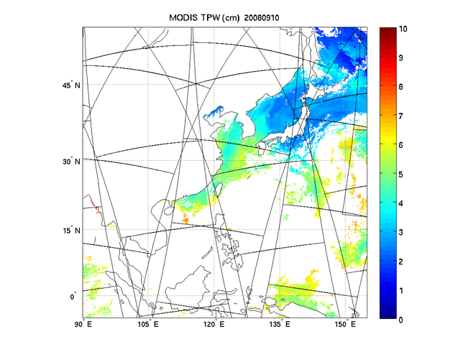
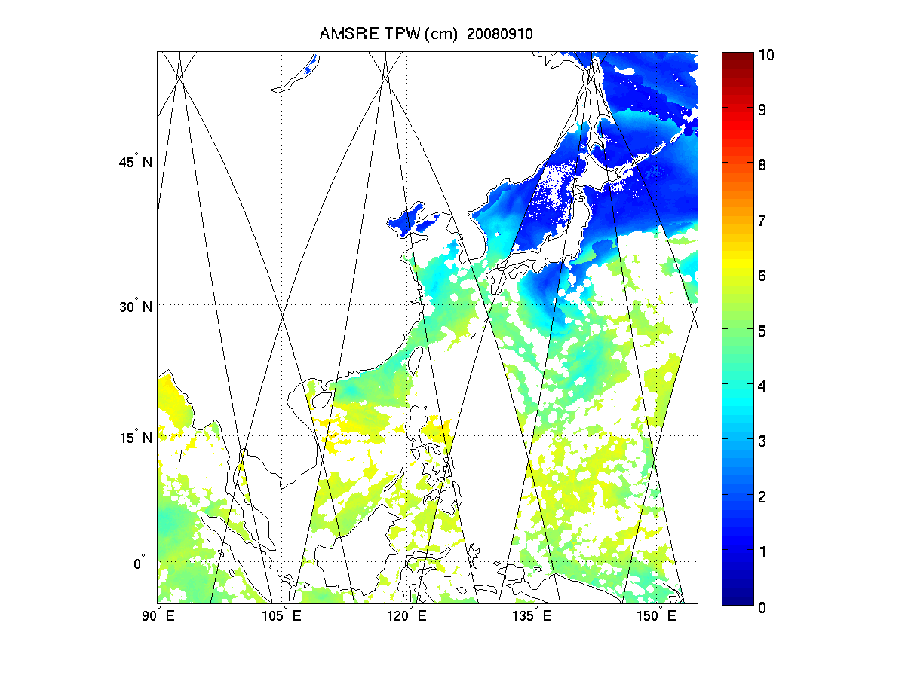
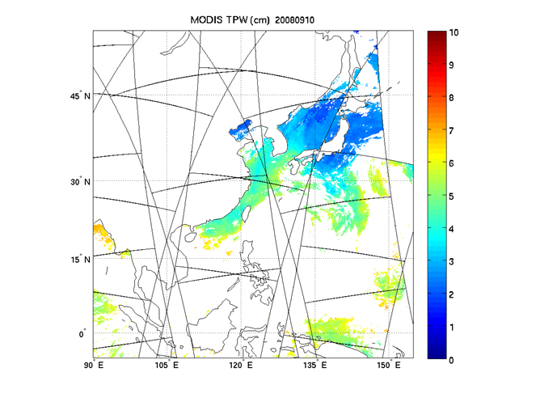
Terra TPW
AMSR-E TPW
Aqua TPW
Terra MODIS (upper left), Aqua MODIS (lower left) and AMSR-E (upper right) TPW images over ocean for 10 September 2008. The spatial resolution is 5 km for MODIS TPW and 17 km for AMSR-E TPW.

Slide 5
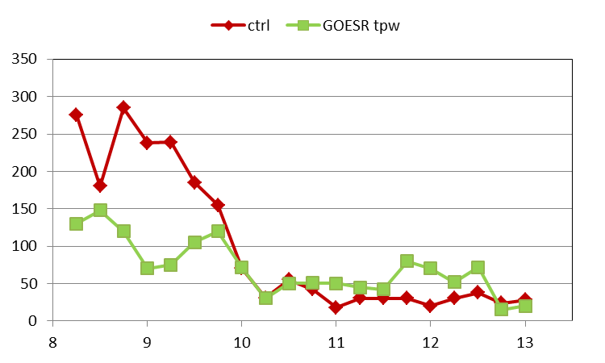
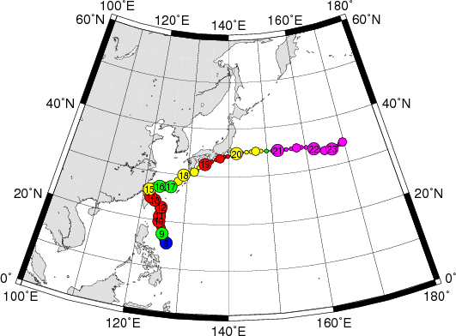
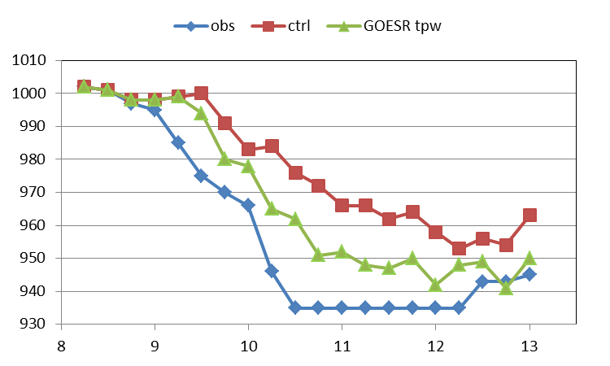
Typhoon Sinlaku (2008) rapid intensification and track analysis with GOES-R TPW (using MODIS/AMSR-E TPW as proxy)
CTL run: assimilate radiosonde, satellite cloud winds, QuikSCAT winds, aircraft data, COSMIC GPS refractivity, ship, and land surface data. WRF model and DART analysis are used.
Track analysis
Track error (km)
September 2008
Sinlaku fact
Intensity analysis
Sea level pressure (hPa)
The track error is significantly reduced with TPW assimilated (upper left panel).
Rapid intensification from 9 to 10 September 2008 captured with TPW assimilated (lower left panel).
September 2008

Slide 6
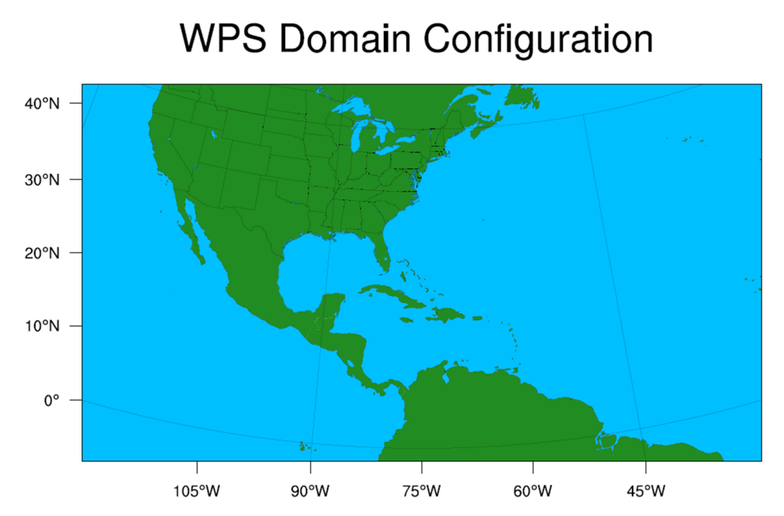
WRF/GSI experiments on hurricane Irene (2011)
Resolution
Horizontal: 12km
Vertical: 52 Levels
from surface to 10hPa
Data
GTS (conventional)
AIRSrad (AIRS radiance)
AIRSsnd (AIRS sounding)
4AMSUA (n15, n18, metop-a, aqua)

Slide 7
Experimental Design
Window Time: -1.5hr to +1.5hr
Spin up
Cyc1
Cyc2
Cyc3
Forecasting
T-18
T-12
T-6
T-0
T+48
8-21-12UTC | 8-21-18 | 8-22-00 | 8-22-06 |  | 8-24-06
8-21-18UTC | 8-22-00 | 8-22-06 | 8-22-12 |  | 8-24-12
8-22-00UTC | 8-22-06 | 8-22-12 | 8-22-18 |  | 8-24-18
8-22-06UTC | 8-22-12 | 8-22-18 | 8-23-00 |  | 8-25-00

Slide 8
Model description
Forecast model: WRF-ARW 3.2.1
Data assimilation: GSI V3
Physical schemes
Microphysics: WRF Single-Moment 6-class scheme
Cumulus: Grell 3d ensemble cumulus scheme
Longwave: RRTMG scheme
Shortwave: RRTMG shortwave

Slide 9
Experiment 1: microwave radiances versus IR radiances in hurricane forecasts
GTS (conventional data)
GTS + AIRSrad
GTS + AIRSrad + AQUA(1AMSUA)
GTS + AIRSrad + 4AMSUA (NOAA 15, NOAA18, Metop-A and Aqua)

Slide 10
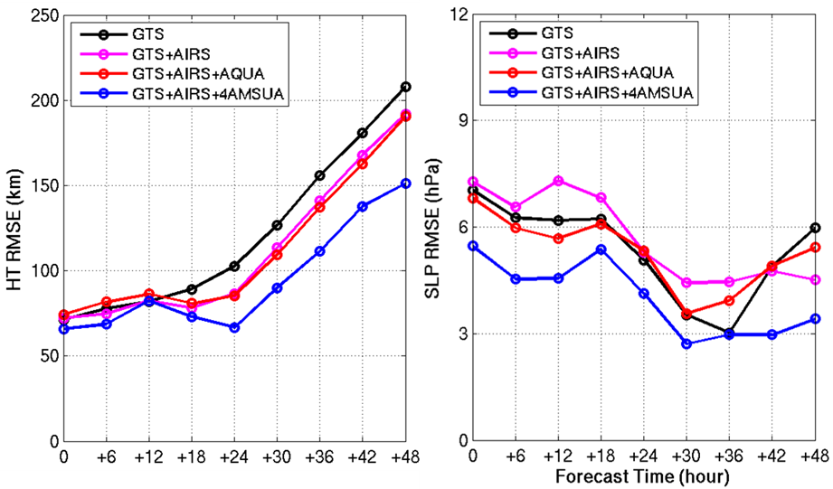
Assimilation and forecast experiments for Hurricane Irene (2011)
Data are assimilated every 6 hours from 06 UTC August 22 to 00 UTC August 24, 2011 followed by 48-hour forecasts (WRF regional NWP model with 12 km resolution). Hurricane track (HT) (left) and central sea level pressure (SLP) root mean square error (RMSE) are calculated
Notes:
In all the assimilation experiments, data are assimilated every 6 hours from 06 UTC August 22 to 00 UTC August 24, 2011 followed by 48-hour forecasts, the spatial resolution of WRF is 12 km in these experiments. Figure 2 shows the track and intensity (central sea level pressure) root mean square error (RMSE) for the forecasts of 00 hour, 06 hour, …., and 48 hours. The 00 hour forecast is from the analysis after assimilation. The AIRS and AMSU channels used are the same as that that used in the NCEP global NWP models, and AIRS and AMSU radiances are used in these experiments. It can be seen than when AIRS and all available AMSU (NOAA15, NOAA18, Aqua and Metop –A) are used, the track and intensity forecasts have the best accuracy (smallest RMSEs) during the forecast period, indicating that both advanced IR and microwave sounder data are needed for improving the tropical cyclone forecasts. Since the soundings are ingested into the PrepBUFR format, our next work is to compare assimilation of radiances and assimilation of soundings.

Slide 11
Experiment 2: hyperspectral IR radiance assimilation versus sounding assimilation
GTS (conventional data)
GTS + AIRSrad
GTS + AIRSsnd
GTS + 4AMSUA + AIRSrad
GTS + 4AMSUA + AIRSsnd

Slide 12
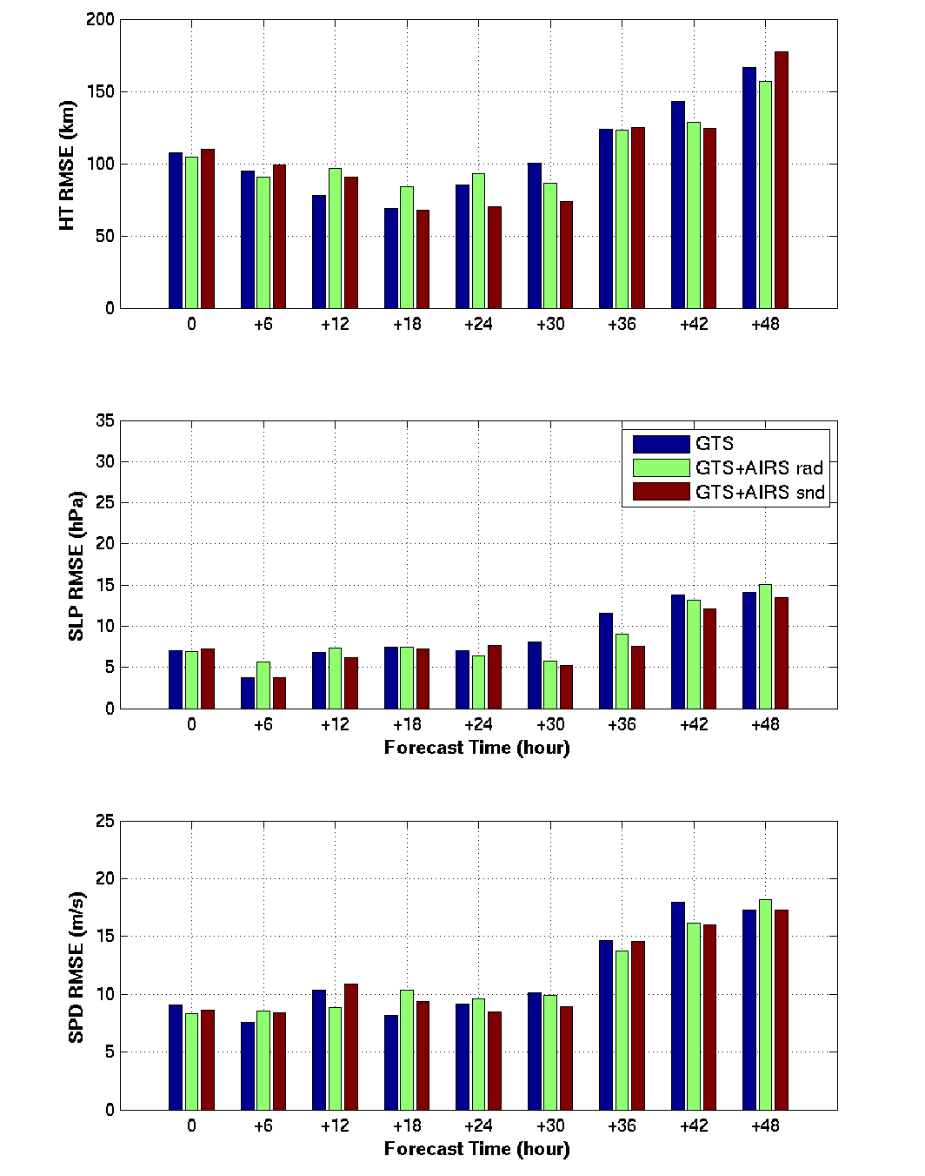
Hurricane track forecast RMSE
GTS + AIRS
1. For hurricane track: soundings perform slightly better than radiances for 18, 24 and 30 hour forecasts, but slightly worse than radiances for 6 and 48 hour forecasts.
2. It is comparable between assimilating soundings and radiances for central sea level pressure and maximum wind speed.
3. Overall it is comparable between assimilating radiances (3DVAR in GSI) and assimilating soundings (1DVAR/3DVAR combination).
Central SLP forecast RMSE
Maximum wind speed forecast RMSE
Notes:
No bias correction applied.

Slide 13
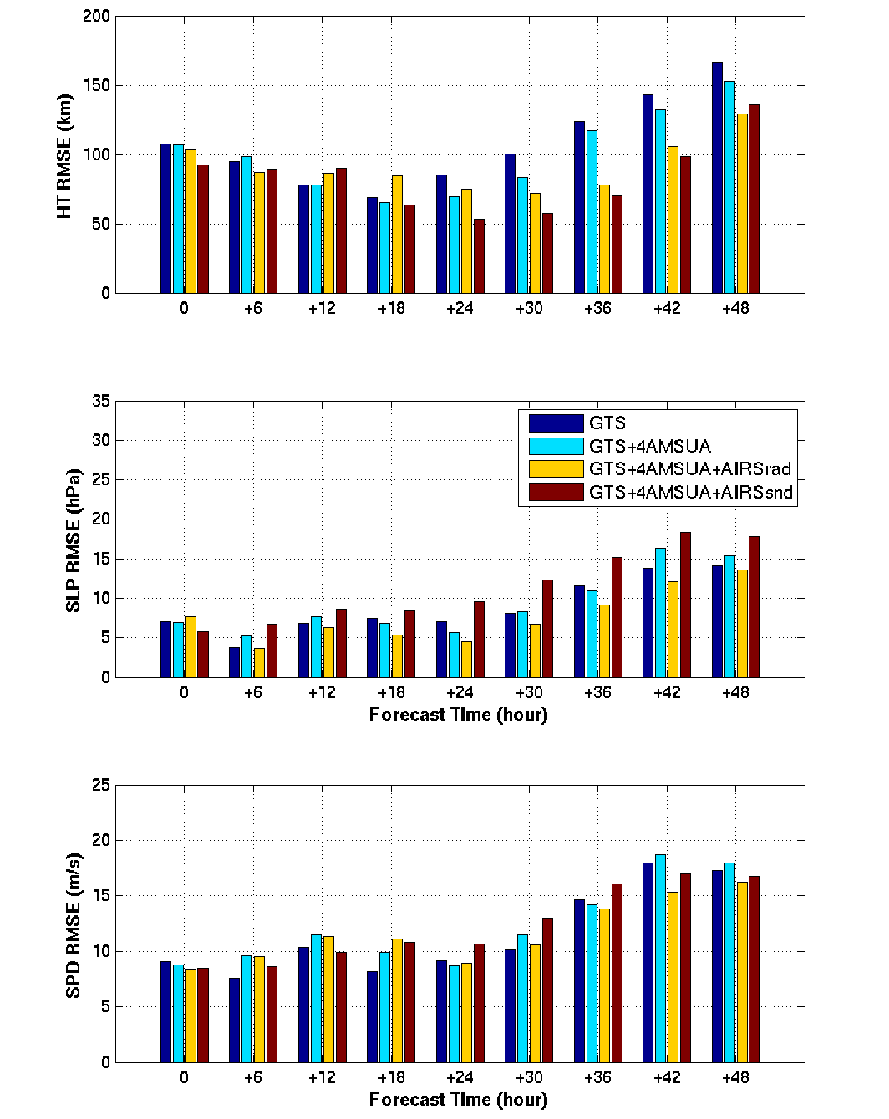
Hurricane track forecast RMSE
GTS + 4AMSUA +AIRS
1. For hurricane track forecasts: soundings perform better than radiances
2. For central sea level pressure forecasts: radiances perform better than soundings
3. For maximum wind speed forecasts: it is comparable between assimilating radiances and assimilating soundings
Central SLP forecast RMSE
Maximum wind speed forecast RMSE
Notes:
No bias correction applied.

Slide 14
Experiment 3: bias correction studies and impact
GTS (conventional data)
GTS + 4AMSUA + AIRSrad (no bias correction)
GTS + 4AMSUA + AIRSrad (with bias correction)

Slide 15
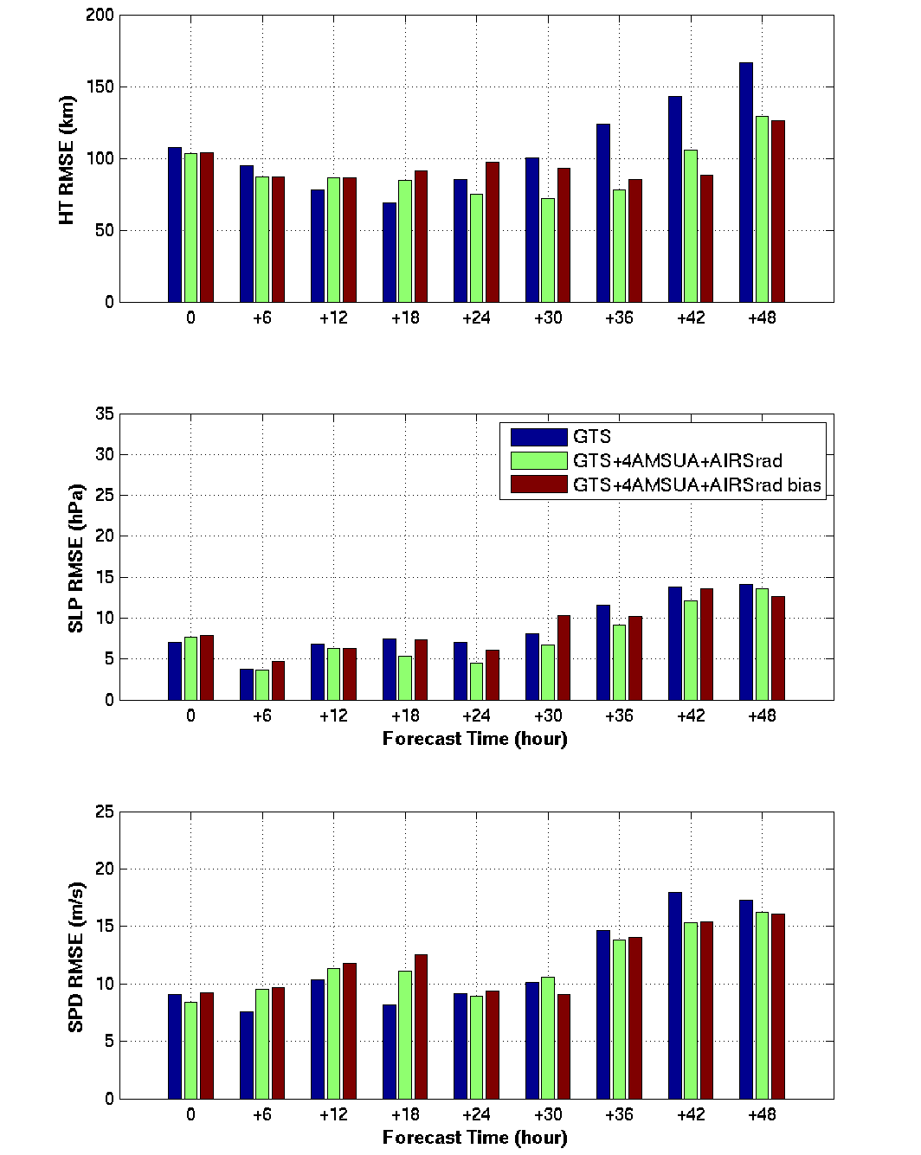
Hurricane track forecast RMSE
GTS + 4AMSUA + AIRS
Bias radiance correction coefficient file from GSI.
Both AMSUA and AIRS measurements are applied bias correction.
Central SLP forecast RMSE
Maximum wind speed forecast RMSE

Slide 16
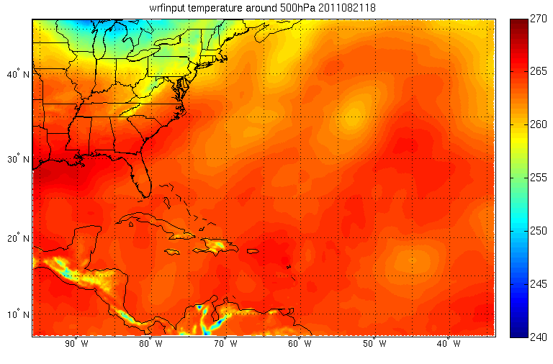
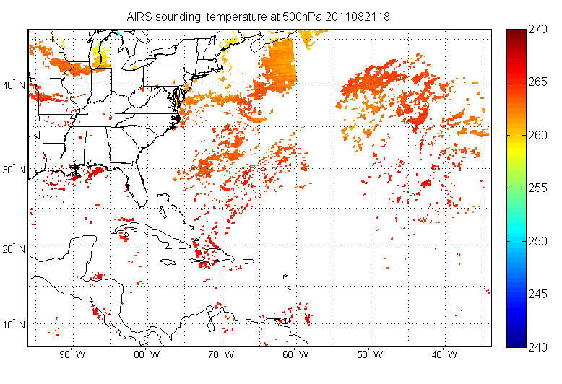
AIRS Sounding bias correction
Background (wrfinput) temperature at 500 hPa (B)
Bias correction
O-B
AIRS sounding temperature at 500 hPa (O)

Slide 17
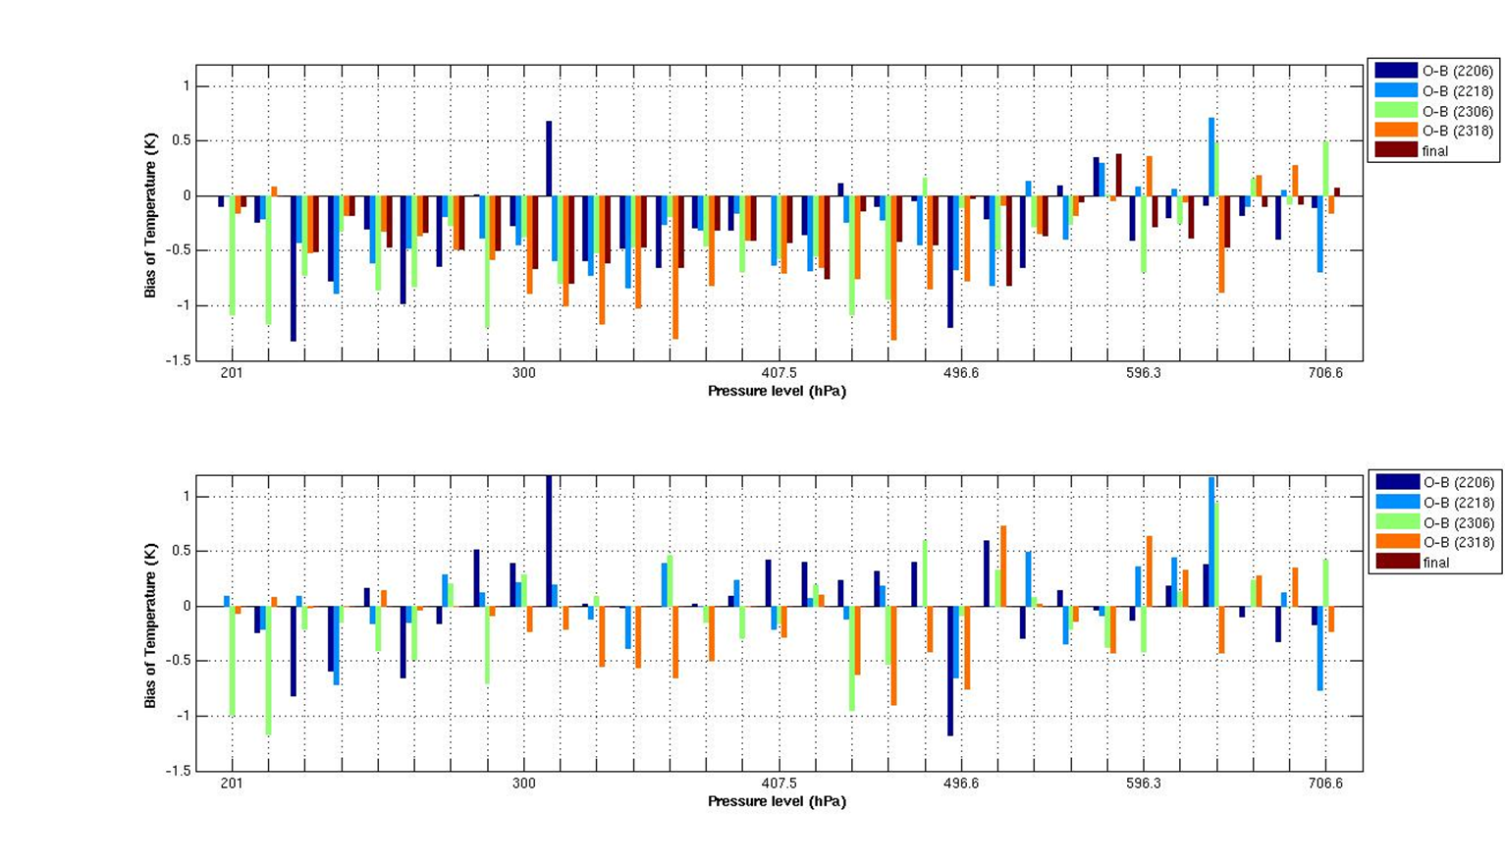
AIRS Sounding bias correction
Bias correction from 200hPa to 700hPa

Slide 18
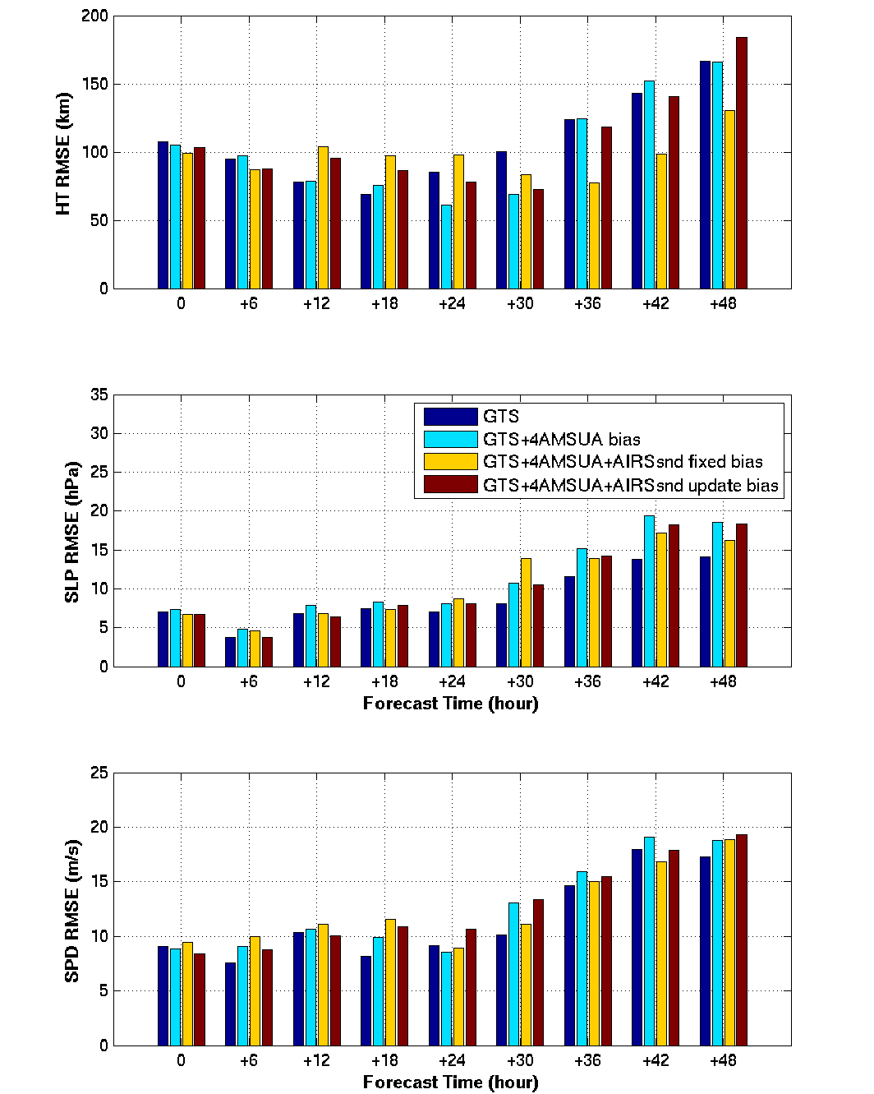
Hurricane track forecast RMSE
GTS + 4AMSUA + AIRSsnd
Fixed bias correction:
This bias correction is level dependent
Average all the O-B for all cycle
AIRS sounding temperature – mean(0-B)
Update bias correction:
This bias correction is level and time dependent
Average O-B per cycle
AIRS sounding temperature – mean(O-B) per cycle
Central SLP forecast RMSE
Maximum wind speed forecast RMSE

Slide 19
Demonstration system flowchart for
JPSS CrIMSS application to hurricane forecast
GDAS/GFS data
GSI/WRF Background & boundary preprocessing
Conventional obs data
GSI background at time t-6 hrs
Data preparation
Radiance obs data
GSI analysis at time t-6 hrs
WRF boundary
update
JPSS and other satellite DP data
WRF 6 hours forecast
Analysis and forecast
Bufr conversion
GSI background at time t
CIMSS SFOV rtv (AIRS/CrIMSS)
Satellite standard DP (soundings, tpw, winds)
GSI analysis at time t
update
IMAPP/CSPP data transfer
WRF 72 hours final forecast
Diagnosis, plotting and validation
WRF postprocessing
Data archive

Slide 20
Satellite sounding and other derived product
AIRS/MODIS data
CrlMSS data
TPW data
AIRS/MODIS collocation
AIRS cloud mask
dump
dump
AIRS sfov rtv
Bufr preparation
Bufr preparation
Bufr preparation
Merge all derived data to prepbufr

Slide 21
WRF/GSI observational data used
gdas1.2012082800.1bamua.tm00.bufr_d
gdas1.2012082800.1bamub.tm00.bufr_d
gdas1.2012082800.1bhrs3.tm00.bufr_d
gdas1.2012082800.1bhrs4.tm00.bufr_d
gdas1.2012082800.1bmhs.tm00.bufr_d
gdas1.2012082800.abias
gdas1.2012082800.airsev.tm00.bufr_d
gdas1.2012082800.atms.tm00.bufr_d
gdas1.2012082800.goesfv.tm00.bufr_d
gdas1.2012082800.gpsipw.tm00.bufr_d
gdas1.2012082800.gpsro.tm00.bufr_d
gdas1.2012082800.mtiasi.tm00.bufr_d
gdas1.2012082800.prepbufr.nr
gdas1.2012082800.satang
gfs.2012082800.1bamub.tm00.bufr_d
gfs.2012082800.1bhrs3.tm00.bufr_d
gfs.2012082800.1bhrs4.tm00.bufr_d
gfs.2012082800.1bamua.tm00.bufr_d
gfs.2012082800.1bmhs.tm00.bufr_d
gfs.2012082800.airsev.tm00.bufr_d
gfs.2012082800.atms.tm00.bufr_d
gfs.2012082800.goesfv.tm00.bufr_d
gfs.2012082800.gpsipw.tm00.bufr_d
gfs.2012082800.gpsro.tm00.bufr_d
gfs.2012082800.mtiasi.tm00.bufr_d
gdas1.2012082800.pgrbanl.grib2
gdas1.2012082800.pgrbf00.grib2
gdas1.2012082800.pgrbf03.grib2
gfs.2012082800.pgrb2f00
gfs.2012082800.pgrb2f03
gfs.2012082800.pgrb2f06
gfs.2012082800.pgrb2f09
gfs.2012082800.pgrb2f12
gfs.2012082800.pgrb2f15
gfs.2012082800.pgrb2f18
gfs.2012082800.pgrb2f21
gfs.2012082800.pgrb2f24
gfs.2012082800.pgrb2f27
gfs.2012082800.pgrb2f30
gfs.2012082800.pgrb2f33
gfs.2012082800.pgrb2f36
gfs.2012082800.pgrb2f39
gfs.2012082800.pgrb2f42
gfs.2012082800.pgrb2f45
gfs.2012082800.pgrb2f48
gfs.2012082800.pgrb2f51
gfs.2012082800.pgrb2f54
gfs.2012082800.pgrb2f57
gfs.2012082800.pgrb2f60
gfs.2012082800.pgrb2f63
gfs.2012082800.pgrb2f66
gfs.2012082800.pgrb2f69
gfs.2012082800.pgrb2f72
gfs.2012082800.prepbufr.nr
gfs.2012082800.syndata.tcvitals.tm00

Slide 22
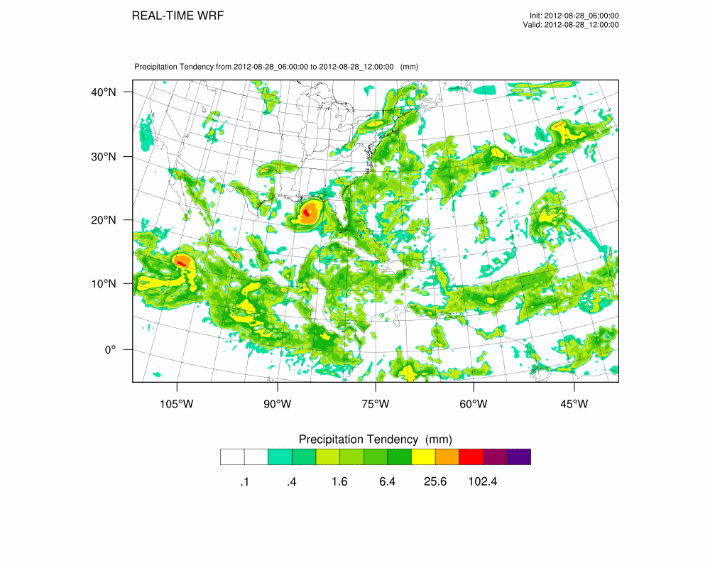
Experiments with tropical storm/hurricane ISAAC (2012)

Slide 23
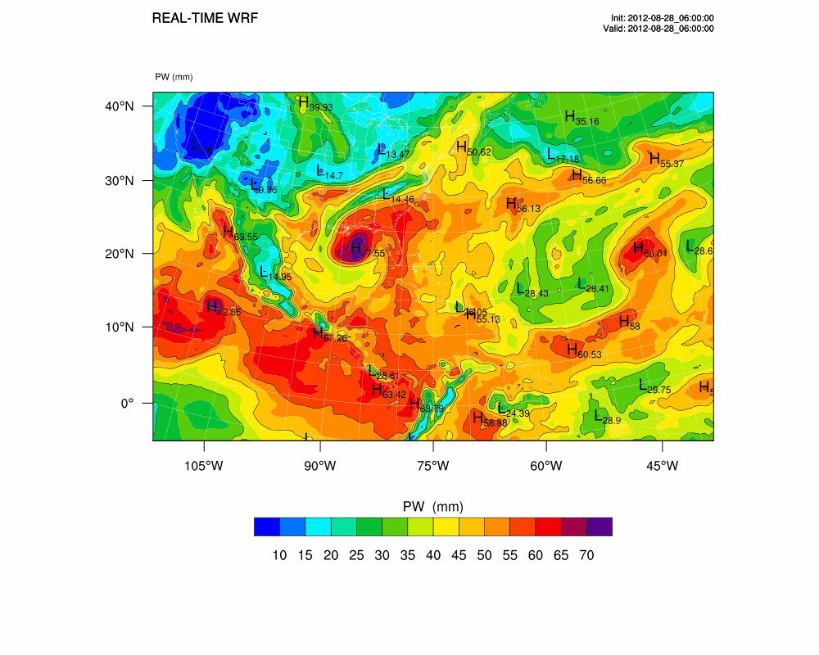
Experiments with tropical storm/hurricane ISAAC (2012)

Slide 24
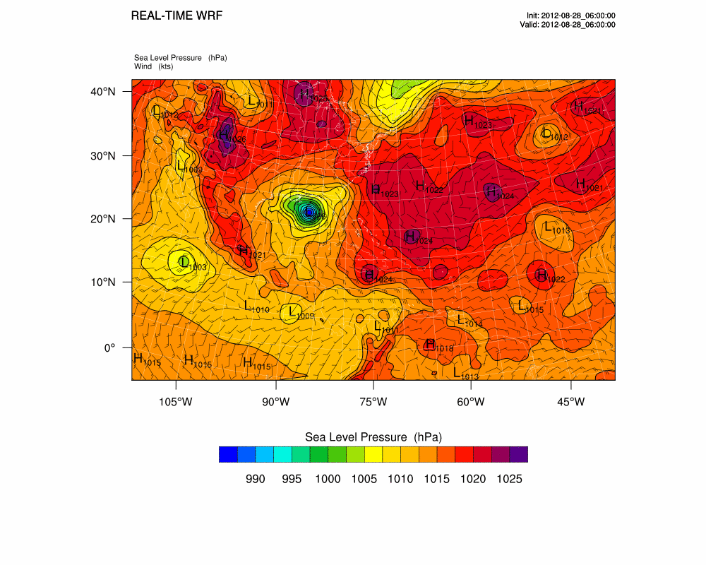
Experiments with tropical storm/hurricane ISAAC (2012)

Slide 25
NPP sounding assimilation experiments on ISAAC forecasts (WRF/GSI)
Assimilation window: -1.5hr to +1.5hr
Assimilation period: every 6 hours
Spin up
Cyc1
Cyc2
Cyc3
Forecasting
T-18
T-12
T-6
T-0
T+48
1 | 8-23-12UTC | 8-23-18 | 8-24-00 | 8-24-06 |  | 8-26-06
2 | 8-23-18UTC | 8-24-00 | 8-24-06 | 8-24-12 |  | 8-26-12
3 | 8-24-00UTC | 8-24-06 | 8-24-12 | 8-24-18 |  | 8-26-18
4 | 8-24-06UTC | 8-24-12 | 8-24-18 | 8-25-00 |  | 8-27-00
5 | 8-24-12UTC | 8-24-18 | 8-25-00 | 8-25-06 |  | 8-27-06
6 | 8-24-18UTC | 8-25-00 | 8-25-06 | 8-25-12 |  | 8-27-12
7 | 8-25-00UTC | 8-25-06 | 8-25-12 | 8-25-18 |  | 8-27-18
8 | 8-25-06UTC | 8-25-12 | 8-25-18 | 8-26-00 |  | 8-28-00

Slide 26
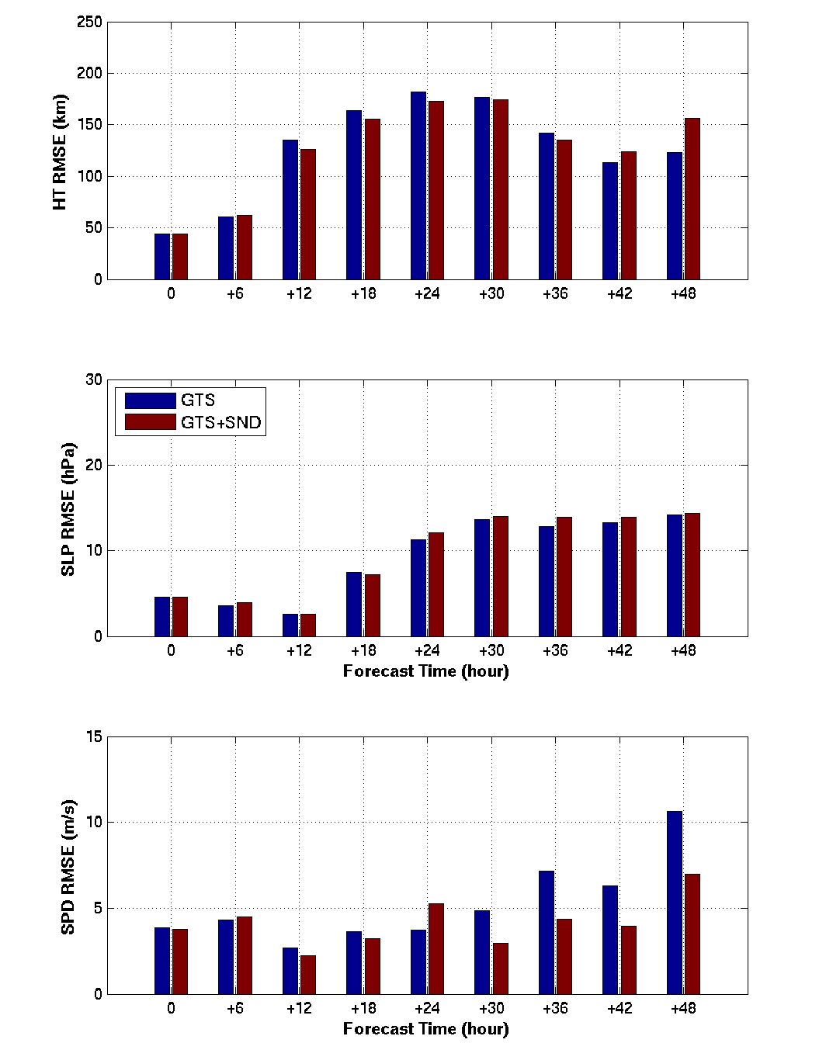
ISAAC (2012) track forecast RMSE
GTS + NPP soundings
(very preliminary results)
Slight improvement from NPP soundings over GTS for ISAAC track except for 48 hour forecasts;
NPP soundings improve maximum wind speed over GTS;
Shown are very preliminary results using NPP sounding EDR, will test radiances and single FOV soundings.
Central SLP forecast RMSE
Maximum wind speed forecast RMSE

Slide 27
Summary and future work
Summary
  WRF/GSI ready for sounder data (either radiances or soundings);
  Experiments show that combined MW and IR sounder data provide better impact on TC forecasts than that from MW or IR alone;
  Assimilating IR radiances and assimilating IR soundings provide comparable results in hurricane Irene (2011) case, more experiments are needed on the comparisons and analysis
Future work
  Combine sounder (JPSS) data and TPW data (GOES-R ABI) for TC forecast experiments;
  Testing the assimilating and forecasting demonstration system;
  Using HWRF/GSI

